Slide 1

LBNF Cryostat:
Status of FEA Structural Analysis
Diego Alvarez Feito
CERN EP-DT Engineering Office
LBNF Discussion
CERN, 5th & 6th of December 2016

Slide 2
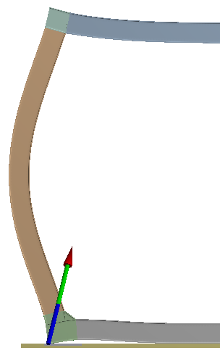
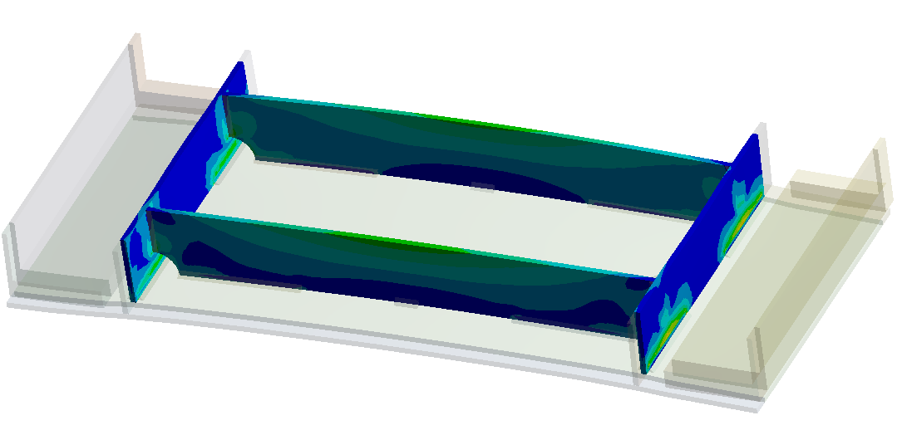

Introduction: Why FEA?
Verify results obtained with SCIA global model
Detail study/analysis of critical areas of the LBNF cryostat
  Beam Connections (welded and bolted)
  Warm membrane plate and reinforcements
  Floor reactions and support conditions
  Local reinforcements (e.g. for access holes)
Floor reaction

Slide 3
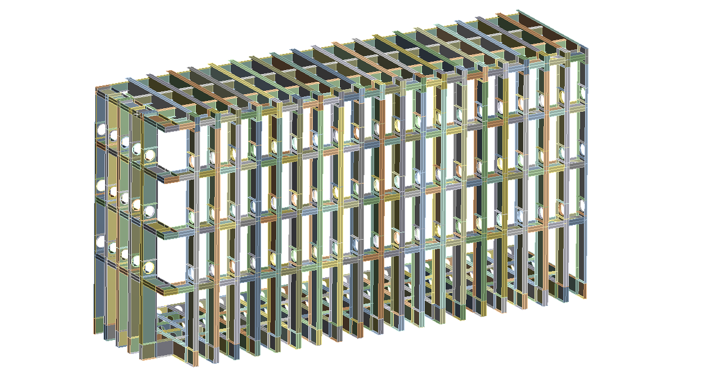
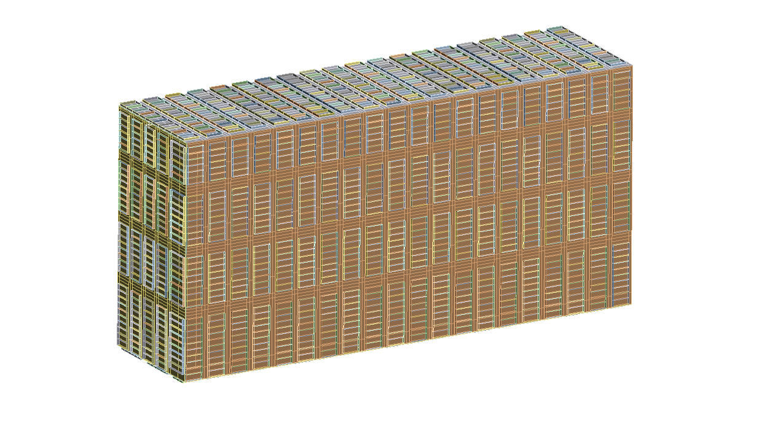
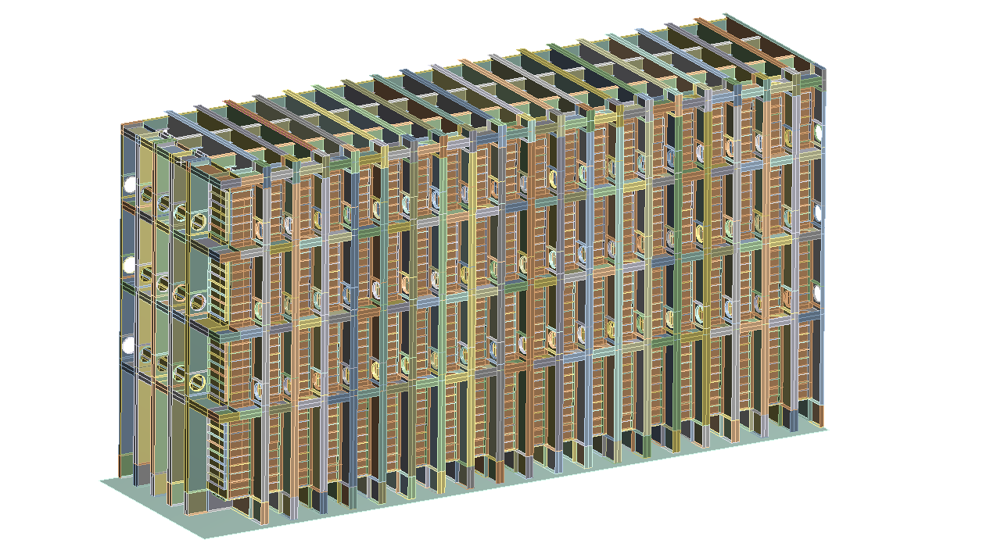

Global Shell Model
Shell model of ¼ cryostat
Continuous development to follow design changes in SCIA & CAD
New design concept
(with reinforcements ribs)
Optimised roof
Access holes
(+ local reinforcements)
Warm Vessel
Outer Skeleton

Slide 4
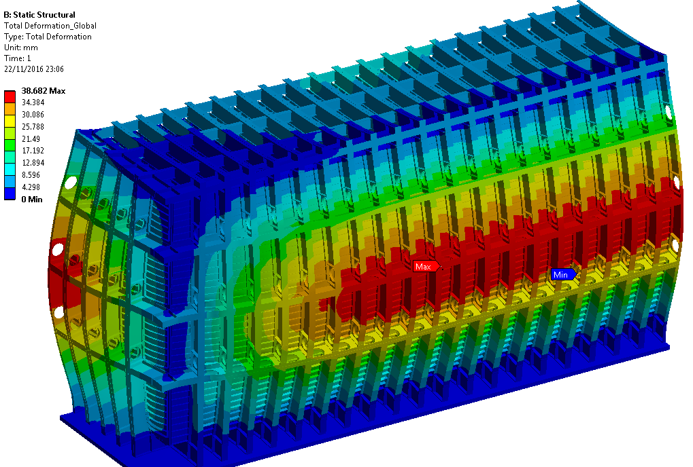
Global Shell Model
Nominal Loads (p₀=350mbar), rigid floor (frictionless)
Total Deformation (mm)
Export BC’s for sub-models
(see Luca’s presentation)

Slide 5
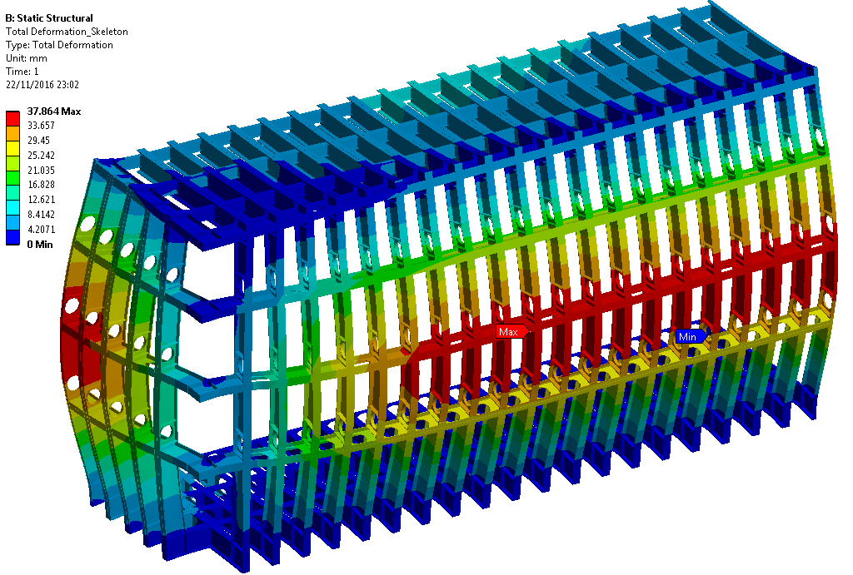
Global Shell Model: Outer Skeleton
Nominal Loads (p₀=350mbar), rigid floor (frictionless)
Total Deformation (mm)

Slide 6
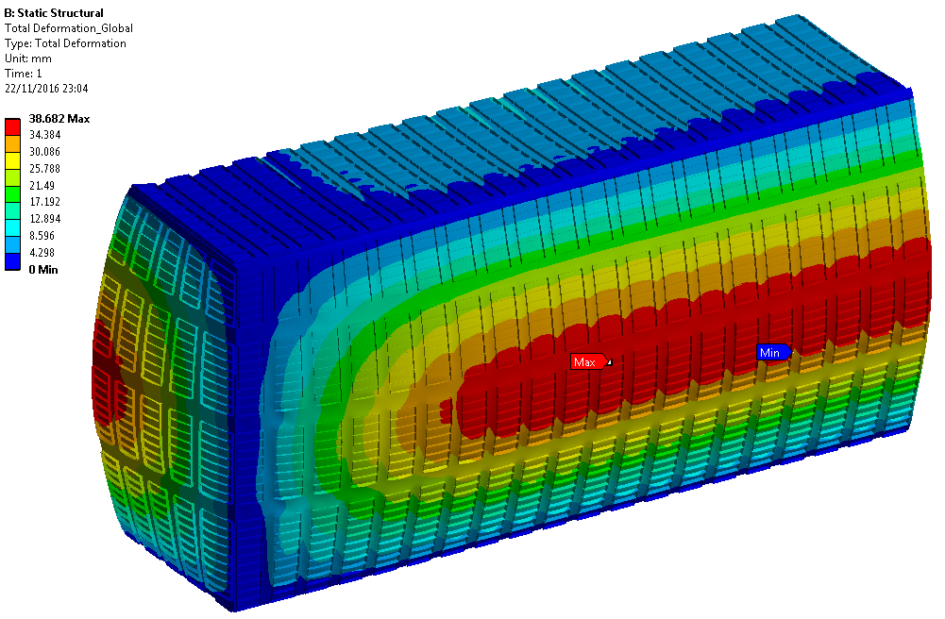
Global Shell Model: Warm Vessel
Nominal Loads (p₀=350mbar), rigid floor (frictionless)
Total Deformation (mm)

Slide 7
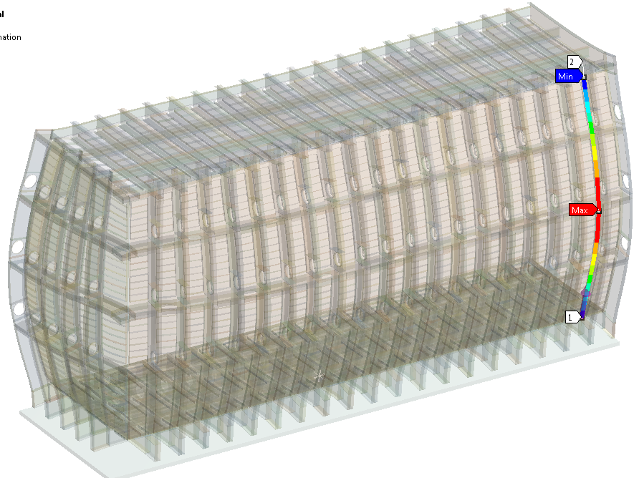
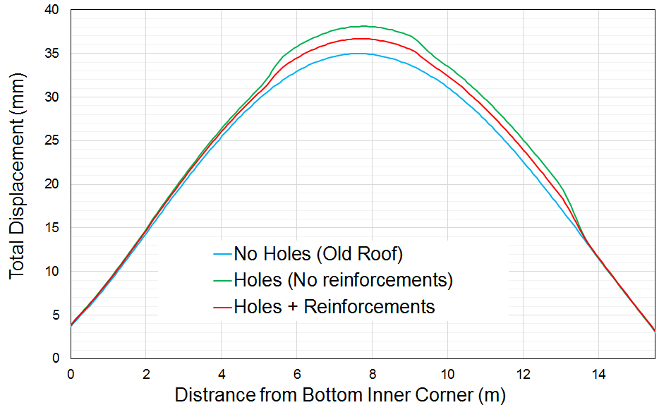
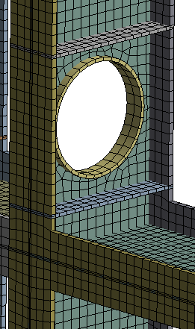
Global Shell Model: Access Holes
The local reinforcements help recovering part of the stiffness lost with the access holes
  Effects on the local instability is evaluated analytically (and in SCIA)
Holes

Slide 8
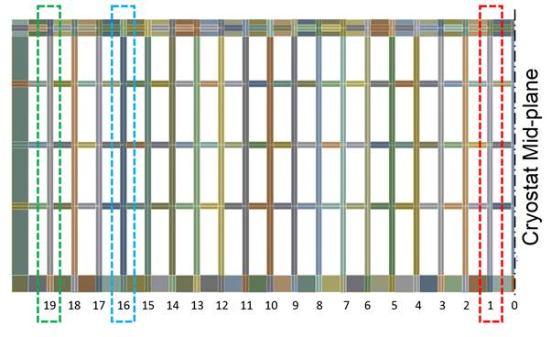
Global Model: Differences between portals
Portal at the centre of the cryostat represents the worst case scenario
  “Typical” portal used for detailed design (e.g. beam connections)

Slide 9
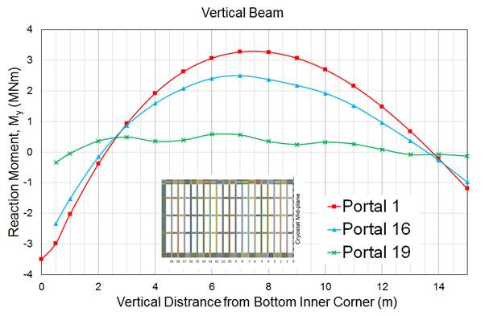
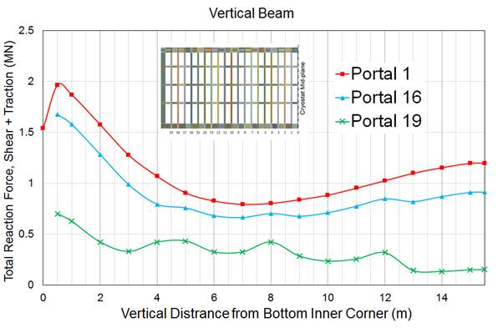
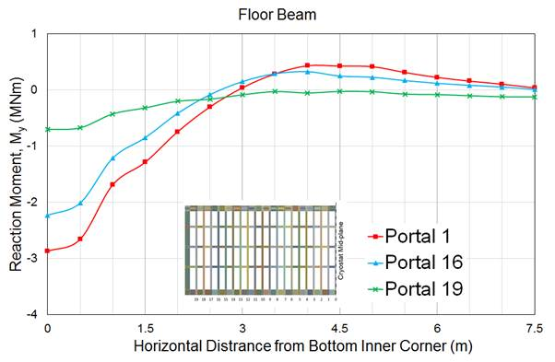
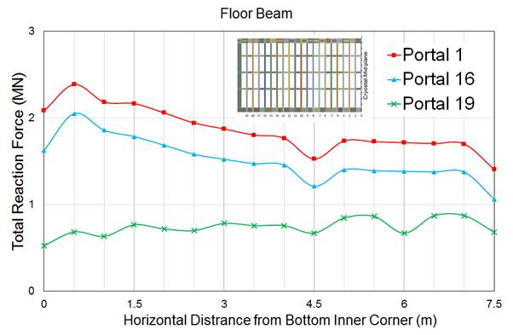
Global Shell Model: Differences between portals

Slide 10
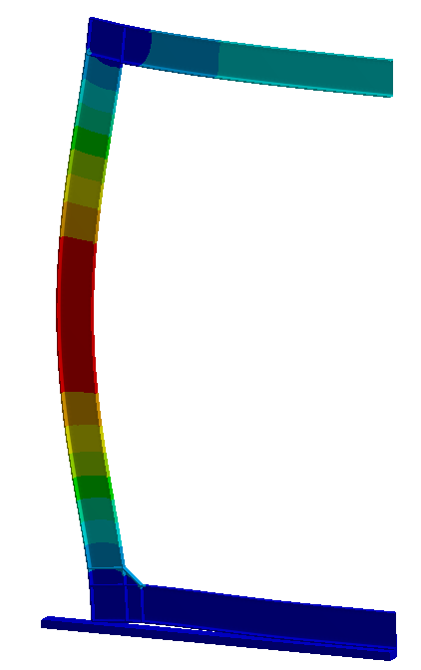
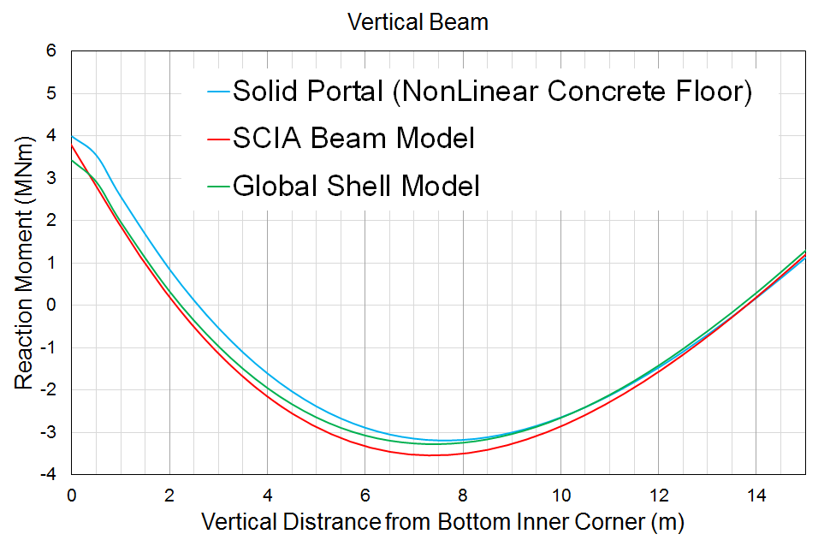
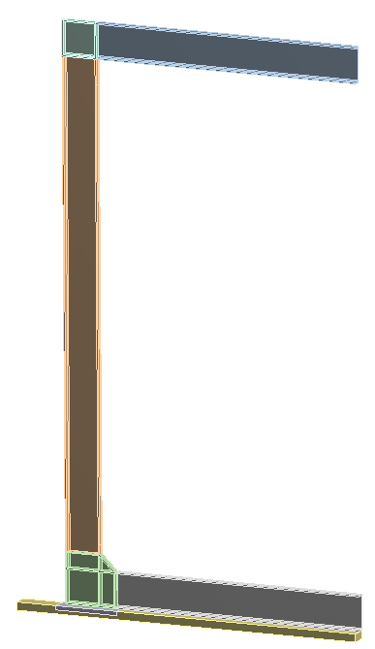
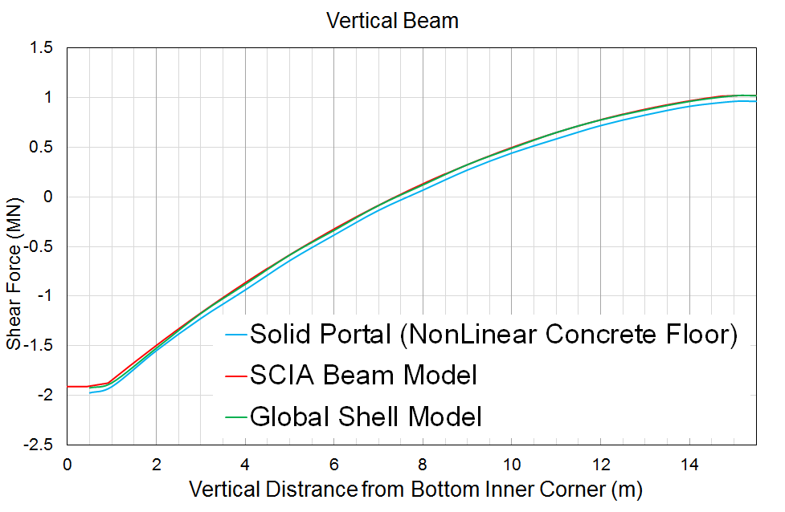
“Typical” Single Portal Frame Model
Very good agreement with Global Shell and SCIA models
Floor Analysis + BC input for beam connections’ sub-models
Reinforced connection

Slide 11
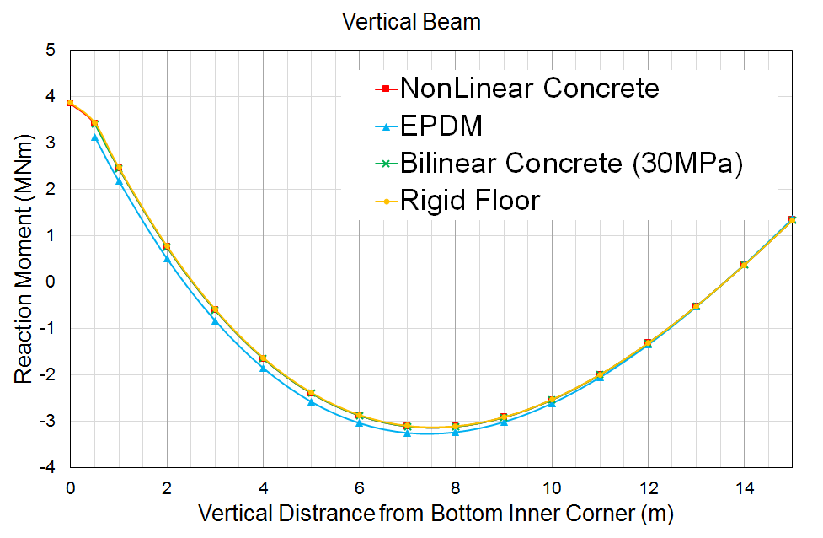
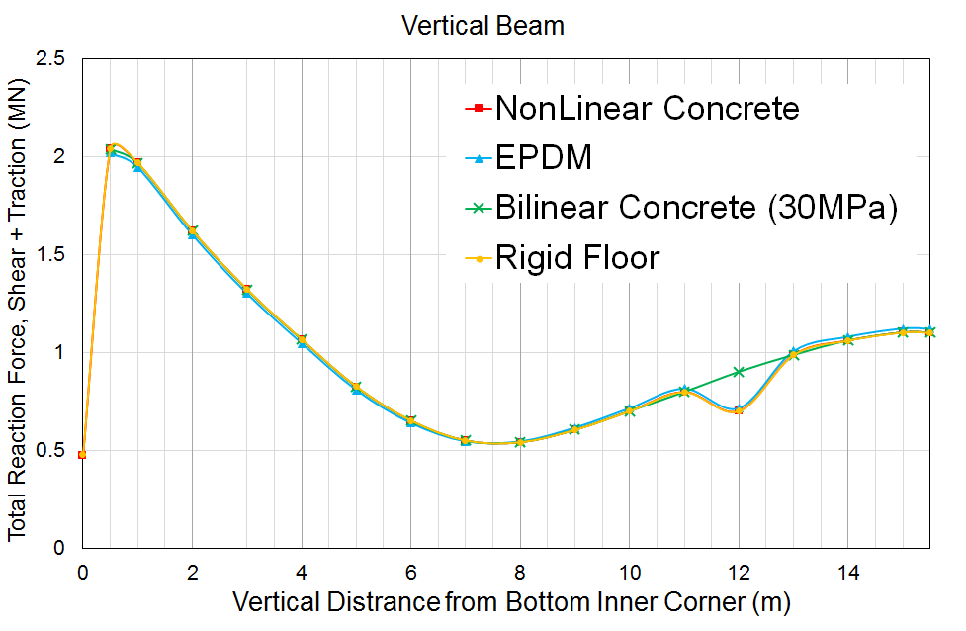
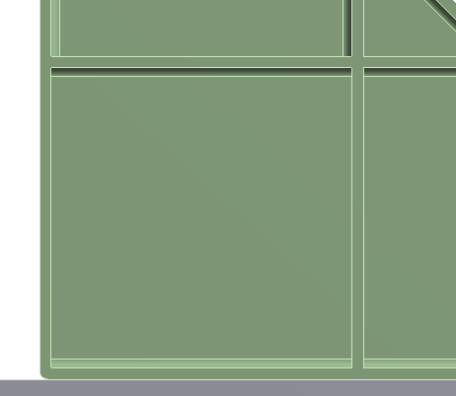
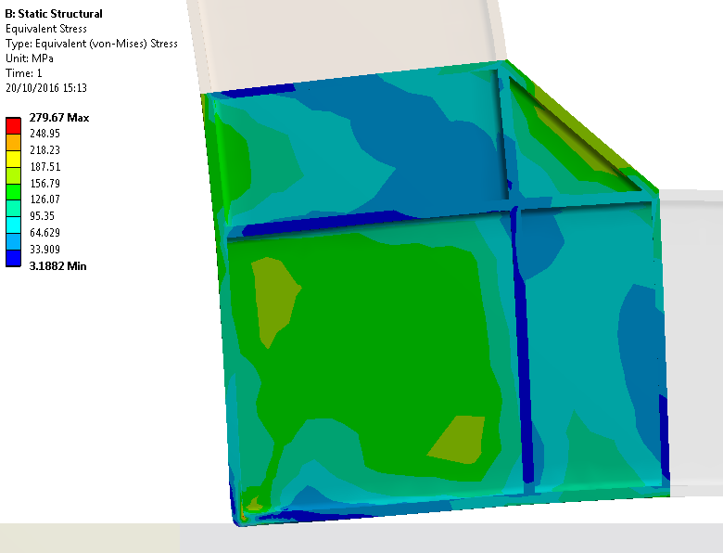

Floor Support Conditions
Effect of floor type on the response of the typical portal
  Impact on the optimal position for Splice connections
  Rounding of the bottom corner edge to avoid local plastic deformation
Eq. VM Stress
(MPa)
Corner Reaction Force
~1.5MN
(Nominal loads)

Slide 12
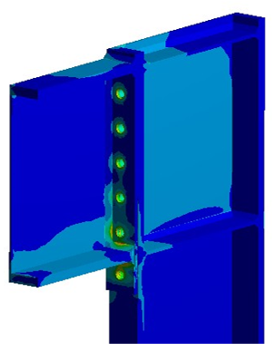
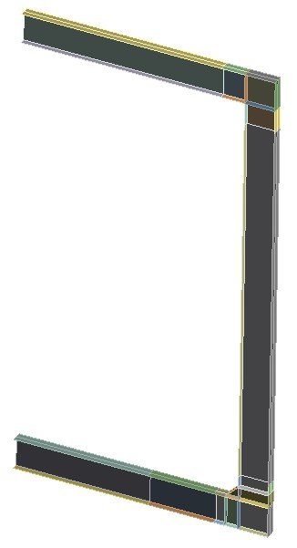
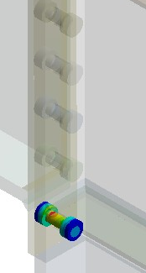
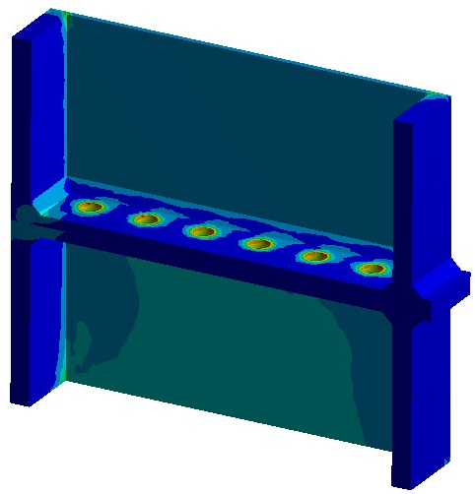
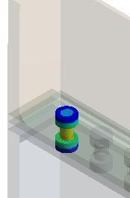
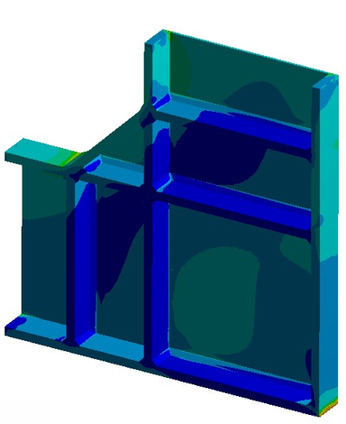
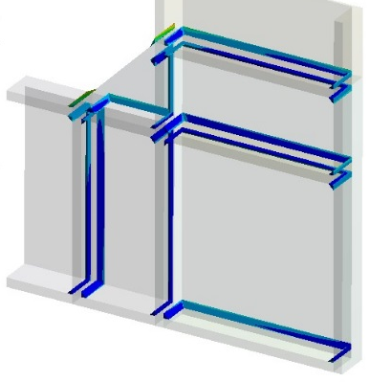
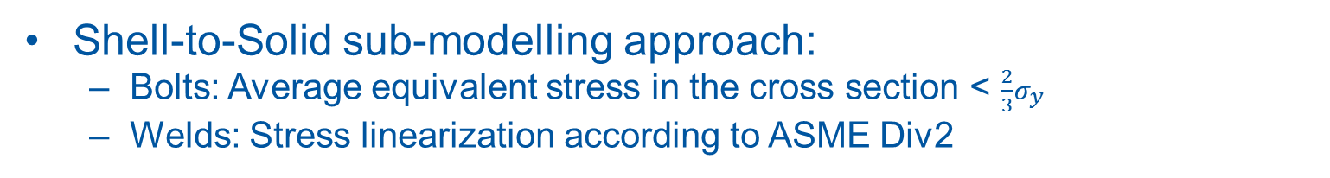
Beam Connections: FEA Sub-Models
Shell-to-Solid sub-modelling approach:
  Bolts: Average equivalent stress in the cross section < $\frac{2}{3}σ_{y}$
  Welds: Stress linearization according to ASME Div2
Top Connection
Shell Model of “Typical” portal frame
Splice Connection
Bottom Connection
Notes:
This approach allows the analysis of local elements such as bolts and welds under realistic conditions.
A few model details:
Bolts (M48) made of Grade 10.9.
The shank of the bolts (M48) had constant cross section.
Bolt head and nut were considered circular cylinders. The washers were omitted.
Bolt-pretension=625kN
Frictional contacts (friction coefficient=0.25).
Welds with triangular cross section & Material S460.

Slide 13
Questions?

