Slide 1
Procedures and Resources for Composite Fabrication at LBNL
Composites Group
E. Anderssen, N Hartman,
LBNL

Slide 2
Goal of Talk
This is a somewhat heuristic approach to design for fabrication, assuming that you have a part design in mind, and some idea of what the laminate needs to look like, i.e. you know Classical Laminated Plate Theory…
The goal of a successful part fabrication is to achieve a finished part that has both the desired dimensional tolerances and properties required for the design
  Resin Content, Fiber orientation, and Internal Stresses affect both part properties and shape
  The various stages of part fabrication, including tool design have impacts on the above three parameters
  Part and Tool material affect these as well, and I will try to convey how to consider these interactions
Of course, some of this may need to feed back into the base design
I will try to convey the relevant processes that can be used to control these parameters as they are applied to the fabrication
I will draw upon lessons learned on ATLAS as well as previous projects
This is/will be a long presentation, hopefully it will remain readable, and give insight into the various stages of design and fabrication
It is more a series of points to consider than real design direction
Please feel free to add to this and ask questions—this is a ‘Boot-Strap’ approach, and relies as much on your curiosity as the information presented here

Slide 3
Scope of presentation
Each of the stages of manufacture have some inter-relation and affect the overall product as deviations from ideal
Understanding these deviations allows you to modify the design, tool and processes to best achieve intent
  Part and Process Design together are best viewed holistically
This presentation will walk through the manufacture of generalized parts with several examples in an attempt to capture some of these interactions
I will focus the discussion to parts fabricated with Pre-impregnated fibers, hand lay-up, and elevated temperature cure as these are the most typical made here
  Room Temp cure is usually associated with ‘wet lay-up’ and has been done in the past here—many of you will already be familiar with this process.
Of course, design of the laminate can have some peculiar ramifications to the manufacturing process
  I will start with an overview of design, but only after a description of the overall fabrication cycle and problems to look out for during the rest of the presentation

Slide 4
Generalized Part Fabrication Cycle
Composite parts are generally made from several plies, stacked together with specific fiber orientation and ply shapes.
They require a rigid tooling surface, to give the part form, which must be capable of withstanding compaction forces and cure process without distortion (usually temp, possibly chemical attack)
To generate specific properties, these ply stacks must be compacted together removing voids (air bubbles) and excess resin in a controlled manner, which must be maintained through part cure
Part cure can occur at Room Temperature (RT) or elevated temperature depending on the chemistry of the resin system
After part cure, the part must be released from the tool, and can subsequently be machined to shape—tool surface integrity is key
Most composite parts are bonded (occasionally bolted) to other components, metal or composite. Preparation involves careful cleaning to remove mold release, and increase surface wettability

Slide 5
General Fabrication Process
Tool Design/Preparation (follows nominal part design)
  First phase of manufacture—may require modifications after first article
  Prep for lamination may require polish/mold release
Fiber impregnation
  Fiber can be bought pre-impregnated, or bought dry, wetting before or after placement on the tool surface
  Prepreg is bought frozen, and has a finite shelf life (6mo) may require several deliveries for production run
Ply Cutting
  Plies are usually cut prior to placement on the tool, though some ‘darting’ can be done on the tool
  Re-packaging or ‘Kitting’ and re-freezing for later assembly
QA—Tracking of material flow through process (part/material-parent/child relation)
  Plies come from a particular batch and roll, and need to be traced
  The time the material spends unfrozen (out time) prior to cure needs to be tracked
Lamination
  Plies are stacked on the tool in appropriate order
  Drape and Tack are key aspects here—may require intermediate compaction (between ply stacks)
Compaction and Resin Control
  Typically applied via vacuum bagging atmospheric pressure, and amplified in Autoclave
  Resin control usually achieved by incorporating various materials into bagging stack as blotters and barriers, controlling resin flow and retaining required resin content in part
Cure Cycle (Recipe)
  Thermal Cycle specific to Resin system and thermal mass of tooling
  Pressure can also be cycled, based on both resin system and tooling constraints
Trim
  Part edge cleanup, and or other machined features are sometimes required
  Tooling to hold part in machine tool is generally required
Bond/Join/Assemble
  Most composite parts are assembled into another structure via bonding
  Mold Release and other possible contaminants need to be cleaned from surfaces

Slide 6
Key Aspects to Control
To control here means to understand and mitigate potential problems
CTE mismatch between Tool and Part, and Overall Tool CTE must be accounted for
  Part Size, Bond Gaps, Part Warpage are all part of Tool/Part interaction
Tool Constraints can have ramifications during fabrication and part release—classic example is a tube
  Male part Tube—mold on outside—Part could be crushed when tool cools
  Female Tube—mold on inside—Part could be crushed by compaction forces, usually shows up as wrinkling (local fiber buckling)
Laminate design affects warpage, springback, and interplays with Tool CTE
  Laminate or Tool shape may need to be ‘tuned’ to minimize dimensional changes during cure
Part Thickness can be unknown by up to ~15% until after some test laminates are made; though good estimates are possible
  CPT (cured ply thickness) can depend on compaction method/pressure
  Re-desing of mating parts/tooling to account for thicker/thinner part
Resin Content and Void fraction will be a direct output of chosen process
  Compaction method can cause uneven resin distribution if not done properly
  Bagging materials/method can also mislocate plies, buckle fibers, even cause voids

Slide 7
Sounds Rather Complicated…
As can be seen from the previous page, there are a lot of things that can go awry during a part fabrication
They do have some inter-relation, but each can usually be solved independently
We do have one thing on our side, which is that once a process is defined which yields acceptable parts, the process is highly repeatable
Of course, it can take several iterations to nail down such a process
  Experience can help to minimize the number of iterations—frequently to 0
  Most issues can be addressed in the design phase, though experience is still key
Experience is best, though some aspects can be taught
  This goes for both the Engineers and the Technicians who fabricate the parts
Composite Design and Fabrication are intimately linked—it is important for Engineers to be involved in all stages, both for their edification, but also to identify and solve some of the problems mentioned before

Slide 8
Some Design Background
Simple Lever rules can get you 90% of the way to understanding base properties of composite materials, say zero^{th} order properties like Moduli, Strength and CTE
Laminated Plate Theory is the basis for understanding higher order mechanical properties, and response of stresses on the materials
  LPT Stiffness/Compliance matrices can easily be programmed into an Excel Spreadsheet, though it is a bit tedious
  Other Software is available, though we need to be re-licenced
Elements of these matrices can help to understand response of materials to various induced stresses of the manufacturing process
  Thermal expansion of the part and Tool/Part interaction are the key effects to understand, though Bagging and Compaction forces can interplay as well
MOST of our laminates are designed ‘Symmetric and Balanced’ and further are designed to be ‘Quasi-Isotropic’
  The sub-class of Symmetric isn’t necessarily Quasi-Isotropic nor Balanced
  Symmetric, Balanced, QI (QIBS) laminates have the special property that many off-diagonal elements of the stiffness matrix are identically cancelled
  Off-Diagonal elements of the stiffness matrix are responsible for ‘anti-clastic’ behavior—bend-twist, and shear-extension coupling of induced strains
Symmetric Balanced Quasi-Isotropic laminates are the easiest to design with, and yield the most predictable parts

Slide 9
Lever Rule Laminate Property Approximation
The Lever Rule is the quickest way to get approximate values for E_{x} and E_{y} for any given laminate
  Ex = Ey for QIBS laminates
Lever rule usually first seen in Engineering Curricula in introductory MatSci course
  Given a ‘composite’ of two materials, the properties can be estimated by the weighted volume fractions of the ‘reinforcement’ in the ‘matrix’
  E_{c} = E_{r}V_{fr} + E_{m} (1-V_{fr})
  For Fiber reinforced composites, E_{r} << E_{m}
  E_{c} = E_{r}V_{fr} (approx)
The Volume fraction for a fiber reinforced composite using prepreg, ranges from 55% to 65%—much less or much more is usually undesired—goal is 58-60% (use 60% for first pass)
  This means that for each lamina, in the laminate, its stiffness contribution is at most 60% of the fiber modulus (this is the ‘0’ direction)
This rule can further be extended to approximate the directional stiffness
  Consider 8-ply QIBS [0, +45, 90, -45]_{s}—only 2 plies of 8 point in the 0 direction
  First order approximation E_{lam}(0) = V_{f}E_{f}(num_plies_0_dir/total_num_plies) = 0.6(2/8)E_{f}
  Simple mindedly, E_{lam}(0) = 0.15E_{f} which on the surface would imply that a 6-ply QIBS might be stiffer… (divide by less total_num_plies)
Contribution of Angle Plies increases Elam(0)
  Angle plies contribute to overall stiffness with angle dependance of Cos⁴(θ)
  Cos⁴(45) = 0.25, so Angle-Ply contribution is significant
  E_{lam}(0) = V_{f}E_{f} [(num_plies_0_dir) + Cos⁴(θ)(num_ang_plies)]/total_num_plies
For QIBS, the Laminate Modulus in plane can be approximated with the above equation
  E_{lam}(8-ply QIBS) = 0.6 E_{f} [(2) + 0.2500(4)]/8 = 0.225E_{f} [0, +45, 90, -45]_{s}
  E_{lam}(6-ply QIBS) = 0.6 E_{f} [(2) + 0.0625(4)]/6 = 0.225E_{f} [0, +60, -60]_{s}
  Note—you get the same approximate modulus for any angle-ply QIBS laminate with common fibers
  This really is a MAXIMUM expected value—it can be 10-30% less in practice depending on how well you fabricate…
These calculations are essentially proximal values of the [A] matrix, i.e. only TENSILE properties—usual sensitivities apply, but are linear in this approximation
  Note—above approximations DO work for ANY laminate, QIBS or not, but if not BS, Off-Diagonal terms will couple shear and extension which can yield funny results
  Volume fraction is frequently less than 60%--re-evaluate after material test samples are available
  Angle sensitivity (Cos⁴(θ) dependance, while hard to impossible to measure is responsible for some of the knock down
Bending properties, [D] Matrix, depend heavily on ply count and angles

Slide 10
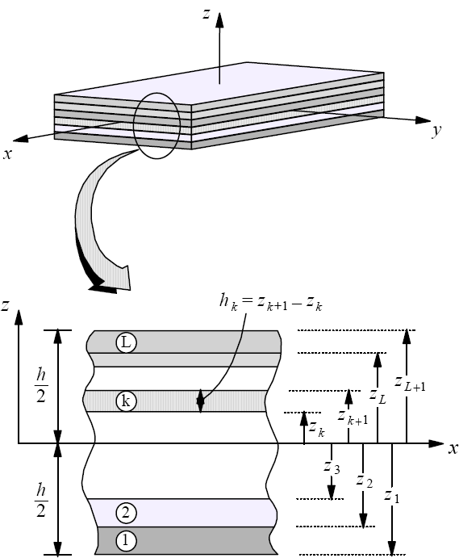
LPT And Coupling
N
=
[A] [B]
[B] [D]
ε
M
γ
This is essentially a tensor form of F = kx where ‘k’ is the ABD matrix…
The ABD matrix is a reduced 6 X 6 Tensor, N and M are each 3 space vectors
N and M are the Normal and Bending load Vectors
[A_{ij}] is the Normal stiffness—off diagonal elements couple shear and extension
[B_{ij}] Non-zero values couple Bending and Extension and should be avoided
[D_{ij}] is the Flexural Stiffness—off diagonal elements couple bend and twist
Technically [A], [B], and [D] are each 6X6 tensors, but each can be ‘reduced’ because many elements cancel for orthotropic materials
Above is often called the ABD matrix, it is in fact a sum of the Q_{ij} of each lamina in the Laminate weighted with it’s thickness and position within the laminate giving the overall laminate stiffness
The Q_{ij} have embedded Fiber orientation and resin/matrix moduli
While complicated, it is essentially a summed form of N=εEA; and M = GIτ/2c (think σ = Mc/I) where the c(z) and I components are tabulated ref the z coord above (γ = τ/2 engineering shear)

Slide 11
Matrix Structure Ramifications
Here I defer to any of a number of excellent texts on the subject for detailed matrix forms, operations and calculations
Assuming you’ve designed a Symmetric Balanced laminate you will minimize to the extent possible, part warpage during cure (QIBS is special case of this set)
The [B] matrix is 0 as are the A₁₆ and A₂₆ elements of the A matrix—the so-called Shear-Extension coupling elements
[D] off diagonal elements do not cancel so there will be Bend-Twist coupling
There are some special part forms which can be illustrative
  Tubes, because of their cylindrical constraint, Shear-Extension and Bend-Twist globally cancel
    If looking at global beam performance of the tube, only E₁/E₂ are needed to describe the performance
    Local Flexure in the wall does however follow plate equations
    Means you can build Asymmetric laminate tube without expecting warpage
  Plates—All Plate Equations apply, should be Balanced Symmetric
  Half-Shells—do not have the cylindrical shear constraint—not self balancing
    Building an un-twisted Half-shell is challenging; requiring careful attention and understanding of all elements of the [A] and [D] matrices—should be Balanced Symmetric—[B] will screw you

Slide 12
Quasi-Isotropic Balanced Symmetric Laminate
This is called ‘Black Aluminum’ because Intermediate Modulus Carbon (40msi), when laid up in this way has approximately the same modulus as Aluminum, and minimal anti-clastic behaviour
As a class, QI laminates are interesting because E₁ = E₂ easing some accounting of properties
Making QI laminates that are also Balanced Symmetric reduces anti-clastic behaviour
QIBS begins to break down for small ply count, E_{x} still equals E_{y}, but at angles between you will see some dips in modulus
Some Examples:
  [0,-45,90,+45]_{s} 8-ply QIBS
  [0,-60,+60]_{s} 6-ply QIBS
Consider: [90, +45, 0, -45]_{s} which is the same 8-ply QIBS above only rotated 90 degrees
  Tensile properties are identical—same [A] matrix
  Bending looks completely different on the two axes—on one axis the 0 fibers are farthest from the neutral plane making the laminate behave stiffer than when bent on the other axis
This is where the [D] matrix comes into play

Slide 13
Stacking Sequence
0
90
90
0
90
0
0
90
Looks Like I-Beam when bent
Looks NOT Like I-Beam when bent on this axis
A Symmetric Laminate is symmetric wrt to ply orientation above and below the laminate mid-plane
  Example [0,+30,+30,0] sometimes written (0,+30)_{s} is symmetric but not balanced
Balanced laminate is one where for every +θ there is also a –θ lamina
  Example [0, +30, -30, -30, +30, 0] or [0, +30, -30]_{s}
For a symmetric laminate, [B] = 0 always
For Balanced laminates, A₁₆ = A₂₆ = 0 i.e. no shear extension coupling
Stacking sequence does not affect [A] matrix
  Both Laminates above have same Tensile properties—same [A] matrix
[D] is most affected by stacking sequence and orientation of the load
  Thickness, or more specifically, number of variegated plies, affects [D]
  D₁₆ and D₂₆ become less significant as ply count increases
  D11 dominates for thick, multi-ply laminates
  For half-shell, consider increasing ply count with thinner plies to reduce D₁₆ and D₂₆ contribution i.e. go from [0, +30, -30]_{s} to [0, +30, -30, 0,+30,-30]_{s} with half ply thickness—this reduces bend-twist by making bending stresses distribute more uniformly

Slide 14
Fiber Angle Sensitivity
Modulus/Strength are affected by both by Fiber orientation and Resin/Fiber volume fraction
Angular Orientation of the fiber is very important
  Elements of the Stiffness matrix depend on angle at Cos⁴(θ) which falls off rapidly from unity with small angular deviations
  Averaging affects of multiple ply laminate do mitigate this
  Angle should be carefully controlled on the Tool
Complex part curvature, fiber shearing (cloth), and excessive darting can change the angle drastically
  This can be controlled with careful selection of ply boundaries within a layer
  Software is available (FiberSIM, et al) which can help to formulate ply shapes using limits placed on angular tolerance and drape-ability (we do not have a license for any)
Generally, these affects require a ‘knock-down factor’ be used in design, typically 10-15% lower modulus than theoretically predicted.
  This also affects CTE calculations

Slide 15
Tooling Design: Example of Part Size After Cure
Part at RT on Mold
This is the first and most basic calculation to do when designing Tooling for parts
The Part laid up on Tool at RT then Cured at elevated Temperature—the part size follows tool expansion
CTE of Tool is usually higher than part so that there is a release gap if Male—care should be taken for female molds or mold features which constrain part on cool-down
Part Cooling from cure temp changes dimension due to CTE from the dimension at cure
Final Part Dimension is straightforward to calculate, but accuracy of calculation hinges on knowing relevant parameters very well
  Tool CTE—can be uncertain up to 20% depending on Alloy
  Part CTE—needs to be calculated using LPT and subject to variations as mentioned before
  Gel Temperature—this is the temperature where resin no-longer flows (viscosity locks in laminate dimensions)
Simple to calculate nominal dimensions, but challenging if required tolerances approach expansion values
Most challenging situation:
  High tolerances with:
  Expensive tool or Long lead—needs to be machined to right size first time
  Other Parts, made in parallel, need to interface to this part with high tolerances
Can mitigate if accept re-machining of tool or relaxation of tolerance, generally a cost/schedule issue
Will discuss how to proceed in most challenging circumstance
Part at Gel Temp on Mold
(expanded)
Part final size mold back at RT

Slide 16
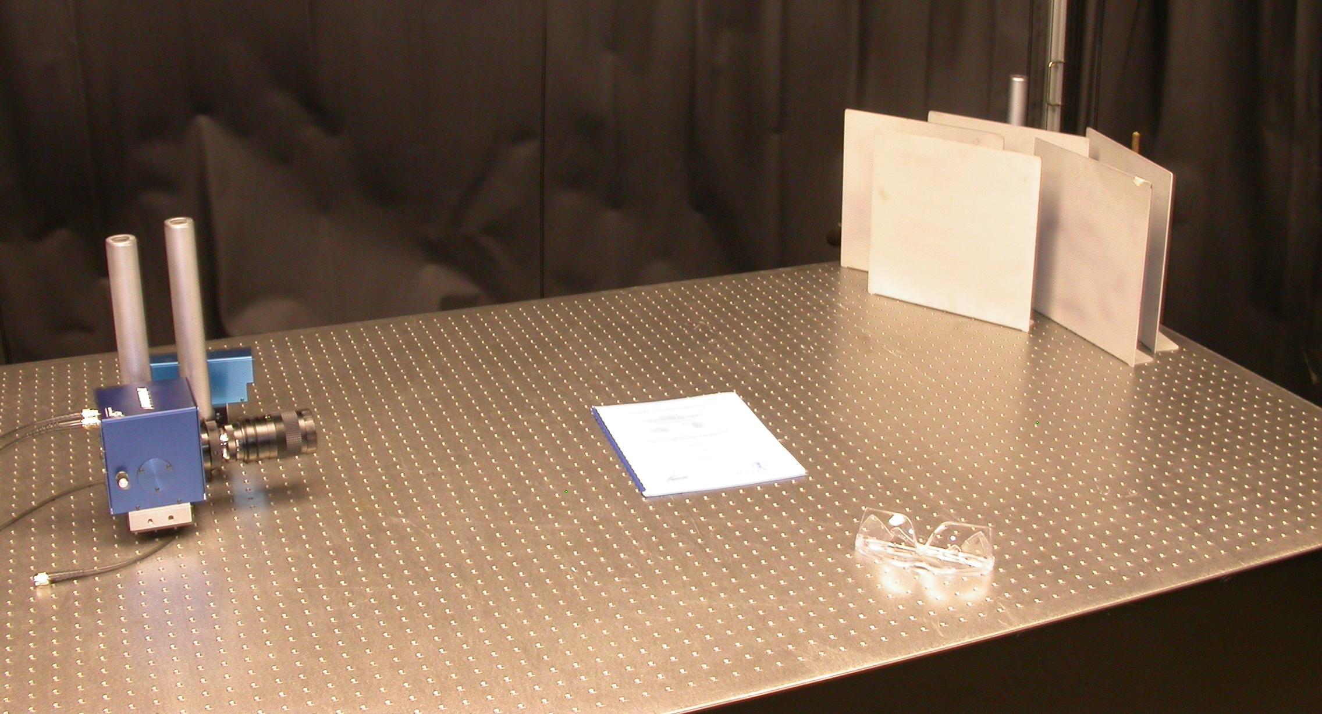
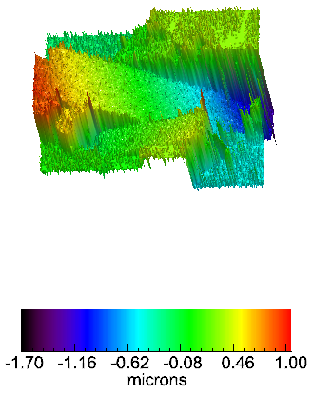
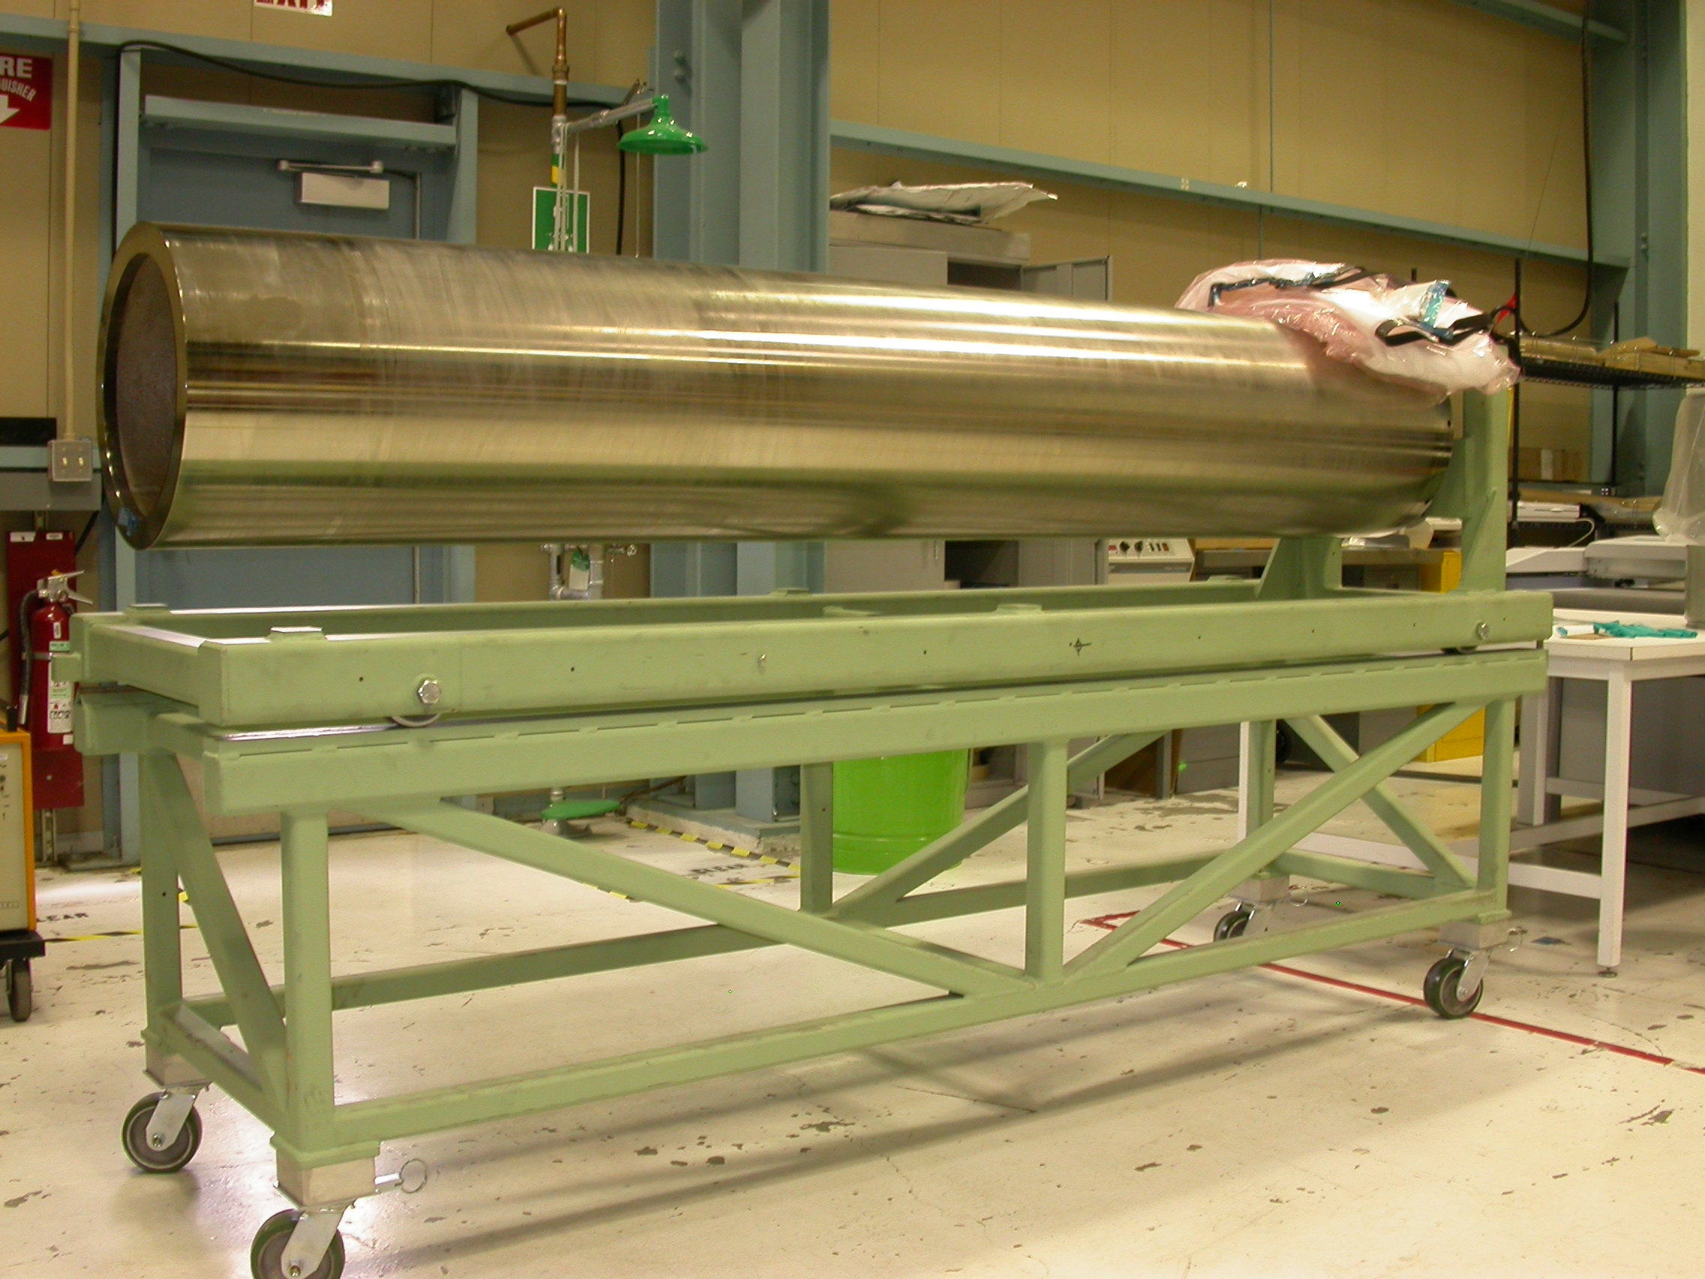
Part Size After Cure—Tool CTE
TVH System with typical outputs
Using TV Holography (or contract out), it is possible to measure CTE of most metals by heating them and watching them shrink as they cool
TVH Accurate for expected values above ~5ppm/C
  Lower than that Tool CTE can usually be ignored
  Do sensitivity study to understand how well you need to know
In this example mandrel was made from sewer pipe, no readily available CTE Data was trustworthy
  Reported values (steel) ~11.8-13.4e-6/C
  Measured value 10.6e-6/C—over 20% difference from average
Schedule and cost wise, could only machine once (Ni plate)
Used sample section of actual pipe to measure CTE

Slide 17
Part Size After Cure—Part CTE
Carbon Fibers have a negative CTE, making their laminates near 0 to slightly negative as a rule
This is usually calculated, though calculations can and should be augmented with some test data
CTE Calculation uses [A] matrix to get α_{x} and α_{y} (thermal strains) in conjunction with published Resin and Fiber properties
  Published Resin and Fiber values are fairly reliable
Variations in your understanding of the [A] matrix as built affect CTE Calculations
Anything you can to do better understand [A] will improve CTE understanding as well
  It is fairly standard practice to make tensile samples of each new batch of materials—first for simple QA—make sure you got what you ordered
  Pure 0 and pure 90 samples are a minimum, but some ‘target’ laminates made with projected resin control methods are desireable
  Usually, cross-ply samples are less stiff than theory would predict
Use of these tensile samples early in the design process (prototype phase) gives valuable information
  Allows you to adjust modulus values to those achievable from proposed manufacture process
  Lets you understand resin content as based on your (proposed) process
  Lends confidence in design parameters
  Lets you adjust proposed resin control process if required (usually try several methods if possible)
Part CTE at the level of manufacturing tolerances can be refined with results from standard material tests of modulus
If CTE MUST be verified for performance reasons, this is much more challenging, but usually beyond what is needed for part manufacture
Incidentally, near 0 CTE QIBS laminates are amongst the easiest to design with and kindest in manufacture.

Slide 18
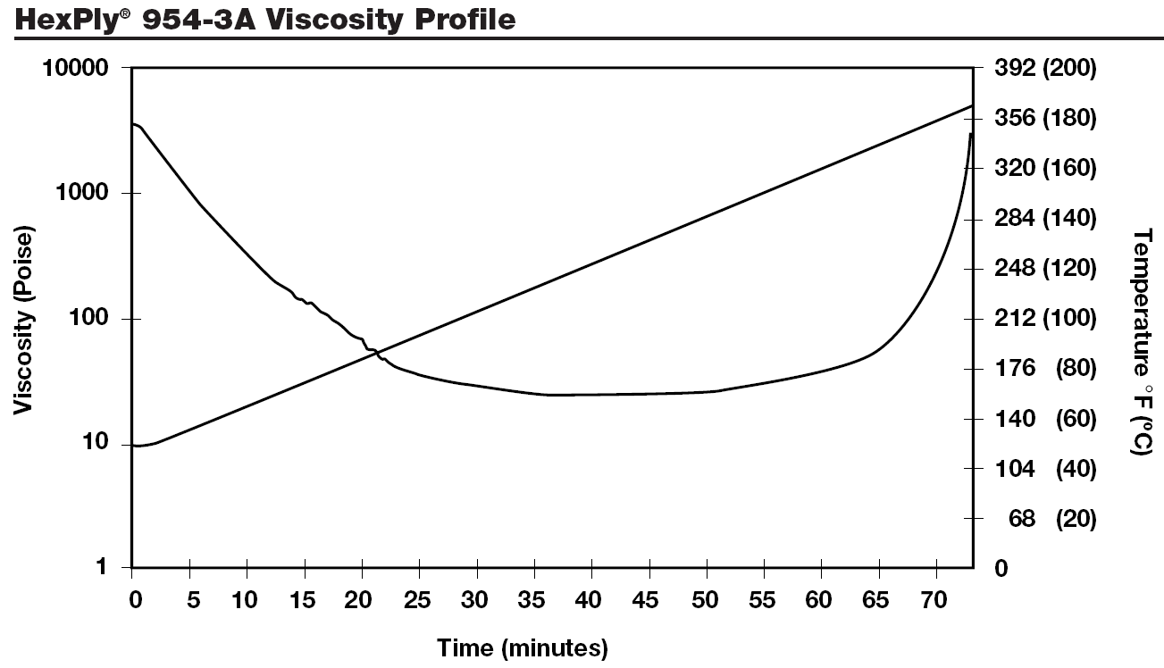
Part Size After Cure—Gel Temperature
This is a typical viscosity profile—μ drops first from increased temp then increases from onset of cure and cross-linking—in this case a 350F cure Cyanate Ester system is shown
Line is temperature ramp—use it to correlate temp with viscosity
These can and do change, sometimes drastically, as a function of temperature ramp-rate, and aren’t published for all resin systems or ramp rates
While somewhat useful, it only tells you that the Gel Temp is likely below the Cure Temp
However it does tell you that the best time/temp for compaction is @ 175F—more on that later

Slide 19
Part Size After Cure—Gel Temperature(2)
The temperature at which a part is locked into final size is not readily available from published data
Using the Cure Temperature is frequently good enough, however Gel Temp could be up to 20% lower ΔT
If you absolutely need to know, and you’ve done your best to know the Part and Tool CTE’s it is possible to extract Gel Temp from a test article
The test article should be cylindrical, made on mandrel of ‘known’ CTE and diameter, using the laminate in question as a test piece
Careful measurement of the part diameter will let you extract the ΔT (from RT) at which the part dimensions are locked in during Cure
It should be obvious, but this is a property of the resin system used. Once determined, other parts using the same resin system and cure profile can use the same value
While seemingly a lot of work, frequently this exercise can be incorporated into early stages of prototyping
Obviously, this data should be recorded and made available for future projects

Slide 20
Part Size After Cure—Calculations
Having the three parameters that you need, determined as well as you care, the calculation is rather simple
Expansion = DiaαΔT, and this is used throughout
First ΔT = (Gel_Temp – Room_Temp) where RT is temp is between 20C and 25C
Size of Mandrel @ Gellation
  Expanded Diameter = D_{mandrel}(1+α_{mandrel}ΔT)
  This is taken as the ID of the Part at Gel Temperature
Size of Part on cool down
  Part ID_{cold} = D_{mandrel}(1+α_{mandrel}ΔT)*(1-α_{part}ΔT)
  α_{part} is the CTE in the hoop direction
  CTE of Part can often be negative, making Part –expand– on cool down…
I’ll mention here some considerations
  Mandrel expansion can help to alleviate compaction induced wrinkling, though only mildly
  Thermal excursions during lay-up can lead to fiber buckling/part wrinkling (mandrel shrinks on cold day)
  Too large a difference between Gel-Temp and Cure-Hold-Temp can rupture tube in Hoop direction (mandrel keeps expanding, but shell does not (in fact could shrink from negative CTE)—check against lamina strength
Part at RT on Mold
Part at Gel Temp on Mold
Part final size

Slide 21
Common Tooling Materials
6061 Al Alloy—light weight, low thermal mass, easiest to machine
  High CTE (23.6ppm/C), less tool longevity than Steels
Steel—moderate CTE, available in more form factors (pipe)
  Needs Nickel or Chrome plating to maintain surface integrity
Stainless Steel (300)—stable surface, easy to machine
  More expensive than Steel or Aluminum
INVAR—near 0 CTE—good match to Carbon Composites
  Extremely expensive, hard to machine, but industry standard for challenging laminates with long production runs
Monolithic Graphite—good CTE match to Carbon Composites
  Easy to machine, but requires special equipment
  Low tool integrity—short production runs or several tool re-works
  Moderately expensive
Composite Tooling—best thermal performance, good CTE match
  Complicated manufacturing process—requires ‘Master’ to create mold
  Difficult to design, though many resources available
‘Tooling Board’ (foam, cast plastics)—good for quick turn around large tools
  Limited temperature performance, CTE 1.5-4X as high as Aluminum
Note—aim here is at Carbon Composites—fiberglass QIBS has ~CTE of STEEL

Slide 22
Tooling Design—Production Oriented
The Tool (mold) needs to have more than just the right shape…
The aim of a good tool design is to make it as easy as possible for you to build a quality part
  Ease increases speed, which makes the parts less expensive overall
  Increased tooling features (cost) can be justified if it speeds part production
Fabrication aids should be incorporated into tooling, outside of part mold line
  Datums, Angular (fiber) References, and Part Edge references should have physically measurable features as references on the mold to allow verification during part assembly
  Bagging (compaction) is one of the more tedious processes, aim should be to make this as easy as possible
    Sufficient area to ‘bag’ the part—3-4” clear space on tool around part
    Sharp edges, through holes, or anything that might rupture a bag should be avoided
    If production QTY is high, consider designing tool to use ‘Re-Usable Vacuum Bag’ (people will love you)
Tools are used by people—some Ergonomic considerations are important
  Tools are Heavy—handling and movement provisions should be addressed, lift-eyes, handles, finger lips should be incorporated as needed
  Access is important—hands, fingers and plies must be able to get where they need to be—if necessary, split parts or molds to allow for this
Consider lamination time—if part is too big or complicated, material may expire before part can be cured (exceptionally important for wet layup)
Consider Part Release—how is part to be removed from Tool Surface?
  If mold is closed, or multi-part, consider adding jacking screws, or pry gaps
  Some parts that are over-constrained by their tool by CTE or simply by their shape, may require jacking features which bear on the part itself (or splitting the tool)
Consider this axiom: The largest loads composite parts ever see is frequently during mold release (!)
  Corollary: make sure you know how you’re going to get the part off
  The last thing you need is your brand-new part bonded/trapped solidly to/into your tool! (happened to me…)

Slide 23
Tooling Design: Other things to Consider
The tool defines the shape of the part, and as suggested previously, it’s shape at Cure needs to be ascertained
  Make sure tool material can take cure temperatures and pressures
  Make sure tool does not warp or otherwise behave anisotropically when heated
Understand Thermal performance of tool as it typically dominates part temperature
  Needs to have low thermal mass to allow even heating—as much as is possible
  Previous CTE Calc assumed constant Tool Temp—thermal gradients can induce warpage
  This is of largest concern for larger, open-form parts—small parts have small effects
Laminate Material Limits and part Quality
  Minimum radii and complex curvature should be avoided as much as practical
    Fiber dependant—drapability and fiber stiffness affect this
    Simpler parts are easier to predict
  Include datum surfaces where appropriate to allow for fiber angle references and ply boundaries
Part Release concerns
  Surface finish and integrity should be compatible with release of production QTY
    64microinch finish or better is adequate for direct release (with wax)
  Make sure features on tool do not trap part on cool down
    allow adequate draft or gaps on trapped parts to allow removal
    Consider including jacking features into the tool for large laminates
    Make tool in multiple parts, but only if absolutely required
Part Stability and Resin Control
  Sometimes, it is best to consider splitting the part into more manageable pieces…
    Drastic changes in part thickness can induce warpage—consider making thick and thin sections separately and bonding together post-cure
    Drastic fiber orientation changes may require similar thought
  Thick Laminates and Thin laminates require different resin control methods/requirements
    Integral Resin Control Dams can trap the part on cool-down, consider splitting them
Part and Tool Count—less is more
  Consider making several parts on one tool where practical, or multiple tools for high part QTY
  Split parts (doubles part count) only where necessary to guarantee part quality—more parts means more assembly labor increasing overall cost

Slide 24
Part Compaction
We’re skipping ahead of lamination at this point because considerations here have influence on both lamination process, Material Specification and Tool design
Compaction Controls both Resin Content, and Resin Distribution within the part
Most often, Compaction forces are applied by Vacuum Bagging—extra forces can be applied with Presses, Autoclave pressure or Clever Tooling (some discussion later)
Compaction and resin control, whether press, clave or vacuum, will generally be referred to as ‘Bagging’
  Proper bagging technique, and material selection are key contributors to proper resin control and void reduction (which is really just resin control)
Will start with general description of Vacuum Bag components, then branch into functions of various materials
  Some of the steps and materials are optional—will indicate which when discussing purpose of each element
Will end with methods and some calculations for selecting the various bagging materials used
Most, if not all, of this is shown in great detail in the Print Catalog from ‘AIRTECH International’ the primary supplier for our bagging materials—I strongly recommend acquiring one of their catalogs and sample books—it is an extraordinary resource for this subject
  http://www.airtechonline.com/ for online catalog or to order print catalog—online catalog is all but useless—make sure to order with sample book
I have excerpted much of this portion of the presentation from figures or descriptions in their catalog, but added some discussion as sometimes the catalog can be rather cryptic
Bagging Techniques (how to manually apply) is a bit beyond the scope here—maybe a good subject for another presentation, but best learned through experience…

Slide 25
General Vacuum Bag Materials
Separator Film
Breather/Bleeder
Vacuum Bag Film
Bag Sealant Tape
“Tacky Tape”
Bleeder/Peel Ply
Resin Dam/Edge Bleeder
Release Film
Part
Tool
Edge Distance 3-4”
2” minimum
This is the generic full bag, though contains all options simultaneously
  Minimum bag includes only separator film (perforated) and breather which then becomes the bleeder
  Controlled bleed bag uses Bleeder/Peel Ply and separator film (impermeable) in addition
  Need for Resin Dam/Edge Bleeder depends on part edge thickness
Relative Overhangs are important—Separator Film protects Breather/Bleeder from getting stuck to part/tool by excess resin
Release film could be permanently attached to tool or as wipe on film (mold release)
Two side Bleeding would place another Bleeder/Peel Ply between part and release film (presents certain complications, but sometimes required)
More complicated additions to the bag will be discussed later

Slide 26
Bag Material Basic Selection
These materials are expendables and should be ordered well in advance of production
  Samples are readily available from vendor on short lead—useful for quick startup of prototype work
Discuss with Vendor intended Cure Cycle and Resin System to determine product compatibility
  Cure temperature, and Autoclave compatibility are the most basic selection criteria
  Most work trivially with Epoxy resin systems—more exotic systems may require release experiments (separator/release films should not stick during cure)
That said, most of our stocked materials are compatible with the majority of what we are capable of processing with our equipment
  Will describe materials we typically use, by product name, in the appropriate sections
  However, some are intended for Room Temp steps in the process—make sure you properly identify what you use and know its properties
‘Stocked’ is a relative term, it is excess from last project production
  Unless composites shop is otherwise funded, all materials including expendables are bought with project funds
  Small side projects are easily handled, though without new funds ‘Stock’ will run out.
Most of these materials are rather inexpensive though only come in large quantities, so up front costs can add up—include these in cost estimates
  Will indicate relative cost (if not actual cost) of materials when discussing a given material class

Slide 27
An Aside on Airtech…
Most of us use Airtech because we are familiar with their products
  They sponsor a lot of student and research projects
  They really are the industry standard—everyone uses them if not their complete product range
Main advantage of Airtech is they are a one-stop shop—they actually make or distribute the entire range of products needed in even the most complex bags
Airtech is not the cheapest vendor around…
  They are actually distributed by J&J paper—all orders go through them
  Samples can be had from Airtech directly though usually pulled from J&J stock
Other manufacturers do make similar products at reduced prices
  Can be 20-35% cheaper, but generally this only makes sense to investigate if you’re going to use literally tons of the stuff for a very specific application
  Airtech products frequently perform better over a broader range which fits our needs better
They also teach Bagging and Tooling techniques (may consider using this in future)
We are small customers though, so response can be somewhat lackluster…
  This is generally true of almost all large (composites) vendors so not really a specific detraction…

Slide 28
Bagging Films
This is the most widely used material you will acquire—you will use it for everything, thankfully it is rather inexpensive
Most Bagging films used are a modified nylon film—more exotic films are available for higher temperatures
  The best films are extruded, not cast, and can have elongations as high as 800%
  Film elongation is an important property—it allows the bag to stretch into potential bridges without breaking
  One potential downside to nylon films is they become brittle when they dry out
    This happens in the autoclave/oven
    It can happen to a roll prior to use, though it can be re-humidified relatively easily
We use Ipplon and Stretchlon exclusively ~$400 for 1000ft 60” roll
  Ipplon is orange-pinkish, and rather tough—excellent all around bagging film, good for RT and Autoclave use (order lots)
  Stretchlon is Green, thin, and extremely flexible (800% elongation) however because it is thin, it wrinkles easily, making it harder to seal with.
    Stretchlon is ~2X as expensive as Ipplon, but you will use less of it
    Stretchlon does not dry out like Ipplon
    Not married to Stretchlon—consider others as needs dictate
Biggest consideration is how wide to order material (this holds for all films)
  Consult catalog for available form factors and widths (tube-form available)
  Too narrow means more tacky tape and more labor
  Too wide means harder to handle and more waste for small parts

Slide 29
Bagging Film Requires Special Handling
While ubiquitous and useful, bagging film is sensitive
  Keep it clean—debris is an enemy, and static makes it stick
  You may need to discard outer layers either due to debris damage or dry-out
Special attention should be paid to handling the film if its intended use is a vacuum bag—it is a seal and pinholes are hard to find
  Never lay roll on surface—rolls are heavy, and small debris will punch holes through several layers on the roll
  Always wipe down surfaces you plan to cut bags out on to remove potential debris (a clean working environment helps loads)
  Use Roll dispenser to store open rolls, and dispense material from—we have one with several available positions—covered for cleanliness
  If a specific bag is pre-cut, best way to store is rolled—folding with any dry-out may induce failure (of course do not store roll laying on film)
During bagging (attaching probes, tacky tape, etc.) maintain same cleanliness, and avoid dinging bag with probes, tools etc—use only smooth tools or fingers to handle bag
Film *is* tough, but best to be cautious—it sucks to have to replace a bag during suck-down because of pinholes…
Of course one can be less anal when using film for purposes other than sealing
  Bag film is a nice transfer media—used as an aid in lamination to bring big plies to the tool, or wet-out large wet layup plies on (and transfer)
  It can be used as a dust cover for parts during lamination
  Uses limited to imagination-remember other than paper, it’s your cheapest expendable

Slide 30
Bag Sealant Tape AKA Tacky Tape
Other than Bagging Film, this is the most used material in a bag
It has only one purpose—to seal the bag to the tool, itself, and any bag penetration, actually anything it touches…
As with Bagging films, there are an overwhelming number of products to select from
  Important parameters are temperature dependant—these are essentially uncured rubbers, so temperature rating at temperature is an important aspect of selection
The MOST common bag failure during cure is caused by creep and flow of Tacky Tape—proper choice and application is a key contributor to successful part processing!
  Autoclave cure accentuates this problem due to increased driving pressures
  Selection isn’t as critical as it seems (assuming within temp rating)—techniques dominate over material selection
Proper use and selection of Tacky Tape is important, but:
  Tensile forces from the bag and overt pressure from Autoclave during cure dominate this problem
  Auxilliary support of these tensile and pressure loads, and proper bag technique can make almost any tacky tape work—even in an Autoclave cure cycle
  Taping (not tacky tape—film backed tapes) can help to reduce pressure and tensile loads on tacky tape
Still, there are some considerations when selecting tapes, and generally we keep two types around
There are two classes—so called ‘De-Bulk’ tapes and Elevated Temp tapes
  De-bulk is an intermediate compaction—part way through lamination—generally not for resin control, but as a lamination aid, to promote tacking (sometimes for thick laminates intermediate debulks actually are used to remove some resin…)
  Debulk tapes are meant to be ‘re-used’ meaning that the bag film is easily removed at RT or moderate Temp—the tape staying in place or replaced for later debulk cycles—usually the tape is replaced—key is re-use of bag film construct which can be hard to make…
  Debulk tape is the cheapest—we use ‘General Sealants G95’
  Note that this tape *is* capable of elevated temp cures, but is less functional than high temp tapes
Elevated Temp Tapes are extremely tacky at RT—Bag is usually destroyed in removal
  These tapes have higher strength and limited flow characteristics during cure
  They are harder to work with—when the bag (or anything) touches them—they STICK! (imagine that)
  They do however release extremely well from the tool surface *after* cure—they cross-link during cure

Slide 31
Part Compaction *is* Resin Control
Resin Control assures that both the resin is evenly distributed, and that the appropriate volume fraction is achieved in the part—resin goes where you force it!
Compaction forces accomplish two things
  Force plies together and press out or reduce void fraction
  Provides driving forces for Resin Control
The Bag should be considered an integral part of the tooling, though it is usually expendable…
  Sharp edges, or bridging across pockets or tight radii can lead to bag rupture or reduced compaction forces
  Limitations on bagging materials can and should affect choices made during tool design—it is good to consider bagging when designing a tool
  Special materials, or even tooling, needs to be incorporated into bag/tool to alleviate these problems
  Some parts with extreme geometries use semi-rigid bags, or tooling incorporated into the bag, blurring the distinction between ‘Bag’ and Tool…
Application of Bag to tool requires certain features to be added to tool
  Space for ‘tacky tape,’ Resin Dam, Bleeder and Breather is required
  Vacuum probe locations need to be considered, both QTY and location
  Thermal sensors (usually thermocouples) frequently need to be placed next to the part, requiring provision for bag-penetration, sometimes special tool features
Re-usable bags should be considered for large part runs
  Seal features need to be incorporated into tool
  Significant amount of labor is spent bagging a part—frequently as much as laminating
  Added cost of ‘Bag’ offset by reduced labor (obviously requires cost benefit analysis)
Resin control methods interact with material order
  Material can be ordered ‘Net-Resin’ or ‘Resin-Rich’ affecting Resin Control Requirements
  Also has ramifications for lamination (differing resin content in pre-pregs affect drape and tack)
  Wet lay-ups by their nature are extremely resin rich requiring different bag materials for resin control
  More on this as we go

Slide 32
Resin Control Method Depends on Amount of Resin
Removing liquid spilled on a carpet is an excellent analog for this process
  Laying a certain thickness of paper towels on the spill does nothing until you ‘Compact’ it into the spill
  While silly here, knowing the thickness of toweling, and it’s absorbency, you can actually calculate how much liquid was extracted, assuming you saturated the toweling
  This is exactly the method used to extract a known volume of resin from a laminate
Think of Resin Content Control as a controlled blotting process
Resin Content is controlled by extraction of a specific volume of Resin—usually over the area, sometimes by edge bleeding
Blotter materials are called ‘Bleeder Plies’ and come in various thicknesses and properties
  They extract a re-producible volume per unit area
  Because they come in a finite number of thicknesses, accuracy for thin parts, where only 1 ply of the thinnest bleader material can be used, can become an issue…
Target Volume fraction depends on accuracy of Bleed process
  Thin parts have very small volumes to extract, so accuracy usually dictates Net Resin System and minimal extraction.
  Thicker laminates have larger volumes and a Bleed system can be more accurate way to achieve desired resin content
In ordering a pre-preg, you specify the volume/mass fraction of resin
  This is always a little ‘rich’ as some resin is always lost during lamination from transfer or bleeding
  How rich to go is the usual conundrum—usually for thin laminates you’ll want ‘Net Resin’ which is ~2-5% rich (~55% volume fraction)
  Resin Rich (50% or higher) is usually specified for ‘Appearance Parts’ or thicker laminates where volumetric flow is larger or a resin rich finish is desirable
  Of course target Volume fraction is a primary design variable, and is usually decided based on intended application
Net Resin system is only option if no blotting is possible or desired (some tool designs)

Slide 33
Bag properties change during elevated temperature cure
  Tacky tape flows, bag becomes more brittle
  Usually these are addressed with bagging technique

