Slide 2
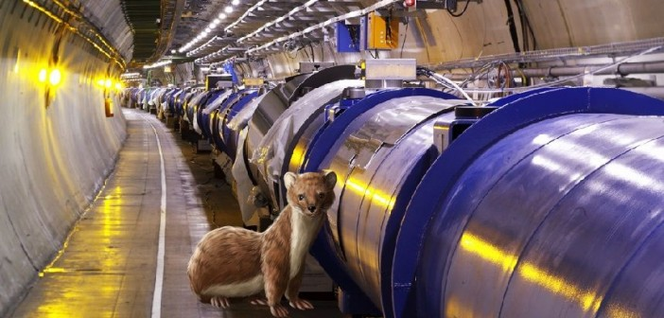
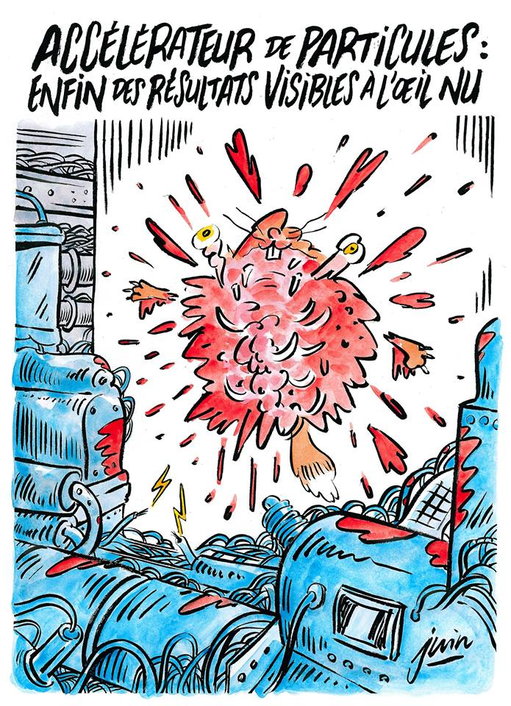

This was the ‘highlight’ last time we talked…
…it remains the biggest media peak for the year...

Slide 3
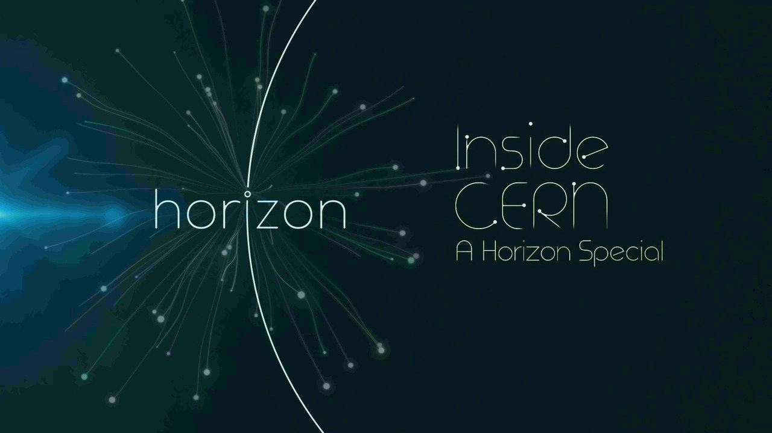
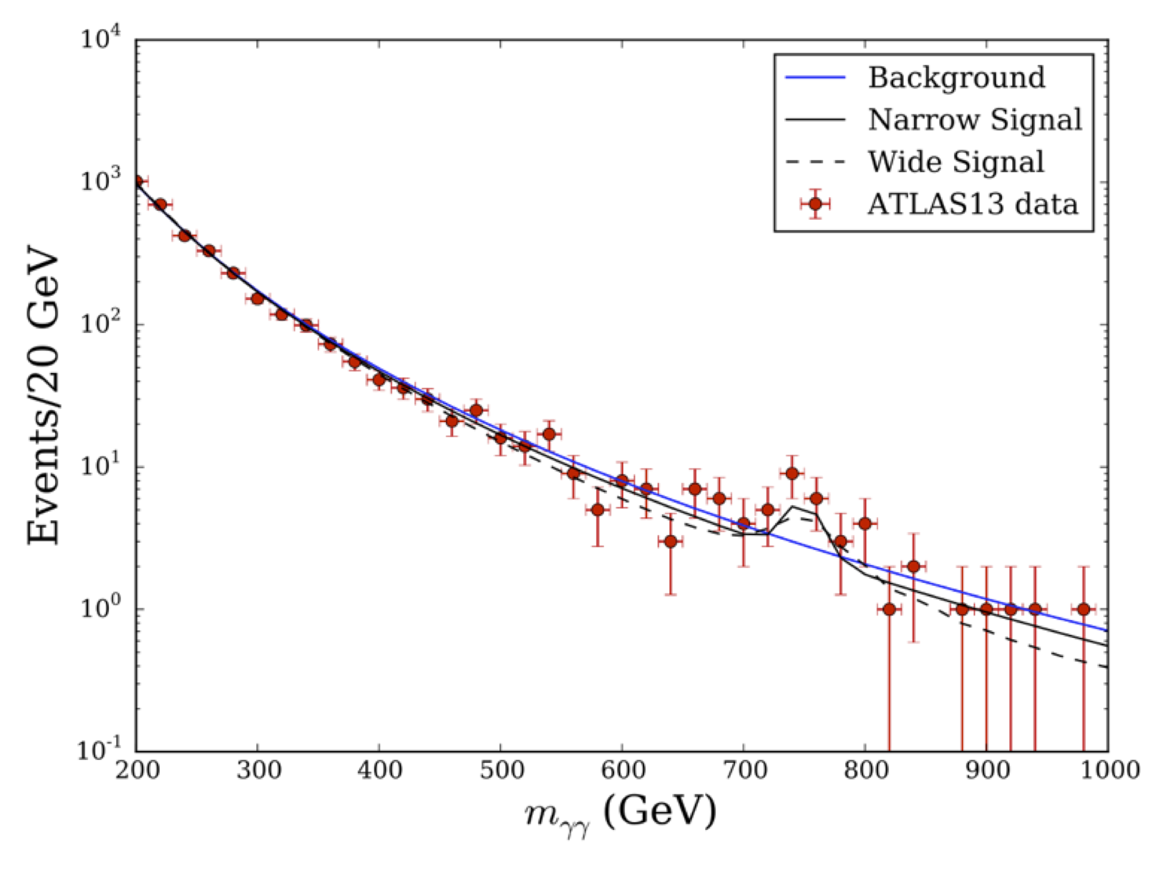
…of course the real big story was this one
(in term of overall media coverage as well probably).

Slide 4
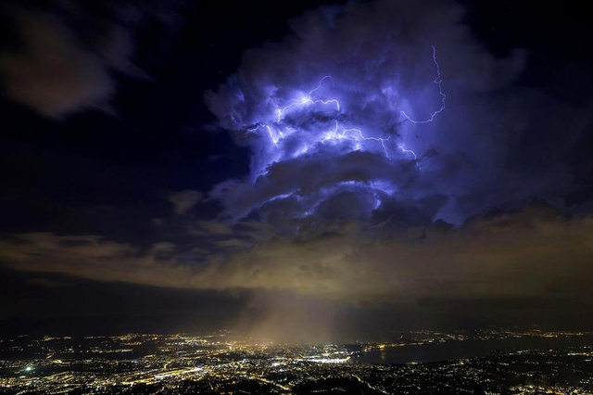
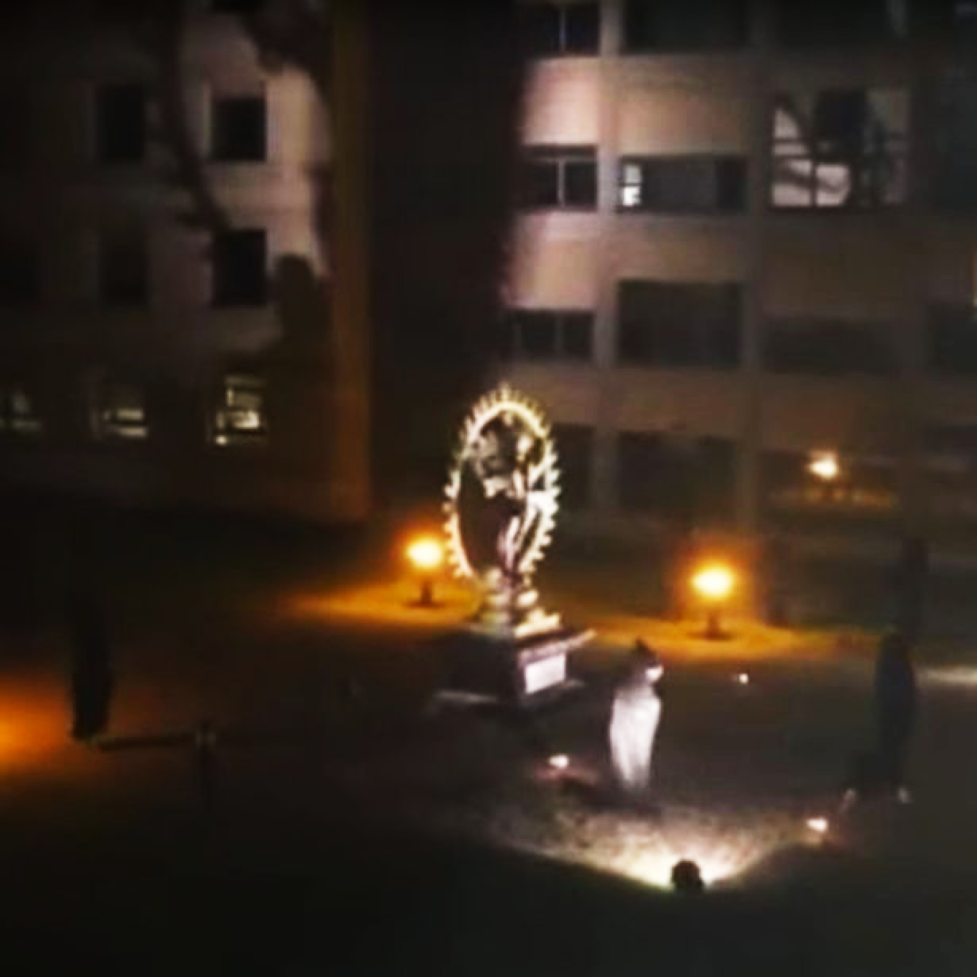
… But we had other interesting stories as well...

Slide 5
1 January – 16 November 2016
2016 Global media coverage
Number of press cuttings – CERN & LHC
The ‘bump and upcoming Moriond
Gravitational waves
Weasel story
2016 LHC Physics Run
LGBT story
LHC first beams

Slide 6
1 January – 16 November 2016
Global Media Coverage
Number of times CERN was mentioned in the news and on social media
News
Social Media
25.05
CLOUD
11.02
Gravitational waves
Week 21.03
LGBT
29.04
#LHCweasel
01.04
April Fools
20.05
Big push
#InTheory
29.03
LHC
1st beams

Slide 7
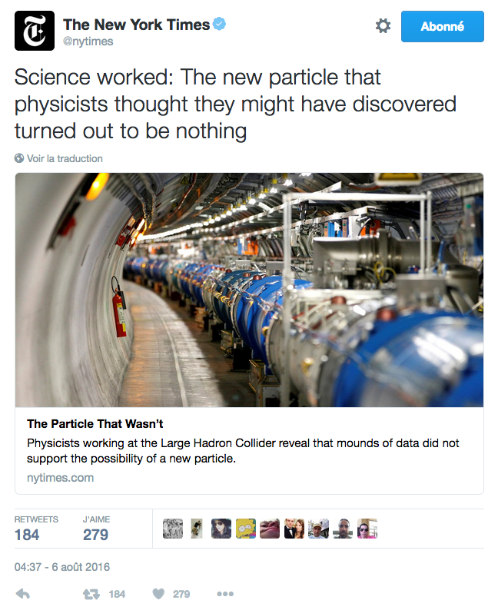


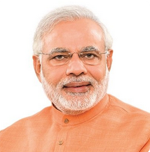

1 January – 16 November 2016
Influential social media accounts talking about CERN
The New York Times: 1 Tweet
31.5M followers
CNN: 3 Tweets
29.5M followers
Narendra Modi, Prime Minister India: 1 Tweet
24.5M followers
BBC News (World): 4 Tweets, 2 Retweets
16.6M followers

Slide 8
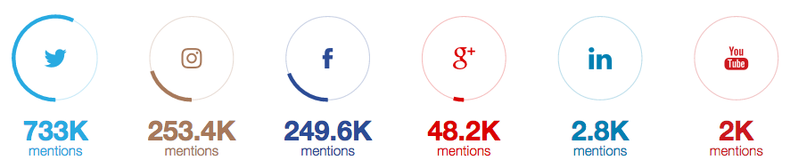
Top media sources
1 January – 16 November 2016
Twitter
Instagram
Facebook
Google+
LinkedIn
Youtube

Slide 9
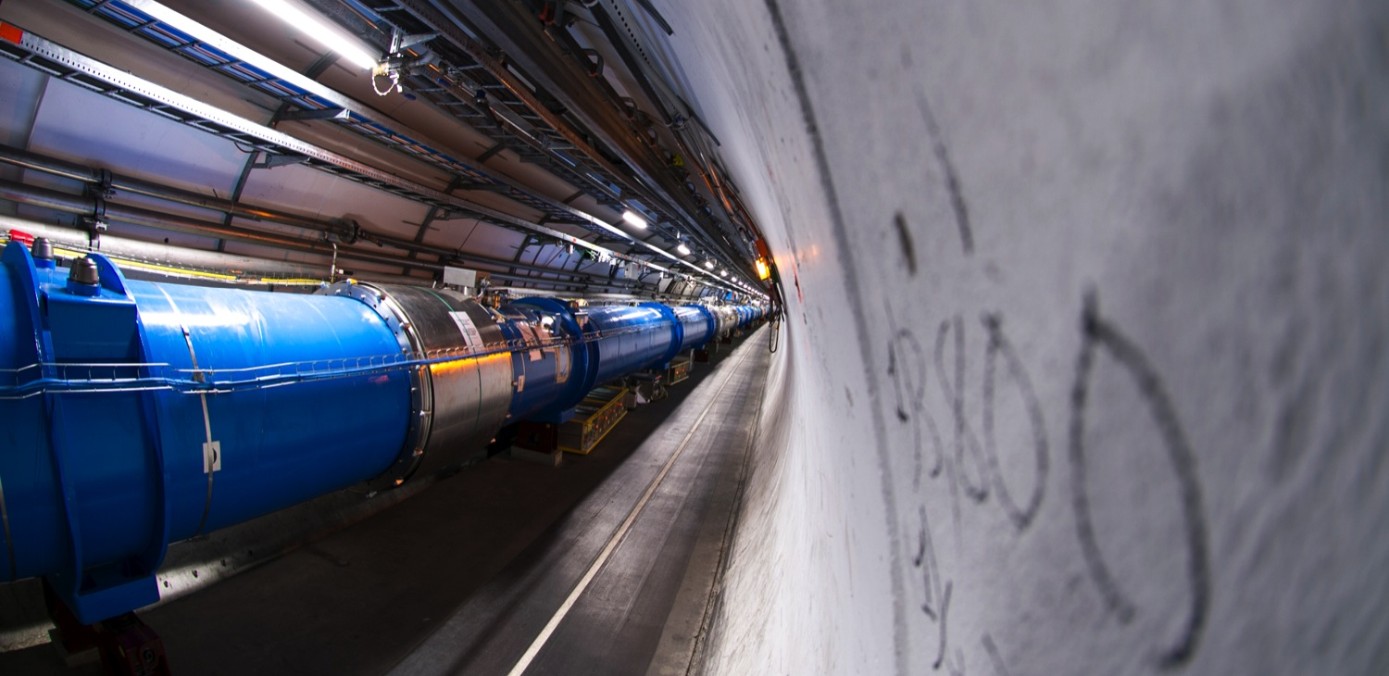
In the end, the most important news of the year is the impressive performances of the LHC: twice more data than expected!

Slide 10
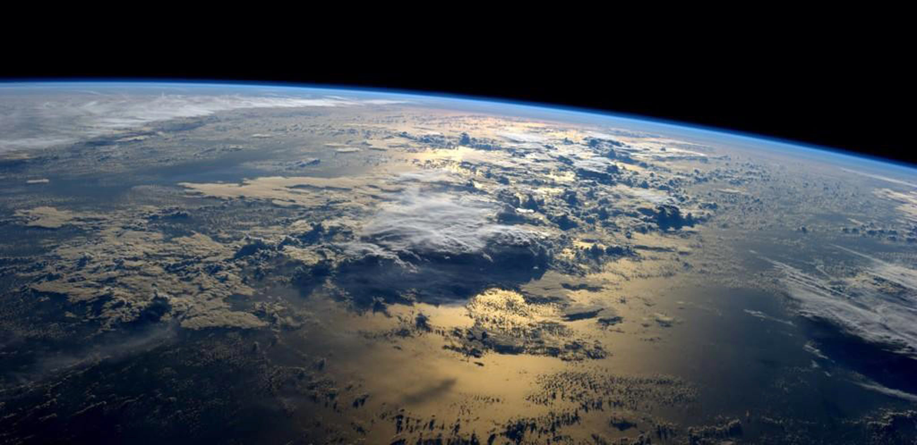
Other important news were about enlargement process:
Romania as new Member,
Ukraine as Associate,
and soon India

Slide 11
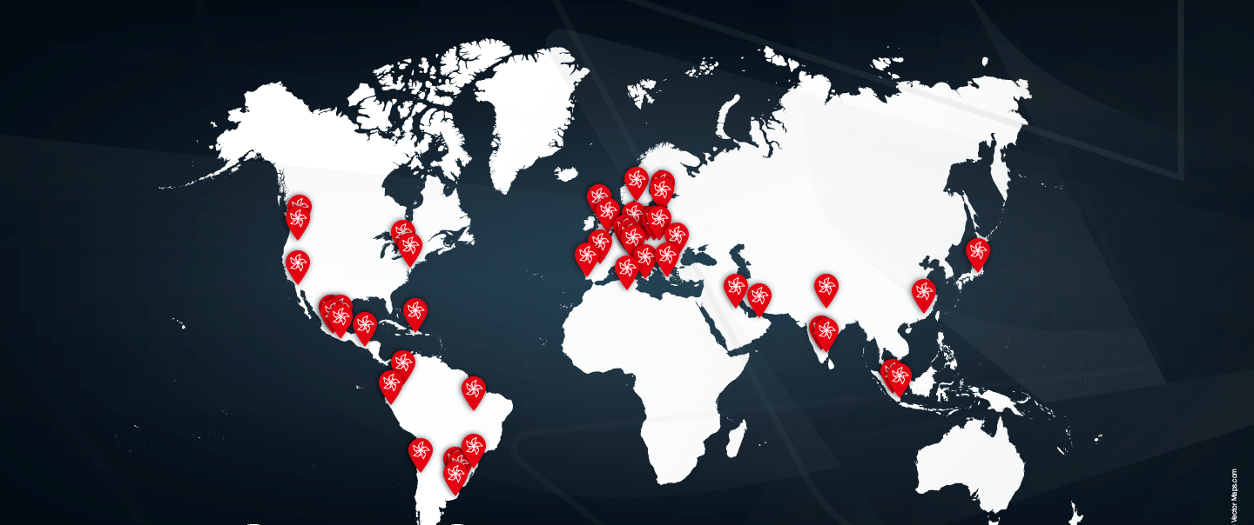
A successful
TEDxCERN 2016

Slide 12
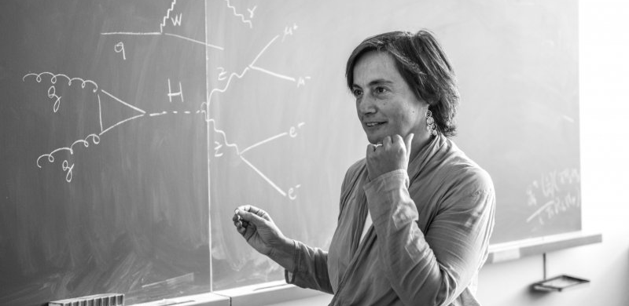
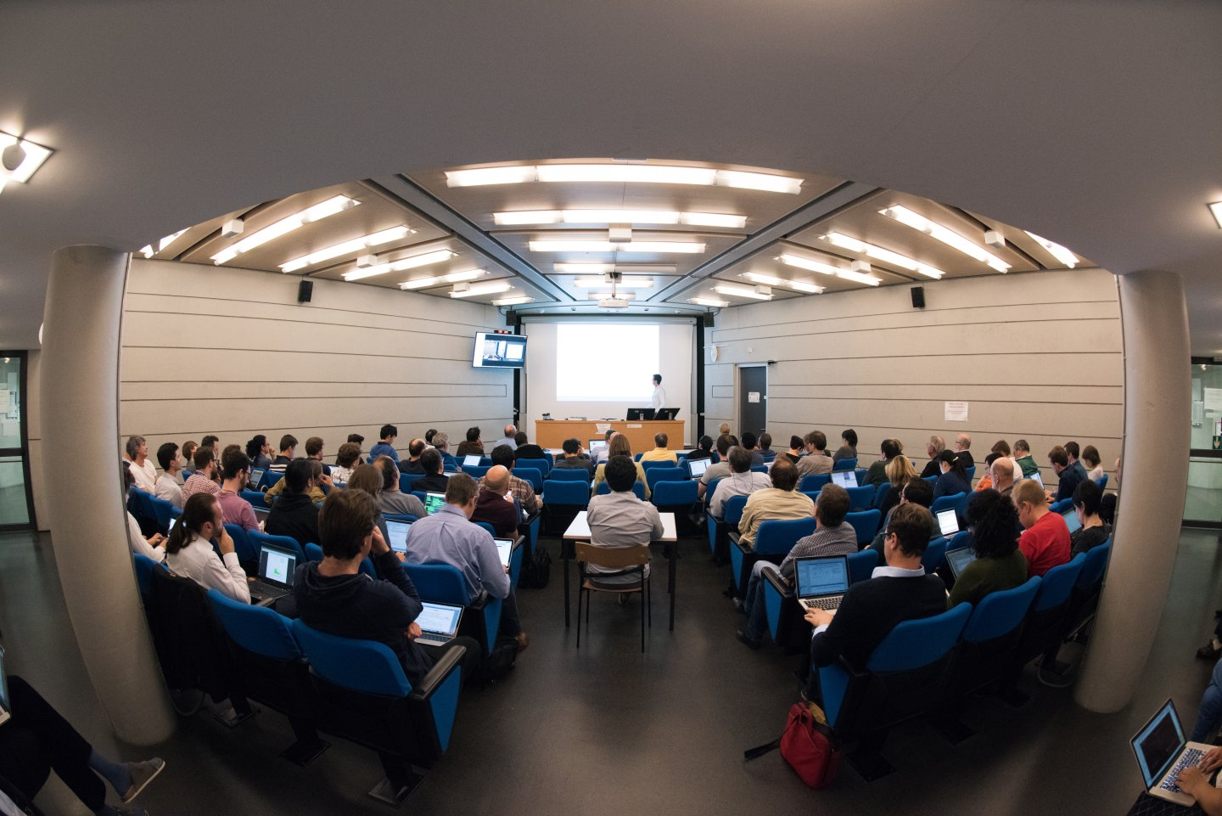
From ‘♯InPractice’
to ‘♯Intheory’

Slide 13
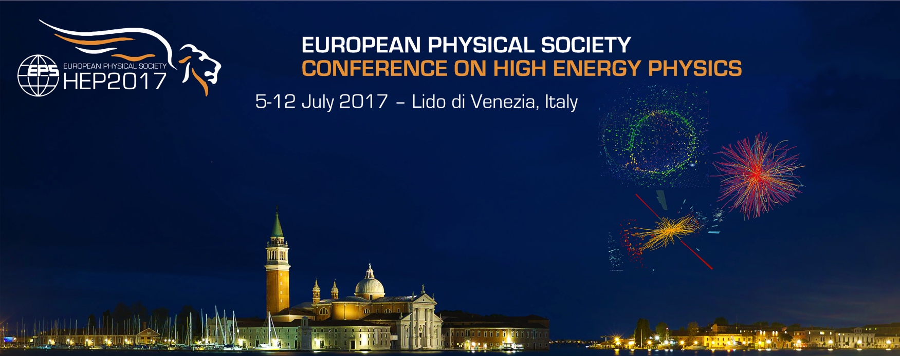
Upcoming conferences:
AAAS 2017 – Boston February 2017 (LHC session)
Quark Matter 2017 – Chicago February 2017 (new results?)
Moriond – March 2017 (new results?)
EPS-HEP2017 – Venice July 2017 (new results?)
World Conference of Science journalists – San Francisco Oct 2017 (antimatter? Dark Matter?)
ESOF 2018 – Toulouse July 2018 (should we organize something there?)

Slide 14

World
Conference
of Science Journalists 2019
In Lausanne?

Slide 15
In our agenda today:
. Relations with Member States¶
. CERN's brochures¶
. Social Media collaboration¶
. Collaborative space for EPPCN
. Discussion with IPPOG ¶
. Report to Council – follow up
. Strengthening EPPCN
. Upcoming Conferences
. Promoting CERN in the UK¶
. SESAME to start soon ¶
What else?

