Slide 2
CERN communications strategy 2017-2020
Ana Godinho
17 November 2016
20th EPPCN Meeting
CERN

Slide 3
The new ECO group
…feeling privileged
Education, Communications & Outreach (ECO)
Editorial Content Develop-ment
Media and Press Relations
Teachers & Student Program-mes
Visitors & Local Engage-ment
Exhibitions & Global Engage-ment
Audiovisual Production Service
Design and Visual Identity Service
…and International Relations sector

Slide 4
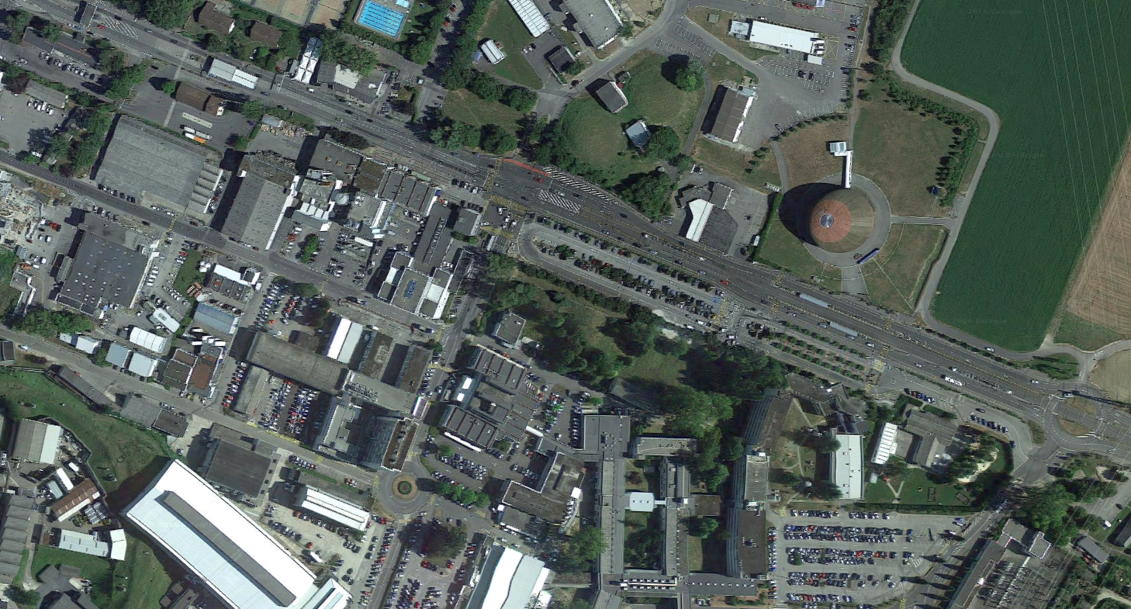
Preparing communications strategy 2017-2020 - Internal communications - External communications
Since September 2016

Slide 5
Agency delivered strategy documents for internal and external communications
May 2016
Notes:
Agency contracted in November 2015 to conduct audience research and make recommendations for CERN’s internal and external communications strategies for 2016-2020
Audience research report delivered March
Internal communications strategy document delivered April
External communications strategy document delivered May

Slide 6

Communications strategy underpinned by:
Our thought process
CERN’s scientific strategy laid out in MTP 2017-2021
Proof’s recommendations
Well-established and very successful communications, education and outreach at CERN
Notes:
Full exploitation of the LHC: - successful operation of the nominal LHC (Run 2, LS2, Run 3; until 2023) - construction and installation of LHC upgrades: LIU and HL-LHC (installed in LS3 – 2024-2026 – to run from 2025 to 2030)
Maintain and update a Scientific diversity programme serving a broad community:
- ongoing experiments and facilities at Booster, PS, SPS and their upgrades (AD/ELENA, HIE-ISOLDE)
participation in accelerator-based neutrino projects outside Europe (presently mainly LBNF in the US) through CERN Neutrino Platform
Preparation of CERN’s future:
- vibrant accelerator R&D programme exploiting CERN’s strengths and uniqueness (including superconducting high-field magnets, AWAKE, etc.)
- design studies for future accelerators: CLIC, FCC (includes HE-LHC) - future opportunities of diversity programme (new): “Physics Beyond Colliders” Study Group

Slide 7
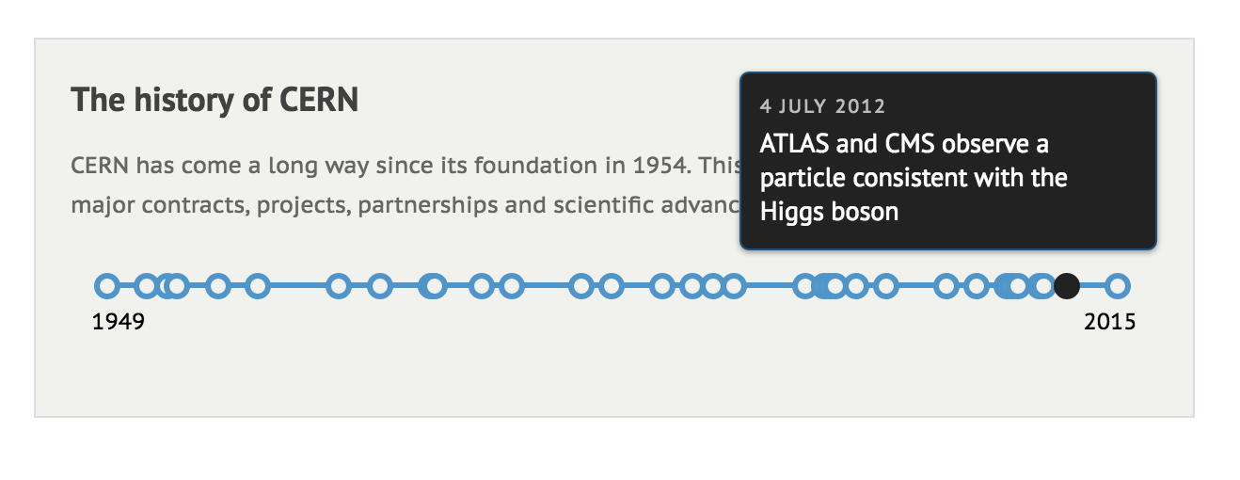
“That was the easy bit” (James Gillies)

Slide 8
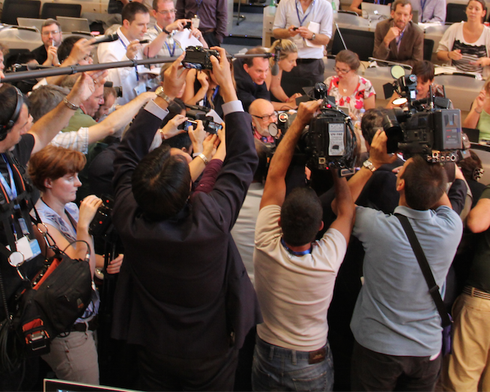
Communication challenges
We have identified
What if there are no new big breakthroughs?
We need an ambitious and costly future accelerator programme
The ups and downs of experimental results

Slide 9
Opportunities to communicate about:
…and also
Diversity of experiments at CERN
The process of science (is not a linear one)
The technological advances
The impact of CERN on society

Slide 10
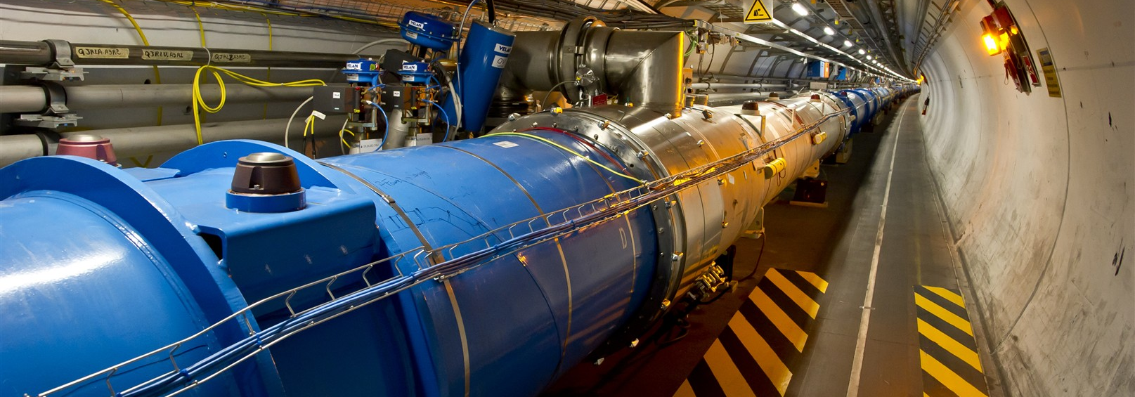
To help to ensure the long term future of CERN and its ambitious projects
Goal of communications in 2017-2020

Slide 11
Six specific objectives
The communication strategy
Maintain and increase support from current member states
Attract new associate member states and member states
Maintain high public awareness and positive public opinion of CERN
Foster community building within CERN and within the international particle physics community
Raise awareness and inform on the societal impact of CERN
Be an effective voice for particle physics and fundamental research
Promote public engagement in particle physics

Slide 12
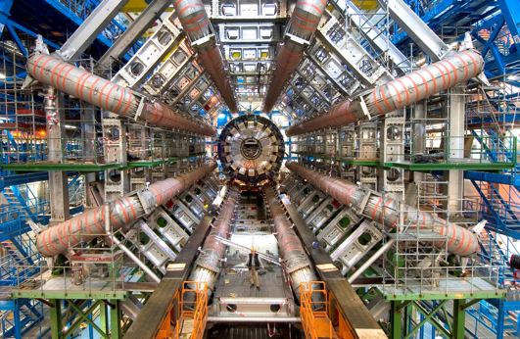
What is CERN about?
Four themes carry the platform for CERN to pass its messages and tell its stories
Research (Discovery through science)
Innovation (Innovation through technology)
Collaboration (Diversity in people)
Inspiration (Scientifically aware citizens)
Notes:
Carry the platform for CERN to pass its messages and tell its stories

Slide 13

Positive messaging
We aim for
Find stories
Find storytellers (and help tell the stories)
Find outlets for the stories
With international partners: EPPCN, Interactions, IPPOG, Member States, Associate States, international organisations, …

Slide 14
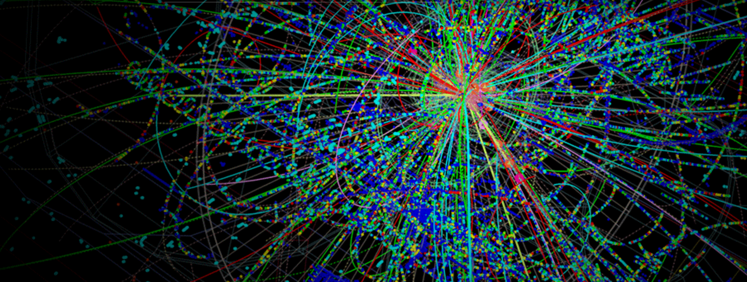
Vision and Mission
Brainstorming

Slide 15
To gain understanding of the most fundamental laws of the Universe
CERN’s vision

Slide 16

CERN’s mission
To provide a unique range of particle accelerator facilities that enable research at the forefront of human knowledge
To unite people from all over the world to push the frontiers of science and technology, for the benefit of all.

Slide 17
Six big key messages
We’ve drafted
CERN is the world leader in particle physics (research, engineering, IT)
A new chapter of particle physics is opening
To continue this journey of discovery we need new accelerators, detectors and IT capacity; to build them we need to push the technology
CERN brings benefits to society
CERN is an open institution
Diversity is intrinsic to CERN

Slide 18
Tailored messages for each target audience
We’ve drafted
International particle physics community
Decision makers (policy)
Teachers and students
Citizens (Voters and Taxpayers)
Local community
Media and opinion-makers
CERN Community
Industry
Donors
Alumni

Slide 19
A portfolio of activities underpinned by goal, themes, key messages
Keeping on track
Social Media
Website (.cern)
Publications
Press Office
CERN Courier
Visual Identity
Photography and video
Teacher programmes
Outreach resources
Public events
Student programmes
Visits
Exhibitions
Internal comms

Slide 20
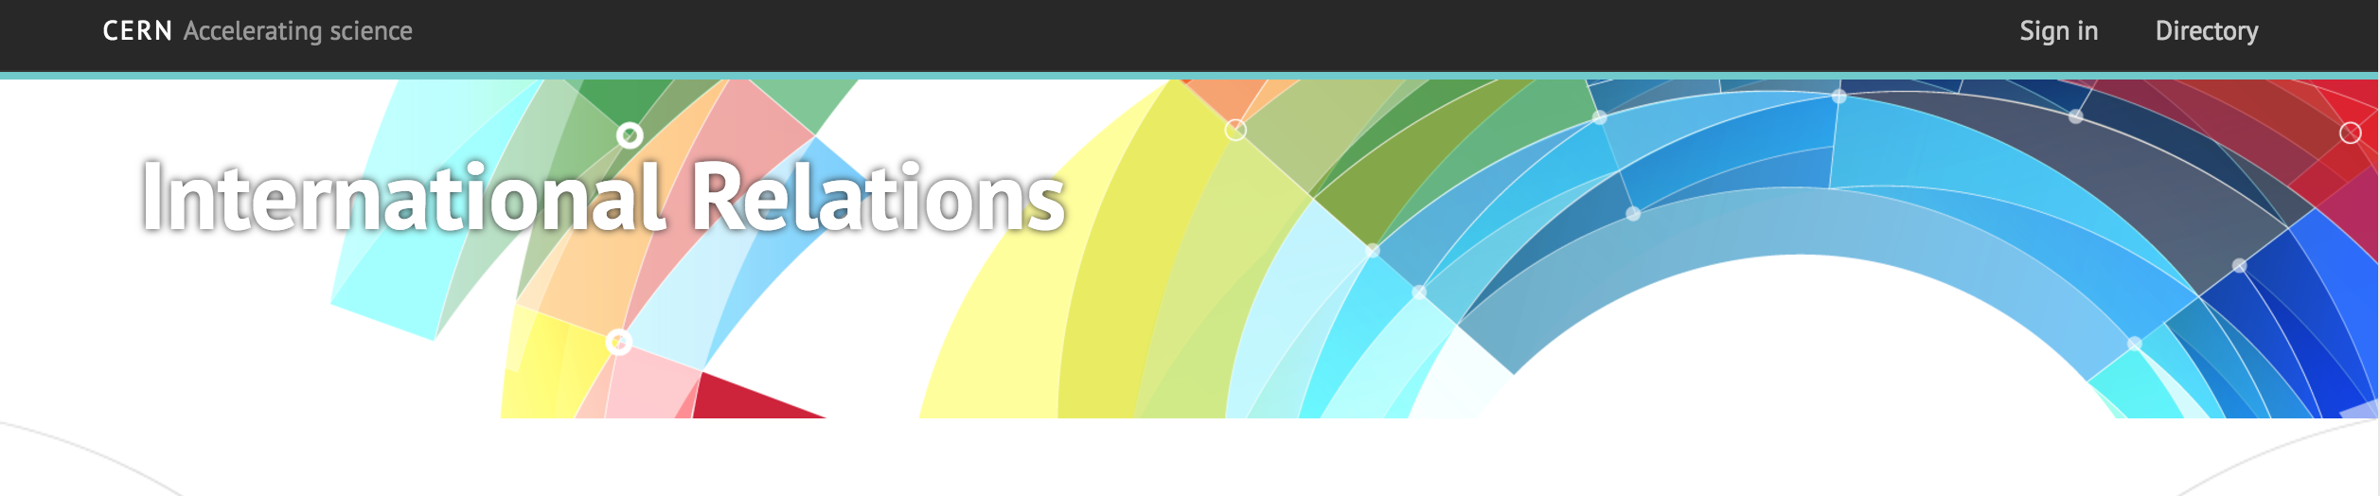
Available soon on the upcoming new International Relations website

