Slide 1

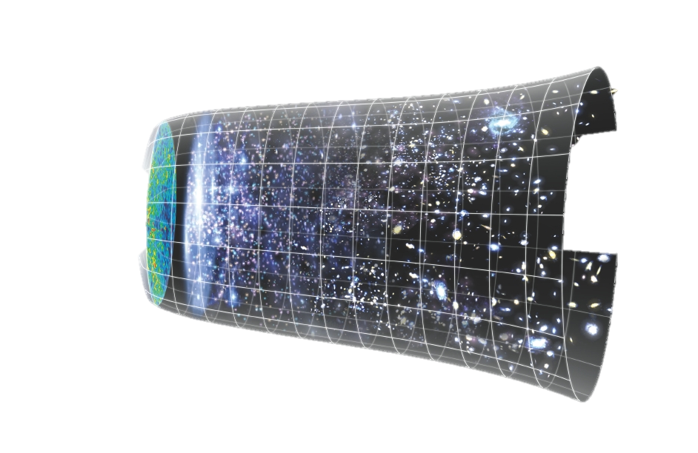

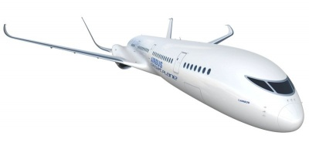
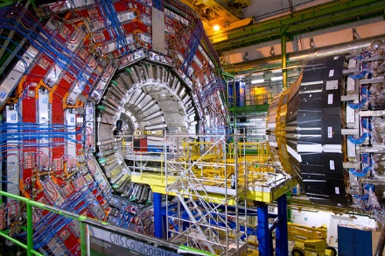
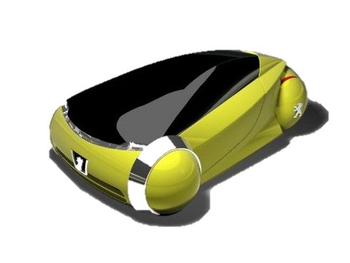
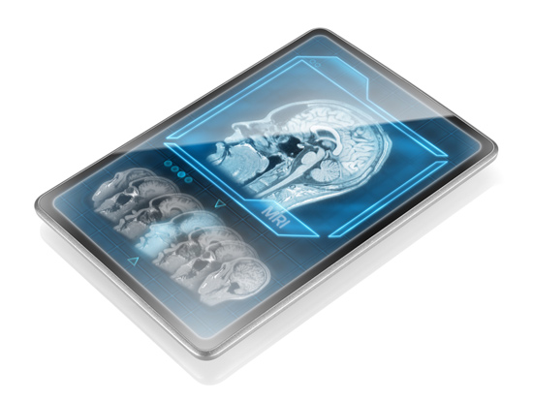
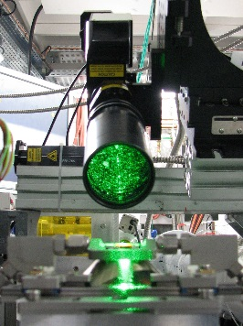
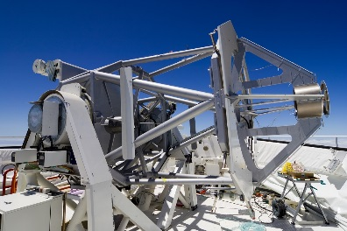
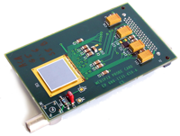
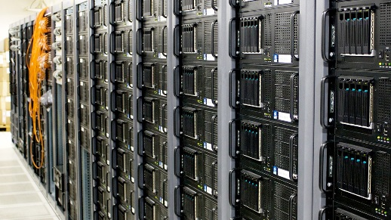
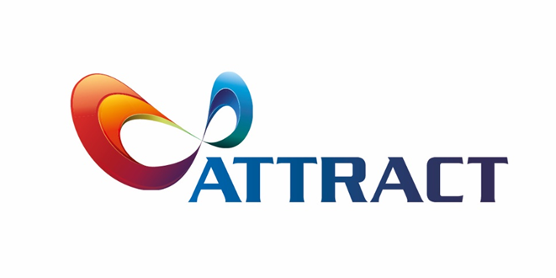
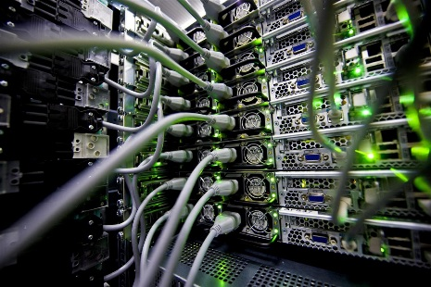
Notes:
ATTRACT is an initiative that leverages in the capacity that the pursuing of fundamental science has in generating breakthrough technologies. We are not talking about incremental advances but technologies with a transformational power towards ourselves and our society.

Slide 2

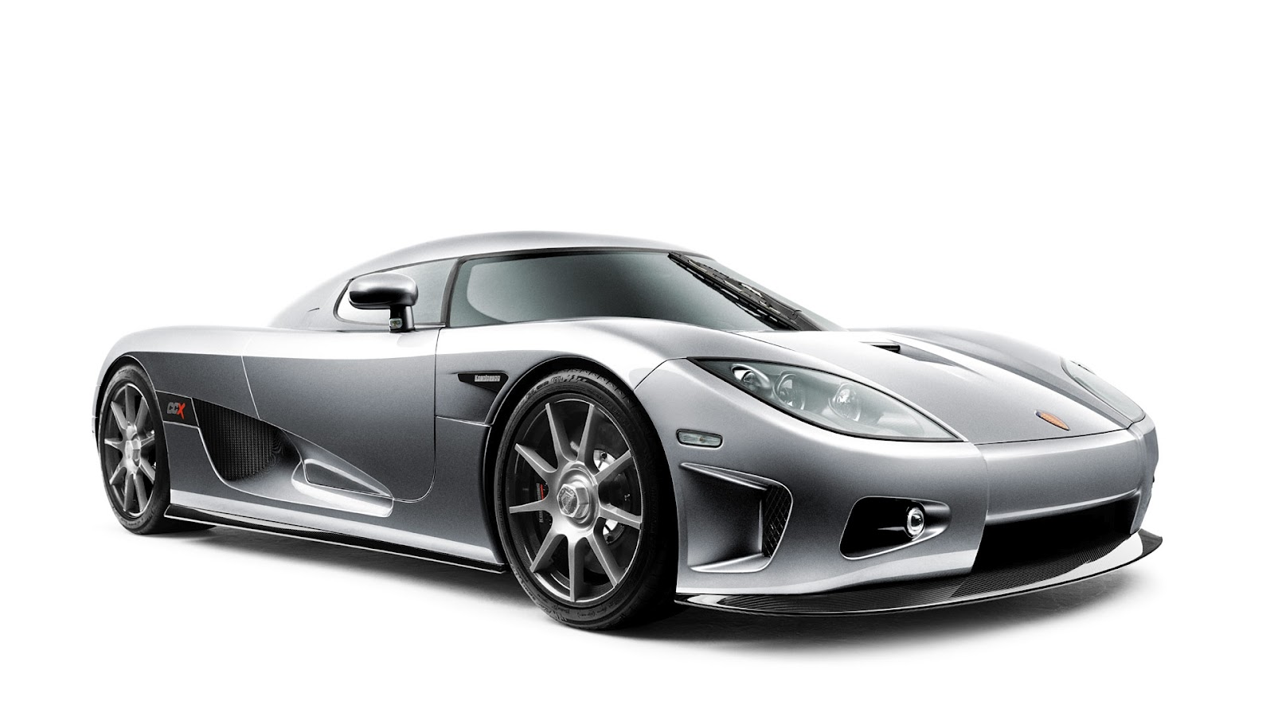
Idea
Market
What is our approach?
Notes:
ATTRACT is a different paradigm about how to bridge the gap between an idea to the market. This new paradigm is characterised by the two key ingredients.

Slide 3





From
Open
Science…
…to Open Innovation
Notes:
First:
Being able to translate the richness of the Open Science model implemented specially by large research facilities into an Open Innovation model.

Slide 4











Business & Innovation Experts
Research
Infrastructures
Public & Private Investment
Industry
Notes:
Second:
Incorporate in the value chain the necessary actors for that:
Value generators: Research Infrastructures and their research communities.
Value captors: Industry, Business and Innovators and Private Investors.
Risk absorption: Public funding.

Slide 5
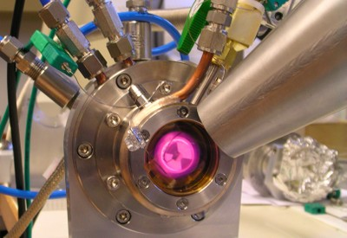
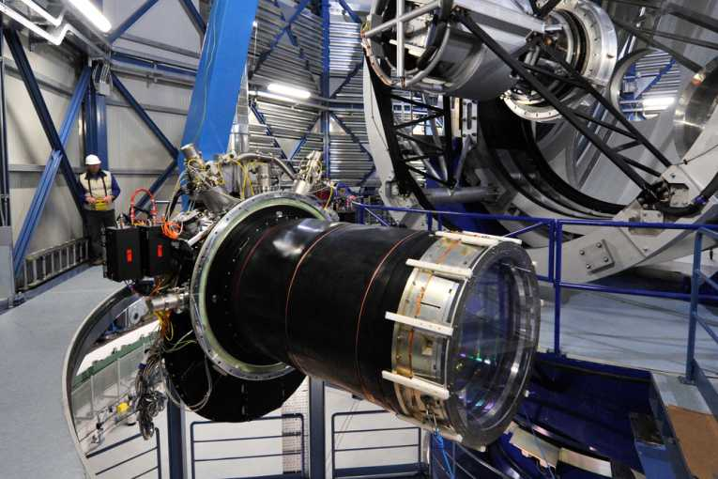
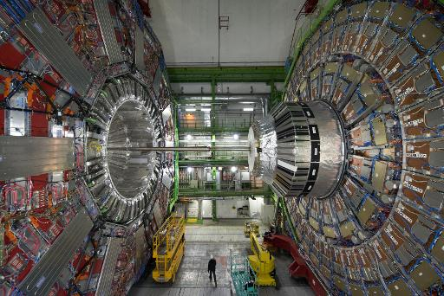
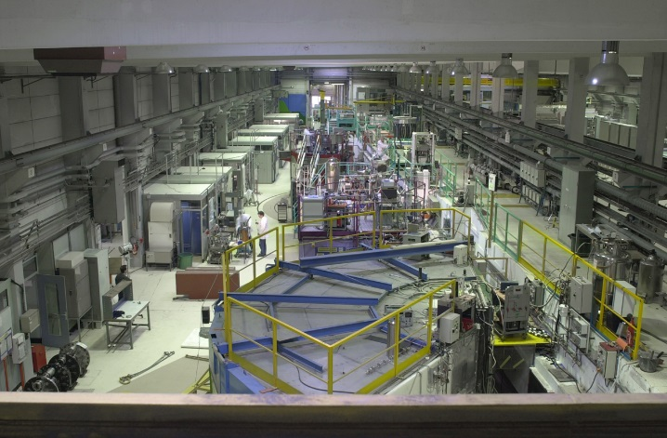
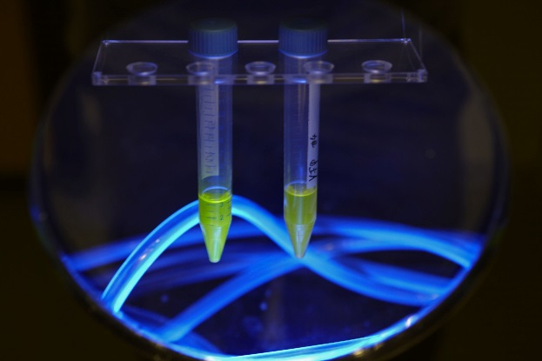
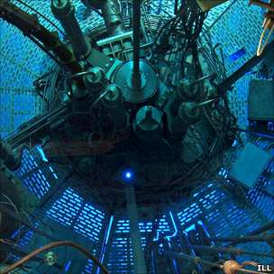
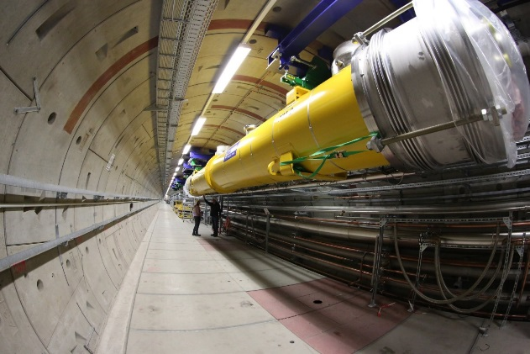

Unique
Notes:
The main differentiator of ATTRACT is the rooting on the value creation by Research Infrastructures, because:
The technology generated in their mission to pursue frontier research is by definition not incremental.
They constitute the first test-bed for this unique technology.
This, contributes enormously to minimize (in-house) development costs and market risk.

Slide 6
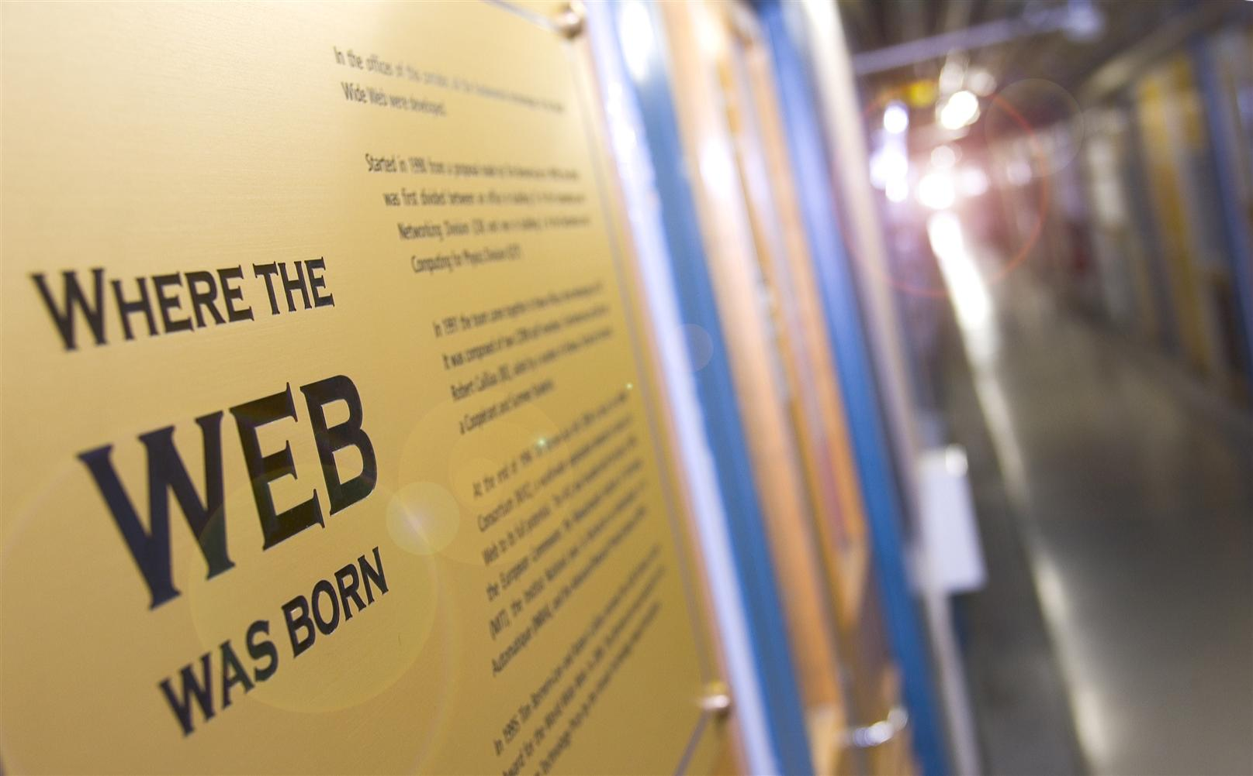
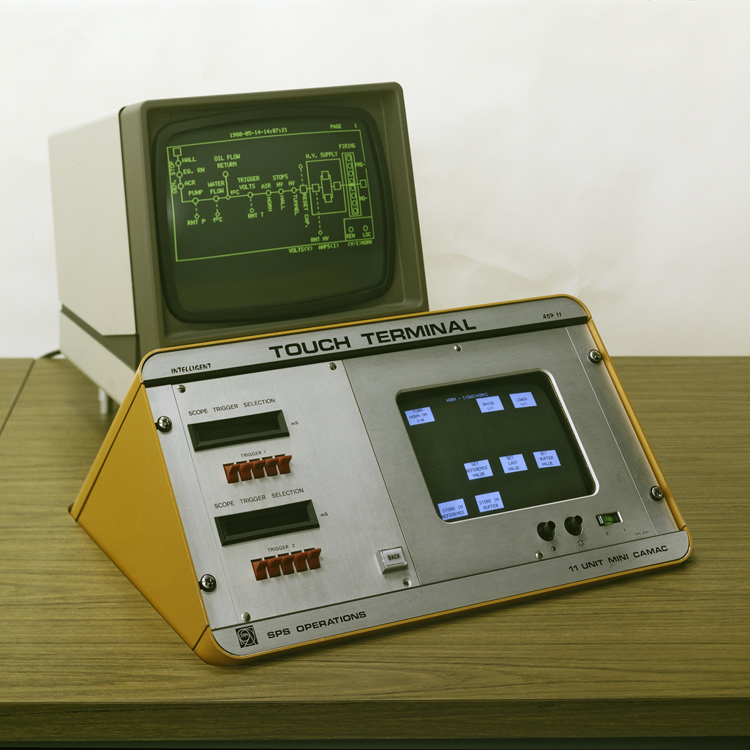
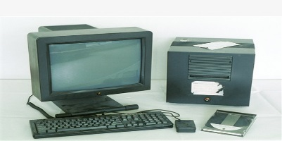
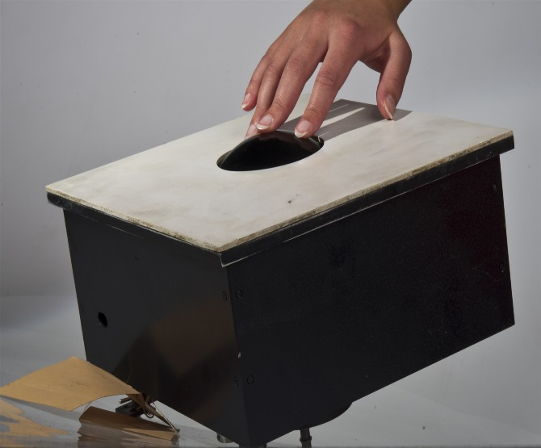
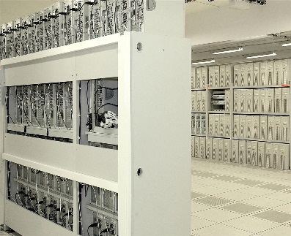
Cashing-in Serendipity
Notes:
If breakthrough technologies were generated and their value captured in the past just by serendipity …why not creating the necessary conditions to do it systematically?
Illustrations: CERN invented the WWW, Mouse, touch screen way before they were known or re-invented.

Slide 7


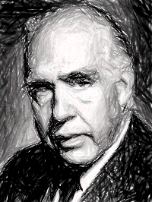
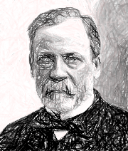
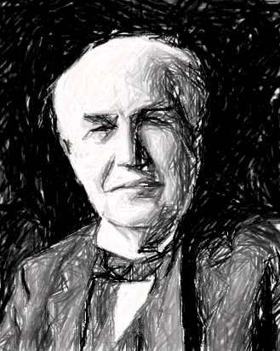
Pure
Basic Research
Use-inspired
Basic Research
Fundamental
Advancement
Applied Research
Applicability
Notes:
It is in this context that ATTRACT operates in the so-called Pasteur Quadrant of value creation-value capture.

Slide 8

Breakthrough
Detection and Imaging
Technologies
Notes:
ATTRACT focus is on Detection and Imaging technologies.

Slide 9

Transforming Society
Notes:
First because they have the capacity to transform our society in a tremendous way.

Slide 10
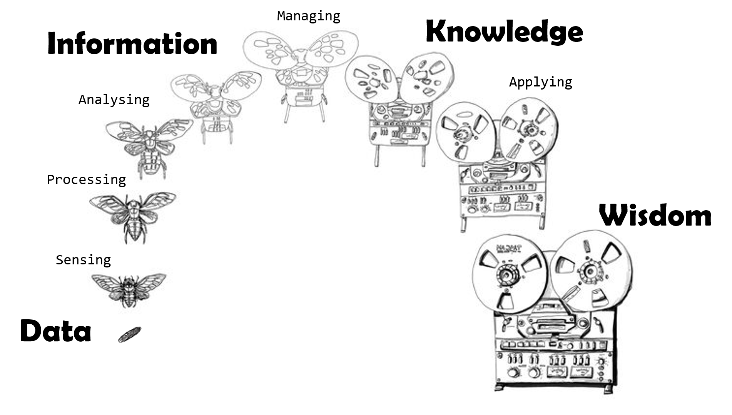

Our value chain
Notes:
Second because their value chain allows multiple value-capture possibilities…from sensors to big data.

Slide 11

A trillion dollar market
Notes:
A paradigmatic example of value capture is the so called Internet of Things.
But what about genomics, proteomics, earth observation technologies, etc…

Slide 12

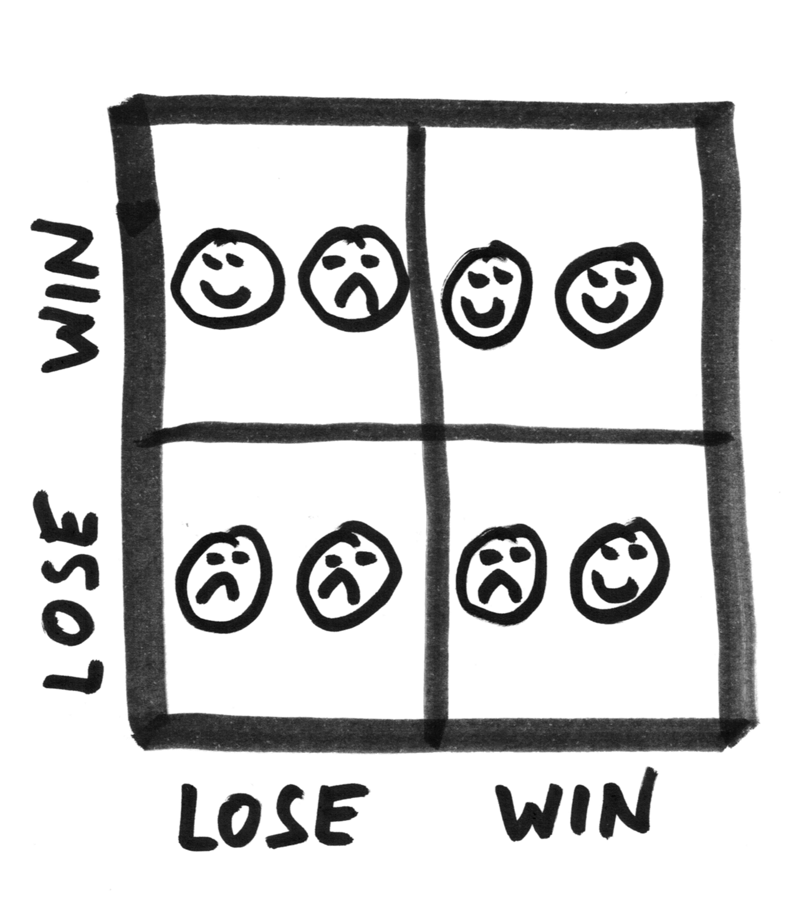

Win-Win
Cooperation
+
Competition
Co-Innovation
Notes:
We mentioned before that the first key ingredient of ATTRACT is the transition from Open Science to Open Innovation.
A model to implement this is through what we call co-innovation.
Co-innovation: the balance between cooperation (value creation) and competition (value capture) that generates win-win situations.
Example: I will be interested in developing a detector in the pico-second range for studying proton collisions. You will make good use of this detector for making a breakthrough PET scanner…why we don’t co-innovate?

Slide 13

From seed…
Notes:
How to implement this model:
First: seed fund initial high-risk stages.
Public money is key to absorb the initial risk from breakthrough idea to breakthrough proof of concept.

Slide 14

…to Growth
Notes:
How to implement this model:
Second: Help Growth when an opportunity is identified.
Public money is key for growth.
Private capital is key to accelerate growth and start to capture value even on early stages.

Slide 15
2018
20 M Euros EC fund.
Seed funding of 180 breakthrough projects.
2025
Scale-up Public-Private
Capital Model
1
2019
4
Scale-up EC fund.
Private capital in place.
2
2020
Sustainable Public-Private
Capital Model
3
Notes:
Our roadmap:
2018: 20 M Euros secured from EC to seed fund 180 projects classified as breakthrough. Projects will range from conceptual idea to early prototype. Seed fund understood as first step for advancement. 1 year after seed funding progress will be checked.
2019: Secure substantial public funding for further funding of selected projects out of the 180. Target to have private investment structure in place with willing investors.
2020: Sustainable model integrating Public and Private capital to repeat the cycle seed/growth several times.
2025: Scale-up the model.

Slide 16



…let’s move through together.
Notes:
We consider the ATTRACT initiative as one in search for a good model to integrate private and public capital. It will be key to count with your help to find it.

