Slide 1
UNICOS Framework
Enrique BLANCO*
Industrial Controls & Electronics Group
Engineering Department, CERN
Geneva, Switzerland
* On behalf of the UNICOS team

Slide 2
OUTLINE
Introduction and Origins
UNICOS framework
  UNICORE
  Packages vs. Applications
Continuous Process Control (CPC) Package
  CPC Devices application
  Generation concept: Tools & mechanisms
Other UNICOS packages
  Use cases (SURVEY, WIC)
Status & Evolution

Slide 3
1.- Introduction and Origins
UNICOS (UNified Industrial Control System) was born at CERN as a need to develop the LHC cryogenics control system.
The goal was to create an industrial control system covering the three layers of the typical automation pyramid.
A necessity of specialized generation tools to create automatically such industrial control systems both in the PLC and the SCADA was identified.
  Rapid startup of commissioning
  Manual intervention is generally required for the control logic and HMI synoptics (process dependent)
SCADA
Supervision
Control
PLC
Field
Field equipment

Slide 4
1.1.- Not only a bunch of devices
UNICOS establishes:
  A well defined set of standard objects (devices) covering most of the equipment and needs of continuous processes
  A formalized and standard way of programming the specific process logic
… and also:
  Provides the developer with the means of producing rapid control applications
  Allows early plant commissioning
  Allows optimized maintenance
  Provides the operator a way to interact all the objects with a little effort
  Tools to diagnose problems (process alarms, control components,…)

Slide 5
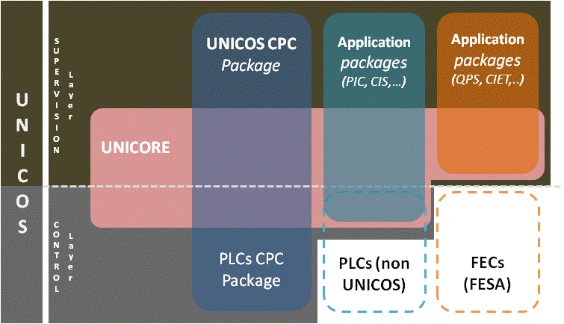
2.- UNICOS FRAMEWORK
  Based on the first implementation of UNICOS and as response of a need for other type of control and/or monitoring systems the UNICOS framework was formalized.

Slide 6
2.1.- UNICOS framework
UNICOS provides
  developers with the means to rapidly
  develop full control or monitoring applications
  operators with ways to interact with all
  items of the process with as little effort
  as possible
  tools to diagnose problems in the process and the
  control system and to access and operate the
  devices without specific development.
UNICOS proposes a reusable environment
composed by a set of components for the
supervision and front-end layers:
  UNICORE component
  A basic package called UNICOS CPC (Continuous Process Control) package* to develop process control applications.
  Facilities to create new packages (new application(s)).
  Generation and deployment mechanisms

Slide 7
2.2.- UNICORE
Deployed in two layers:
  Supervision:
    Distribution control allowed
    System Integrity monitoring
    Interface with the LHC services:
      DB logging, LASER, CMW (client/server)
    Default set of front-ends: PLC, CMW, Soft-FE, OPC, DIP
    Interface to include new packages
  Front-end:
    Communications protocol: TSPP
    Events mechanism
At the supervision layer offers operators a homogenous and entirely customizable user interface. The main features are:
  Navigation capabilities between panels and trends: WWW browser-like, contextual buttons, pop-up navigation
  Access to the device without creating a panel (tree device overview)
  Process Alarm and Event list
  Access Control

Slide 8
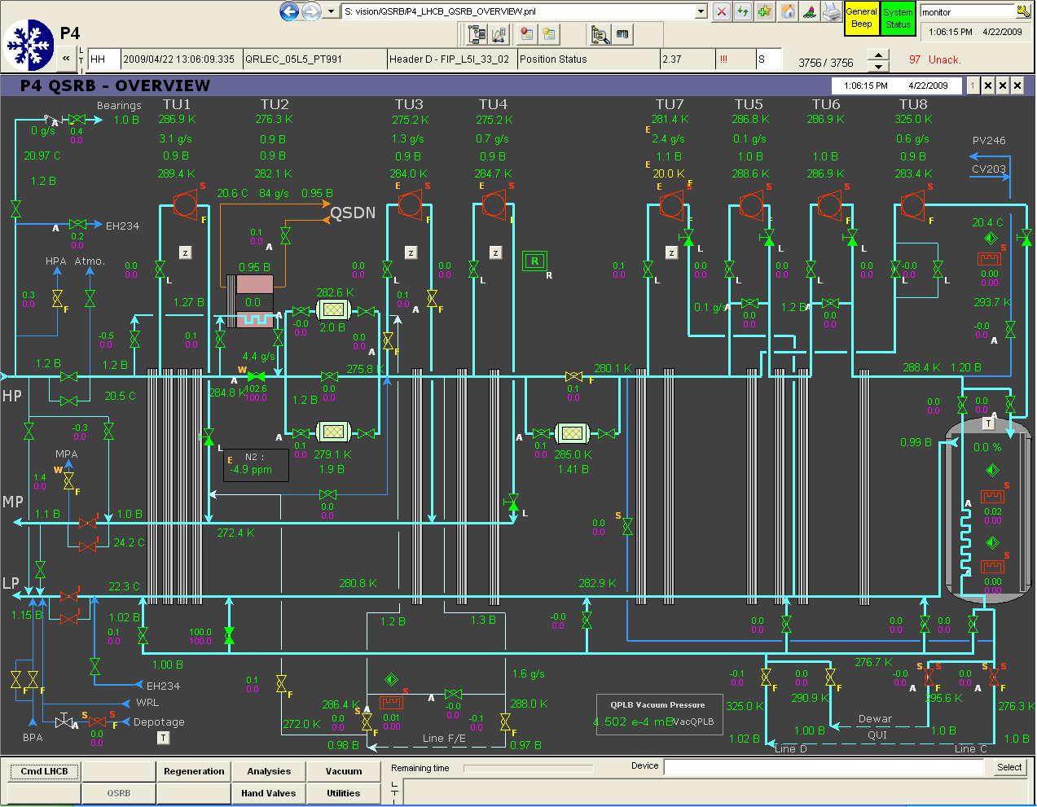
2.3.- UNICOS User Interface

Slide 9
2.4.- CPC Package
Continuous Process Control package:
Proposes a method and tools for developing control applications
PLCs as front-ends (Siemens & Schneider)
It reuses the UNICORE component
CMS tracker
thermal screen
LHC Collimators Interlocks
UNICOS
SUPERVISION Layer
LHC Gas Control
UNICOS CPC
Package
PLCs CPC Package
LHC cryogenics
UNICORE
CONTROL Layer
Process Control applications
http://ab-project-unicos.web.cern.ch/ab-project-unicos/S7-Unicos/S7-UNICOS_projects.htm

Slide 10
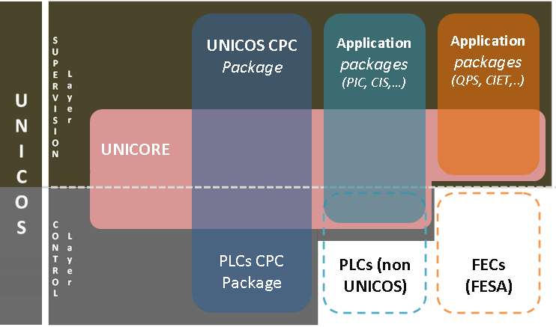
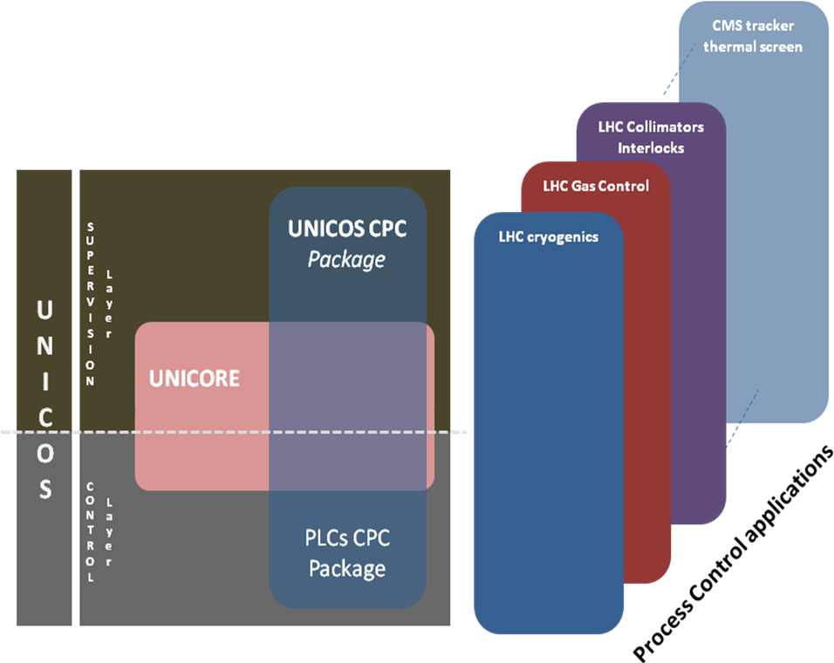
2.5.- Packages vs. applications
CPC applications
UNICOS framework

Slide 11
2.6.- Frameworks Integration
UNICOS frameworks reuses some of the JCOP framework components
LHC Experiments Applications
Fixed target Experiments Applications
LHC Cryo &
Exp Magnet, LHC GCS, …
Application packages
PIC, CIS,…
Application packages
QPS, CIET,..
UNICOS CPC
package
UNICORE (PVSS side)
JCOP Framework
PVSS

Slide 12
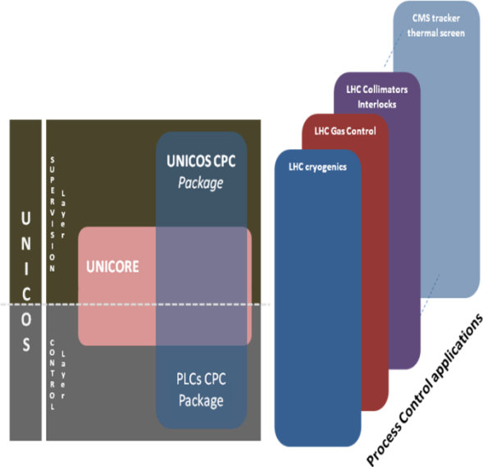
3.- CPC package
The package consists mainly on:
Devices
Methodology
  Modeling of the process. Process breakdown (IEC 61512-1)
  Operation and Diagnostics oriented
  From process analysis to code production
Tools
  Common language for process experts and developers
  Versatile suite of tools open to extension
    Generation
    Instantiation of devices and logic code

Slide 13
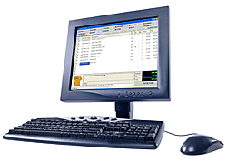



3.1.- Classical architecture
Supervision Layer
Interface to operators
(Monitoring & Command emission)
Operator Consoles (HMI)
Real time DB & Archiving
SCADA Servers
Ethernet Network
Control layer
Control Logic Actions
PLC Process Control
& Field interface
Field layer
control system connection to the process directly or through field-buses
Fieldbus Networks

Slide 14
3.2.- Early CPC Devices
  CPC package provides
  a library of well defined
  set of standard devices
  covering most of the
  equipment and needs
  of continuous processes.
Devices
  I/O devices
    Temperature (AI),
    Level (AI),
    end-switches, … (DI)
  Field devices
    Valves (ANALOG),
    PWM heaters,…
    Controllers (PID)
    Alarms (ALARM)
  Process Control objects
    Process units: (PCOs)
AI
M value
PID
An Input
position
Control
Valve
An Output
position
Equipment module
DI
End switch
On-Off Valve
DO
position
UNIT
Equipment module
AI
M value
PID
AI
position
Control
Valve
AO
position
Equipment module
DI
End switch
On-Off Valve
DO
position
I/O devices
Field devices
Process Control Objects
Controller (PID)
Analog (valve)
AI (Measure)
AI (Feedback)
AO (action)

Slide 15
3.3.- More devices added
The basic package includes:
  I/O
  Field (Valves, Heaters, Pumps, …), Alarms, Controllers
  PCO
Extensions added (CGS):
    General devices:
      xParameter: (mainly intended for recipes mechanism, but also used to hold thresholds)
      xStatus: for large data handling and low PLC memory usage
      Alarms (Analog & Digital) to deal with delays and thresholds
    Specialized devices:
      MassFlowController
      Advanced Controllers

Slide 16
3.4.- CPC Applications methodogology
Specifications creation
  Instances: data captured by filling EXCEL worksheets
  Logic specification: Word templates
  Additional tools. (e.g.: OLPROC)
Automatic generation
  Instance generator
  Logic
Manual intervention
  Process synoptics: drag & drop
  Process logic coded by the control engineer in an standarized way. Some applications may create automatic code generators.

Slide 17
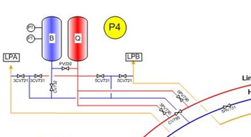








3.5- UNICOS CPC Environment
I/O Channels
Field Objects (Valves, Heaters, …)
C
P
Process Control Objects
(Compressors, feedbox, …)
UNICOS CPC package
Instances
Logic
Specifications
Instance
Generator
CMW interface
Long-Term archiving
LHC alarm system
PLC and SCADA Baseline
Logic
Generator
PLC and SCADA Instances
Diagnostics tools
System Integrity
C
O
Precise placeholders where the control engineer must write the process logic
Simplified HMI tool to create process synoptics (drag & drop)
O
Operators
P
Process Engineer
C
Control Engineer

Slide 18
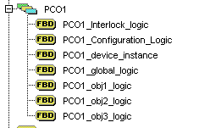
3.6.- Generation and Deployment
SCADA
Devices Specification
device type
templates
Instantiation generation
Supervision device
instance
PVSS UNICORE
Scripts
Device
instantiation
Instance
Generator
PLC device instance
Basic Logic generation
Device
instantiation
Logic
Generator
Logic Files
PLC logic
Logic skeleton
Logic templates
UNICOS CPC baseline
Placeholder
Skeletons
PLC

Slide 19
4.- Other UNICOS packages
There are other application packages than CPC
  Packages with front-ends (FECs) non UNICOS
      Examples: CIET, QPS, SURVEY
  Packages with PLCs non UNICOS
      Examples: PIC, WIC, CIS

Slide 20
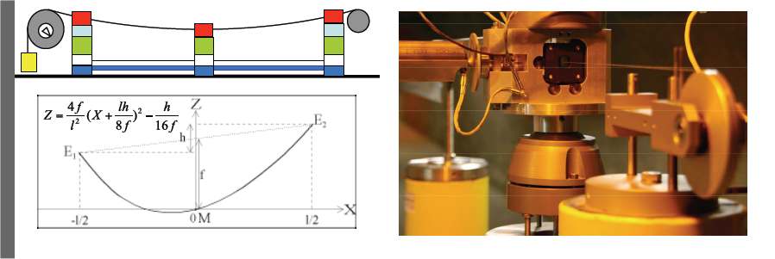

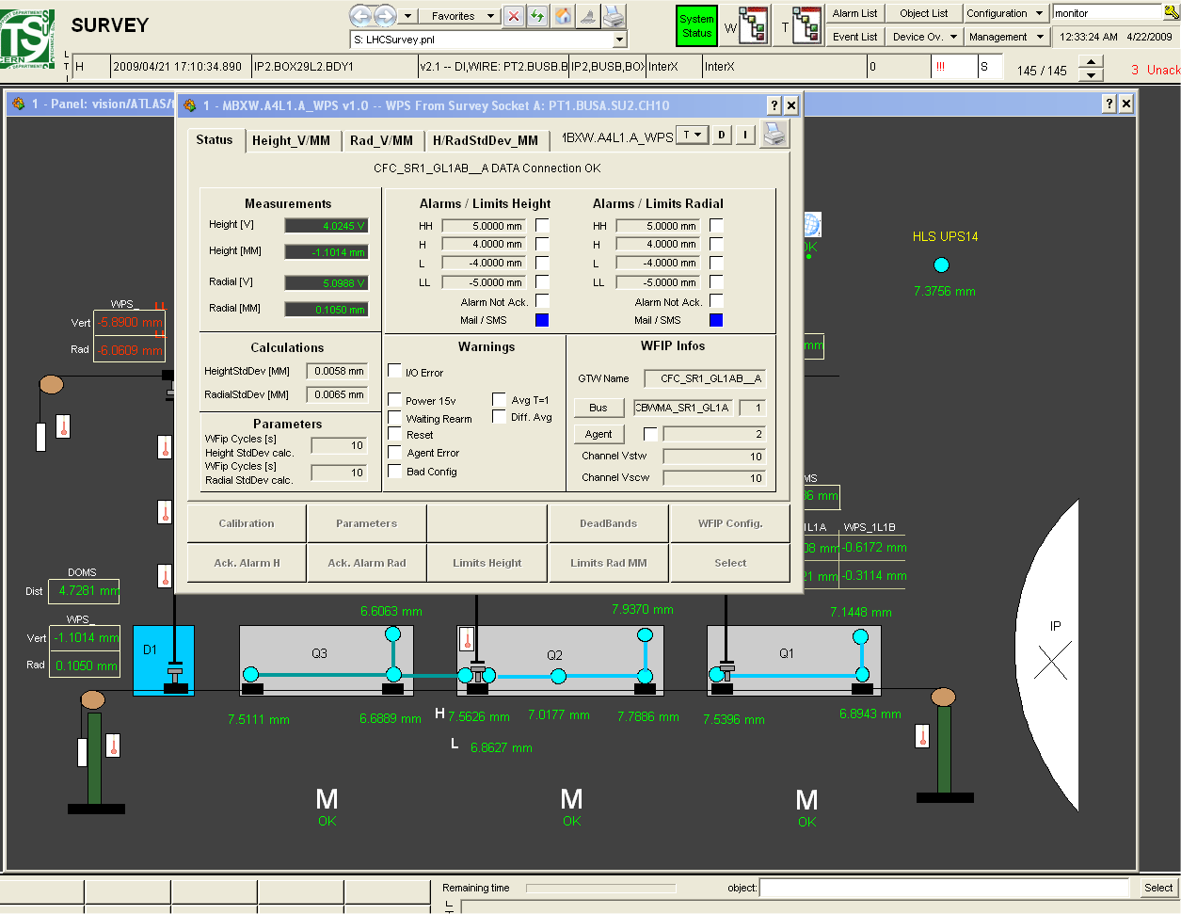

4.1- Use Case: SURVEY
  LHC Inner Triplet magnet alignment (tolerance ~ 100 micron)
  Front End: FESA devices (DOMS, WPS, HLS, Steiner, ZTS, ESTOP, …)
Central
Control Rooms
  WPS: streched-wire pos. system
SCADA Data Servers
Ethernet (TN)
WorldFIP
General Architecture

Slide 21
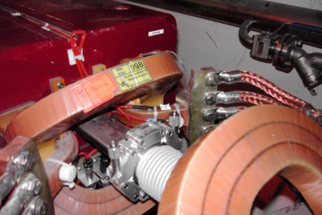
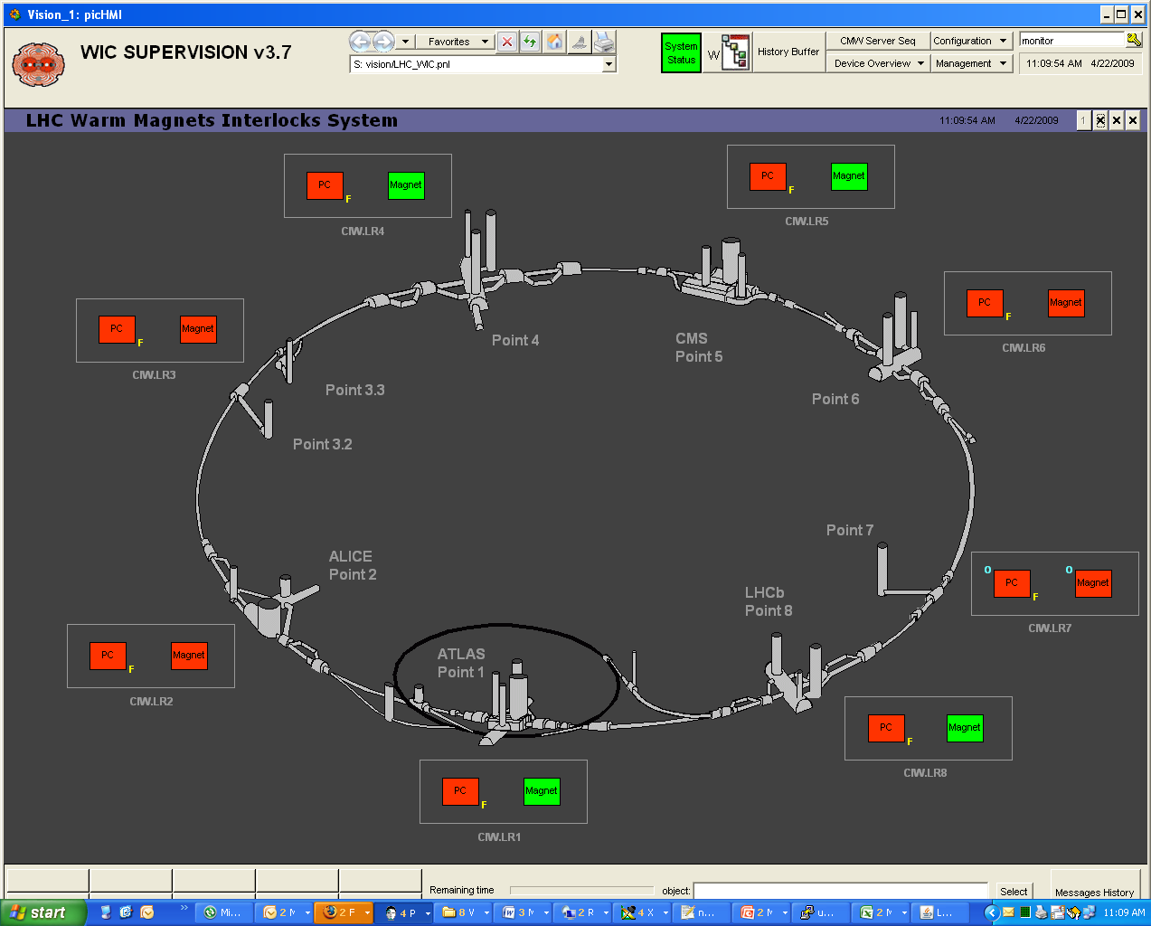
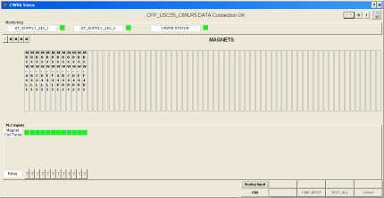
4.2.- Use Case: WIC
  Warm Interlock controller: monitors the magnet and safeguards it from overheating
  Reuses the UNICORE even at the
  front-end level even if the PLC
  is not UNICOS-like.
  Magnet thermo-switches @ 60C
Central
Control Rooms
Ethernet (TN)
Profibus

Slide 22
5.- Status and Evolution
Current status
  High global reliability: right choice of hard & software
Evolutions
  Recipes mechanism
  Generation
    UAB (UNICOS Application Builder): ease creation of new packages and/or devices
Domains of use
  Accelerator
    CPC package applications: Cryogenics, Collimators Interlocks, Linac4 H- source
    Other packages: QPS, CIET, SURVEY, CIS, PIC, WIC, CIRCUIT, FGC
  Experiments
    CPC package applications: GCS, Cryogenics, NA48 cryogenics, MCS, Alice (SSD, SDD cooling, Water valves control), CMS (ECAL cooling), Atlas (Tracker thermal screen, Big wheels),

