Slide 1

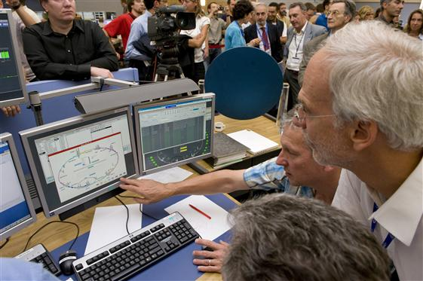
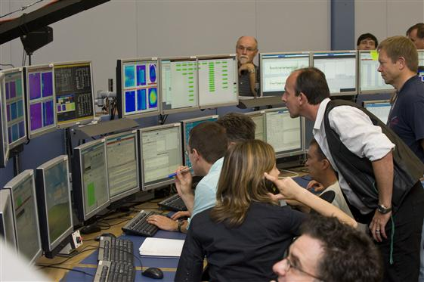
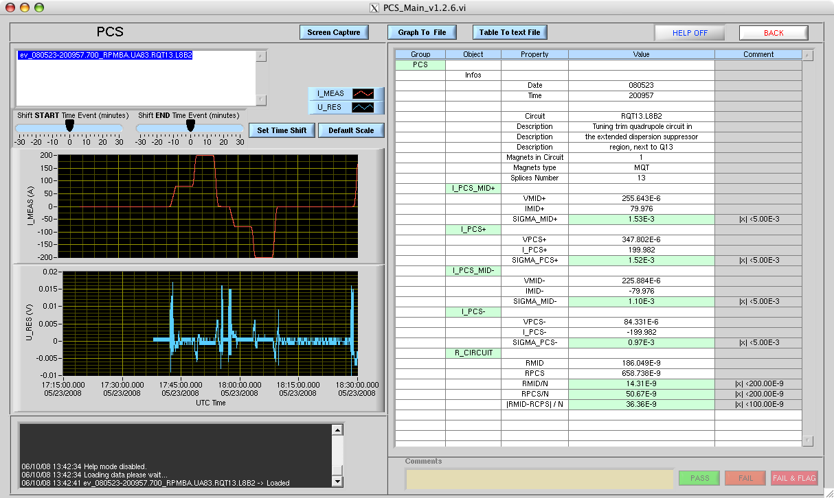
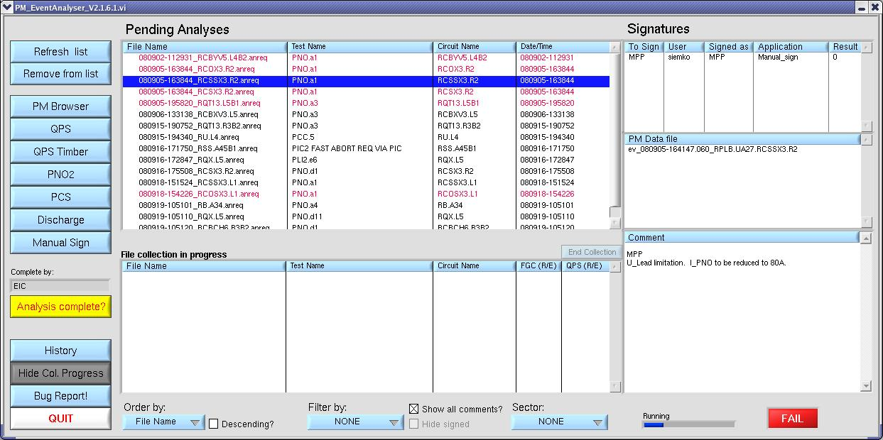
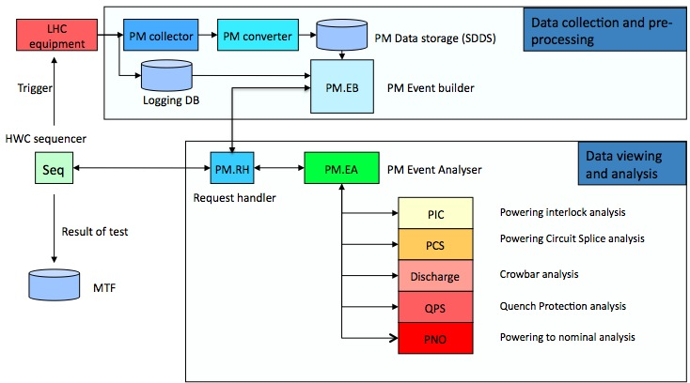
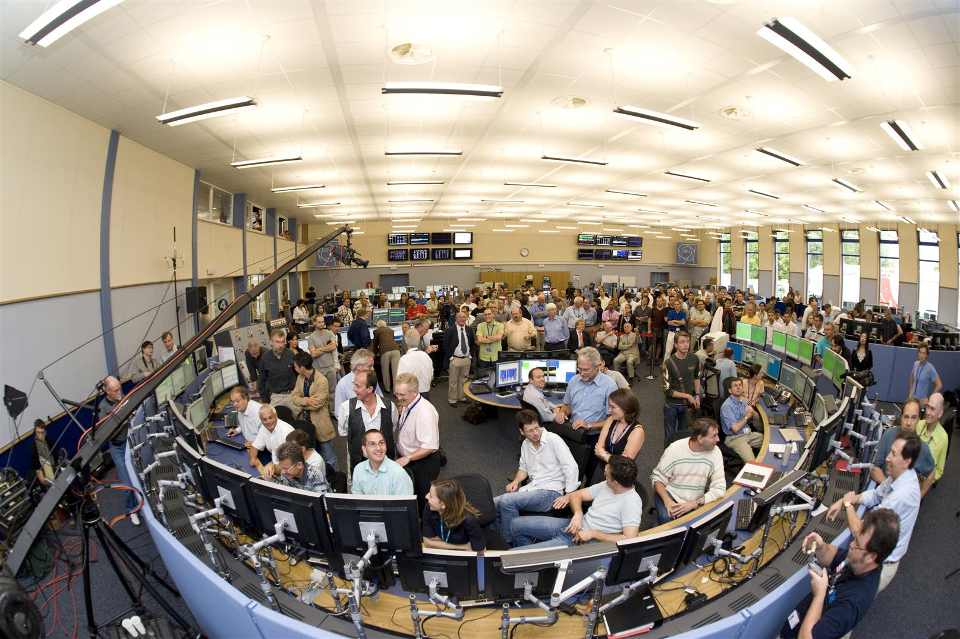
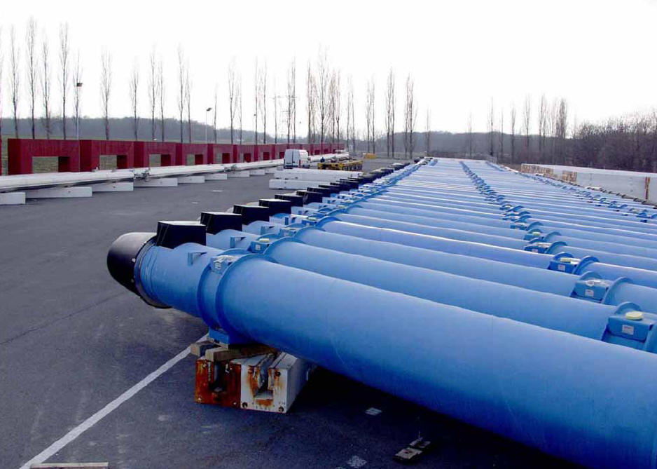
Post Mortem for the LHC

Slide 2
Post Mortem for the LHC
Post Mortem
Technology
System overview
Tools
Responsibilities
Clients
Challenges
Some numbers
Questions?

Slide 3
Post Mortem
Provide comprehensive monitoring of the various machine systems in order to understand any malfunction.
Improve the operational efficiency of the LHC by:
  Providing understanding of causes of failure
  Quickly determine if systems can be restarted
Assure coherency across sub-systems

Slide 4
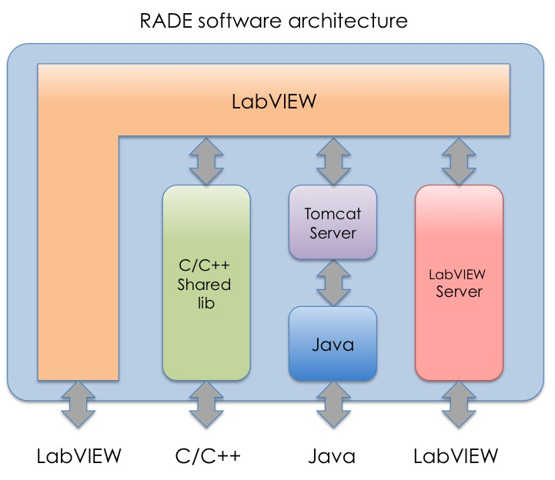
Technology
Developed in LabVIEW using RADE
Fully developed and maintained by MTA

Slide 5
PM System overview
In place for Hardware Commissioning
Data collection and pre-processing
LHC
equipment
PM collector
PM converter
PM Data storage (SDDS)
PM.EB
Trigger
PM Event builder
Logging DB
HWC sequencer
Seq
PM.RH
PM.EA
Data viewing and analysis
PM Event Analyser
Request handler
PIC
Powering interlock analysis
Result of test
PCS
Powering Circuit Splice analysis
Discharge
Crowbar analysis
MTF
QPS
Quench Protection analysis
PNO
Powering to nominal analysis

Slide 6
PM System overview
The Sequencer starts a test and warns post mortem
Data collection and pre-processing
LHC
equipment
PM collector
PM converter
PM Data storage (SDDS)
PM.EB
Trigger
PM Event builder
Logging DB
HWC sequencer
Seq
PM.RH
PM.EA
Data viewing and analysis
PM Event Analyser
Request handler
PIC
Powering interlock analysis
Result of test
PCS
Powering Circuit Splice analysis
Discharge
Crowbar analysis
MTF
QPS
Quench Protection analysis
PNO
Powering to nominal analysis

Slide 7
PM System overview
The Sequencer starts a test and warns post mortem
PM File collection starts searching for data belonging to the specific test
Data collection and pre-processing
LHC
equipment
PM collector
PM converter
PM Data storage (SDDS)
PM.EB
Trigger
PM Event builder
Logging DB
HWC sequencer
Seq
PM.RH
PM.EA
Data viewing and analysis
PM Event Analyser
Request handler
PIC
Powering interlock analysis
Result of test
PCS
Powering Circuit Splice analysis
Discharge
Crowbar analysis
MTF
QPS
Quench Protection analysis
PNO
Powering to nominal analysis

Slide 8
PM System overview
The Sequencer starts a test and warns post mortem
PM File collection starts searching for data belonging to the specific test
All data are found, and the test is moved to the Post Mortem Event Analyzer
Data collection and pre-processing
LHC
equipment
PM collector
PM converter
PM Data storage (SDDS)
PM.EB
Trigger
PM Event builder
Logging DB
HWC sequencer
Seq
PM.RH
PM.EA
Data viewing and analysis
PM Event Analyser
Request handler
PIC
Powering interlock analysis
Result of test
PCS
Powering Circuit Splice analysis
Discharge
Crowbar analysis
MTF
QPS
Quench Protection analysis
PNO
Powering to nominal analysis

Slide 9
PM System overview
The Sequencer starts a test and warns post mortem
PM File collection starts searching for data belonging to the specific test
All data are found, and the test is moved to the Post Mortem Event Analyzer
The involved experts starts analyzing the test
Data collection and pre-processing
LHC
equipment
PM collector
PM converter
PM Data storage (SDDS)
PM.EB
Trigger
PM Event builder
Logging DB
HWC sequencer
Seq
PM.RH
PM.EA
Data viewing and analysis
PM Event Analyser
Request handler
PIC
Powering interlock analysis
Result of test
PCS
Powering Circuit Splice analysis
Discharge
Crowbar analysis
MTF
QPS
Quench Protection analysis
PNO
Powering to nominal analysis

Slide 10
PM System overview
The Sequencer starts a test and warns post mortem
PM File collection starts searching for data belonging to the specific test
All data are found, and the test is moved to the Post Mortem Event Analyzer
The involved experts starts analyzing the test
Experts sign their part of the test
Data collection and pre-processing
LHC
equipment
PM collector
PM converter
PM Data storage (SDDS)
PM.EB
Trigger
PM Event builder
Logging DB
HWC sequencer
Seq
PM.RH
PM.EA
Data viewing and analysis
PM Event Analyser
Request handler
PIC
Powering interlock analysis
Result of test
PCS
Powering Circuit Splice analysis
Discharge
Crowbar analysis
MTF
QPS
Quench Protection analysis
PNO
Powering to nominal analysis

Slide 11
PM System overview
The Sequencer starts a test and warns post mortem
PM File collection starts searching for data belonging to the specific test
All data are found, and the test is moved to the Post Mortem Event Analyzer
The involved experts starts analyzing the test
Experts sign their part of the test
Analysis is complete (Pass, fail-repeat, fail-hold)
Data collection and pre-processing
LHC
equipment
PM collector
PM converter
PM Data storage (SDDS)
PM.EB
Trigger
PM Event builder
Logging DB
HWC sequencer
Seq
PM.RH
PM.EA
Data viewing and analysis
PM Event Analyser
Request handler
PIC
Powering interlock analysis
Result of test
PCS
Powering Circuit Splice analysis
Discharge
Crowbar analysis
MTF
QPS
Quench Protection analysis
PNO
Powering to nominal analysis

Slide 12
PM System overview
The Sequencer starts a test and warns post mortem
PM File collection starts searching for data belonging to the specific test
All data are found, and the test is moved to the Post Mortem Event Analyzer
The involved experts starts analyzing the test
Experts sign their part of the test
Analysis is complete (Pass, fail-repeat, fail-hold)
EIC verifies the test and does the final signoff
Data collection and pre-processing
LHC
equipment
PM collector
PM converter
PM Data storage (SDDS)
PM.EB
Trigger
PM Event builder
Logging DB
HWC sequencer
Seq
PM.RH
PM.EA
Data viewing and analysis
PM Event Analyser
Request handler
PIC
Powering interlock analysis
Result of test
PCS
Powering Circuit Splice analysis
Discharge
Crowbar analysis
MTF
QPS
Quench Protection analysis
PNO
Powering to nominal analysis

Slide 13
PM System overview
The Sequencer starts a test and warns post mortem
PM File collection starts searching for data belonging to the specific test
All data are found, and the test is moved to the Post Mortem Event Analyzer
The involved experts starts analyzing the test
Experts sign their part of the test
Analysis is complete (Pass, fail-repeat, fail-hold)
EIC verifies the test and does the final signoff
Test outcome and comments are sent back to the Sequencer
Data collection and pre-processing
LHC
equipment
PM collector
PM converter
PM Data storage (SDDS)
PM.EB
Trigger
PM Event builder
Logging DB
HWC sequencer
Seq
PM.RH
PM.EA
Data viewing and analysis
PM Event Analyser
Request handler
PIC
Powering interlock analysis
Result of test
PCS
Powering Circuit Splice analysis
Discharge
Crowbar analysis
MTF
QPS
Quench Protection analysis
PNO
Powering to nominal analysis

Slide 14
PM System overview
The Sequencer starts a test and warns post mortem
PM File collection starts searching for data belonging to the specific test
All data are found, and the test is moved to the Post Mortem Event Analyzer
The involved experts starts analyzing the test
Experts sign their part of the test
Analysis is complete (Pass, fail-repeat, fail-hold)
EIC verifies the test and does the final signoff
Test outcome and comments are sent back to the sequencer
The data is uploaded to MTF
Data collection and pre-processing
LHC
equipment
PM collector
PM converter
PM Data storage (SDDS)
PM.EB
Trigger
PM Event builder
Logging DB
HWC sequencer
Seq
PM.RH
PM.EA
Data viewing and analysis
PM Event Analyser
Request handler
PIC
Powering interlock analysis
Result of test
PCS
Powering Circuit Splice analysis
Discharge
Crowbar analysis
MTF
QPS
Quench Protection analysis
PNO
Powering to nominal analysis

Slide 15
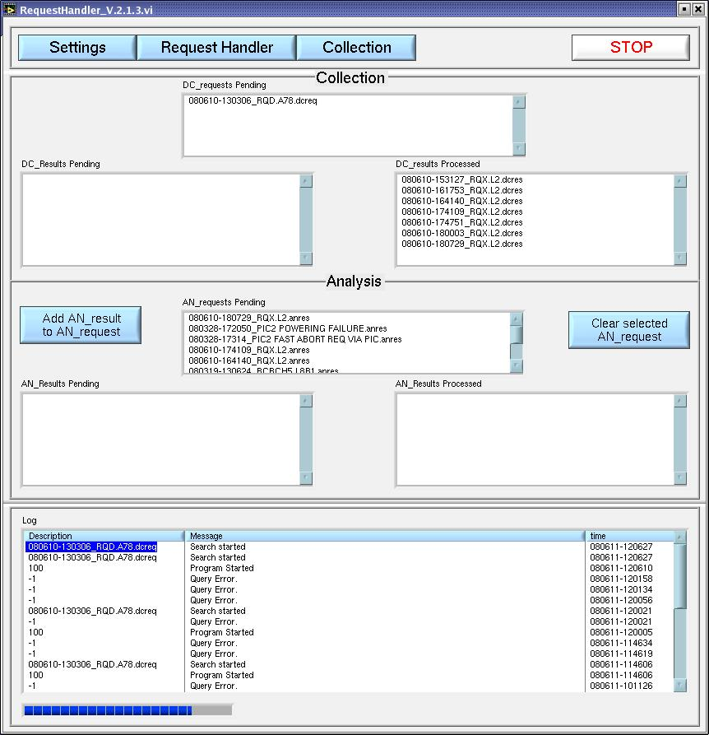
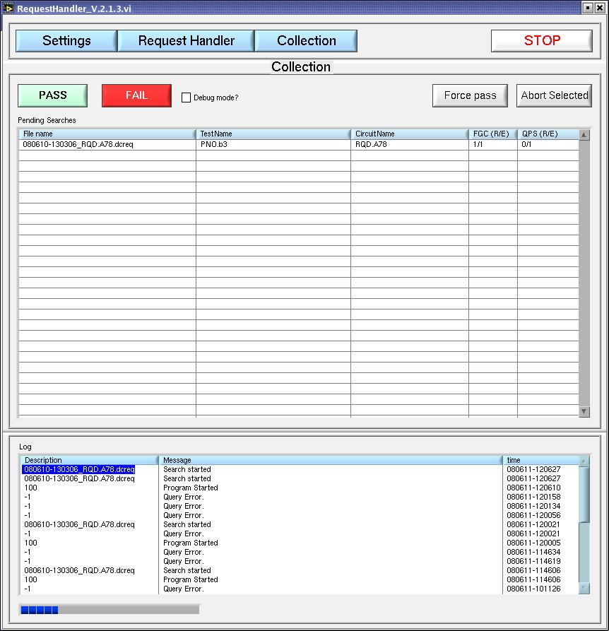
Tools
Server tools
PM Request handler
PM Event builder

Slide 16
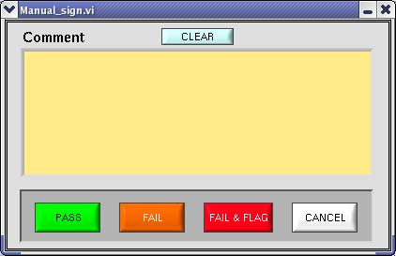
Tools
Event tools
PM Event Analyzer

Slide 17
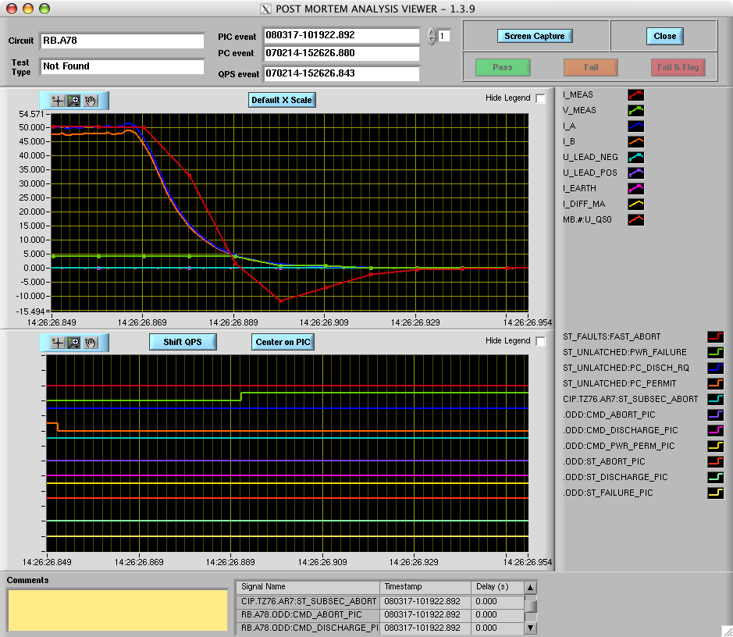
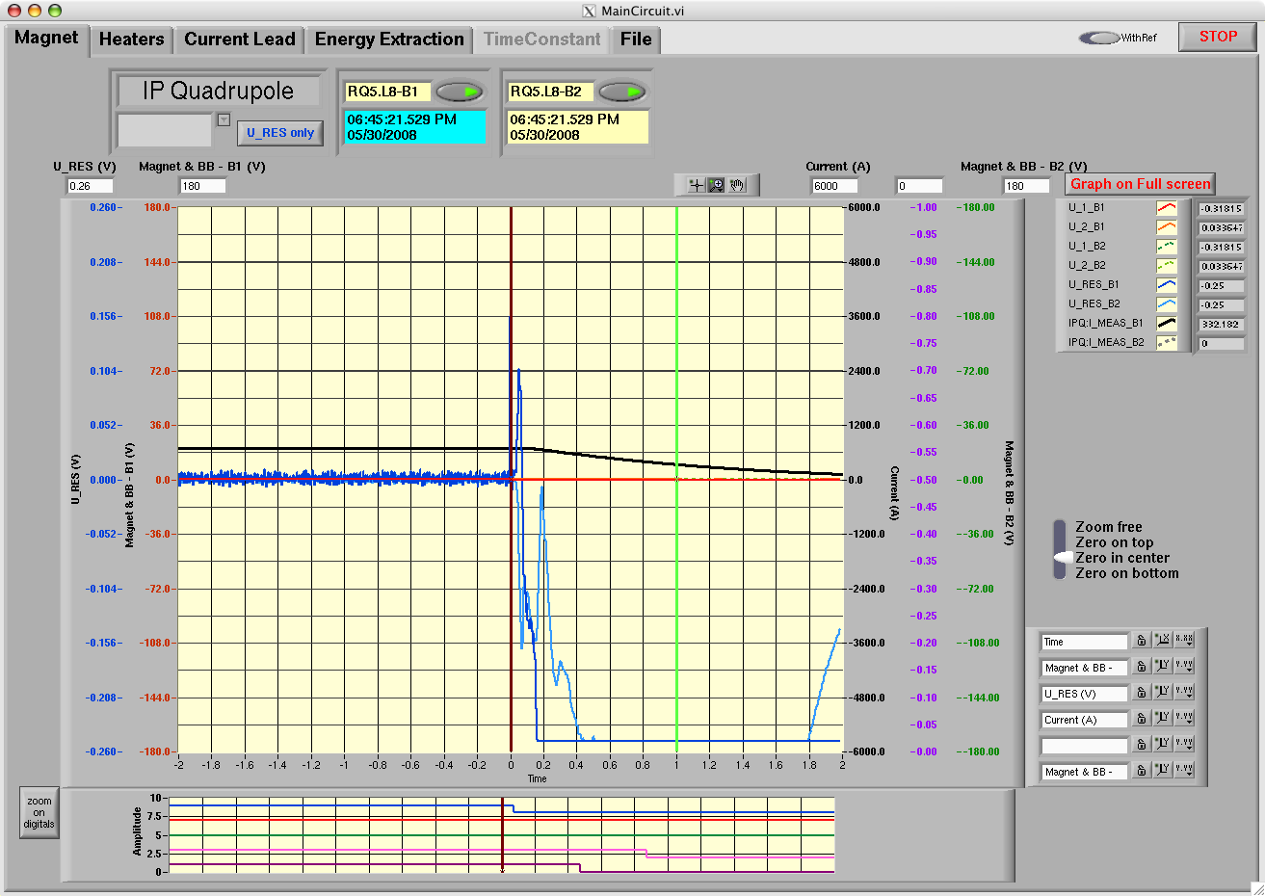
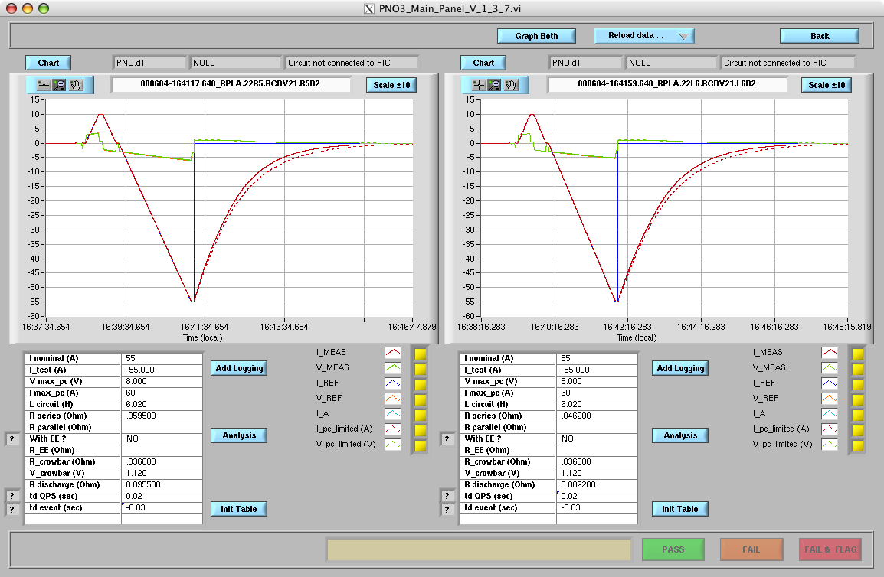
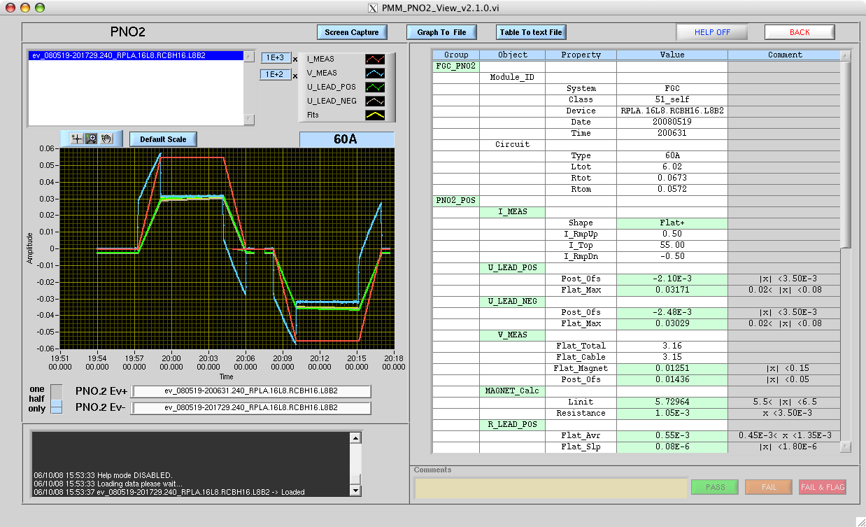
Tools
Analysis tools
PIC – Powering interlock
QPS – Quench Protection system
PCS – Circuit Splice
Discharge
PNO2 – circuit parameters at nominal current

Slide 18
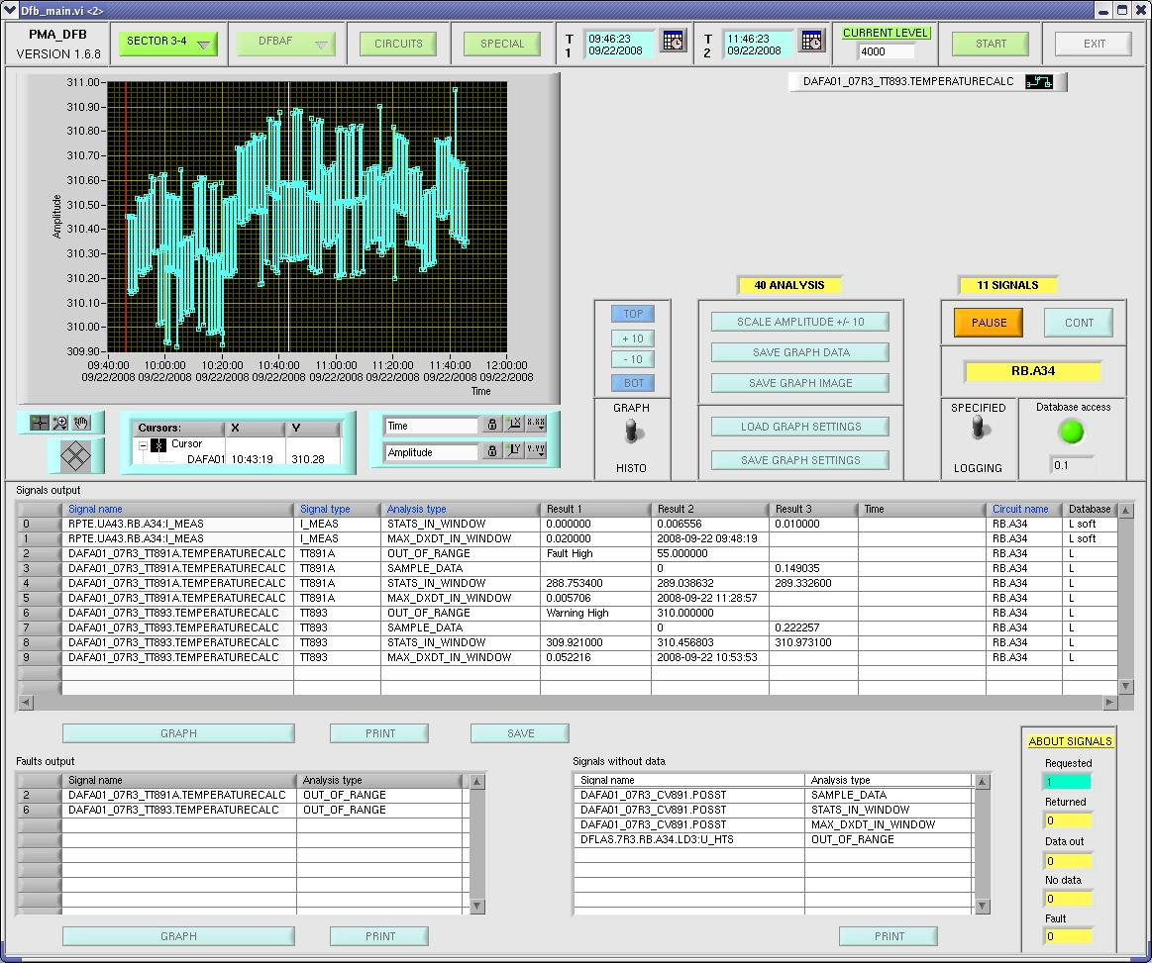
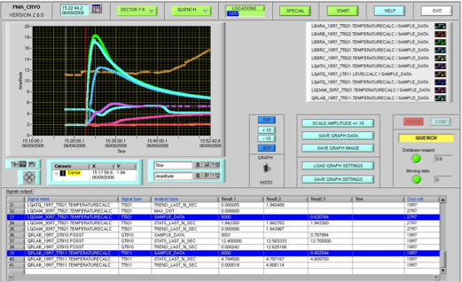
Tools
Analysis tools
DFB – Distribution feed box
Cryogenics

Slide 19
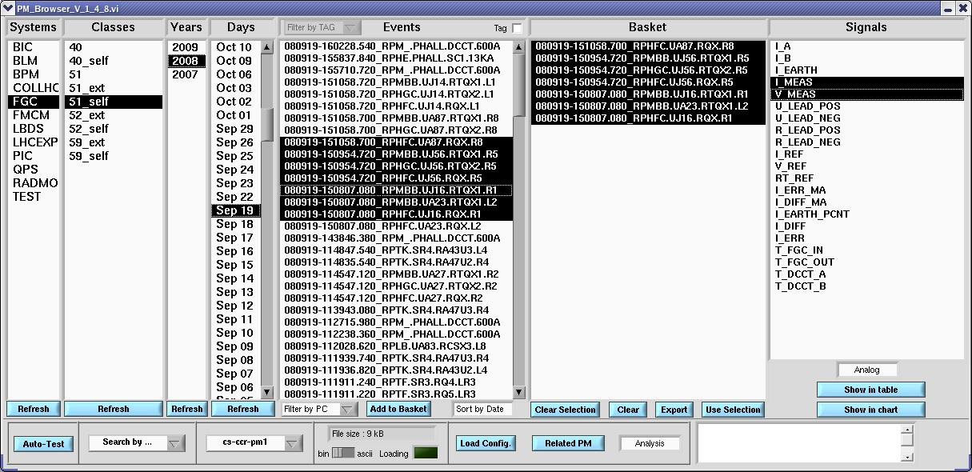
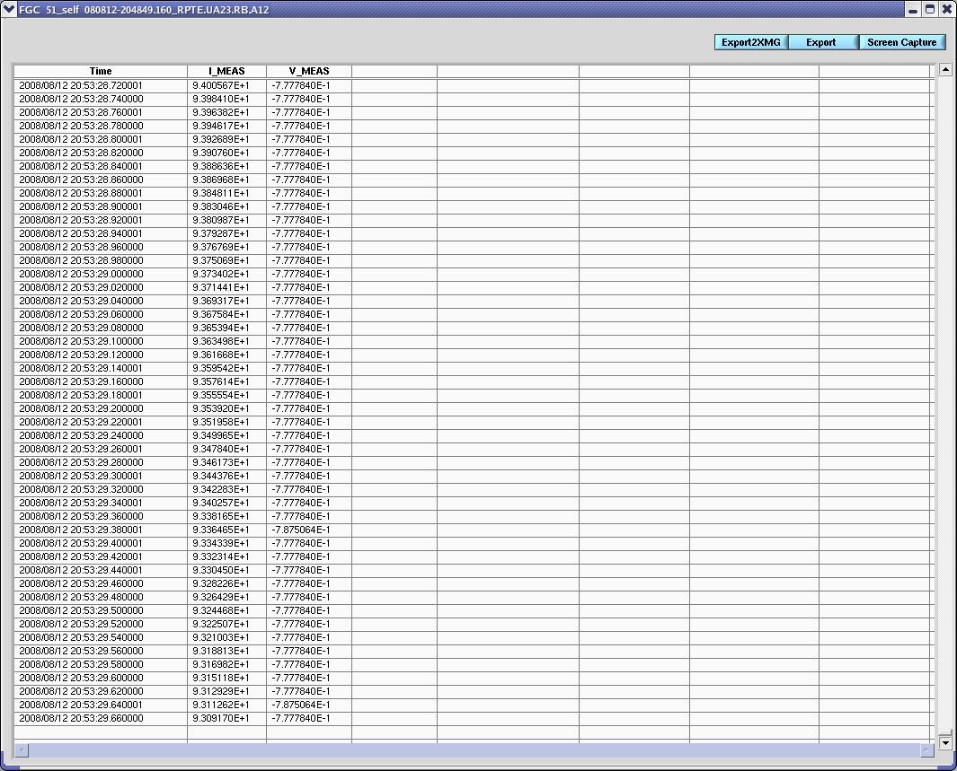
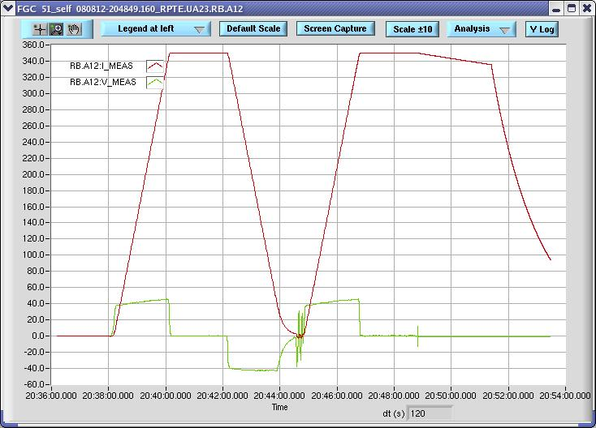
Tools
Analysis tools
Post Mortem Browser

Slide 20
Responsibilities
LHC
equipment
PM collector
PM converter
PM Data storage (SDDS)
PM.EB
Trigger
PM Event builder
Logging DB
HWC sequencer
Seq
PM.RH
PM.EA
PM Event Analyser
Request handler
PIC
Powering interlock analysis
Result of test
PCS
Powering Circuit Splice analysis
Discharge
Crowbar analysis
MTF
QPS
Quench Protection analysis
PNO
Powering to nominal analysis

Slide 21
Responsibilities
LHC
equipment
PM collector
PM converter
PM Data storage (SDDS)
PM.EB
Trigger
PM Event builder
Logging DB
HWC sequencer
Seq
PM.RH
PM.EA
PM Event Analyser
Request handler
PIC
Powering interlock analysis
Result of test
PCS
Powering Circuit Splice analysis
Discharge
Crowbar analysis
MTF
QPS
Quench Protection analysis
PNO
Powering to nominal analysis

Slide 22
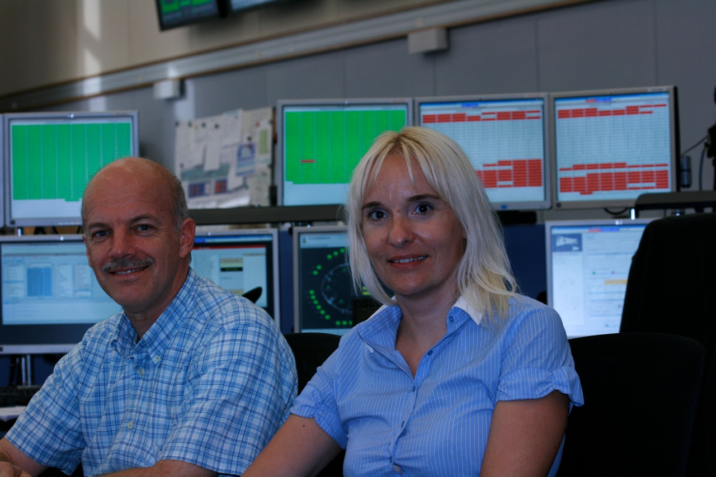
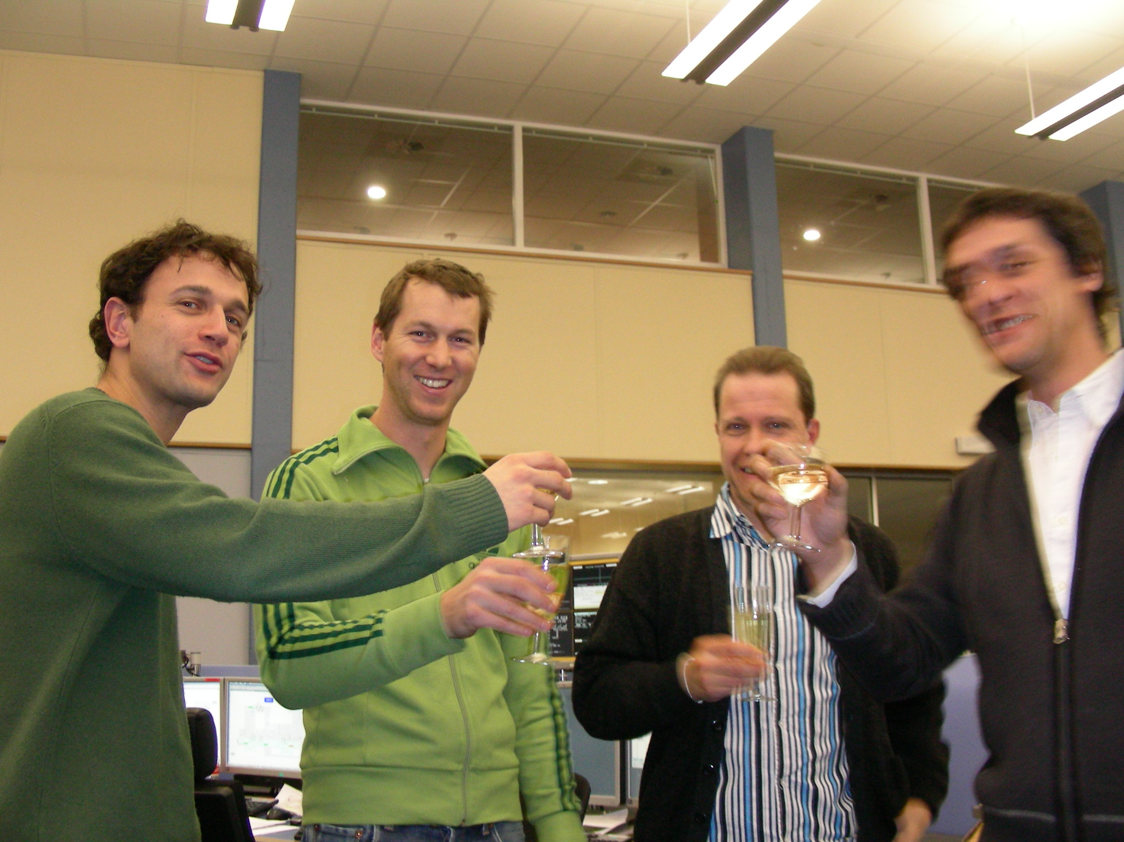

Clients
  MPP
  PO
  QPS
  PIC
  Cryo
  EIC

Slide 23
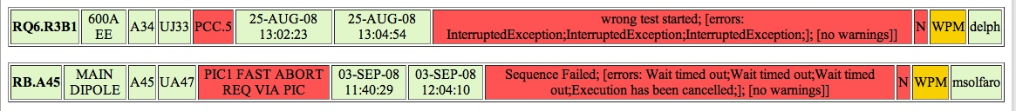
Challenges
Time (more tests, less people, changes..)
Grouping and sorting of event data
Signatures (RBAC)
Manual overrides
Changes in test-plan
Sequencer communication
Equipment failure (missing buffers)

Slide 24
Some Numbers
(Jan. – Sep. 2008)
In 2008, 11735 tests where performed involving Post Mortem
Of the 11735 tests, 11548 where analyzed and signed
17766 signatures where put on those tests
In the peak month (08 – august) we did 3234 tests

Slide 25
Questions?

