Slide 1


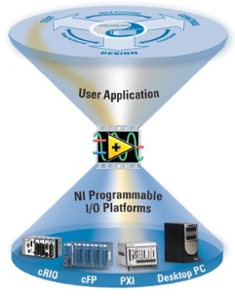
EN-ICE Workshop
MTA - LabVIEW
Clients development
Projects type
Clients support
LabVIEW support
Organisation
Issues

Slide 2
Clients for Development
Require short or long term development/maintenance.
Need technical expertise in control domain.
Need to control industrial or custom hardware.
Need online and/or offline data analysis.
Spread all around CERN and outside if necessary.
Workload History
1997
2009

Slide 3
Clients for Development
Clients from BE and TE are mainly requiring development for a dedicated system. (~ 50 clients)

Slide 4
Projects type
Magnet manufacturing
Magnet tests in SM18
Control industrial or custom hardware
Post-Mortem analysis for Hardware commissioning

Slide 5
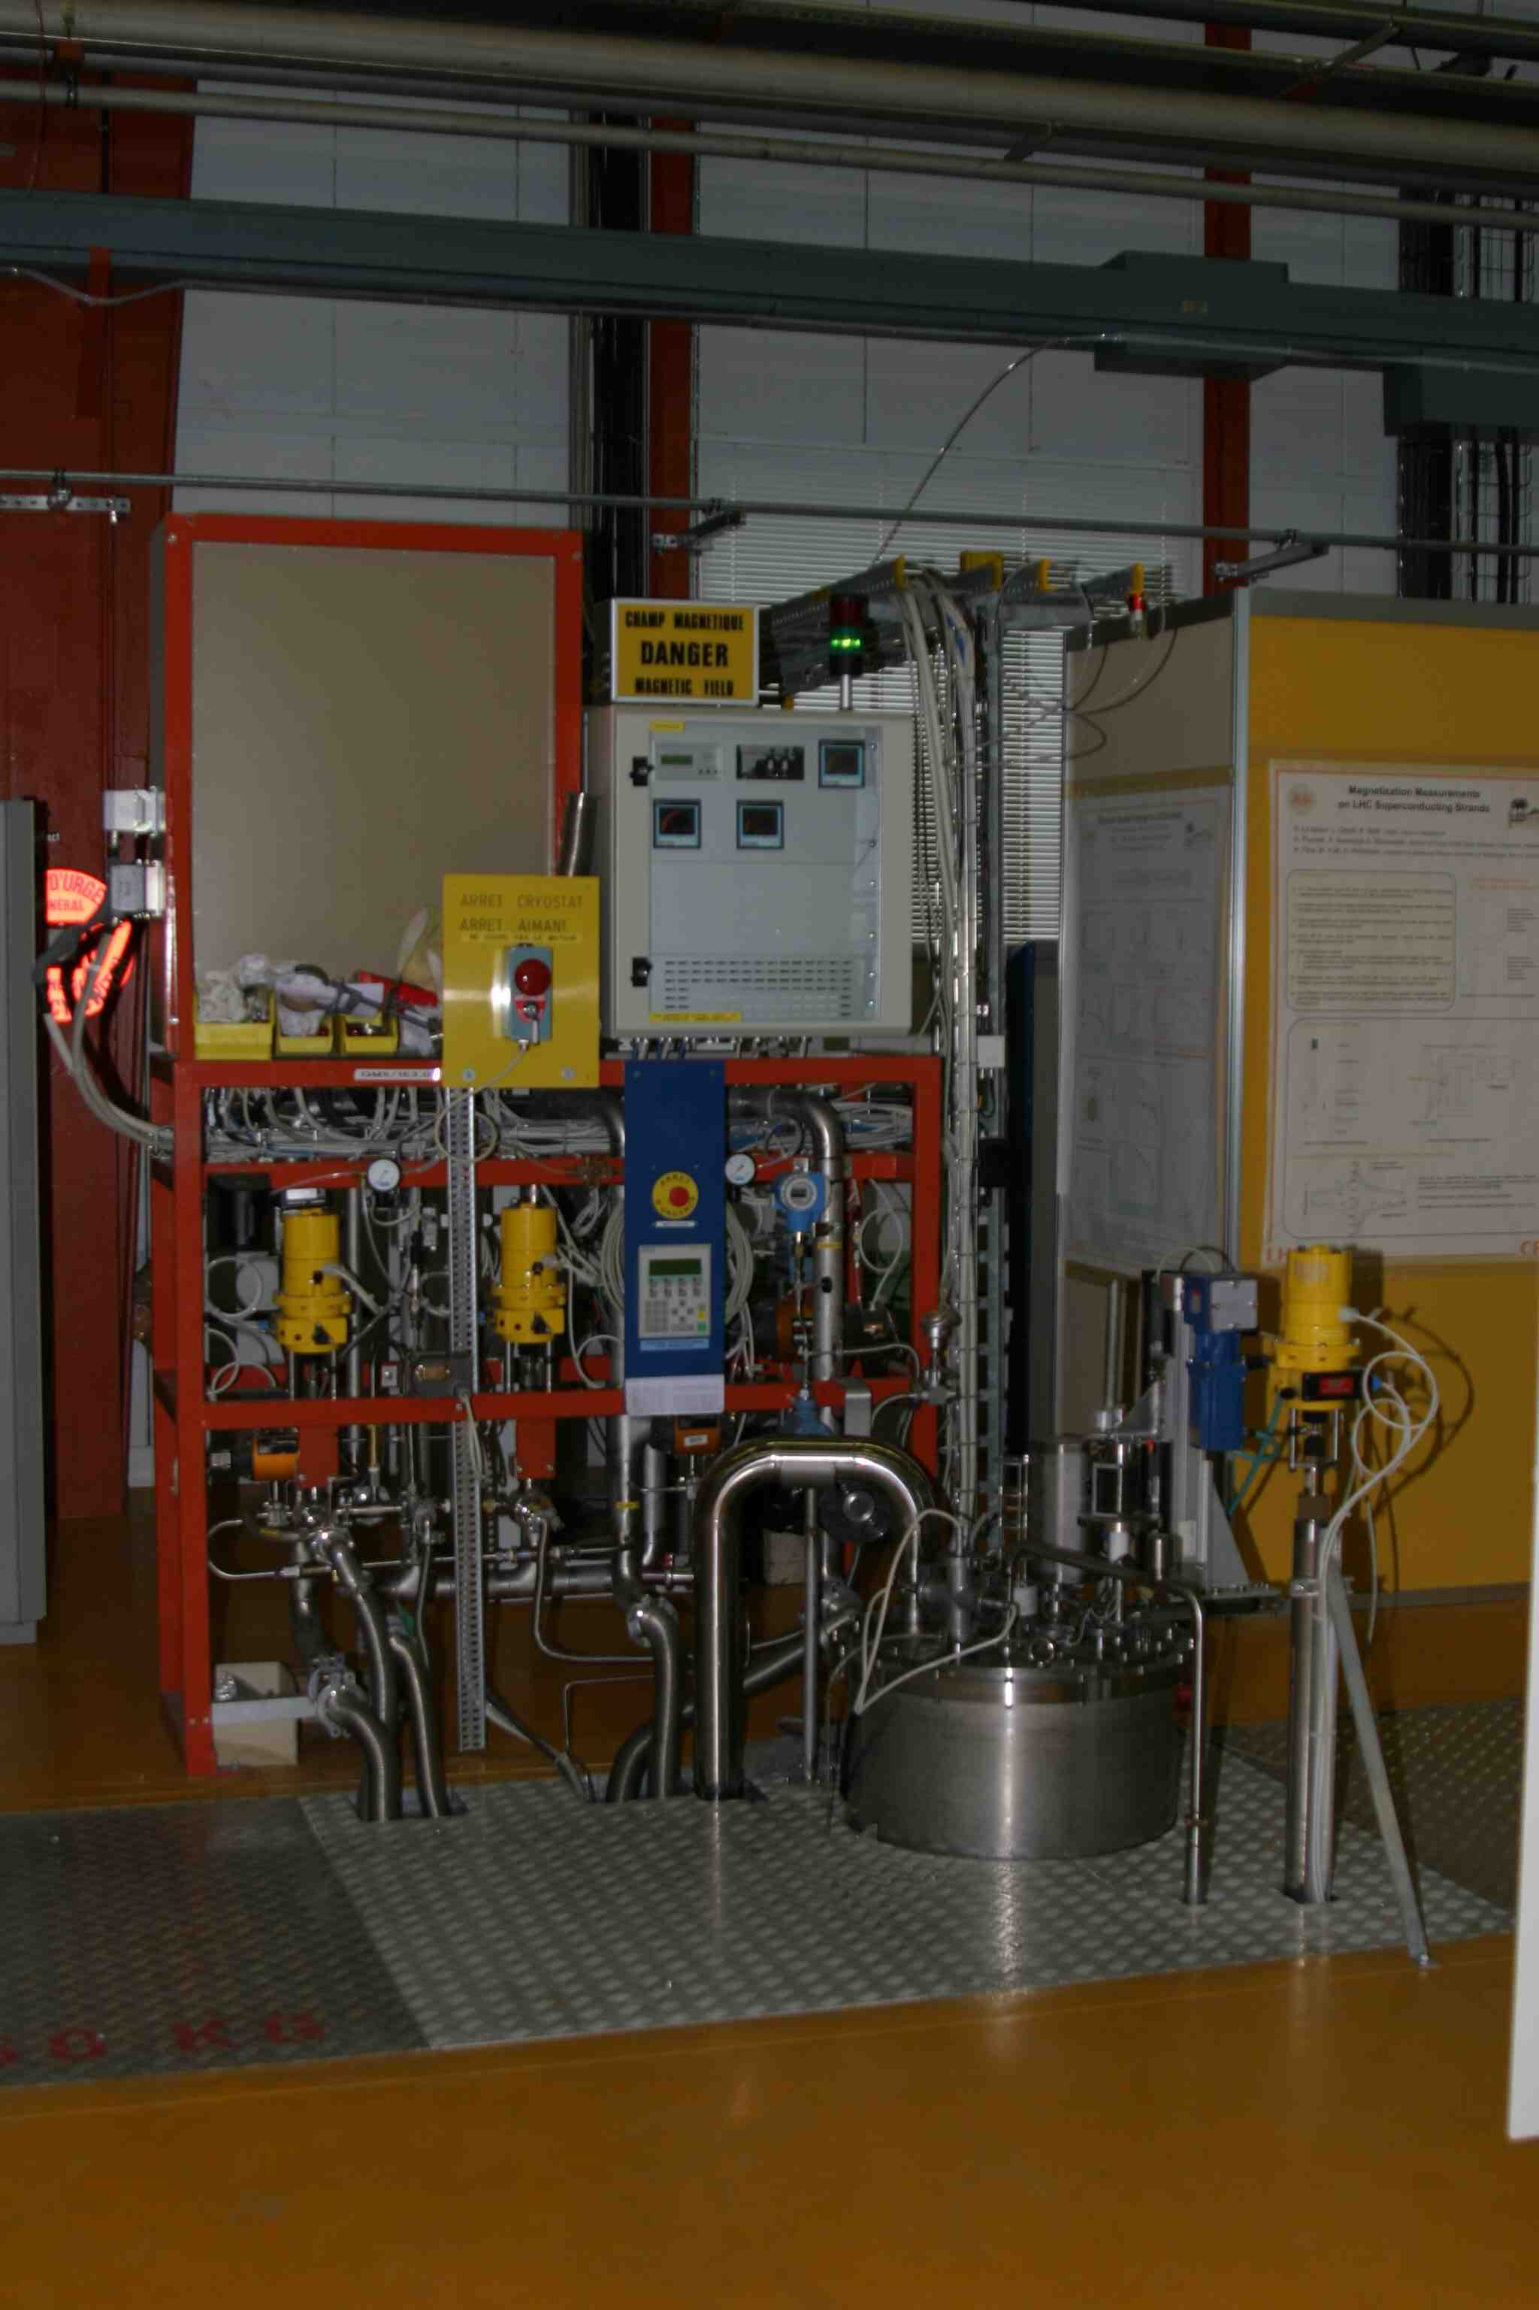
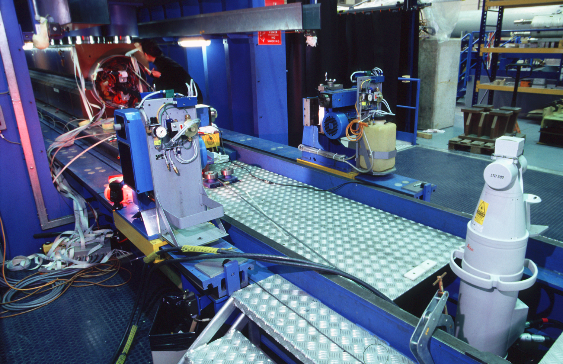
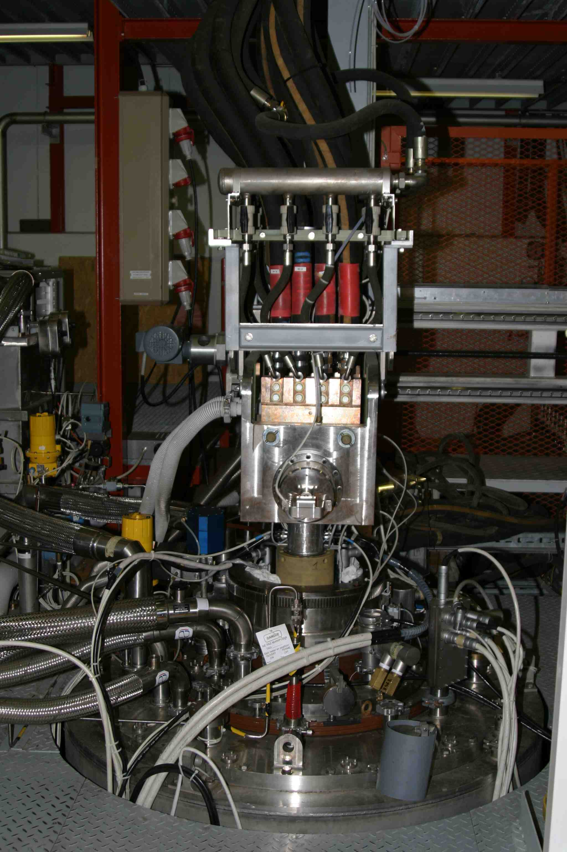
Projects type - manufacturing
Magnet manufacturing systems
→ Superconductive strand test. (B163)
→ Superconductive cable test. (B163)
→ Geometric measurements. (B181)
→ Magnetic, geometric, electric and data acquisition. (Industry)

Slide 6
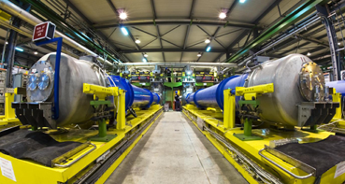
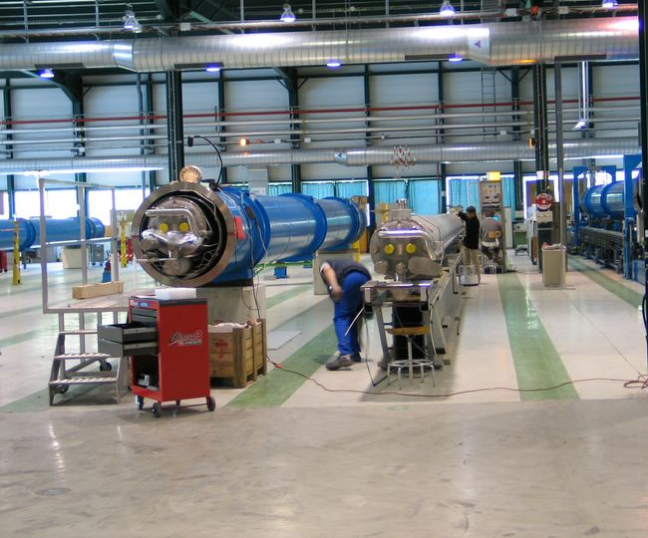
Projects type – Magnet tests
Magnet tests in SM18, Bloc4, SMI2, 904
→ Full control for magnetic, electric or geometric measurements.
→ Data acquisition systems for several hundred channels.
→ Projects fully developed by the section or with external contractor.

Slide 7
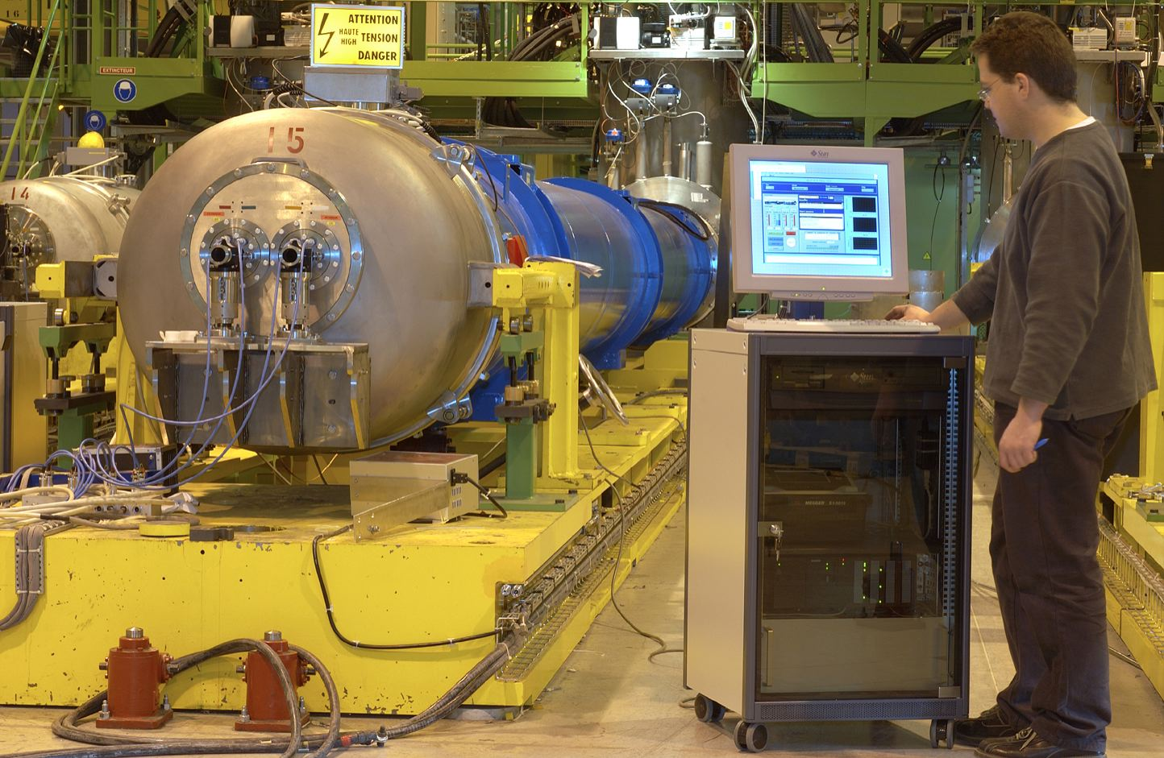
Projects type – mobile systems
Control industrial or custom hardware
→ Mobile measurement equipment for electrical tests.
→ Enhanced control system for collimator alignments.
→ Power Supply control for magnet powering.
→ Small data acquisition systems.

Slide 8
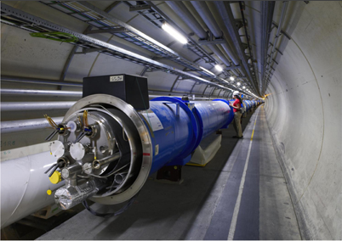
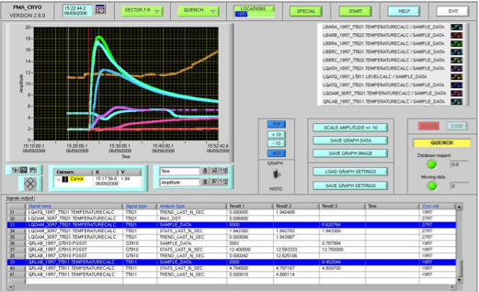
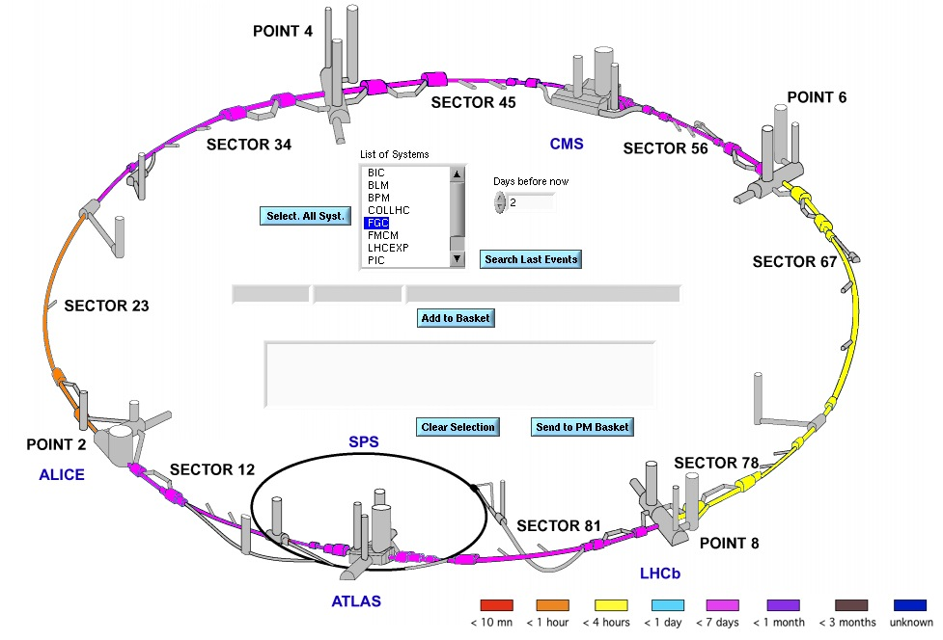
Projects type – Post-Mortem
Post-Mortem analysis for Hardware commissioning
→ Online data analysis and validation. (CCC)
→ Offline data viewing and analysis.

Slide 9
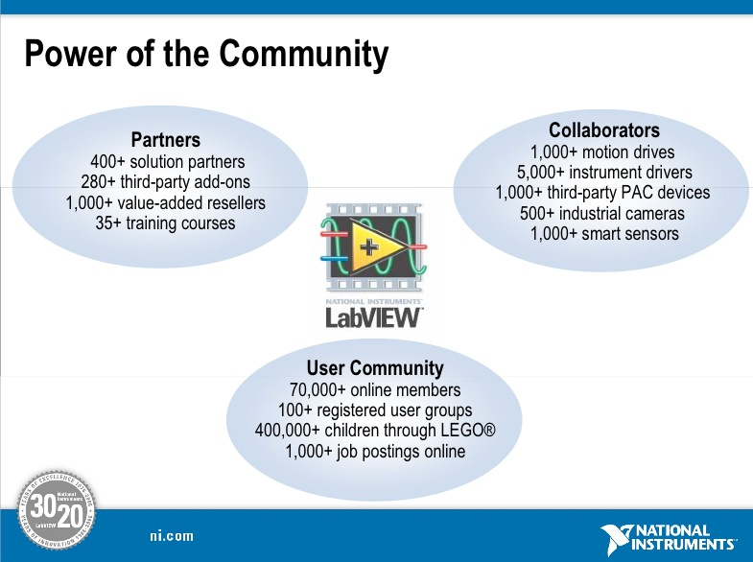
LabVIEW support
Support of NI product at CERN
→ CERN-wide: NI Software + Hardware
User Community
~400 active users
Software
Hardware
Training
Assistance

Slide 10
Clients for LabVIEW support
Clients from PH and EN are mainly requiring general software or hardware support and expertise.

Slide 11






LabVIEW support - Software
Supported platforms: Windows, Linux, Mac
→ Site license for all NI Software (2008-2009)
→ Distribution for Windows through NICE/CMF
→ Distribution for Mac and Linux through afs & dfs
→ Version management
Evaluation of new products & releases

Slide 12
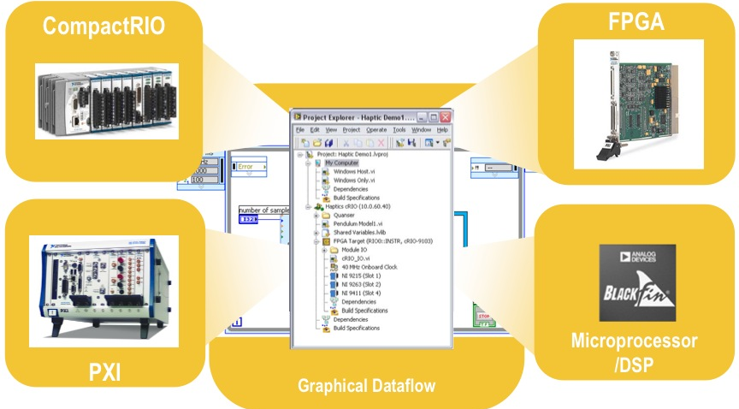
LabVIEW support - Hardware
Lab available for product evaluation and testing
Advice and support for hardware selection
Support for repairs (“lend & send”)

Slide 13

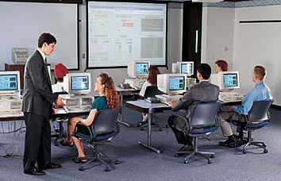

LabVIEW support - Training
NI training available on site for all NI products
Organized through technical training
Organized by EN-ICE-MTA for specialized subjects
NI Seminars (~4 per year)

Slide 14
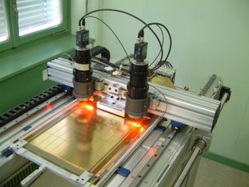
LabVIEW support - Assistance
Direct involvement in projects (help, consultancy and development)
Feedback to NI (bugs, user requirement, Beta testing ..etc…)

Slide 15

Organisation
Daily support:
→ One contact person for each project.
→ Remedy is used for general LabVIEW support.
Best Effort SM18 and hardware commissioning (HWC)
→ List of staff on call during shift hours.
→ One first line and one back up person.
Members in section
→ 7 staffs
→ 7 non-staffs

Slide 16
Issues
Systems in industry:
→ Interventions take time.
→ Mandatory to put the system back into working condition within 5 days.
→ Low number of staff lead us to send Russian collaborators in industries.
Systems at CERN:
→ Hardware commissioning support during 2 shifts.
→ SM18 support 24h/24h at the same time as industry.
→ SMI2, B181, B904 and B892 support 16h/24h for a limited number of trained people.

Slide 17



Issues
Solutions:
→ Intervention DataBase
→ Have a minimum of 2 people per project
→ Use common structures for programming
→ Configuration parameters separate from applications
Training
Data Bases
Configuration files
Documentations
Good Support

Slide 18

Thank you!
Questions ?

