Slide 1

EIS-Beam for the Booster zone with Linac4 connected
Support Documents, 03-10-2016

Slide 2
Courtesy EN/STI, extracted from EDMS 1698144
3-10-2016
EIS-Beam for the Booster zone with Linac4
BE Safety Unit

Slide 3
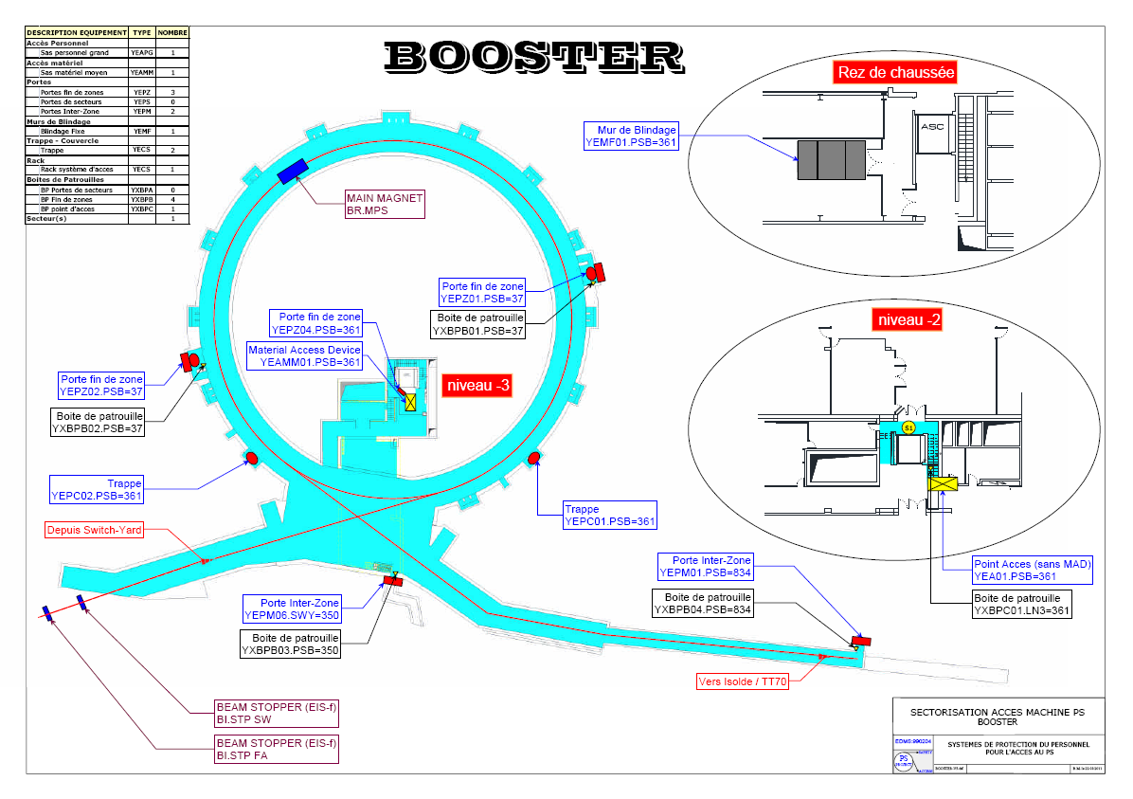
3-10-2016
EIS-Beam for the Booster zone with Linac4
BE Safety Unit

Slide 4
STPFA
STPSW
Booster
LBE
BI line
LBS
PS Ring
3-10-2016
EIS-Beam for the Booster zone with Linac4
BE Safety Unit

Slide 5
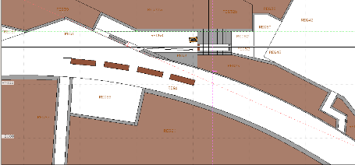
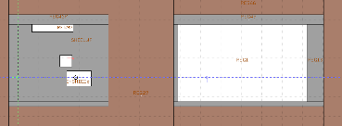
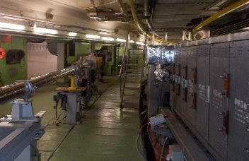
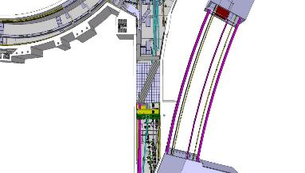
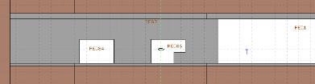
PSB side
PS ring
Horizontal View
Courtesy J. Vollaire,
Installation coordination meeting – connection L4-PSB, 4 April 2016
3-10-2016
EIS-Beam for the Booster zone with Linac4
BE Safety Unit

Slide 6
3-10-2016
EIS-Beam for the Booster zone with Linac4
BE Safety Unit

Slide 7
3-10-2016
EIS-Beam for the Booster zone with Linac4
BE Safety Unit

Slide 8
Beam stoppers specifications
EDMS 1283556, Released
Functional specification, “Definition of Beam Stoppers, Beam Dumps and Stopper/Dumps”
L4T.TDISA.0740, EDMS 1301655, Released
Engineering specification, “Beam stoppers L4T”
BI.STPFA and BI.STPSW, EDMS 1698144, In Work
Functional specification, “Description and thermo-mechanical analysis of the beam stoppers BI.STPFA and BI.STPSW”
3-10-2016
EIS-Beam for the Booster zone with Linac4
BE Safety Unit

