Slide 1
EIS for access in the PS-Booster
J. Vollaire HSE-RP
03/10/2016

Slide 2
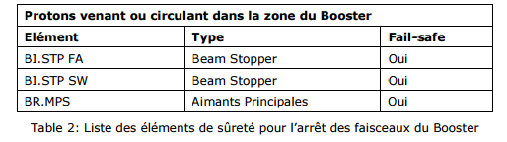
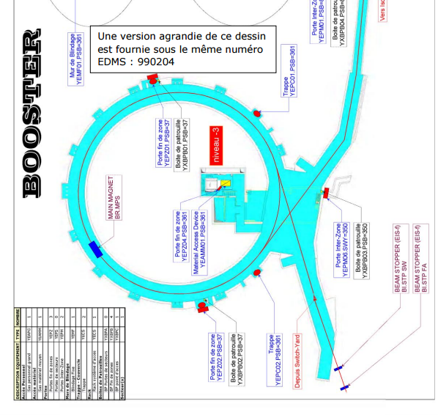
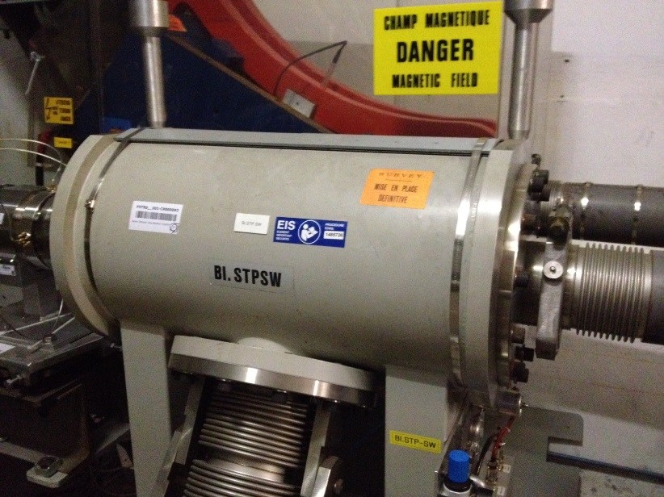
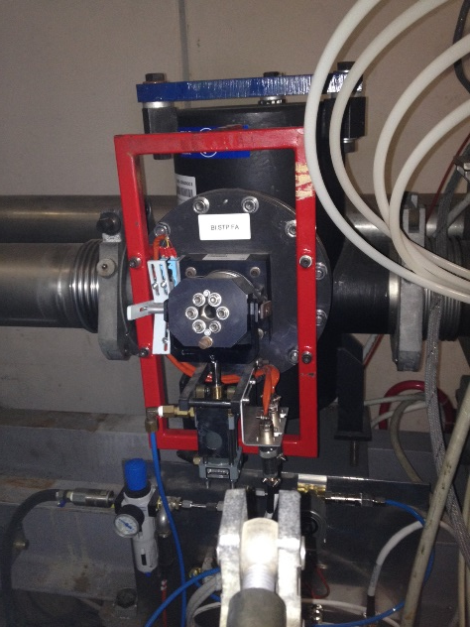
EIS for the PS-Booster: current situation
Three EIS used to stop the circulating beam (intrusion) and the beam injection
Concerned beams: Linac2 or Linac3 beams (measurement lines: LBE or LBS)

Slide 3
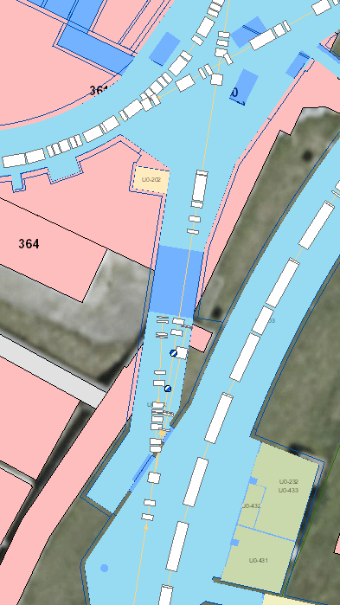
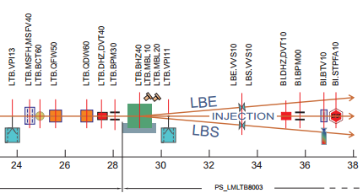
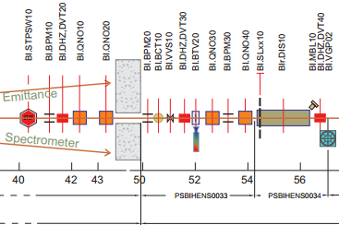
Current situation
Protection from beam injection: redundancy ensured by two beam stoppers (no electromagnetic element in this case)
Default beam direction (BHZ40 failure - not an EIS) is the stopper(s)

Slide 4
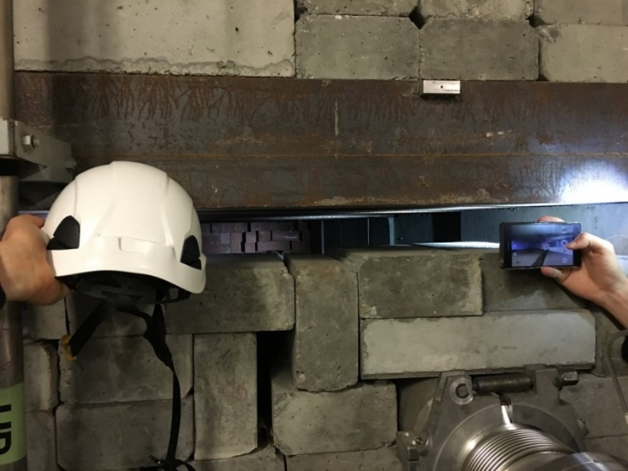
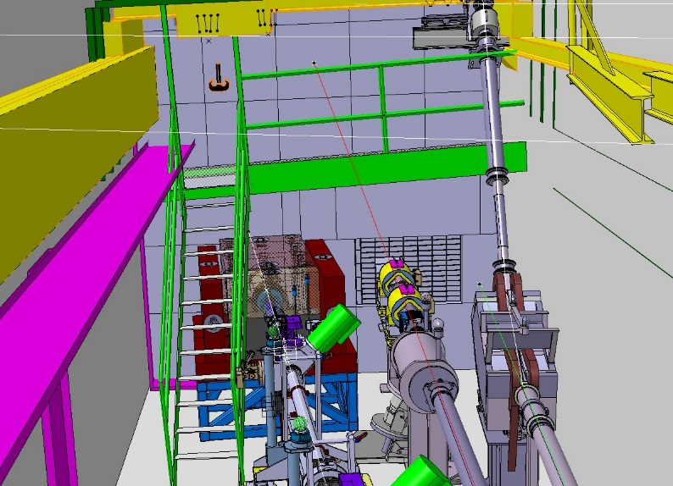
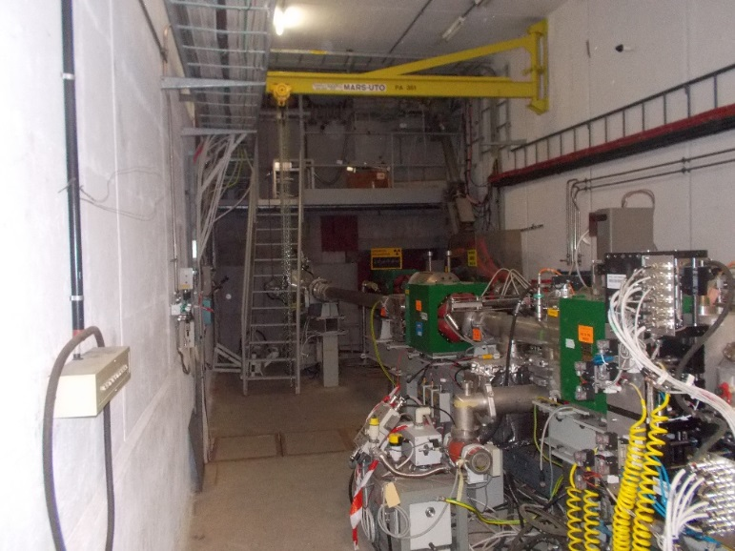
Shielding and beam line modification in LS2
New shielded beam dump at the end of the LBE beam line (160 MeV H⁻ from the Linac4)
New beam dump used for the L4T beam commissioning (end of LS2) and for beam setting during standard operation (injection in PSB)
Physical integration of the beam dump and shielding require to reduce the shielding between the PS Switchyard and the PS-Booster (6 m to 4 m)

Slide 5
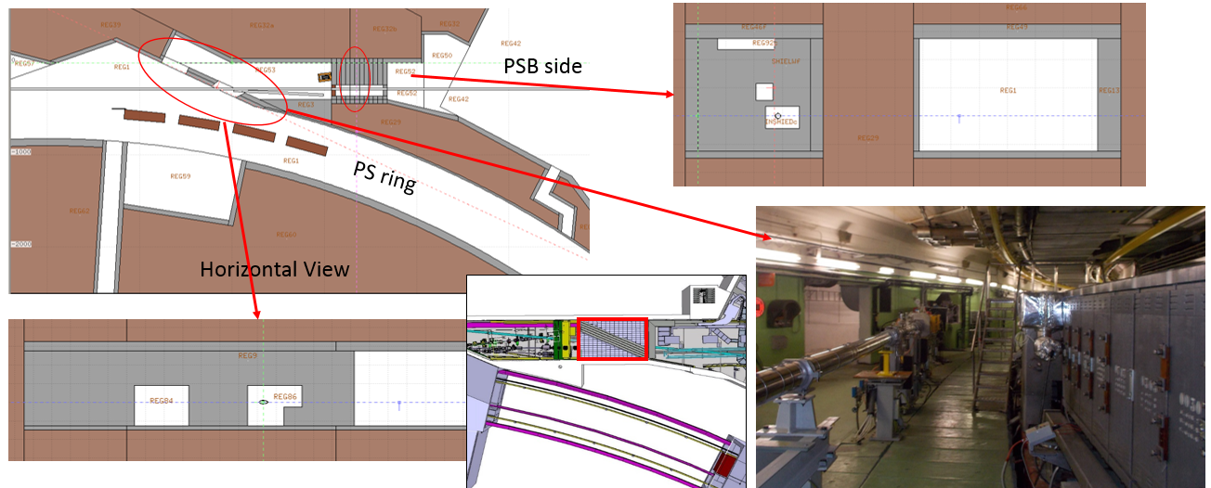
Stray radiation with the Linac4 beam on LBE
Current Shielding wall (6 m thick wall) and iron shielding around the dump

Slide 6
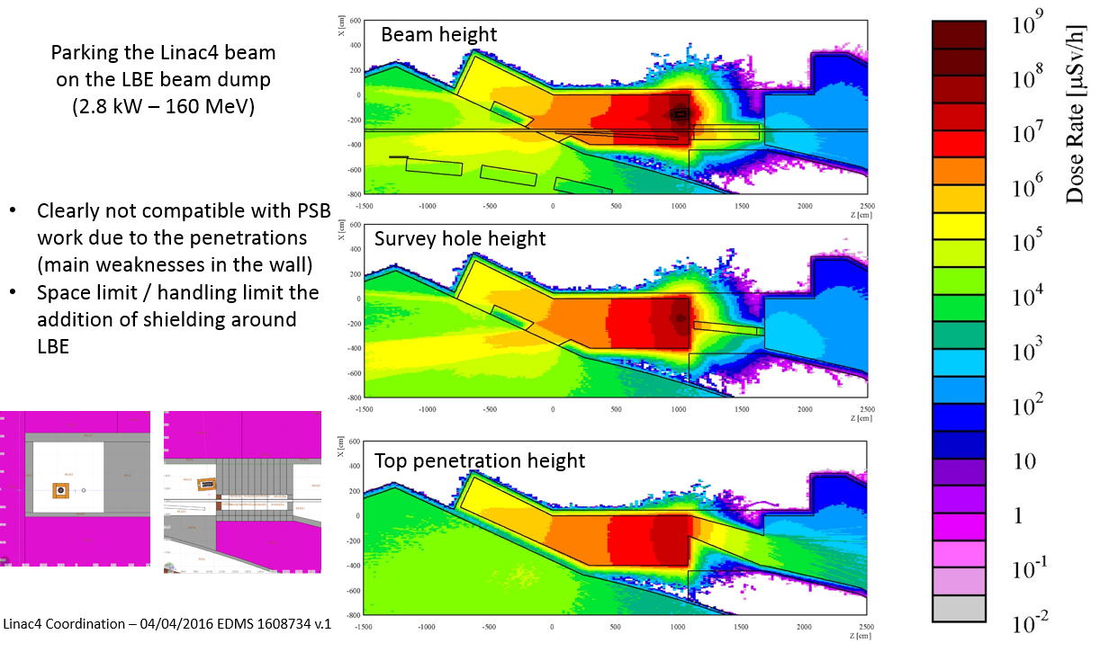
Stray radiation with the Linac4 beam on LBE
Current Swiss cheese shielding wall (6 m thick wall) and iron shielding around the dump

Slide 7
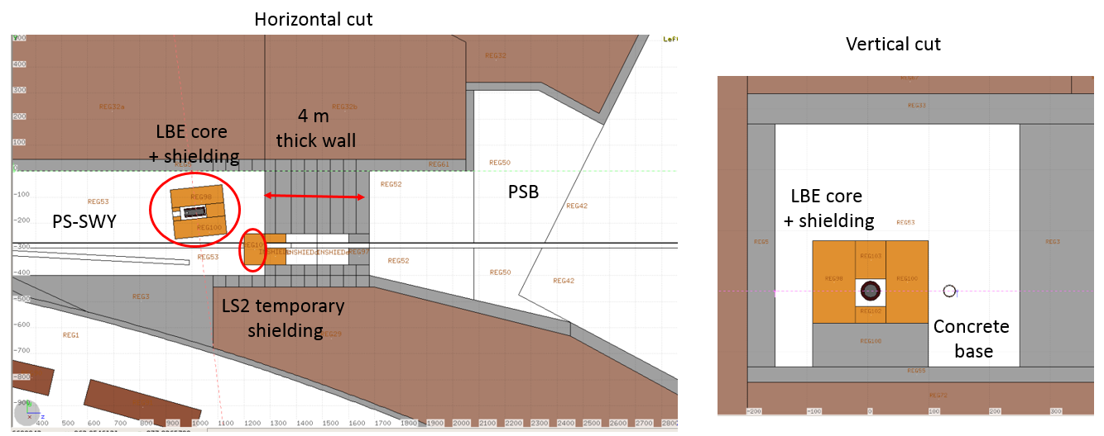
New wall proposal (4 m thick)
Improved shielding of penetrations, more shielding around LBE and temporary shielding in front of the BI line feedthrough
Configuration to ensure the protection of personnel working in the PSB at the end of LS2 during L4 T commissioning only

Slide 8
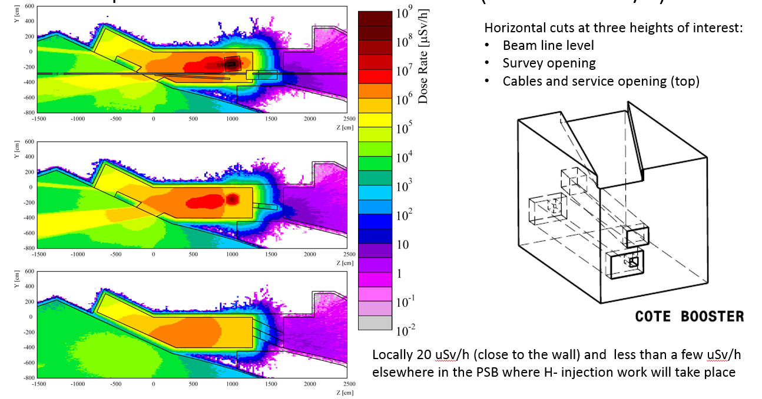
New wall proposal (4 m thick)

Slide 9
Proposal for after LS2 (Linac4 connection)
Modify the logic of the access system to prevent beam delivery in the PS Switchyard (LBE line) if the PSB is in access (or in case of intrusion…)
Advantages:
  Possibility to reduce the shielding thickness around the LBE dump (accessibility)
  No concerns about personnel safety and stoppers integrity in case of BHZ40 failure
Proposal endorsed by BE-OP (loss of the possibility to have the beam in LBE when interventions are finishing in the PSB after a TS…)
EIS in the L4T line (used to protect of the PS-SWY from H⁻ in the future) would be also used for the PSB protection (L4T.TDISA.0740 / L4T.MBH.0250)
The LBS line could still be used for measurements of the Linac3 beam while the PSB is in access need for EIS in the BI line for Linac3 ions

Slide 10
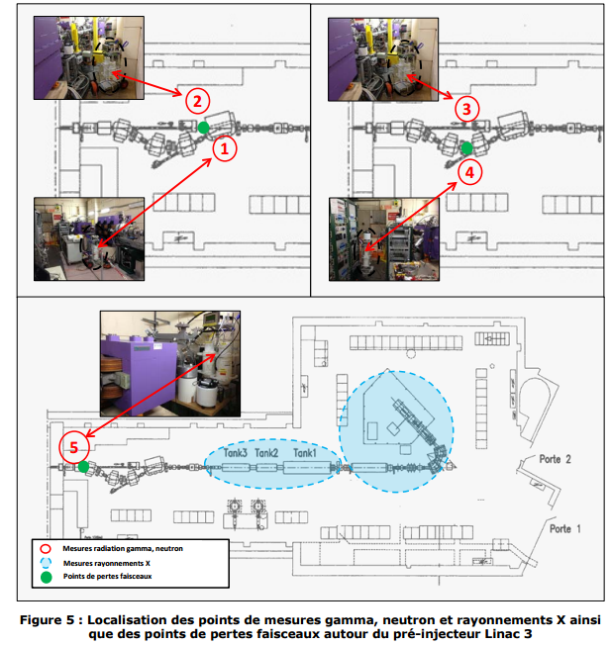
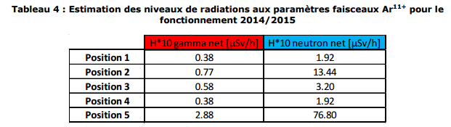
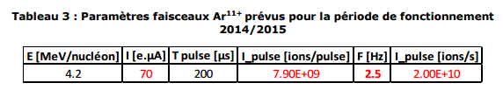

Linac3 beam: radiological risks
Linac3 is not equipped with an access system (measurements with Ar beam )
Risks from Linac3 beam limited as compared to Linac4 beam

Slide 11
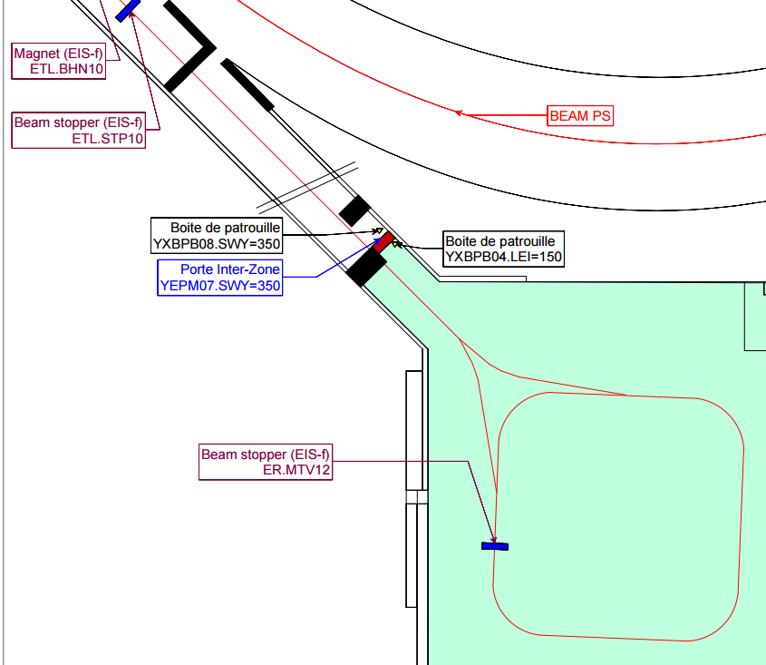
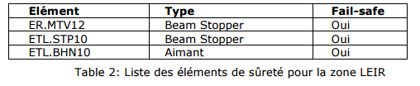
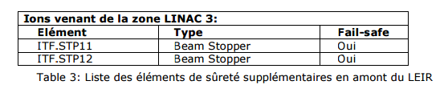
EIS for protection of LEIR
Not in Layout database as EIS ??
https://layout.web.cern.ch/default.aspx?navigator=eis&id=6078998&name=
Linac3 ion beam can be present in the PS-SWITCHYARD during access ?

Slide 12
Conclusions
Proposed change: no H- beam in the PS Switchyard with personnel in the PSB
Temporary shielding solution for L4T commissioning (end of LS2)
Stopper(s) must ensure protection against incidental injection of the Linac3 beam in the PSB (radiological risks still lower than for the Linac2/4 beams)
Stoppers must be in the MPS system to ensure that they will never see the H- beam as it could be damaging (condition is stopper out to send the H⁻ beam to LBE)
Is the current situation for the fast and slow stoppers acceptable with the Linac2 beam ? (mode not used often)

