Slide 1
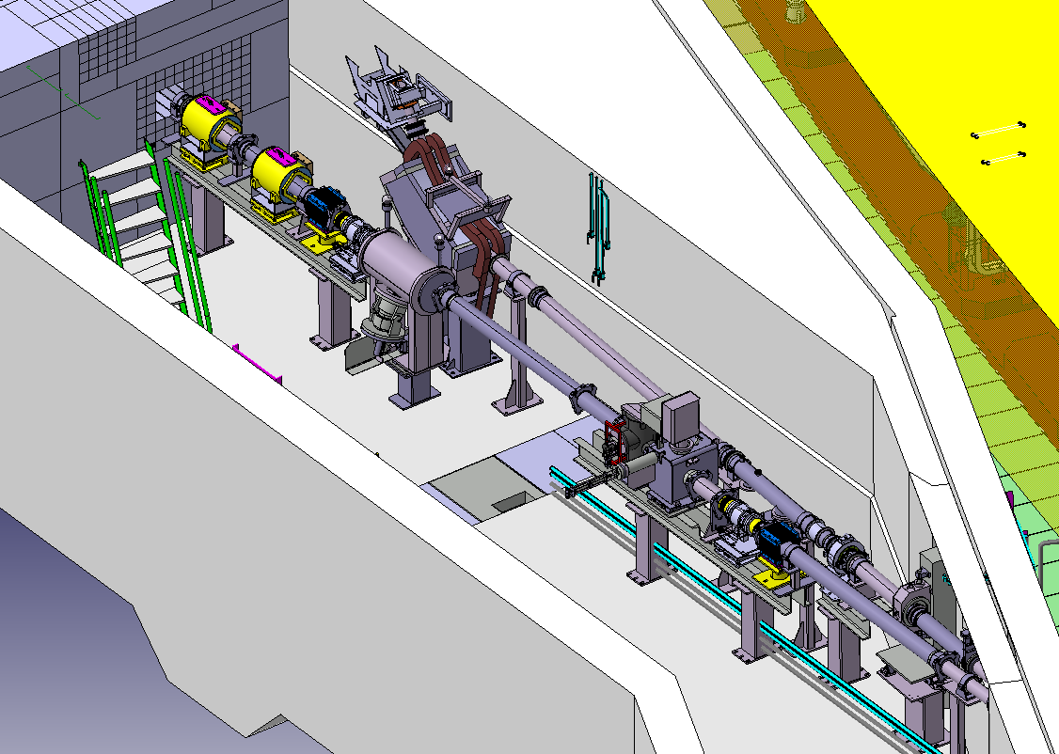
Technical specification for the beam stopper(s) in BI line
Edouard Grenier-Boley (EN-STI)
Andre Pilan Zanoni (EN-STI)

Slide 2
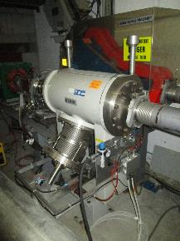
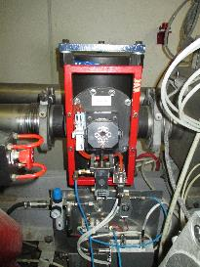
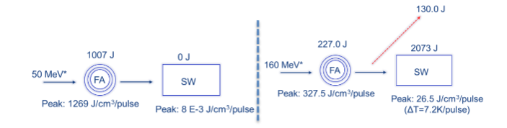
Actual Beam Stoppers
BI.STP-SW
BI.STP-FA
1698144 v.0.1

Slide 3
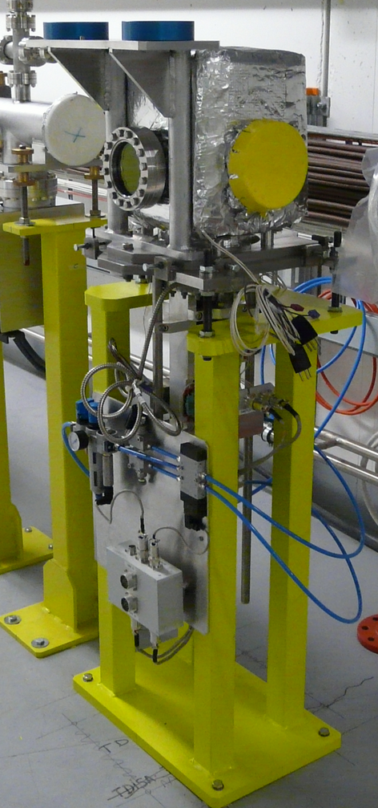
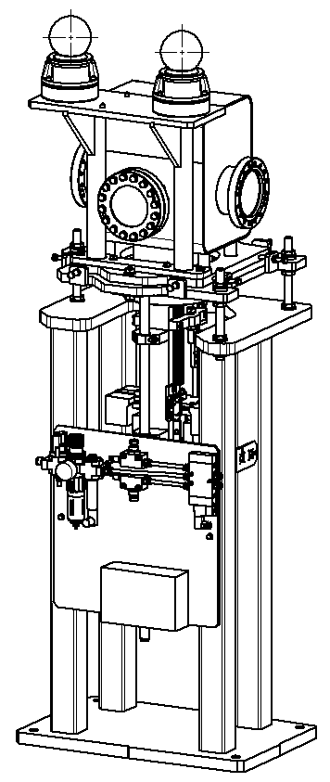
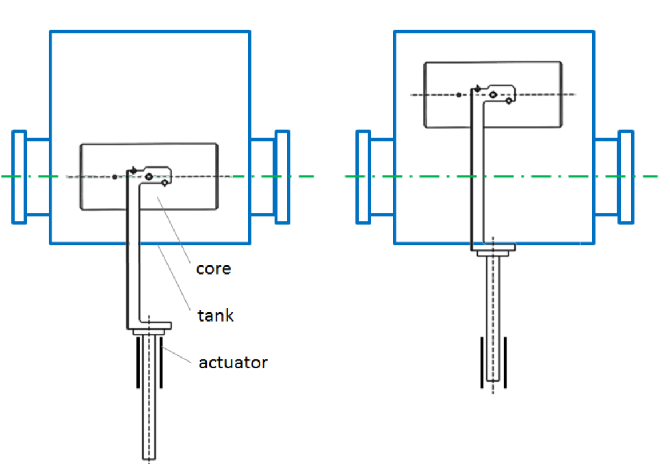
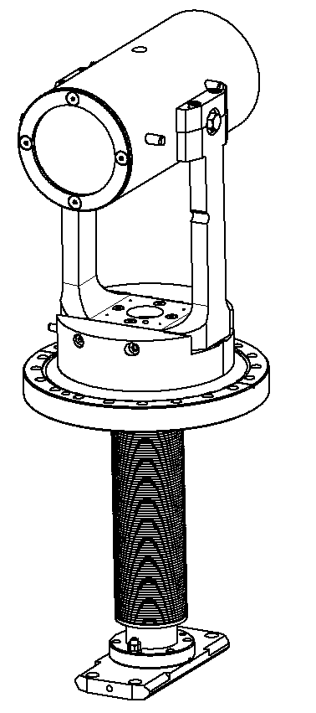
Beam stopper PXTBS_011 (LINAC4)
EDMS: 1301655
Position: L4T.TDISA.0740
Bdlg. 410/U0-004
Core: graphite (ø 80 x 120 mm) / st. steel (ø 105 x 220 mm)
SPLTDISA0078
In-beam
Out-beam
SPLTDISA0079
EDMS: 1301655
EDMS: 1551988
Switches to control end positions
Pneumatic double actuator
400 – 800 ms to cover 125 mm stroke
Vacuum tank: 400 x 419 x 275mm

Slide 4
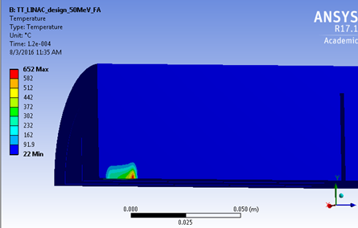
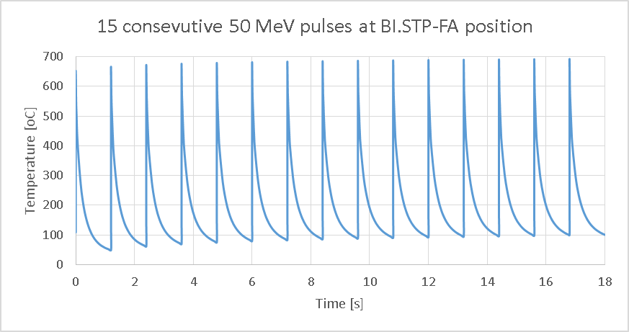
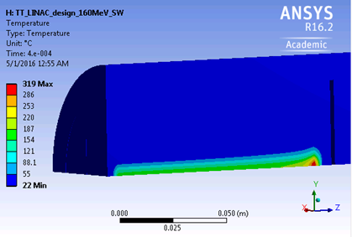
Beam stopper PXTBS_011 for the BI line
Temperature distribution (peak)
Any position between BI.STP-FA and SW are acceptable. Towards BI.STP-SW slightly safer.
Critical result at BI.STP-FA under 50 MeV. Peak temperature: 652ºC. Safety factor: 6.7 (minimum tolerable: 1)
Time to cool down to room temperature after two pulses: 10.2 s
All energy absorbed by the graphite core.
Our model did not consider the gap of ~ 2mm at the entrance
50 MeV pos.: BI-STP-FA
Max. temperature: 692ºC
160 MeV pos.: BI-STP-SW
15 consecutive pulses
EDMS: 1698144

Slide 5
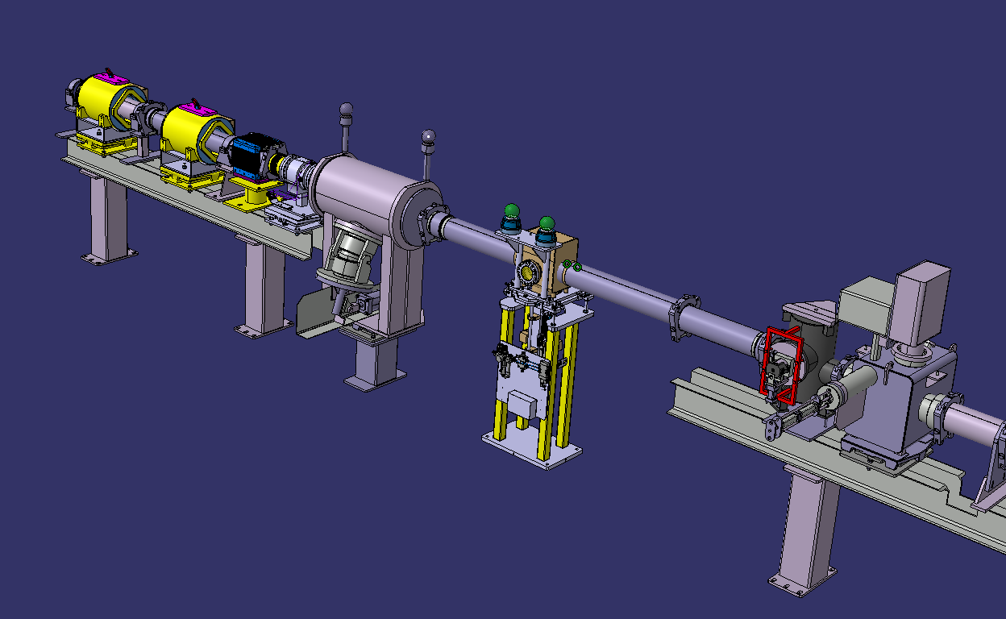
Intégration in the BI line
Pre-integration made by me just to have an overview

