Slide 1



Slide 2
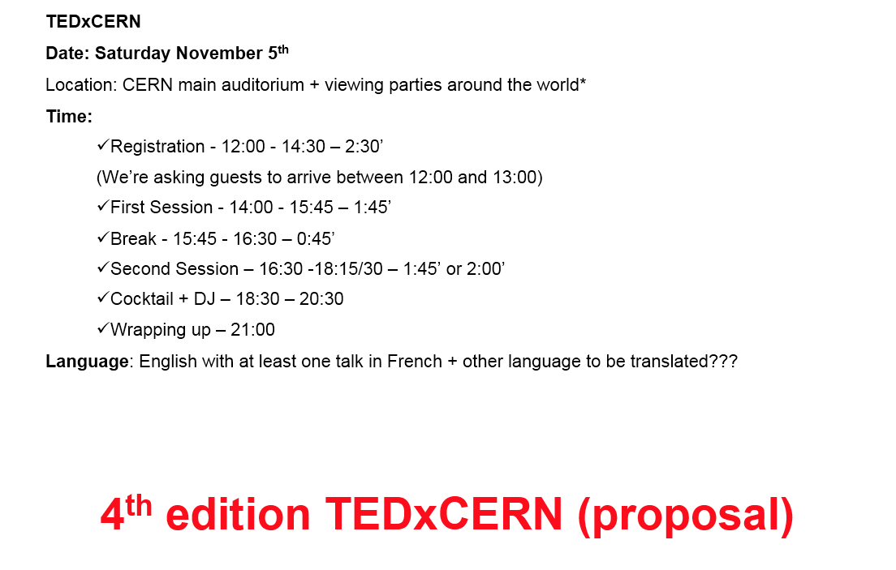
4th edition TEDxCERN (proposal)

Slide 3
Pre-event – Debate among few CERN speakers
When: Friday November 4^{th;}
Time: 17:30 to 19:00
Where: Globe of Science and Innovation
Format: 10 minutes seated presentation by four TEDxCERN speakers + 50 minutes panel debate on the ethics behind the topics
Moderator: Olivier Dessibourg, Science journalist - Le Temp
Questions: system: to be defined and managed by Arnaud Massolier
Speakers: Marcus Gary on artificial intelligence, Jun Wang Genetic on sequencing on big scale, Denis Lo on liquid biopsy and Eleonore Pauwels on CRISPR and governance of genomic technologies
Audience: all external guests of TEDxCERN + a link for public + CERN community submission
Language: English with simultaneous translation to French
Communication: “emerging and intelligent technologies in health: what ethics and what governance?”, a panel discussion among few TEDxCERN 2016 speakers

Slide 4
Work Packages (WBS)
Project Management – Organize (propose project, plan, develop, implement) & Track of budget and other administrative issues
Volunteer - Recruit, engage, motivate and manage volunteer to tasks
Speakers: Curation (Define content of programme, Invite speakers and define message talks) & Liaison with speakers (travel, accommodations and schedule)
Audience: Invite an audience of CERN’s scientists and professionals from multiple cross-cutting domains as guests
Production: Create stage and lighting set up & Manage video and photo caption & post- production
Viewing parties: Engage institutes and other TEDx to organize a viewing party of TEDxCERN
Logistic Events@CERN: Provide all logistic aspects to welcome guests to event and post event @CERN
Visual Identity: Create an unique visual to 4th edition of TEDxCERN coherent with all platforms
Editorial: Announce Event, Theme, Speakers and satellite events on all online platforms, website and social media included
Media Coverage: Promote the event @CERN and institutes worldwide among members of the media

Slide 5
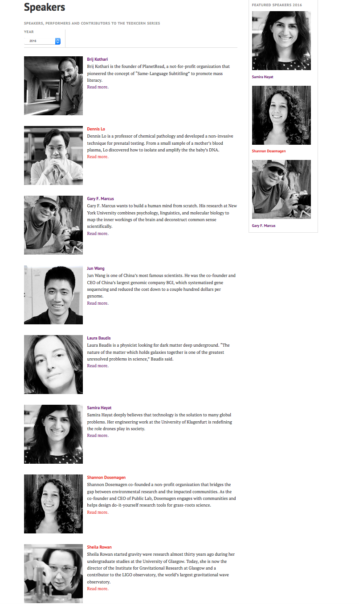
Speakers
8 on TEDxCERN
4 more to be announced:

Slide 6
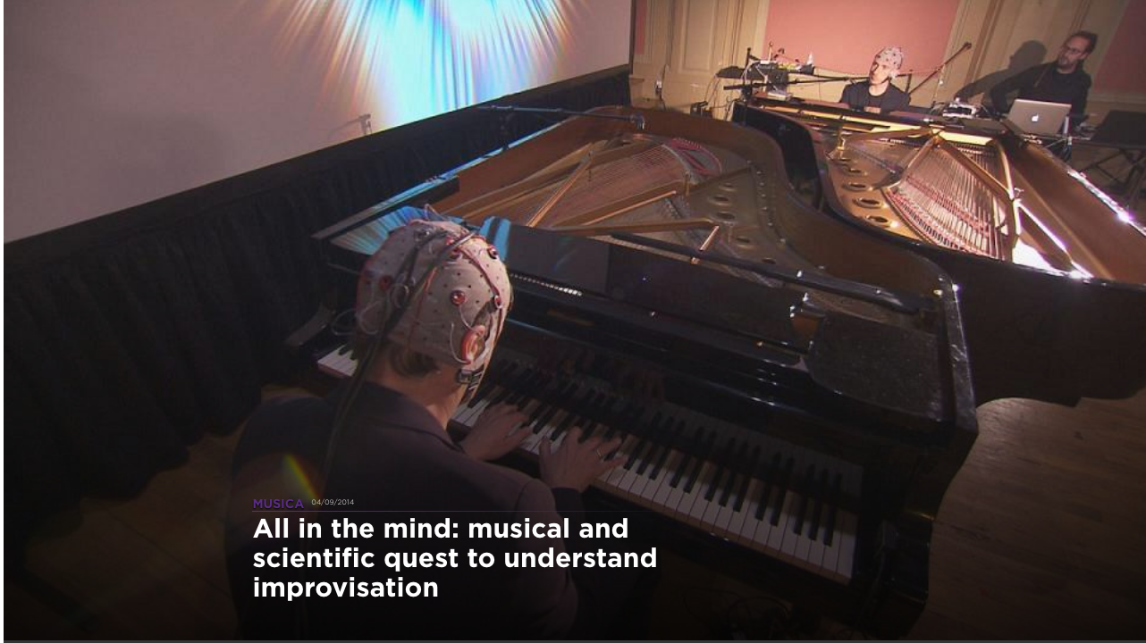
Speakers
Speakers Line-up completed and 4 speakers bio’s missing:
Eleonore Pauwels - is a science policy expert who explores ethical governance and crafts regulations for emerging technologies. She is particularly interested in the perils and promises of DNA editing, which involves replacing faulty genes to treat and cure diseases. Her talk will focus mostly on CRISPR.
Kate Stafford - her research has focused on the geographic and seasonal occurrence of large whales based on sound production. What the whales have to say, regarding climate change.
Stephanie Lacour - her research focuses on the materials, technology and integration of soft bioelectronic interfaces including artificial skin, ultra-compliant neural electrodes for in vitro platforms as well as in vivo implants such as prosthetics and brain to spine circuit.
Agalma Fondation - project called Music and Brain. The goal is to study where and when creativity happens in the brain. Neuroscientists use EQG apparatus and record the brain waves of two pianists making an improvisation.

Slide 7
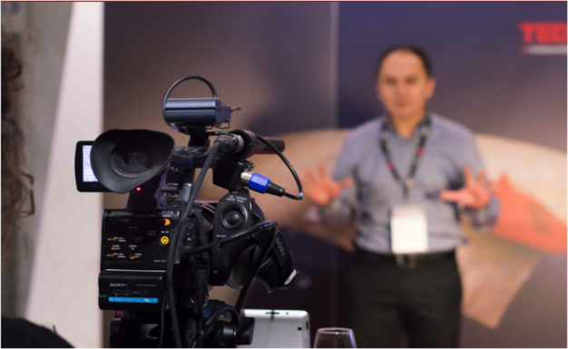
Sponsorship/Activities
Sponsorship
Rolex is confirmed participation
Mazda???
Activities:
1) Speakers show and tell:
  Samira with drones?
  Shannon with a kit
  Kate with the device to record sounds of the whales
  Nathan – EQG?
  Stephanie – flexible materials?
2) Photo machine
3) Photo booth
4) Be a TED speaker for one minute. WHERE WILL TAKE PLACE?

Slide 8
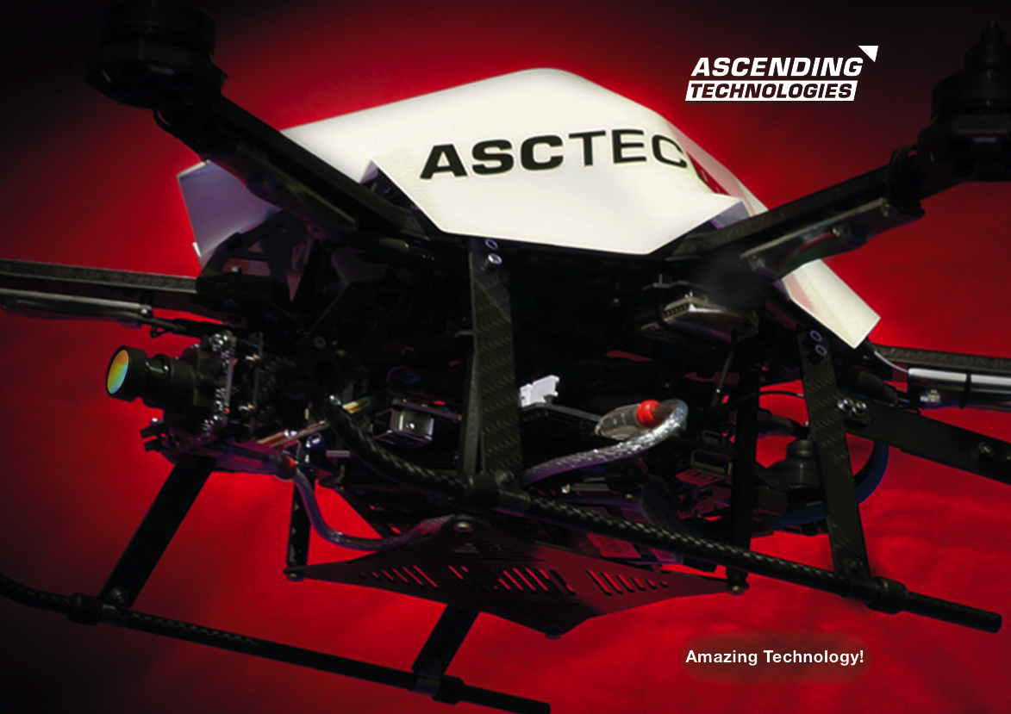
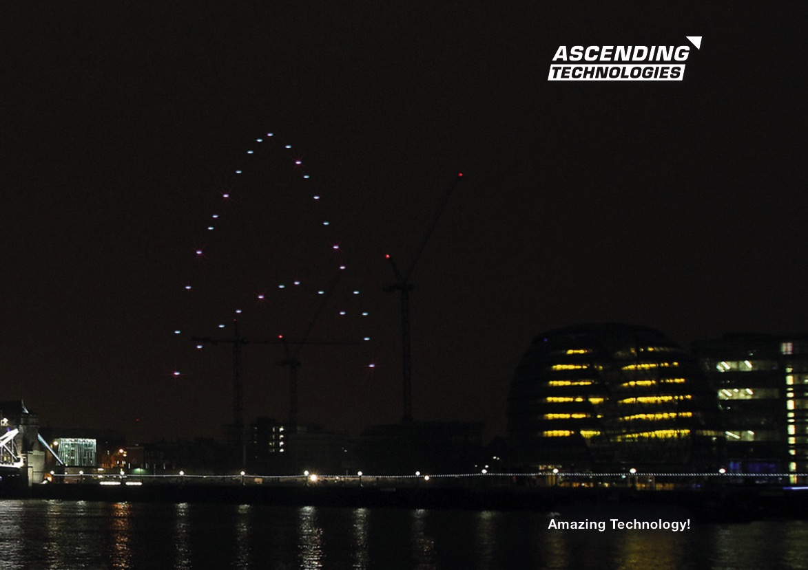
Installations
Drones – have Samira’s drone on a table, flying around or flying in a light who performance?

Slide 9
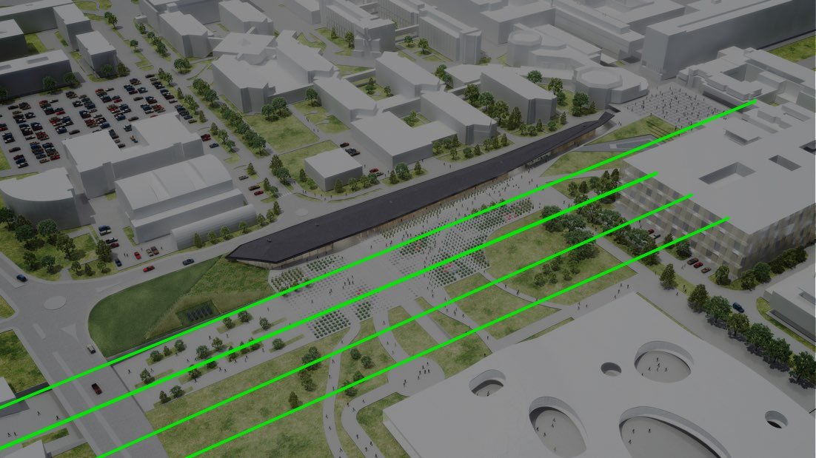

Installations
2) GENOME is composed of four parallel lines traced in the sky by high power lasers. Each laser is associated with one of the nucleotide bases A, G, C, T. By juxtaposing the Human Referenced Genome sequence with the 1000 Genomes Project variations, we can obtain a representative map of humankind, in all its beauty and diversity.
http://happycitylab.com/en/project/genome/

Slide 10
TED Translators
Schedule suggested:
9:00 - Welcome to TEDxCERN at CERN reception (Aurelie Goldblatt)
9:30 - Visit to CERN facilities (Francois Briard)
11:00 - Welcome from head of CERN translation service (John Pym)
12:00 - Lunch at cafeteria
Goals:
Priority of languages: French! then Italian, German and Chinese
Priority of talks: Gary Markus, Jun Wang, Dennis Lo and Eleonora Pauwels (still to be announced)
Requests:
10 tickets – Andreas
5 double room hotel – Bettina/Przemek
Visit – Francois
Meeting room – Pzermek?
Welcome – John Pym?
Contact for pos-production - Emma
10 - translators
02 - TED staff (Kristin and Helene)
01 - TEDxCERN team member to be the main organizer of TED translators@ TEDxCERN (Aurelie Goldblatt)

Slide 11
Feed-back from TED
stage manager right next to stage right (so everyone could hear him talking into his headset, calling speakers over, etc.). Need a separate room or manager's booth to dampen sound (PRODUCTION)
the entrances are quite narrow, and also making it so we could only use one exit on the stage side made it difficult to move in and out of the room, made attendees frustrated. Way to fix: having clear communication and all exits open and volunteers to direct on all levels of exit for the theatre to make the process quicker (USHER)
wifi overall was confusing, so prepping attendees and somehow ensuring that all are able to connect before (maybe having one person on team in charge of that process and pinging attendees to ensure they understand how to connect)--although this might have been because many of our attendees were from other countries.(GUESTS)
would recommend buildout of space outside of theatre (cool furniture, high top tables, signage, etc. the way you had at TEDxCERN) to encourage mingling between sessions (LOGISITICS)
would recommend blocking theatre, space between council room and theatre, and cafeteria in total (if possible) so that CERN employees/students aren't confused and it feels more like a "TEDx zone" with signage (LOGISTICS)

Slide 12
Fun
2014- Helina and Roxanda
2015 – Berta and Vasilis
Are coming….

Slide 13
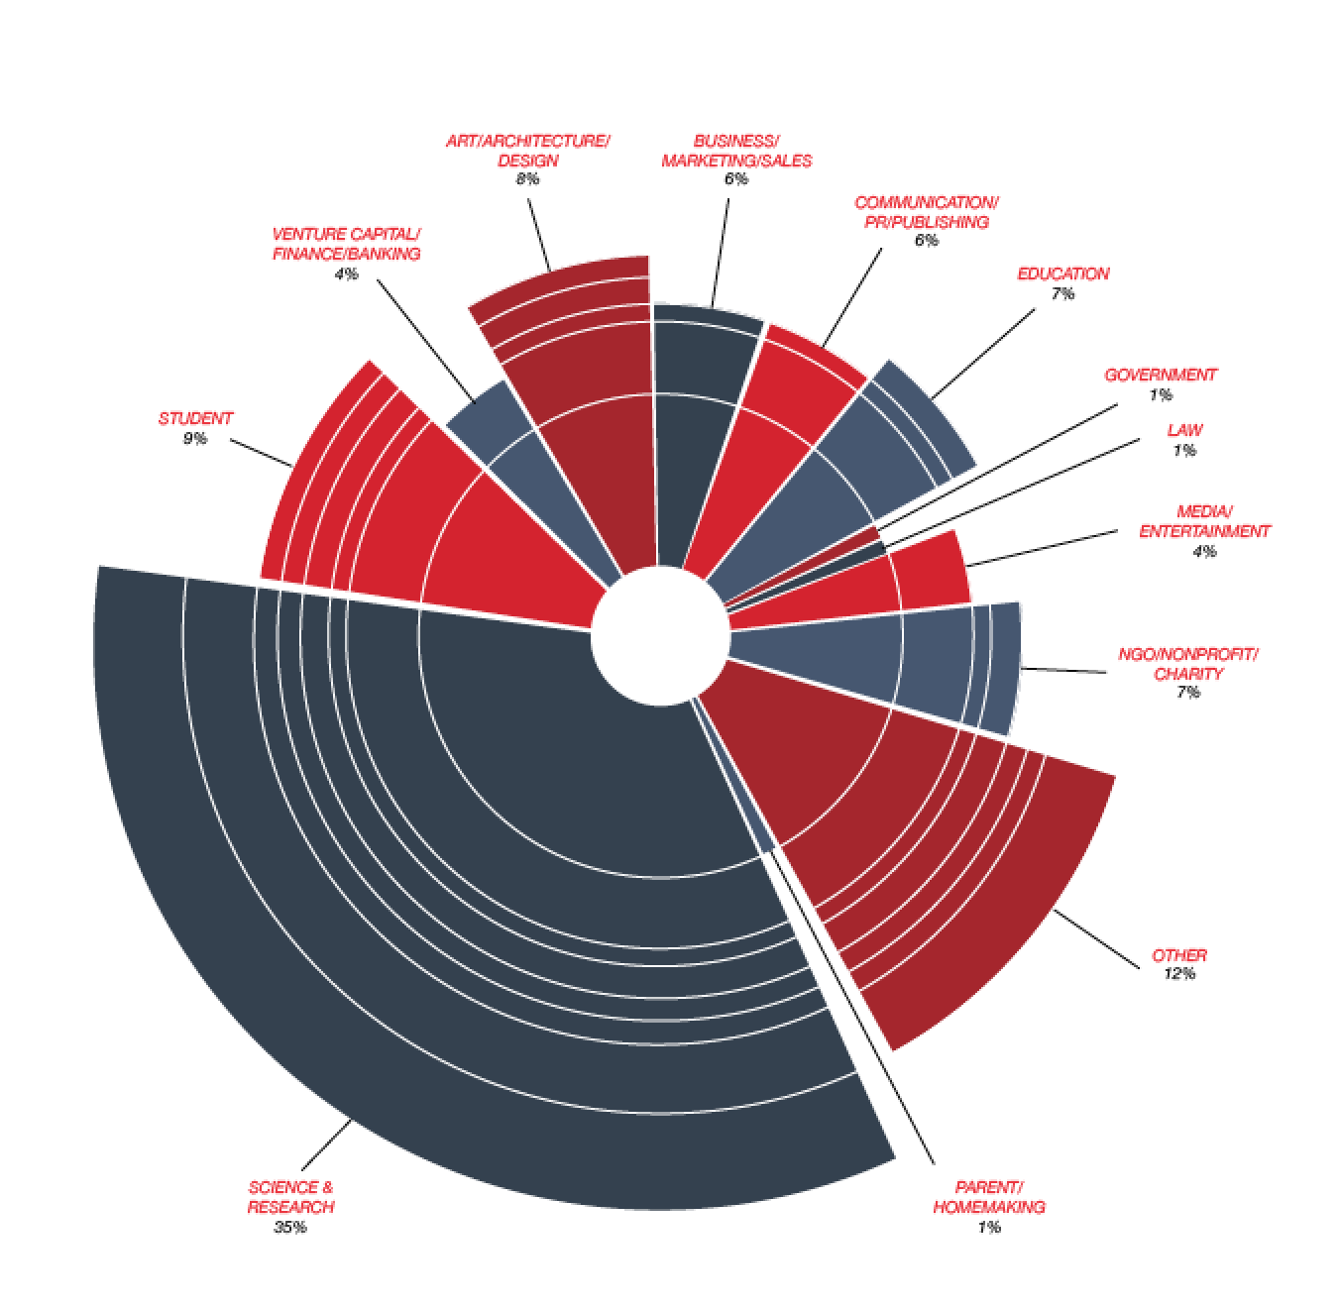
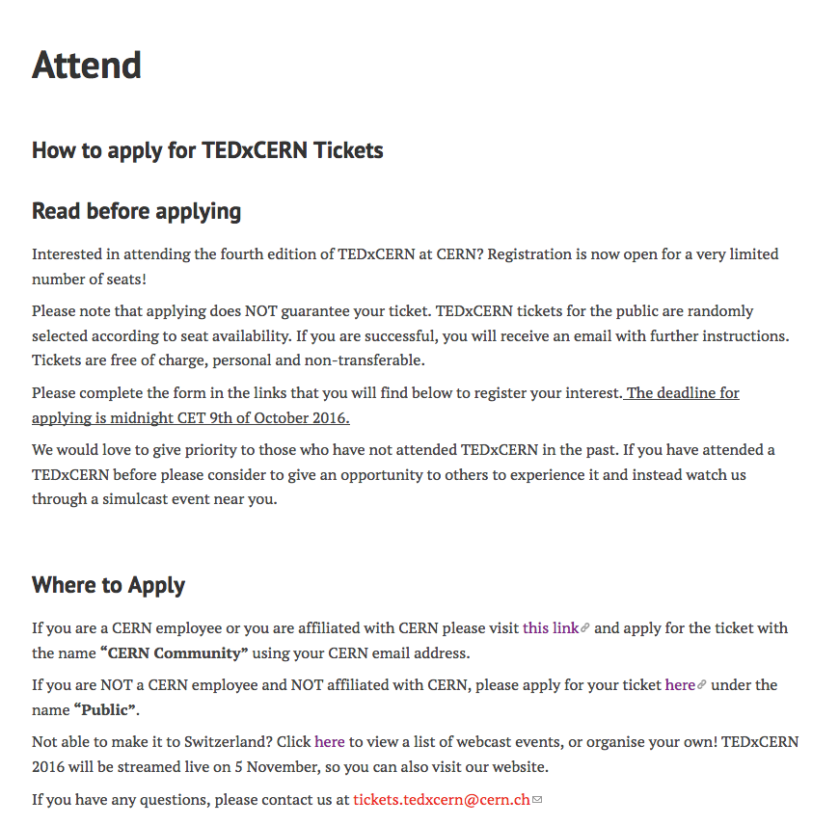
Audience
380 seats + 20% Overbooking + (Volunteers /2)
50 – 50 Policy
  Self Submitted CERN & Public – Random Selection Algorithm
  Tickets distributed by CERN – Directors, Heads of Dep. & Heads of ECO
Team & Volunteers no extra Invitations… sorry!

Slide 14
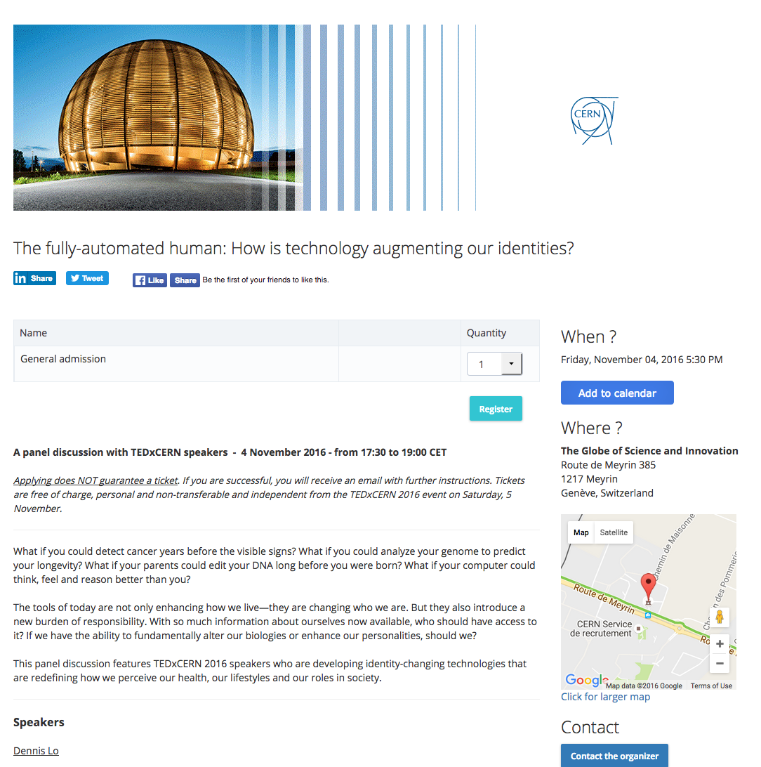
Panel Nov 4th!
https://www.eventora.com/en/Events/fully-automated-human-how-tech

Slide 15
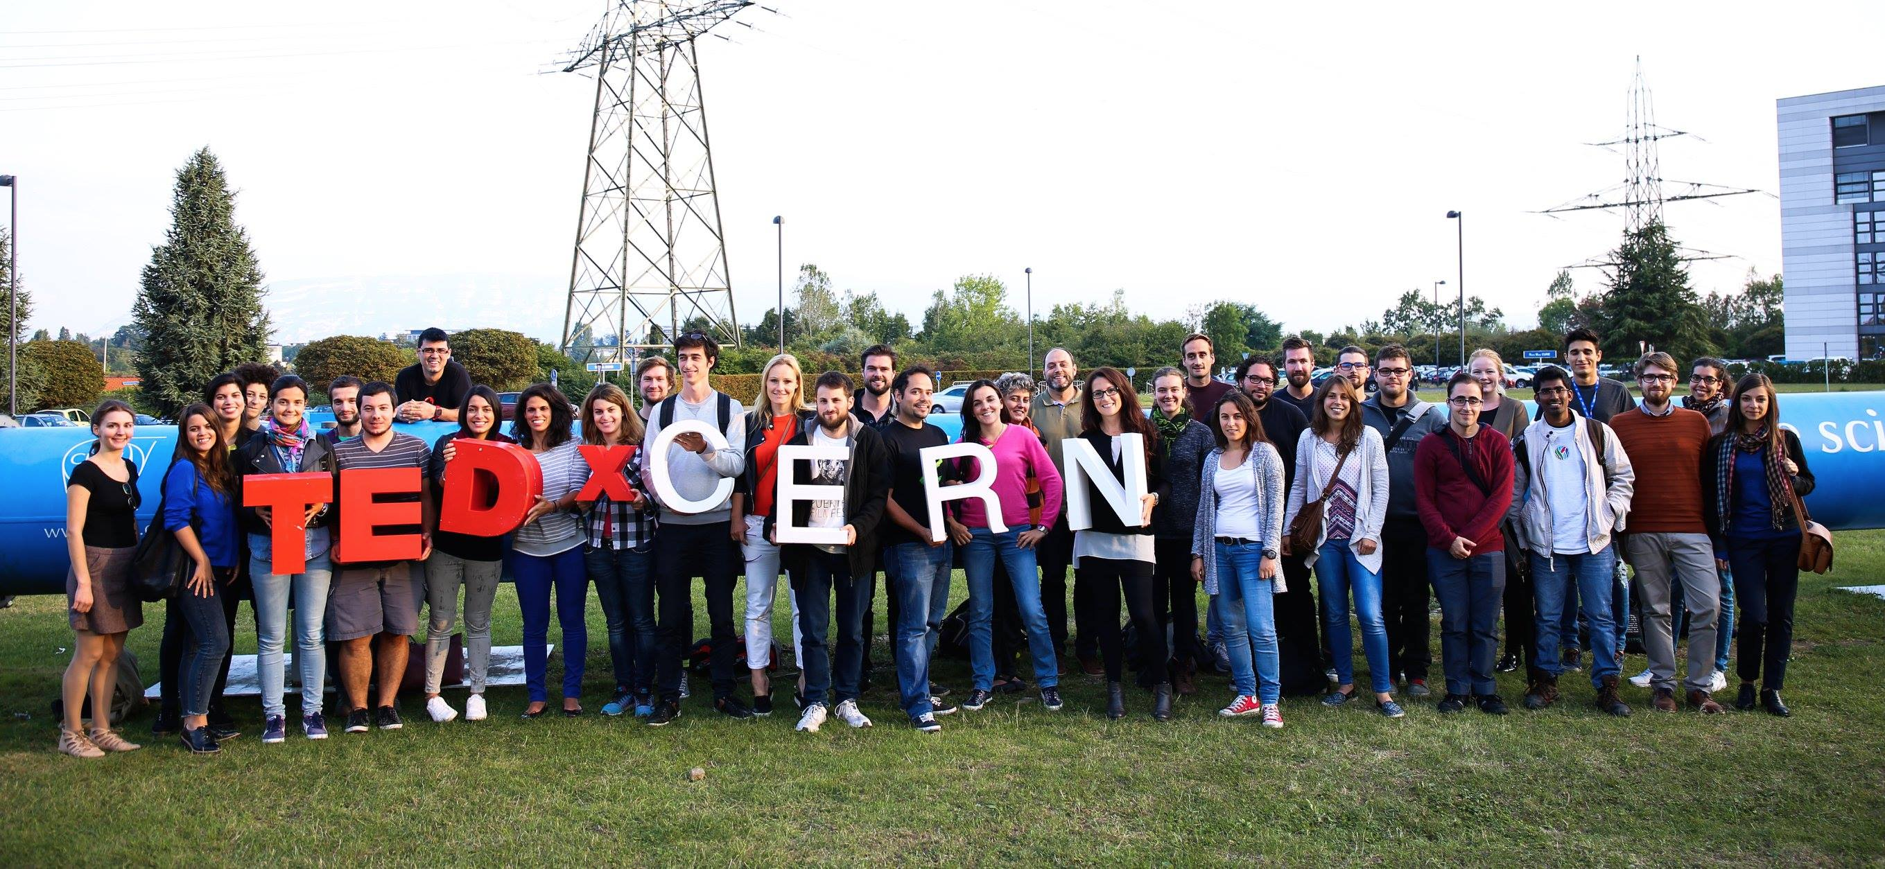
Volunteers
https://www.facebook.com/tedxcern/photos/a.299871823474887.67326.186376758157728/969757306486332/?type=3

Slide 16
Production
There will be only 380 seats!
No stage set, but mapping
extra seats for speakers
Social media/photographers on the alley above
5 cameras with a crane
Herve covers day before
Interviews middle of event with Paola and speakers on main stage during the break and after event

Slide 17
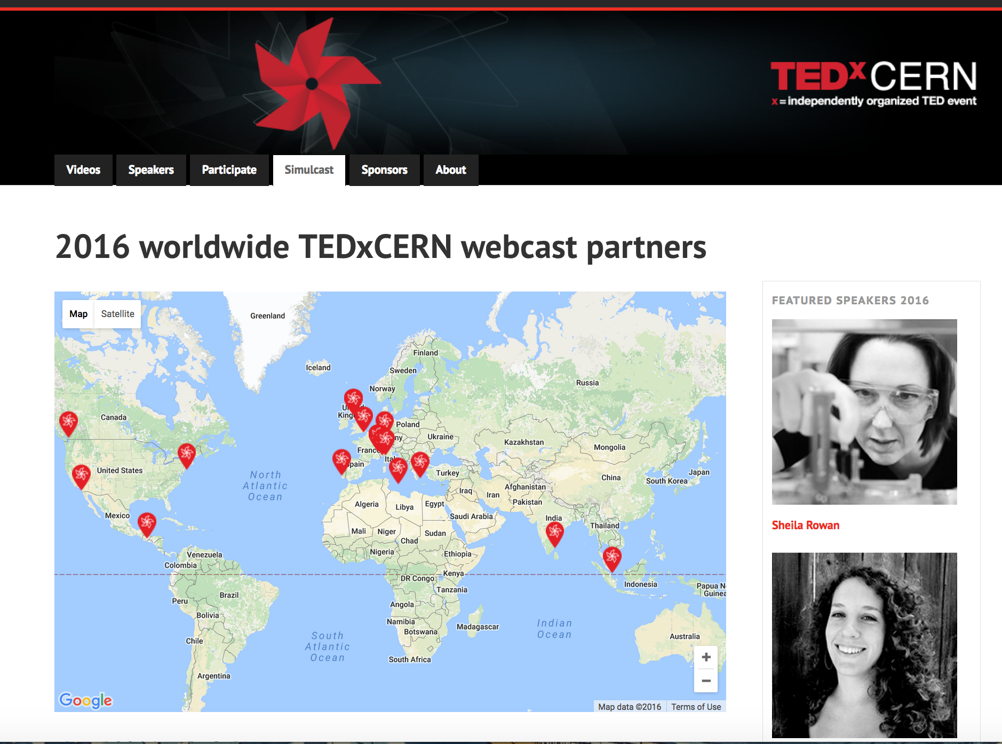

Slide 18
Visual Identity
Need to add a panel with Rolex logo behind it

Slide 19
Editorial
Press Release and Article on CERN homepage on October 5th – One month to TEDXCERN!

Slide 20
Logistics

Slide 21
Next – correction on dates!
When: October 13, 27 at 16:00 and 31 at 17:00 for Photo, Tetras, etc Whole team!

Slide 22


