Slide 1
ELENA Project
E. Harrouch
Installation follow-up & Planning update

Slide 2
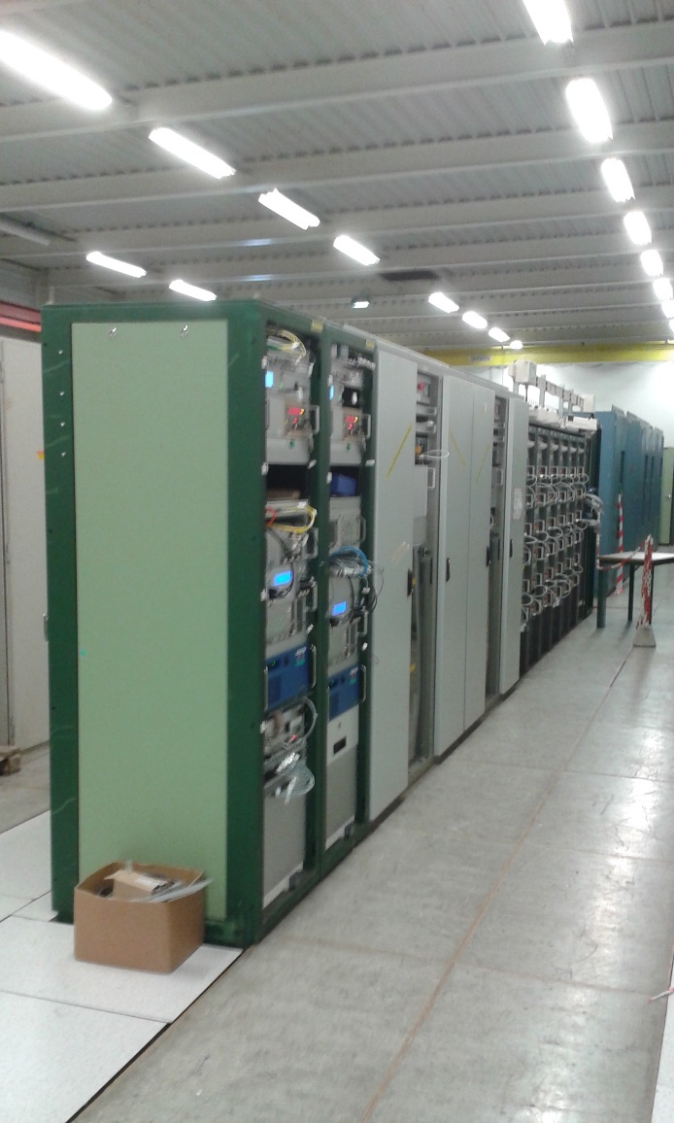
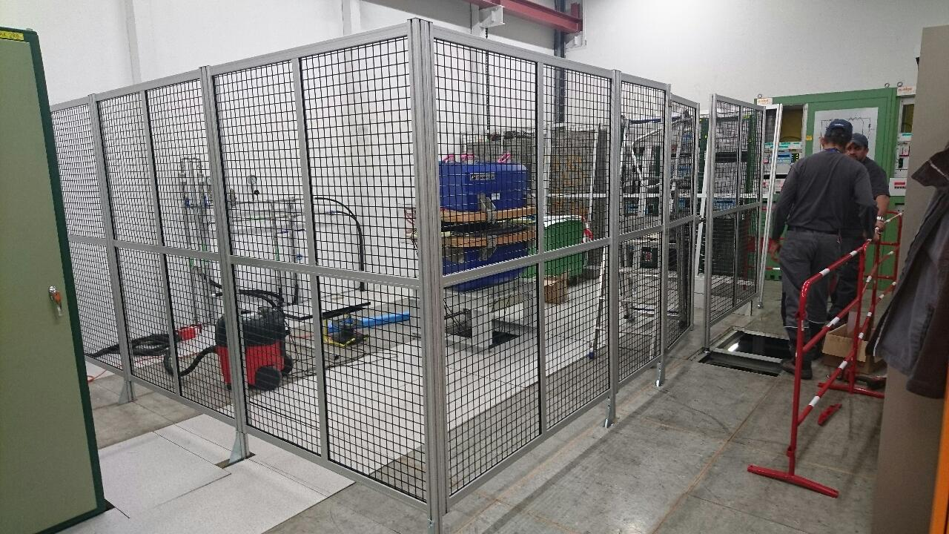
Follow-up
Btrain installation :
  Completion of the Btrain system to be performed

Slide 3
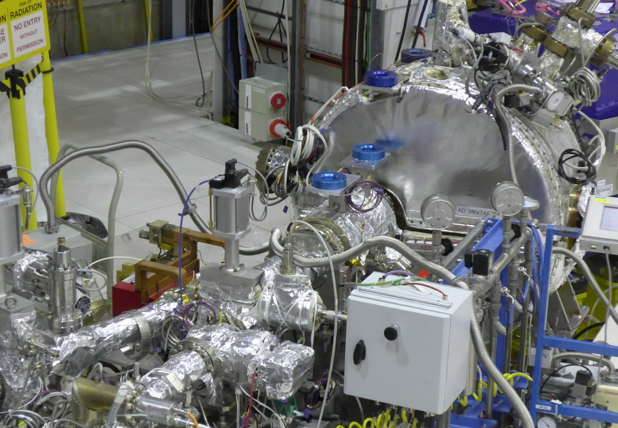
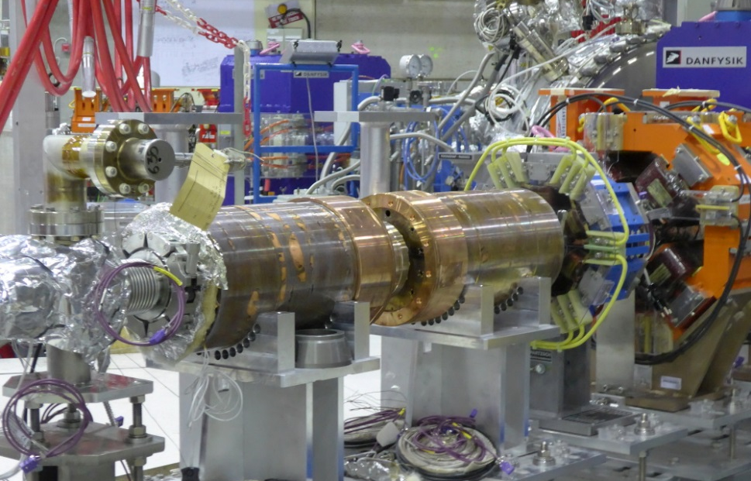
Follow up
Other equipment installation
  Tune measurement : Installed and aligned
  Scrapers : Installed and tested.
  Long PU : Installed
  BTV : Installed and tested
  BPMs : Installed
  Injection Kicker : Installed
  SEMs : First SEM : Installed on LNS. 3 / 4 SEM at CERN.

Slide 4
ELENA Magnets status w39
12 MCCAY H/V correctors status:
  MCCAY03: Installed in position LNR.MCCAY.0130.;
  MCCAY04: Installed in position ;
  MCCAY02: Certification is not OK, Investigating ongoing by contractor ;
  MCCAY05: Certification is OK, Magnetic measurements are ongoing, Installation should be possible on 04/10/2016;
  MCCAY06: Certification is ongoing, Installation foreseen on 10/10/2016;
  MCCAY07: Certification is ongoing, Installation foreseen on 10/10/2016;
  MCCAY08 and MCCAY09, Shipment is ongoing. Delivery foreseen on 03/10/2016, Installation foreseen on 14/10/2016;
  MCCAY10 and MCCAY11, delivery foreseen on 14/10/2016, Installation foreseen on 24 /10/2016;
  MCCAY12 and MCCAY13, delivery foreseen on 20/10/2016, Installation foreseen on 01 /11/2016.

Slide 5
Alignment
Statut de l’alignement : 100%
  Magnets :
    All the magnets are aligned
    Correctors magnets are not aligned, the survey only measures their position after installation : Difference of 5mm in the radial direction (Toward the inside of the machine)
  All the other beamlines components are aligned
Last step on-going : « Lissage » of the machine
Alignment required to close vacuum
Alignment progress

Slide 6
Vacuum advancement
Vacuum sector | Desc. | Bake-out | Pressure reached
LNI-LNE | Inject, from AD + Eject. To exp. | Starting date to be defined | -
LNS20 | Source | Start expected by the end of the week | -
LNR10 | Eject. to exp. | Done | 1x10⁻¹²mbars
LNR20 | Inject. To ELENA | On-going | -
LNR30 | Eject. to GBar | Done | 2x10⁻¹²mbars
LNR40 | E-Cooler Sect | Done | 1x10⁻¹⁰mbars
LNR50 | Scrapers + RF | Done | 5x10⁻¹²mbars

Slide 7
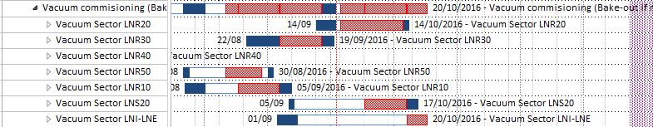
Bake-out planning
Bake-out planning if we do not wait for the SEM
LNR 10,30,40,50 bake-out completed
LNR20 Bake-out on-going
LNS20 Bake-out start expected by the end of the week
LNI-LNE bake-out cannot be done in parallel of LNS20/LNR20 bake-out (Not enough power socket and space available)

Slide 8
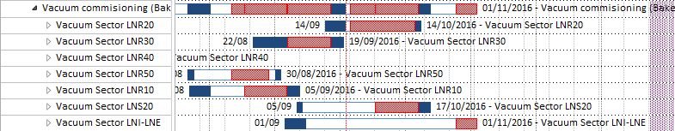
Bake-out planning
Bake-out planning if we wait for the SEM
3 weeks from now before the SEM are sent for vacuum tests
2 weeks of vacuum test
Bake-out completed by the 1/11 with this scenario

Slide 9
Summary of next week
Bake-out LNR20 (TE-VSC)
Bake-out LNS (TE-VSC)
“Lissage” of the machine (EN-ACE)
  Installation of one corrector magnets (TE-MSC)

Slide 10
Hardware tests
REMINDER
Any tests performed on the machine should follow the same procedure :
  Notify Francois Butin and Jose Gascon by email with a description of the tests that you foresee.
  Francois will then trigger a Visite d’Inspection Commune (VIC) if required
Please notify to me all the tests/work that will be performed after the end of the bake-out so they will be integrated to the planning.

Slide 11
Spare slides

Slide 12
Lock-outs
REMINDER
Racks sous la responsabilité de TE-EPC :
Liste des Racks Convertisseurs se trouvant sur la plateforme :
  RYE01 à RYE03 Powering Ring (Responsable équipement : Kuczerowski, Nicolas)
  RYE08 Ion Switch (Responsable équipement : Machado Christophe)
  RYE10 à RYE13 Transfert Line HV (Responsable équipement : Machado Christophe)
  RYE18 à RYE21 Electron Cooler Low Converters (Responsable équipement : Yves Thurel, Ludovic Charnay)
Liste des Racks Convertisseurs se trouvant en salle de puissance :
  RA-K302 à RA-K307 ELENA Electron Cooler (Responsable équipement : Ludovic Charnay)
  RB300 et RB301 Convertisseurs APOLO + Spare (Responsable équipement : Christophe Mutin)
LNI bendings: Locked-out (C.Carli) + ground straps on magnets
La demande de consignation peut se faire via le service first line EPC 163668 ainsi qu’à Michal DUDEK ou un responsable d’équipement.

Slide 13
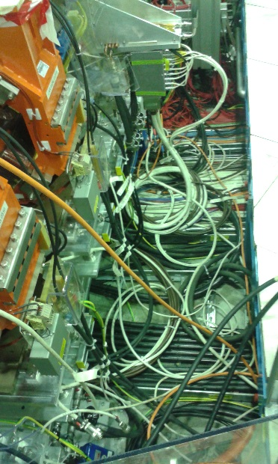
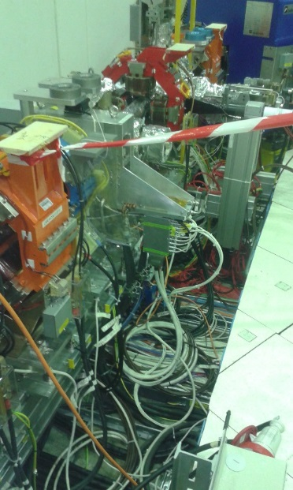
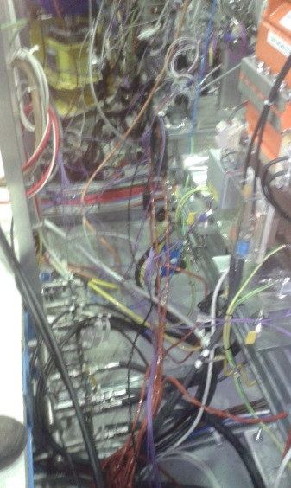
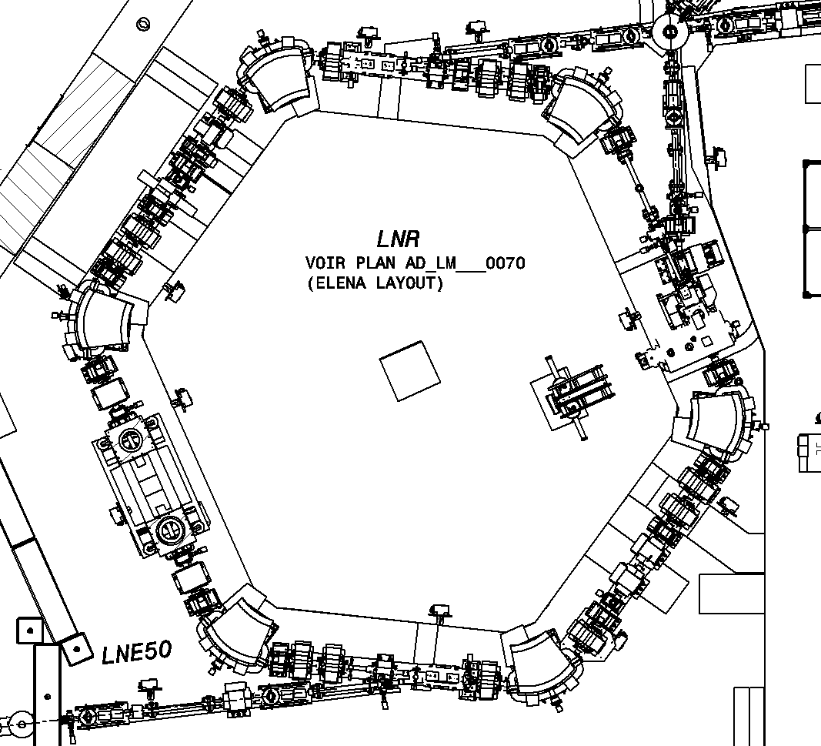
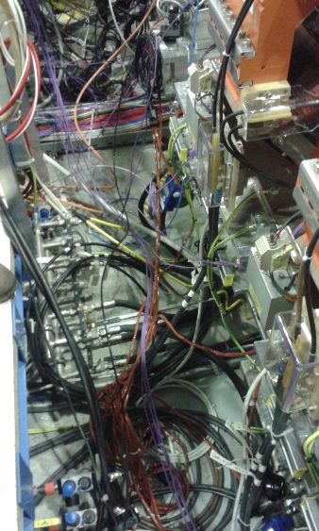
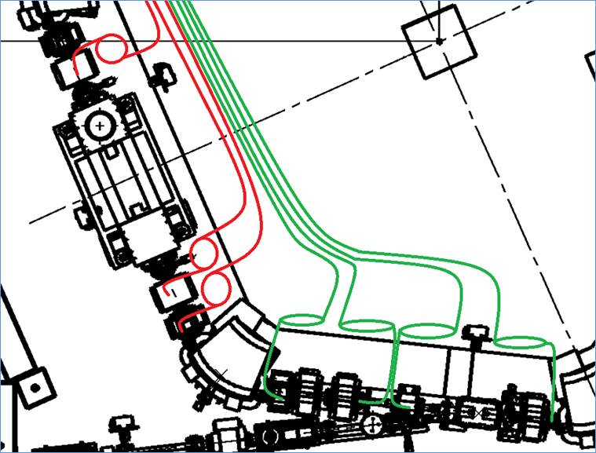
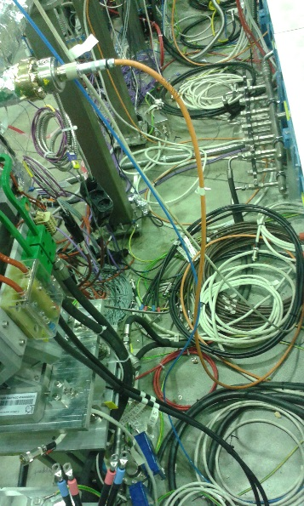
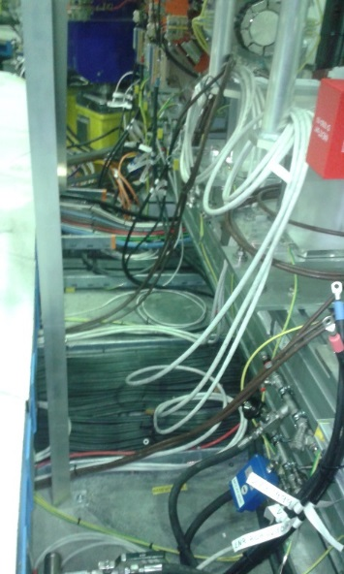
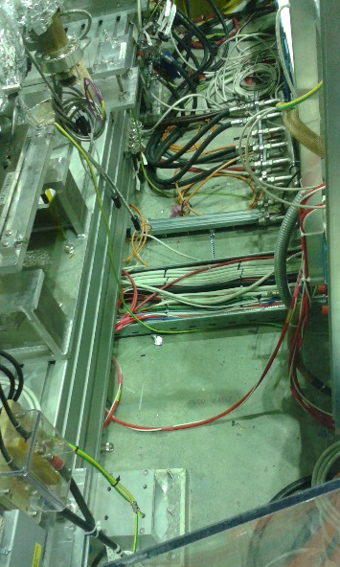
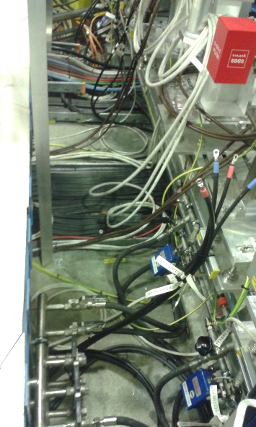
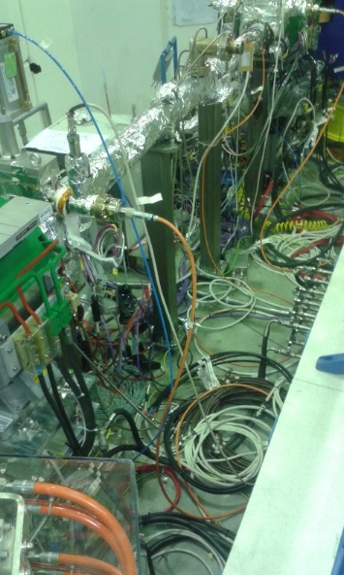
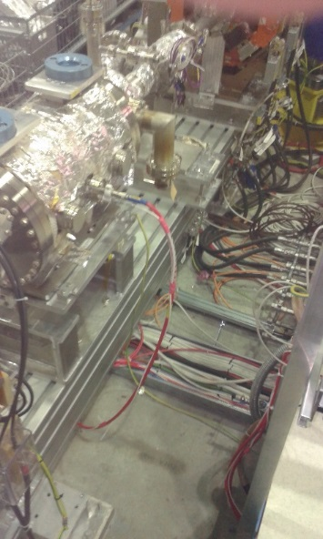
On the 07/09
Please put your cables in the green configuration

Slide 14
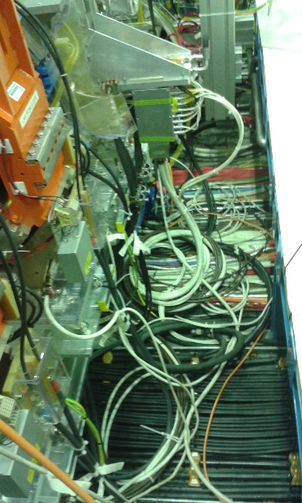
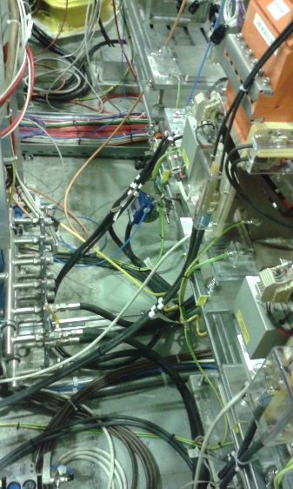
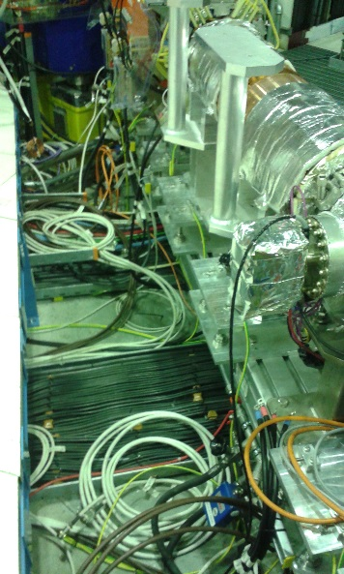
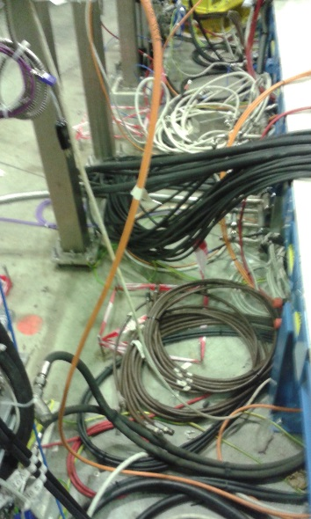
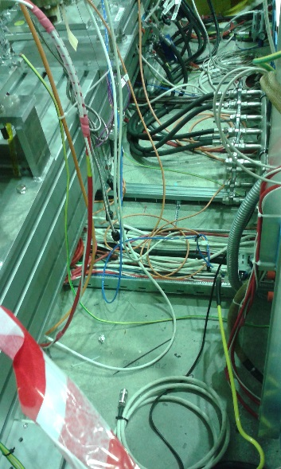
On the 21/09
Please put your cables in the green configuration

