Slide 1
Event skimming using indexing
Jin Chang,Igor Mandrichenko, Jim Pivarsky
Big Data Meeting, September 28, 2016

Slide 2
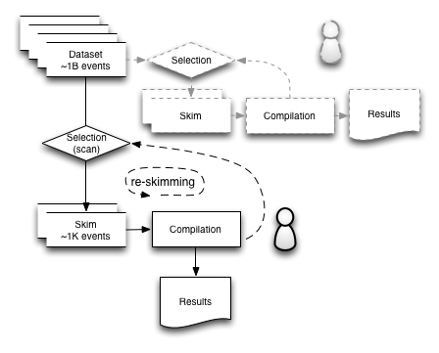
Event Skimming
Skimming and re-skimming is an iterative process
Goal: reduce re-skimming time

Slide 3
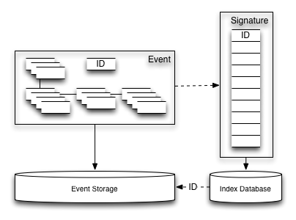
Event Indexing
Signature is a tuple of ~100 quantities calculated for each event
E.g.:
4 highest muon P_{t}’s
4 highest jet P_{t}’s
…

Slide 4
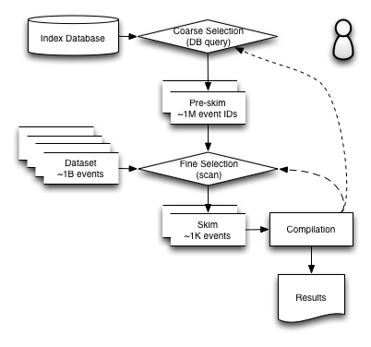
Skimming and Indexing
Coarse selection is a database query returning set of event IDs
Can significantly reduces the size of the dataset to scan
Reduces re-skimming time
Produce mini-dataset for personal use

Slide 5
Test of the concept
Posrgres 9.5 database
Index table with 40 single precision floating point columns
  4 highest P_{t}’s for 10 types of particles
~40M rows
  8 GB table size
Individual index for each column
  1 GB per index = 40 GB total index space
5 GB RAM allocated to the database

Slide 6
Pre-skimming Speed
Single parameter selection (highest P_{t} of ”type 1” particle)
Threshold | Nevents | % events | Time, s | Time/total events
5 | 2.594E+07 | 68.27 | 55 | 1.45E-06
10 | 2.298E+07 | 60.47 | 46 | 1.21E-06
20 | 1.569E+07 | 41.28 | 31 | 8.16E-07
50 | 4.955E+06 | 13.04 | 9.8 | 2.58E-07
100 | 1.142E+06 | 3.01 | 2.2 | 5.79E-08
200 | 1.090E+05 | 0.29 | 0.2 | 5.26E-09
500 | 1.592E+03 | 0.00 | 0.0035 | 9.21E-11
1000 | 3.000E+01 | 0.00 | 0.00013 | 3.42E-12
2 parameter selection (highest and second highest P_{t} of ”type 1” particle)
Threshold p01_1 | p01_2 | Nevents | % events | Time, s | Time/total events
5 | 2 | 1.11E+07 | 29.32 | 14 | 3.68E-07
10 | 5 | 1.08E+07 | 28.47 | 14 | 3.68E-07
20 | 10 | 6.77E+06 | 17.83 | 11 | 2.89E-07
50 | 20 | 1.48E+06 | 3.90 | 6.6 | 1.74E-07
100 | 50 | 1.18E+05 | 0.31 | 1.1 | 2.89E-08
200 | 100 | 7.25E+03 | 0.02 | 0.071 | 1.87E-09
Five parameter selection
Threshold p01_1 | p01_2 | p05_1 | p06_1 | p07_1 | Nevents | % events | Time, s | Time/total events
2 | 1 | 2 | 1 | 2 | 3.52E+06 | 9.26 | 11.7 | 3.08E-07
10 | 5 | 2 | 5 | 20 | 3.44E+06 | 9.06 | 12.2 | 3.21E-07
20 | 10 | 5 | 10 | 50 | 2.37E+06 | 6.23 | 11.2 | 2.95E-07
50 | 20 | 10 | 20 | 100 | 7.07E+05 | 1.86 | 10.8 | 2.84E-07
100 | 50 | 20 | 50 | 200 | 9.12E+04 | 0.24 | 0.97 | 2.55E-08
200 | 100 | 50 | 100 | 500 | 3.52E+03 | 0.01 | 0.0066 | 1.74E-10
500 | 200 | 100 | 200 | 1000 | 3.20E+01 | 0.00 | 0.022 | 5.79E-10

Slide 7
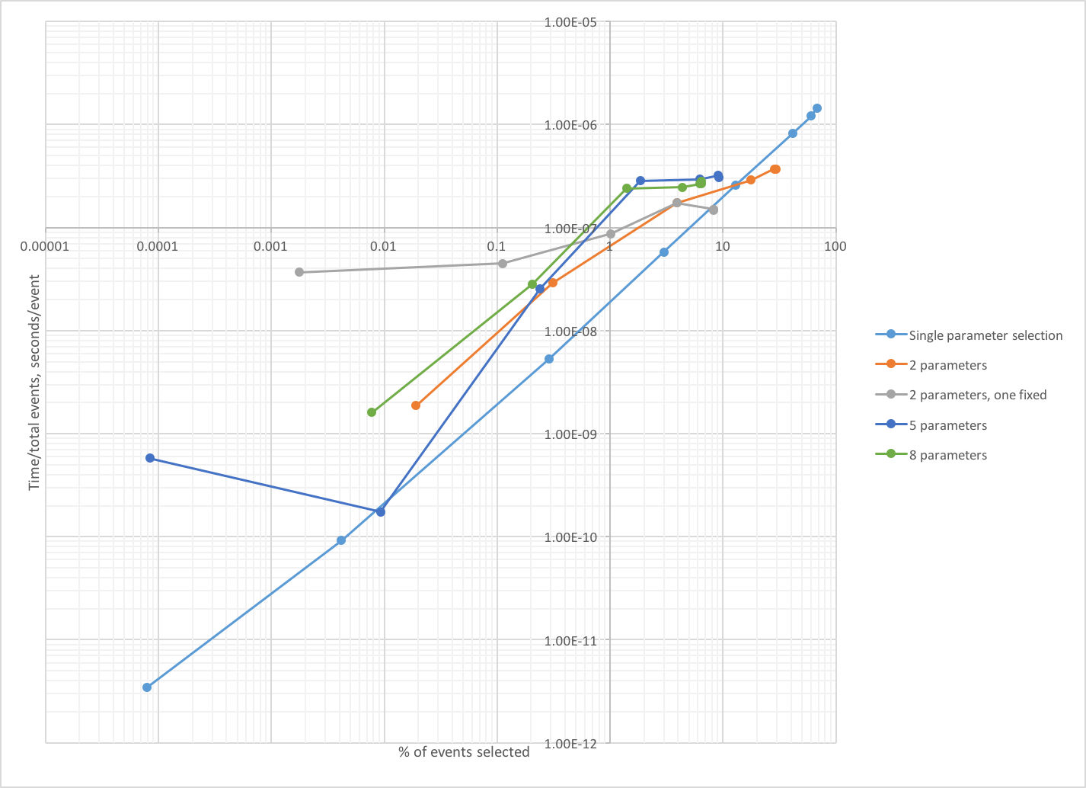
Index Scan Speed
10⁻⁷ sec/event
1% cut

Slide 8
What’s next ?
Research other indexing technologies
  Distributed databases
Look into use cases
  Re-indexing
  Analysis cases
    Centralized facility
    Individual analysis

