Slide 1



16T Cosθ Dipole Mechanical Analysis
BARBARA CAIFFI
on behalf of INFN team:
G. Bellomo, P. Fabbricatore, S.Farinon, V. Marinozzi, M. Sorbi and G. Volpini

Slide 2
Overview
Principal stresses and failure criteria
2D calculation: plain strain vs plain stress
2D mechanical optimization
Cosθ 2D models
Conclusions

Slide 3
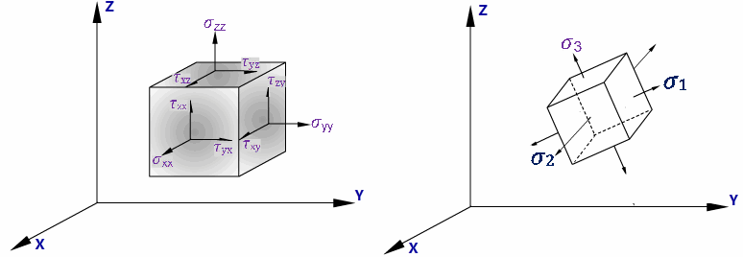
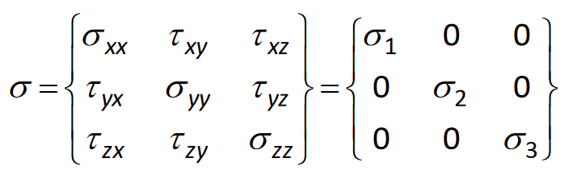
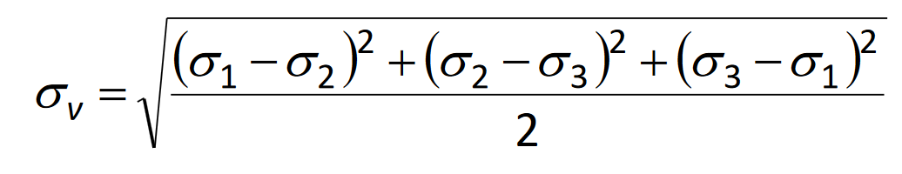
Principal Stresses
The principal stress σ1, σ2 and σ3, defined for each single element, are those in which the stress-strain tensor is diagonal
(σ3< σ2< σ1).
σ3 ~ σx in block coil geometry
σ3 ~ σθ in cosθ geometry
Von Mises stress is defined as:
Stress-strain tensor
In cartesian coordinate system
PRINCIPAL coordinate system: system in which the SS tensor is DIAGONAL

Slide 4
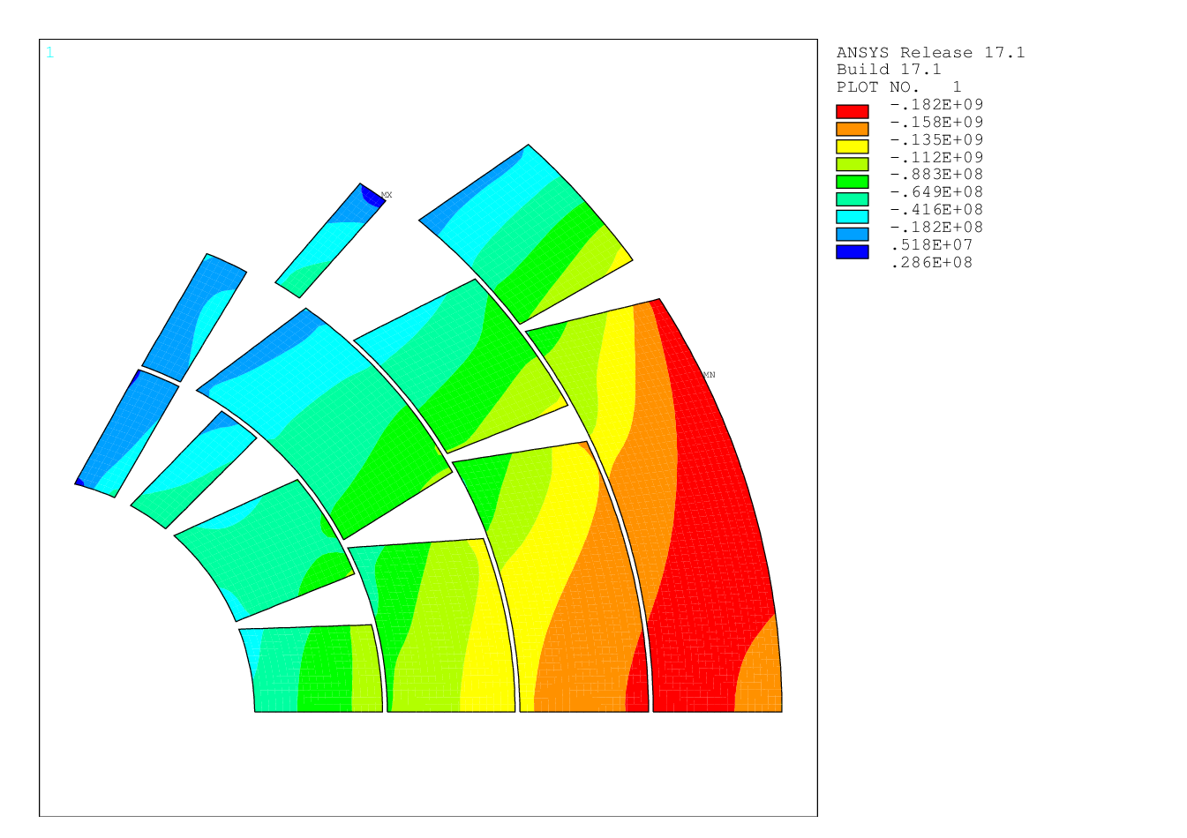
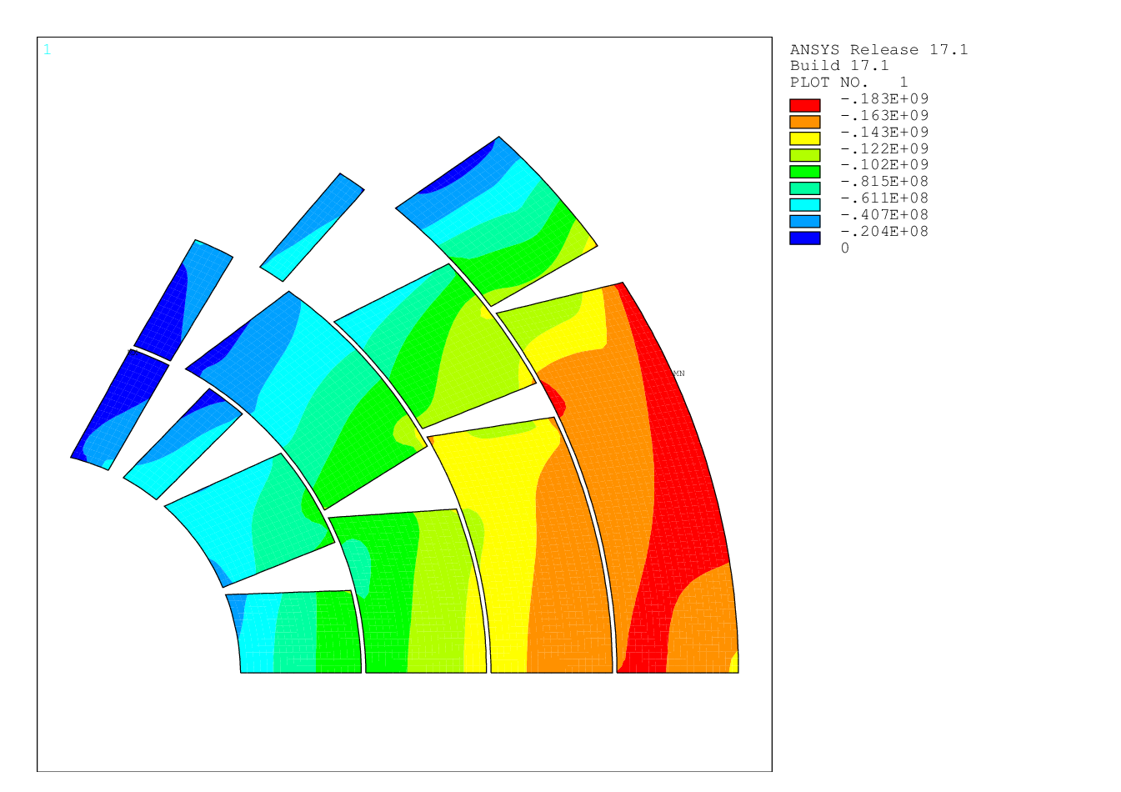
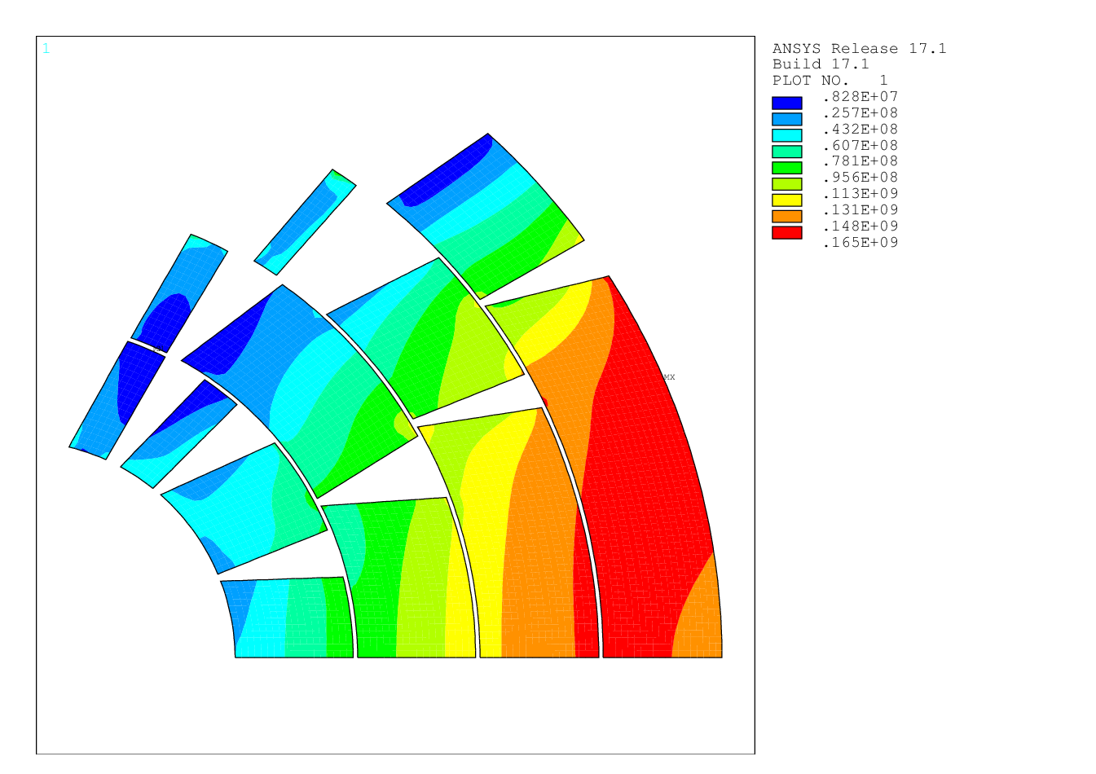
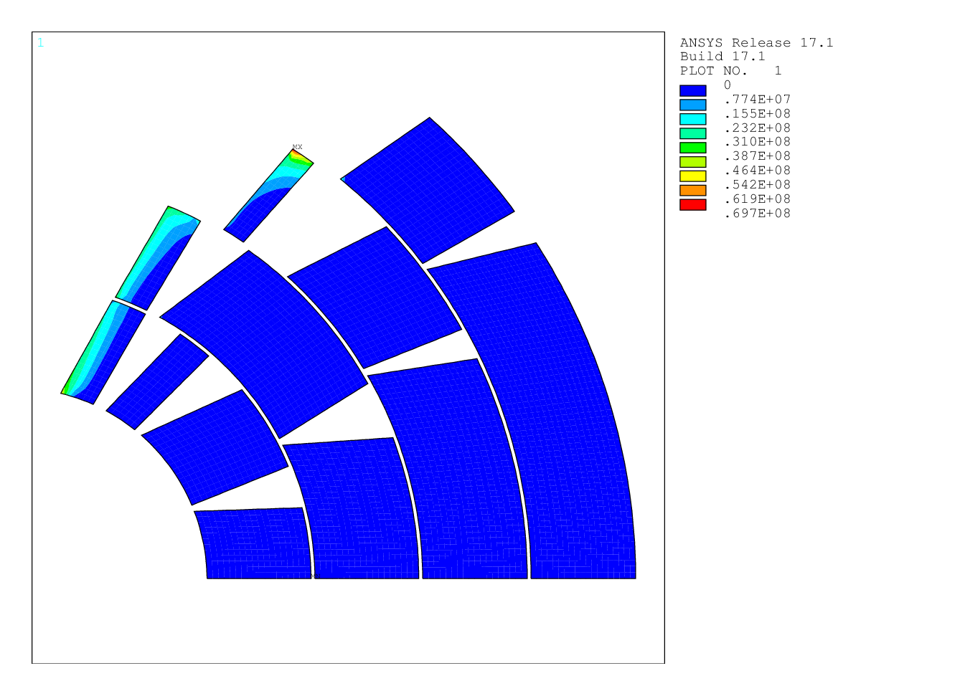
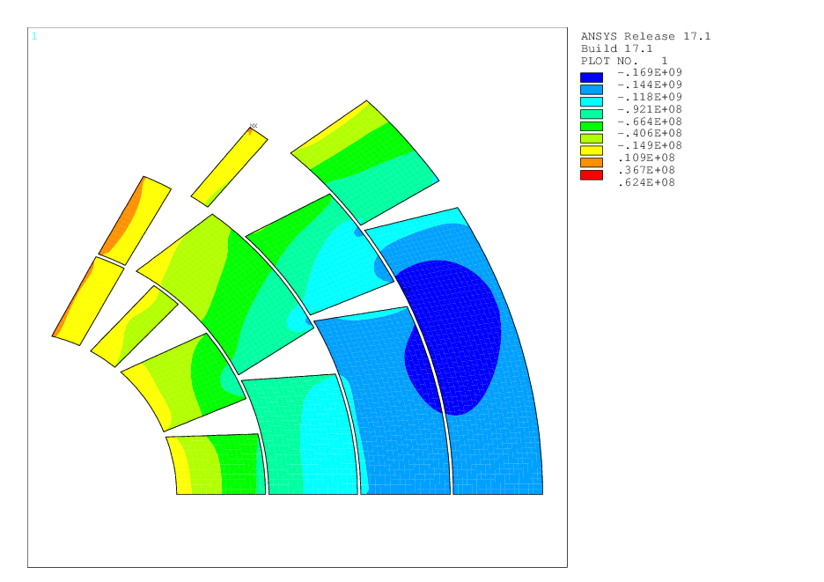
Principal Stresses
Principal stresses σ₁, σ₃ are shown together with σ_{r}, σ_{θ} σ_{VM} for comparison.
In cosθ design, the symmetry is almost azimuthal: σ3 ≈ σθ. σθ can be compared with σy of block coil configuration.
σ_{r} is negligible.
σ_{VM} is a sort of average between σ₁ and σ_{3.}
σθ
σ₃
σ_{VM}
σ_{r}
σ₁

Slide 5
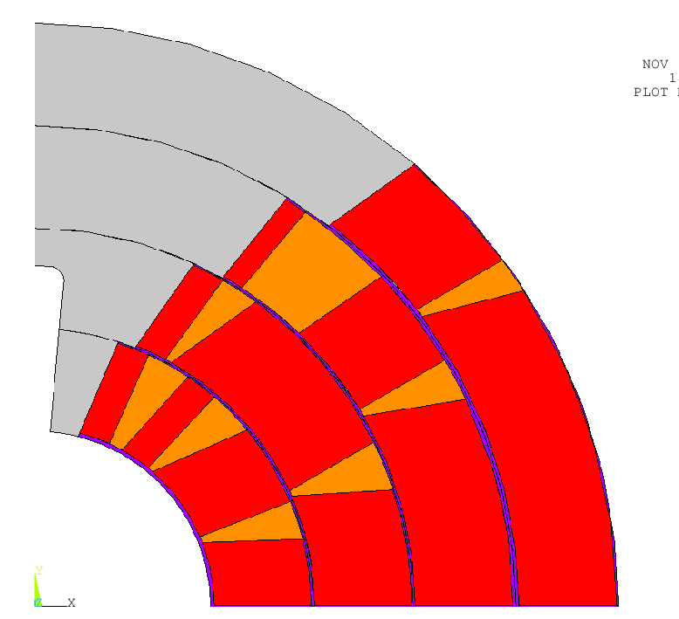
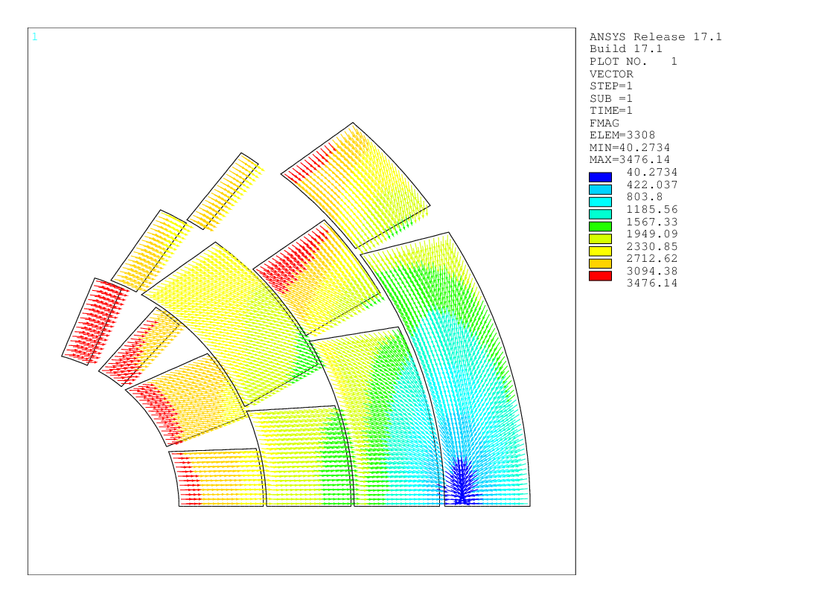
2D Mechanical Optimization
Cables undergo degradation if:
stress on conductors >150 MPa @room temperature;
stress on conductors > 200 MPa @cold;
stress on conductors > 150 MPa @cold after energization in the high field region → attention must be given in particular to first layers.
Tensile stress on the iron yoke at 4 K < 200 MPa.
Contact pressure Ti pole-conductors > 2 MPa after energization at 16T.
 | Nº turns | σ_{θ –layer} (MPa) | σ_{θ –winding} (MPa)
layer 1 | 13 | 86 | 121
layer 2 | 20 | 123
layer 3 | 29 | 126
layer 4 | 39 | 148
F[N]

Slide 6
Material Properties
 | E modulus [GPa] (T=4K) | E modulus [GPa] (T=300K) | α (K⁻¹) | ν_{xy}
Conductor | E_{x}=33 E_{y}=27.5 | E_{x}=30 E_{y}=25 | α_{x}=3.08E-3/296 α_{y}=3.36E-3/296 | 0.3
Steel | 210 | 191 | 2.8e-3/296 | 0.28
Iron | 224 | 204 | 2.0e-3/296 | 0.28
Aluminum | 79 | 72 | 4.2e-3/296 | 0.3
Copper | 110 | 100 | 3.4e-3/296 | 0.3
Resin | 27.5 | 25 | 2.5e-3/296 | 0.2
Titanium | 126.5 | 115 | 1.7e-3/296 | 0.3
+10%

Slide 7
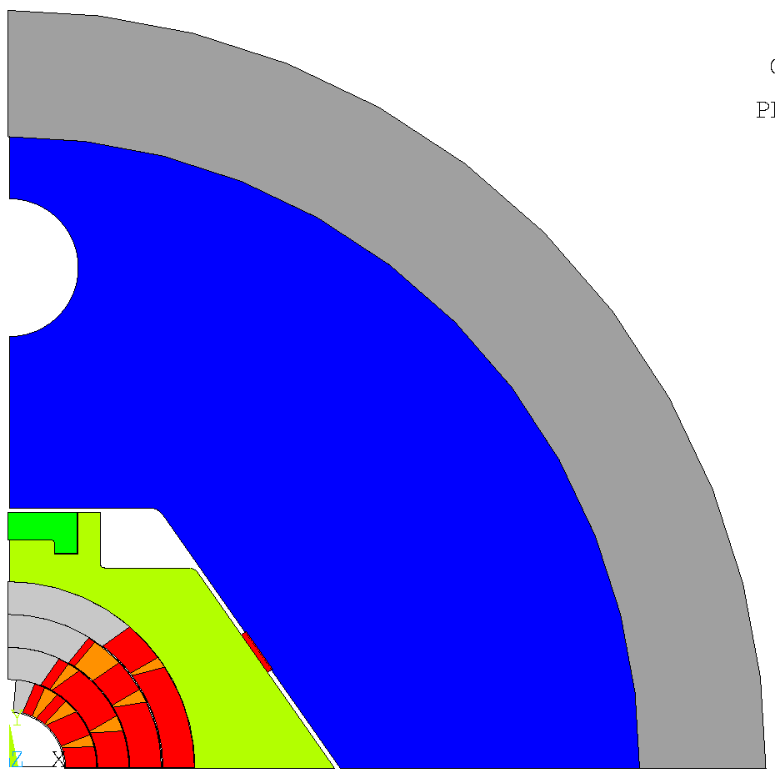
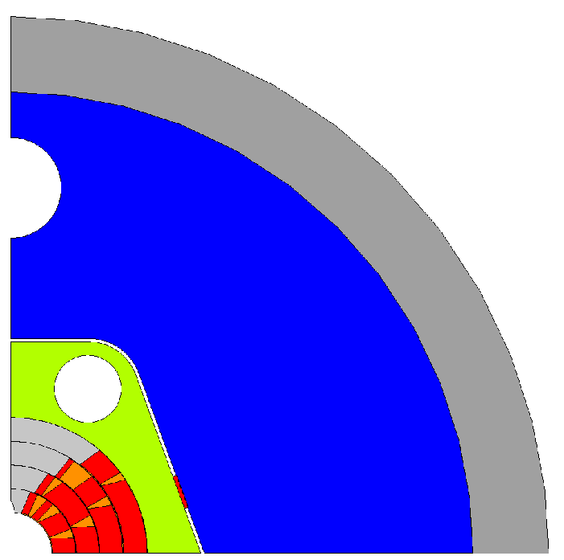
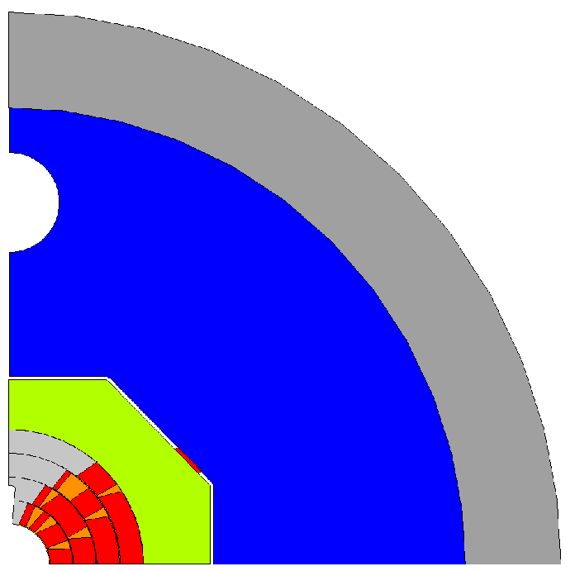
2D Mechanical Model
Configurations studied:
Vertical cut in iron yoke and steel pad
Bladder&key
C-clamp
Vertical cut in the steel pad
Horizontal cut in the iron yoke
Bladder&key
Horizontal cut in iron yoke and steel pad
Bladder&key
There is not a best mechanical solution, each E.M. design must be optimized with ad hoc configurations!

Slide 8
2D Mechanical Model
New E.M. design and new material properties (EM modulus for conductors, etc.) requires new mechanical solutions and optimizations.
Aluminum alloy shell;
Iron yoke cut at 45º;
Rectangular steel pad cut vertically;
Bladder&key, used to give pre-stress, 4 keys place horizontally and 4 keys placed vertically

Slide 9
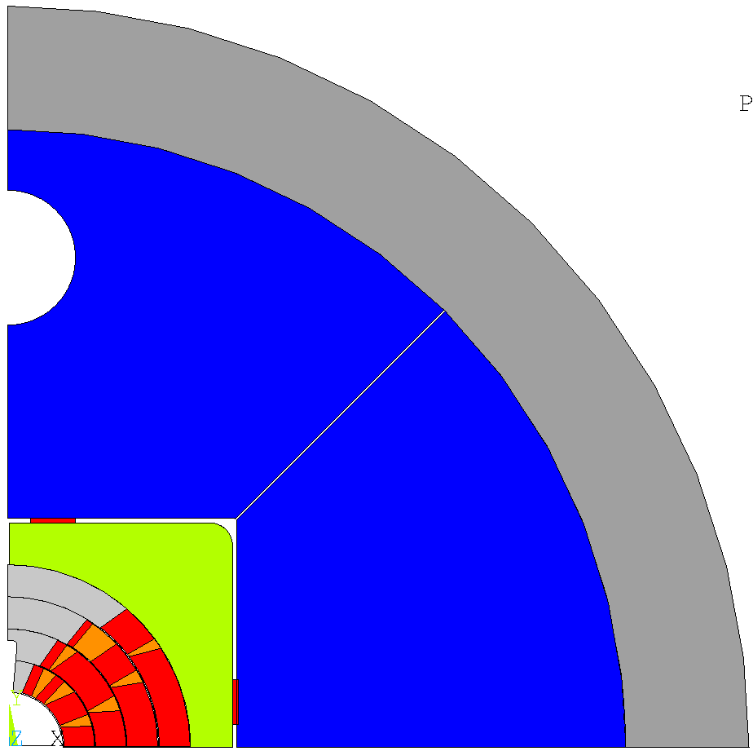
2D Ansys Model
Al alloy
ANSYS model
Bladder & key configuration
Keys length= 20 mm, x_{key1}=10 mm, y_{key1}=10 mm,
interference key1= 0.1 mm, interference key2= 0.5 mm.
Rectangular steel pad, cut vertically, 20-60 mm thick.
Circular iron yoke, cut at 45º, 133-175 mm thick.
Rectangular shaped steel pad and horizontal and vertical keys allow to decouple x and y component of pre-stress.
45º cut
55 mm
Iron
Vertical cut
Key1
Intf=0.1 mm
133 mm
20 mm
SS
60 mm
Key2
Intf=0.5 mm
175 mm
20 mm

Slide 10
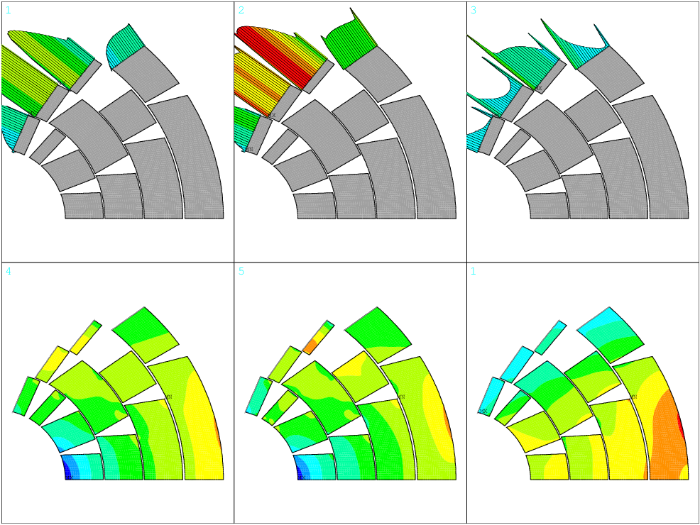
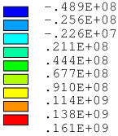
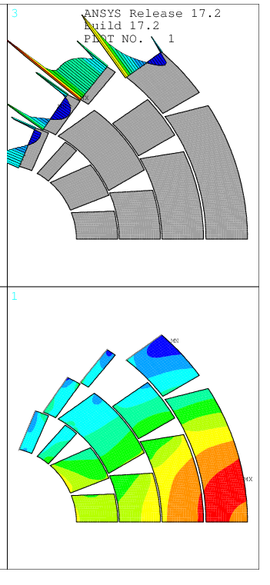
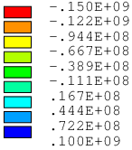
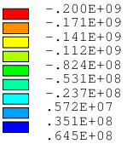
Contact Pressure and Azimuthal Stress
Assembly
Cool Down
Energization
Energization @ 105%I
Contact Pressure [Pa]
Contact Pressure [Pa]
Contact Pressure [Pa]
Contact Pressure [Pa]
Azimuthal Stress σ _{θ} [Pa]
Azimuthal Stress σ _{θ}[Pa]
Azimuthal Stress σ _{θ} [Pa]
Azimuthal Stress σ _{θ} [Pa]
σ_{θ peak}= -100 MPa
σ _{θ peak}=-176 MPa
σ _{θ peak}= -179 MPa
σ _{θ peak}= -177 MPa

Slide 11
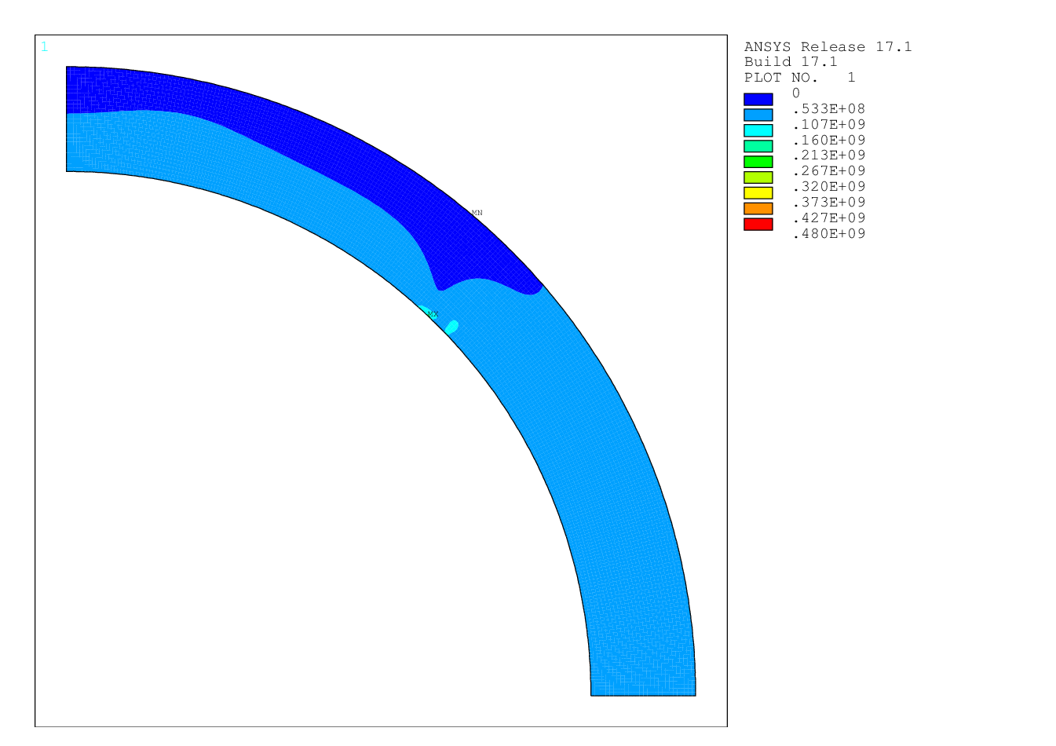
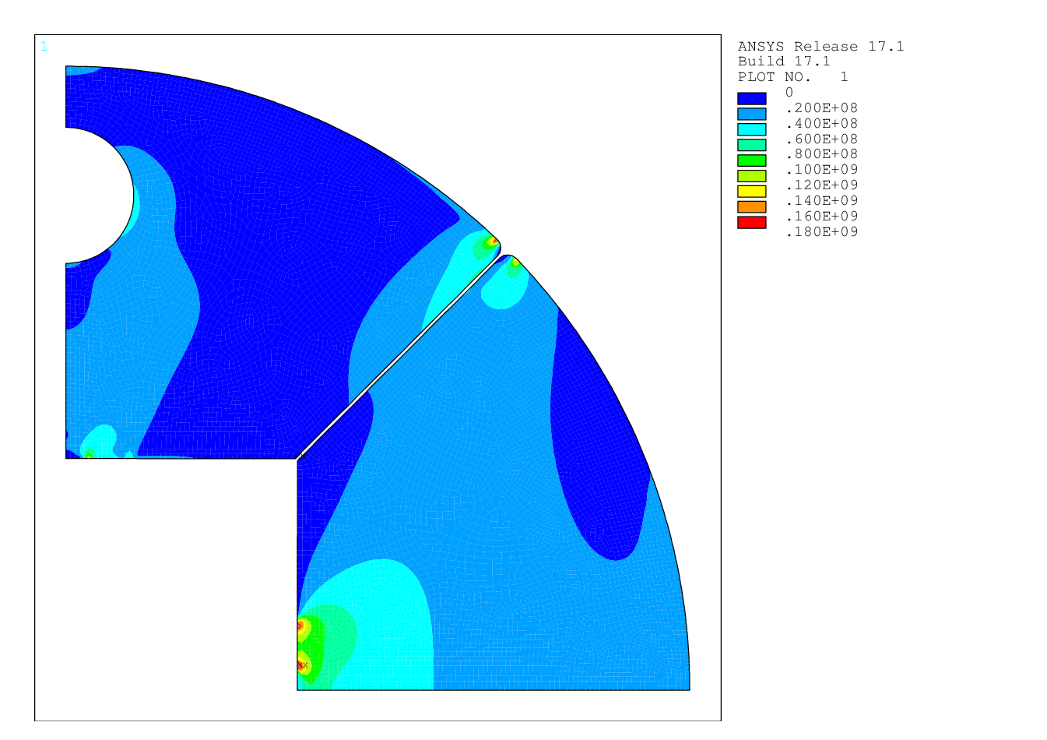
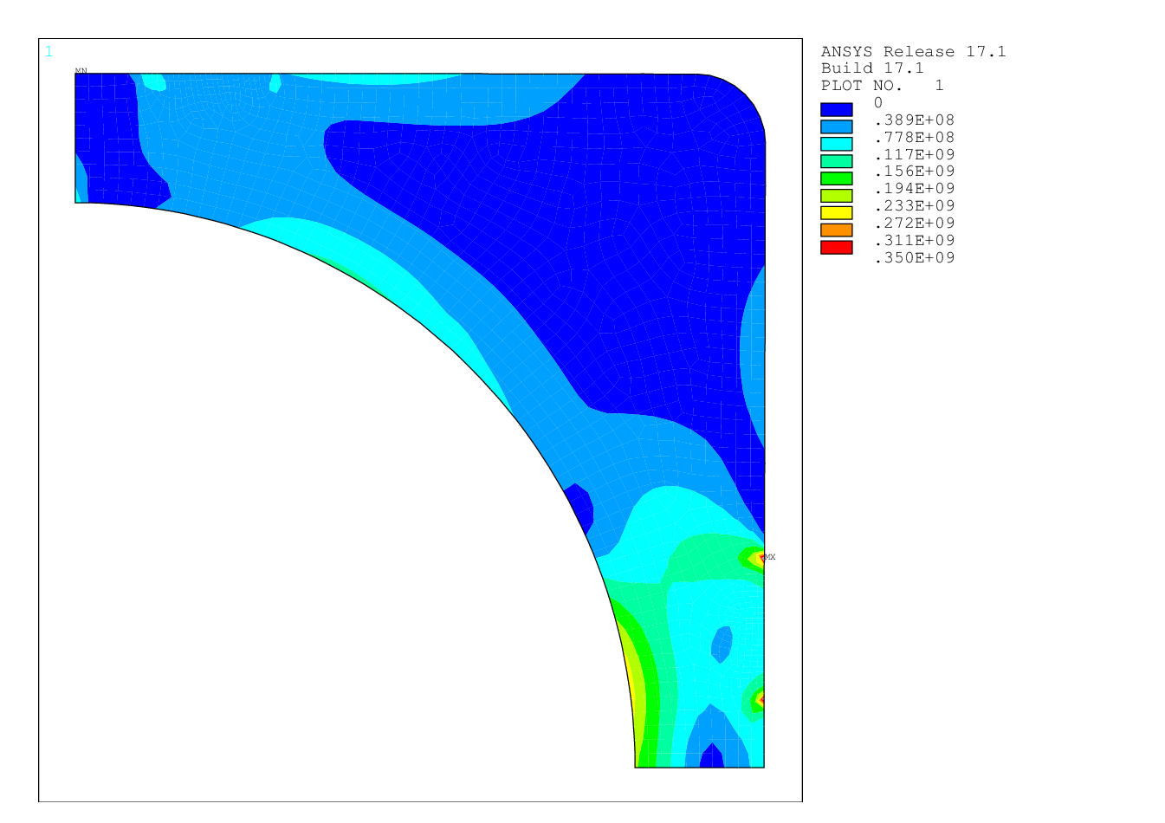
Von Mises Stress in Mechanical Structures
(color scale fixed at yield limit in Pa)
Assembly
Al alloy
Iron Yoke
YIELD
LIMIT
Steel Pad
YIELD LIMIT
YIELD LIMIT
σ_{VM} ^{peak}=225 MPa
σ_{VM} ^{peak}=272 MPa
σ_{VM} ^{peak}=410 MPa
σ_{VM} ^{av}= 24 MPa
σ_{VM} ^{av}= 54 MPa
σ_{VM} ^{av}=52 MPa

Slide 12
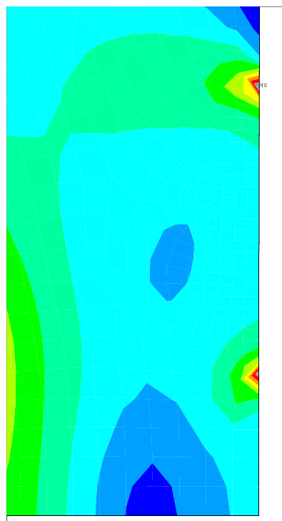
Von Mises Stress in Mechanical Structures
(color scale fixed at yield limit in Pa)
Assembly
Al alloy
Iron Yoke
YIELD
LIMIT
Steel Pad
YIELD LIMIT
YIELD LIMIT
σ_{VM} ^{peak}=225 MPa
σ_{VM} ^{peak}=272 MPa
σ_{VM} ^{peak}=410 MPa
σ_{VM} ^{av}= 24 MPa
σ_{VM} ^{av}= 54 MPa
σ_{VM} ^{av}=52 MPa

Slide 13
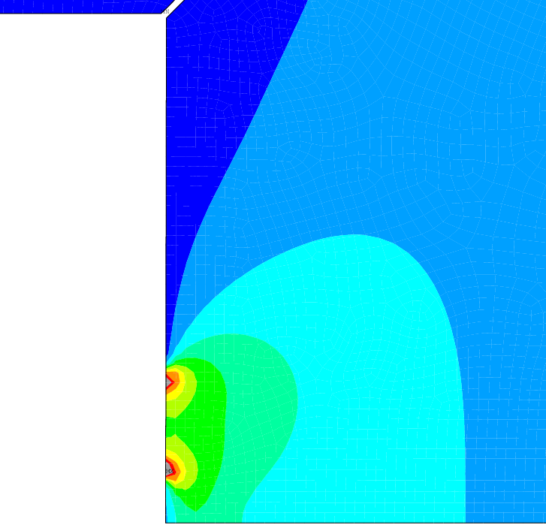
Von Mises Stress in Mechanical Structures
(color scale fixed at yield limit in Pa)
Assembly
Al alloy
Iron Yoke
YIELD
LIMIT
Steel Pad
YIELD LIMIT
YIELD LIMIT
σ_{VM} ^{peak}=225 MPa
σ_{VM} ^{peak}=272 MPa
σ_{VM} ^{av}= 24 MPa
σ_{VM} ^{peak}=272 MPa
σ_{VM} ^{peak}=410 MPa
σ_{VM} ^{av}= 54 MPa
σ_{VM} ^{av}=52 MPa

Slide 14
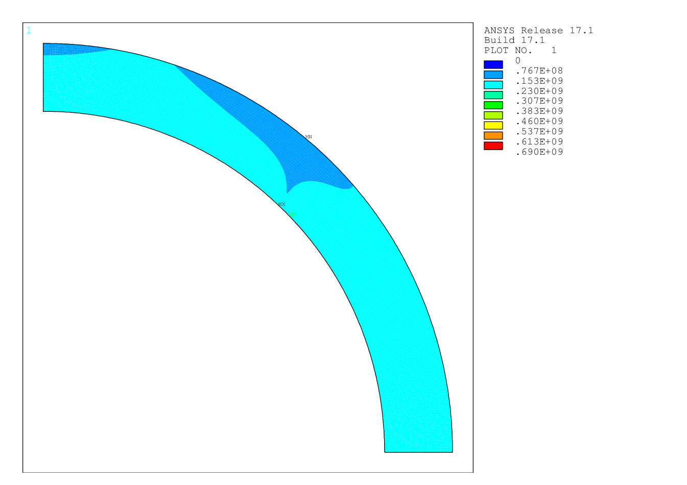
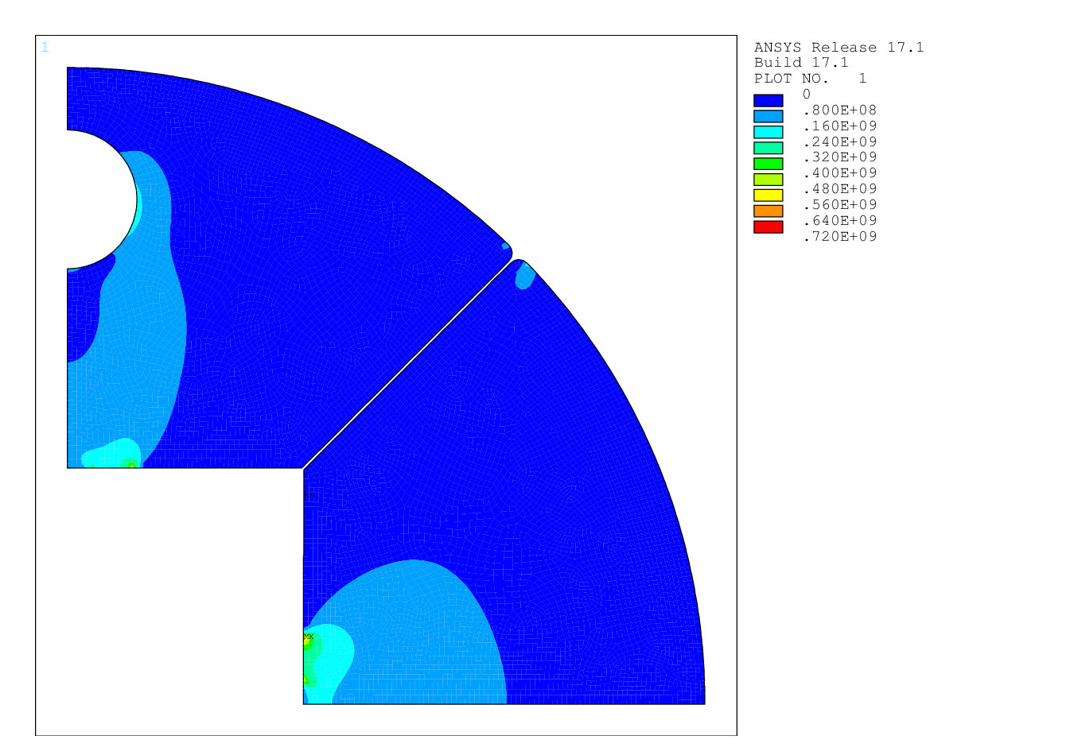
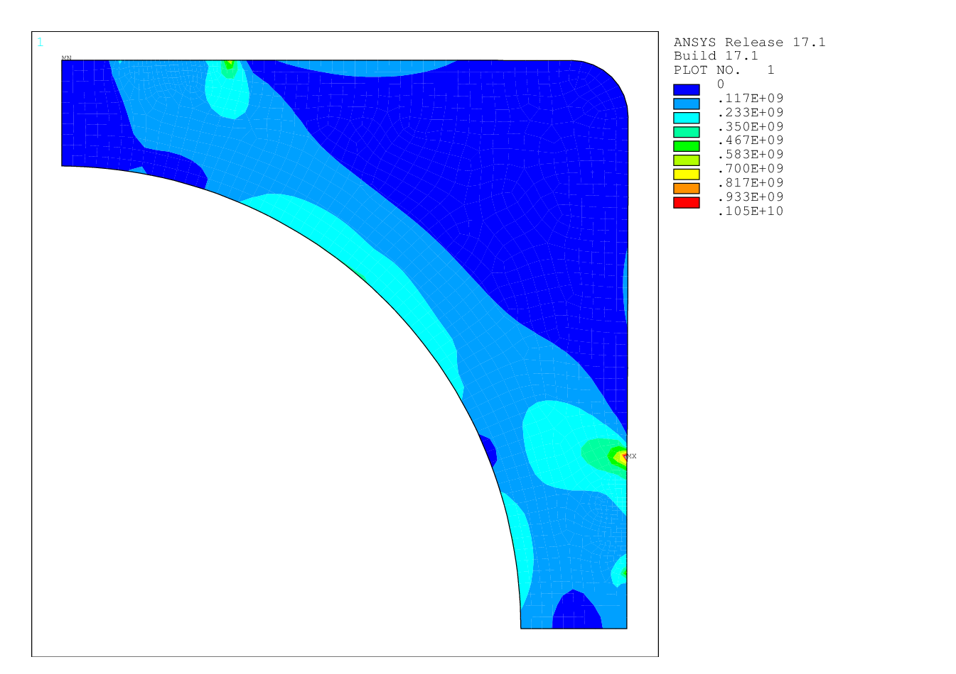
Von Mises Stress in Mechanical Structures
(color scale fixed at yield limit in Pa)
Cool Down
Al alloy
Iron Yoke
YIELD
LIMIT
Steel Pad
YIELD LIMIT
YIELD LIMIT
σ_{VM} ^{peak}=640 MPa
σ_{VM} ^{peak}=277 MPa
σ_{VM} ^{peak}=1200 MPa
σ_{VM} ^{av}=56 MPa
σ_{VM} ^{av}=170 MPa
σ_{VM} ^{av}=131 MPa

Slide 15
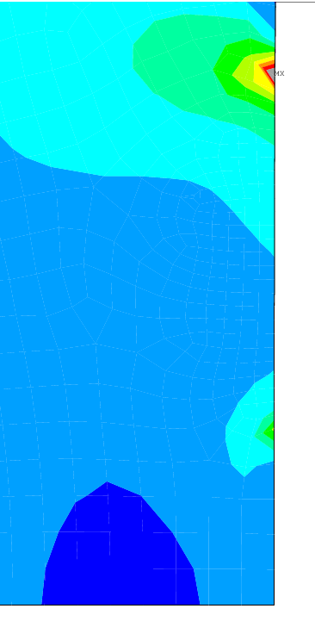
Von Mises Stress in Mechanical Structures
(color scale fixed at yield limit in Pa)
Cool Down
Al alloy
Iron Yoke
YIELD
LIMIT
Steel Pad
YIELD LIMIT
YIELD LIMIT
σ_{VM} ^{peak}=640 MPa
σ_{VM} ^{peak}=277 MPa
σ_{VM} ^{peak}=1200 MPa
σ_{VM} ^{av}=56 MPa
σ_{VM} ^{av}=170 MPa
σ_{VM} ^{av}=131 MPa

Slide 16
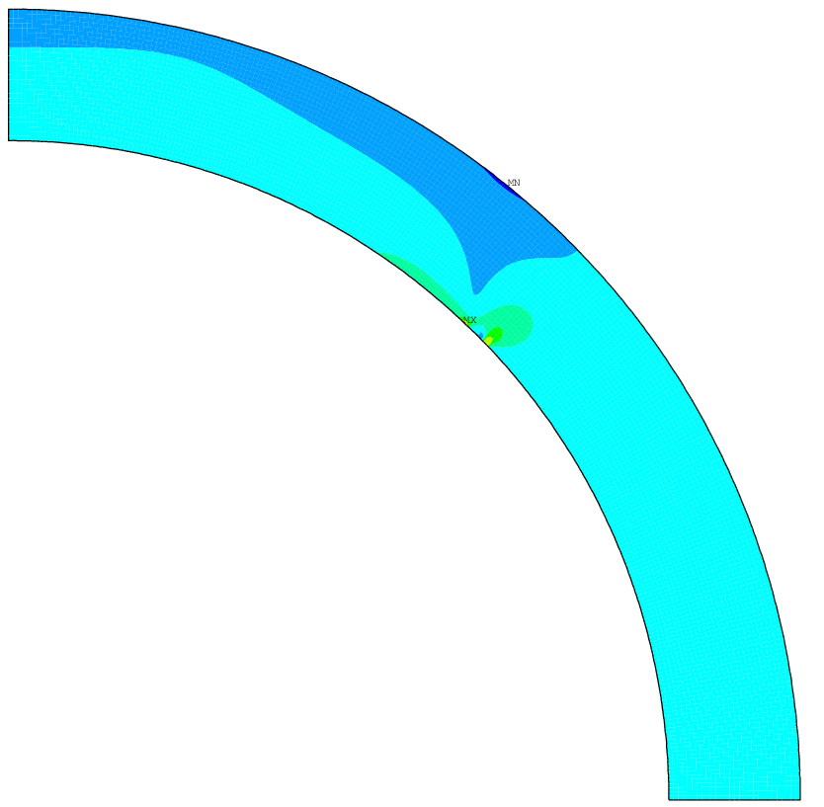
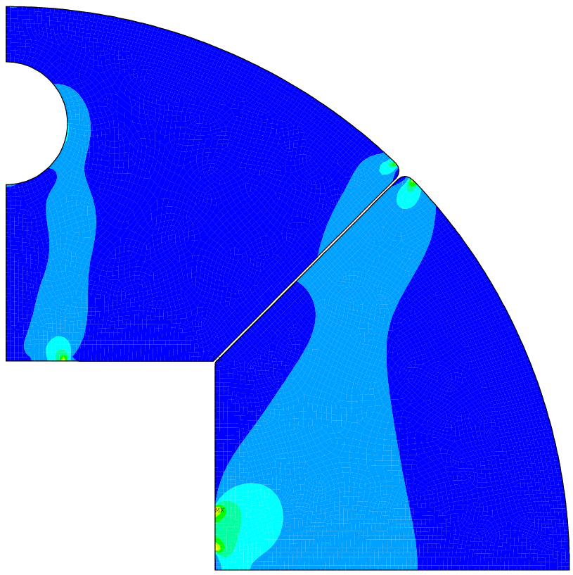
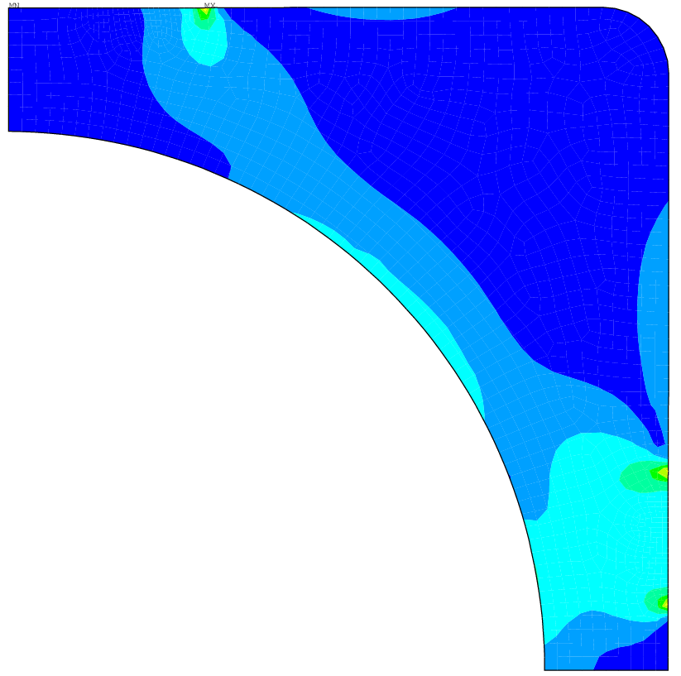
Von Mises Stress in Mechanical Structures
(color scale fixed at yield limit in Pa)
Energization
Al alloy
YIELD
LIMIT
Steel Pad
YIELD LIMIT
YIELD LIMIT
σ_{VM} ^{peak}=589 MPa
σ_{VM} ^{peak}=521 MPa
σ_{VM} ^{peak}=819 MPa
σ_{VM} ^{av}=70 MPa
σ_{VM} ^{av}=175 MPa
σ_{VM} ^{av}=122 MPa

Slide 17
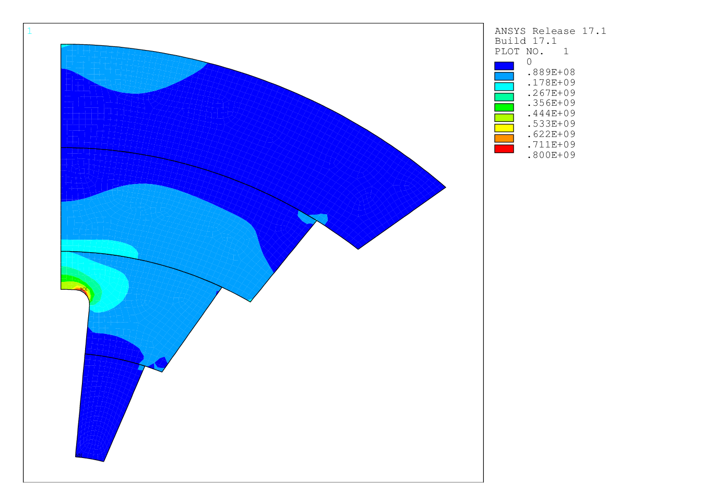
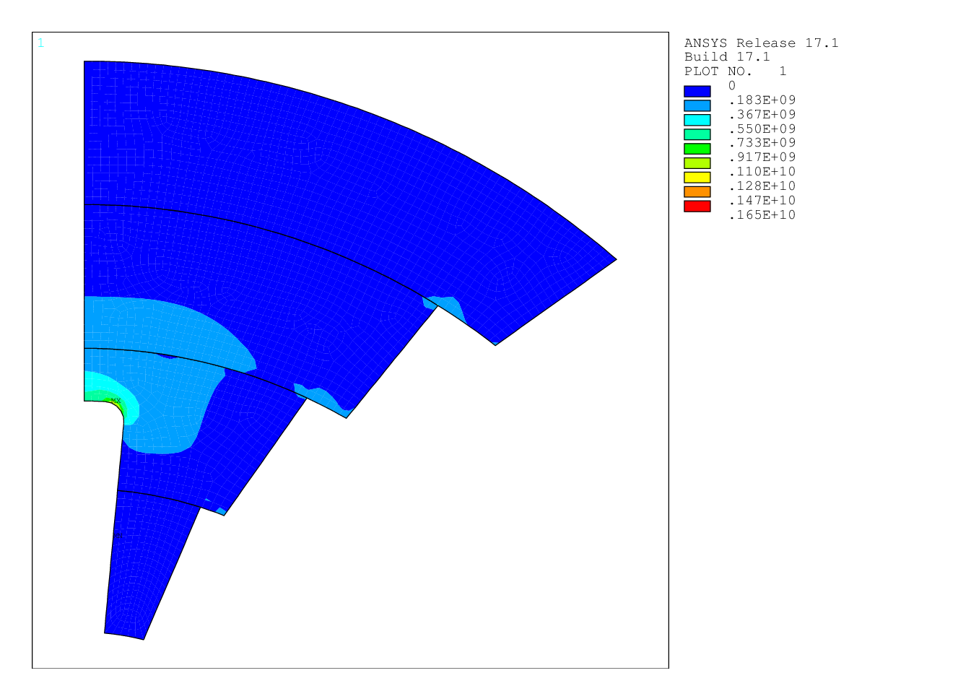
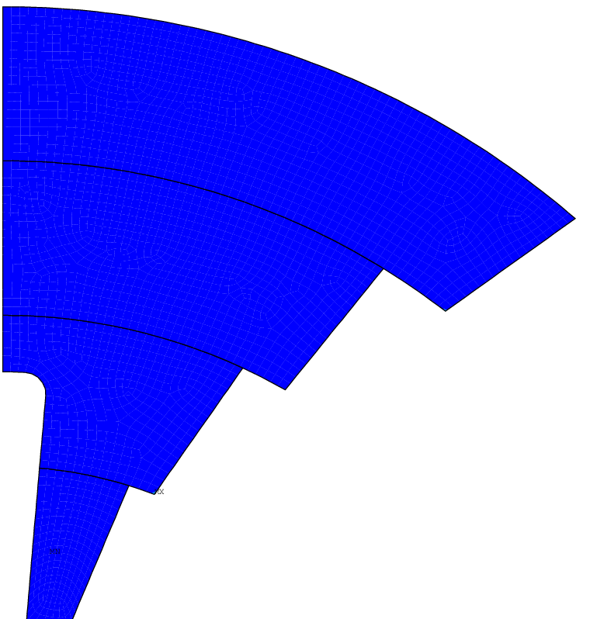
Von Mises Stress in Titanium Poles
(color scale fixed at yield limit in Pa)
Assembly
Cool Down
Energization
YIELD LIMIT
YIELD
LIMIT
YIELD
LIMIT
σ_{VM} ^{peak}=850 MPa
σ_{VM} ^{peak}=1120 MPa
σ_{VM} ^{peak}=255 MPa
σ_{VM} ^{av}=84 MPa
σ_{VM} ^{av}= 124 MPa
σ_{VM} ^{av}=50 MPa

Slide 18
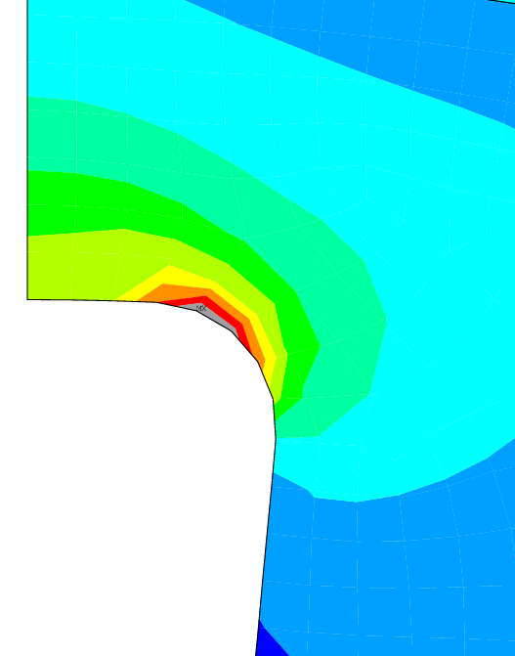
Von Mises Stress in Titanium Poles
(color scale fixed at yield limit in Pa)
Assembly
Cool Down
Energization
YIELD LIMIT
YIELD
LIMIT
YIELD
LIMIT
σ_{VM} ^{peak}=850 MPa
σ_{VM} ^{peak}=1120 MPa
σ_{VM} ^{peak}=255 MPa
σ_{VM} ^{av}=84 MPa
σ_{VM} ^{av}= 124 MPa
σ_{VM} ^{av}=50 MPa

Slide 19
Conclusions
The mechanics of the 16T cosθ dipole has been investigated, giving particular importance to the fulfillment of the following requirements: stress on conductors ( <150 MPa @room temperature, < 200 MPa @cold, <150 MPa after energization in the high field zone), contact pressure Ti pole-conductors > 2 MPa after energization.
Taking into account that:
- recommended material properties list was finalized during last EuroCircol
collaboration meeting;
- a new E.M. for cos-theta model was considered after US-EuroCirCol meeting;
a completely new mechanical model was developed, in order to fulfil these new conditions.
The new configuration has:
- rectangular steel collar, cut vertically;
- circular your yoke, cut at 45°;
- 4 key placed horizontally and 4 key placed vertically, in order to give x and y pre-stress
separately
ANSYS calculations show that the new configuration:
- fulfills stress limits on the conductor;
- has good contact pressure at the pole for all the layers;
- almost fulfills stress limit on stress on structure materials .

Slide 21
Back-up slides

Slide 22
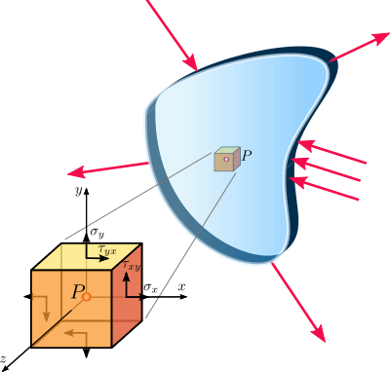
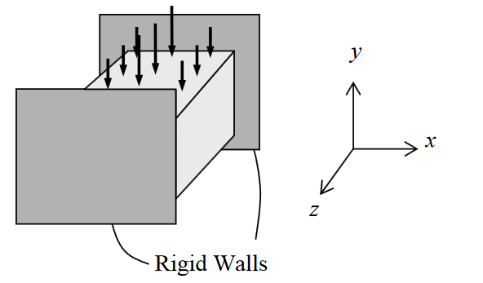
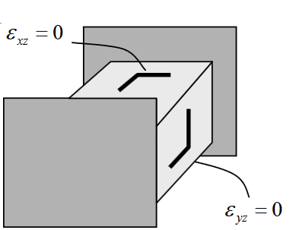
Plain Strain vs Plain Stress
Plane strain
Plane stress
Plane stress is a stress state that varies only in the X and Y directions. The stress in the Z direction is always zero, as are the XZ and YZ shear stresses.
Plane stress is generally used on flat, thin structures, where the deformation is assumed to be solely in the plane of the structure.
Plane strain is a stress state that varies only in the X and Y directions. The strain in the Z direction is always zero, as are the XZ and YZ shear strains, since the boundaries are fixed.
Plain stress approximation is less conservative but more compatible with 3D simulation results.

