Slide 1


Discussion
D. Schoerling
8th of November 2016, Annual EuroCirCol meeting

Slide 2
Discussion
Comparison of different design options in terms of performance to be able to take a decision on the reference option or options for the CDR
Distribution of the work for the reference option(s)
Structural FEA analysis, possible options and optimization criteria
Material properties of materials used in the magnet (focus on wedges)
Required loadline margin in the ends
Yield strength in the iron/steel
Cost model considerations

Slide 3
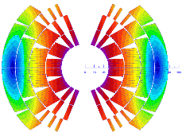
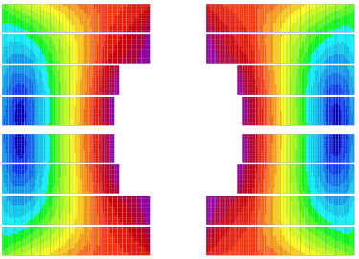
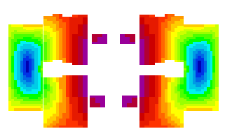
Magnet design for 16 T (EuroCirCol – 18%)
Design |  | Cos-θ | Block | Common-C
Operating current | (kA) | 10.275 | 8.47 | 9.0
Field in the aperture | (T) | 16.0 | 16.0 | 16.0
Margin at 4.2 K | % | 10.0 | 9.3 | 10.0
Intrabeam spacing | (mm) | 250 | 250 | 280
Stored magnetic energy per unit length/ap | (MJ/m) | 1.5 | 1.7 | 2.4
Inductance/aperture | (mH/m) | 25 | 44 | 58
LI/aperture | (H.A/m) | 257 | 374 | 522
Diameter IL | (mm) | 1.1 | 1.1 | 1.1
Strands/cable IL | - | 28 | 24 | 24
Cu/Non-Cu IL | - | 1.0 | 1.0 | 1.0
Diameter OL | (mm) | 0.7 | 0.7 | 1.05-1.1
Strands/cable OL | - | 38 | 37 | 14-12
Cu/Non-Cu OL | - | 2.0 | 1.0 | 1.8-2.2
Total area of Cu/aperture | (mm²) | 5004 | 4751 | 5400
Total area of Non-Cu/aperture | (mm²) | 3403 | 4751 | 3470
Total mass of Non-Cu for FCC-hh | (t) | 3876 | 5412 | 3954
Total mass of conductor for FCC-hh | (t) | 9576 | 10824 | 10104
J_{eng} IL | (A/mm²) | 386 | 371 | 394
J_{eng} OL | (A/mm²) | 703 | 595 | 789
J_{overal} IL | (A/mm²) | 270 | 260 | 265
J_{overal} OL | (A/mm²) | 459 | 386 | 480
Hot spot temperature | (K) | 328 | 308 | 350
Voltage to ground | (V) | 1400 | 1200 | TBA
Voltage turn-to-turn | (V) | 103 | 82 | TBA
V layer-to-layer | (V) | 1800 | 1100 | TBA
Cos-θ
Block
Common-Coil

Slide 4
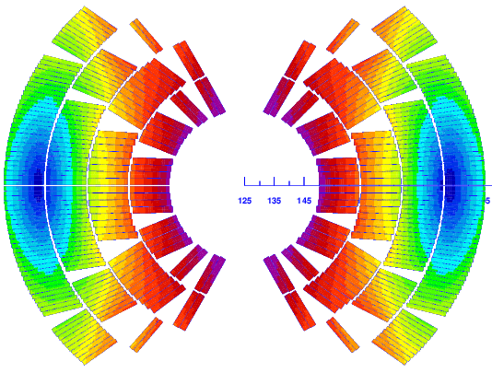
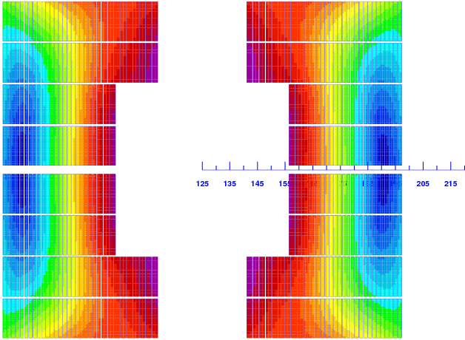
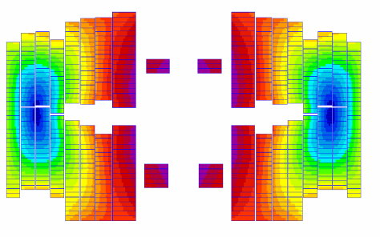
Magnet design for 16 T (EuroCirCol – 14%)
Design |  | Cos-θ | Block | Common-C
Operating current | (kA) | 11.18 | 10.93 | 9.17
Field in the aperture | (T) | 16.0 | 16.0 | 16.0
Margin at 1.9 K | % | 14.0 | 14.0 | 14.0
Intrabeam spacing | (mm) | 250 | 250 | 320
Stored magnetic energy per unit length/ap | (MJ/m) | 1.3 | 1.5 | 2.1
Inductance/aperture | (mH/m) | 19.9 | 24 | 49
LI/aperture | (H.A/m) | 222 | 262 | 452
Diameter IL | (mm) | 1.1 | 1.1 | 1.2
Strands/cable IL | - | 22 | 24 | 18
Cu/Non-Cu IL | - | 0.85 | 0.8 | 1
Diameter OL | (mm) | 0.712 | 0.7 | 1.2-1.15
Strands/cable OL | - | 36 | 39 | 10
Cu/Non-Cu OL | - | 2.15 | 1.6 | 2.2-3.5
Total area of Cu/aperture | (mm²) | 3920 | 4300 | 4971
Total area of Non-Cu/aperture | (mm²) | 2730 | 3295 | 2572
Total mass of Non-Cu for FCC-hh | (t) | 3110 | 3750 | 2930
Total mass of conductor for FCC-hh | (t) | 7590 | 8650 | 8590
J_{eng} IL | (A/mm²) | 540 | 480 | 450
J_{eng} OL | (A/mm²) | 780 | 730 | 760
J_{overal} IL | (A/mm²) | 360 | 330 | 320
J_{overal} OL | (A/mm²) | 510 | 480 | 490
Hot spot temperature | (K) | 344 | 350 | 384
Voltage to ground | (V) | 770 | 1200 | 3200
Voltage turn-to-turn | (V) | 86 | 105 | 100
V layer-to-layer | (V) | 910 | - | 4300
Cos-θ
Block
Common-Coil
Auxiliary coils not shown

Slide 5
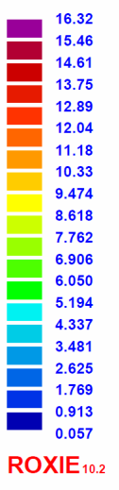
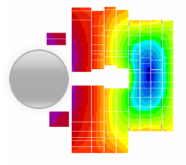
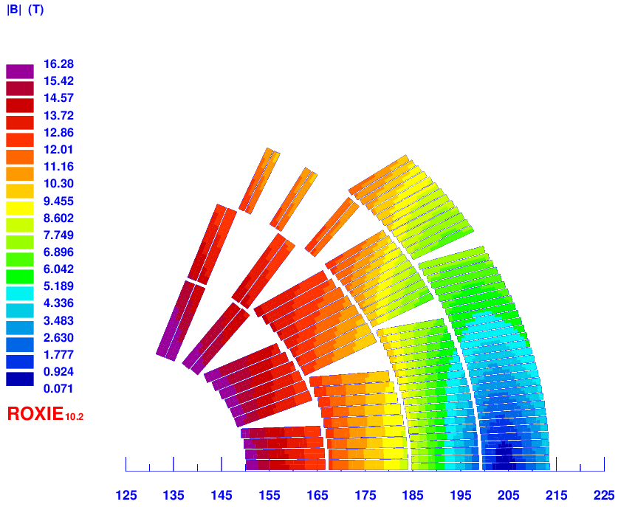
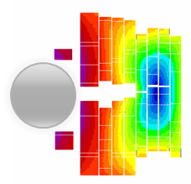
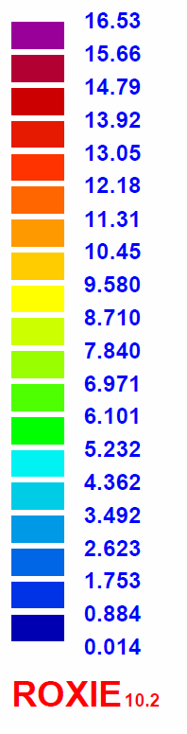
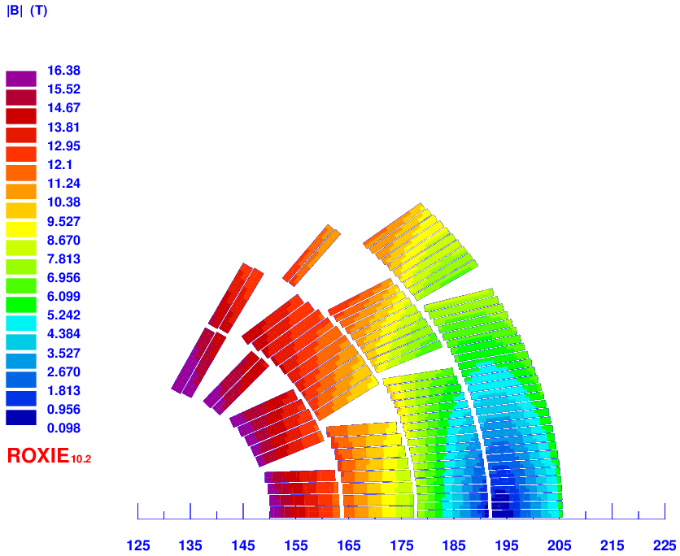
EuroCirCol-Design options
A specific feature of this program is that different design options are being considered with the same specification and analysis tools so that they can be compared relatively to each other.
scale / 2
2LPo1D-02
M.Sorbi; G.Bellomo; P.Fabbricatore;
S.Farinon; V.Marinozzi; G.Volpini
2LPo1D-03
C.Lorin; M.Durante; M.Segreti
2LPo1D-08
F.Toral; J.Munilla; T.Martinez;
L. Garcia-Tabares
The reference parameter space has been finalized considering recommendations from the 1st WP5 EuroCirCol Review (11-13 May 2016, http://indico.cern.ch/event/516049)

Slide 6
Distribution of the work

Slide 7
Structural FEA analysis, possible options and optimization criteria
(1/12)
Von Mises, Third Principal Stress, Azimuthal stress -> Barbara/Stefania
Plane stress vs strain -> Barbara/Stefania
Stress pattern within the cos-theta coil -> Barbara/Stefania

Slide 8
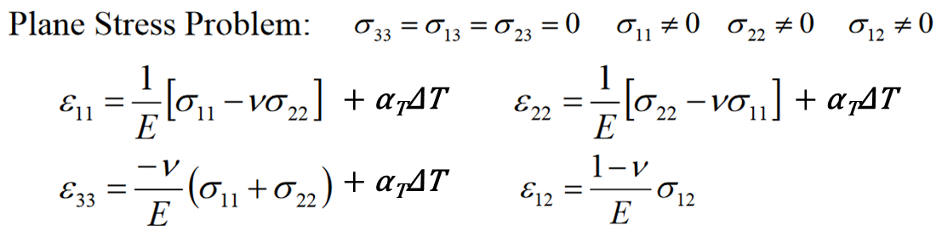
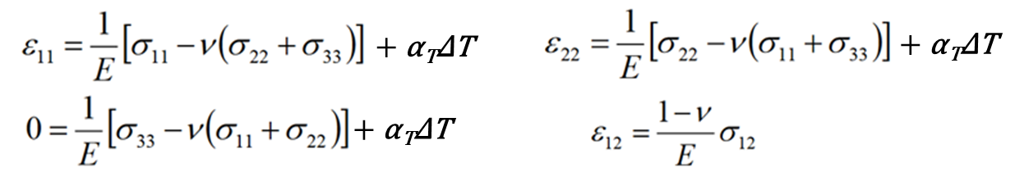

Plane stress vs plane strain (2/12)
Plane stress:
All stress components that are associated with magnet longitudinal dimension are zero (shear and normal stress)
Plane strain:
All strain components that are associated with magnet longitudinal dimension are zero (shear and normal strain)
Jaakko Murtomäki

Slide 9
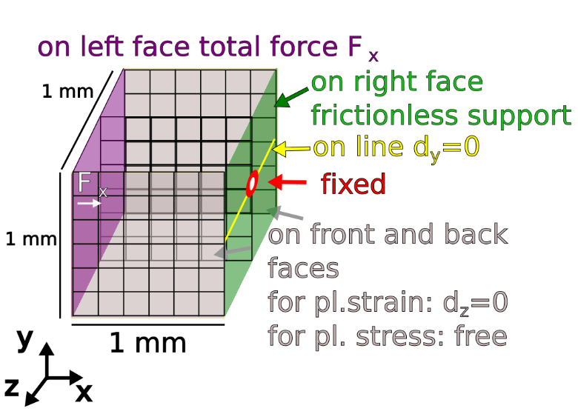
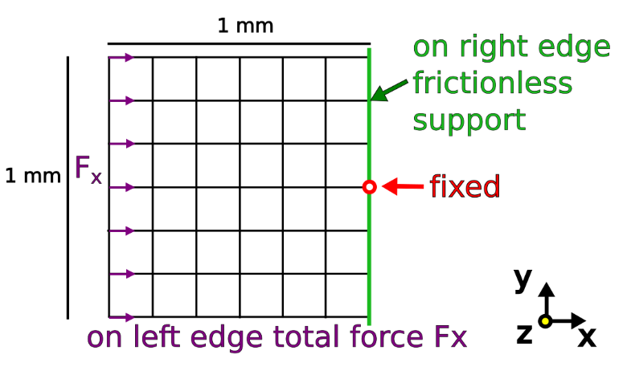
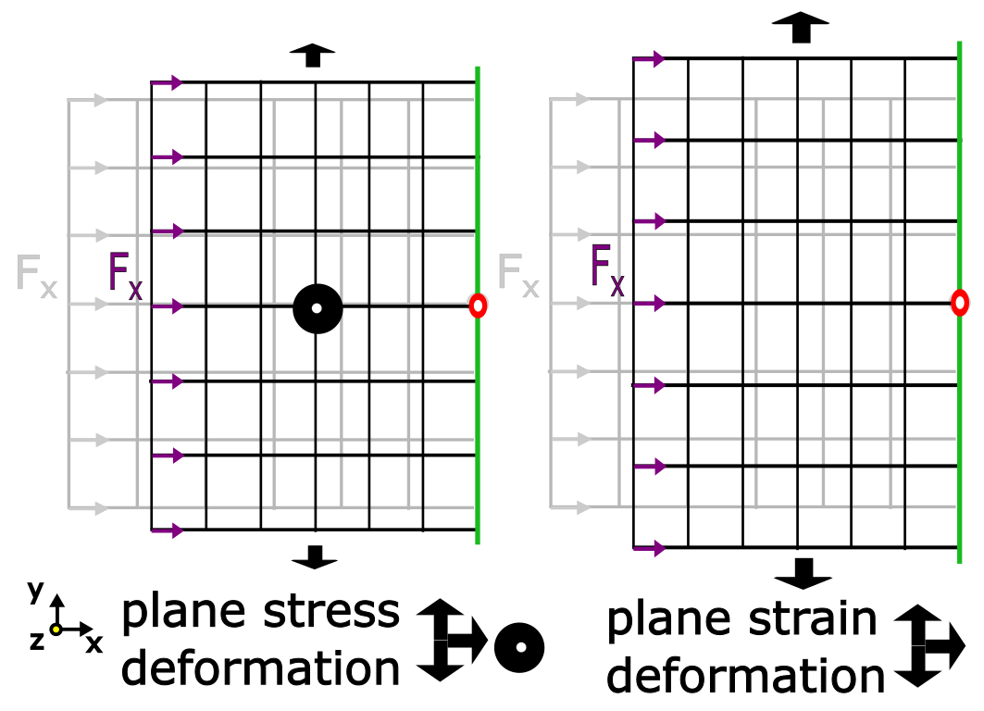
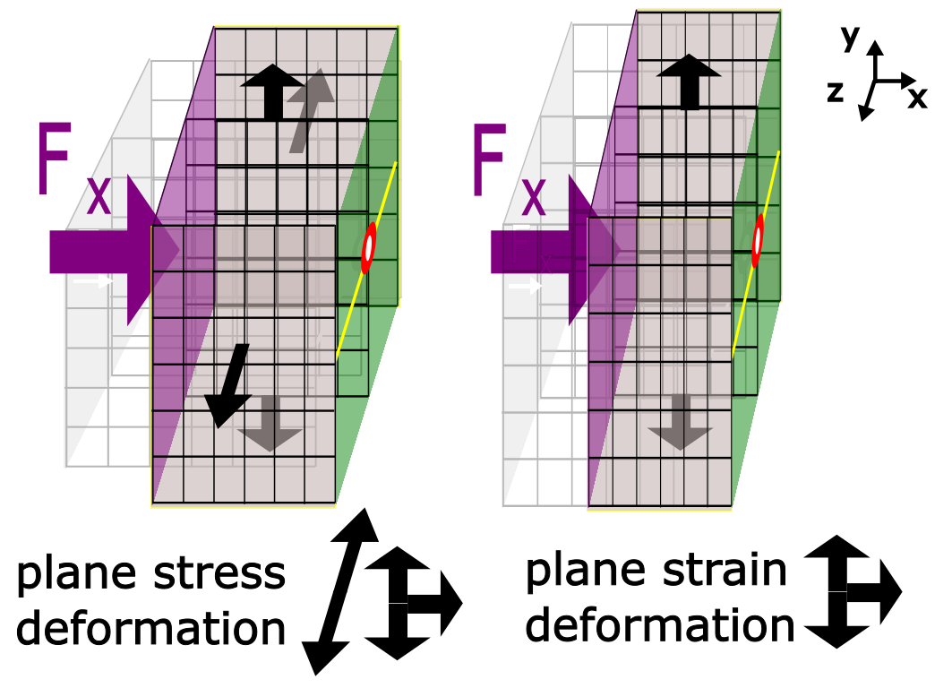
2D and 3D model (3/12)
2D model boundary conditions, F_{x} = 68 N
3D model boundary conditions, F_{x} = 68 N
E = 200 GPa, ν = 0.3
Jaakko Murtomäki

Slide 10

Plane strain vs stress (4/12)
Plane stress allows z-displacement and plane strain does not
Plane-strain assumption e_33:
Plane stress: F_{z} = ν F_{x} (friction less boundary)
Von Mieses:
$$σ_{v}=\sqrt{\left[{\left(σ_{1}−σ_{2}\right)}^{2}+{\left(σ_{2}−σ_{3}\right)}^{2}+{\left(σ_{3}−σ_{1}\right)}^{2}\right]}$$
Plane stress:
$σ_{v}=\sqrt{σ_{1}^{2}+σ_{2}^{2}−σ_{1}σ_{2}}$
Plain strain:
$$ε_{3}=\frac{1}{E}\left[σ_{3}−ν{(σ}_{1}+σ_{2})\right]=0$$
$$σ_{3}=ν(σ_{1}+σ_{2})$$
$$σ_{v}=\sqrt{\left(σ_{1}^{2}+σ_{2}^{2}\right)\left(ν^{2}−ν+1\right)+σ_{1}σ_{2}(2ν^{2}−2ν−1)}$$
Jaakko Murtomäki & Felix Wolf

Slide 11
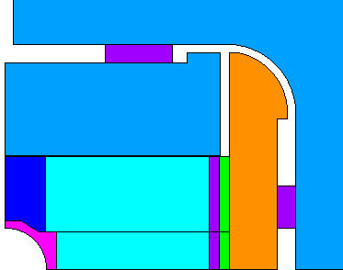
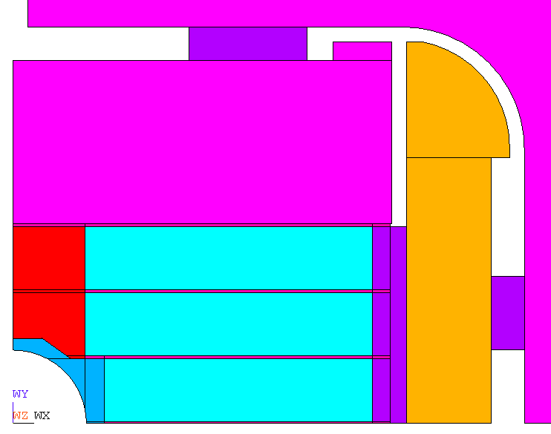
RMM: Geometry (5/12)
2D
3D
1
3
Contacts:
Pole – pole: sliding (contacts 1 and 3 only)
Middle coil – external coil: sliding
Inside coil (pole, layer, inter-layer): bonded
Coil properties:
44 GPa isotropic cold and warm
3.36/3.08 mm/m orthotropic
Slide of E. Rochpault

Slide 12
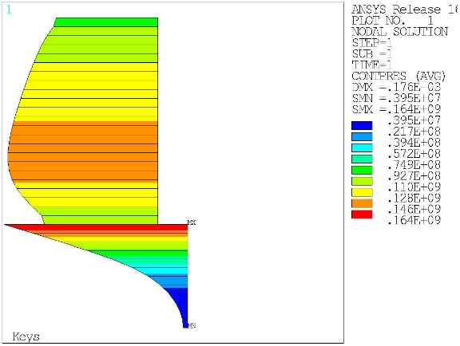
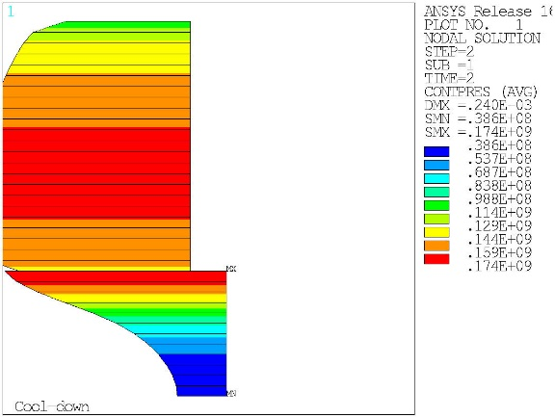
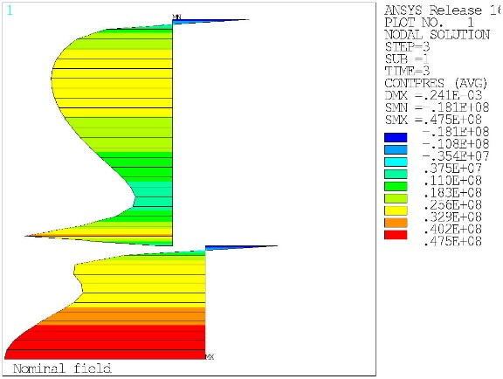
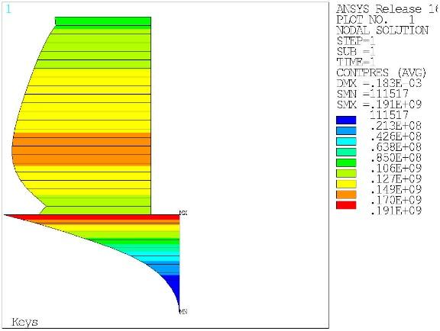
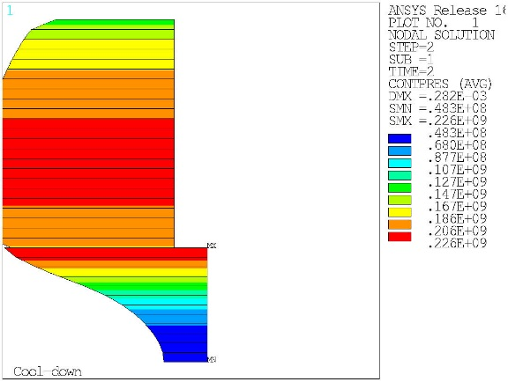
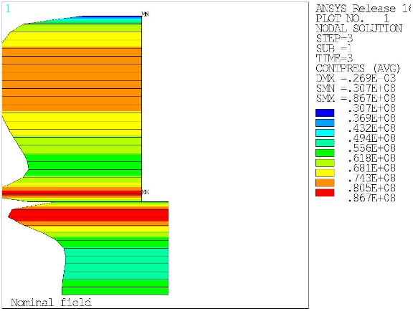
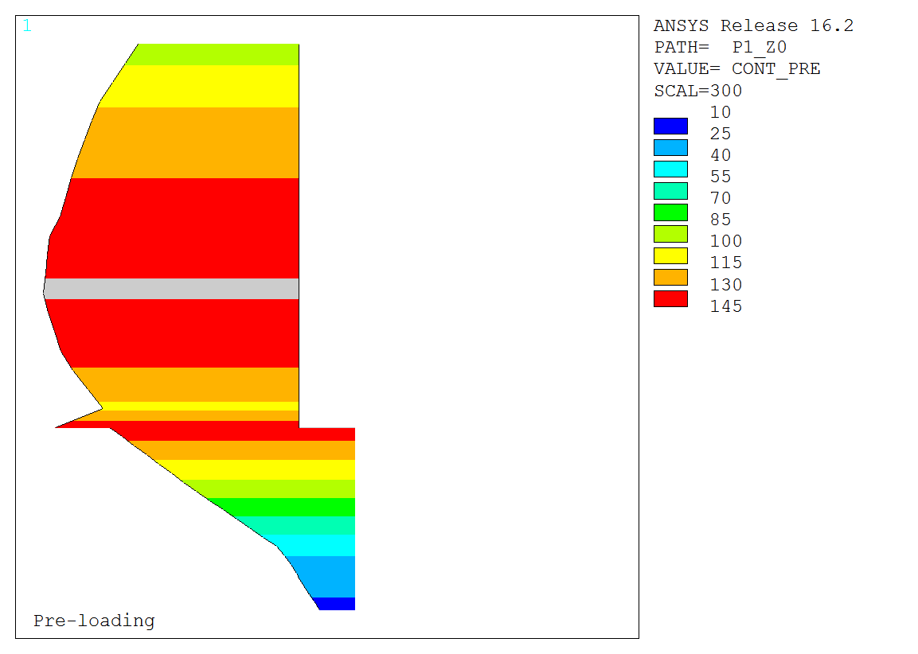
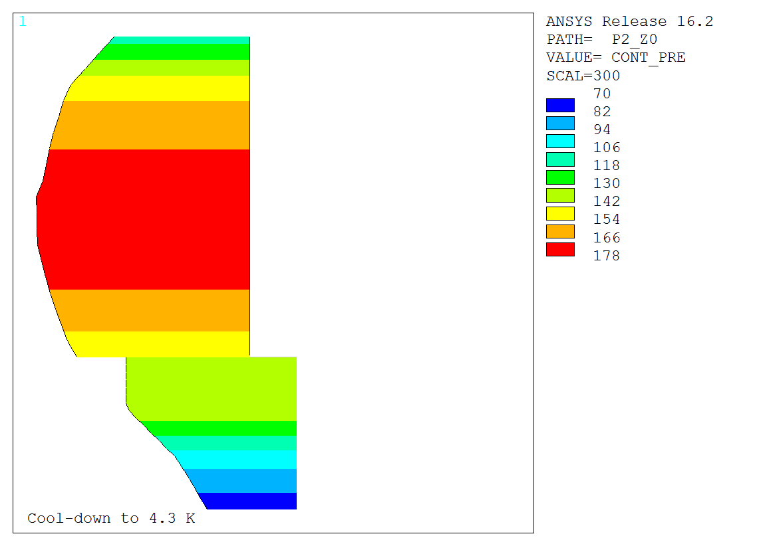
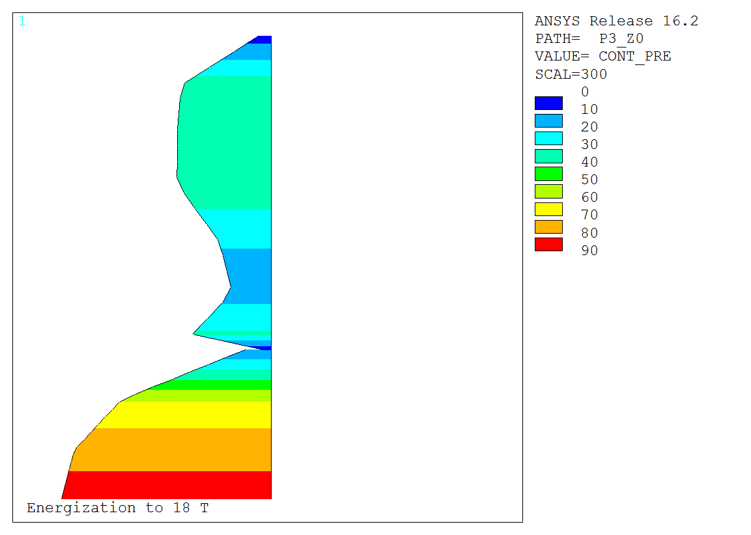
RMM: Contacts (6/12)
-18.1
2D
Pl Stress
v18
174
164
3.95
38.6
47.5
30.7
2D
Pl Strain
v18
226
191
86.7
0.1
48.3
5.1
3D
v5d
146
177
20.1
74.0
82.9
Slide of E. Rochpault

Slide 13
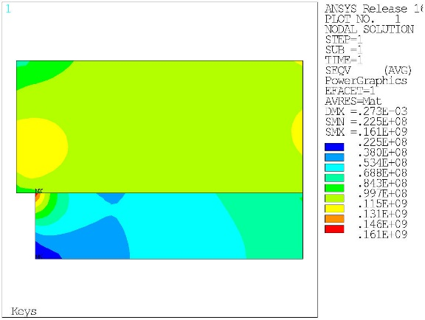
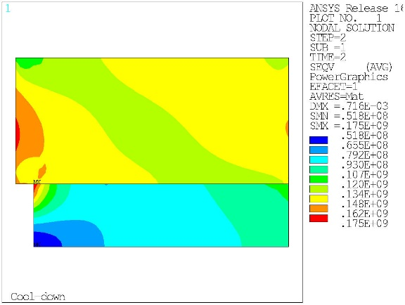
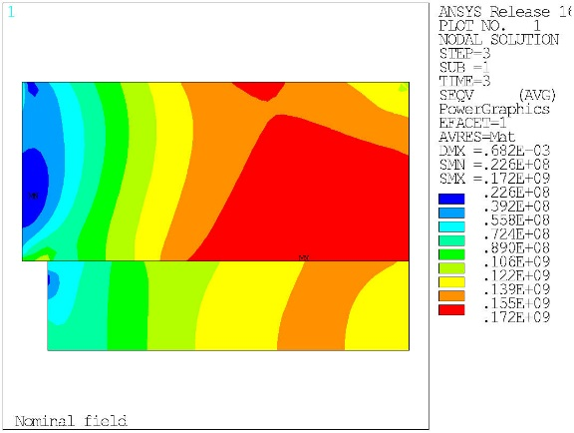
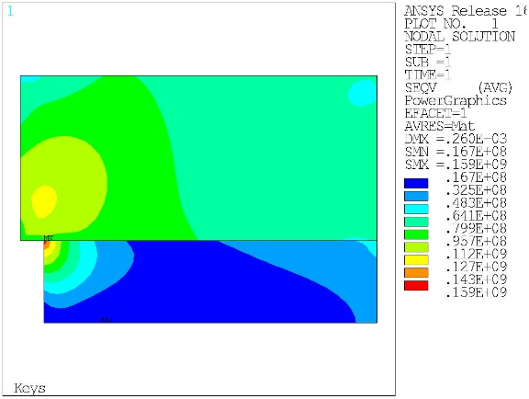
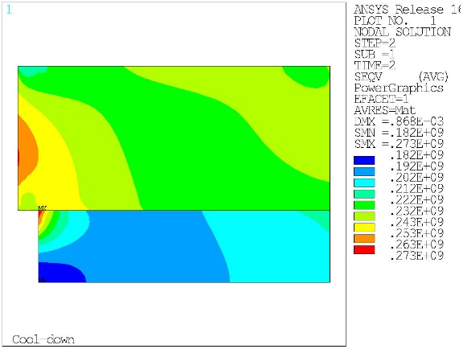
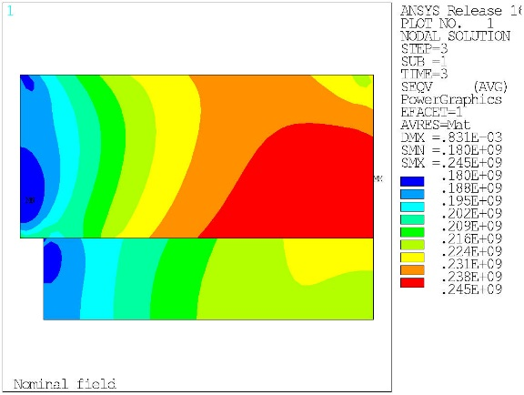
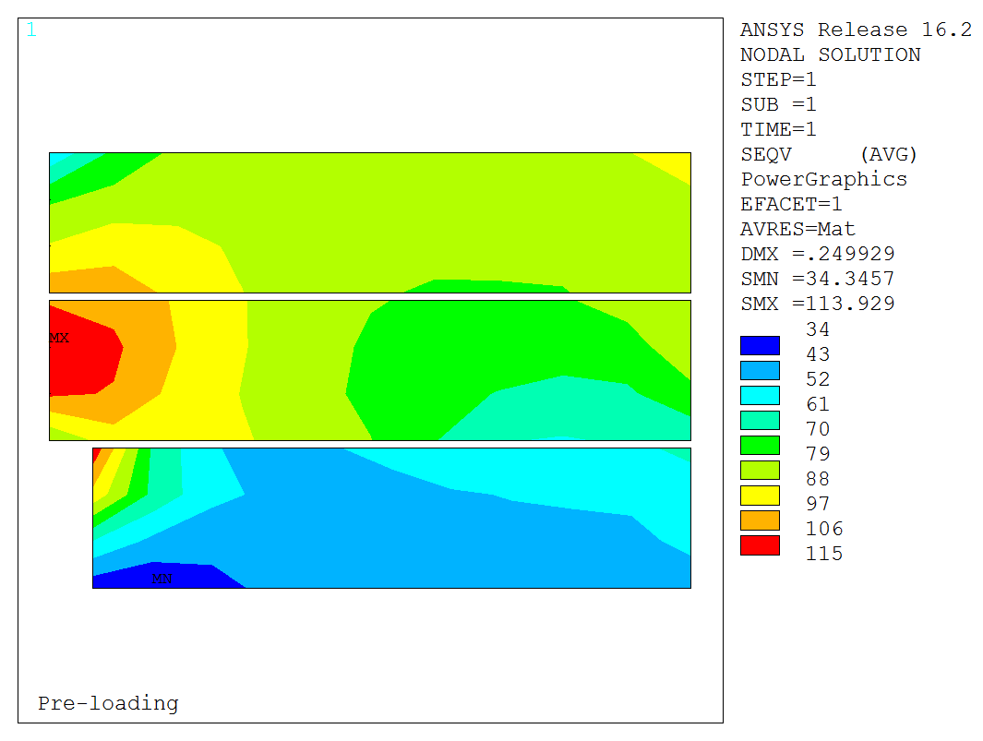
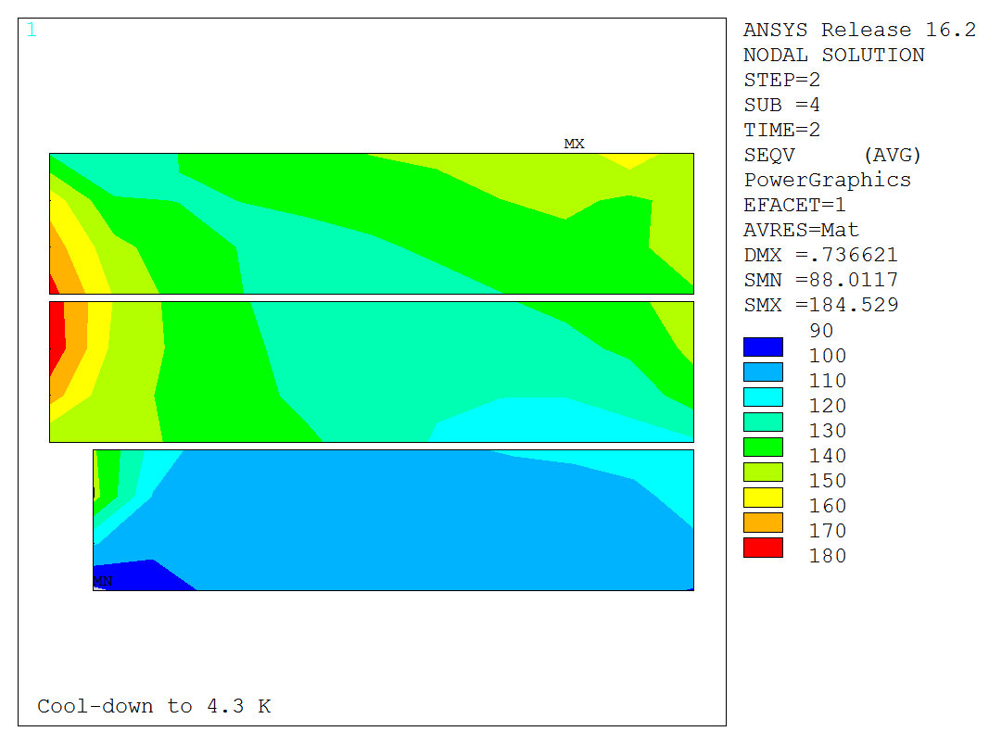
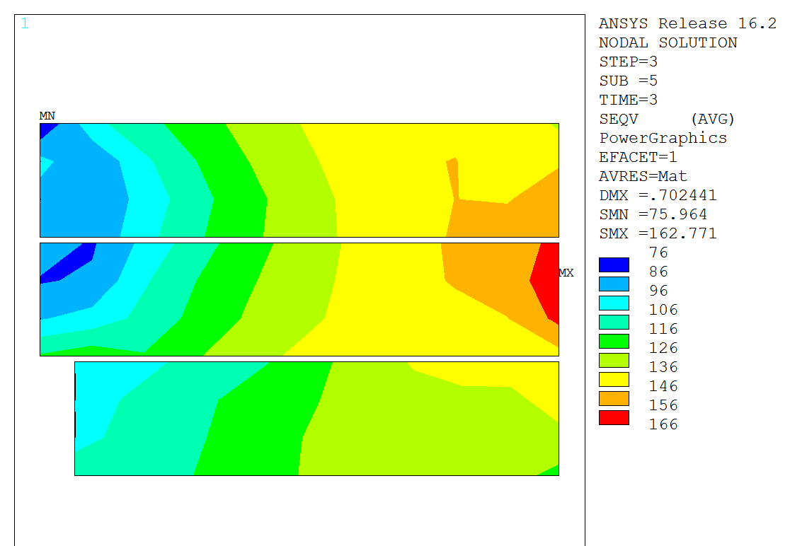
RMM: Coil Seqv (7/12)
2D
Pl Stress
v18
130
175
22.6
161
172
22.5
51.8
2D
Pl Strain
v18
245
125
265
180
159
273
16.7
182
3D
v5d
114
185
76.0
163
34.3
88.0
Slide of E. Rochpault

Slide 14
RMM: Summary (8/12)
 | Contact [MPa] |  |  | Seqv [MPa]
 | Loading | 4.2 K | 18 T | Loading | 4.2 K | 18 T
3D | 20.1..146 | 74.0..177 | 5.1..82.9 | 34.3..114 | 88.0..185 | 76.0..163
2D P. stress | 4.0..164 | 38.6..174 | -18.1¹..47.5 | 22.5..130² | 51.8..175 | 22.6..172
2D P. strain | 0.1..191 | 48.3..226 | 30.7..86.7 | 16.7..125² | 182..265² | 180..245
+/-10%
+/-20%
No match in value or location
¹Sharp peak effect
²discarding corner effects
Slide of E. Rochpault

Slide 15
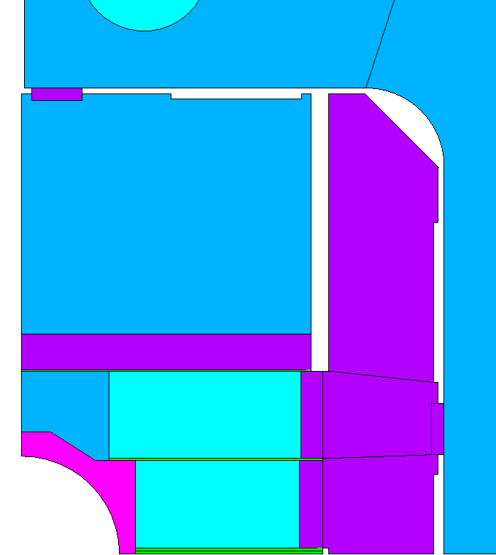
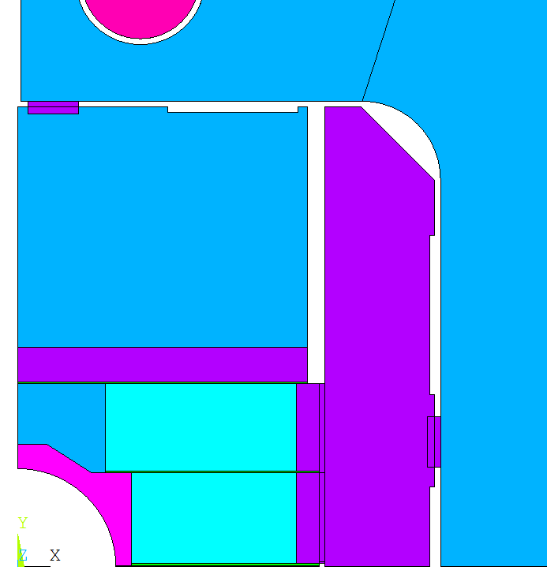
Fresca2: Geometry (9/12)
2D
3D
Contacts:
Pole – pole: sliding
Middle coil – external coil: sliding
Inside coil (pole, layer, inter-layer): bonded
Coil properties:
44/52 GPa orthotropic cold and warm
3.36/3.08 mm/m orthotropic
Slide of E. Rochpault

Slide 16
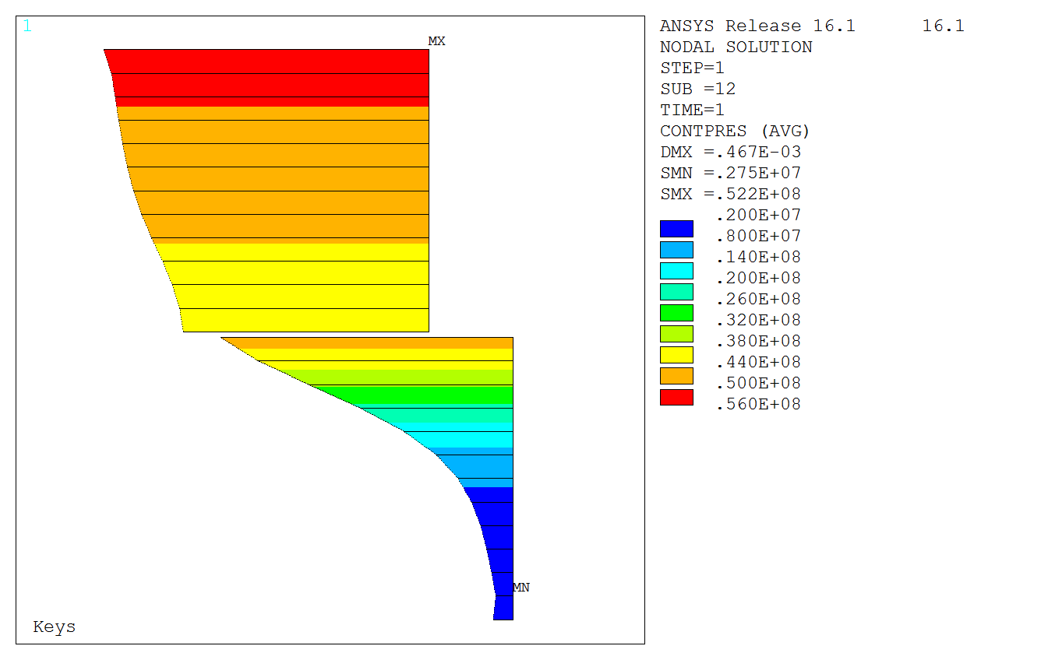
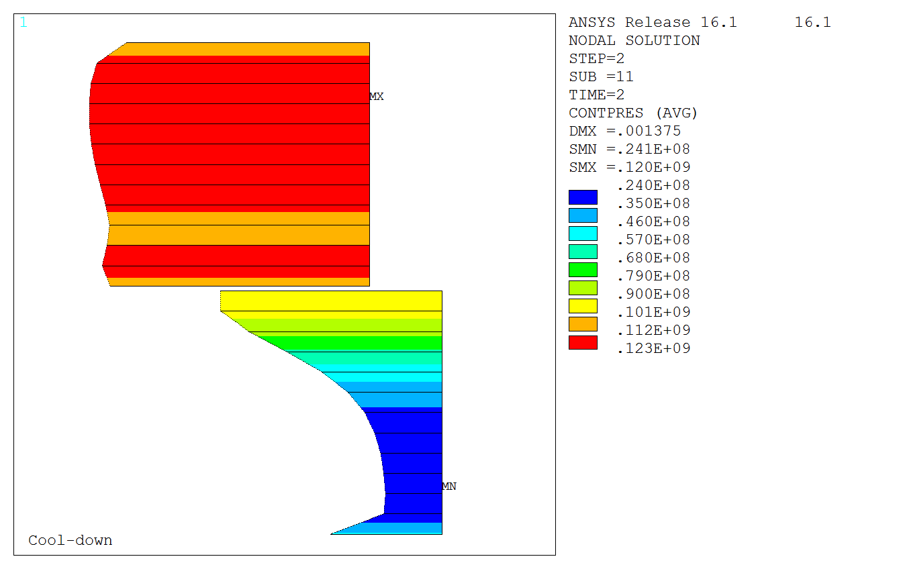
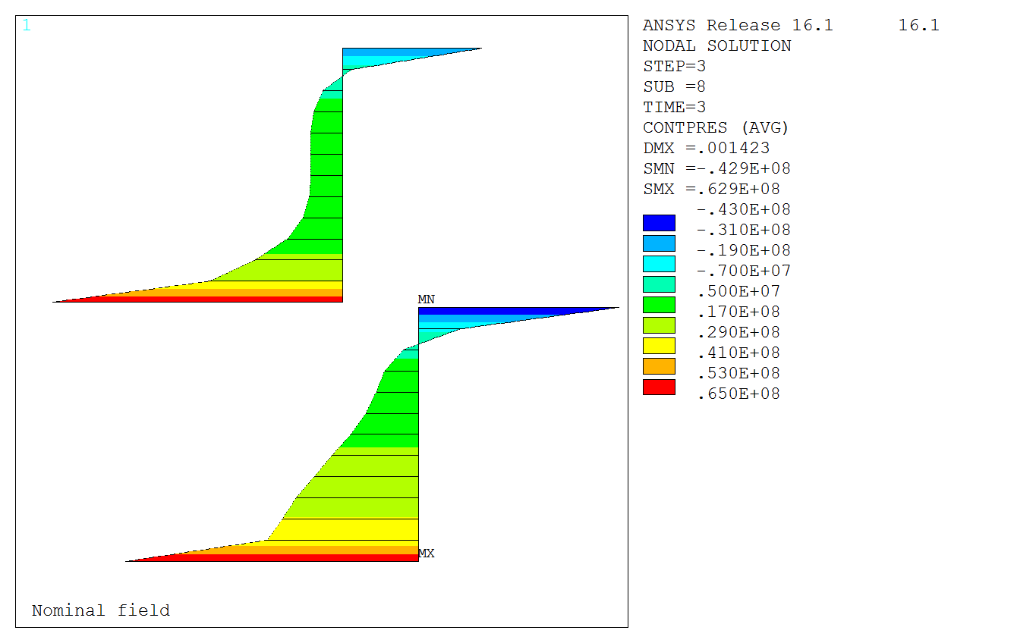
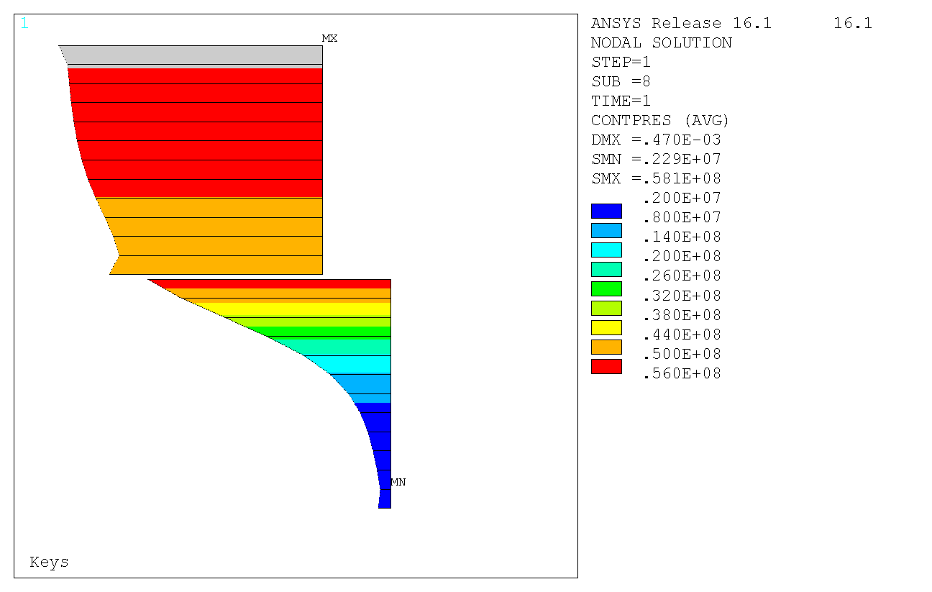
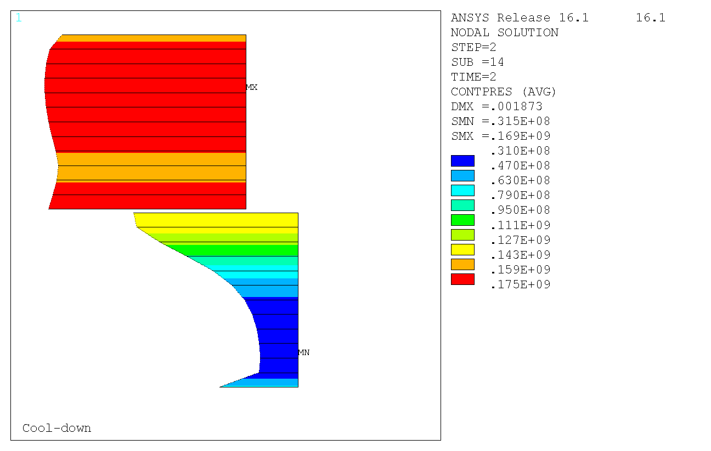
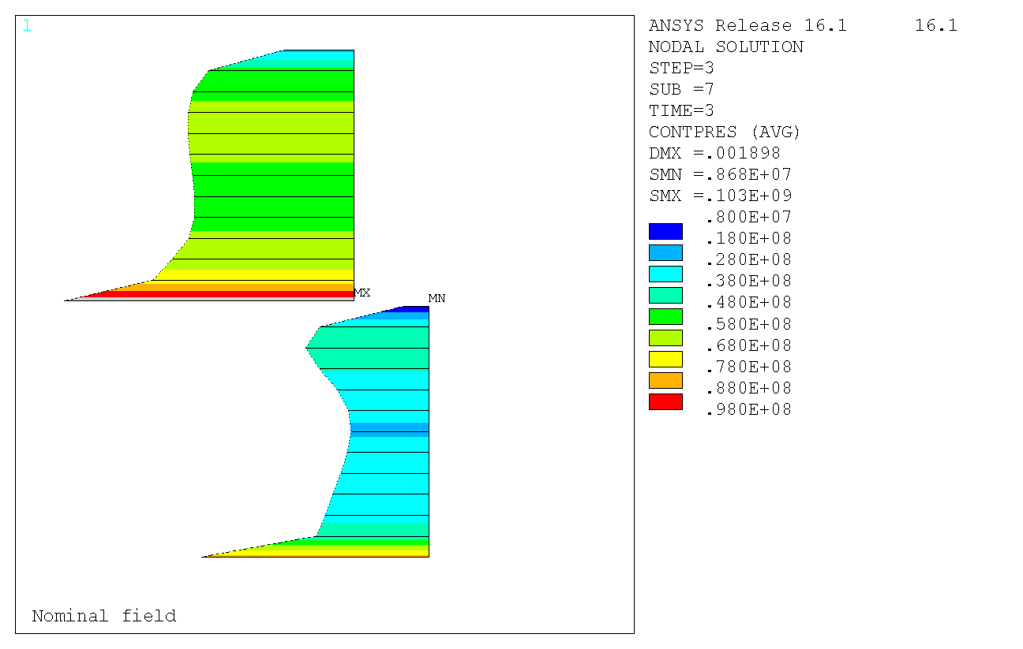
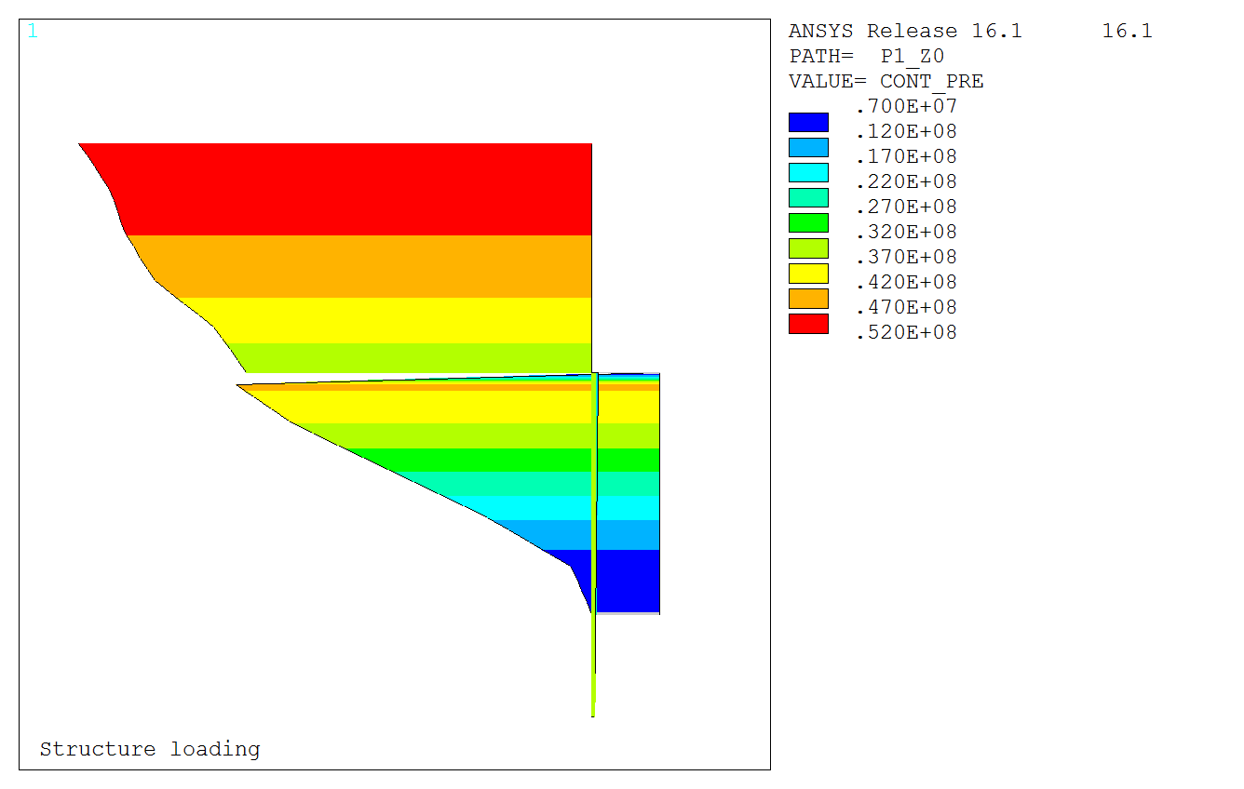
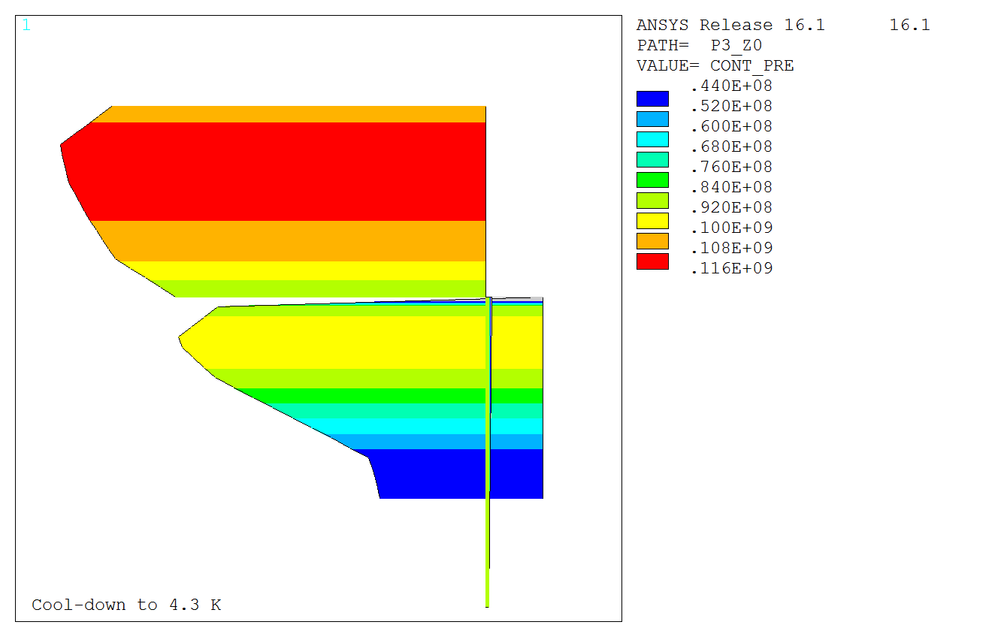
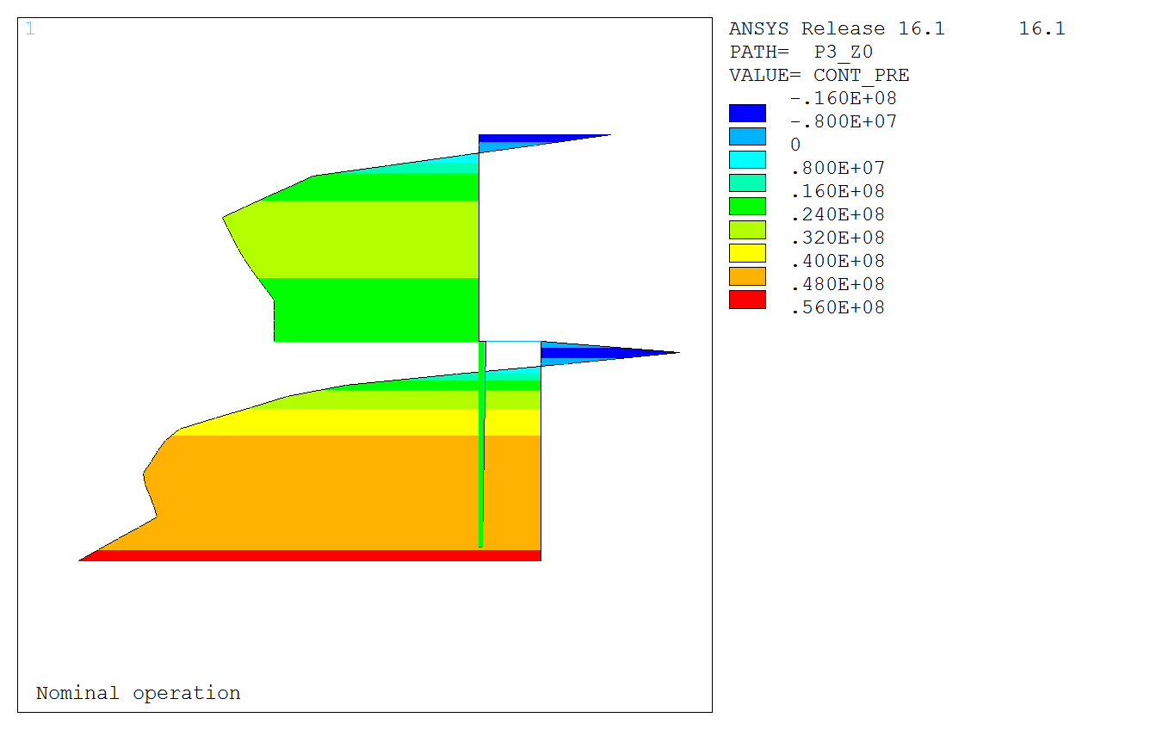
Fresca2: Contacts (10/12)
52.2
120
2D
Pl. stress
13T
0.6 mm
-42.9
2.8
24.0
58.1
62.9
169
2D
Pl. strain
13T
0.6 mm
103
8.7
2.3
31.5
51.8
-22.5
3D
V3,13T
0.6 mm
116
50.1
44.3
6.8
Slide of E. Rochpault

Slide 17






Fresca2: Coil Sx (11/12)
-147
-50
-137
2D
Pl. stress
13T
0.6 mm
-53.8
111
-2.7
-23.5
-60
-198
-181
2D
Pl. strain
13T
0.6 mm
-60.0
-14.7
-2.1
-30.6
-51.3
-138
3D
V3,13T
0.6 mm
-130
14.6
-4.8
-35.9
Slide of E. Rochpault

Slide 18
Fresca2: Summary (12/12)
 | Contact [MPa] |  |  | Sx [MPa]
 | Loading | 4.2 K | 18 T | Loading | 4.2 K | 18 T
3D | 6.8..51.8 | 44.3..116 | -22.5..50.1 | -51.3..-4.8 | -130..-35.9 | -138..14.6
2D P. stress | 2.8..52.2 | 24.0..120 | -42.9..62.9 | -50²..-2.7 | -137..-23.5 | -147..111
2D P. strain | 2.3..58.1 | 31.5..169 | -8.7..103 | -60²..-2.1 | -198..-30.6 | -181..-14.7
+/-10%
+/-20%
No match in value or location
¹Sharp peak effect
²discarding corner effects
Slide of E. Rochpault

Slide 19
Mechanical properties of Cu wedges (1/4)
The stress-strain behaviour of annealed Cu is non linear. Plastic behaviour is already observed when the stress exceeds about 20 MPa. The 0.2% proof stress (R_{p0.2}) is less than 50 MPa.
Young‘s modulus cannot be derived from the initial loading curve. Instead it is estimated from the unloading curve (E_{a}).
Even at 4.2 K annealed Cu cannot cary substantial loads.
Tensile properties of cold drawn Cu wire before and after annealing at 695 °C (measured at RT).
 | E_{a} (GPa) | R_{p0.2} (MPa) | R_{m} (MPa)
Cold-worked Cu wire | 127±0.8 | 397±15 | 427±5.9
Annealed Cu wire | 108±2.1 | 46.2±2.6 | 204±1.6
From: C. Scheuerlein, F. Lackner, F. Savary, B. Rehmer, M. Finn, P. Uhlemann, “Mechanical properties of the HL-LHC 11 Tesla Nb₃Sn magnet constituent materials”, IEEE Trans. Appl. Supercond., submitted
Slide of C. Scheuerlein

Slide 20
Mechanical properties of Glidcop wedges (2/4)
RT properties
Al oxide dispersion strengthened Cu (tradename Glidcop) RT mechanical properties measured after prior 650°C coil reaction heat treatment. Stres-strain curves of Ti-6Al-4V and 316LN stainless steel are shown for comparison.
Comparison of Glidcop stress strain curvers under longitudinal tensile and transverse compressive loading.
Slide of C. Scheuerlein

Slide 21
Glidcop Young’s modulus temperature dependence (3/4)
Temperature dependent Young’s and shear moduli are measured by the resonance method in the temperature range 20-650 °C.
A 4.2 K Glidcop Young’s modulus of 109 GPa is obtained by fitting and extrapolating the 20-650°C data.
Slide of C. Scheuerlein

Slide 22
Glidcop, some add. information (4/4)
The raw material is patented (http://www.cep-freiberg.de/en/), owned by a professor of Technical University Bergakademie Freiberg.
The production process of the wedges is such that CEP Freiberg produces the granulate and does a first extrusion, with a die produced by Luvata. Then this raw material is transported to Luvata, which are then probably performing some annealing to reduce internal stress, do acid cleaning to clean the surface and bring the wedges to final shape. Their extrusion is limited to 5 kg (currently). We at CERN have 6 m long wedges received from Luvata. The price is around 200 EUR/kg.
The material was selected because it does not transform its state during the heat treatment (no grain growth), it has a high specific heat and thermal conductivity. Another suitable material would be Ni-super-alloy, but it is very expensive and maybe magnetic (to be checked).
Should we start a study if the extrusion amount can be increased and the cost reduced?
D. Smekens

Slide 23
Required loadline margin in the ends
A reduction of the field of around 1 T (loadline margin around 20%) in the ends seems appropriate?

Slide 24
Yield strength in the iron/steel (1/6)
Material | Production | Thickness [mm]
Magnetil | Hot-rolled Laminations | 2.5-8
ST430 | Laminations
Armco | Hot-rolled Laminations | 1.5-30
HSLA | Hot-rolled pole sheets | 2-12
Silicon steels | Cold-rolled | <1.5
Slide of E. Rochpault

Slide 25
Mechanical properties (2/6)
Material | Modulus [GPa] |  | R_{p0.2} [MPa] |  | Contraction [μm/m/K]
 | RT | 4.2 K | RT | 4.2 K | To 4.2 K
SS 316LN | 203 [1], 193* | 210* | 324 [1], 286* | 930* | 10.3 [2], 9.83*
Magnetil | 213* [1], 200 [4] | 211 [4], 224* | 117/124 [1], 115/123 [4] (rolling/perp.); 180* [4] | 821 (77K) [4], 723* | 7.5 (11.5K) [4], 6.28*
ST430 | 200* [3], 200 [5,6] | 210* [3] | 205 [5], 310* [3],[6] | 830* | 6.03*
Armco | 200 [6], 213* | 224* | 305 [6], 170 [3], 233 [8], 180* | 723* | 6.28*
HSLA | ~200 [7] |  | 250-900 [7]
Silicon steels |  |  | 295 (2.5% Si) [3], 450?
*RMM baseline, best reference
[1] Scheuerlein et al., Mechanical properties of the HL-LHC 11 Tesla Nb3Sn magnet constituent materials, ASC 2016
[2] Collings, Applied Superconductivity, Metallurgy, and Physics of Titanium Alloys. International Cryogenics Monograph Series, 1986.
[3] Sgobba, Private Communication + ASM Handbook, 9th ed., vol. 3.
[4] Bertinelli, Production of Low-Carbon Magnetic Steel for the LHC Superconducting Dipole and Quadrupole Magnets, 2006
[5] http://www.pennstainless.com/ [6] http://www.azom.com/
[7] Keppert, Pole sheets Data sheet, voestalpine Steel Division
[8] EDMS#1382378 + Izquierdo, Private communication
Slide of E. Rochpault

Slide 26
HSLA steels (3/6)
HSLA = High-strength low-alloy
Classified by yield strength:
    Norm EN 10265 (EU): 700-TG-179 = 700 MPa
    Norm SAE (Society of Automotive Engineers): 980X = 80 ksi = 552 MPa
Low carbon content: 0.05-0.25 %
Other elements up to 2%: mainly Mn, also Cu, Ni, Nb…
Magnetic polarization inversely proportional to the yield strength
Mainly obtained in sheets and strips (already annealed), but also in plates, shapes and bars
Sheets from 2 to 12 mm thick
Big press for punching required?
Open questions: properties at cold?, cycling test?
Slide of E. Rochpault

Slide 27
Steel: Magnetic properties (4/6)
Material | Coercivity [A/m] | Max. μr | Saturation [T]*
Low-carbon [3] | 60-140 | 2200-5500 | 2.15
Magnetil [4] | 80 | ~7000 | 2.19
Armco [8] | ~200 | 3000-6000 | ~2.15
ST430 [3] | 240-320 | 1100-1600 | 1.47
1010 [3] | 80-160 | ~3800 | 2.10
HSLA [7] | ~400 | ~3000 | <2.0?
Silicon steels [3] 1% 2.5% 3% | 140-260 60-150 100-160 | 1700-6000 1800-11000 7500-15000 | 2.06 2.00 ~1.80
*lim(B-μ₀H) _{H→∞}
Slide of E. Rochpault

Slide 28
Steel: Conclusion (5/6)
Low-carbon steel usually used in SC magnets: Magnetil, Armco
  Very high saturation fields: 2.0-2.1 T
  But, limited yield strength: <200 MPa at RT
Si steels:
  Very high saturation fields: up to 2.0 T
  Higher yield strength ~300 Mpa
  But, cold rolled, then laminations < 1.5 mm
ST430:
  Higher yield strength ~300 Mpa
  Low saturation field: ~1.5 T
  Should we explore this option in more detail?
  HSLA:
  Very high saturation fields: up to 2.0 T
  Very high (and large choice of) yield strength: 250-900 MPa
  Small impact of strength on saturation field
  Should we explore this option in more detail? Which one?
Slide of E. Rochpault

Slide 29
Steel: Test specification (6/6)
Traction tests at room temperature and 4.2 K to determine the yield limit.
Fracture tests at 4.2 K to determine the fracture toughness (K_{Ic}). The best reference we have now is 30 MPa*m^{1/2}, that translates in a maximum tensile stress in the yoke of 280 MPa at cold assuming that we can have cracks of 1 mm in the material
Fatigue tests at 4 K
  Cycling to 200 MPa to determine the number of cycles before rupture (it should be larger than 20.000 for HiLumi magnets)
  Cycling to 300 MPa to determine the number of cycles before rupture (useful for 16 T magnets). If someone thinks that it would be very useful for the design to have S1(4K)>300 MPa, we can ask to perform this test at slightly larger load.
Slide of S.I. Bermudez

Slide 30
Cost model considerations (1/1)
Detection equipment and circuit protection is not part the EuroCirCol cost model
Tolerances are very important for the cost of the parts. At the time for LHC performed Monte-Carlo simulations in 2D. What is your opinon to include this in the study?
End spacers could be done from a material, which is easily machinable and does not have (excessive) grain growth during the heat treatment, is non-magnet and fulfils the mechanical/structural specifications (if it exists or can be created). Should we write a specification and start a study?
Wedges, study of different materials to be started?

Slide 31
Tensile stress (1/3)
The CCT design has seen some tensile stress, which influence does it have on the performance?

Slide 32
Axial tensile stress-strain relation of Nb₃Sn/Cu PIT wire at 4.2 K (2/3)
At 4.2 K 100 MPa axial tensile stress on the PIT type Nb₃Sn wire causes an axial strain of about 0.25%.
The reversible axial strain influence on I_{c} increases with increasing applied field. At 16 T more than 30% I_{c} reduction are possible, depending on the Nb₃Sn strain state in the unloaded conductor.
The axial tensile strain irreversibity limit reported for RRP and PIT type Nb₃Sn wires is typically below 0.25% strain (at 4.2 K).
Lattice strain in the different constituents of a Nb₃Sn PIT wire measured simultaneously by X-ray diffraction as a function of wire stress at 4.2 K.
From C Scheuerlein et al, Supercond. Sci. Technol. 27 (2014) 044021
Slide of C. Scheuerlein

Slide 33
4.2 K uniaxial tensile stress-strain behaviour of PIT, RRP and Bronze Route wires (3/3)
Similar stress-strain behaviour in RRP and PIT type wires.
Strong Nb3Sn lattice softening during cooling to 4.2 K.
Stress in the BR, RRP and PIT wire as a function of Nb₃Sn axial strain at 4.2 K. Stress is tensile force normalised to the wire cross section.
Comparison of the stress-strain in the Nb₃Sn PIT wire at RT and at 4.2 K. Stress is normalised to the non-Cu wire cross section, assuming that the Cu does not carry substantial loads.
Slide of C. Scheuerlein

Slide 34
Conclusion

