Slide 1


Common coil configuration: electromagnetic calculations
T. Martinez, J. Munilla, F. Toral - CIEMAT
Thanks to R. Gupta (BNL) for his suggestions and help
EuroCirCol WP5 Meeting, Nov 8th, 2016

Slide 2
Electromagnetic design: stored energy
We have found the origin of the discrepancy about the stored magnetic energy. It is a bug in the 32-bits version of Roxie: the coenergy is provided instead of energy (thanks to Susana and Bernhard for their support).
It allows a further improvement of the design, because the quench propagation is not so critical.
2

Slide 3
Electromagnetic design: voltages
We have kept a large value of the current, around 16 kA. We are trying to decrease the voltages during the quench.
However, it decreases the efficiency of the superconductor.
Parallel studies are ongoing trying to see if the voltages can be reduced with a different connection of the coils (Tiina & Marco).
3

Slide 4
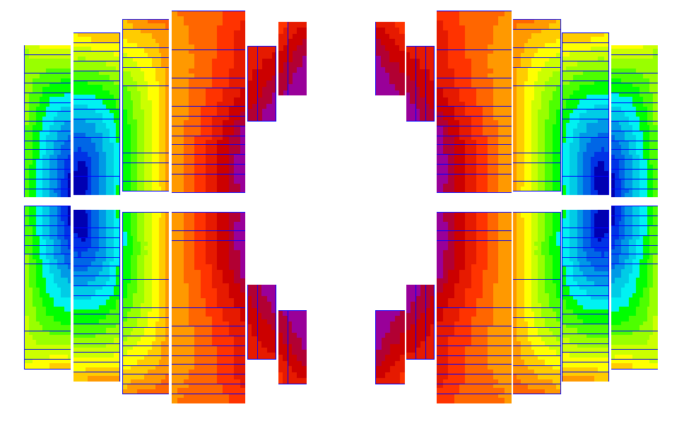
Electromagnetic design: field quality
We aim to understand the sensitivity of the field harmonics with the design variables.
B3: gap at midplane, outermost turns of blocks 1&2, ancillary coils
B5: ancillary coils (close to main coils)
B7: ancillary coils
A2: vertical position of the main coils respect the aperture (symmetry with aperture)
A4: vertical position of blocks 1&2
Peak field: ancillary coils in vertical position help to decrease Bpeak/Bnom
2
1
4

Slide 5
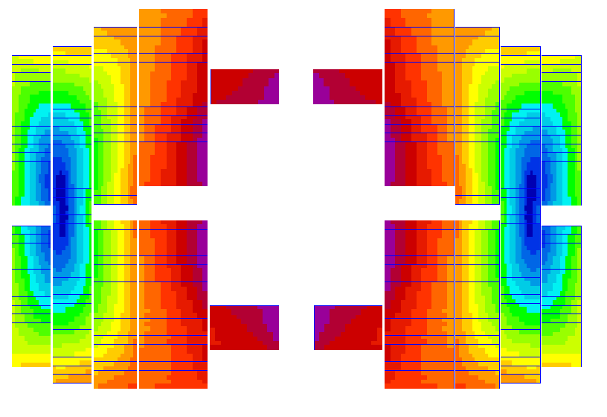
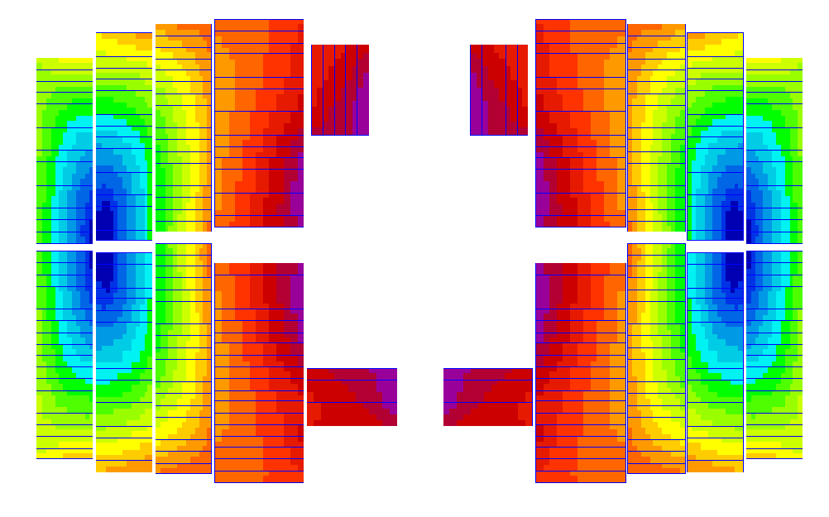
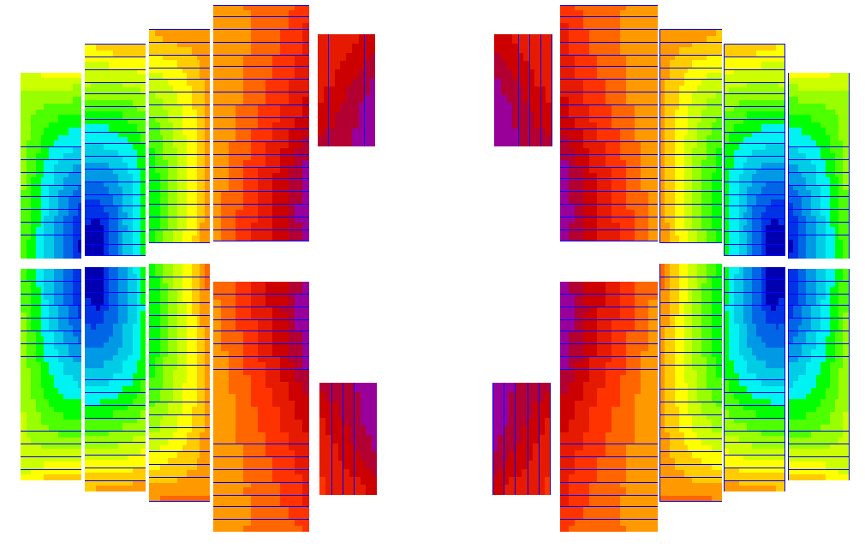
Electromagnetic design: ancillary coils
We have studied different configurations of the ancillary coils.
5

Slide 6
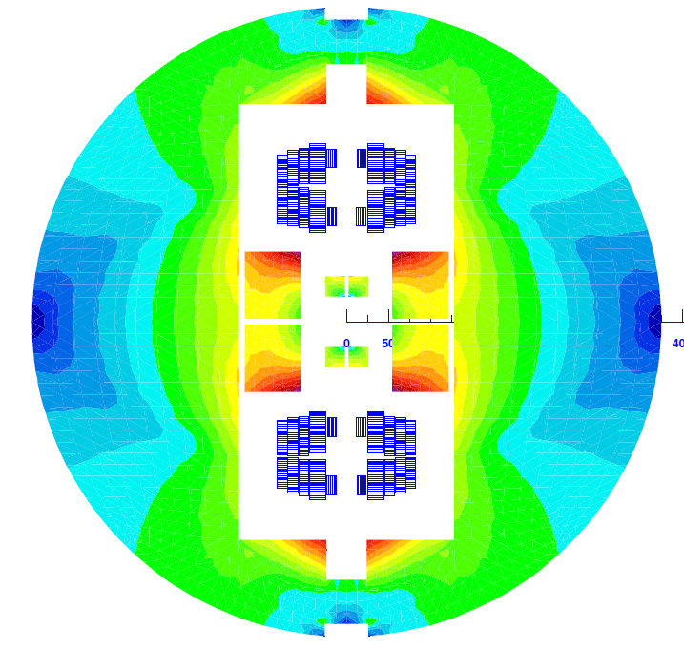
Electromagnetic design
6

Slide 7
Conclusions
CIEMAT and BNL are collaborating on common coil design.
It is very important to study the way to decrease the induced voltages.
We have studied different configurations of ancillary coils: we wanted to optimize a common coil magnet… but now we have to optimize a block magnet.
7

