Slide 1
Neutrino Astronomy present and future
Maarten de Jong
Rencontres de Blois
May 28 − June 2 2017

Slide 2
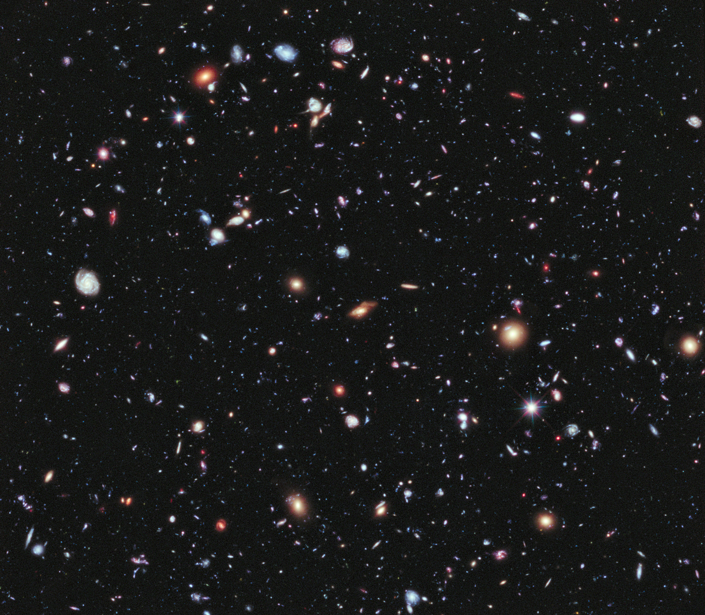
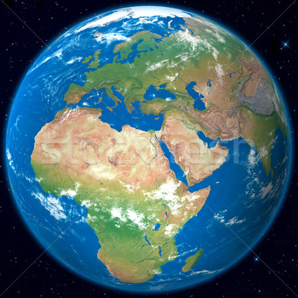
?
neutrinos

Slide 3


Neutrino sources
Thermal
bottom-up
top-down
M
x
y
Sun
SN1987A
cosmic particle accelerators
dark matter
GUT…

Slide 4
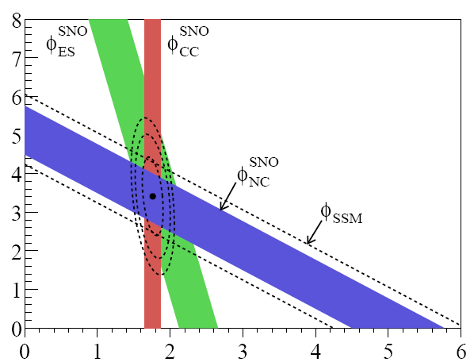

Solar neutrinos
Solar power
radiation
conserved
flux
other neutrinos [10⁶ cm⁻² s⁻¹]
$$4p+2e⟶{}_{}^{4}{He}$$
2 ν_{e}
no
oscillations
electron neutrinos [10⁶ cm⁻² s⁻¹]

Slide 5
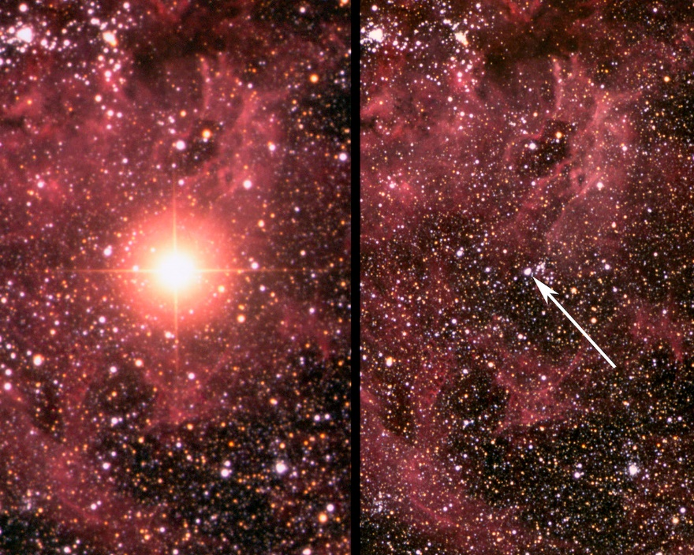
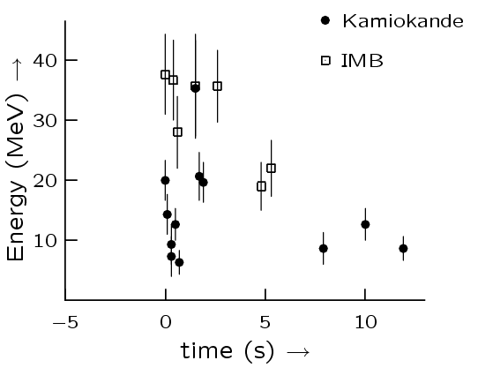
SN1987A
before
after

Slide 6
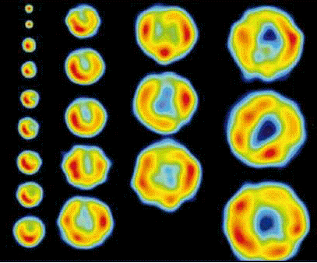







Fermi shock acceleration
radio maps SN1993J – M81 April 1993–June 1998
V
$$\frac{\ln\left(N/{N_{0}}\right)}{\ln\left(E/{E_{0}}\right)}=\frac{\ln\left(β\right)}{\ln\left(1+α\right)}$$
Acceleration
$$∆E=αE$$
Probability
$$P = β$$
$$\frac{N}{N_{0}}={\left(\frac{E}{E_{0}}\right)}^{\frac{\ln\left(β\right)}{\ln\left(1+α\right)}}$$
k steps
$$E=E_{0}{\left(1+α\right)}^{k}$$
$$\frac{dN}{dE}∝E^{ \frac{\ln\left(β\right)}{\ln\left(1+α\right)} − 1}$$
particle
$$N=N_{0}{\left(β\right)}^{k}$$

Slide 7
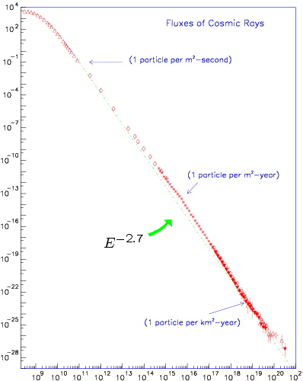


cosmic ray spectrum
Thermodynamics
1 per m² per second
$$\frac{dN}{dE}∝E^{ \frac{\ln\left(β\right)}{\ln\left(1+α\right)} − 1} = E^{ −2} ≅$$
$$∝E^{−2.7}$$
flux [(m² sr s GeV)⁻¹]
10²⁷
Relativity
1 per km² per year
10¹⁰
10¹⁰
10²⁰
E [eV/particle]
Origin of cosmic rays?

Slide 8
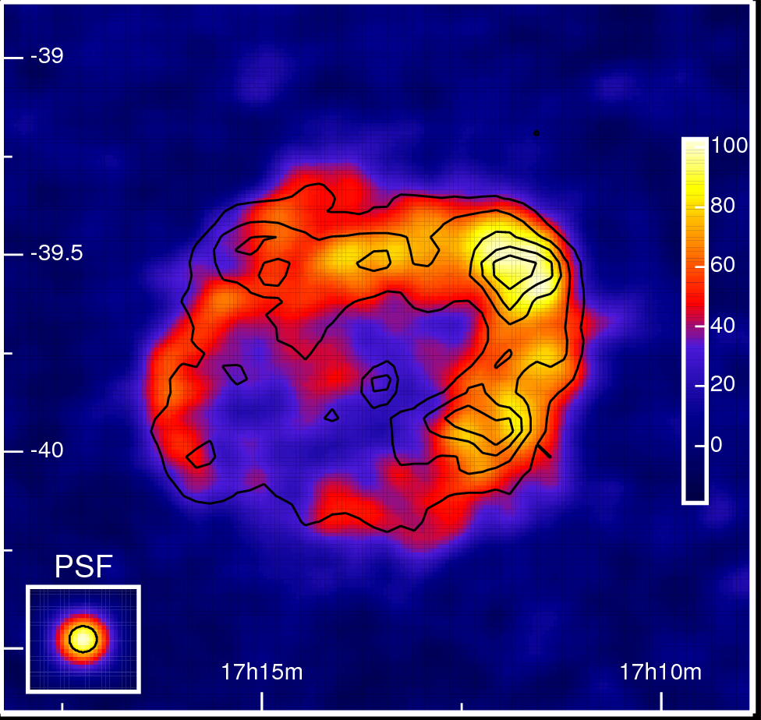
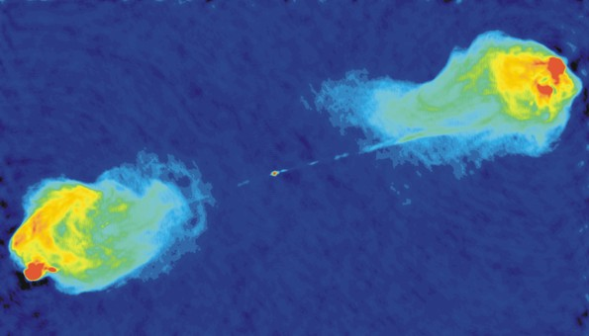
Possible cosmic particle accelerators
Galactic
Extra-galactic
Supernova remnants
Active Galactic Nuclei
Missing link with cosmic rays

Slide 9


Astro-particle physics
electro-magnetic
gamma rays
hadronic
gamma rays
p
π⁰
Synchrotron
radiation
Δ⁺
e
$$\overline{B}$$
p
inverse
Compton
scattering
$$π^{0}⟶γγ$$
e

Slide 10
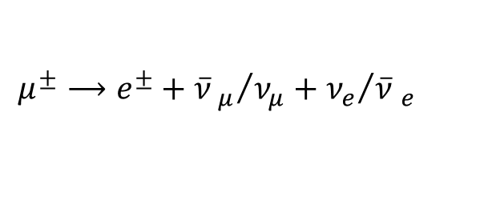
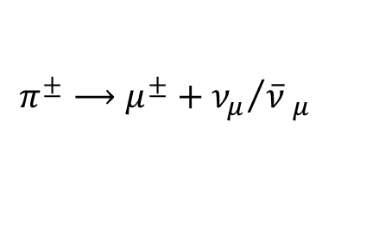

Astro-particle physics
electro-magnetic
gamma rays
hadronic
neutrinos
p
π⁺
Synchrotron
radiation
Δ⁺
e
$$\overline{B}$$
n
inverse
Compton
scattering
$$π^{±}⟶μ^{±}+{ν_{μ}}/{\overline{ν} _{μ}}$$
e
$$μ^{±}⟶e^{±}+{\overline{ν} _{μ}}/{ν_{μ}}+{ν_{e}}/{\overline{ν} _{e}}$$

Slide 11





Dark matter
$$E_{ν} ≅ M_{χ}$$
Sun
$$\overline{χ}$$
neutrinos
$${\overline{ν}}_{l}$$
χ
?
$$χ$$
$$ν_{l}$$
Existence of dark matter?

Slide 12



Neutrino propagation
weak states
=
“what you see”
mass states
=
“what you get”
$$\left(\begin{matrix}{\text{n}}_{e} \\ {\text{n}}_{μ} \\ {\text{n}}_{τ}\end{matrix}\right)=U×\left(\begin{matrix}{\text{n}}_{1} \\ {\text{n}}_{2} \\ {\text{n}}_{3}\end{matrix}\right)$$
CP-violation
Majorana
U = $\left[\begin{matrix}1 & 0 & 0 \\ 0 & { c}_{23} & s_{23} \\ 0 & {−s}_{23} & c_{23}^{}\end{matrix}\right]\left[\begin{matrix}c_{13} & 0 & s_{13}e^{−iδ} \\ 0 & 1 & 0 \\ {−s}_{13}e^{iδ} & 0 & c_{13}\end{matrix}\right]\left[\begin{matrix}{ c}_{12}^{} & s_{12} & 0 \\ {−s}_{12} & c_{12} & 0 \\ 0 & 0 & 1\end{matrix}\right]\left[\begin{matrix}1 & 0 & 0 \\ 0 & e^{iα_{1}/2} & 0 \\ 0 & 0 & e_{}^{iα_{2}/2}\end{matrix}\right]$
$$c_{ij}=\cos{θ_{ij}} s_{ij}=\sin{θ_{ij}}$$
Test of fundamental physics

Slide 13





Neutrino telescope
$$l^{−}$$
$$ν_{l}$$
$$θ_{s}$$
$$X$$
$$N$$

Slide 14
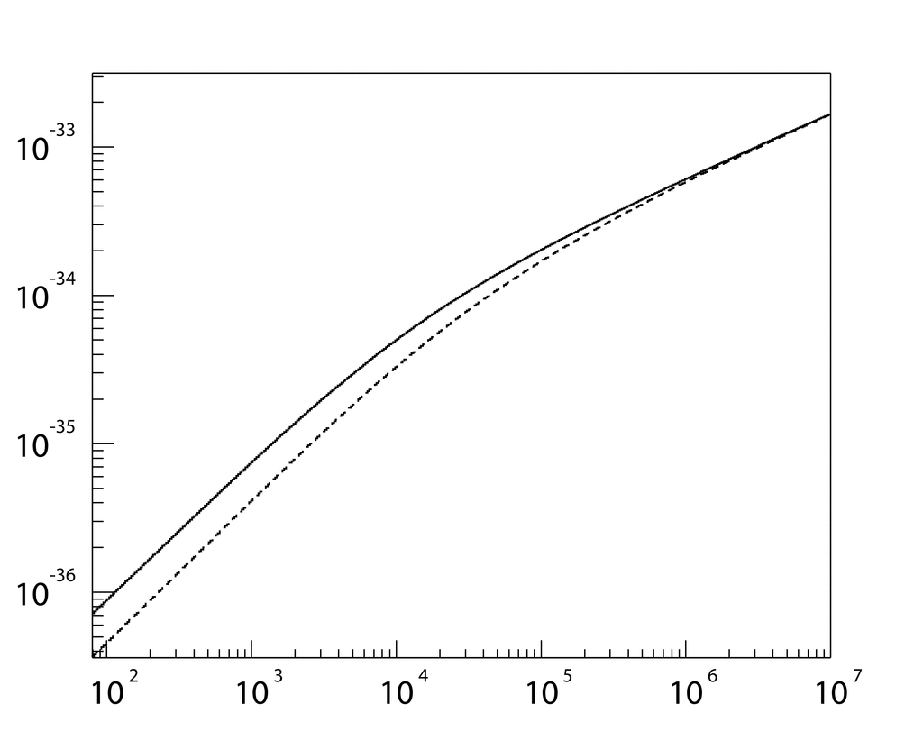
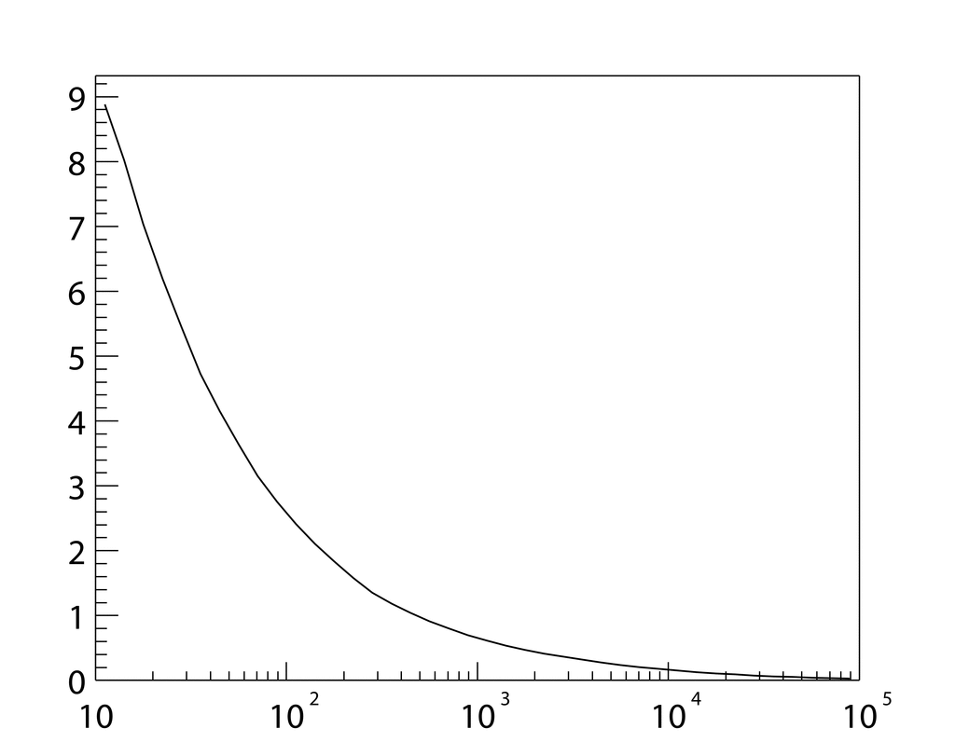



The case for TeV−PeV neutrino astronomy
cross section
scattering angle
background
10⁻³
10⁻⁵
10⁻⁷
10⁻⁹
10⁻¹¹
10⁻¹³
10⁻³³
10⁻³⁴
10⁻³⁵
10⁻³⁶
9
8
7
6
5
4
3
2
1
$$ν_{l}$$
$${\overline{ν}}_{l}$$
median angle
$σ\left(ν_{l}N⟶lX\right)$ [cm²]
$θ_{s}$ [deg]
E² Φ [GeV cm⁻² s⁻¹ sr⁻¹]
ν_{μ} (Honda)
ν_{e} (Honda)
“prompt” (Enberg)
10²
10³
10⁴
10⁵
10⁶
10⁷
10¹
10²
10³
10⁴
10⁵
10²
10³
10⁴
10⁵
10⁶
10⁷
10⁸
E_{ν} [GeV]
E_{ν} [GeV]
E_{ν} [GeV]

Slide 15
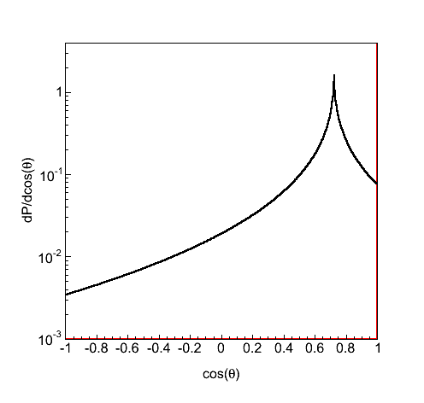
Neutrino detection
muon neutrino
electron neutrino
θ
1
2
3
4
5
~100 m
light
absorption
cos(θ)
~ [km] ln(E/TeV)
~ [m] ln(E/TeV)
muon energy loss
radiation length

Slide 16
Neutrino detector
dispersion
1 km
2−3 km
light absorption
intensity
1 km
light
scattering
3D array of PMTs
arrival time [ns]

Slide 17
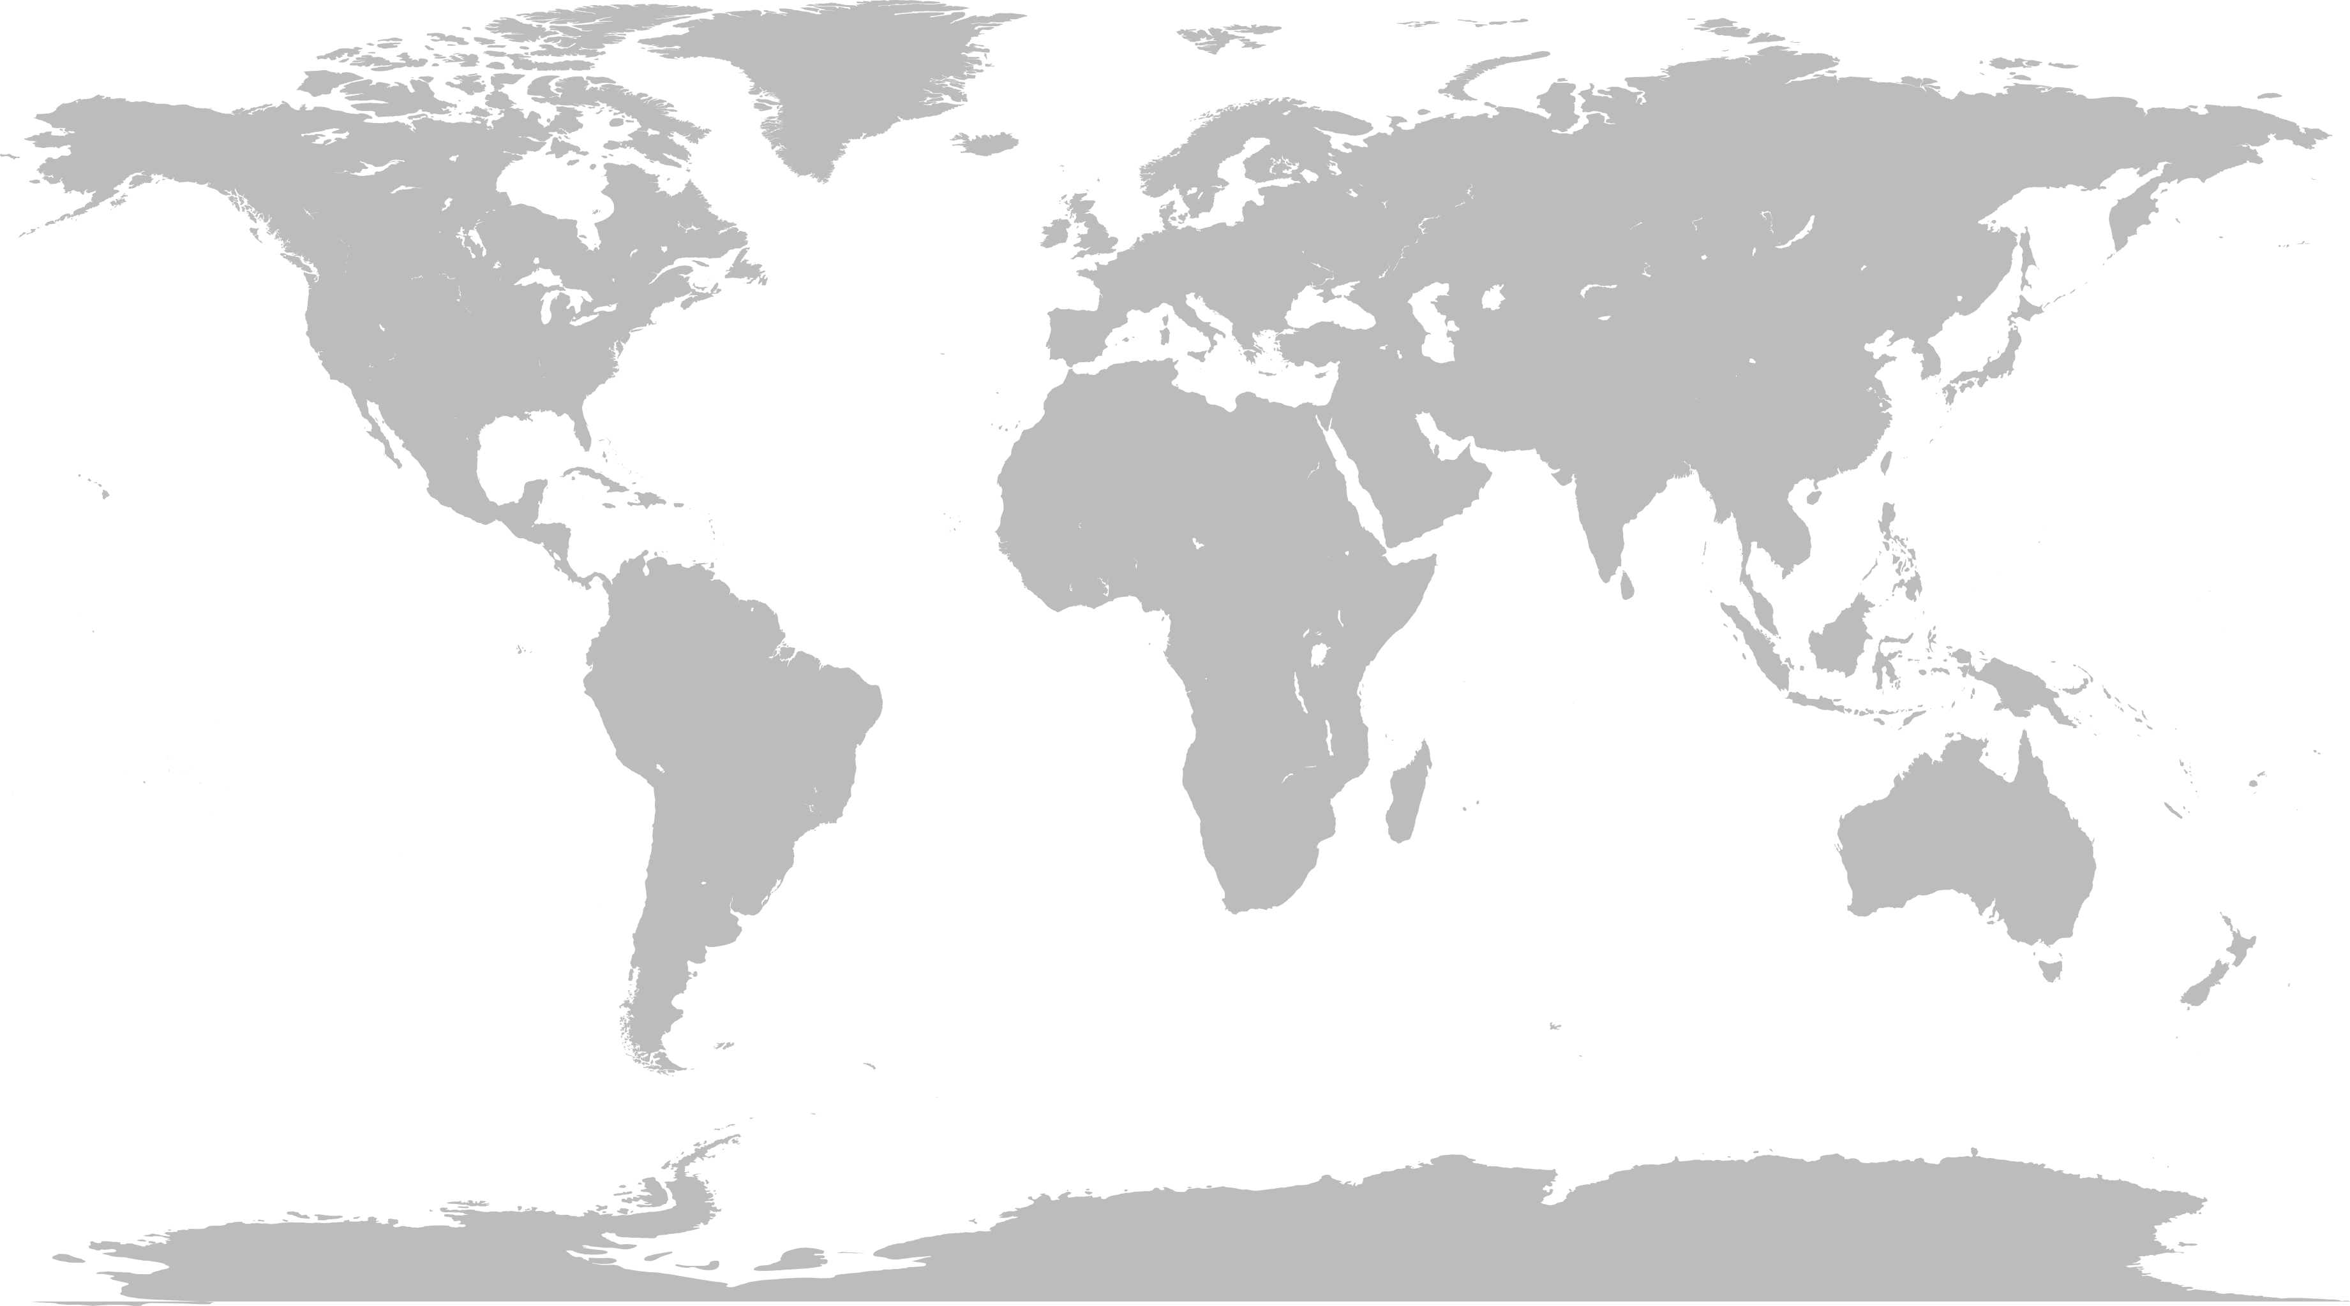
Antares
KM3NeT
GVD
Global Neutrino Network
IceCube

Slide 18

Neutrino telescopes
 |  | IceCube | GVD | Antares | KM3NeT
Status |  | completed 2011 | under construction | completed 2007 | under construction
Location |  | South Pole | Lake Baikal | Mediterranean Sea
Medium |  | ice | lake | sea
Light transmission |  | $$λ_{s}<λ_{abs}$$ | $$λ_{s}≫λ_{abs}$$ | $$λ_{s}≫λ_{abs}$$
Resolution | ν_{μ} ν_{e} | 0.4 deg 10 deg | 0.5 deg 2 deg | 0.4 deg 2 deg | 0.1 deg 1.5 deg
Noise |  | extremely low | medium | medium
PMT size (QE) |  | 10” (25%) | 10” (35%) | 10” (20%) | 3” (30%)

Slide 19
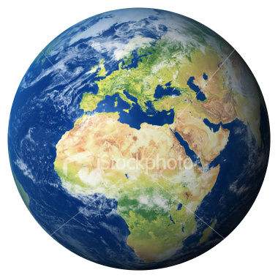
Multi-messenger astronomy
cosmic rays
p, He, ..
ν
γ
neutrinos?
gamma rays

Slide 20
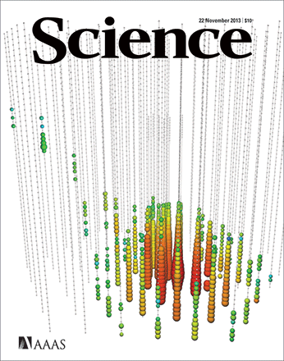
Multi-messenger astronomy
cosmic rays
p, He, ..
ν
γ
neutrinos?
gamma rays

Slide 21
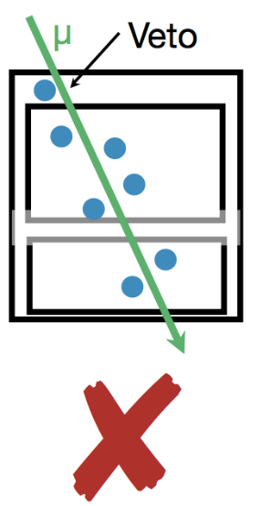
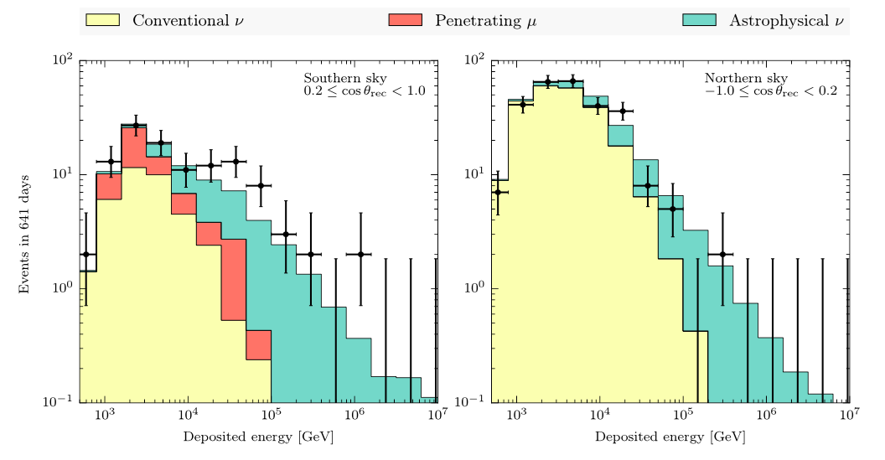
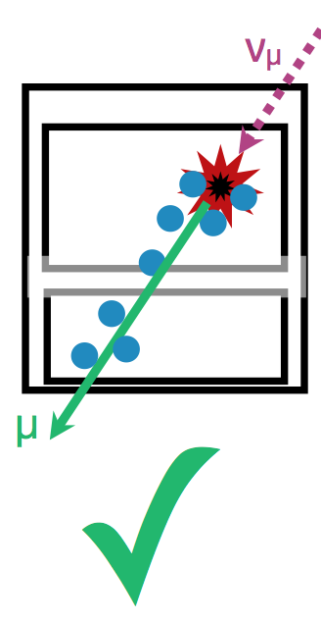
Diffuse flux
IceCube
IceCube
μ
ν_{μ}

Slide 22
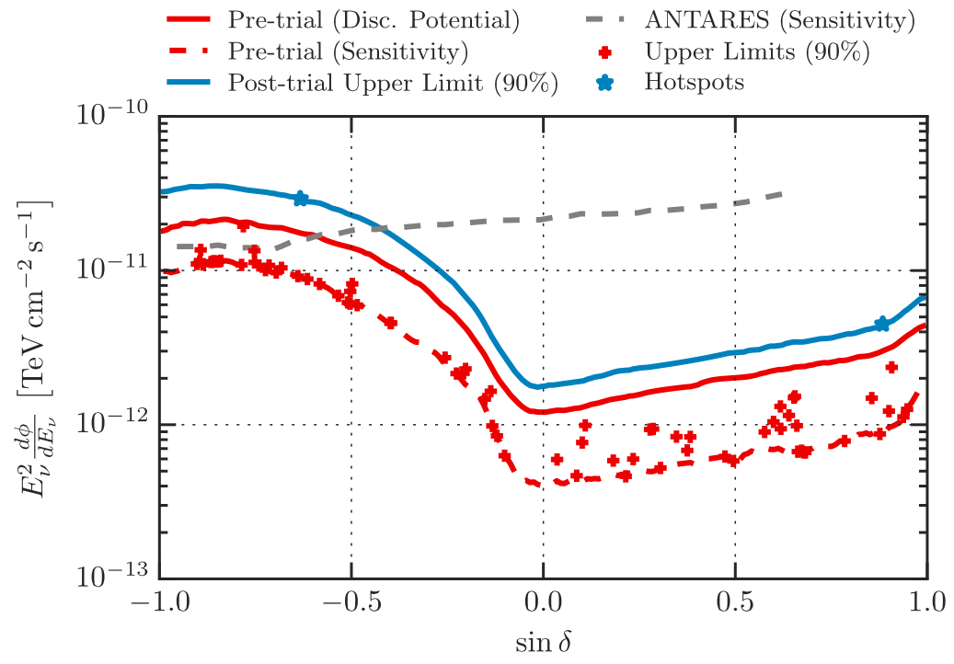
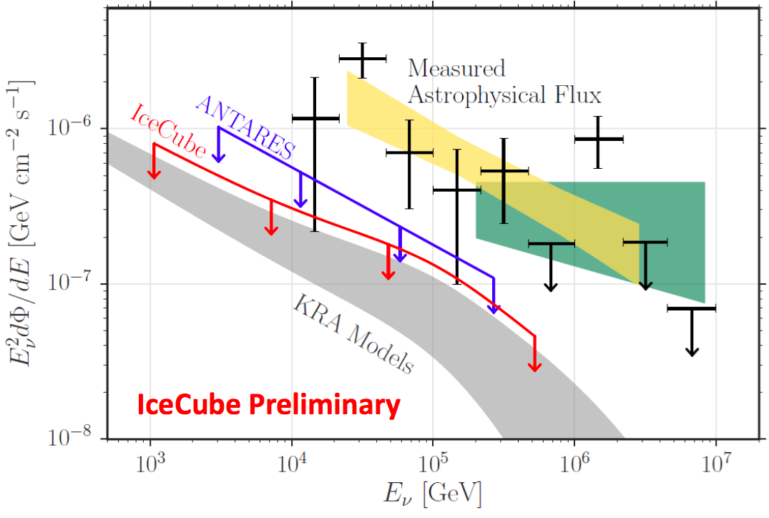
(point) source(s)
point sources
galactic plane

Slide 23
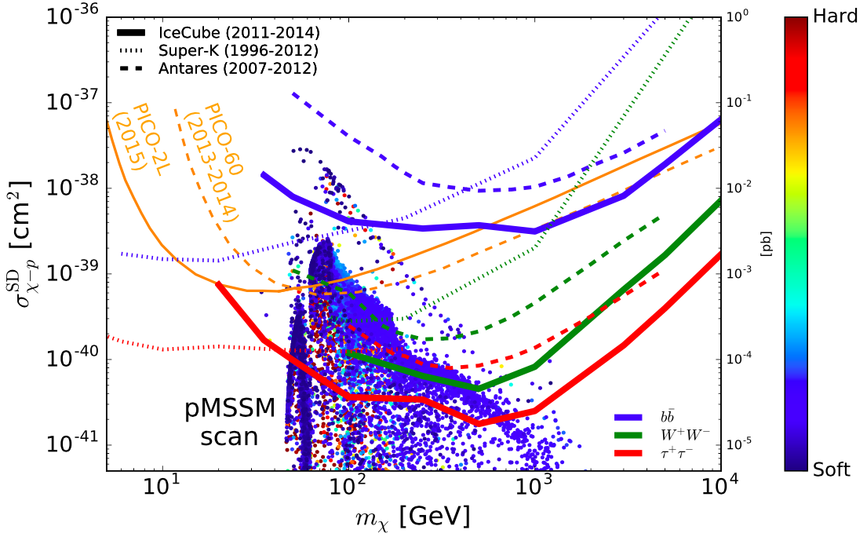

Dark matter
spin dependent cross section
$$b\overline{b}$$
$$W^{+}W^{−}$$
$$τ^{+}τ^{−}$$

Slide 24
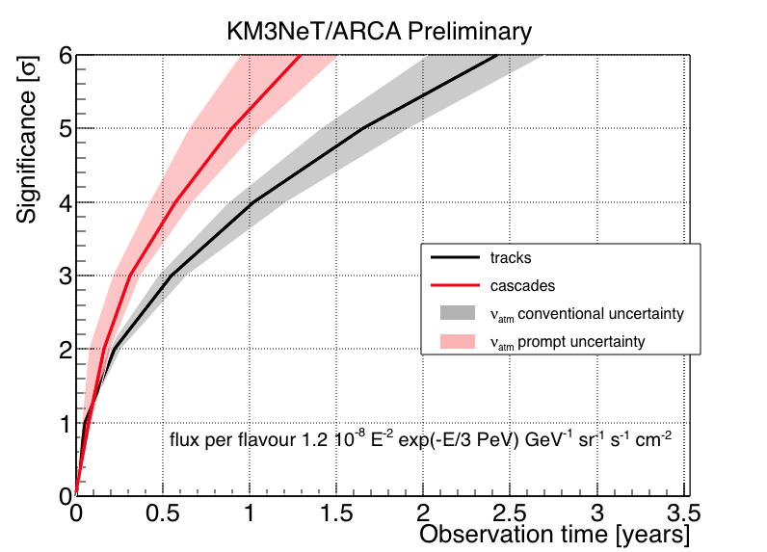
Future – KM3NeT
IceCube signal
Supernova remnant
6
5
4
3
2
1
0
5
4
3
2
1
0
KM3NeT
KM3NeT
significance [σ]
tracks
cascades
significance [σ]
RXJ1713
Vela X
0
1
2
3
0
2
4
6
8
10
12
observation time [y]
observation time [y]

Slide 25
Future
Point sources / catalogues
  origin of cosmic rays
  energy spectra
  morphology of sources
Galactic plane
  probing interactions of cosmic rays with matter
Neutrino flavour composition
  tau appearance
  Glashow resonance
  test of fundamental physics
Atmospheric neutrinos
  determine neutrino mass hierarchy
GZK neutrinos
  link with comic rays
Supernova monitoring
  link with astronomy
Dark matter
  links with particle physics, astrophysics and cosmology
Long baseline experiments
  Protvino to KM3NeT
Serendipity
  Earth and sea sciences

