Slide 1


Expression Methods in ART@CMS
MIRZIASHVILI Keti
Georgian Technical University
SCCWT2016 06 October, 2016

Slide 2
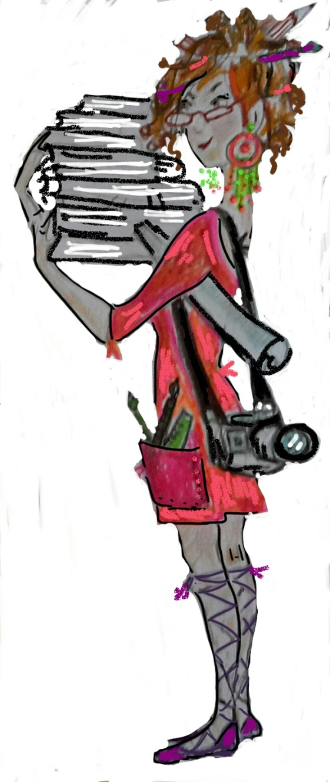

Art@Science
Art@Science is cooperation of two different fields of activity working with harmony
Objective of project is expression of scientific ideas by different artistic ways

Slide 3
Art@Science
Two concepts of expression:
DIRECT: composition of scenes which are directly represent scientific ideas
INDIRECT: expression of scientific ideas by meaning of other event having similar purpose and logic

Slide 4

Direct Scenes : Example #01
CERN popular slogan:
“Collaboration of different countries, institutes and peoples”

Slide 5
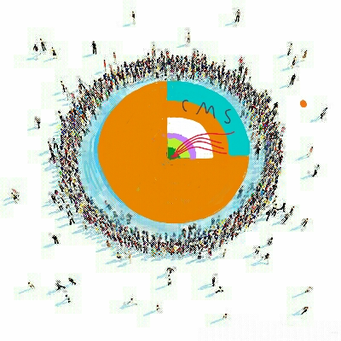
Direct Scenes : Example #02
CERN popular slogan:
“4’800 professionals participating in CMS experiment”

Slide 6
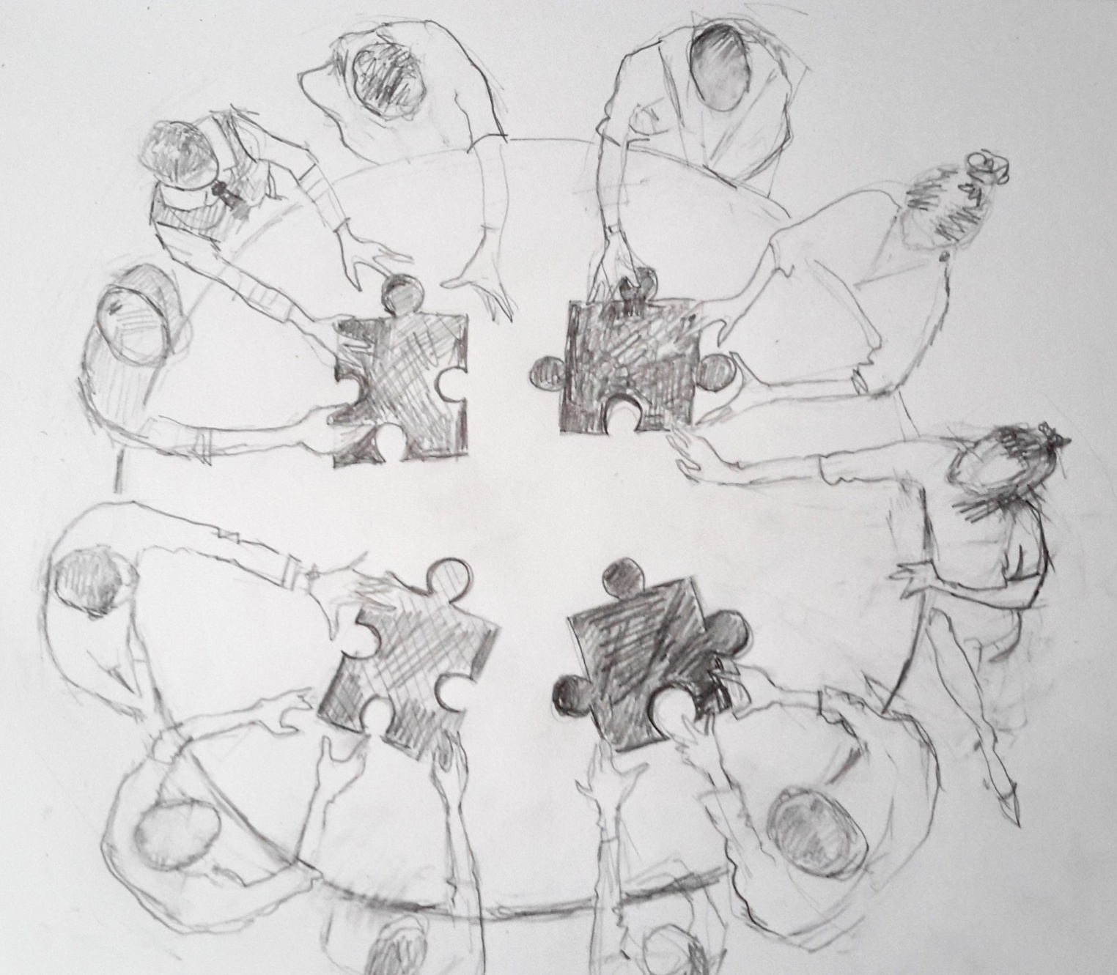
Direct Scenes : Example #03
CERN popular slogan:
“Different teams of professionals are working together to find solution”

Slide 7
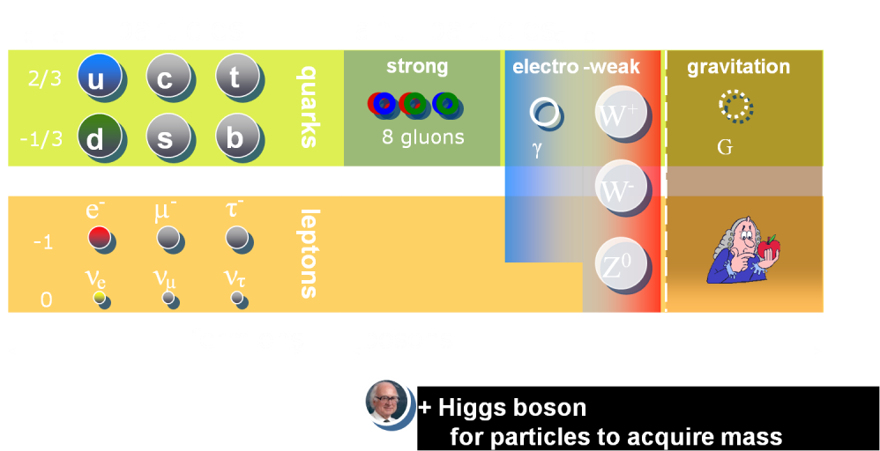
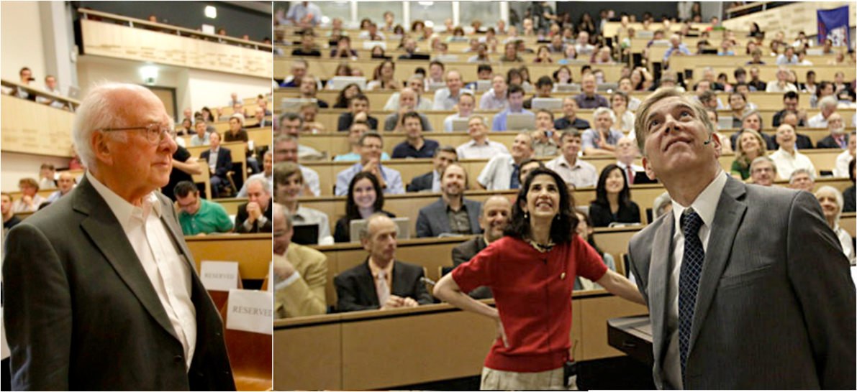
Indirect expression : Example #01
CERN popular slogans:
“Discovery of Higgs Boson”; “Approve of Supersymmetry”
4th of July, 2012 CERN, Discovery event of Higgs boson

Slide 8
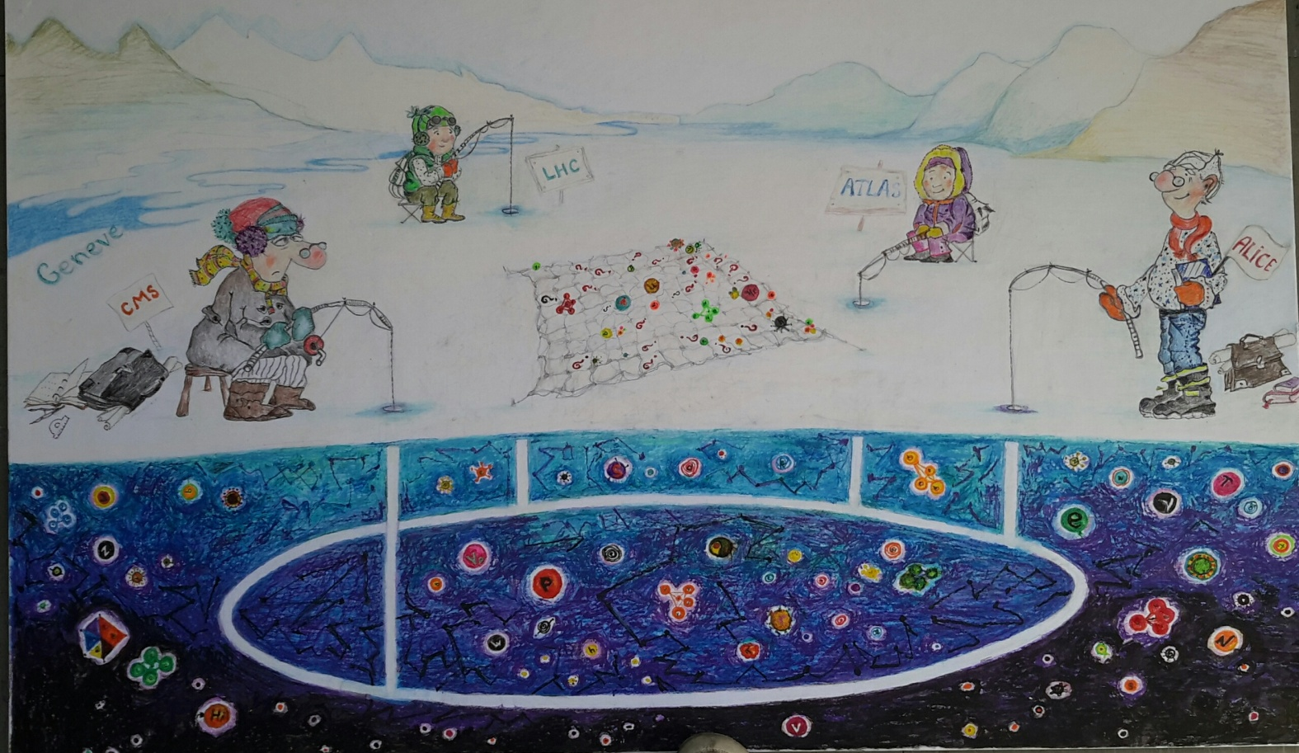
Indirect expression : Example #01

Slide 9
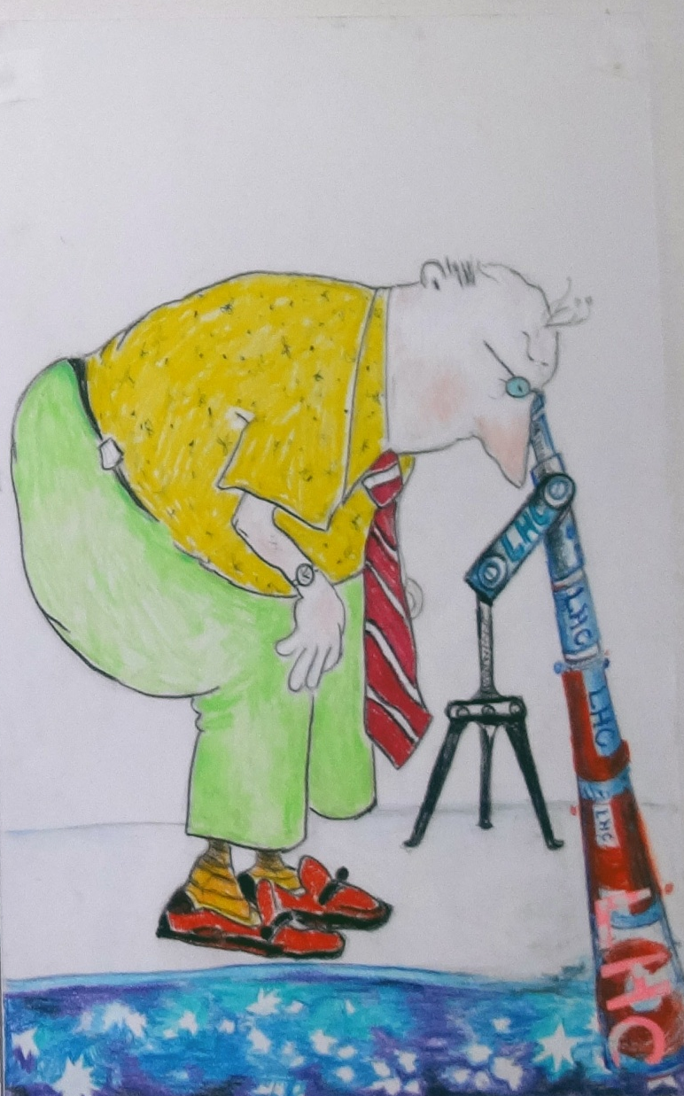
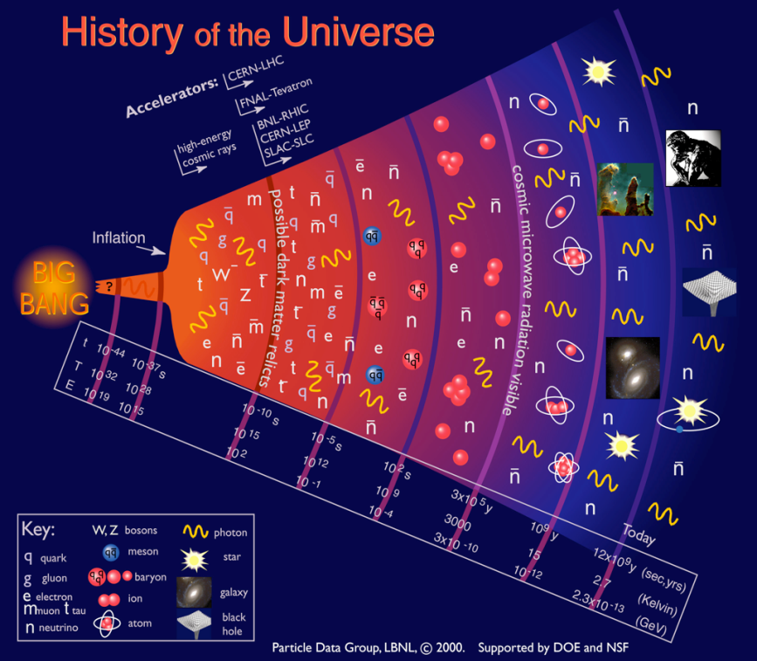
Indirect expression : Example #02
CERN popular slogans:
“LHC enables watch the micro universe in 10⁻¹⁷ centimetre”

Slide 10

Working Tools and Methodology
Art scenes development connected with implementation of two main methodologies:
    e-Painting
    e-Design
Also various e-Painting software applications can be used

Slide 11
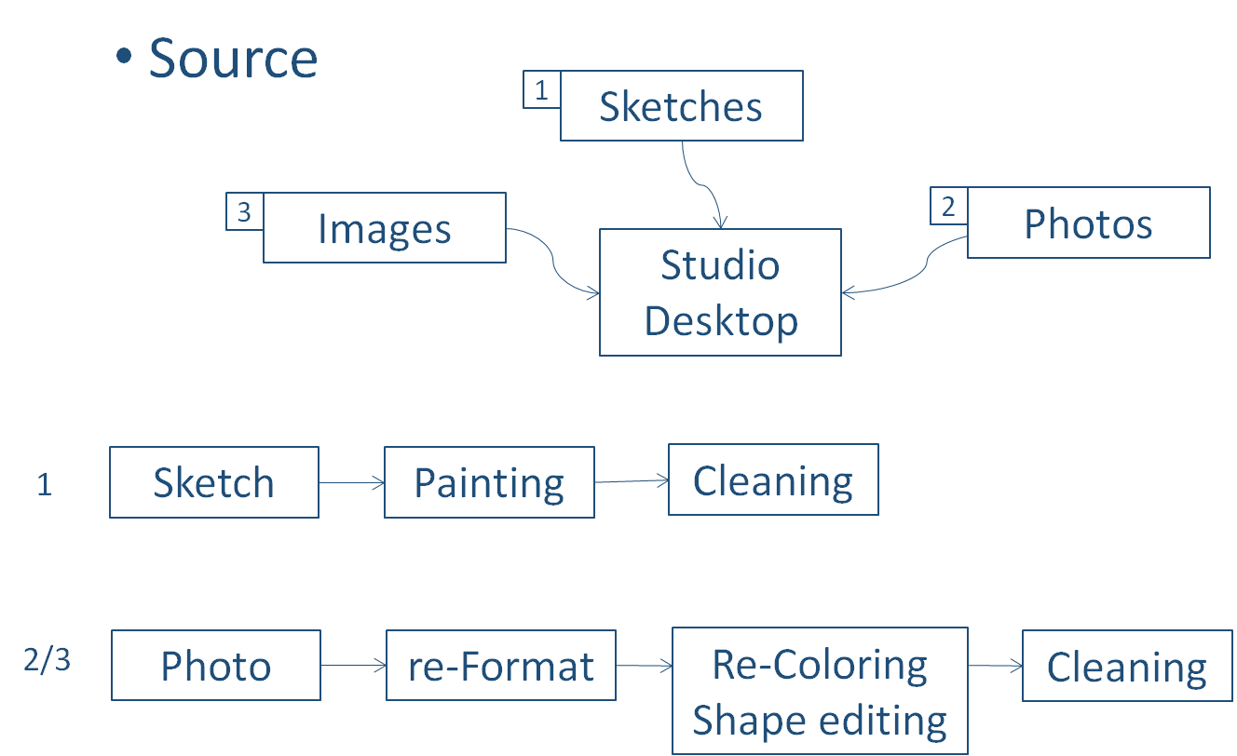
e-Painting

Slide 12
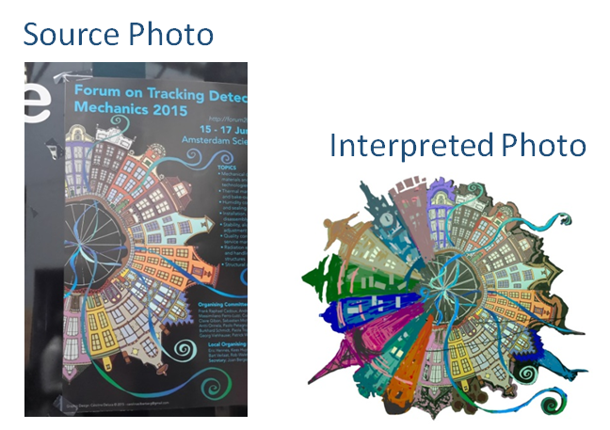
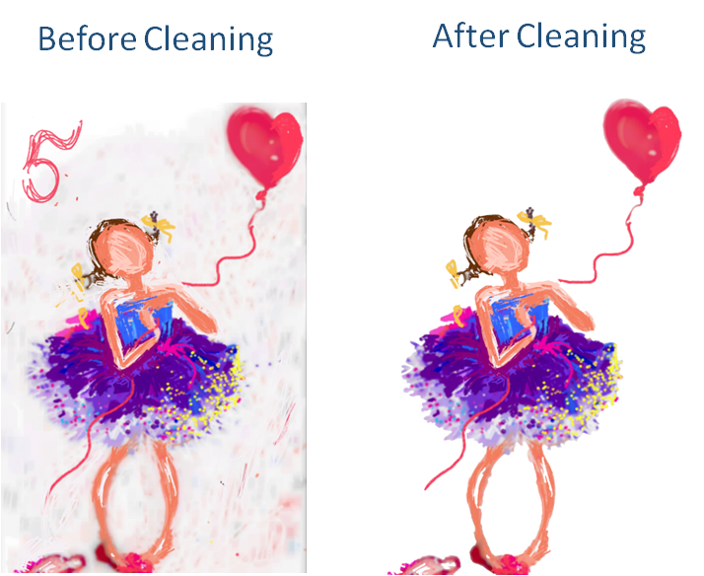
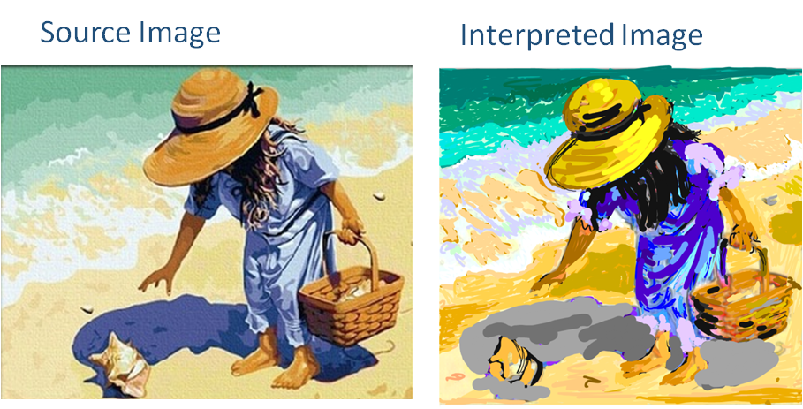
e-Painting
Photo Processing
Sketch Processing
Image Processing

Slide 13
e-Painting
Tools
Photo
re-Format
Re-Coloring
Shape design
Cleaning
Tablet
Paint Studio
PhotoShop
PhotoShop
Paintrala

Slide 14
e-Design Methodology
01
Composition of paper sketch
02
Search and Download scene elements from internet
03
Transforming of elements for scene
04
Composition of rough scene
05
Final composition and polishing

Slide 15
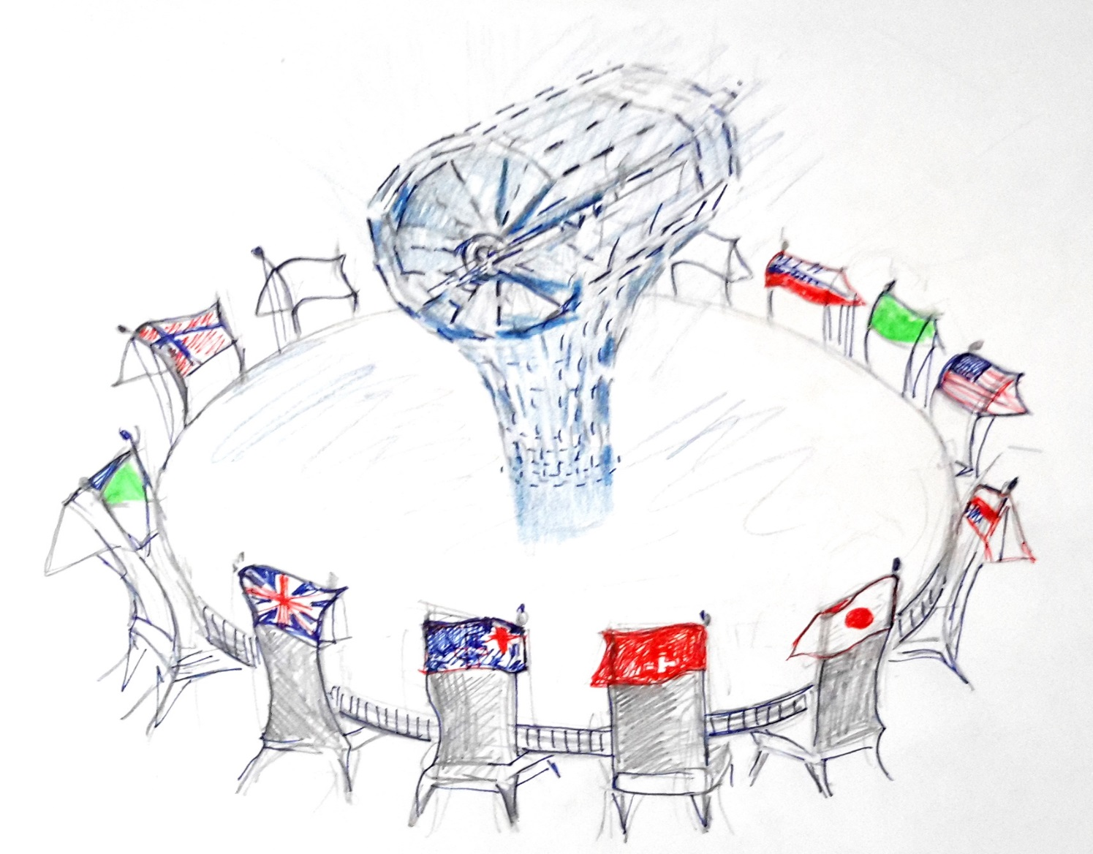
e-Design Methodology
01
Paper sketch Composition

Slide 16




















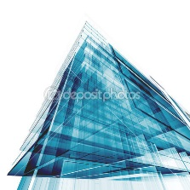














e-Design Methodology
02
Downloading of Scene Elements

Slide 17


e-Design Methodology
03
Transforming of elements for scene

Slide 18


e-Design Methodology
03
Transforming of elements for scene

Slide 19

e-Design Methodology
04
Rough Scene Composition

Slide 20



e-Design Methodology
05
Final composition and polishing

Slide 21

e-Design Methodology
05
Final composition and polishing

Slide 22
Thanks for your attention!
ketevan.mirziashvili@cern.ch

