Slide 1



ATLAS Tracer
Engine and functionalities
Davit Varamashvili
Georgian Technical University

Slide 2
Overview
About Engine
  About WebGL
  About three.js
Three.js possibilities
Engine possibilities
ATLAS Tracer engine and functionalities
Davit Varamashvili

Slide 3
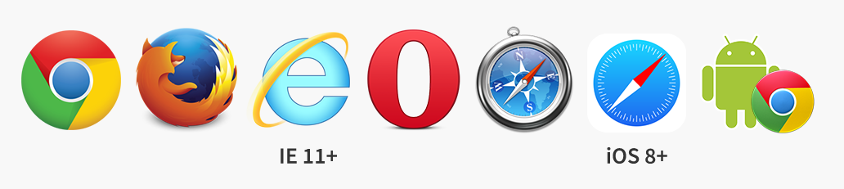
About Engine
WebGL
JavaScript API for rendering interactive 2D and 3D graphics inside an HTML <canvas> element.
Browser Support
ATLAS Tracer engine and functionalities
Davit Varamashvili

Slide 4

About Engine
Three.js
ATLAS Tracer is using three.js ( Javascript )
three.js is WebGL based library.
Which gives opportunity to display 3D objects in web browser.
http://threejs.org/
ATLAS Tracer engine and functionalities
Davit Varamashvili

Slide 5
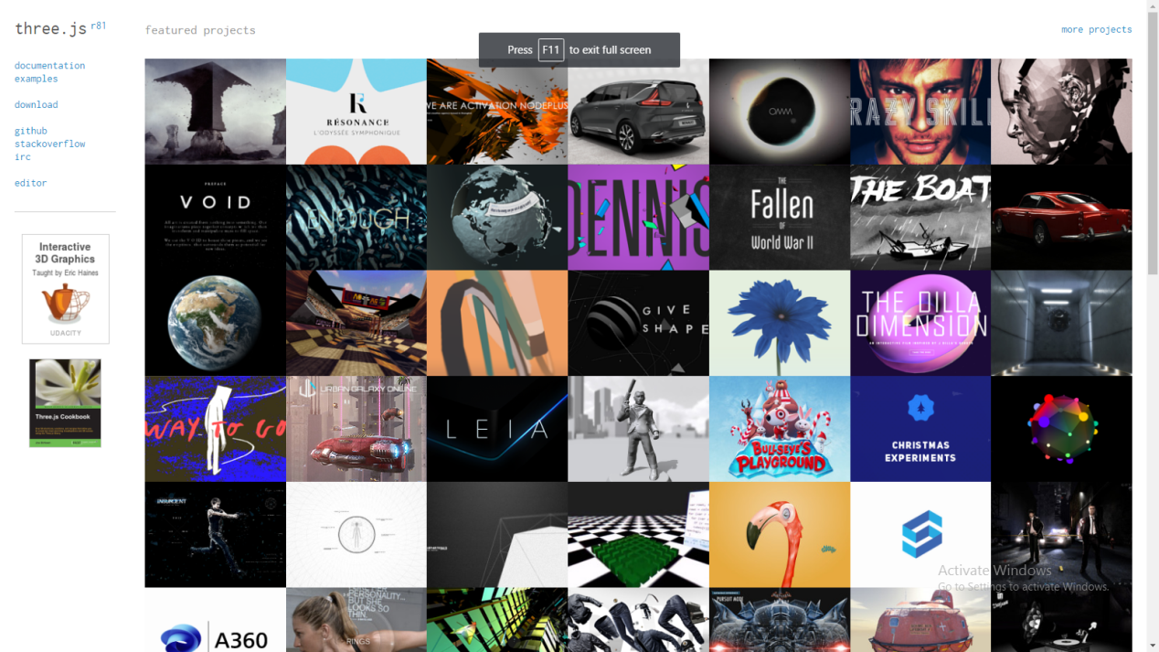
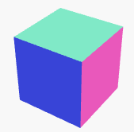
About Engine
Three.js
Three.js can use an HTML <canvas>, <svg> elements to show and
interact 3D graphics
It can render Scenes, cameras, geometry, 3D model loaders, lights, materials, shaders, particles, animation, math utilities
ATLAS Tracer engine and functionalities
Davit Varamashvili

Slide 6
About Engine
Javascript
Three.js
container = $("#vrmlPart1")[0];
canvas = $("#vrmlPart1 > canvas")[0];
canvasPosition = $(canvas).position();
renderer = new THREE.WebGLRenderer(…);
HTML
<html>
<body>
<div id="vrmlPart1" style="display:block">
<canvas></canvas>
</div>
</body>
</html>
ATLAS Tracer engine and functionalities
Davit Varamashvili

Slide 7
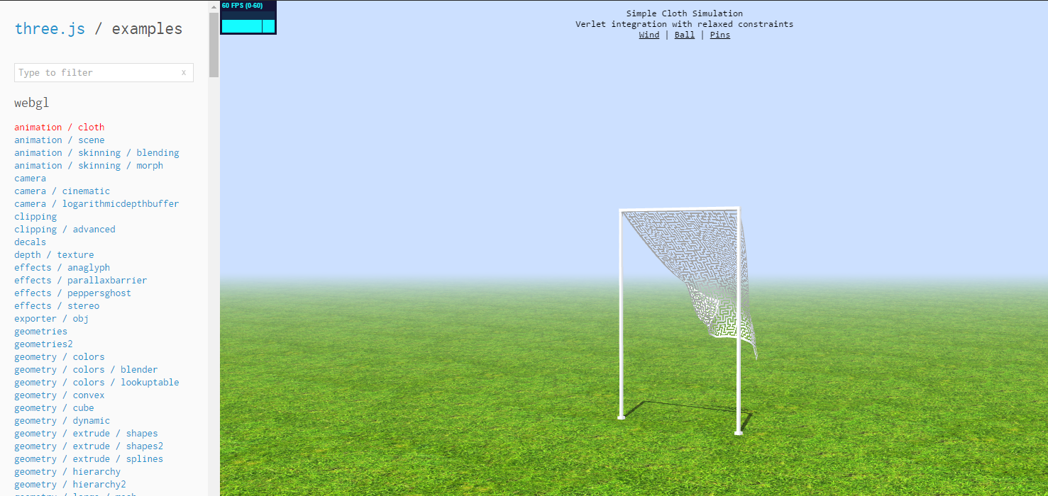
About Engine
Three.js Examples
ATLAS Tracer engine and functionalities
Davit Varamashvili

Slide 8
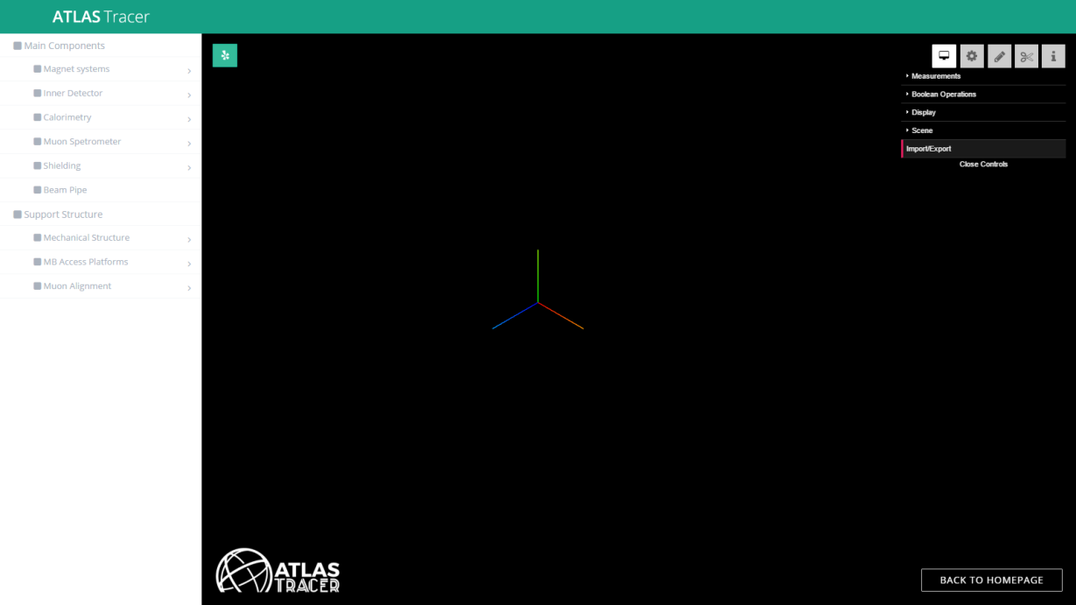
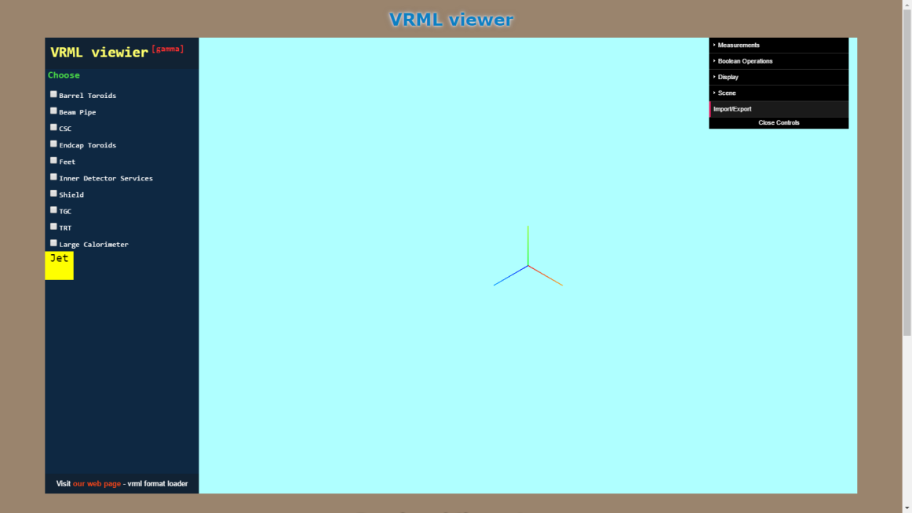
ATLAS Tracer engine and functionalities
Davit Varamashvili

Slide 9


Engine possibilities
Loading and manipulating 3D objects
ATLAS Tracer engine and functionalities
Davit Varamashvili

Slide 10
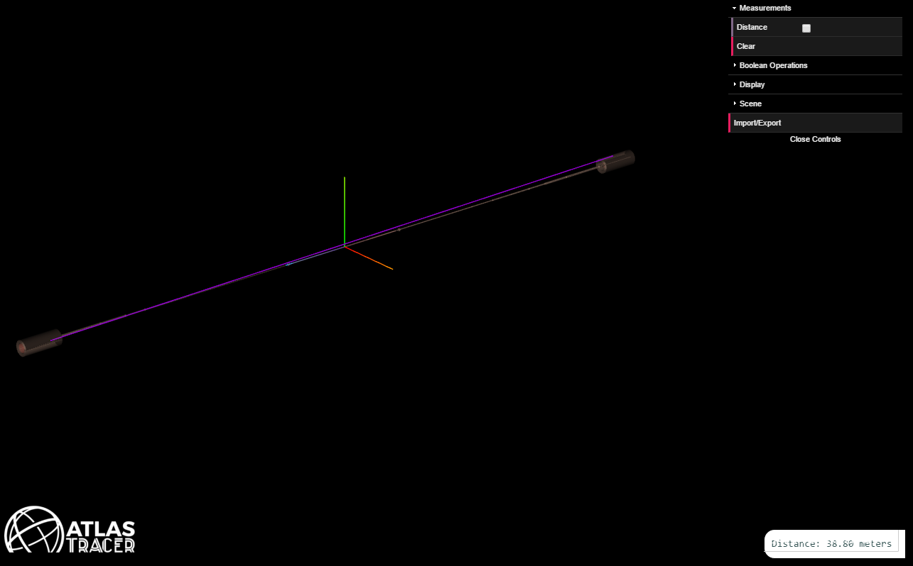
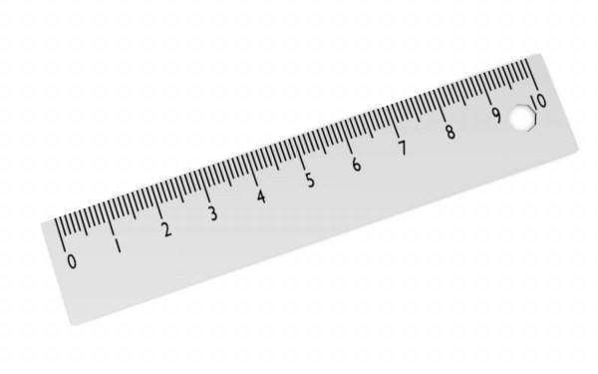
Engine possibilities
Distance measurement
ATLAS Tracer engine and functionalities
Davit Varamashvili

Slide 11
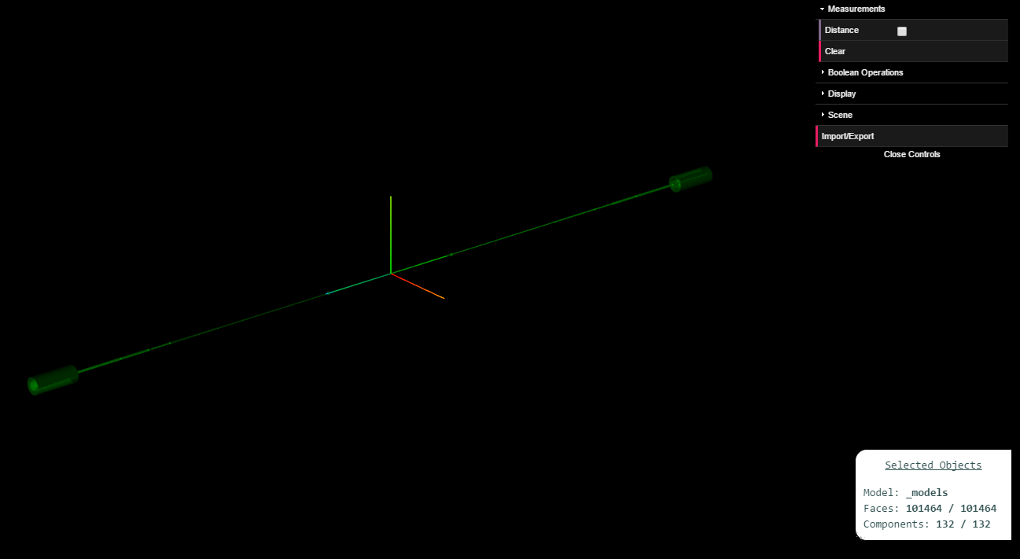
Engine possibilities
Model selecting
Selected faces/number of faces
Selected components/number of components
ATLAS Tracer engine and functionalities
Davit Varamashvili

Slide 12
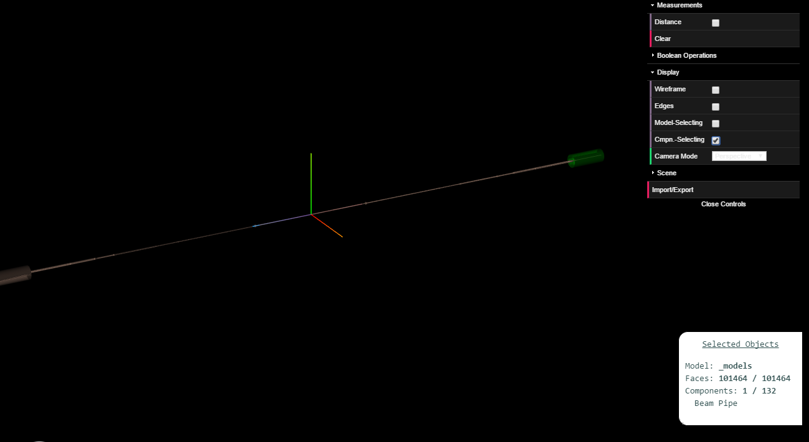
Engine possibilities
Component selecting
Selected faces/number of faces
Selected components/number of components
ATLAS Tracer engine and functionalities
Davit Varamashvili

Slide 13
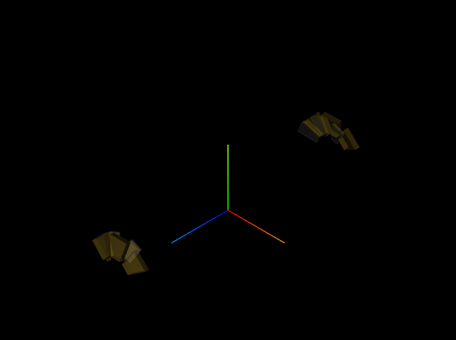
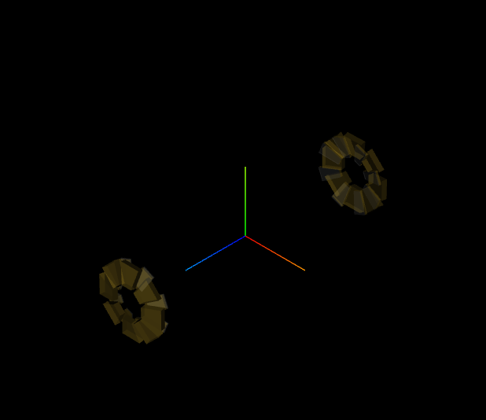
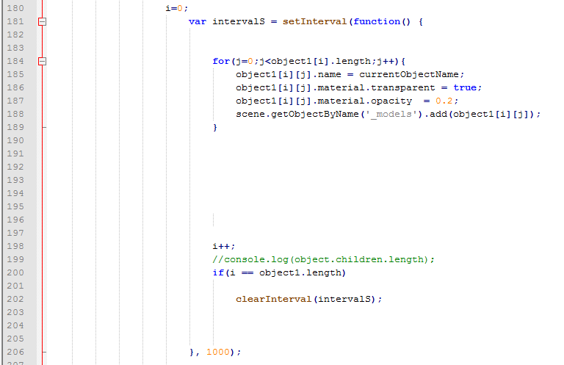
Engine possibilities
Loading Animation

Slide 14
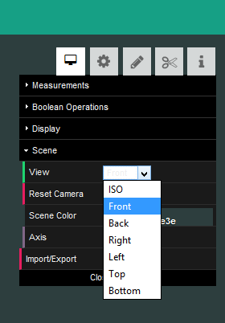
Engine possibilities
Scene

Slide 15
Thank you for your attention
ATLAS Tracer engine and functionalities
Davit Varamashvili

