Slide 1
STRUCTURE OF MATTER
Discoveries and Mysteries
Rolf Landua
CERN

Slide 2
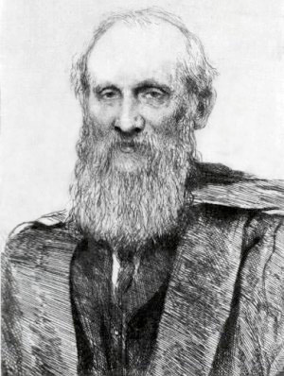
PREFACE
This is a lecture about 100 years of particle physics.
It covers about 100 years of ideas, theories and experiments.
More than 50 Nobel prize winners on particle physics
This is a broad overview about the main discoveries.
In the early 1900s, most physicists believed that physics was complete, described by classical mechanics, thermodynamics, and the Maxwell theory.
“There is nothing new to be discovered in physics now. All that remains is more and more precise measurement. “ (Lord Kelvin, 1900)
DARK CLOUDS:
1) Blackbody radiation - Quantum Physics
2) Michelson-Morley experiment - Special Relativity
Lord Kelvin

Slide 3

Particles
Fields
Electromagnetic
Weak
Strong
1895
1
1900
e⁻
Brownian motion
Photon
Radio-activity
1905
Atom
Special relativity
1910
Nucleus
Quantum mechanics
Wave / particle
Fermions / Bosons
1920
p⁺
1930
e⁺
n
Spin Antimatter
Fermi Beta-Decay
Yukawa
π exchange
1940
μ ⁻
π
1950
Particle zoo
QED
P, C, CP violation
τ⁻
p⁻
2
1960
νe
W bosons
Higgs
νμ
u
d
s
EW unification
1970
GUT
QCD
Colour
c
SUSY
1975
τ⁻
STANDARD MODEL
1980
ντ
b
Superstrings
g
W
Z
1990
3 generations
t
2000
ν mass
2010

Slide 4
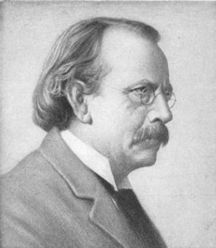
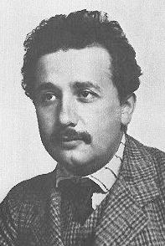
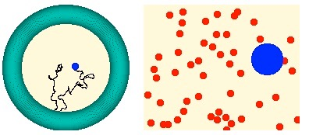

MATTER IS MADE OF PARTICLES
1897: ELECTRON - the first ‘discrete’ building block of matter
J.J. Thomson
1905: ATOMS ARE REAL - Explanation of Brownian Motion (Perrin)
A. Einstein

Slide 5
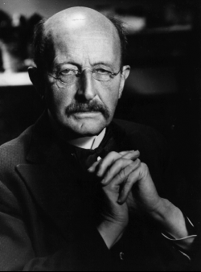
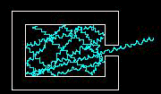


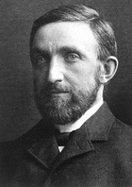
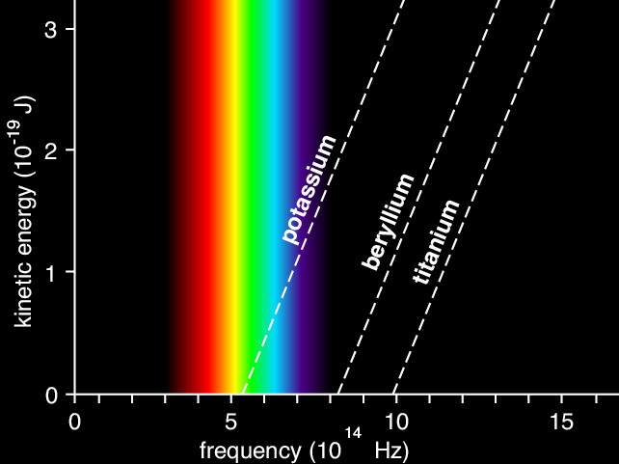
ENERGY COMES IN QUANTA
1900: ELECTROMAGNETIC RADIATION IS EMITTED IN QUANTA
ε = h ν
M. Planck
1902: PHOTOELECTRIC EFFECT
“The electron energy does not show the
slightest dependence on the light intensity”
P. von Lenard
1905: LIGHT IS EMITTED AND ABSORBED IN QUANTA
Emax = hν - W
“My only revolutionary contribution to physics”
A. Einstein

Slide 6
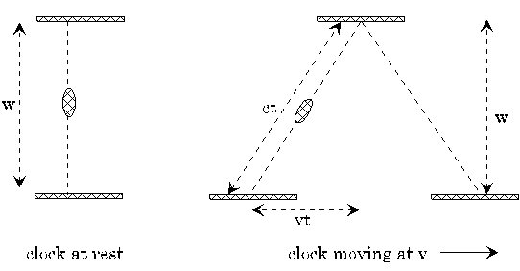

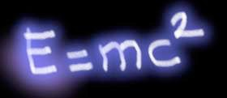
SPECIAL RELATIVITY
1905: SPEED OF LIGHT IS ALWAYS CONSTANT
c²t² = v²t² + w²
A. Einstein
1) Time dilation, space contraction
2) Modification of Newton’s laws, relativistic mass increase.

Slide 7
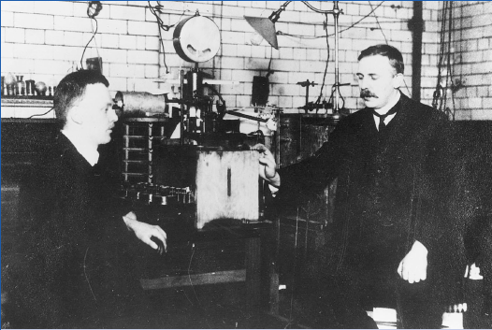
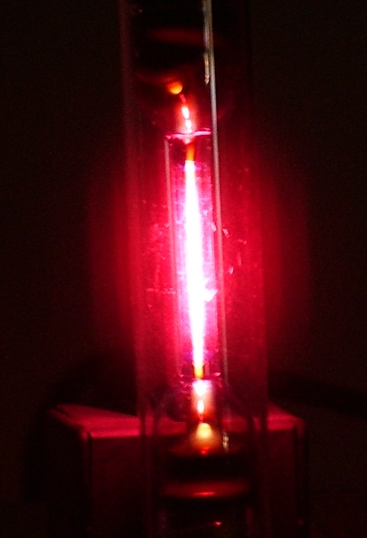
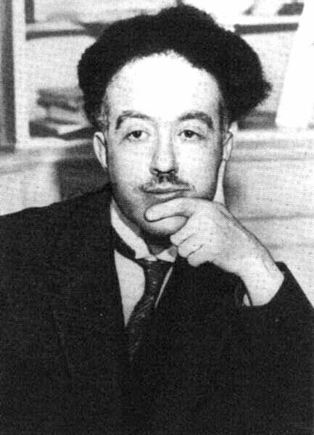
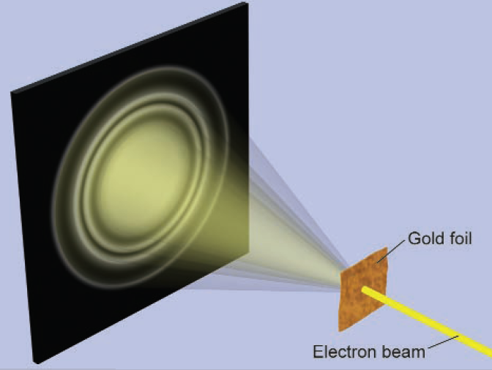

THE BEGINNING OF ATOMIC PHYSICS
1909: NUCLEI: very small + heavy within (almost) empty atom
Rutherford
1913: BOHR MODEL- (empirical) explanation of discrete spectral lines
(using Planck’s constant h) to quantize angular momentum
Hydrogen
1923: DE BROGLIE
Particles are waves
L. de Broglie

Slide 8
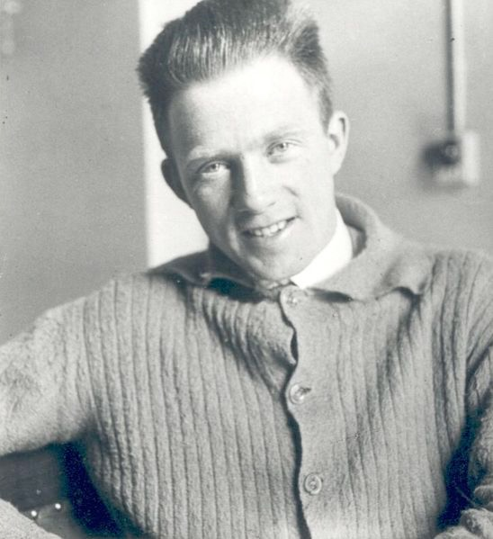

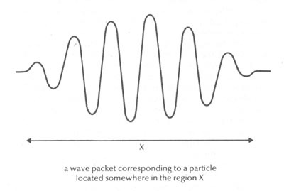
QUANTUM MECHANICS
1923: UNCERTAINTY RELATION
Heisenberg

Slide 9

From classical to quantum mechanics
Energy E of a particle with mass m,
momentum p, in a potential V(r)
Total energy = kinetic + potential energy

Slide 10


How to translate
from particle to wave language?
A wave is described by a spatial function ψ(x) with circular frequency
and wave vector

Slide 11


De Broglie momentum of a “particle wave”:
Energy of a “particle wave”:

Slide 12



Get momentum using gradient:

Slide 13


Get energy using time derivative:

Slide 14


Schrödinger equation:

Slide 15
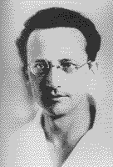
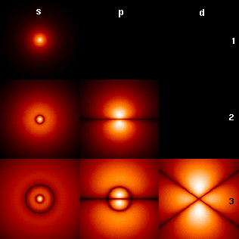
  1926: SCHRÖDINGER EQUATION
Schrödinger
  (electrons in atoms form ‘standing waves’)
Interpretation (Born, 1927):
ψ = probability amplitude
|ψ|² = probability

Slide 16
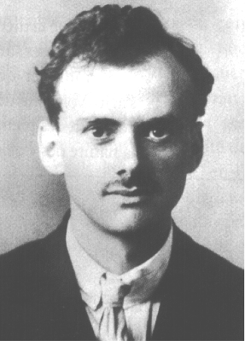


RELATIVISTIC QUANTUM MECHANICS
e⁻
Spin
e⁻
Ψ =
e⁺
Antimatter
Paul A.M. Dirac
(1928)
e⁺
ELECTRON SPIN 1/2 EXPLAINED
ANTIPARTICLES MUST EXIST !
SPIN 1/2 PARTICLS (FERMIONS) MUST OBEY EXCLUSION PRINCIPLE

Slide 17
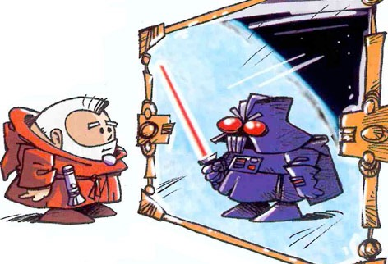
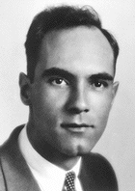
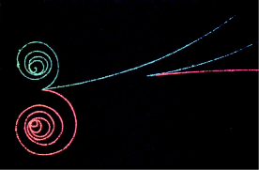
ANTIPARTICLES
1932: POSITRON DISCOVERY
EVERY PARTICLE HAS AN ANTIPARTICLE
Anderson
WHEN ENERGY CONVERTS TO MASS,
PARTICLES AND ANTIPARTICLES ARE PRODUCED

Slide 18
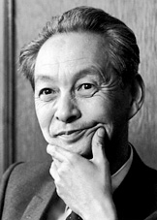
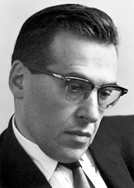
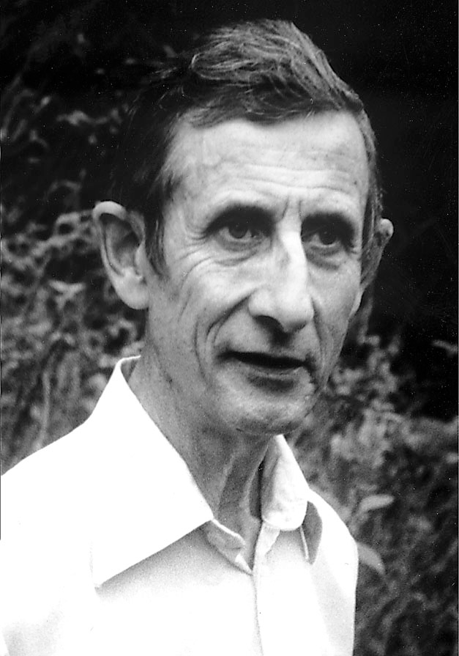
QUANTUM FIELD THEORY (1927 - 1948)
It was known that the electromagnetic field consists of photons
S.I. Tomonaga
How could the interaction between electrons and photons
be correctly described, respecting quantum mechanics and special relativity?
J. Schwinger
Many people worked on this problem ...
F. Dyson

Slide 19
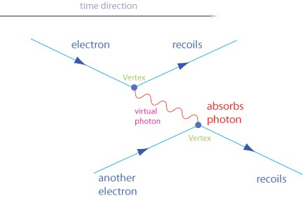
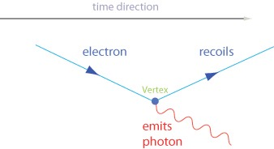
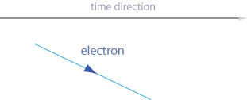
Quantum Electrodynamics (QED)
R.P. Feynman

Slide 20
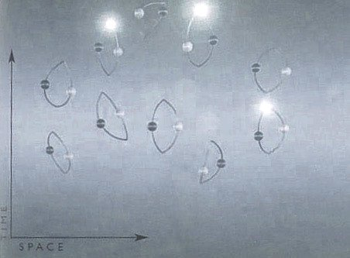
VACUUM FLUCTUATIONS
Quantized fields: Ground state energy is ≠ 0
Photons and particle-antiparticle-pairs populate empty space !
[ Remark: should give rise to (lots of) “vacuum energy” ]
UNCERTAINTY RELATION:
Δ E x Δ t ≥ h/2π

Slide 21
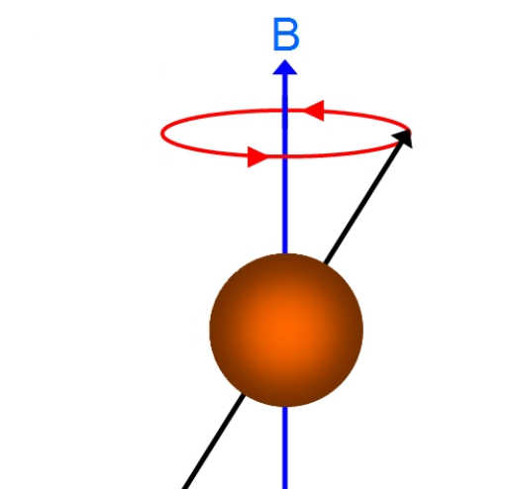

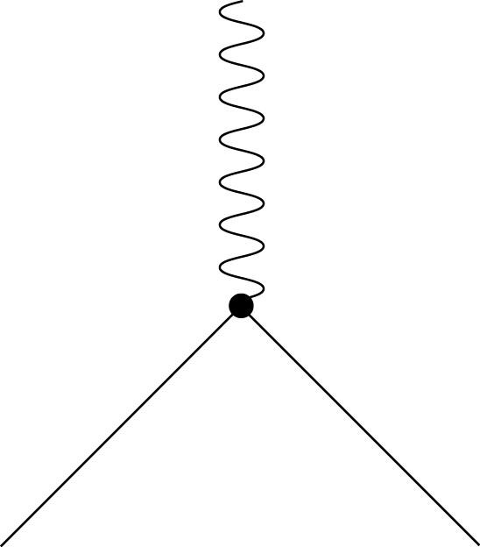
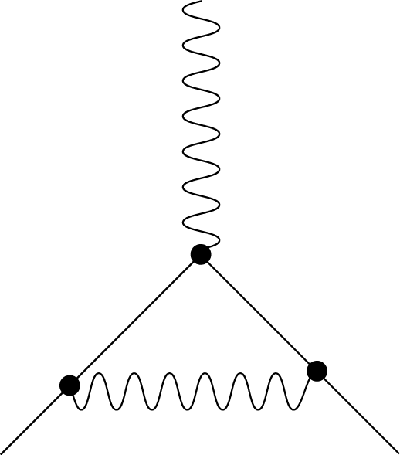
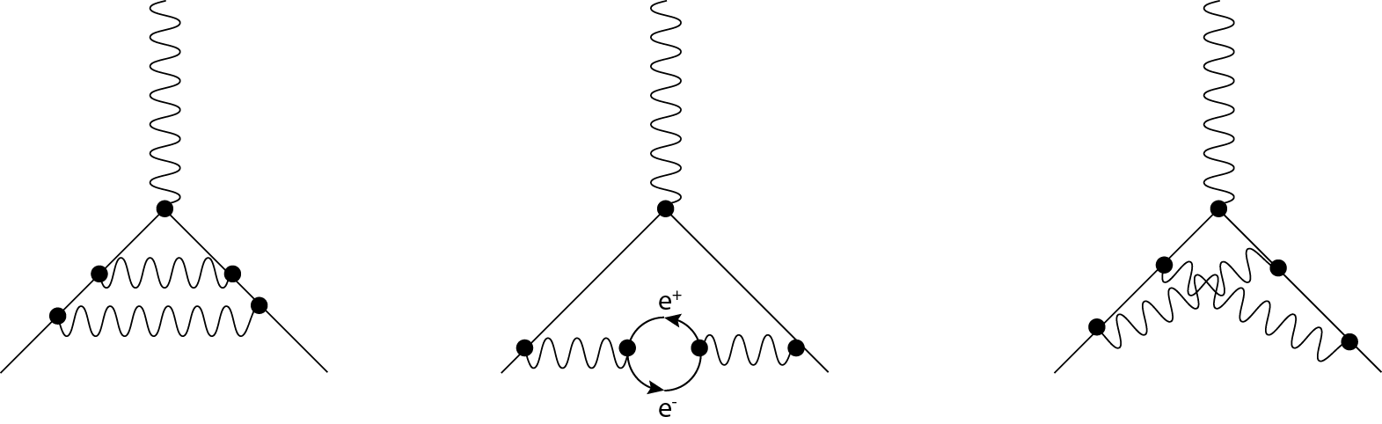
Vacuum fluctuations have observable effects
The world record for the most precise calculation in physics goes to:
Electron anomalous magnetic moment “g”
+
+
“Leading order”
Second order
Fourth order corrections
g = 2
a = (g-2)/2 = 1/2π * 1/137
~ 0.0011614
Current precision (theory and experiment agree!) :
a = 0.00115965218073(28)

Slide 22
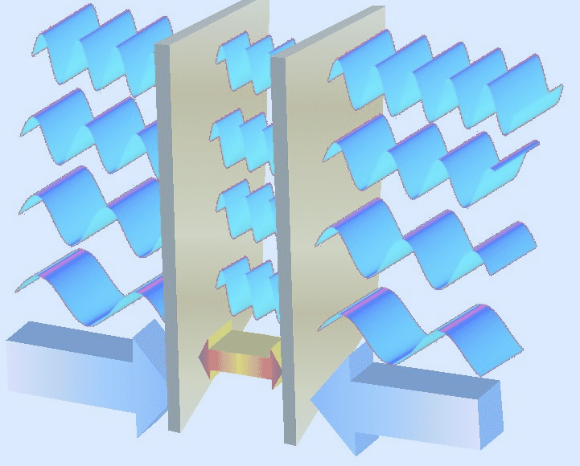

CASIMIR EFFECT
p = 100 kPa (d=11 nm)
SPOOKY: at 11 nm distance, the pressure is 1 atm.
(force on two uncharged metal plates)

Slide 23
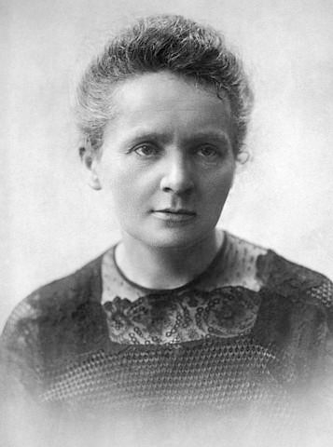
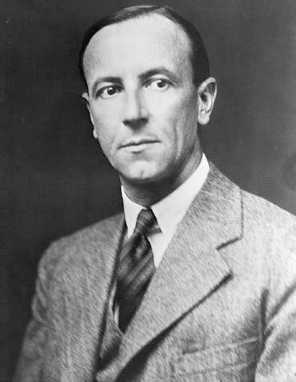
NUCLEAR PHYSICS
1895-1900: RADIOACTIVITY - strange radiation phenomena
M. Curie
1903: Alpha-, Beta-, Gamma-Radiation known
(different penetration depth)
E. Rutherford
1911: Nucleus positive, small - surrounded by electrons
1932: DISCOVERY OF THE NEUTRON
J. Chadwick
Alpha particle = He nucleus

Slide 24
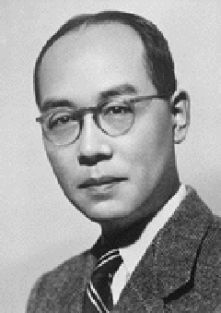
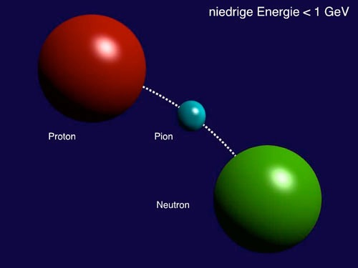
NUCLEAR PHYSICS - 1934
What keeps protons and neutrons together ?
Yukawa (1934)
Why is the range of nuclear forces finite?
(maximum size of nuclei ~ 5 fm)
Yukawa model:
New “strong” interaction
Exchange of “pion”
Pion has mass: finite range of 1-2 fm

Slide 25
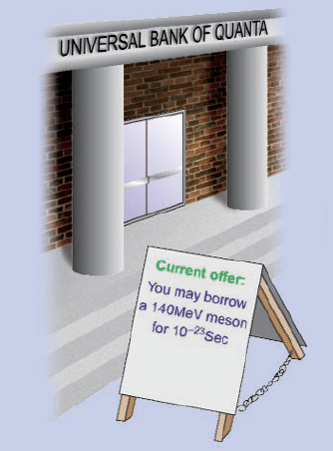
Toy model:
UBS offers you a loan of
1000 Euro x Seconds
UNCERTAINTY RELATION:
Δ E x Δ t ≥ h/2π

Slide 26
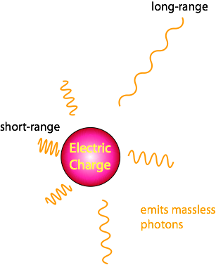
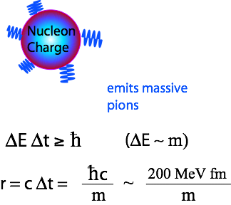

Electromagnetic
vs
Nuclear
Exchange Forces
Coulomb law
Yukawa potential ~ Modified “Coulomb” law

Slide 27



QUARKS AND QCD
An accelerator is a giant microscope ….
… and can also produce new particles:
E = mc²

Slide 28
1948 - 1960s: New accelerators and detectors
PARTICLE ZOO contains ~ 200 'elementary particles'
Mesons
BARYONS
π ⁺
π ⁻
π ⁰
Δ⁺⁺, Δ⁺, Δ⁰, Δ⁻
Pions
K⁺
K⁻
K⁰
η'
Delta
Λ⁰
Kaons
Eta-Prime
η
Σ⁺, Σ⁰, Σ⁻
Lambda (strange!)
φ
Eta
Sigma (strange!)
Phi
Ξ⁰, Ξ⁻
ρ ⁺
ρ ⁻
ρ º
Sigma(very strange!)
Rho
Underlying structure ?

Slide 29
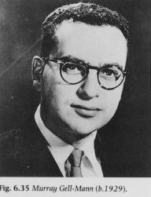

Classification scheme based on ‘quarks’
1963
3 types of “quarks” : up, down, strange (and their anti-particles)
u
d
s
+2/3 e
-1/3 e
-1/3 e
electric charge
+2/3
-1/3
-1/3
Gell-Mann, 1963
(G. Zweig, 1963)
u
u
u
d
d
π⁺
p
Meson
Baryon

Slide 30
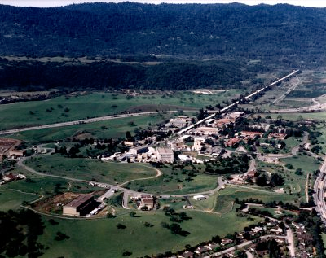
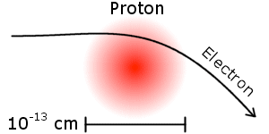
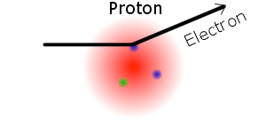
Discovery of quarks
Electron-Proton scattering at Stanford
1956 Hofstadter: proton radius ~ 1 fm
E = 0.2 GeV
Stanford Linear Accelerator Centre
1967 Friedmann, Kendall, Taylor: three ‘point-like particles’ inside a proton
E = 20 GeV
Measured cross-sections perfectly
compatible with presence of
2 up- and 1 down-quark in proton

Slide 31
The concept of “Colour” charge
How can you explain this particle ?
u
Δ⁺⁺
u
three fermions are not allowed to be in the same quantum state
(Pauli exclusion principle)
+2/3
u
+2/3
Spin = 3/2
+2/3
+2/3
A new concept: “colour charge”
Colour charge is source of ‘strong force’
There are three types of colour (e.g. “red”, “green”, “blue”)
Only colour-neutral states can exist
(Bardeen, Fritzsch, Gell-Mann)

Slide 32




Quarks carry a “colour” charge - in addition to their electric charge
(that makes them different and hence exclusion principle does not apply)
red
u
Δ⁺⁺
u
u
green
blue
red
WHITE
(colour-
neutral
state)
green
blue

Slide 33
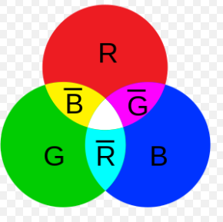
Quarks interact by exchanging ‘gluons’ that carry colour (and anti-colour)
red
blue
quark
Gluon
red-antiblue
blue
red
quark
Total number of gluons: 3 x 3 - 1 = 8
(1 combination is a ‘colour-singlet’, i.e. neutral)

Slide 34
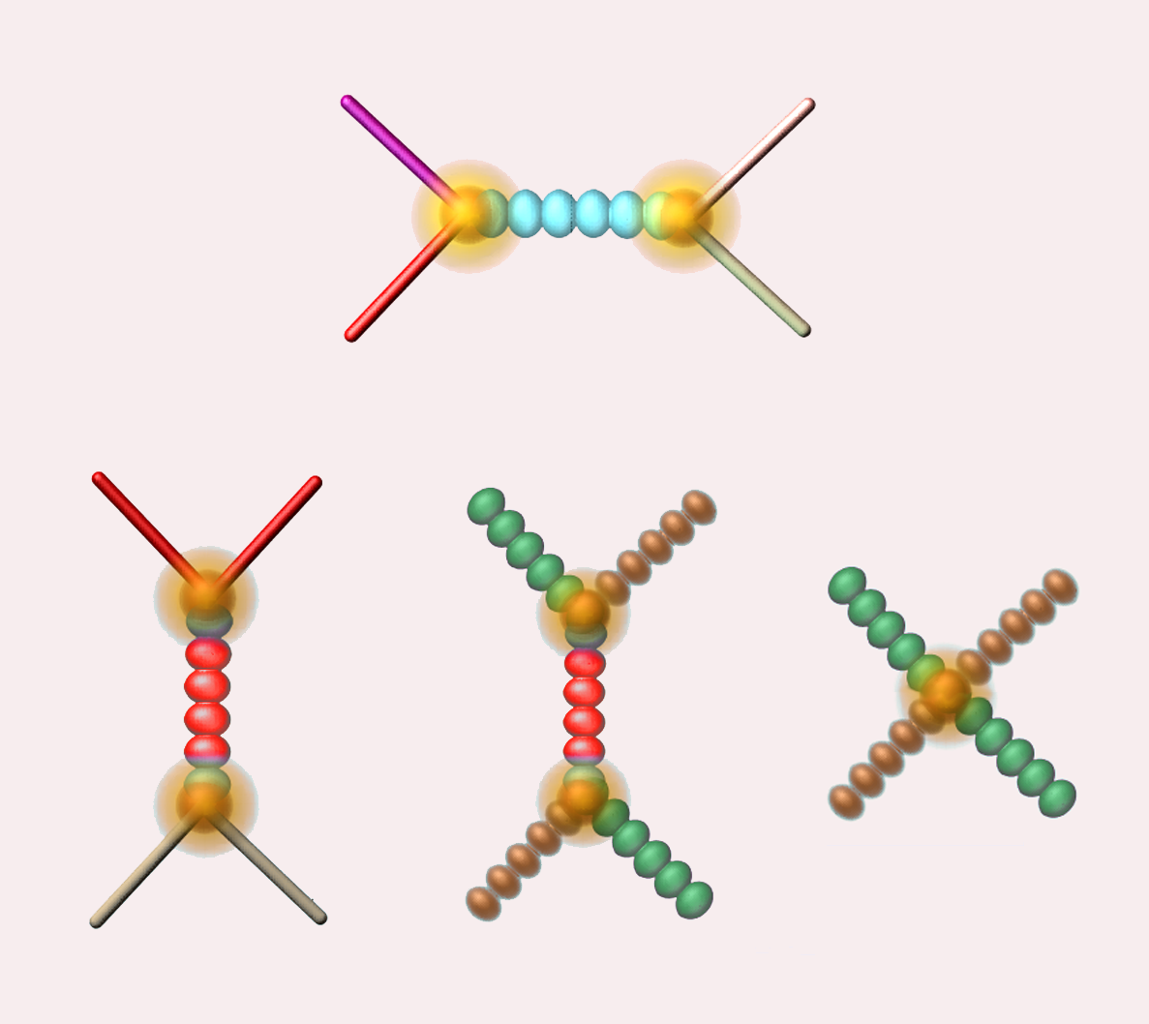
Since gluons carry a (colour) charge:
Gluons can interact with other gluons
Quark
Quark
Quark
Quark
Quark
Quark
GLUON
GLUON
GLUON
GLUON
GLUON
GLUON
Quark
Quark
GLUON
GLUON

Slide 35

The self-interaction of the gluons results in the energy of the gluon string
increasing with distance between quarks.
This produces a force that keeps the quarks as ‘prisoners’.
quark
quark

Slide 36
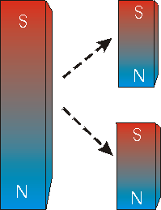

Gluon ‘strings’ break : new quark-antiquark pairs
Analogy to breaking a
magnet into two halves: does not produce a magnetic monopole
Meson
excited
state of
meson
string breaking: two mesons

