Slide 1


Future strategies and technologies
M. Benedikt
gratefully acknowledging input from FCC coordination group the global design study team and all contributors
LHC
PS
FCC
SPS
http://cern.ch/fcc
Work supported by the European Commission under the HORIZON 2020 project EuroCirCol, grant agreement 654305

Slide 2

High energy accelerators & colliders
Using electrical fields (RF cavities)to accelerate and magnetic fields (accelerator magnets) to guide and collide charged particle beams (electrons, protons & anti-particles)
Aim at higher energy accelerators for 2 reasons:
  Production of new heavier particles (according to Einstein): E = mc² ≤ 2E beam (collider)
  Resolving smaller distances (according to de Broglie): Wavelength λ = hc/E for LHC ∼ 2⋅10⁻¹⁸ cm
Higher energy → Increased potential for discoveries
Notes:
New slide from Davide.
Showing that conductor development is launched at international level, Russia, Japan, (Korea and Europe in preparation)
Underline importance of that development as main cost driver for the hadron collider machine.

Slide 3
Colliders constructed and operated
Colliders with
superconducting RF system
Colliders with
superconducting arc magnet system
Colliders with
superconducting magnet & RF
Notes:
New slide from Davide.
Showing that conductor development is launched at international level, Russia, Japan, (Korea and Europe in preparation)
Underline importance of that development as main cost driver for the hadron collider machine.

Slide 4
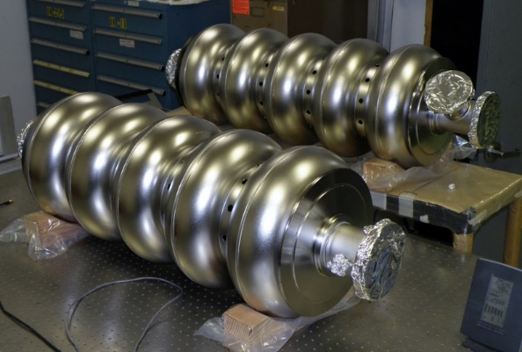
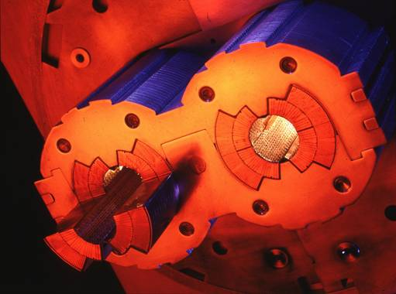
Colliders constructed and operated
Colliders with
superconducting RF system
Colliders with
superconducting arc magnet system
Colliders with
superconducting magnet & RF

Slide 5

Discoveries by colliders
Standard Model
Particles and forces
LHC:
Higgs-boson
SppS:
Z-boson
W-boson
Tevatron:
top-quark
PETRA:
gluon
SPEAR:
charm quark
tau lepton
Colliders are powerful instruments in High Energy physics
for particle discoveries and precision measurements
Notes:
New slide from Davide.
Showing that conductor development is launched at international level, Russia, Japan, (Korea and Europe in preparation)
Underline importance of that development as main cost driver for the hadron collider machine.

Slide 6
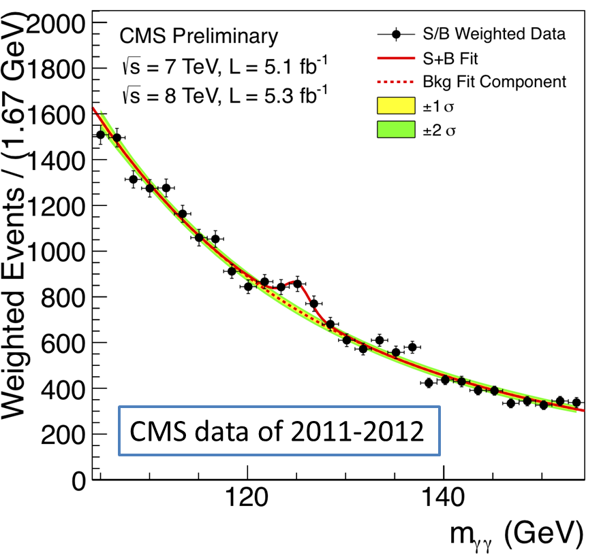
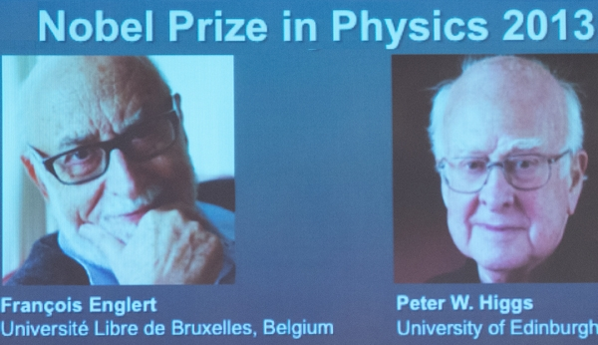
LHC: present collider flagship
2012: Higgs boson discovery
    Completes standard model describing known matter, BUT this is only 5% of the universe!
    what is dark matter?
    what is dark energy?
    why is there more matter than antimatter?
    what about gravity?
    etc…
➔ Upgrade and full exploitation of LHC as first step
Notes:
New slide from Davide.
Showing that conductor development is launched at international level, Russia, Japan, (Korea and Europe in preparation)
Underline importance of that development as main cost driver for the hadron collider machine.

Slide 7
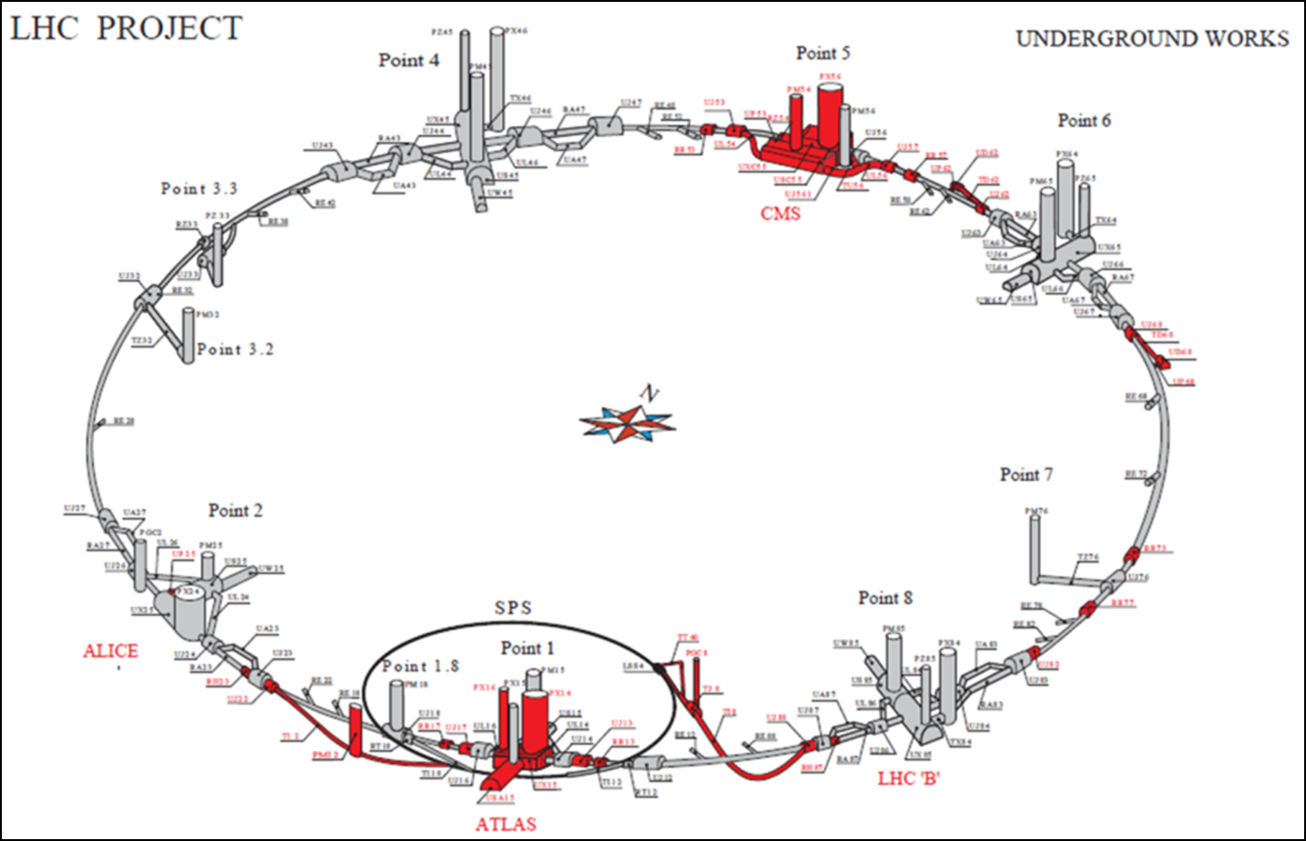
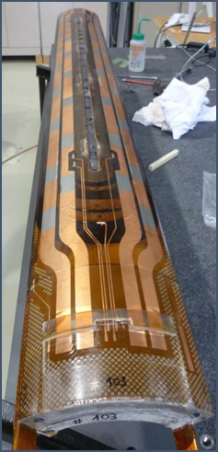
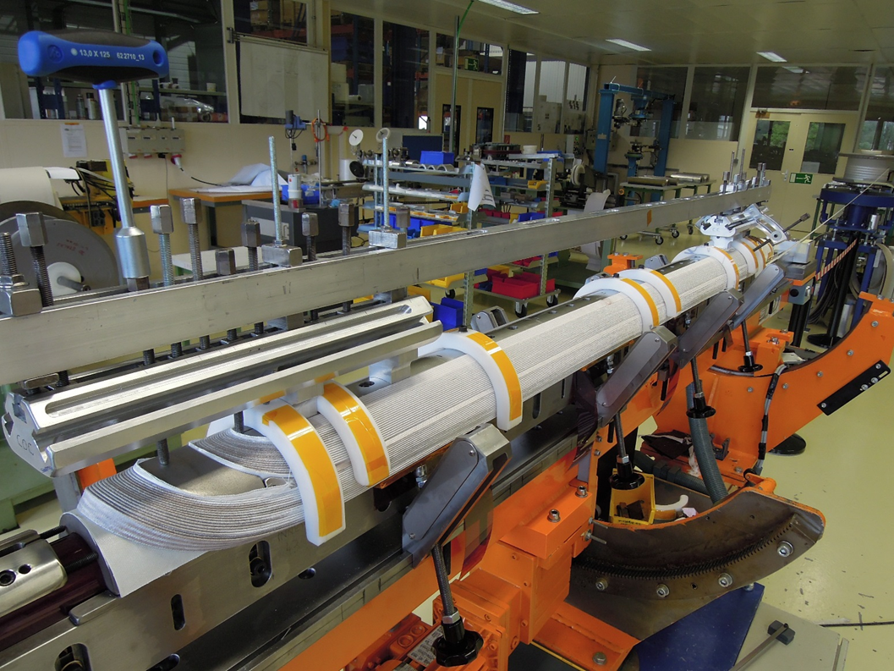
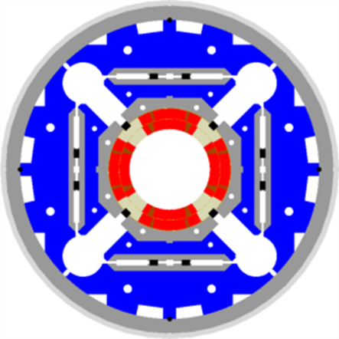
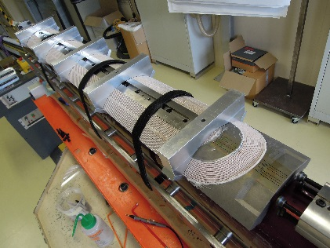
High Luminosity LHC project scope
More than100 new SC magnets
36 large magnets in Nb₃Sn
Powering via SC Links and HTS Current Leads
20 new RF cavities
New tunnel and surface infrastructures
New and upgraded cryo plants
L. Rossi
Notes:
New slide from Davide.
Showing that conductor development is launched at international level, Russia, Japan, (Korea and Europe in preparation)
Underline importance of that development as main cost driver for the hadron collider machine.

Slide 8
Step 1: HL-LHC upgrade – ongoing
    HL-LHC significantly increases data rate to improve statistics, measurement precision, and energy reach in search of new physics
    Gain of a factor 5 in rate, factor 10 in integral data wrt initial design
Notes:
New slide from Davide.
Showing that conductor development is launched at international level, Russia, Japan, (Korea and Europe in preparation)
Underline importance of that development as main cost driver for the hadron collider machine.

Slide 9
Step 2: Future high energy colliders
For physics beyond the LHC and beyond the Standard Model, under study (synergy of):
    Linear e⁺e⁻ colliders (CLIC, ILC)
    E_{CM} up to ∼ 3 TeV
    Circular e⁺e⁻ colliders (CepC, FCC-ee)
    E_{CM} up to ∼ 400 GeV - limited by e± synchrotron radiation. Ideal for precision measurements
    Circular p-p colliders (SppC, FCC)
    E_{CM} up to ∼ 100 TeV
    Ideal for discoveries at higher energy frontiers

Slide 10
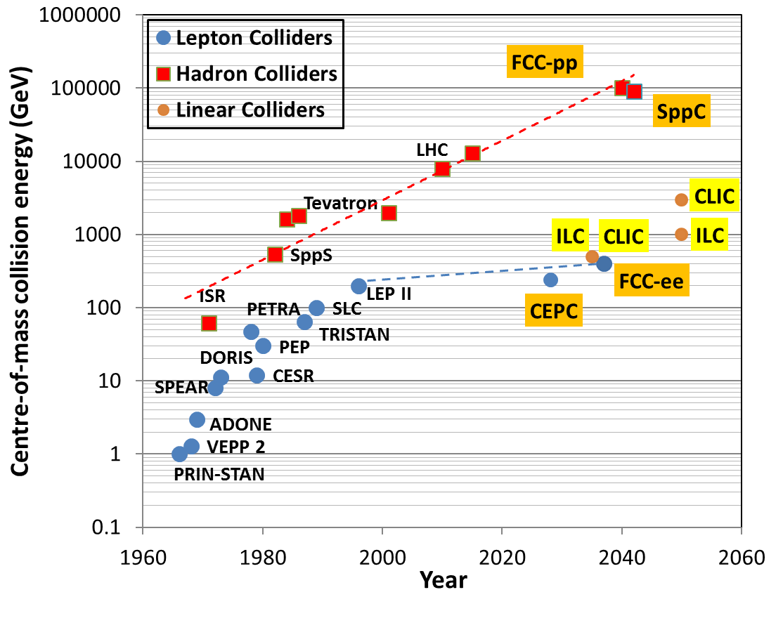
High Energy Colliders under study
100 TeV
100 TeV pp → 10⁻¹⁹ m
discovery of new particles at 10 TeV mass scale

Slide 11
European Strategy Update 2013
“CERN should undertake design studies for accelerator projects in a global context, with emphasis on proton-proton and electron-positron high-energy frontier machines.”

Slide 12
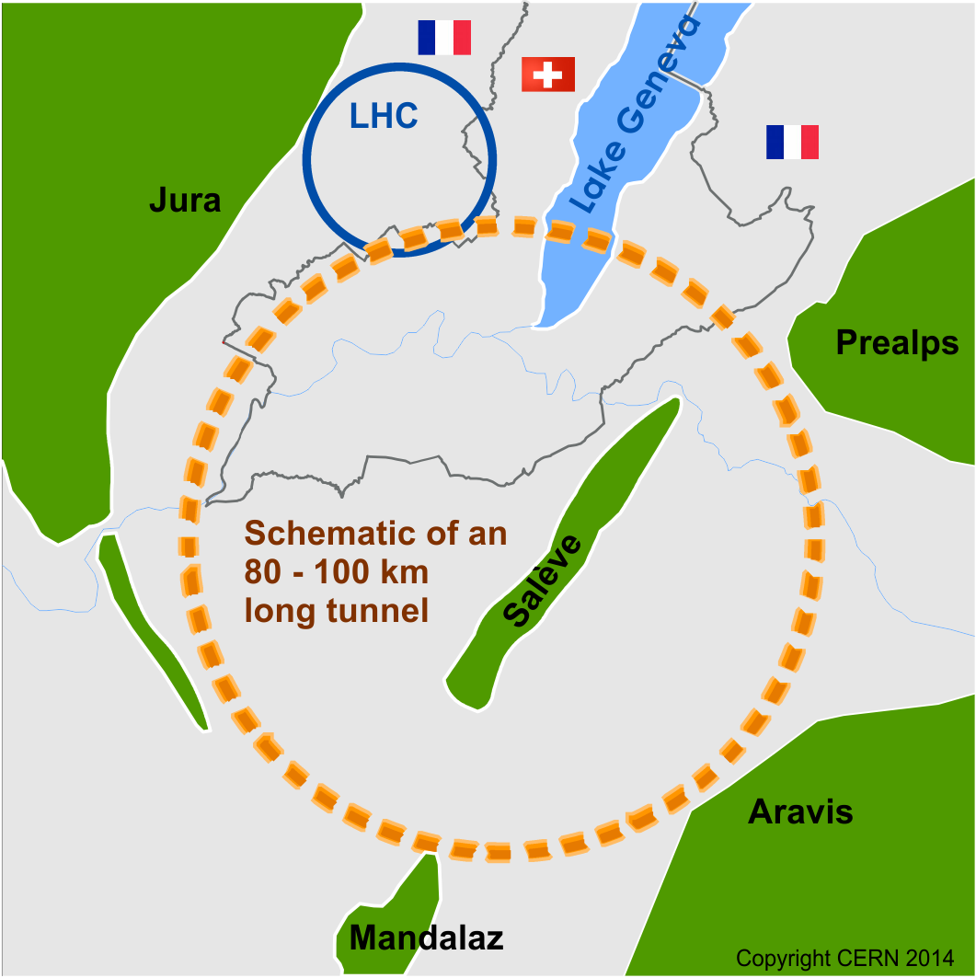
Future Circular Collider Study
GOAL: CDR and cost review for the next ESU (2019)
International FCC collaboration (CERN as host lab) to study:
pp-collider (FCC-hh) → main emphasis, defining infrastructure requirements
80-100 km tunnel infrastructure in Geneva area, site specific
e⁺e⁻ collider (FCC-ee), as potential first step
p-e (FCC-he) option, integration one IP, FCC-hh & ERL
HE-LHC with FCC-hh technology
~16 T ⇒ 100 TeV pp in 100 km

Slide 13
Tevatron (closed)
Circumference: 6.2 km
Energy: 2 TeV

Slide 14
Large Hadron Collider
Circumference: 27 km
Energy:
- 14 TeV (pp)
- 209 GeV (e⁺e⁻)

Slide 15
Future Circular Collider
Circumference: 80-100 km
Energy:
100 TeV (pp)
>350 GeV (e⁺e⁻)

Slide 16
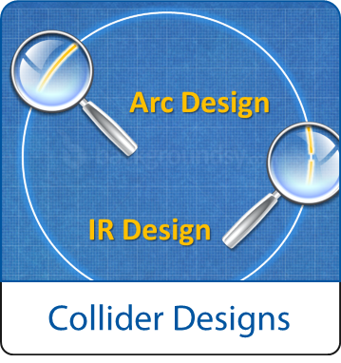
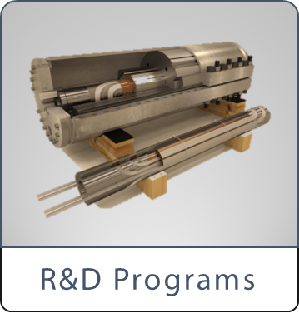
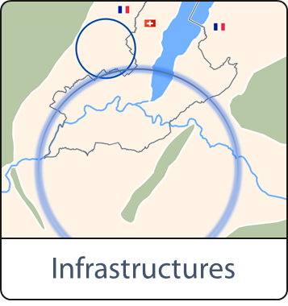
FCC Scope:
Accelerator and Infrastructure
FCC-hh: 100 TeV pp collider as long-term goal
→ defines infrastructure needs
FCC-ee: e⁺e⁻ collider, potential intermediate step
HE-LHC: based on FCC-hh technology
Launch R&D on key enabling technologies
in dedicated R&D programmes, e.g.
16 Tesla magnet program, cryogenics,
SRF technologies and RF power sources
Tunnel infrastructure in Geneva area, linked to CERN accelerator complex;
site-specific, as requested by European strategy

Slide 17

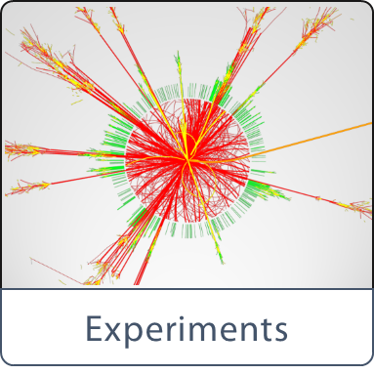

FCC Scope:
Physics & Experiments
Elaborate and document
- Physics opportunities
- Discovery potentials
Experiment concepts for hh, ee and he
Machine Detector Interface studies
R&D needs for detector technologies
Overall cost model for collider scenarios
including infrastructure and injectors
Develop realization concepts
Forge partnerships with industry

Slide 18
Role of CERN
Host the study
Prepare organisation frame
Setup collaboration
Identify R&D needs
Estimate costs

Slide 19
Strategic Goals
Make funding bodies aware of strategic needs for research community
Provide sound basis to policy bodies to establish long-range plans in European interest
Strengthen capacity and effectiveness in high-tech domains
Provide a basis for long-term attractiveness of Europe as research area

Slide 20
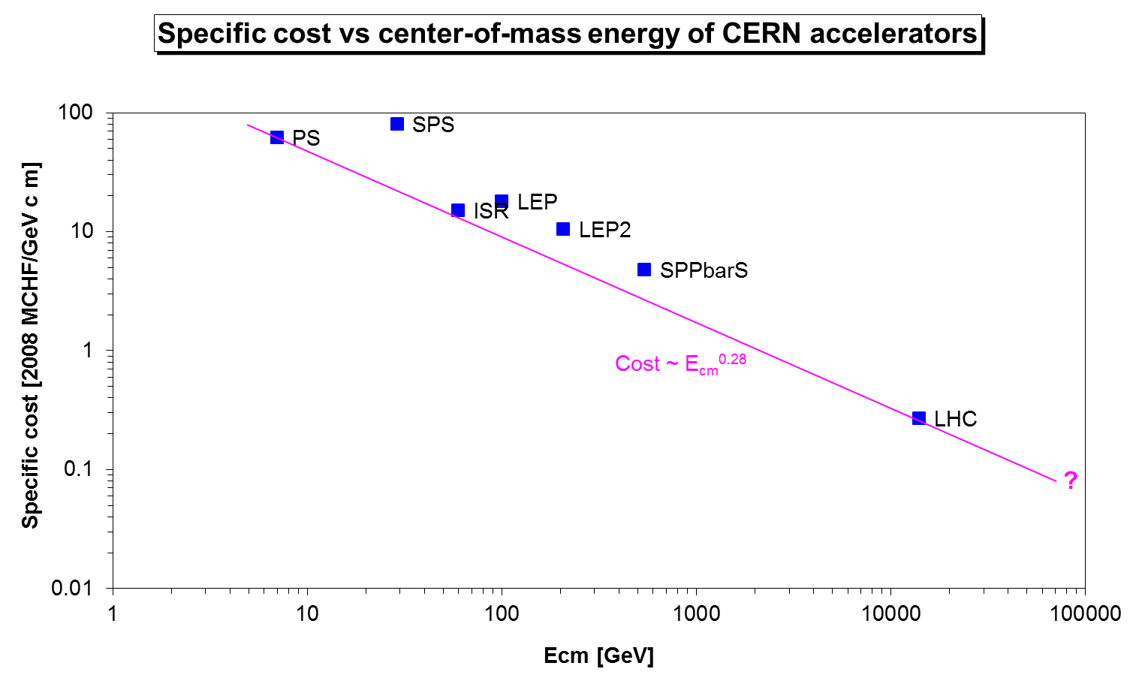
A sustained decrease in specific cost
Will FCC pass below the specific cost of
100 kCHF/GeV c.m.?

Slide 21
CERN Circular Colliders & FCC
1980
1985
1990
1995
2000
2005
2010
2015
2020
2025
2030
2035
Constr.
Physics
LEP
Design
Proto
Construction
Physics
LHC – operation run 2
HL-LHC - ongoing project
Design
Construction
Physics
~20 years
FCC – design study
Design
Proto
Construction
Physics
Must advance fast now to be ready for the period 2035 – 2040
Goal of phase 1: CDR by end 2018 for next update of European Strategy

Slide 22
Time Indicator
Case: LHC superconducting dipole magnets
Conceptual studies
R & D
Development
Industrialization
Series production
Industry participation
Total
1980
1985
1990
1995
2000
2005
2010
~ 15 years
~ 25 years

Slide 23
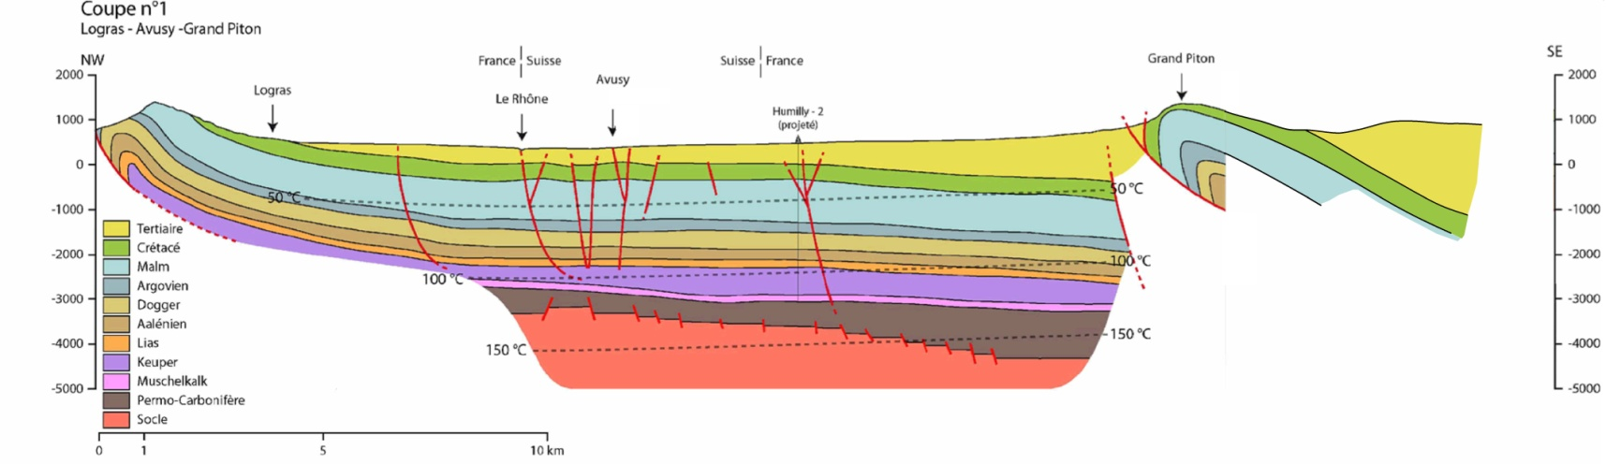
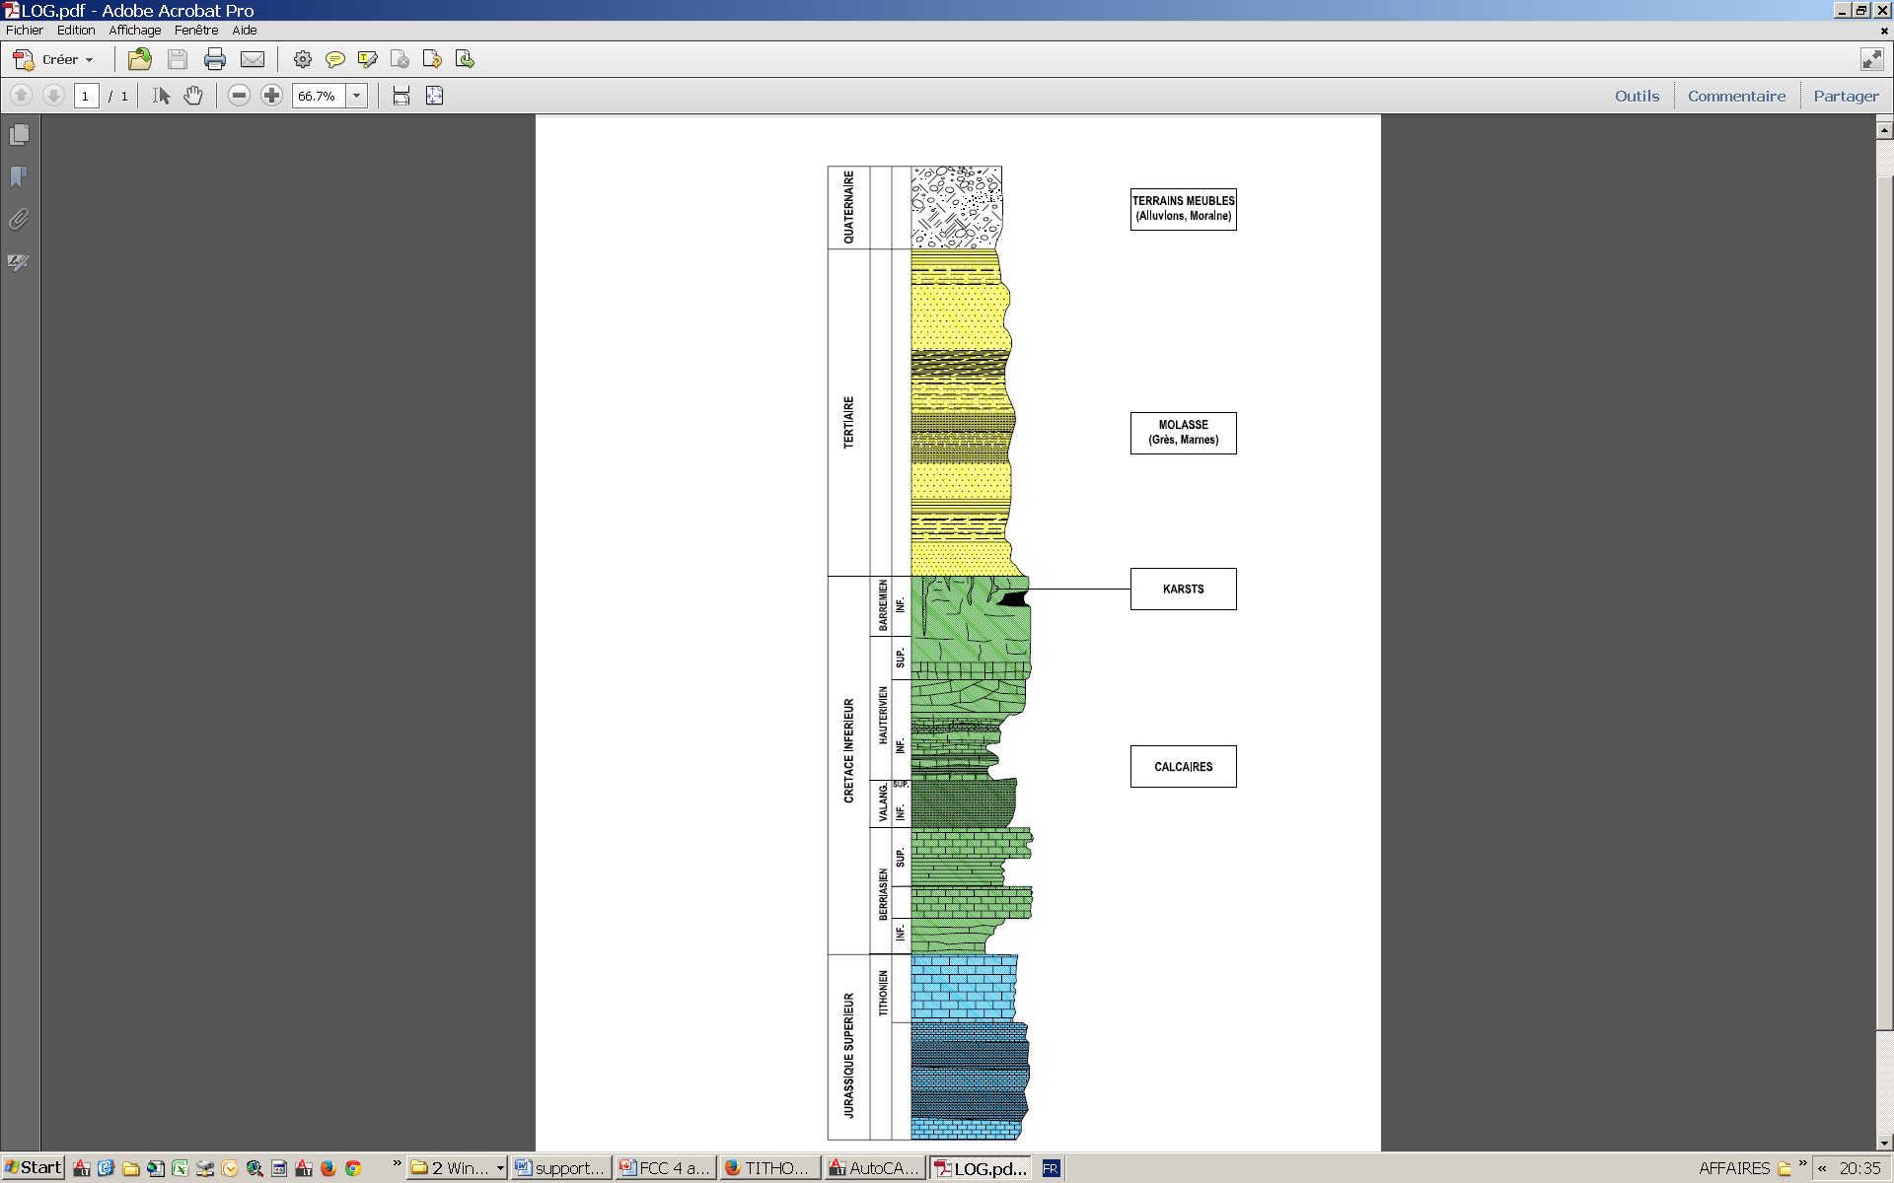
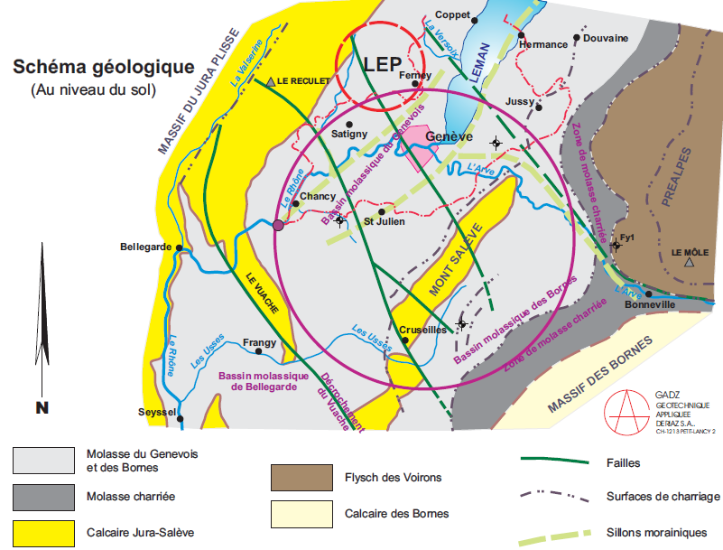
Geological background
TERRAINS MEUBLES
(Moraine, Alluvions)
MOLASSE
(Grès, Marnes)
Karsts
CALCAIRE

Slide 24
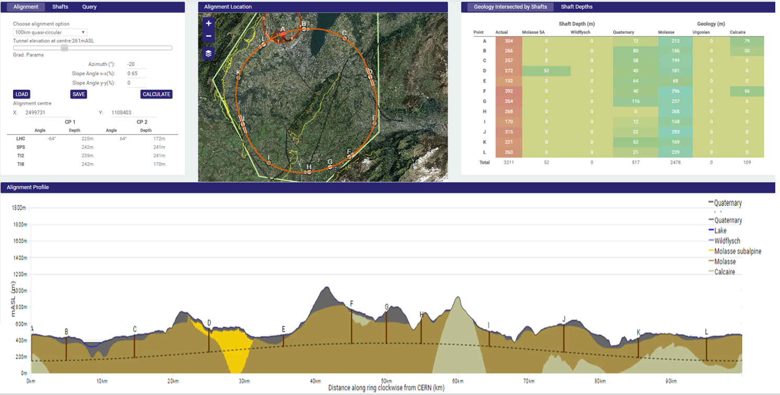
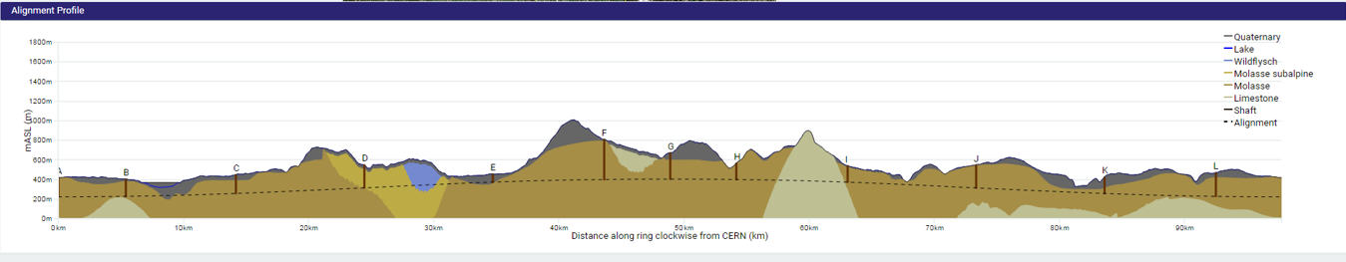
Progress on site investigations
Notes:
Use the latest slides from John/Charlie.
100 km machines, possibly with both versions intersecting and non-intersecting?

Slide 25
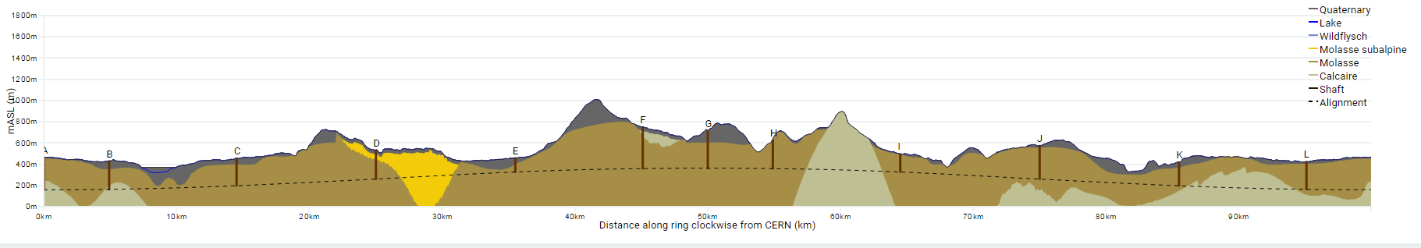
Progress on site investigations
90 – 100 km fits geological situation well
LHC suitable as potential injector
The 100 km version, intersecting LHC, is now being studied in more detail
Notes:
Use the latest slides from John/Charlie.
100 km machines, possibly with both versions intersecting and non-intersecting?

Slide 26
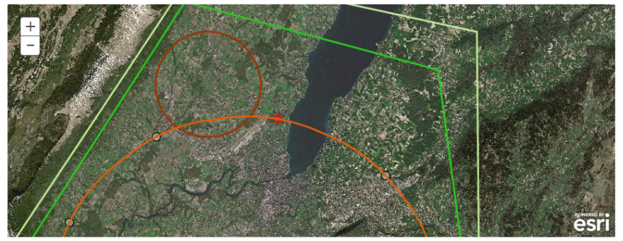
Tunnelling options for crossing the lake
Superficial
sediments
Immersed Tube Tunnel
Moraine
Slurry TBM
Molasse
Open Shield TBM

Slide 27
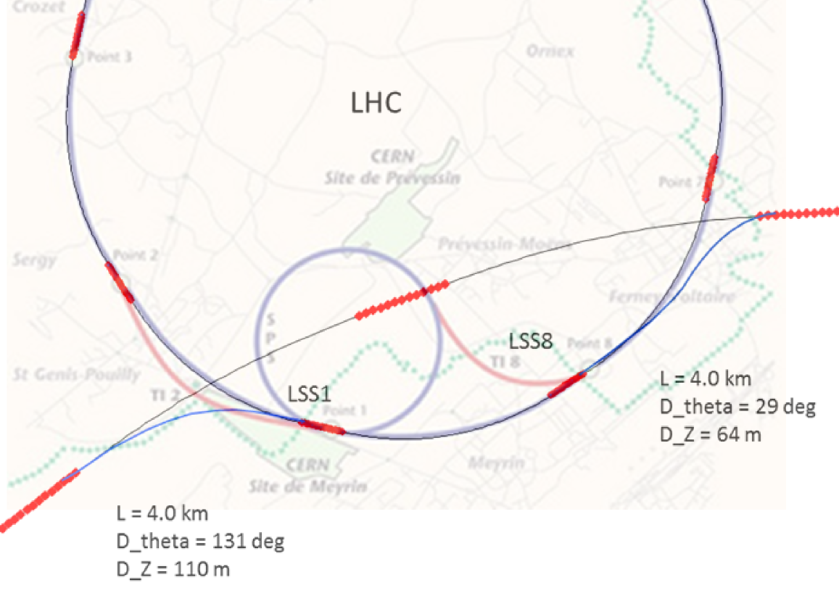
FCC-hh injector considerations
High energy and large size of the ring requires a pre-injector chain:
“gear-box” principle
LHC
100 km FCC
SPS
Baseline:
3 TeV, directly from LHC, reusing the whole CERN complex
Alternative:
1.5 TeV with new SPS (7 km machine circumference) based on fast-cycling SC magnets, 6-7T, ~ 1T/s ramp
Notes:
See talk of Oliver on injection energy
Several options, present baseline is 3.3 GeV
Ínjection at 1.5 TeV studied as alternative, potentially compatible with SPS upgrade

Slide 28
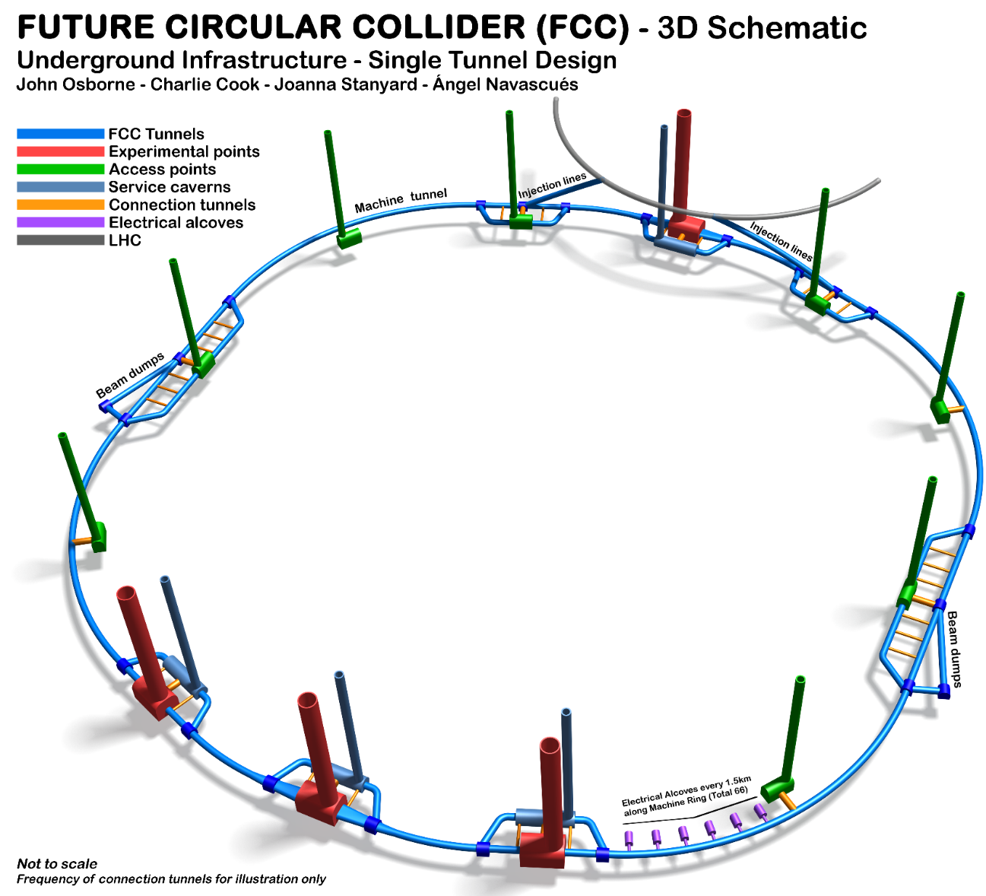
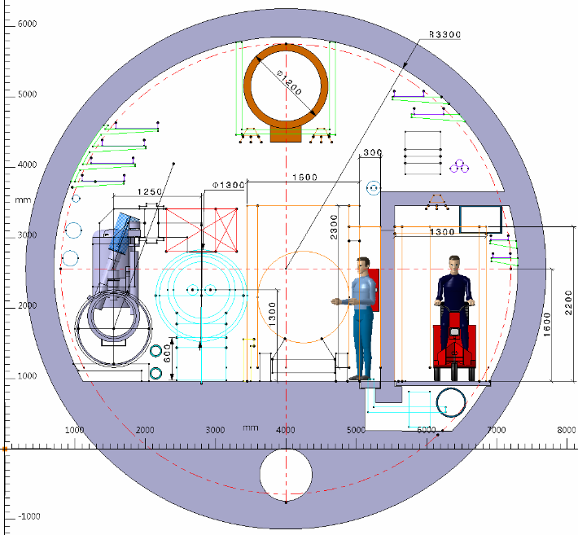
FCC Tunnel Layout
  ‘Baseline’ Layout
    100 km tunnel 6 m inner diameter
    4 large experimental caverns
    8 service caverns for infrastructure
    12 & 4 vertical shafts (3 km integral)
    2 transfer tunnels (10 km)
    2 beam dump tunnels (4 km)
Notes:
Studies are now shifting more on integration aspects, safety, access, installation.
Single vs. double tunnels, optimisation of cross sesctions, etc.

Slide 29
Hadron collider parameters
parameter | FCC-hh |  | HE-LHC* | (HL) LHC
collision energy cms [TeV] | 100 |  | 27 | 14
dipole field [T] | 16 |  | 16 | 8.3
circumference [km] | 100 |  | 27 | 27
# IP | 2 main & 2 |  | 2 & 2 | 2 & 2
beam current [A] | 0.5 |  | 1.12 | (1.12) 0.58
bunch intensity [10¹¹] | 1 | 1 (0.2) | 2.2 | (2.2) 1.15
bunch spacing [ns] | 25 | 25 (5) | 25 | 25
beta* [m] | 1.1 | 0.3 | 0.25 | (0.15) 0.55
luminosity/IP [10³⁴ cm⁻²s⁻¹] | 5 | 20 - 30 | >25 | (5) 1
events/bunch crossing | 170 | <1020 (204) | 850 | (135) 27
stored energy/beam [GJ] | 8.4 |  | 1.2 | (0.7) 0.36
synchrotron rad. [W/m/beam] | 30 |  | 3.6 | (0.35) 0.18
*tentative

Slide 30
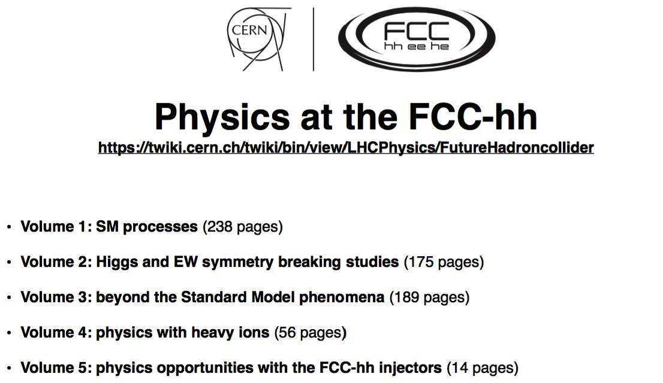
Physics prospects
Being published as CERN yellow report

Slide 31
Key Technologies
16 T superconducting magnets
Synchrotron radiation
Affordable & reliable cryogenics
Superconducting RF cavities
RF power sources
Reliability & availability concepts

Slide 32
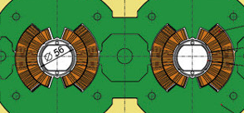
High –field SC dipoles
SC dipole: field defined via current distribution
  High current densities close to the beam for high fields
  Only possible with super conductors I > 1 kA/mm2
Ideal coil geometry for dipolar fields:
  Azimuthal current distribution I(φ) = I₀cos(φ) Dipol, (I₀cos(2φ) Quadrupol)
  2 horizontally displaced circles
Cross section
B
I(φ)
φ
I(φ)

Slide 33
Cryo-magnet cross sections
0.57 m
0.78 m
LHC FCC-hh
cos theta block coil
Nb3Sn as SC material

Slide 34
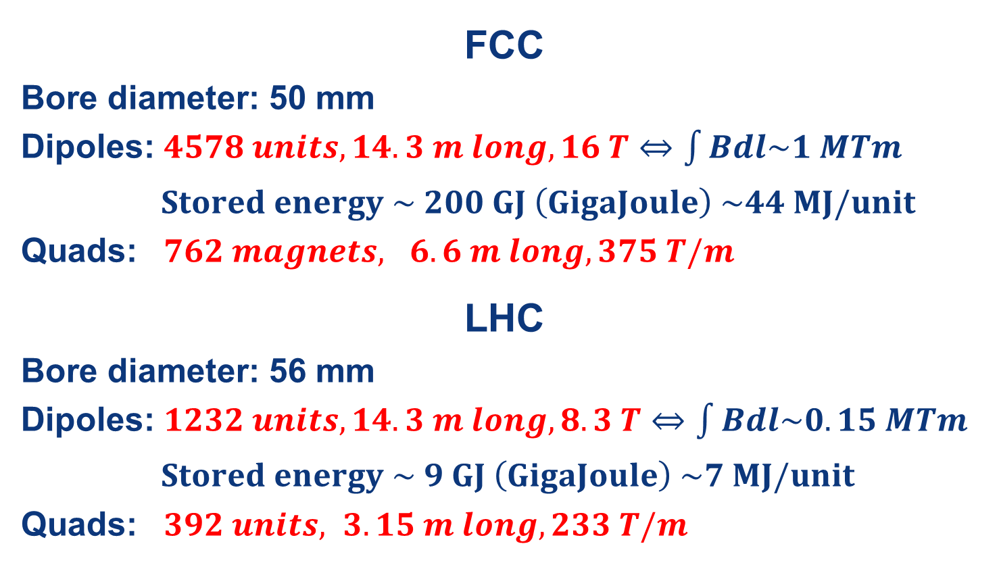
Main SC Magnet system
FCC (16 T) vs LHC (8.3 T)
FCC
Bore diameter: 50 mm
Dipoles: $4578 units, 14.3 m long, 16 T⇔\int{Bdl\sim 1 MTm}$
$Stored energy \sim 200 GJ \left(GigaJoule\right) \sim 44 MJ/unit$
Quads: $762 magnets, 6.6 m long, 375 T/m$
LHC
Bore diameter: 56 mm
Dipoles: $1232 units, 14.3 m long, 8.3 T⇔\int{Bdl\sim 0.15 MTm}$
$Stored energy \sim 9 GJ \left(GigaJoule\right) \sim 7 MJ/unit$
Quads: $392 units, 3.15 m long, 233 T/m$

Slide 35
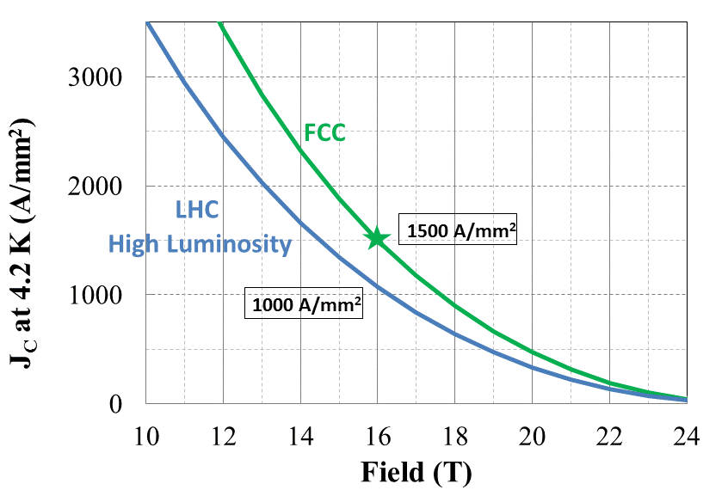
Nb₃Sn conductor program
Nb₃Sn is one of the major cost & performance factors
Main development goals until 2020:
J_{c} increase (16T, 4.2K) > 1500 A/mm² i.e. 50% increase wrt HL-LHC wire
Reference wire diameter 1 mm
Potentials for large scale production and cost reduction
Impact on coil section and conductor mass
5400 mm²
3150 mm²
~1.7 times less SC
~10% margin
HL-LHC
~10% margin
FCC ultimate
Notes:
New slide from Davide.
Showing that conductor development is launched at international level, Russia, Japan, (Korea and Europe in preparation)
Underline importance of that development as main cost driver for the hadron collider machine.

Slide 36

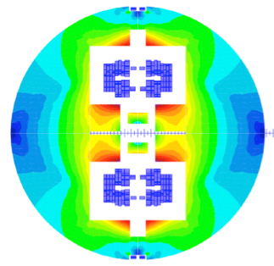
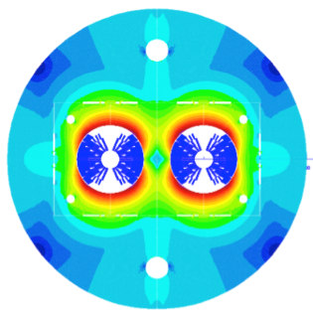

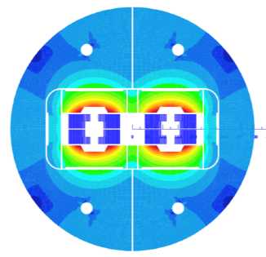
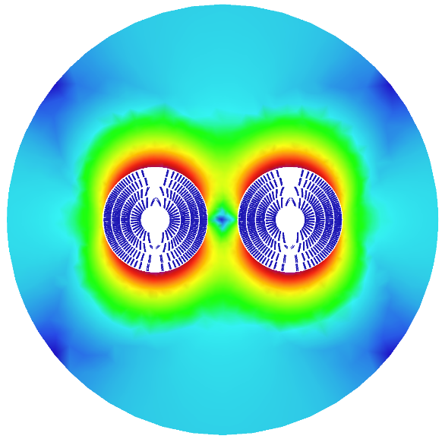
16 T dipole options
under consideration
Cos-theta
Common coils
Swiss contribution
via PSI
Canted
Cos-theta
Blocks
Down-selection of options end 2017 for more detailed design work
Prototyping with short (~1.5 m) model magnets 2017 - 2021
Notes:
New slide from Davide.
Showing that conductor development is launched at international level, Russia, Japan, (Korea and Europe in preparation)
Underline importance of that development as main cost driver for the hadron collider machine.

Slide 37
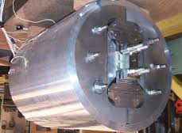
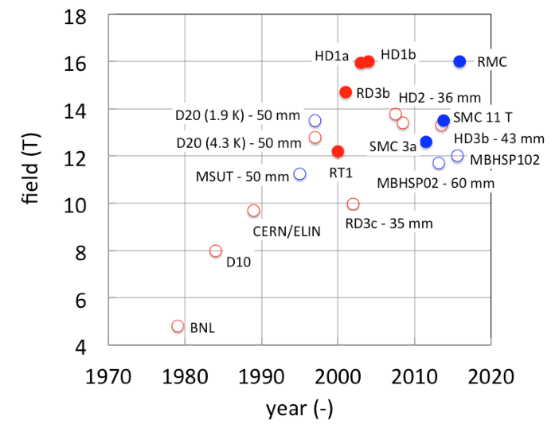
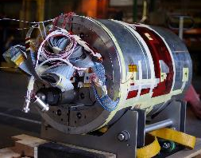
Towards 16T magnets
Record fields for SC magnets in “dipole” configuration
LBNL HD1
Magnets with bore
(need of margin)
Field records
16 T “dipole” levels reached with small racetrack coils
Berkeley 2004, CERN 2015
CERN RMC

Slide 38
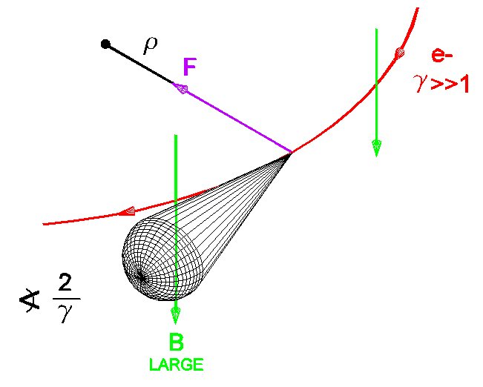
Synchrotron radiation
Charged particles on a curved trajectory irradiate energy:
  ΔE ~ const⋅γ⁴/r = const⋅(E/E₀)⁴/r = konst⋅(E/m₀)⁴/r
  Energy loss ΔE must be compensated and corresponding heat has to be removed from cold mass of SC magnets (for hadron collider)
ΔW= ΔQ⋅(T – T_{tief}) / T_{tief} = ΔQ⋅(300 – 1.9) / 1.9 ~ 155⋅ΔQ
  For realistic process efficiency is ~1000: 1 W@1.9 K == 1 kW @ room temp.

Slide 39
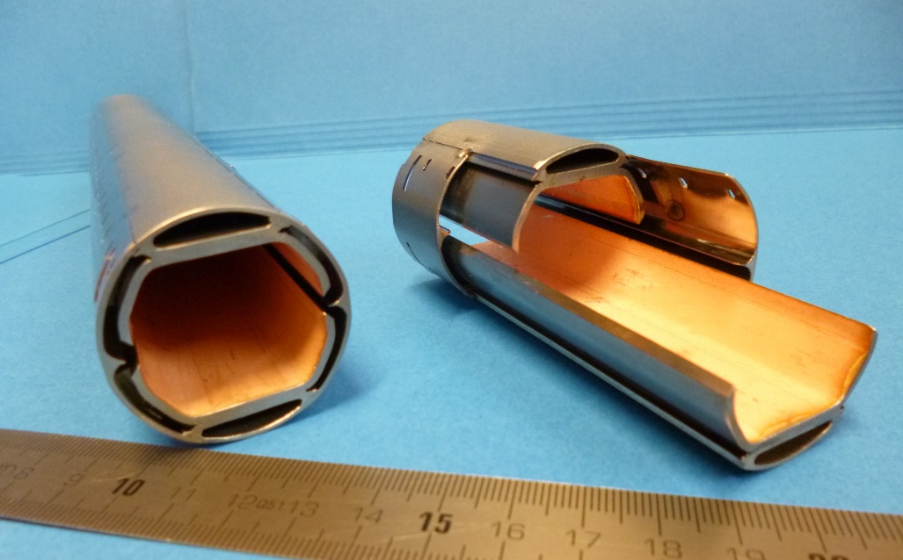
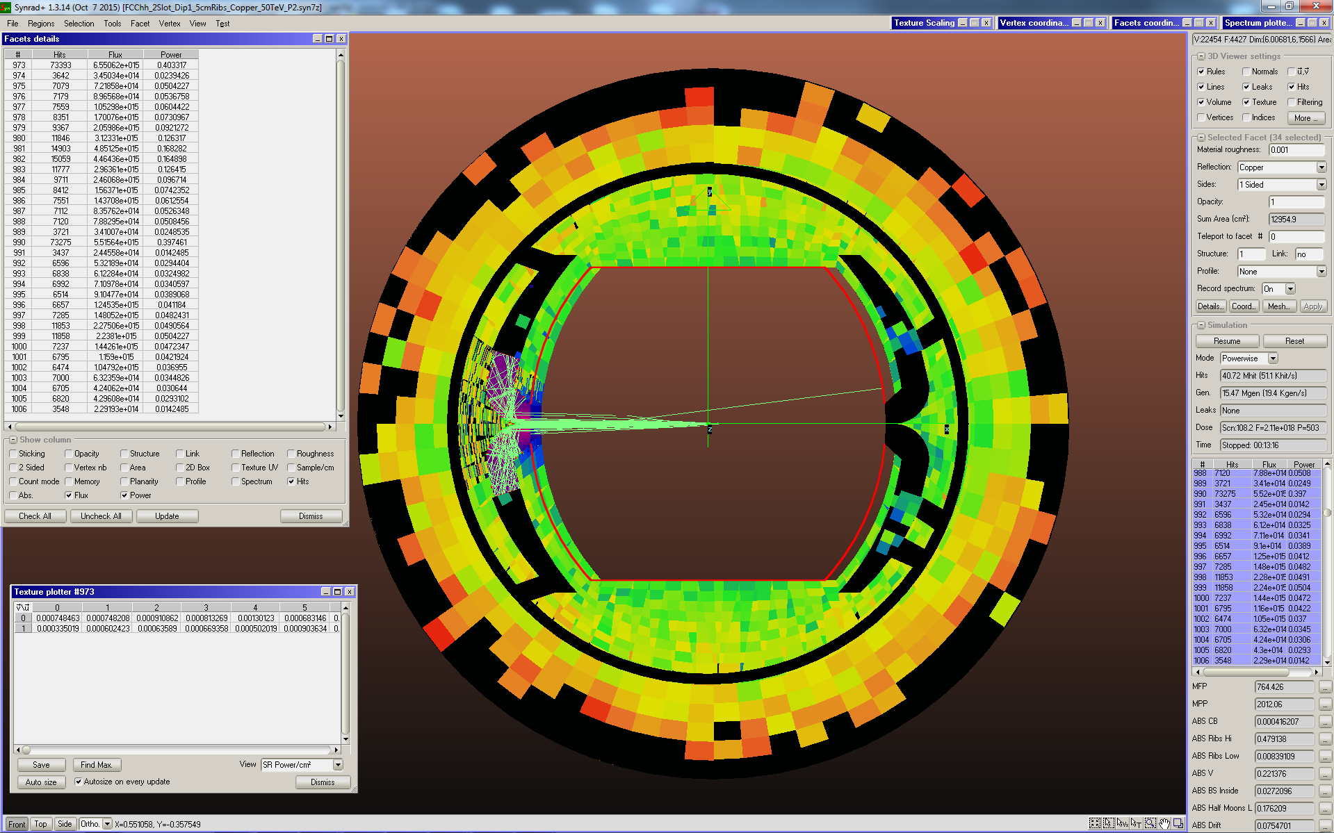
Synchrotron radiation
beam screen prototype
High synchrotron radiation load of proton beams @ 50 TeV:
~30 W/m/beam (@16 T) (LHC <0.2W/m)
5 MW total in arcs (@1.9 K!!!)
New Beam screen with ante-chamber
absorption of synchrotron radiation at 50 K to reduce cryogenic power
factor 50! reduction of power for cryo system
First FCC-hh beam screen prototype
Testing 2017 in ANKA within EuroCirCol
Photon distribution

Slide 40
Cryo power for cooling of SR heat
contributions: beam screen (BS) & cold bore (BS heat radiation)
Overall optimisation of cryo-power, vacuum and impedance
Termperature ranges: <20, 40K-60K, 100K-120K
300MW
200MW
100MW
Multi-bunch instability growth time: 25 turns 9 turns (ΔQ=0.5)

Slide 41
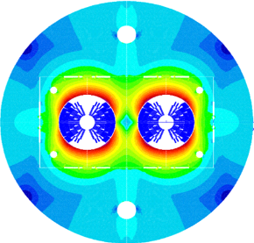
Main cryogenics parameters and layout
Vacuum vessel
Bayonet heat exchanger, 1.85 K saturated
Cold mass, 1.9 K (1.3 bar)
Beam screen, 40-60 K (50 bar)
Magnet thermal shield 60 K (44 bar)
Support post
Cryoplants overall layout
Temperature level | [W/m]
1.9 K, cold mass of magnets Beam losses Resistive heating of splices | 1.4
40-60 K, beam screen, thermal shield Synchrotron radiation Beam Image current | 71
Baseline
Total load
1 MW equivalent @4.5 K
10 cryoplants
20 MW electrical/plant
6 technical sites
Cryoplant | 40-60 K [kW] | 1.9 K [kW]
 | 592 | 11
 | 618 | 12

Slide 42
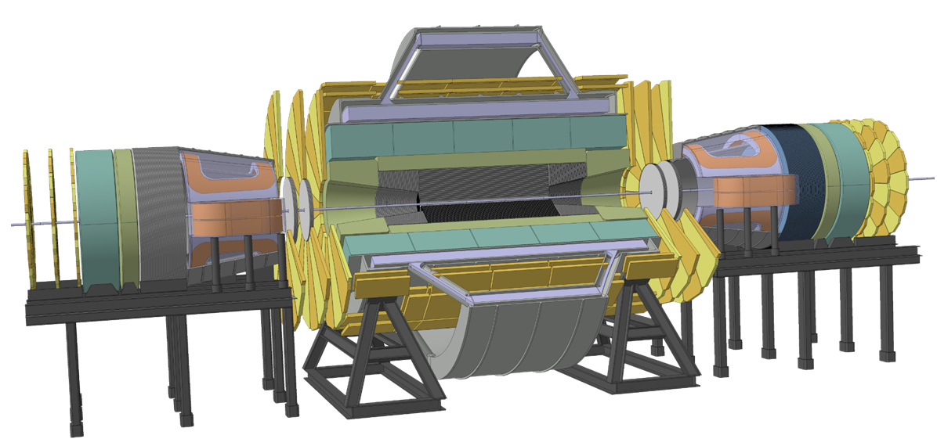
Detector Concepts for 100 TeV pp
Very large volume of high magnetic field needed to measure momentum of charged particles.
Expanding from LHC detector concepts:
B=6 T, 12 m bore, solenoid with shielding coil and 2 dipoles 10 Tm.
Length 64 m, diam. 30 m, magnet 7000 tons, stored energy 50 GJ
Notes:
See with Werner about detector

Slide 43

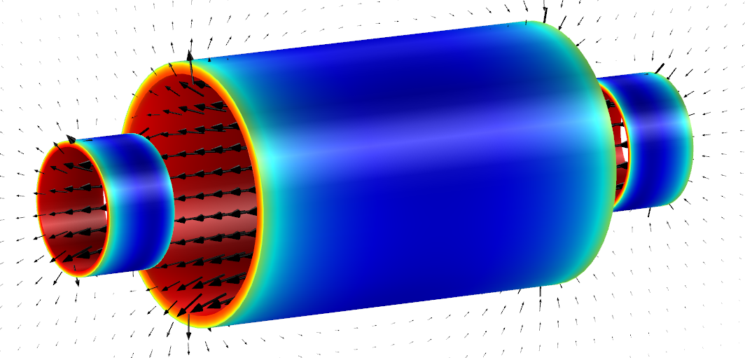
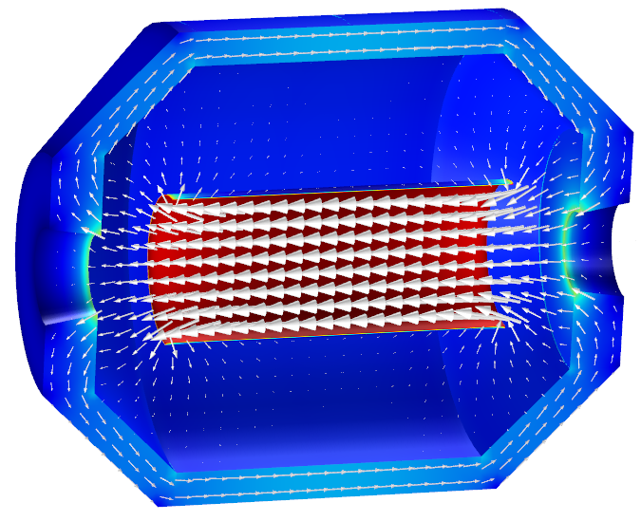
Detector Magnet Studies
  Designs for physics-performing and cost-efficient magnet systems
Today’s baseline:
4T/10m bore 20m long Main Solenoid 4T Side Solenoids – all unshielded
14 GJ stored energy, 30 kA and 2200 tons system weight
Alternative challenging design:
4T/4m Ultra-thin, high-strength Main Solenoid allowing positioning inside the e-calorimeter,
280 MPa conductor (side solenoids not shown)
0.9 GJ stored energy, elegant, 25 t only,
but needs R&D!
ECAL + HCAL
Tracker
Notes:
See with Werner about detector

Slide 44
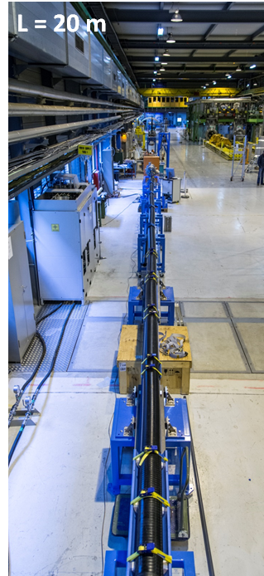
SC links for circuit powering
MgB₂ industrial conductor, He gas cooled
Example HL-LHC (I_{tot} up to ∼|150 kA| @ 25 K)
All circuits in single cryostat – compact & efficient
2x20 kA @ 24 K
2x20 m long CERN cable
Notes:
See with Werner about detector

Slide 45
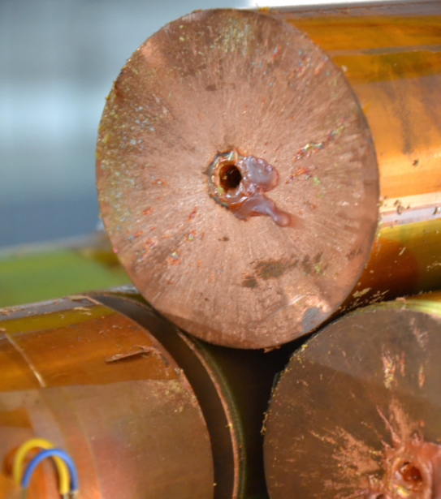

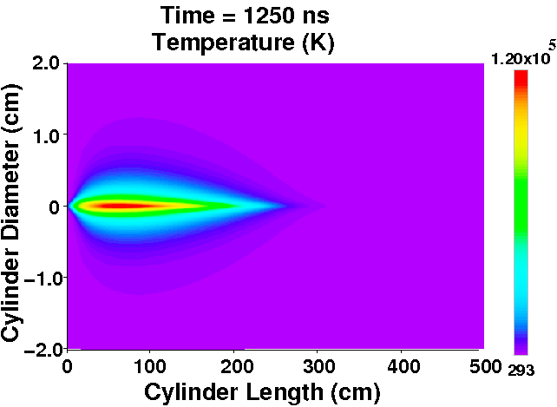
Beam power & machine protection
contributions: beam screen (BS) & cold bore (BS heat radiation)
Stored energy 8.4 GJ per beam
  Factor 25 higher than for LHC, equivalent to A380 (560 t) at nominal speed (850 km/h). Can melt 12t of copper.
  Collimation, control of beam losses and radiation effects (shielding) are of prime importance.
  Injection, beam transfer and beam dump all critical.
Damage of a beam with an energy of 2 MJ
Hydrodynamic tunneling:
beam penetrates ~300 m in Cu
Machine protection issues to be addressed early on!

Slide 46
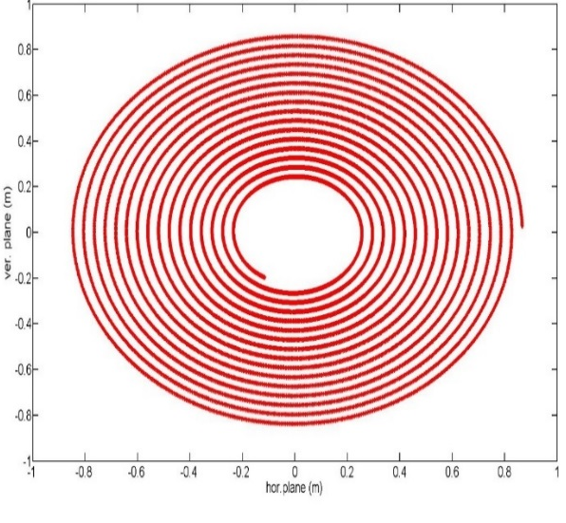
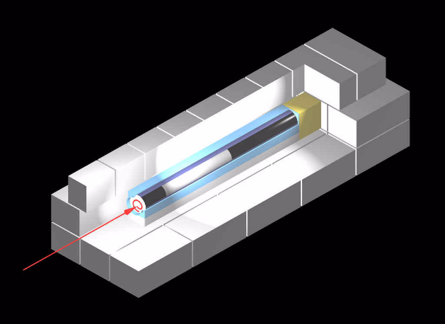
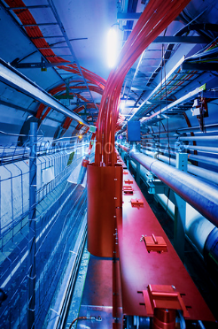

FCC-hh beam dilution system
Huge energy to be extracted and dumped => need large dump section
Beam rigidity: 167 T.km => need long way to dilute beam ~2.5km!
2m
2.5 km dump line
1.4 km dump insertion
2.8 km collimation insertion
Fluka studies:
Bunch separation >1.8 mm
Branch separation: 4 cm
Keeps T<1500°C
Kicker
Septum
10 mrad bend
Dilution
Absorber
Very reliable kickers, high segementation,
new methods for triggering (laser)
SC septum

Slide 47

FCC Collaboration & Industry Relations
111
Institutes
25
Companies
32
Countries
EC
H2020

Slide 48


Future Circular
Collider Study
Large scale technical infrastructures
Conceptual design study 2014 – 2018
Driven by international contributions
Establish long-term liaisons with industry
Collaborate on technology evolution (> 2025)
Notes:
CERN

Slide 49




