Slide 1
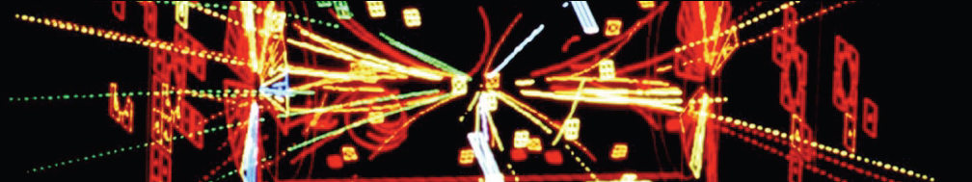
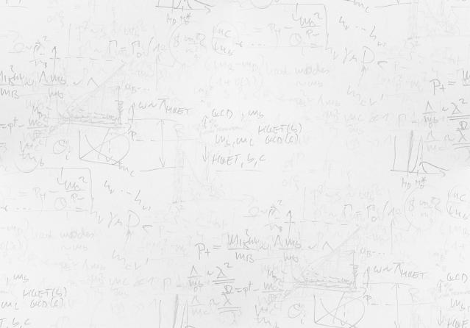
The Physics of Particle Detectors / Future Trends
Lecture I – Tracking Detectors (History, Gas/Si- Detectors)
Maxim Titov, CEA Saclay, France
Artist's View
of a Bubble
chamber by
a CERN
physicist
Ukrainian Teacher Programme,
CERN, April 8-12, 2019

Slide 2
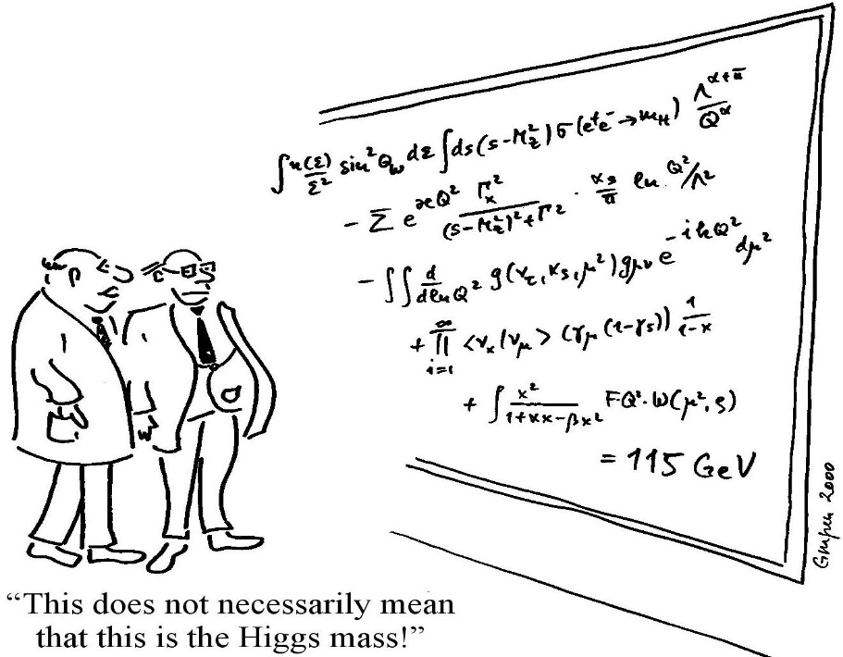
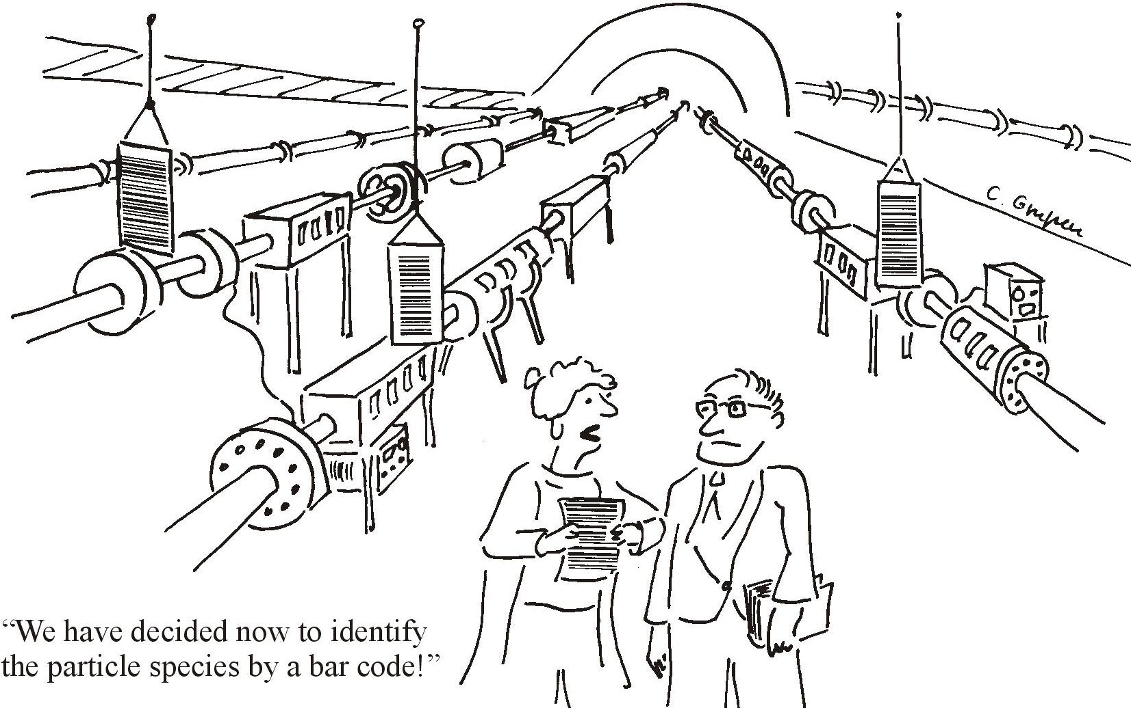
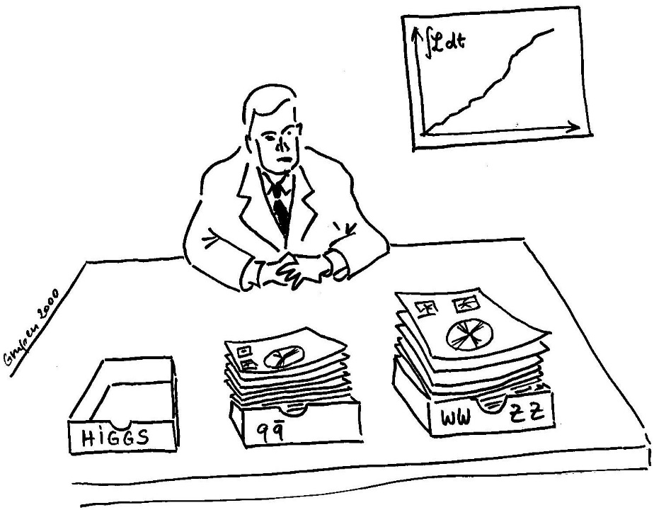
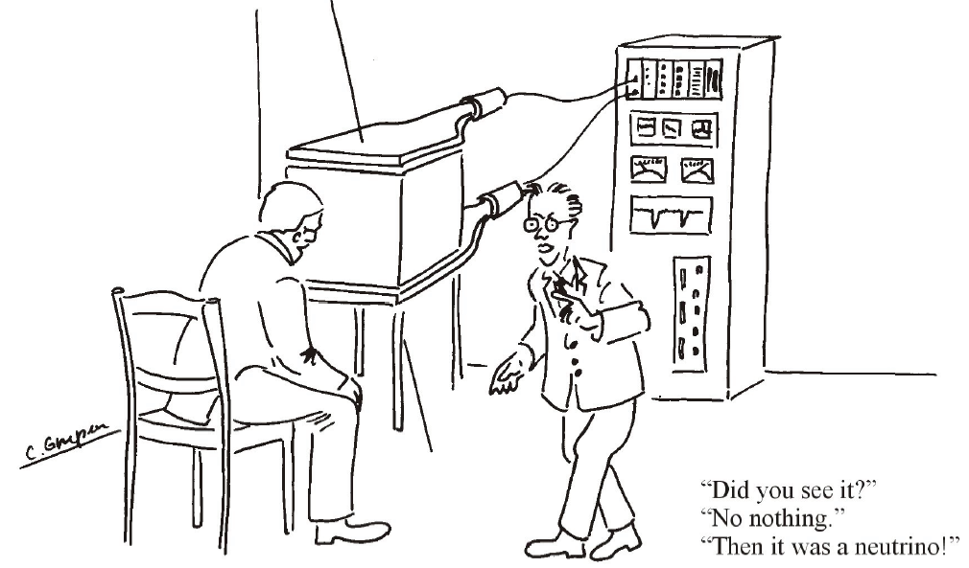
How (different) Physicists See the World ?
Theoretical
physicist
Accelerator
physicist
“This does not necessarily mean
that this is the Higgs mass”
“We have decided now to identify
the particle species by a bar code!”
Experimental
physicist
(analysis
oriented)
Experimental physicist
(detector oriented)
Cartoons by Claus Grupen
no comment
“Did you see it?”
”No nothing.”
“Then it was a
neutrino!”

Slide 3
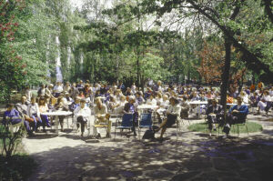
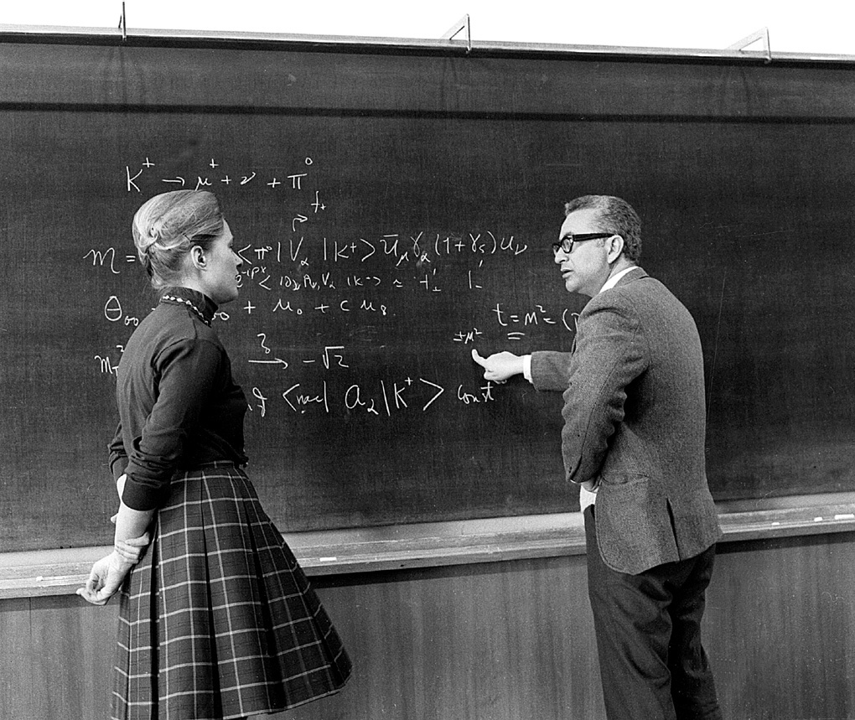

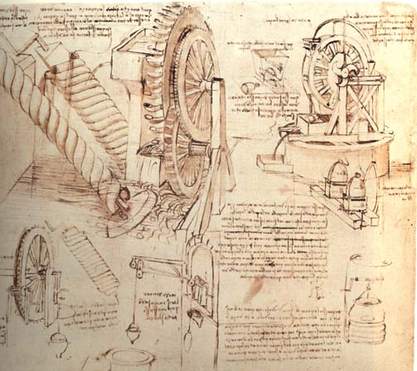
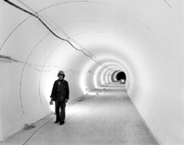

To do a HEP experiment, one needs:
A theory:
and a cafeteria
Mary Gaillard
Murray Gell-Mann
and a tunnel for the accelerator and magnets and stuff
Clear and easy understandable drawings

Slide 4
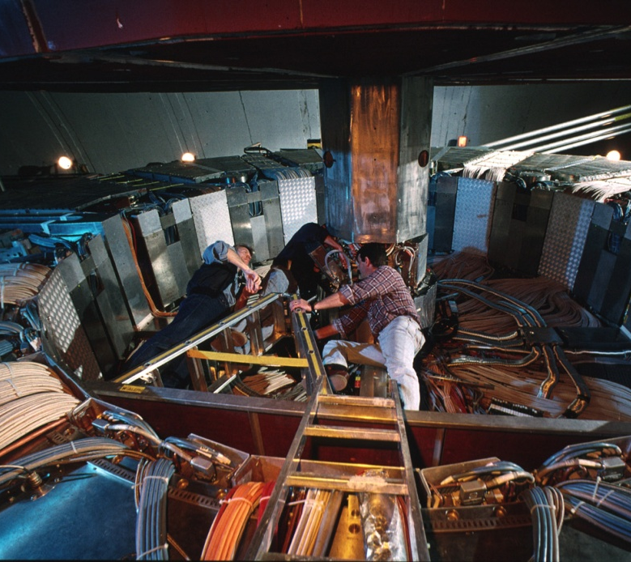
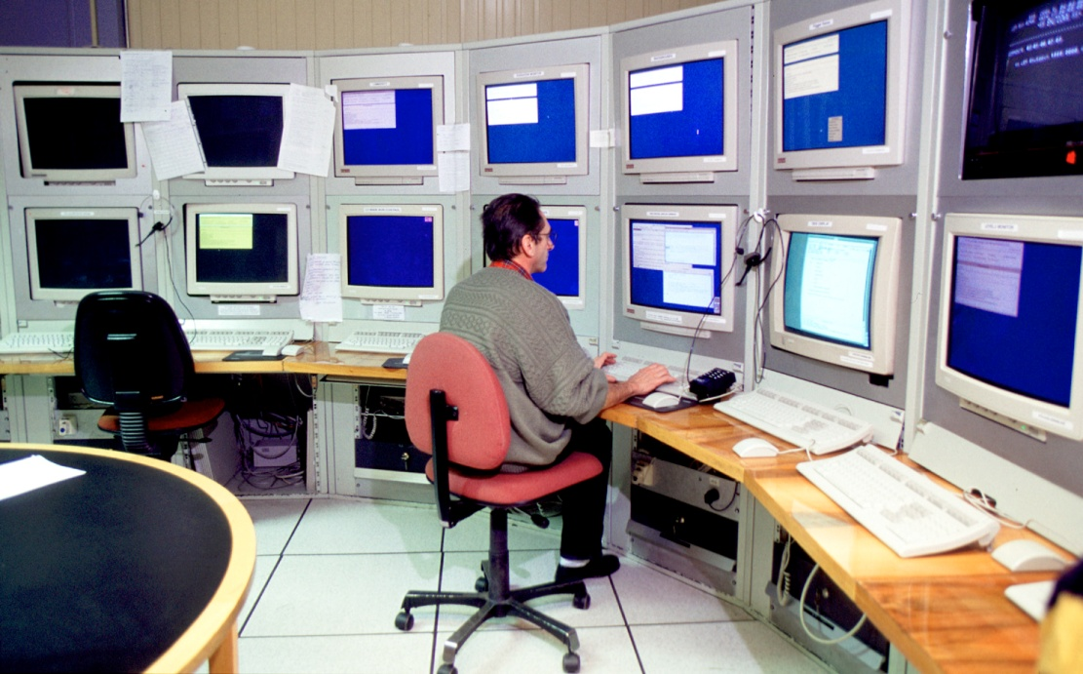
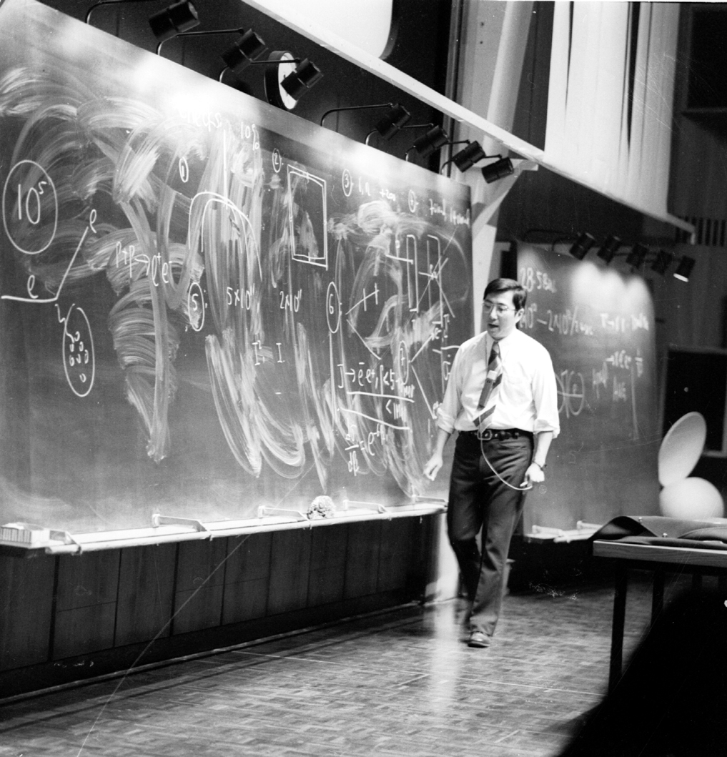
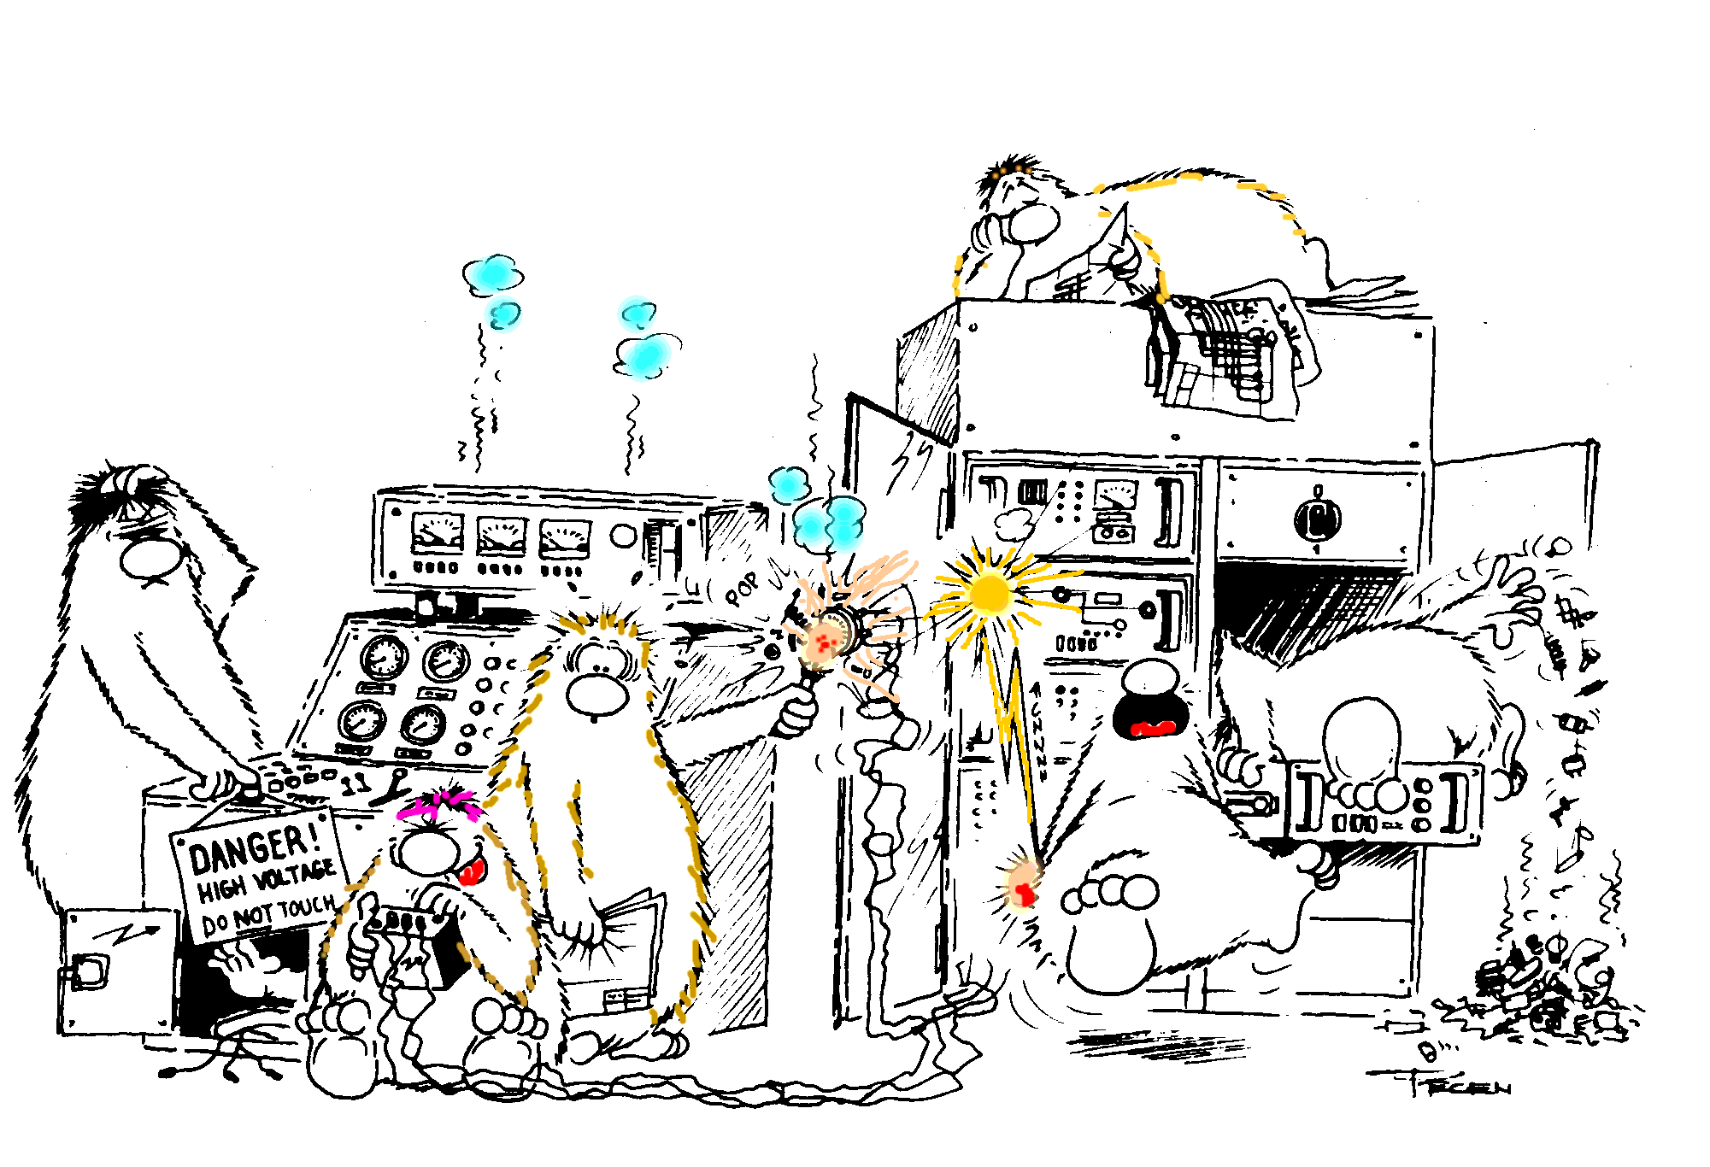
Easy access to the experiment
Physicists to operate detector/analyze data
and a
Nobel prize
We will just concentrate on
detectors

Slide 5
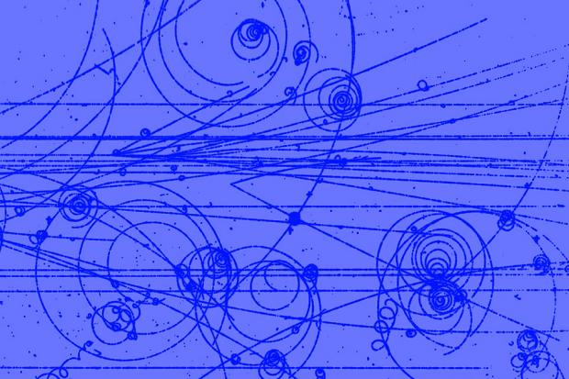
The History of Instrumentation is VERY Entertaining
A look at the history of instrumentation in particle physics
→ complementary view on the history of particle physics, which is
traditionally told from a theoretical point of view
The importance and recognition of inventions in the field of instrumentation is proven by the fact that
→ several Nobel Prices in physics were awarded mainly or exclusively
for the development of detection technologies
Nobel Prizes in instrumentation (“tracking concepts”):
1927: C.T.R. Wilson, Cloud Chamber
1960: Donald Glaser, Bubble Chamber
1992: Georges Charpak, Multi-Wire Proportional Chamber

Slide 6
Timeline of Particle Physics and Instrumentation
< 1950s: Cloud Chambers,
Nuclear Emulsions + Geiger-
Muller tubes dominated
1960-1985:
peak time for
Bubble Chambers
>1980: solid state detectors
in common use
>1970: Wire Chambers (MWPCs and drift chambers) started to dominate

Slide 7
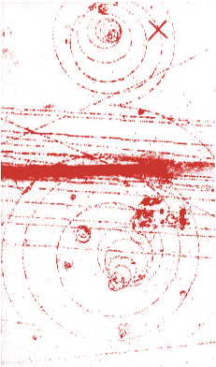
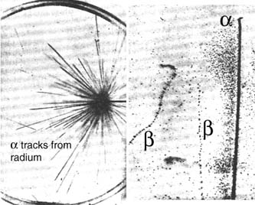
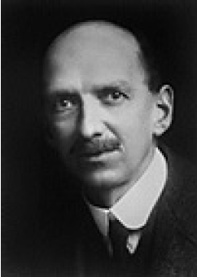

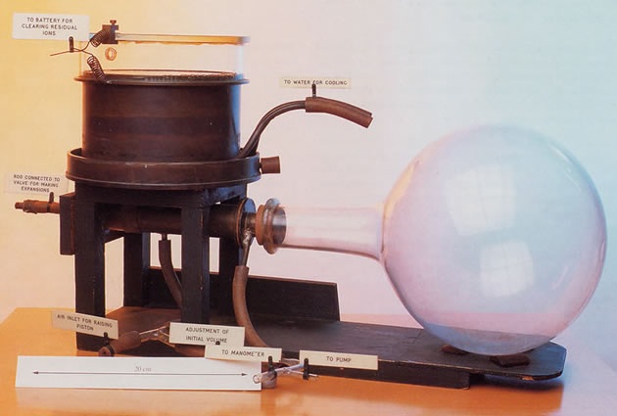
Classic Particle Tracking Detector: Cloud Chamber
Passage of charge particle
would condense the vapor
into tiny droplets,
marking the particle’s path
→ their number being
proportional to dE/dx
Observer
Flux of particles
Cloud Chamber
+ Magnet
Cloud chamber (1911 by Charles T. R. Wilson, Noble Prize 1927)
  chamber with over-saturated water vapour
    originally developed to study formation of rain clouds
  charged particles leave trails of ions
    water is condensing aound ions
  visible track as line of small water droplets

Slide 8
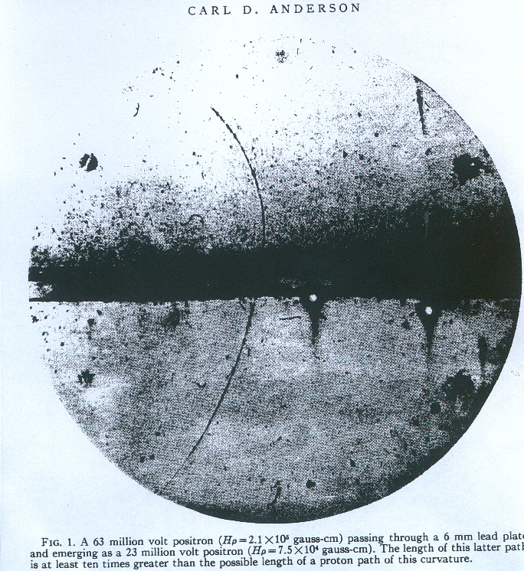
Discovery of a Positron e+ from Cosmic Rays
1932 C.D. Anderson :
Particle with positive curvature and minimum ionisation (droplets size)
Track length is at least 10 times greater than the possible length of a proton path of this curvature
Energy loss in a 6 mm of Pb:
compatible with that of electron
Hypothesis (discovery !) :
particle with mass ~m_{e}
and charge +1, the positron
First anti-particle
Cloud chamber
+ magnetic field
B
Positron loses
energy in lead:
narrower curvature
23 MeV at exit
lead plate
upward going
positron of 63 MeV
Discovery of the positron by Cloud Chamber
(1932 by Carl Anderson, Noble Prize 1936)

Slide 9
Nuclear Emulsion (I)

Slide 10
Nuclear Emulsion (II)

Slide 11
Nuclear Emulsion (III)

Slide 12
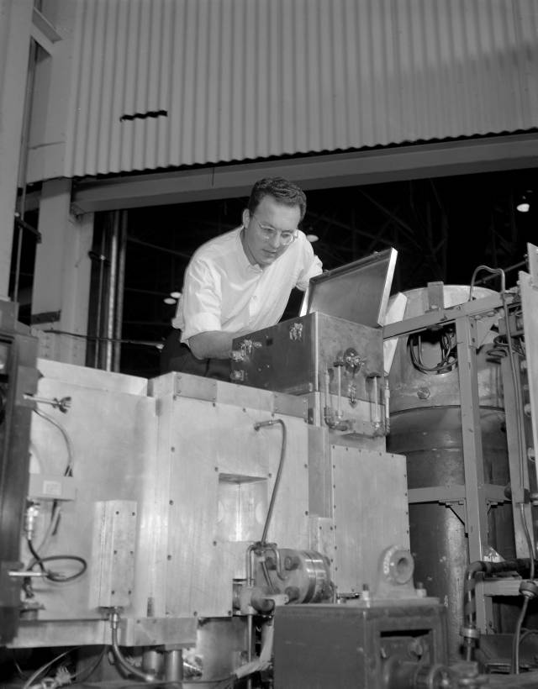
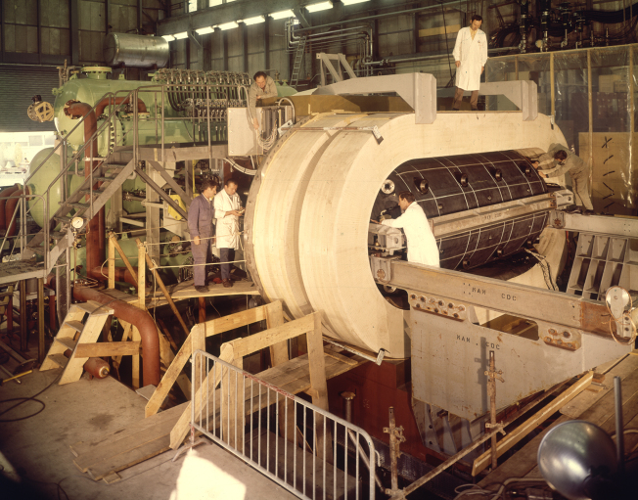
Bubble Chamber (I)
1952 by Donald Glaser, Noble Prize 1960
(4.8 x 1.85 m²) chamber with liquid (H₂) at boiling point (“superheated”)
LBNL Image Library
Similar principle as cloud chamber:
Instead of supersaturating a gas with a vapor
one would superheat the liquid.
A particle leave a trail of ions along its path → make a
liquid boil, and form gas bubbles around ions
ν_{μ}
ν_{μ}
Z⁰
e⁻
e⁻
was used for discovery of the “neutral current”
(1973 by Gargamelle Collaboration, no Noble Prize)
Gargamelle bubble chamber
CERN

Slide 13
Bubble Chamber (II)

Slide 14
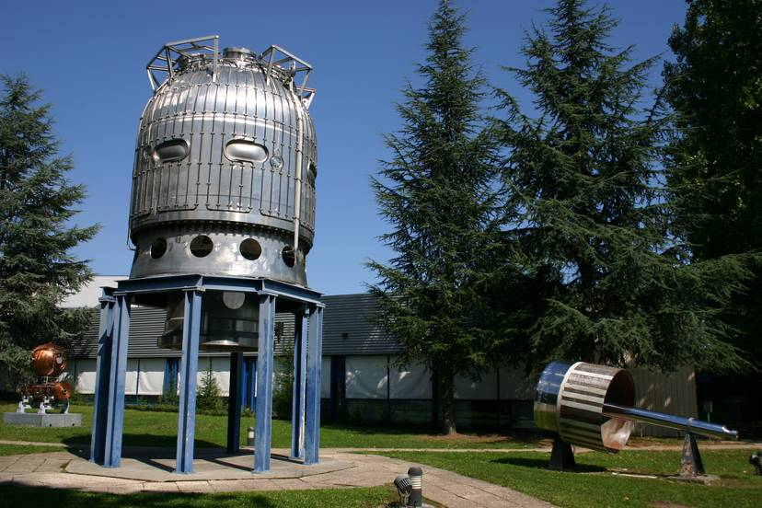
Bubble Chamber
Advantages:
liquid (hydrogen) is
BOTH detector medium AND target
high precision
(~ 5 μm)
Disadvantages:
- NO TRIGGER ->
has to be in superheated
state when particle is
entering
LOW RATE CAPABILITY
Need FASTER
detector (electronics !)
Liquid hydrogen “bubble chamber”
The hydrogen acts as a target (for incoming particles) and a detection medium

Slide 15
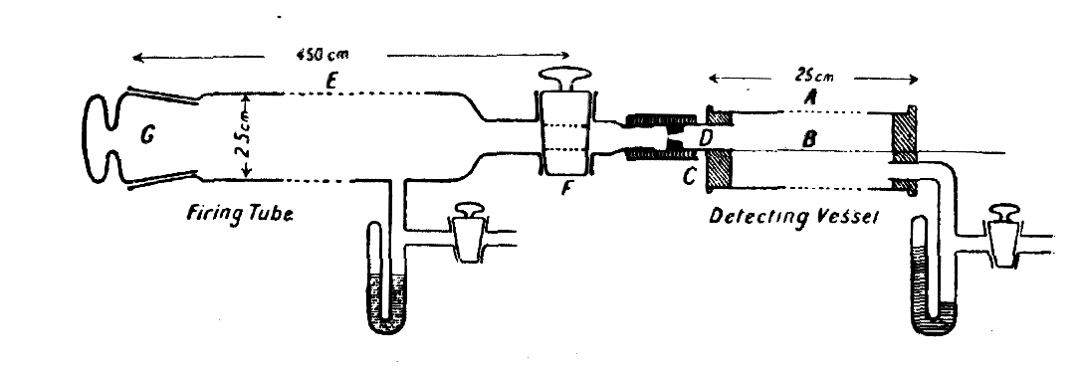
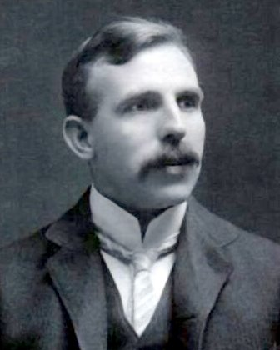
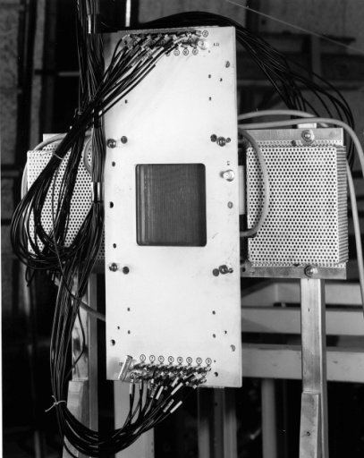
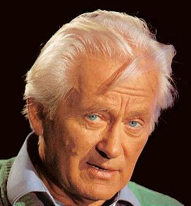
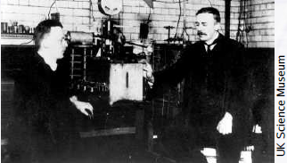
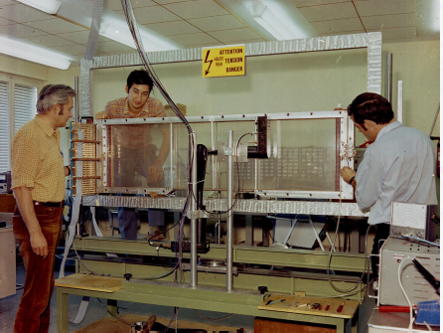
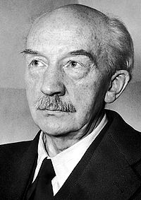
In the Family of Gaseous Detectors with a glorious tradition
1st Revolution: The invention of the MWPC revolutionized particle detection and HEP, which passed from the manual (optical) to the electronic era.
1908: FIRST WIRE COUNTER USED BY RUTHERFORD
IN THE STUDY OF NATURAL RADIOACTIVITY
1968: MULTIWIRE PROPORTIONAL CHAMBER
E. Rutherford and H. Geiger , Proc. Royal Soc. A81 (1908) 141
Nobel Prize in Chemistry in 1908
1928: GEIGER COUNTER
SINGLE ELECTRON SENSITIVITY
Nobel Prize in 1992
G. Charpak, Proc. Int. Symp. Nuclear Electronics (Versailles 10-13 Sept 1968)
Fabio Sauli
1st revolution:
MWPC
Ernst Rutherford
Hans Geiger
Walther Bothe
Nobel Prize in 1954 for the “coincidence method”
H. Geiger and W. Müller, Phys. Zeits. 29 (1928) 839
George Charpak
Jean-Calude Santiard

Slide 16
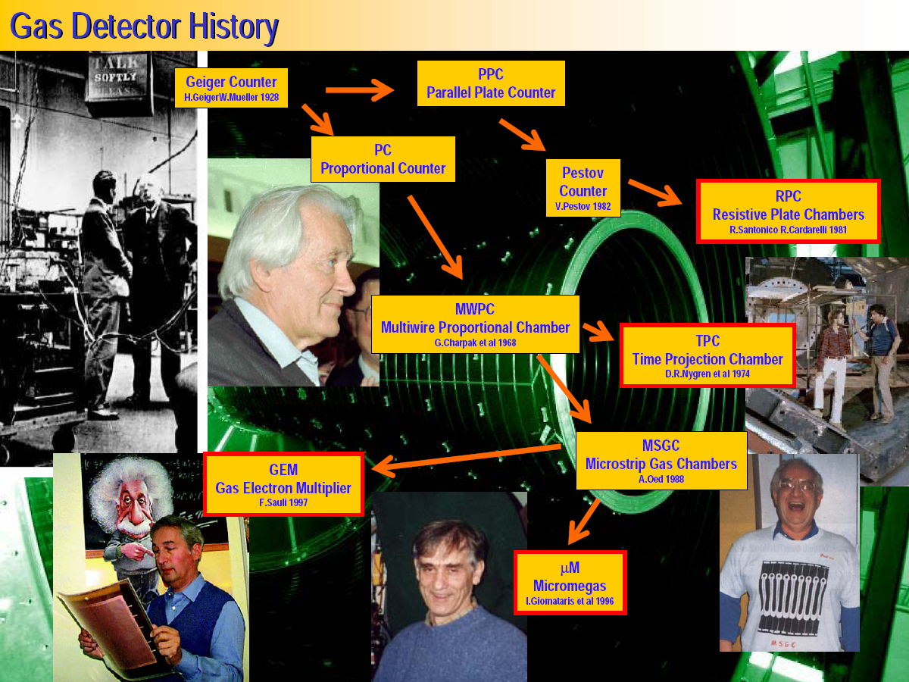
M. Hoch, 2004 Wire Chamber Conference

Slide 17
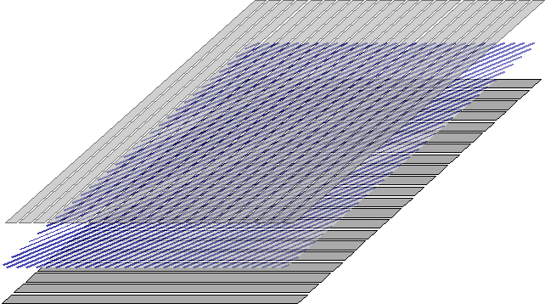
Multi-Wire Proportional Chamber (MWPC)
High-rate MWPC with digital readout:
Spatial resolution is limited to σ_{x} ~ s/sqrt(12) ~ 300 μm
TWO-DIMENSIONAL MWPC READOUT CATHODE
INDUCED CHARGE (Charpak and Sauli, 1973)
S ~ 1 mm
Spatial resolution determined by: Signal / Noise Ratio
Typical (i.e. ‘very good’) values: S ~ 20000 e: noise ~ 1000e
Space resolution < 100 μm
Resolution of MWPCs limited by wire spacing
better resolution → shorter wire spacing → more (and more) wires...

Slide 18
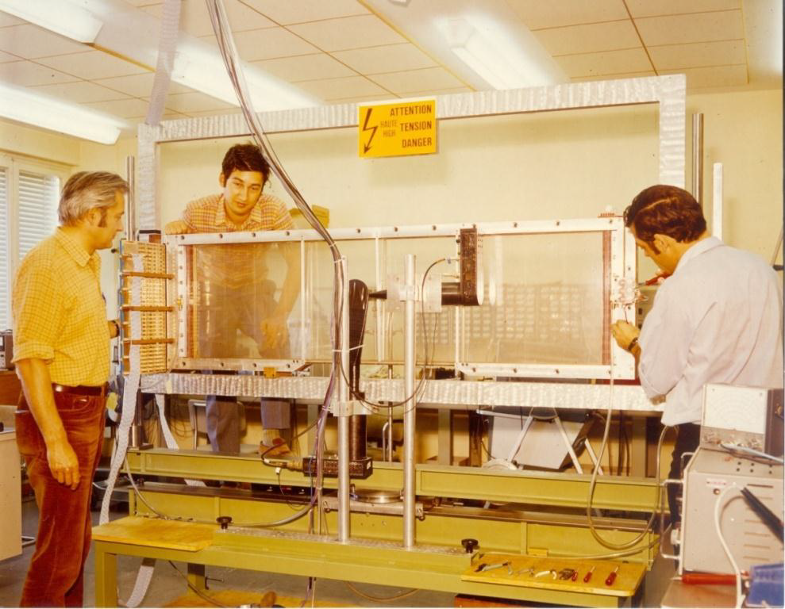
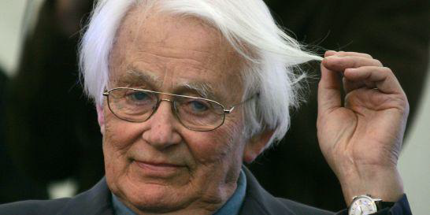
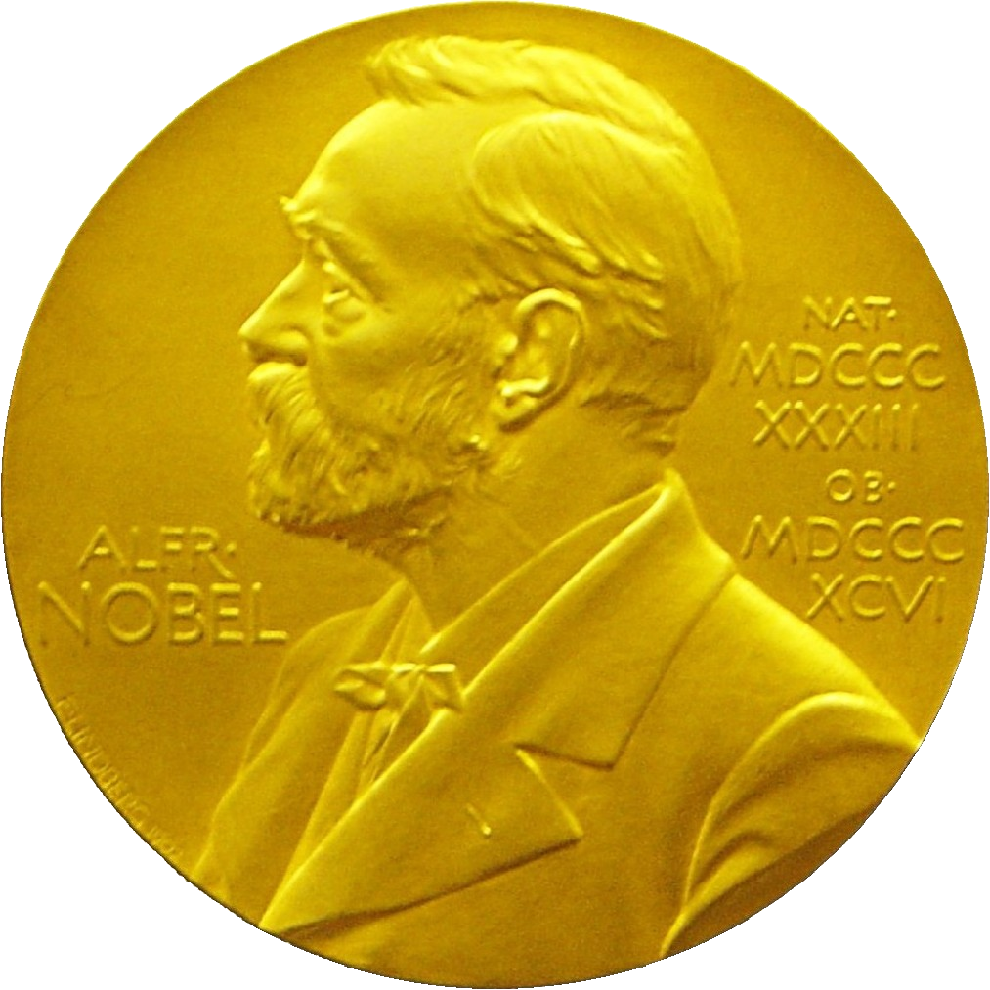
1968: MWPC – revolutionising the way particle physics is done
Detecting particles was a
mainly a manual, tedious and
labour intensive job – unsuited
for rare particle decays
George Charpak developed
the MultiWire Proportional
Chamber, which revolutionized
particle detection and
High Energy Physics -
which passed from the manual
to the electronic era.
1992:
Electronic particle track
detection is now standard
in all particle detectors

Slide 19
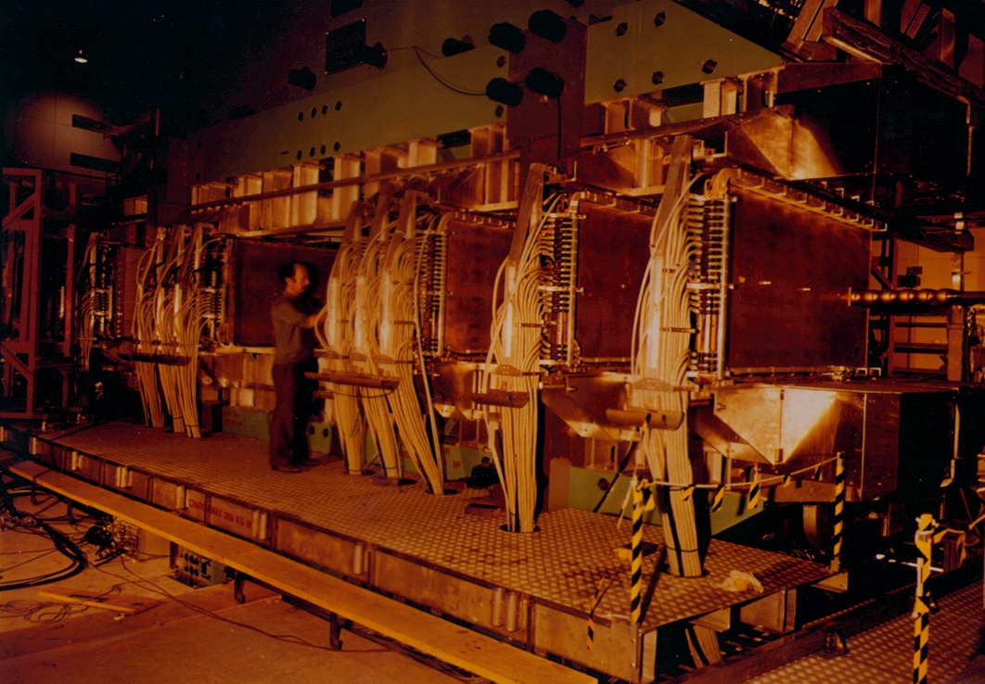
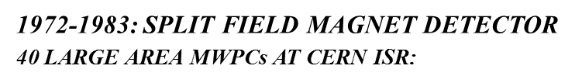
First Large Experiment with MWPCs

Slide 20
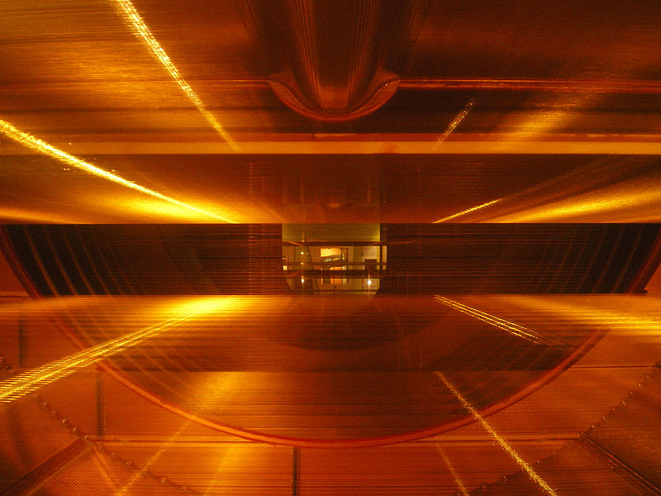
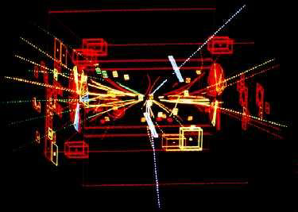
Nobel Prize: W, Z - Discovery at UA1/UA2 (1983)
UA1 used the largest imaging drift chamber of its day
(5.8 m long, 2.3 m in diameter)
It can now be seen in the CERN Microcosm Exhibition
Particle trajectories in the CERN-UA1
3D Wire Chamber
Discovery of W and Z bosons
C. Rubbia & S. Van der Meer Nobel 1984
Z → ee (white tracks)

Slide 21
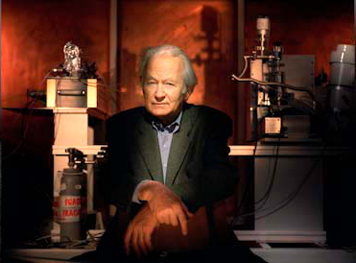
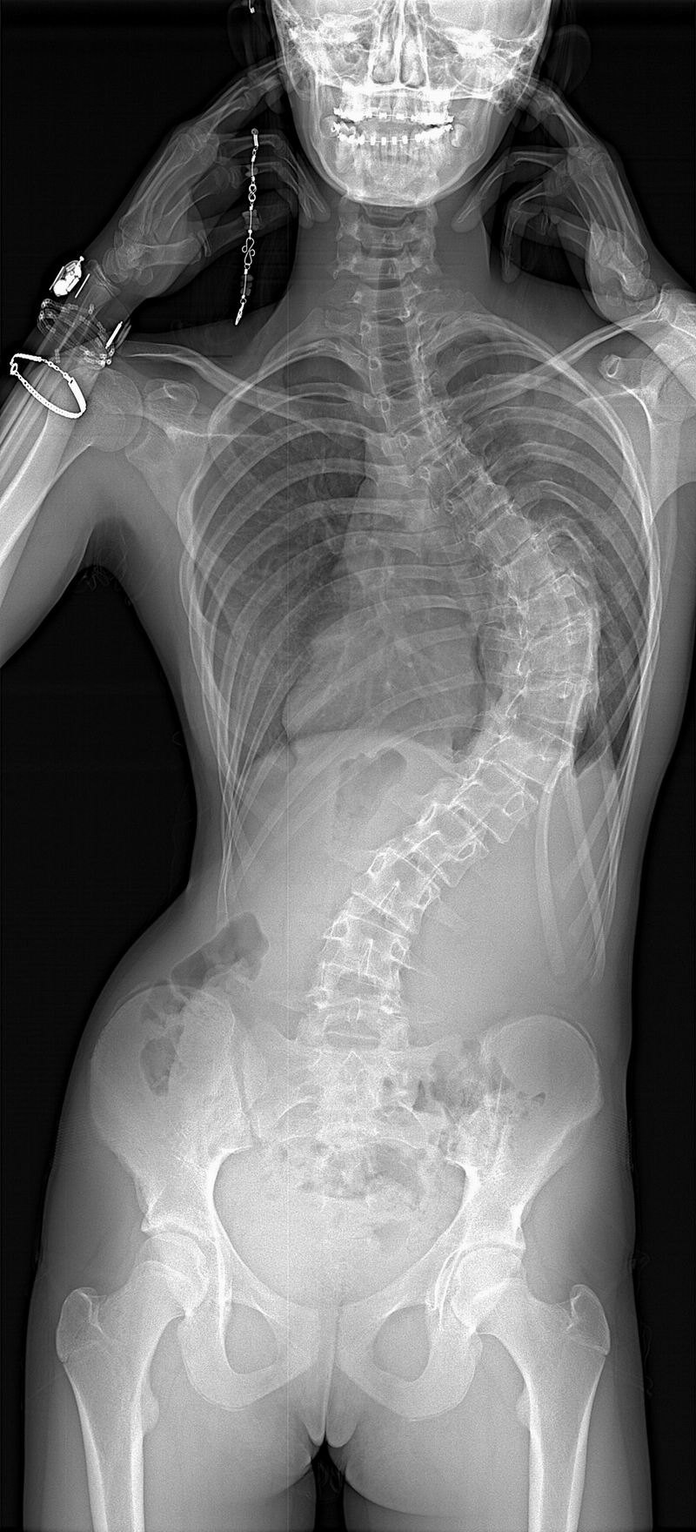
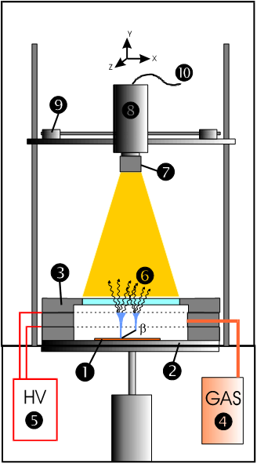
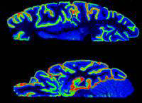
The 1970’s Dream: Digital radiography with MWPC
1992:
Biospace: Company Founded
In 1989 by Georges Charpak
~ 2000: LOW-DOSE 3D IMAGING
(&à times less)
COMMERCIAL AUTORADIOGRAPHY SYSTEMS WITH GASEOUS DETECTORS
http://www.biospacelab.com

Slide 22
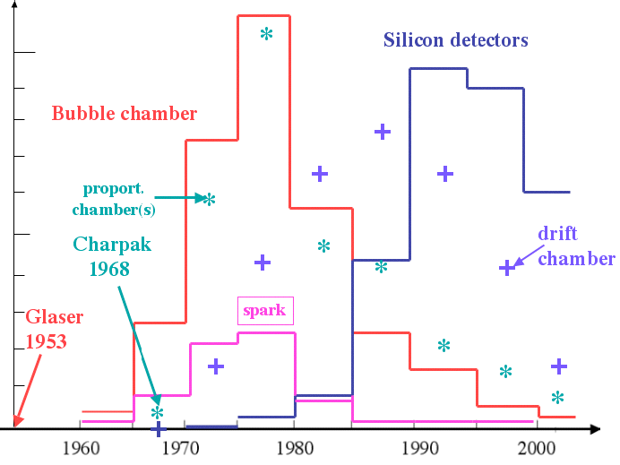
Tracking Detectors: History and Trends
Cloud Chambers, Nuclear Emulsions + Geiger-Müller tubes
→ dominated until the early 1950s: Cloud Chambers now very popular in
public exhibitions related to particle physics
Bubble Chambers had their peak time between 1960 and 1985
  → last big bubble chamber was BEBC at CERN
Since 1970s: Wire Chambers (MWPCs and drift chambers) started
to dominate
Since late 1980s: Solid state detectors
are in common use
→ started as small sized vertex detectors
(at LEP and SLC)
→ now ~200 m² Si-surface in CMS tracker
Most recent trend: hybrid detectors
  combining both gaseous and solid
  state technologies

Slide 23
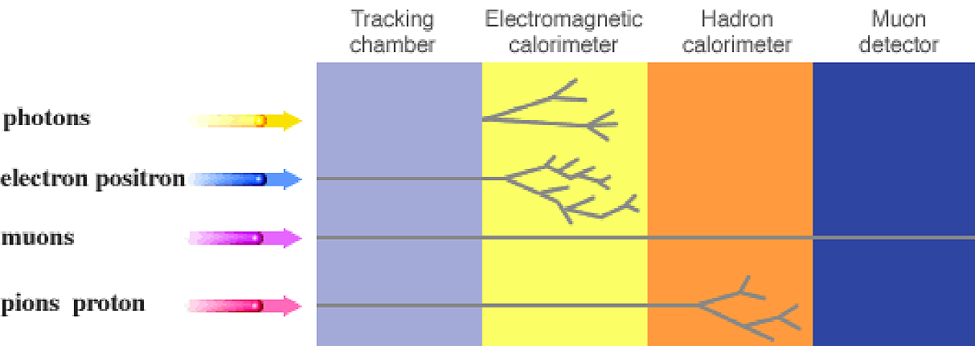
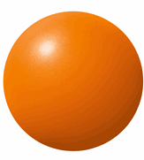
Schematical View of a HEP Detector
There is not one type of detector which provides all measurements we need ->
“Onion” concept -> different systems taking care of certain measurement
Detection of collision production within the detector volume
  → resulting in signals due to electro-magnetic interaction
  → exceptions: strong interactions in hadronic showers (hadron calorimeters)
  → weak interactions at neutrino detection (not discussed here)
undetected
neutrinos...
electromagnetic hadronic
shower
muon detection with
improved momentum
measurement (long
lever arm)
energy measurement
by creation and total
absorption of showers
momentum measurement
by curvature in magnetic field

Slide 24
Particle Detectors: Physics Principles
Tracking Detector (or Tracker) = momentum measurement
  closest to interaction point: vertex detector (often silicon pixels)
    measures primary interaction vertex and secondary vertices from decay particles
  main or central tracking detector
    measures momentum by curvature in magnetic field
    two technologies: solid state detectors, Si strips or gaseous detectors
Calorimeters = energy measurement
  electro-magnetic calorimeters
    measures energy of light EM particles (electrons, positrons, photons) based on electro-magnetic showers by bremsstrahlung and pair production
    two concepts: homogeneous (CMS) or sampling (ATLAS)
  hadron calorimeters
    measures energy of heavy (hadronic) particles (pions, kaons, protons, neutrons) based on nuclear showers created by nuclear interactions
Muon Detectors = momentum measurement for muons (more precise)
  outermost detector layer, basically a tracking detector

Slide 25
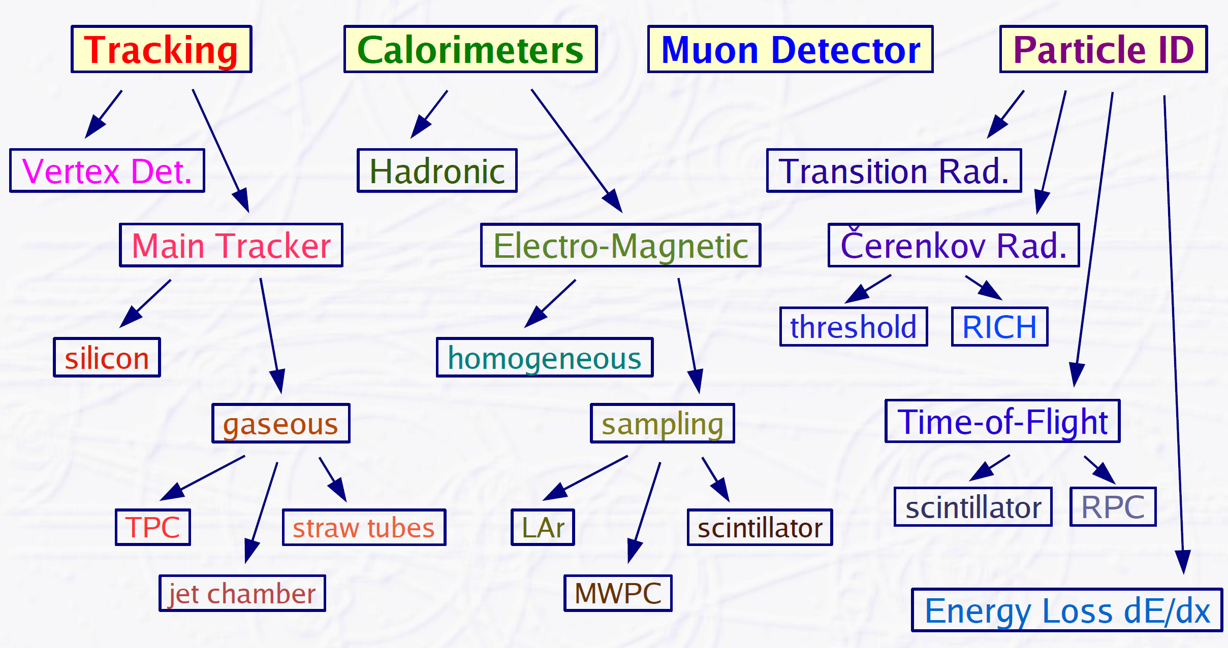
Particle Physics: Modern Detector Technologies

Slide 26
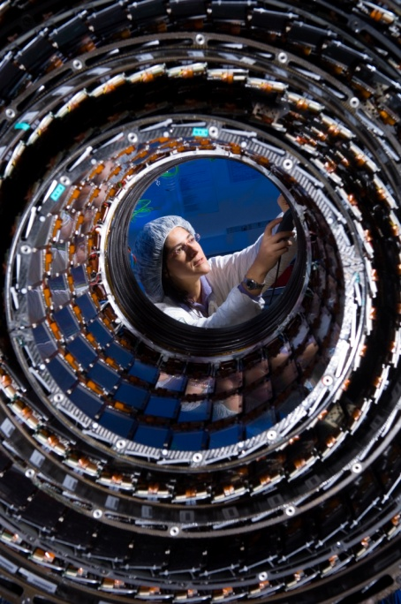
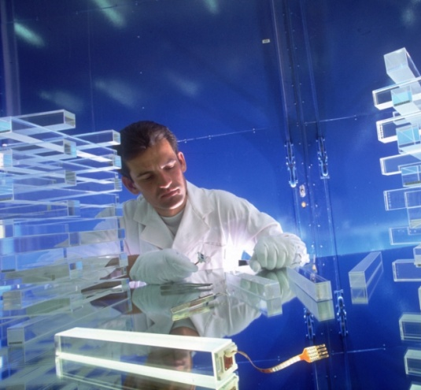
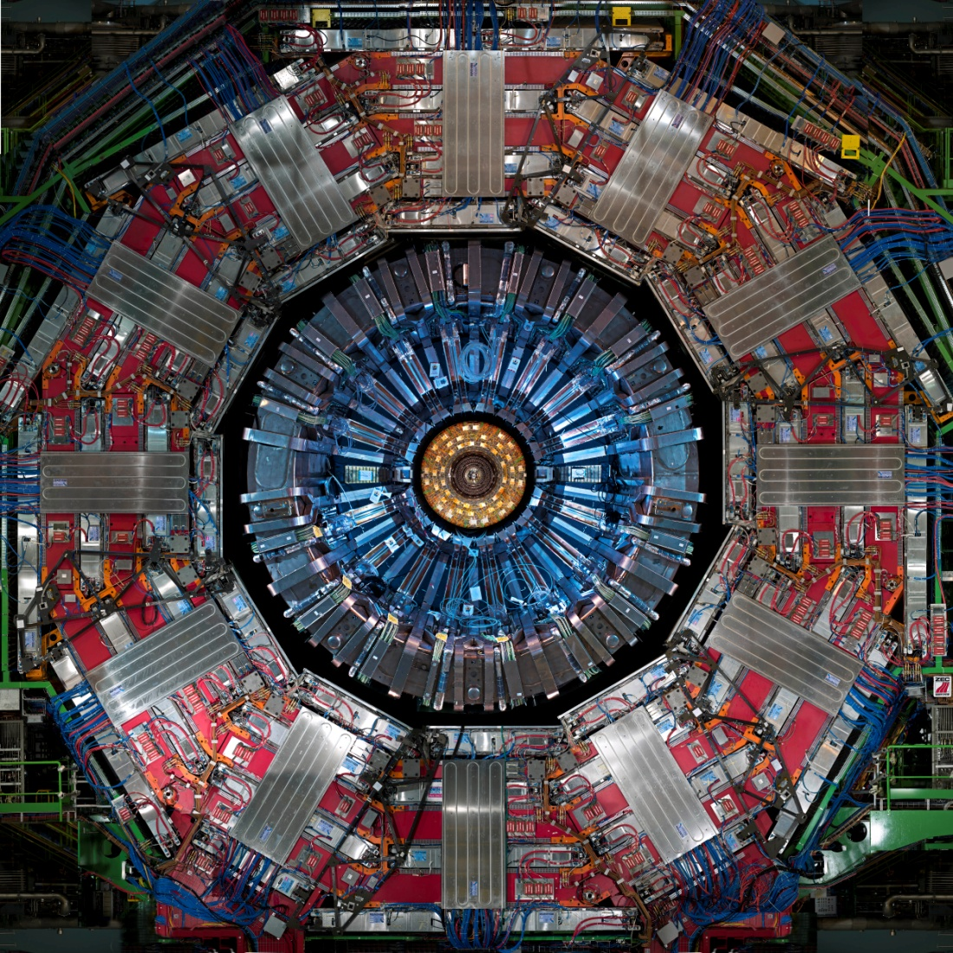


CMS Detector: Concept to Data Taking in 18 Years
3000 scientists from 40 countries
CMS Letter of Intent (Oct. 1992)
Scintillating Crystals
Silicon Tracker
Brass plastic scintillator
Gaseous detectors

Slide 27


The Largest and Most Complex Microscopes we’ve ever built
The “Gothic Cathedrals”
of the 21st Century

Slide 28


Computer Simulated Event in ALICE
In practice we detect only:

Slide 29

What do We See in Reality – The Challenge of Pileup
5 cm
It is very important to determine with precision the
particle trajectories to know their properties (momentum,
position, direction etc) and to reconstruct the event
*real LHC pp event (~50 Vertices, 14 Jets, 2 TeV)

Slide 30










Micro-Pattern Gaseous Detector Technologies for Future Physics Projects
Micromegas
GEM
Thick-GEM, Hole-Type and RETGEM
MPDG with CMOS pixel ASICs (“InGrid”)
Micro-Pixel Chamber (μPIC)
Rate Capability:
MWPC vs MSGC
Micromegas
GEM
THGEM
MHSP
μPIC
Ions
40 %
60 %
Electrons
InGrid

Slide 31


GEM (Gas Electron Multiplier)
Thin metal-coated polymer foil chemically pierced by a high density of holes
A difference of potentials of ~ 500V is
applied between the two GEM electrodes.
→the primary electrons released by the
ionizing particle, drift towards the holes
where the high electric field triggers the
electron multiplication process.
I⁺
e⁻
Induction gap
e⁻
S1
S2
S3
S4
Electrons are collected on patterned
readout board.
A fast signal can be detected on the lower
GEM electrode for triggering or energy
discrimination.
All readout electrodes are at ground potential.
F. Sauli, Nucl. Instrum. Methods A386(1997)531
F. Sauli, http://www.cern.ch/GDD

Slide 32




ALEPH Experiment
DELPHI Experiment
Silicon Detectors in Particle Physics
Strip and hybrid pixel detectors are mature technologies employed in almost every experiment in high energy physics.
H1 Experiment
CDF Experiment

Slide 33

1983: First Silicon Strip Detector in HEP
NA11/NA32 Experiment at CERN –Measure Lifetime and Mass of Charm Mesons
Ratio of detector surface
to nearby electronics
surface 1:300 !
1200 diode strips on 24 x 36mm2 active area
250-500 μm thick bulk material
4.5 μm resolution

Slide 34




1995: Discovery of Top Quark at Tevatrion
1980’s: The post era of the Z and W discovery, after the observation of Jets at UA1 and UA2 at CERN – “To proceed with high energy particle physics, one has to tag the flavour of the quarks!”
Top Quark Production at Tevatron
(t tbar → bW bbarW):
b-jet identification is crucial,
making use of 1.5 ps b lifetime:
→flight distance few 100 μm
→ need hit precision ~ 10 μm

Slide 35



Slide 36



Silicon Detectors has transformed the way we look at particles
2010s: SiD concept for ILC
• Si vertexing, Si tracking
• Si calorimetry
1950-1970: Pre-Silicon Era-
photo of ionization trails
1990: Si-vertex detector
& gaseous tracking (TPC)
It might look like we are actually seeing
less now,but we can see a lot more than
in pre-silicon era !
Silicon surface:
  ATLAS and CMS need to exchange
  Si-trackers during LS3 (2022/23) due
  to radiation effects: 400 m²
  CMS ECAL/HCAL Endcap: 600 m² ?
  ILD/SiD ECAL: 2500 (1200) m²
From Microelectronics to Nanoelectronics:
Detectors are more and more based on
semi-conductor technology
from vertex elements (20 um feature size)
to Si-calorimetry (ILC)

Slide 37

Why are Silicon Detectors such a Success ?
Enormous benefit (compared to gaseous detectors):
→ Huge technological advances of silicon technology in the IT industry
→ Pattern and structure are industry standard

Slide 38
Si-Detector Electronics and Si-Pixels

Slide 39



Silicon Detectors in Particle Physics: Evolution of Scale
CMS: ~ 220 m² Silicon:
→ More than all other previous HEP experiments combined !

Slide 40


The CMS Tracker: Pixels and Strips
Silicon only
tracker solution
Silicon Strip Detectors: 220 m²
25000 silicon sensors
10 M strips = electronic ch.
75376 readout chips
26.000.000 bonds
37.000 analog optical links
10 layers of Si-strip (barrel)
9 endcap Si-strip wheels

Slide 41
The CMS Tracker: Pixels and Strips
Silicon only
tracker solution
Half disk of forward pixels:
Pixel Detector: ~ m²
3 layers of pixels
1440 pixel modules
66 M pixel =
electronic channels

Slide 42
The ATLAS Inner Central Tracker (Barrel)
The most critical parts are the sensors, ASICs and system engineering
(mechanics, power, cooling, assembly, etc) and integration

Slide 43
The CMS Inner Central Detector (Barrel)
The most critical parts are the sensors, ASICs and system engineering
(mechanics, power, cooling, assembly, etc) and integration

Slide 44



Solid State Tracking: Detector-Electronics Integration Trends
Radiation hardness improvements demand newer technologies
Improved functionality can only be achieved with higher integration
Power dissipation and material budget must be reduced
TODAY: Pixels
50 – 100s μm
TODAY: Monolithic
25 – 50 μm (e.g. CMOS)
TOMORROW: 3D
Detectors (25–50 μm)
Day After Tomorrow:
3D TSV (< 20 μm)
Integrated sensor &
electronics: Less X0,
no bonding, low noise
3D vertical
Integration (TSV)
Lower V_{dep} (power)
Faster charge collection
Motivation to develop new Pixel Detectors:
Decrease fabrication cost
Develop thinner pixel systems
Easy fabrication of large area devices
Integrate More (= denser) Intelligence
Trends and Perspectives:
Improve rad. hardness (p-type bulk)
Reduce the thickness to 50 μm
From 6” to 8” and 12” wafers
R&D on SLID/TSV interconnect.

Slide 45
From LHC Particle Detectors to Medicine
Silicon pixel detectors, and crystals of lead tangstate, used for calorimetry, have already found various applications, especially in medicine:
- Silicon pixels are deployed as Medipix, for medical imaging and diagnosis.
- CMS electronics to read out these crystals in a magnetic field opened the way to combined PET/MRI scanners.
MEDIPIX: https://medipix.web.cern.ch/
ClearPET: https://crystalclear.web.cern.ch/crystalclear/pet.html

Slide 46


CMS Electromagnetic Calorimeter
Designed for
Ultimate e/γ
Energy Resolution
of 1-2%
m³
CMS
75000 PWO
10
Cleo II
7800 CsI(Tl)
Belle
8816 CsI(Tl)
5
Babar
6580 CsI(Tl)
75 800 Lead Tungstate Crystals
More (by number & volume)
than all other previous HEP
experiments combined!
Crystal Ball
672 NaI(Tl)
Crystal Barrel
1380 CsI(Tl)
Alice
17920 PWO
L3
12000 BGO
TAPS
600 BaF2
KTeV
3100 CsI
1972
1985
1990
1999
2008

Slide 47



CERN to become established as an important facilitator
of medical physics in Europe

Slide 48


Slide 49
Future e+e- Colliders: “Higgs Factory” + possible Extension to Higher Energies
Linear colliders: ILC, CLIC (extendable to higher energies)
International Linear Collider (ILC):
Japan (Kitakami)
√s = 250 - 500 GeV (1 TeV)
Length: 21 km, 31 km (50 km)
Compact Linear Collider (CLIC): CERN
√s = 380 GeV, 1.5 TeV, 3 TeV
Length: 11 km, 29 km, 50 km
Circular colliders: CEPC, FCC-ee
Circular Electron-Positron Collider (CEPC):
China
√s = 90 - 240 GeV (1 TeV)
Circumference: 100 km
Future Circular Collider (FCC-ee):
CERN
√s = 90 - 350 GeV (1 TeV)
Circumference: ~100 km

Slide 50

Example: ILC DETECTOR
Central and forward
Si tracking system
Large TPC
R~1.8m
Z/2~2.0m
Sketch of ILD cerntal detector
Vertex detector
Inner radius~1.6cm
Outer radius~ 6 cm

Slide 51





Two Validated Detector Concepts: ILD and SiD
ILD
SiD
~13m
~13m
~14m
~12m
ILD | SiD
Both optimized for PFA PFA Performance ~B･R_{ECAL,inner}² (two-track separation @ ECAL)
B = 3.5 T | B = 5 T
R_{ECAL,inner} = 1.8 m | R_{ECAL,inner} = 1.27 m
Si + TPC tracking | Tracking: Si only
Share interaction point via push-pull

Slide 52




ILC CMOS-based sensors for Science and Industry
CMOS sensors expected to provide an attractive trade-off between granularity, material budget, radiation tolerance, speed and power dissipation
Sub-atomic Physics:
BT (EUDET, AIDA),
Vertex det. (STAR, ALICE)
ILC
STAR
BT: PLUME
X-Ray imaging lights sources equipment (SOLEIL)
Industrial quality control (soldering, u-cracks)
X-Ray imagers molecular
biology (nano-science)
Mass spectroscopy (PIMMS)
Art: C. Monet, Nymphéas et Pont Japonais

Slide 53


From SiPM-based ILC Calorimeter to Advanced PET-Systems
2006: ILC Calorimetry (8k ch.):
First large experience
with SiPM operation (2006):
C. Monet, Nymphéas et Pont Japonais
Today’s PET imaging platforms using SiPMs:
GE clinical PET/MR
uses analog SiPM
VEREOS Philips PET/CT uses digital SiPM
Multi-channels arrays of crystals + SIPM:
minimum dead material between crystals
SiPM packaging is crucial →up to 50%
sensitivity improvement
Monolithic arrays/high density of chan.
A muli-modality approach (PET/CT,PET/MR) will be more and more requested in the clinical practice.
SiPMs represent today the future of Nuclear
Medical Imaging → the only slowing down
factor at the moment being
the high associated cost.

