Slide 1

IPPOG Meeting, 10-12 November 2016
Hans Peter Beck: IPPOG Co-chair, Bern University
Marjorie Bardeen: IPPOG Co-chair, Fermilab

Slide 2

1st issue of
Nov 4, 1869
A WEEKLY ILLUSTRATED JOURNAL OF SCIENCE
'The objective which it is proposed to attain by this periodical may be broadly stated as follows. It is intended, First, to place before the general public the grand results of scientific work and scientific discovery; and to urge the claims of science to move to a more general recognition in education and in daily life.
'Secondly, to aid scientific men themselves, by giving early information of all advances made in any branch of natural knowledge throughout the world, and by affording them an opportunity of discussing the various scientific questions which arise from time to time.'

Slide 3
IPPOG
  Strengthening the sustainability, reproduction and growth of outreach activities in particle physics
    through the provision of reliable and regular discussion forums and information exchange for science institutions and laboratories as well as for individual scientists engaged in science outreach and informal science education world-wide
  Raising standards
    for outreach and informal science education initiatives by proposing and implementing strategies designed to share lessons learned and best practices for outreach in particle physics and related fields
  Providing explanatory materials
    for helping disseminate results from particle physics and related subjects.

Slide 4
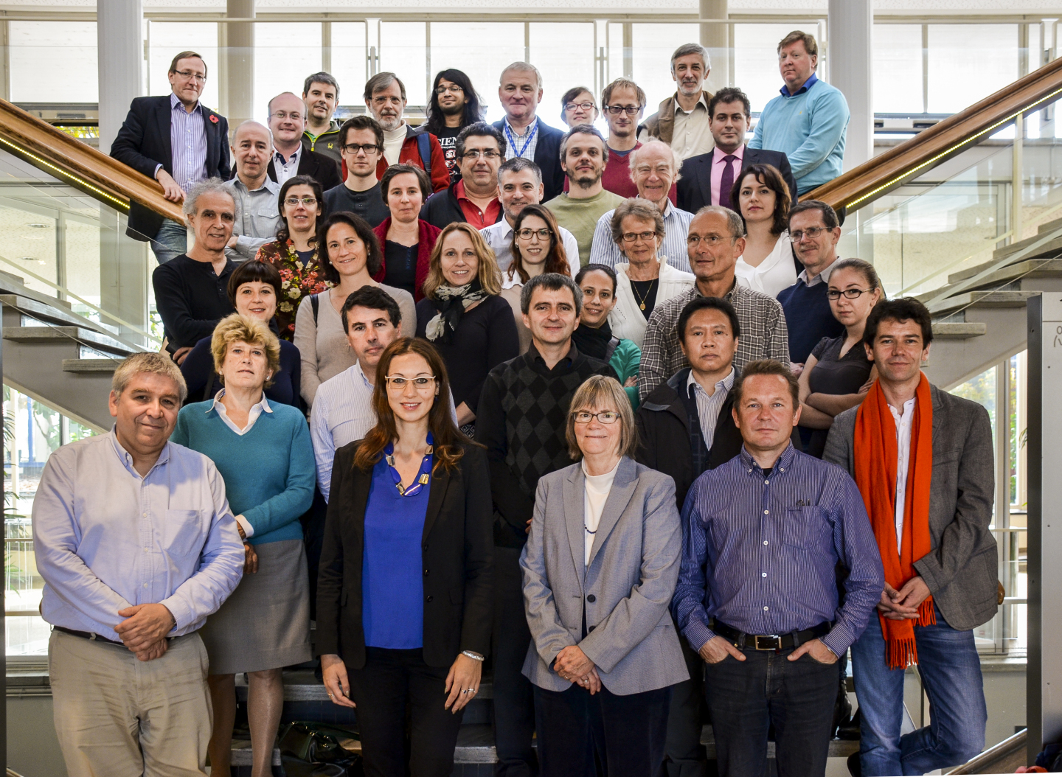
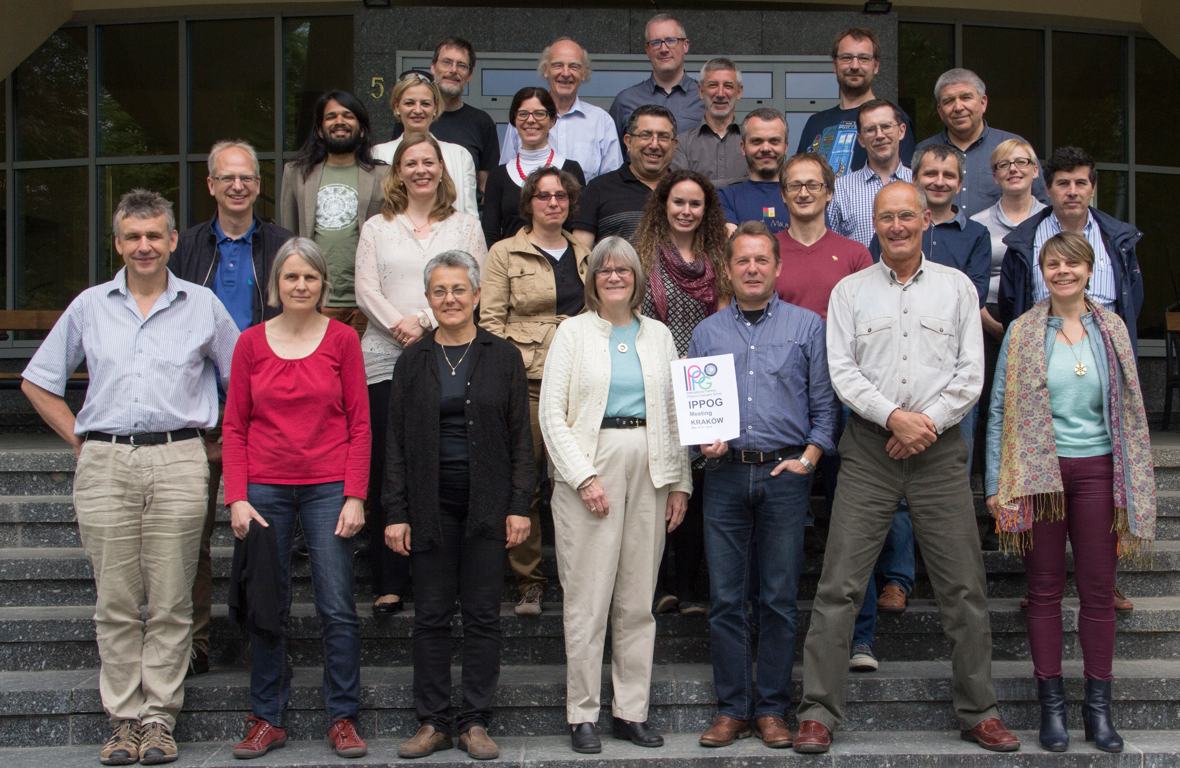
IPPOG
– an International Network
Current members come from the 22 member states of CERN, Australia, Ireland, Slovenia, South Africa, the USA, and from DESY, CERN and five of the major experiments at the Large Hadron Collider (LHC).
http://ippog.web.cern.ch
International network of (mainly) physicists who commit a fraction of their time in education and outreach.
These are your local contacts
in your country, laboratory,
and experiment when you need,
advice, help, support,
in your education and
outreach activities.
IPPOG meets twice a year
in Spring and Autumn to discuss
and exchange thoughts and
success stories, get inspirational
ideas, and getting organized world-wide.
IPPOG Fall meeting 2015 – CERN
Incl. half-day session with EPPCN
IPPOG Spring meeting 2016 – Krakow, IFJ PAN

Slide 5
New Member in 2016 - Slovenia
New countries, laboratories, experiments engaged in all fields of particle physics are welcome to strengthen IPPOG further.
http://ippog.web.cern.ch/ippog_membership
  Slovenia voted in as 27th country in IPPOG
  Particle Physics in Slovenia is based at the Jožef Stefan Institute in Ljubljana, providing a framework also including Universities of Ljubljana, Nova Gorica, and Maribor. Andrej Gorisek is representing Slovenia in IPPOG.
Contacts and interest expressed firmly by the Belle II Collaboration
Toru Iijima, Nagoya and Zdenek Dolesal, Prague
are both visiting us for this meeting
Discussions ongoing with the Physics Society of Brazil
agreed to send an official invitation letter (after this meeting over)
and there are few more informal discussions / interests at early stages.

Slide 6
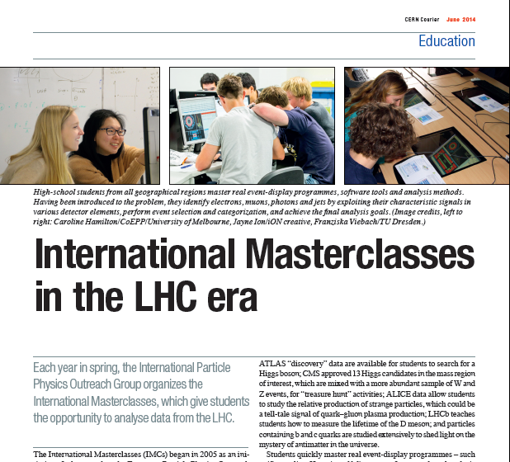
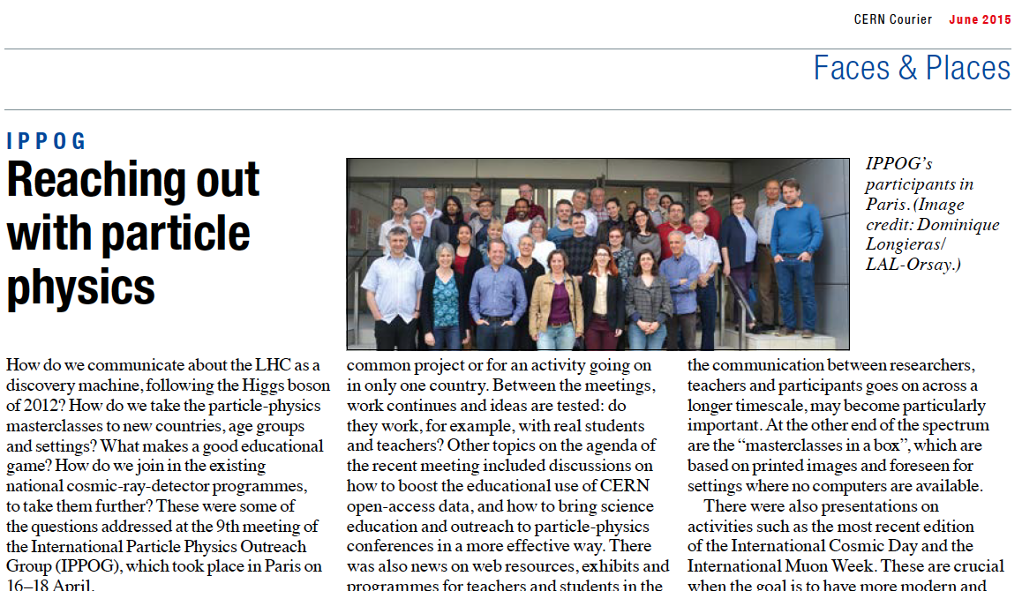
IPPOG an umbrella for making outreach global
International Masterclasses,
the flagship activity of IPPOG
trained over 13’000 students
and 1’000 teachers in
Spring every year !
Over 200 institutions in over 46
countries participating.
CERN Courier
June 2014 edition
    &
June 2015 edition

Slide 7
IPPOG at Conferences
Education & Outreach becoming an integral part in international HEP conferences,
where IPPOG is an active player and driver
EPS HEP 2015 – Vienna
  Parallel sessions on education and outreach
  – sessions chairs are IPPOG members
  Panel discussion "IPPOG: Experts in bringing new discoveries to the public" (Michael Kobel –IPPOG Germany)
Lepton Photon 2015 – Ljubljana
  plenary talk “education & outreach” (Kate Shaw – IPPOG ATLAS)
LHCP 2016 – Lund
  Parallel sessions on education and outreach ← this session here !
ICHEP 2016 – Chicago
  Parallel sessions on education and outreach (IPPOG engaged and invited)
Physics, Technology, Ethics– Žilina
  Invited contribution on Some Ethical Questions related to Particle Physics (Ivan Melo – IPPOG Slovakia; Thomas Naumann – IPPPOG DESY; HPB)
WCPE 2016 – Sao Paulo
  CERN Masterclass courses and the impact on school physics (Uta Bilow – IPPOG Masterclasses)
…

Slide 8

Fourth Annual Large Hadron Collider Physics Conference
Lund, Sweden, 13th - 18th June 2016
Outreach parallel session (6 invited talks + interactive panel session!
CERN: Outreach in the International Context
Sascha Schmeling on behalf of CERN
LHC Masterclasses. Bringing Particle Physics into the Classroom
Vladimir Gligorov on behalf of ALICE, ATLAS, CMS, & LHCb
IPPOG: Worldwide Outreach
Hans Peter Beck on behalf of IPPOG
LHC Communication & Enagement with New Audiences
Despina Hatzifoadou on behalf of ALICE, ATLAS, CMS, & LHCb
Education and Communication with Art at ATLAS and CMS
Pierluigi Paolucci
on behalf of ATLAS & CMS
ATLAS & CMS Data Release and Tools
Felix Socher on behalf on ATLAS &CMS

Slide 9
ICHEP, Chicargo, USA
3th - 10th August 2016
Outreach parallel sessions
3 sessions, 260 minutes in total
45 abstract submissions!!
18 talks (some merged) + 14 posters
Very popular sessions! Full house!
Fruitfull panel session

Slide 10
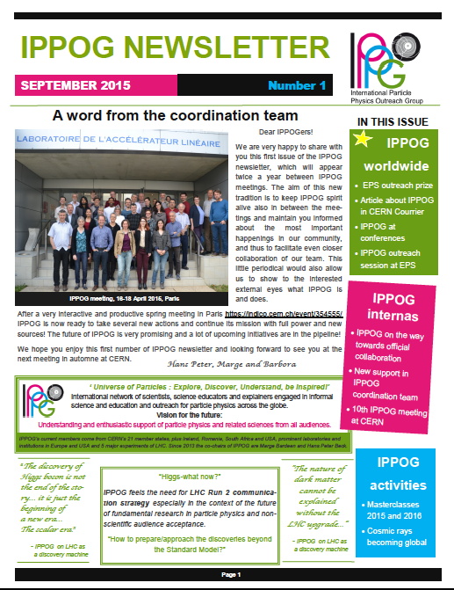
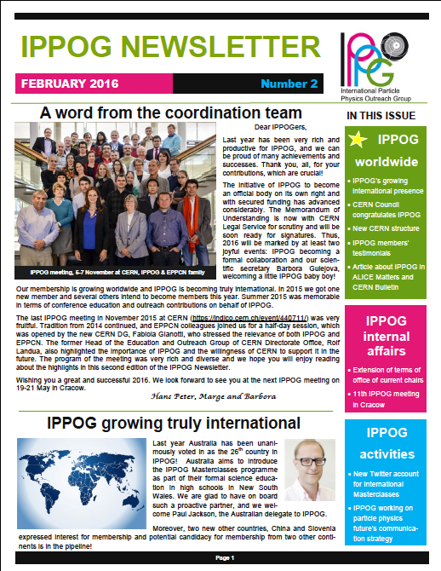
IPPOG Newsletter
Professionalizing IPPOG
Newsletter twice a year in-between IPPOG meeting.
Memorandum of Understanding between IPPOG members circulating for being signed.
Well defined IPPOG structure and tasks.
IPPOG Working groups, with action items.
All these advances would be un-thinkable without the help from a dedicated scientific secretary to IPPOG!

Slide 11
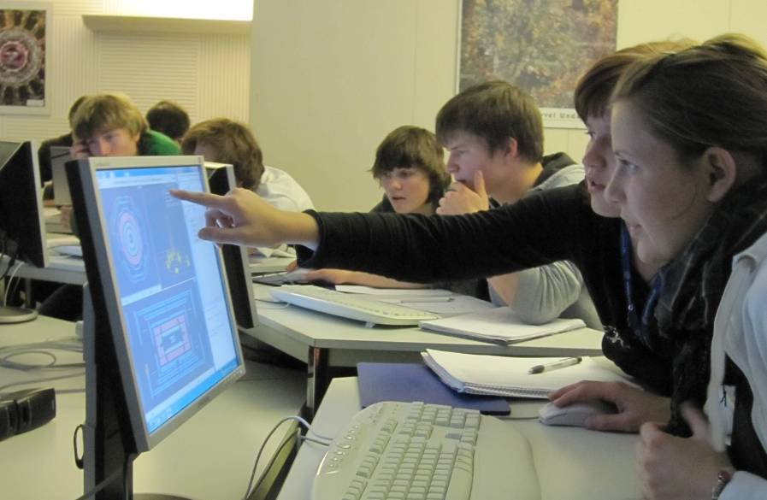
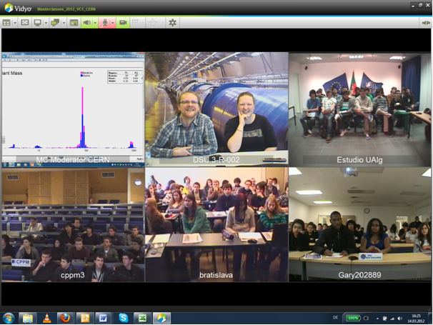
IPPOG’s Flagship:
International Masterclasses
High school students (15 – 19) are „scientists for one day“
Get invited to a research institute or university
Introductory talks (standard model, detectors, accelerators)
2 h measurement with LHC data
  New also with Icecube data
International video conference ( 2 – 5 inst. + CERN/Fermilab)

Slide 12
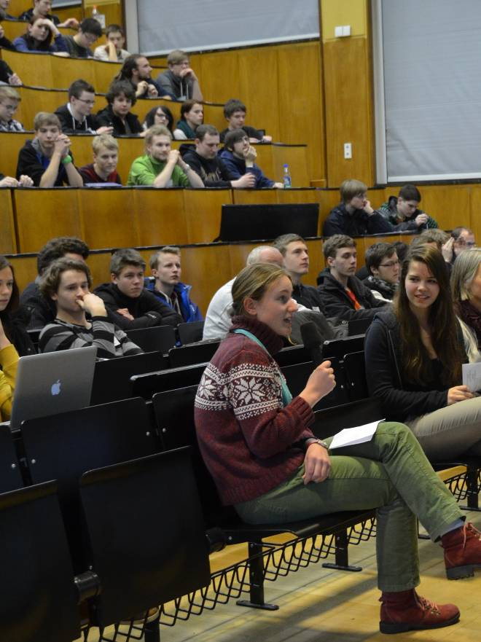
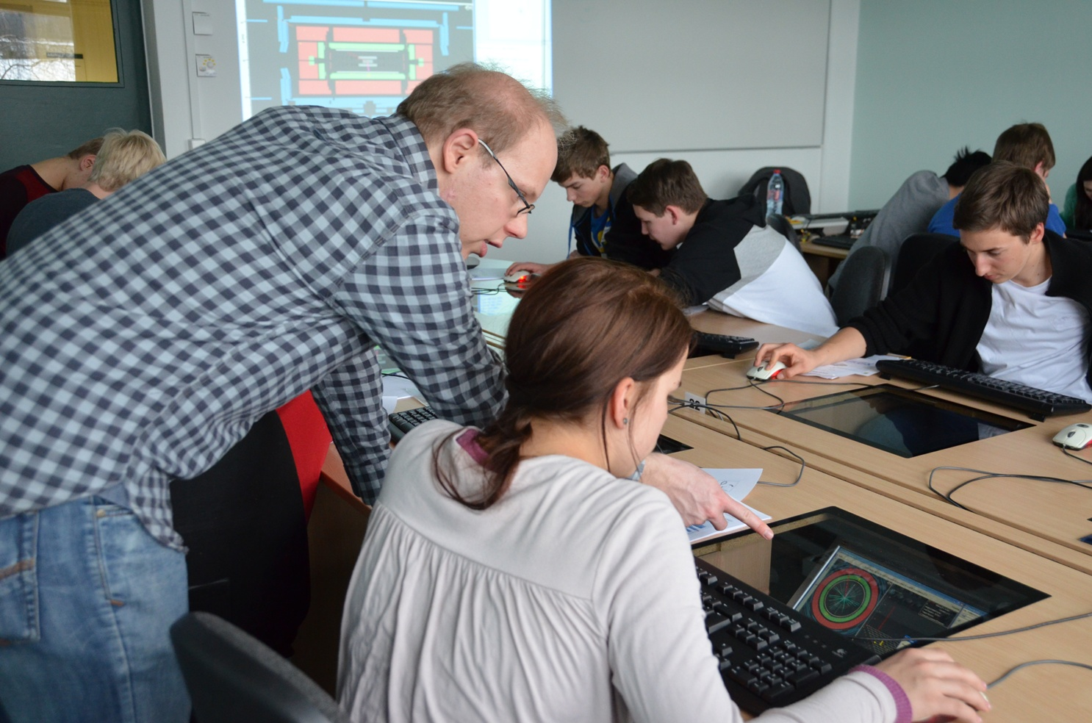
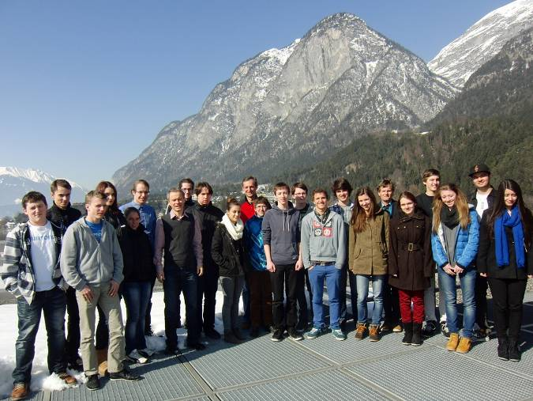
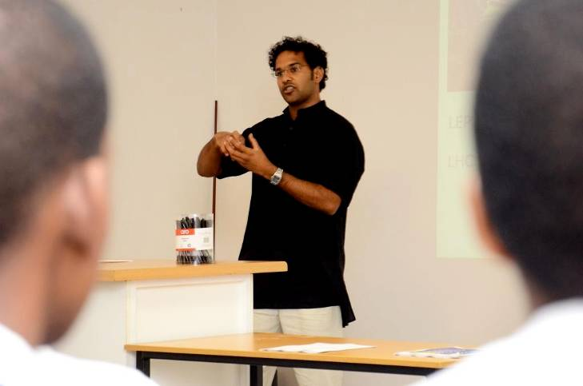
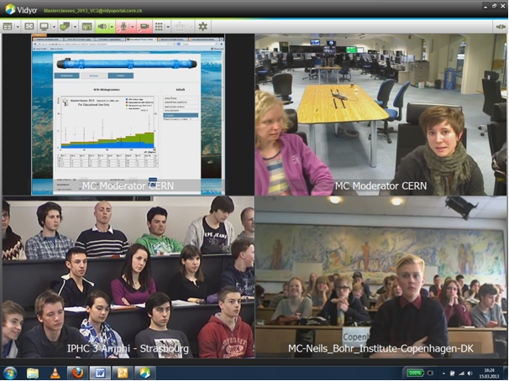
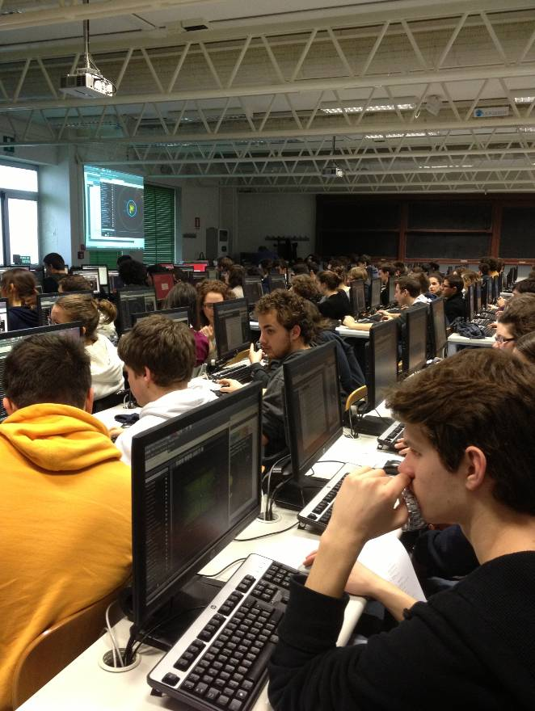
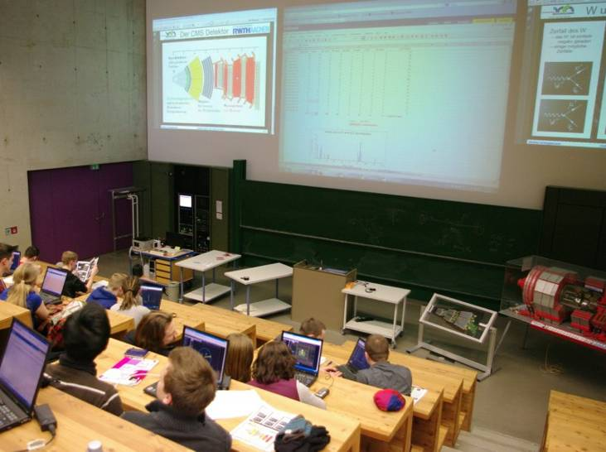
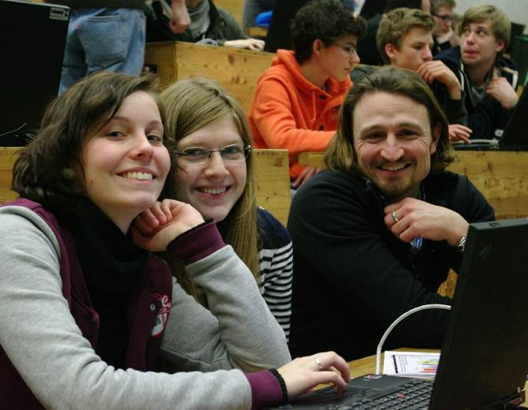

Slide 13
Evolution of Masterclass participation
2005
2006
2007
2008
2009
2010
2011
2012
2013
2014
2015
2016
18
countries
46
58
institutes
213
72
masterclasses
276
3k
students
13k
12
video conferences
75

Slide 14
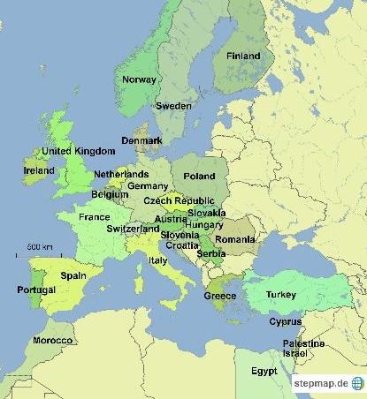
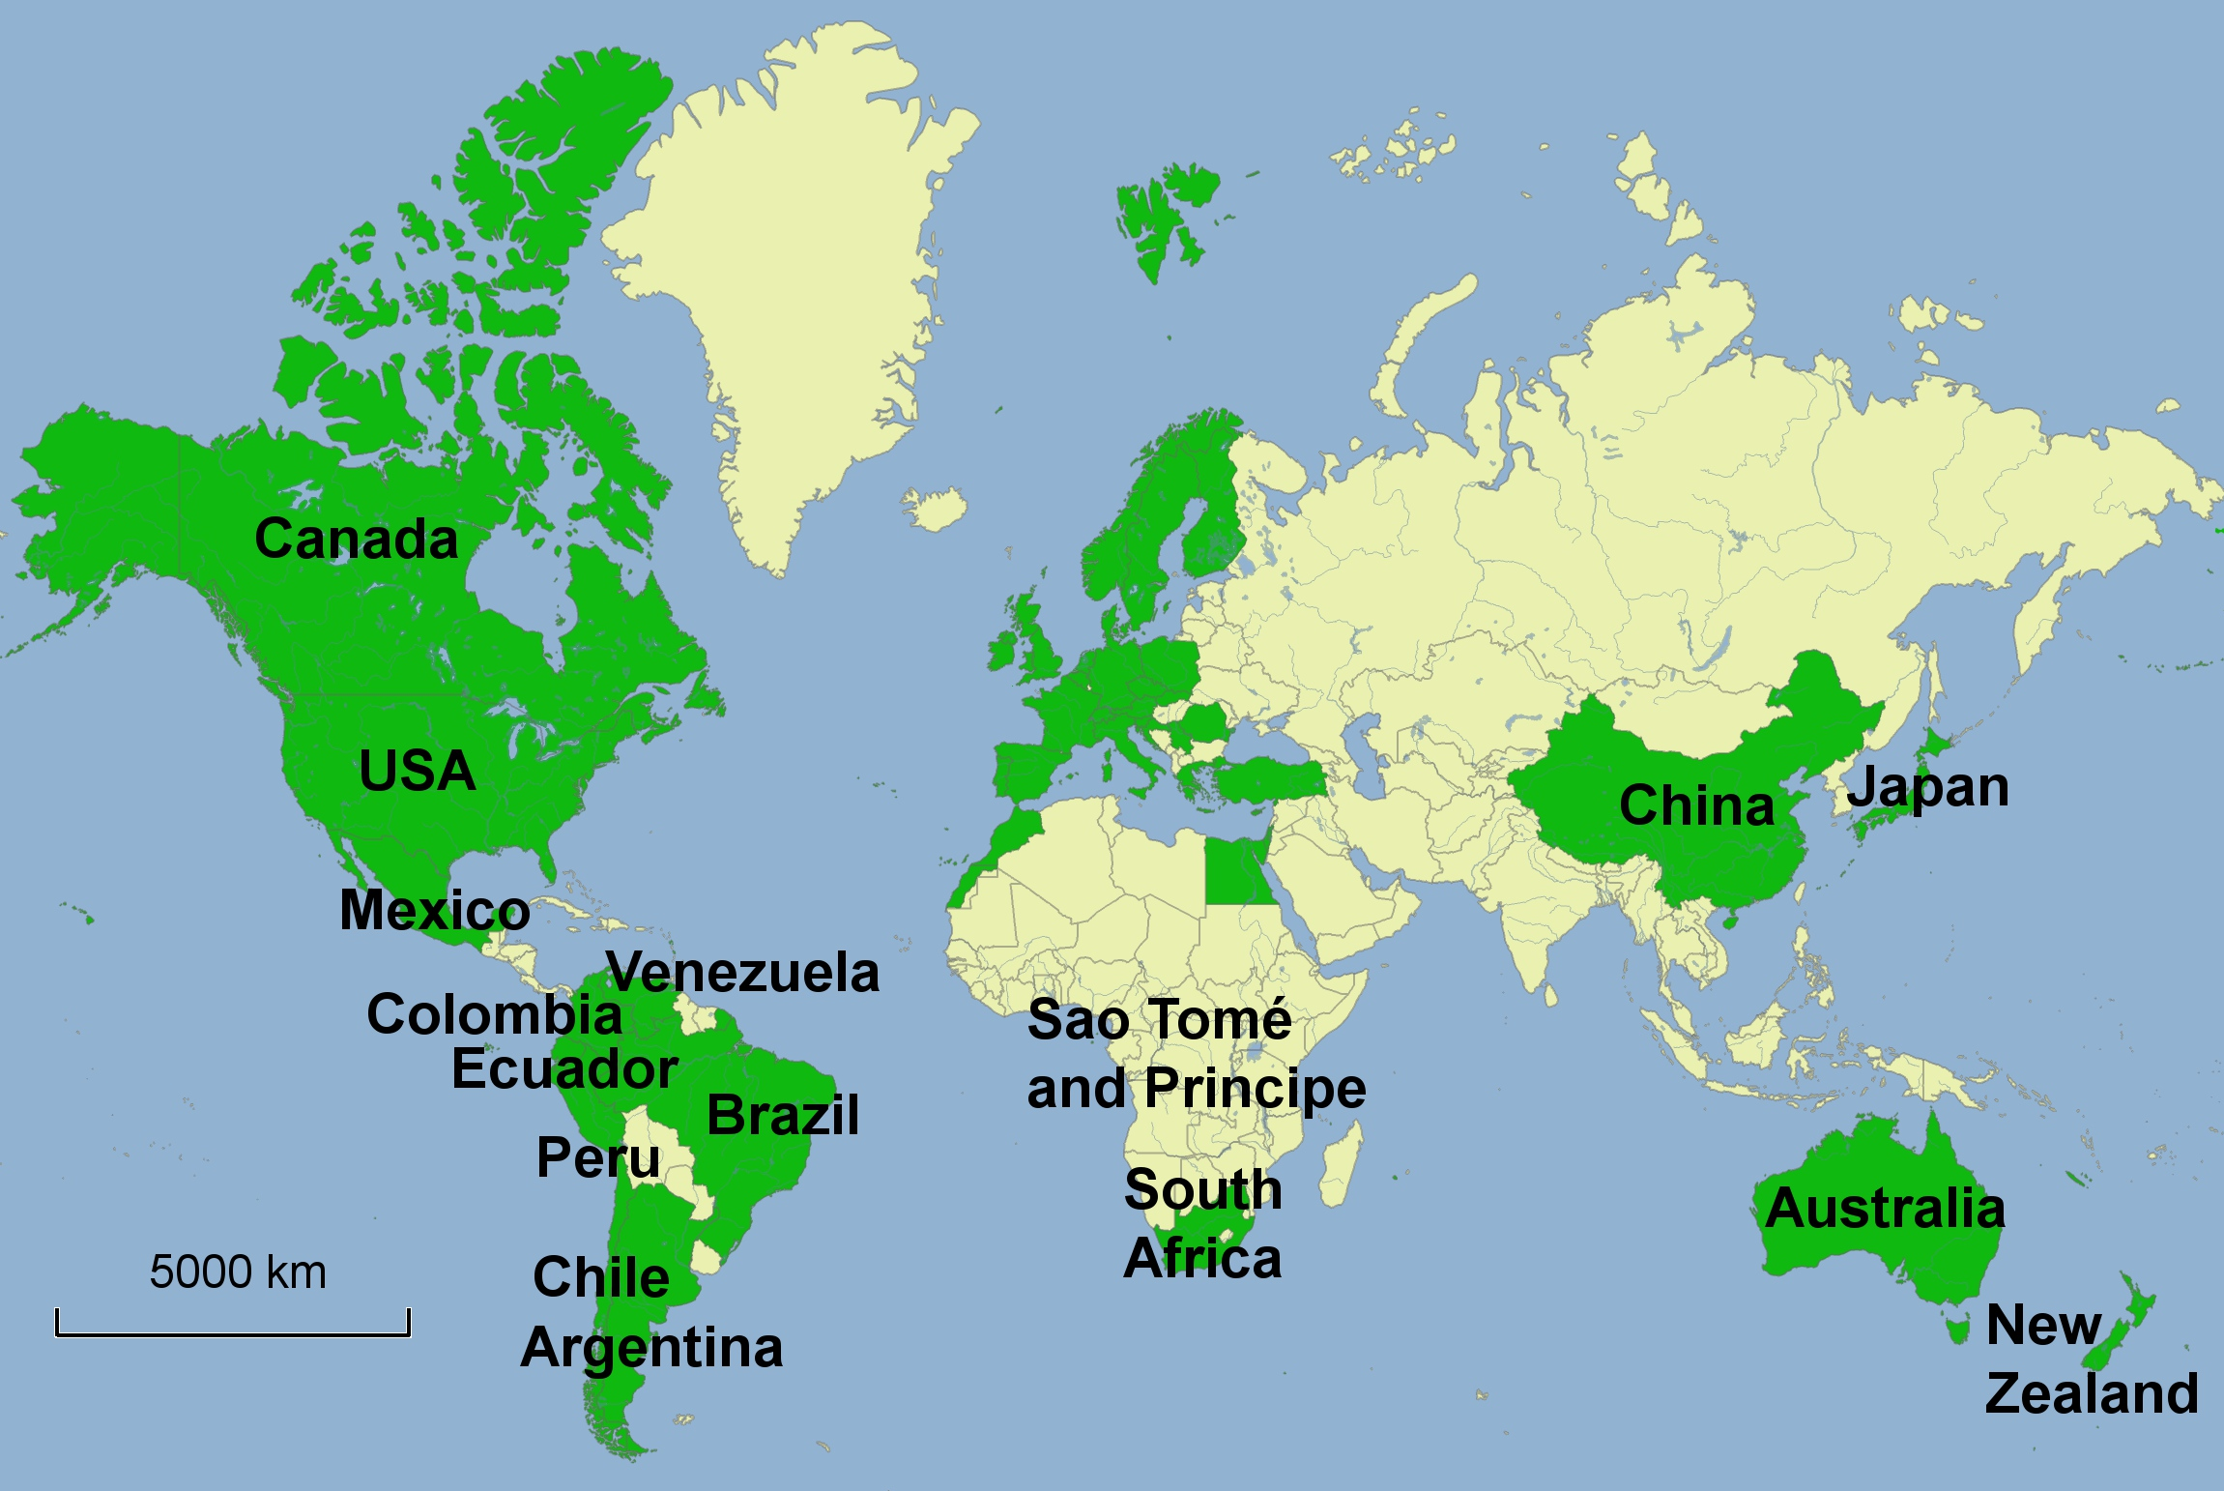
International Masterclasses
11 February – 23 March 2016
46 countries – 213 institutes – 13’000 high-school students – 1’100 teachers

Slide 15
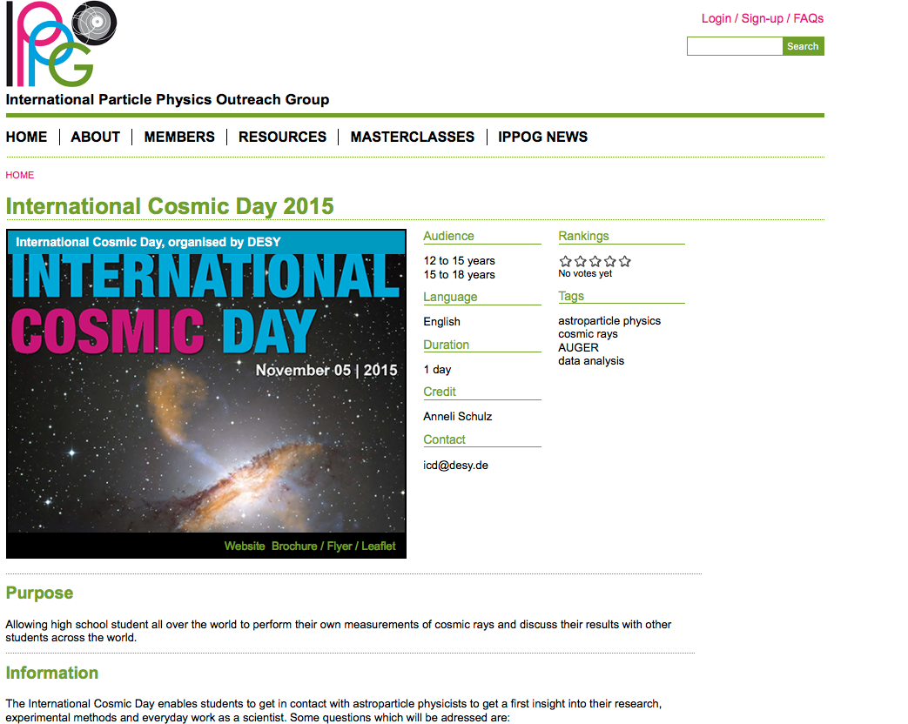
Expanding to Astroparticle physics – discussions and pilot tests
IceCube Masterclass
http://icecube.wisc.edu/masterclass/home
Auger Masterclass
http://auger.colostate.edu/ED/
Pilot tests in German Netzwerk Teilchenwelt
International Muon Week
Quarknet
http://Internationalmuonweek.org
International Cosmic Day
http://icd.desy.de
IPPOG is embracing all particle physics activities.
Although, historically, there is a strong bias towards LHC physics.
This bias is lingering with a broader base.

Slide 16

Int. Day of Women and Girls in Science
February 11, 2017
http://www.un.org/en/events/women-and-girls-in-science-day/index.shtml
→ encourage girls to pursue a career in science
→ encouraging the development of science education policies and programming
→ recognize the achievements of women in science
IPPOG: MasterClasses for girls only on Feb 11
will be advertised to all MC institutes, see how many are interested
  MCs for girls only
  female tutors and moderators, as much as possible
  adapt focus of the video conference

Slide 17
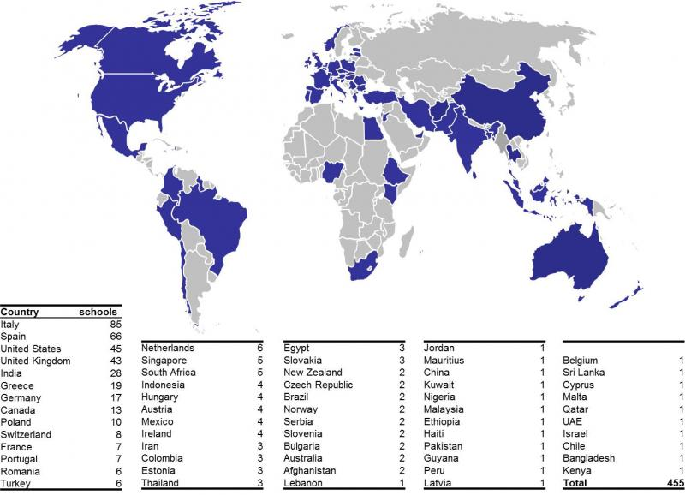
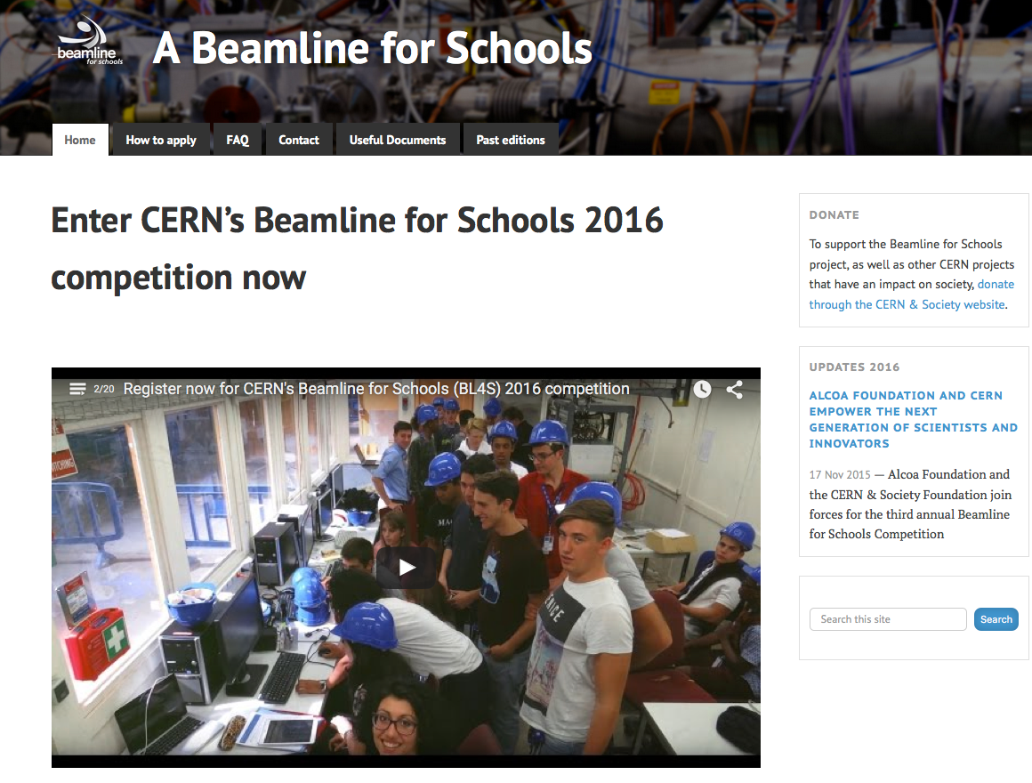
Competition: a beam line for schools
Report on Beamline for Schools (BL4S) competition (Markus Joos)
IPPOG acts as local contacts
to schools in many countries.
IPPOG members take responsibilities
for multiple countries to ensure that language
barriers will not be a insurmountable hurdle.
Competition for 2016
Winner teams arrived at CERN this week
Competition 2017 call on 14 July
http://beamline-for-schools.web.cern.ch

Slide 18
Effort, Needs & Support
Support (FTEs, use of infrastructure, in-kind, ad-hoc,…) from
CERN, Fermilab, EPS HEPP High-Energy and Particle Physics Division of the European Physical Society, TU Dresden, US National Science Foundation and the US Department of Energy.
Manpower for coordinating masterclasses
Uta Bilow (Dresden) funded by CERN
before: Helmholtz Alliance: Physics at the Terascale 2008-2012
Ken Cecire (Notre Dame) funded by Quarknet for US based Masterclasses
Barbora Gulejova (CERN) IPPOG Coordination and Support
A lot of voluntary effort provided by IPPOG members, and local teams at universities,… Nothing is sustained – as of today !!
Thanks to all who are helping !!
We can linger the burden on few and distribute the load internationally in a fair way. This is possible when IPPOG structures itself as a Collaboration.
New members will be interested in joining in a strong and healthy collaboration, ready to expand and bring new initiatives on board.

Slide 19
IPPOG MoU
Massive consultations and discussions with stake holders in and outside IPPOG over the past few years.
After an initial proto-MoU was established, CERN Legal Service took over to give it its final form.
This was discussed and agreed at the IPPOG meeting in Krakow
Membership fee not final defined
  Proposal and discussion on this Friday

Slide 20

IPPOG MoU
is not legally binding. IPPOG will continue to be based on trust and best efforts;
is setting out IPPOG’s objectives, governance, including decision-making;
is providing for financial and in-kind contributions by all IPPOG members, with the annual membership fee for countries, ranging between 1000€ and (a maximum of) 5000€;
and for laboratories and institutes, as well as scientific collaborations to be negotiated individually and subject for agreement by the IPPOG Collaboration board.
Collaboration will be considered starting when 10 Member have signed.
Today signed, or clear commitment to sign: CH, D, I, F, FIN, N, NL, P, RO, S, SK

Slide 21
IPPOG election of Chairperson(s)
Terms of Marge and HP come to an end and elections are therefore required.
Four candidates
  Nicolas Arnaud
  Steven Goldfarb
  Marge Bardeen
  HPB
Candidate statements have been circulated to IPPOG representatives
Election scheduled for Friday afternoon.

Slide 22

IPPOG Photosession
Thursday after the IPPOG session at 6 pm
you will have a chance to have your portrait
taken for the new IPPOG web page.
Representatives and associates are invited.
Please have your photo taken if you didn't do
so at last year’s IPPOG meeting, or take a
new photo if you would like to improve the
one you took a year ago.
You can download last year’s photos in the
registration form.
You can also come along if you just would like to enjoy the drinks and finger food that we will provide.
Please bring a typical object with you that will personalise your portrait even more.

Slide 23
Panel Discussions
Friday 14:45 – 15:45
Broadening of the physics scope of MC – Charpak
Nicolas Arnaud, Zdenek Dolezal, Andrej Gorisek, Farid Ould-Saada, Dirk Ryckbosch, Pedro Abreu, Kenneth Cecire, Thomas McCauley, Kate Shaw, Gabriel Stoicea, Bilow Uta
Ethics in particle physics – 33 / R-016
Hans Peter Beck, Barbora Bruant Gulejova, Celso Martinez Rivero, Ivan Melo, Thomas Naumann, Steven Goldfarb
Special events and exhibitions – Mezannine in 510
Marge Bardeen, Catarina Espirito Santo, Despina Hatzifotiadou, Catia Peduto, Panagiotis Charitos, Christine Kourrkoumelis, Jiri Rames, Peter Watkins, Natascha Hoermann, Nick Tracas, Beatrice Zuaro
Table top experiments – in front of Charpak
Yiota FOKA, Rasmus Mackeprang, Julia Woithe, Krzysztof Wieslaw Wozniak, Paul Jackson, Daniel Lellouch, Arturo Sanchez Pineda

Slide 24
Panel Discussions
During the panel preparations
an intense exchange of ideas and experiences made can be made among those active/interested in a given topic.
At the panel presentation
An overview of activities/items/topics can be given to the IPPOG plenary, and conclusions/recommendations/suggestions coming out of the panel preparation can be disseminated.

Slide 25
Working Groups
Friday 09:00-10:30
Cosmic Rays Going Global WG – 40 / R-C10
Nicolas Arnaud, Marge Bardeen, Hans Peter Beck, Catarina Espirito Santo, Yiota FOKA, Despina Hatzifotiadou, Rasmus Mackeprang, Catia Peduto, Charles Timmermans, Julia Woithe, Krzysztof Wieslaw Wozniak
Explaining PP Hot Topics to Lay Audience WG – 40 / R-D10
Barbora Bruant Gulejova, Panagiotis Charitos, Zdenek Dolezal, Andrej Gorisek, Paul Jackson, Christine Kourrkoumelis, Daniel Lellouch, Celso Martinez Rivero, Ivan Melo, Thomas Naumann, Farid Ould-Saada, Jiri Rames, Dirk Ryckbosch, Jonas Strandberg, Peter Watkins
MC in new Countries WG – Charpak
Pedro Abreu, Kenneth Cecire, Steven Goldfarb, Natascha Hoermann, Marzena Lapka, Thomas McCauley, Arturo Sanchez Pineda, Kate Shaw, Gabriel Stoicea, Nick Tracas, Bilow Uta, Beatrice Zuaro

Slide 26
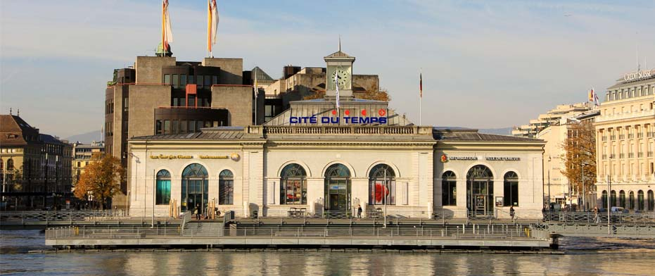
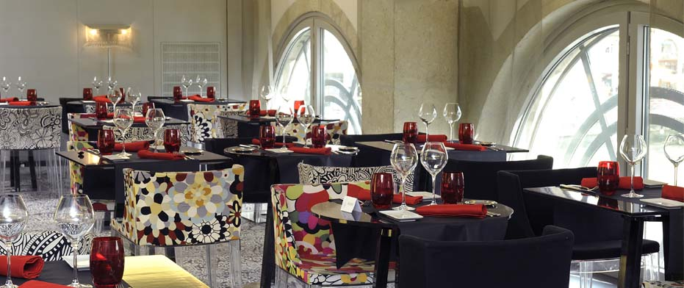
IPPOG dinner Friday Evening
LA CITÉ DU TEMPS
Pont de la Machine 1
1204 Genève
Tél. +41 22 818 39 00
Cite du Temps, Geneva http://www.citedutemps.com/index.php/en
Bus at 19:00
in front of the Hostel, bldg 39
You can also take tram 18 from CERN and exit at Coutance
(Bel-Air also possible)
It’s a 30’ trip

Slide 27
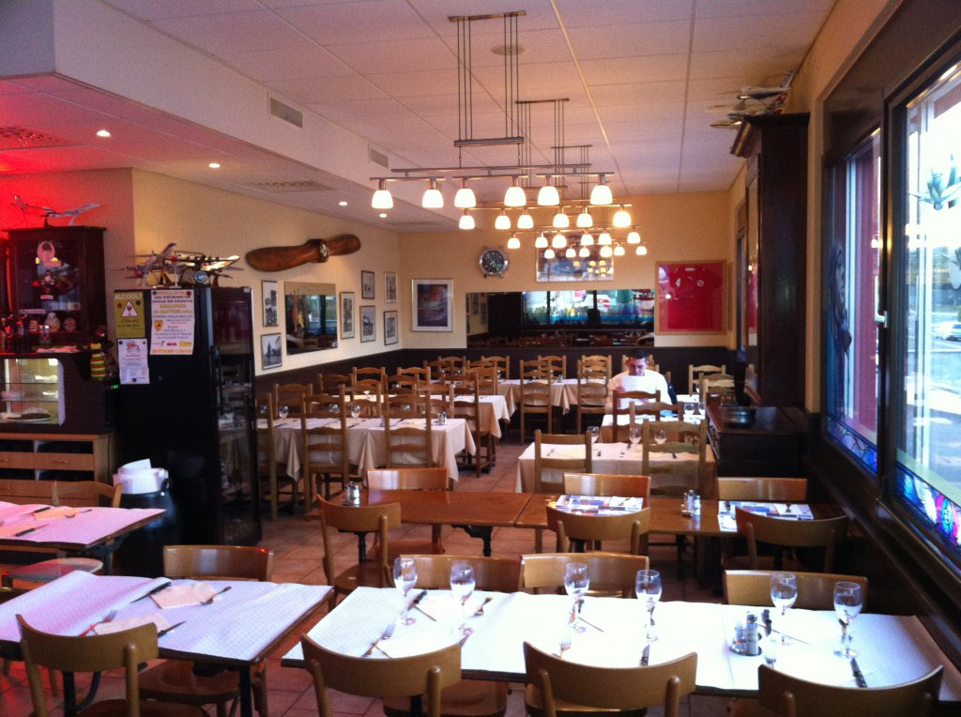
IPPOG informal dinner Thursday
Café restaurant de l'aviation
ch. des Coquelicots 18
1214 Vernier
Suisse
Téléphone: +41 22 341 12 32
Transport:
Tram 18 to Blandonnet
Check http://www.tpg.ch for timetables
Those who have cars and will drive:
Please inform Barbora and me, we will then arrange further.

Slide 28
Backup

Slide 29
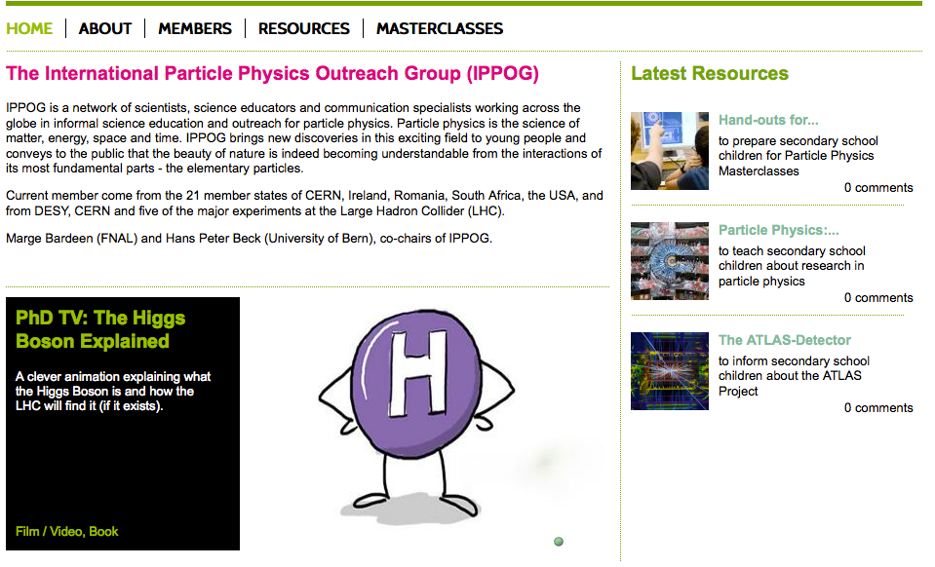
The roots of IPPOG
  IPPOG has its roots in 1997, where under the joint auspices of the European Committee for Future Accelerators (ECFA) and the High Energy Particle Physics Board of the European Physical Society (EPS-HEPP Board) the European Particle Physics Outreach Group (EPPOG) was formed. EPPOG transformed to IPPOG in 2011, to reflect its true international stature.
http://ippog.web.cern.ch

Slide 30
The European strategy update – 2013
CERN-Council-S/106
What the European Strategy for Particle Physics says on the
Wider impact of particle physics
Sharing the excitement of scientific discoveries with the public is part of our duty as researchers. Many groups work enthusiastically in public engagement.
They are assisted by a network of communication professionals (EPPCN) and an international outreach group (IPPOG).
For example, they helped attract tremendous public attention and interest around the world at the start of the LHC and the discovery of the Higgs boson.
☞ Outreach and communication in particle physics should receive adequate funding and be recognised as a central component of the scientific activity.
EPPCN and IPPOG should both report regularly to the Council.

Slide 31
Sustainable funding
Today, particle physics has become a global activity, with experimental collaborations featuring thousands of researchers from all over the world.
Commensurate with this reality, IPPOG as well needs to evolve to cover more countries, laboratories and experiments in the areas of particle physics, astrophysics and associated technologies.
In particular, IPPOG should be given a formal, albeit simple, organizational structure so as to guarantee the sustainability of its work. This means as well that IPPOG should be able to rely on some basic regular funding as well as in-kind contributions.
Based on the existing IPPOG model, we have over the past few months carefully examined various elements for such a formal structure, and we have extensively consulted with stakeholders.
A Memorandum of Understanding (‘MOU’), which is similar to existing instruments used for international scientific collaborations in particle physics, reflects these efforts.

Slide 32
IPPOG MoU
aims for sharing and distributing the load over all members in a fair manner.
with IPPOG being truly international and independent, we can also bring major international labs and major international scientific collaborations (experiments) on board - on equal footing!
  Indeed, there is interest expressed once the Collaboration is formed, the structure defined, and the fees known

Slide 33
IPPOG
International Particle Physics Outreach Group
an example for concerted and systematic effort for outreach
Enabling Outreach Globally
as a Collaboration in a collaborative effort

