Slide 1

IPPOG CB ISSUES
Hans Peter Beck: IPPOG Co-chair, Bern University
Marjorie Bardeen: IPPOG Co-chair, Fermilab

Slide 2
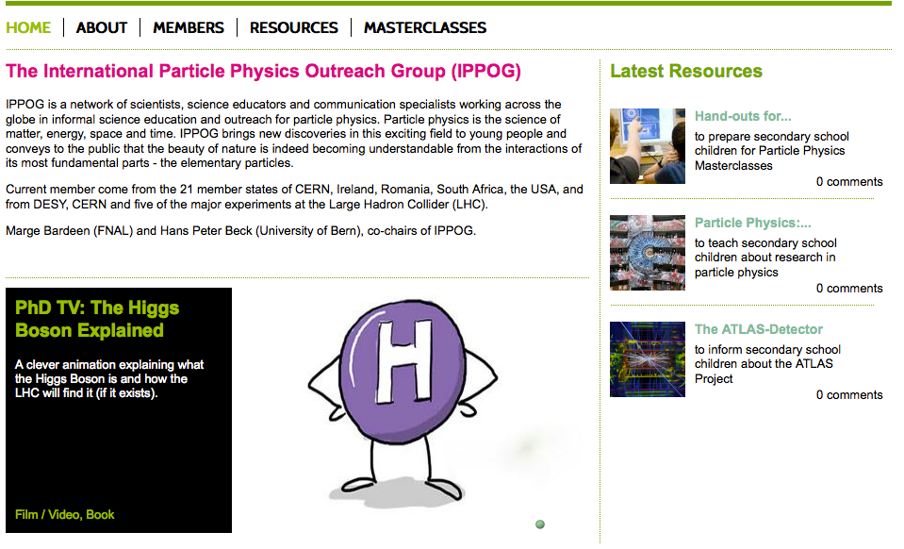
The roots of IPPOG
  IPPOG has its roots in 1997, where under the joint auspices of the European Committee for Future Accelerators (ECFA) and the High Energy Particle Physics Board of the European Physical Society (EPS-HEPP Board) the European Particle Physics Outreach Group (EPPOG) was formed. EPPOG transformed to IPPOG in 2011, to reflect its true international stature.
http://ippog.web.cern.ch

Slide 3
The European strategy update – 2013
CERN-Council-S/106
What the European Strategy for Particle Physics says on the
Wider impact of particle physics
Sharing the excitement of scientific discoveries with the public is part of our duty as researchers. Many groups work enthusiastically in public engagement.
They are assisted by a network of communication professionals (EPPCN) and an international outreach group (IPPOG).
For example, they helped attract tremendous public attention and interest around the world at the start of the LHC and the discovery of the Higgs boson.
☞ Outreach and communication in particle physics should receive adequate funding and be recognised as a central component of the scientific activity.
EPPCN and IPPOG should both report regularly to the Council.

Slide 4
Sustainable funding
Today, particle physics has become a global activity, with experimental collaborations featuring thousands of researchers from all over the world.
Commensurate with this reality, IPPOG as well needs to evolve to cover more countries, laboratories and experiments in the areas of particle physics, astrophysics and associated technologies.
In particular, IPPOG should be given a formal, albeit simple, organizational structure so as to guarantee the sustainability of its work. This means as well that IPPOG should be able to rely on some basic regular funding as well as in-kind contributions.
Based on the existing IPPOG model, we have over the past few months carefully examined various elements for such a formal structure, and we have extensively consulted with stakeholders.
A Memorandum of Understanding (‘MOU’), which is similar to existing instruments used for international scientific collaborations in particle physics, reflects these efforts.

Slide 5
IPPOG MoU
aims for sharing and distributing the load over all members in a fair manner.
with IPPOG being truly international and independent, we can also bring major international labs and major international scientific collaborations (experiments) on board - on equal footing!
  Indeed, there is interest expressed once the Collaboration is formed, the structure defined, and the fees known

Slide 6
Effort, Needs & Support
Support (FTEs, use of infrastructure, in-kind, ad-hoc,…) from
CERN, Fermilab, EPS HEPP High-Energy and Particle Physics Division of the European Physical Society, TU Dresden, US National Science Foundation and the US Department of Energy.
Manpower for coordinating masterclasses
Uta Bilow (Dresden) funded by CERN
before: Helmholtz Alliance: Physics at the Terascale 2008-2012
Ken Cecire (Notre Dame) funded by Quarknet for US based Masterclasses
Barbora Gulejova (CERN) IPPOG Coordination and Support
A lot of voluntary effort provided by IPPOG members, and local teams at universities,… Nothing is sustained – as of today !!
Thanks to all who are helping !!
We can linger the burden on few and distribute the load internationally in a fair way. This is possible when IPPOG structures itself as a Collaboration.
New members will be interested in joining in a strong and healthy collaboration, ready to expand and bring new initiatives on board.

Slide 7
IPPOG MoU
Massive consultations and discussions with stake holders in and outside IPPOG over the past few years.
After an initial proto-MoU was established, CERN Legal Service took over to give it its final form.
This was discussed and agreed at the IPPOG meeting in Krakow
Membership fee not final defined
  Proposal and discussion on this Friday

Slide 8

IPPOG MoU
is not legally binding. IPPOG will continue to be based on trust and best efforts;
is setting out IPPOG’s objectives, governance, including decision-making;
is providing for financial and in-kind contributions by all IPPOG members, with the annual membership fee for countries, ranging between 1000€ and (a maximum of) 5000€;
and for laboratories and institutes, as well as scientific collaborations to be negotiated individually and subject for agreement by the IPPOG Collaboration board.
Collaboration will be considered starting when 10 Member have signed.
Today signed, or clear commitment to sign: CH, D, I, F, FIN, N, NL, P, RO, S, SK

Slide 9
Membership Fee for Countries
As discussed in Krakow in Spring 2016
  Fee should be 1 k€, 3 k€, 5k€
  for small, medium, and large countries estimated according the GDP
GDP alone, however, turns out not to be the best estimator.
It works for homogenous societies with comparable history in findamental research activities.
  Think of countries with large GDP, but very modest, i.e. new or relatively new !, in PP, whit no long established history and only building up an emerging understanding of the relevance of fundamental science.
  Think of countries with a rich history in fundamental science but a troublesome economic situation to struggle through.
A new proposal to estimate who should contribute at a small, medium, or large level, should take into account the GDP and the investment in particle physics.
  No clear cut way to estimate the particle physics investments per country.
  Could count the money in PP, the number of professional physicists (with, without PhD, in the field), but not clear how to get these numbers for every country.

Slide 10
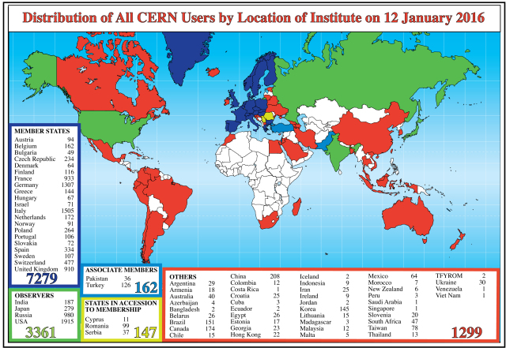
Membership Fee for Countries
Estimating the investment in particle physics research by counting the number of users at major international labs.
  CERN and FNAL (but should not forget KEK, DUBNA, …?)

Slide 11
Membership Fee for Countries
Estimating the investment in particle physics research by counting the number of users at major international labs.
  CERN and FNAL (but should not forget KEK, DUBNA, …?)
  Double counting of users active in more than one lab is wanted and shall not be corrected.
    If a country affords to send its physicists to be active in multiple labs on different continents, this counts as adding up in the estimator for gauging the investment in particle physics research.
  Proposal: The country investment in particle physics research can be gauged as small, medium and large by the community size through counting the total number of users per country at major international labs.
With GDP and community size, two independent qualifiers are identified for gauging countries as small, medium, or large.
  For many countries, both estimators lead to consistent gauge.
  For other countries, the smaller gauge shall be used.

Slide 12
Membership Fee for Countries
Proposal:
Member | cern users | fnal users | cern+fnal users | GDP | GDP-fee | CERN-fee | Cern+FNAL fee | Min(GDP,CERN+FNAL)
USA | 1915 | 2386 | 4301 | 17'348'072 | 5 | 5 | 5 | 5
Italy | 1505 | 118 | 1623 | 2'141'161 | 5 | 5 | 5 | 5
Germany | 1307 | 79 | 1386 | 3'868'291 | 5 | 5 | 5 | 5
United Kingdom | 910 | 235 | 1145 | 2'988'893 | 5 | 5 | 5 | 5
France | 933 | 44 | 977 | 2'829'192 | 5 | 5 | 5 | 5
Switzerland | 477 | 58 | 535 | 701'037 | 3 | 5 | 5 | 3
Spain | 334 | 46 | 380 | 1'381'342 | 3 | 3 | 3 | 3
Poland | 264 |  | 264 | 544'959 | 3 | 3 | 3 | 3
the Netherlands | 172 |  | 172 | 879'319 | 3 | 3 | 3 | 3
Belgium | 162 |  | 162 | 531'547 | 3 | 3 | 3 | 3
Finland | 116 |  | 116 | 272'217 | 3 | 3 | 3 | 3
Sweden | 107 |  | 107 | 571'090 | 3 | 3 | 3 | 3
Austria | 94 |  | 94 | 436'888 | 3 | 3 | 3 | 3
Norway | 91 |  | 91 | 500'519 | 3 | 3 | 3 | 3
Australia | 40 | 18 | 58 | 1'471'439 | 5 | 3 | 1 | 1
Israel | 71 |  | 71 | 305'673 | 3 | 3 | 1 | 1
Denmark | 64 |  | 64 | 346'119 | 3 | 3 | 1 | 1
South Afrika | 47 |  | 47 | 349'819 | 3 | 3 | 1 | 1
Ireland | 9 |  | 9 | 250'814 | 3 | 1 | 1 | 1
czech republic | 234 | 18 | 252 | 208'796 | 1 | 3 | 3 | 1
Greece | 144 |  | 144 | 235'574 | 1 | 3 | 3 | 1
Portugal | 106 |  | 106 | 230'117 | 1 | 3 | 3 | 1
Romania | 99 |  | 99 | 192'094 | 1 | 3 | 3 | 1
Slovakia | 72 |  | 72 | 97'713 | 1 | 3 | 3 | 1
Hungary | 67 |  | 67 | 133'424 | 1 | 3 | 1 | 1
Bulgaria | 49 |  | 49 | 54'481 | 1 | 3 | 1 | 1
Slovenia | 20 |  | 20 | 49'491 | 1 | 1 | 1 | 1
Total |  |  |  |  | 76 | 88 | 76 | 64
Bold font:
signature sheet of the MoU arrived as of today
Green font:
committed to sign the MoU
Black font:
In negotiation, or waiting for more information

Slide 13
Membership Fee for Laboratories
International laboratories* sign the MoU and have same rights as countries
  * MoU § 3.2
  international bodies, including laboratories and scientific collaborations having a significant, international participation, are eligible to apply for membership in their own right.
  Membership fee not to be 1, 3, or 5 k€
  There are different needs and expectations from international laboratories.
  Proposal: Laboratories shall sign upon a special agreement signed and amended to the MoU, where in-kind and monetary contributions are negotiated individually.
  A vote is required:
    MoU § 15 AMENDMENT
      § 15.1 This MoU may be amended by a decision of the Collaboration Board by a two-thirds majority of the votes cast.
      § 15.2 The amendment of Addenda shall be subject to agreement of its signatories.
Negotiations on in-kind contributions from CERN have started.

Slide 14
Membership Fee for Experiments
Experiments* sign the MoU and have same rights as countries
  * MoU § 3.2
  international bodies, including laboratories and scientific collaborations having a significant, international participation, are eligible to apply for membership in their own right.
  Membership fee not to be 1, 3, or 5 k€
  There are different needs and expectations from experiments.
Experiments are the source of data, expertise, manpower, etc. upon which IPPOG bases its activities.
  We need to launch an internal discussion on how to formalize the contributions and support structure for experiments participating in IPPOG.
  Should define a template approach for all experiments in IPPOG that makes it both attractive and useful for experiments joining IPPOG.

Slide 15
Backup

Slide 16
IPPOG election of Chairperson(s)
Terms of Marge and HP come to an end and elections are therefore required.
Four candidates
  Nicolas Arnaud
  Steven Goldfarb
  Marge Bardeen
  HPB
Candidate statements have been circulated to IPPOG representatives
Election scheduled for Friday afternoon.

