Slide 1


IPPOG and DESY
mutual benefits
Thomas Naumann
Meeting
CERN 11.11.2016

Slide 2
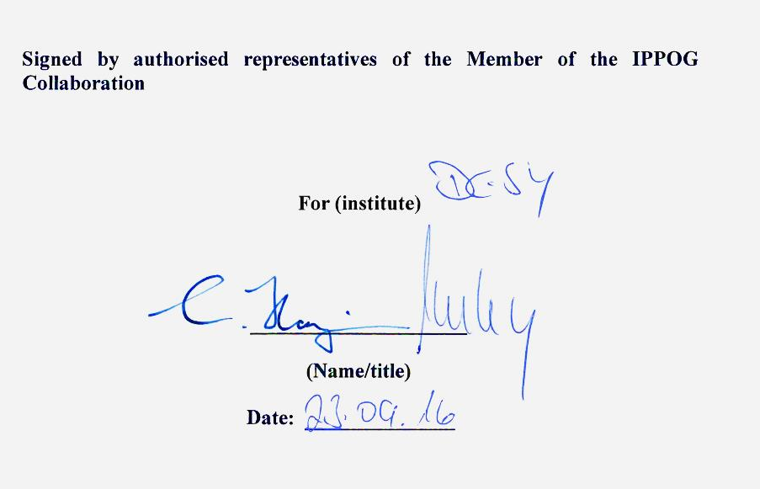
mutual benefit between institution and IPPOG
DESY signed IPPOG MoU
for DESY and Germany
5.000 EUR contribution
by DESY

Slide 3

mutual benefit between institution and IPPOG
regular discussion and information exchange
Example:
planetarium show
by Michael Barnett, ATLAS
www.interactions.org/cms/?pid=1036001
http://PhantomOfTheUniverse.com
  4kx4k full-dome version.
  German version co-financed by DESY:
  www.phantomdesuniversums.at
  German premiere in October at the
  opening of the exhibition
  ‚Of Galaxies, Quarks and Collisions‘
  Museum of Natural History in Vienna
proposed to the newly opened
Grand Planetarium in Berlin

Slide 4
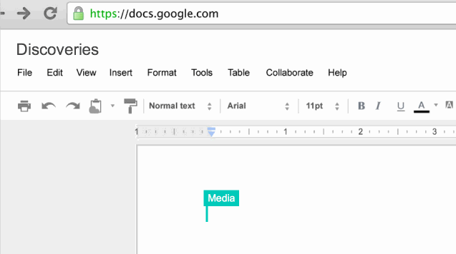
mutual benefit between institution and IPPOG
propose, test and implement outreach ideas + strategies
share lessons learned and best practices between
countries, institutions, experiments
Example: Physics and the Media
  idea of Achintya Rao:
Example: Higgs - What now ?
  many discussions in IPPOG
  messages taken by HP to ICHEP, ICNFP, …
  messages taken by TN to DESY, German RECFA evaluation, …
Example: Precision counts
  idea of HP Beck
  reused by IPPOG members

Slide 5
Higgs: What now?
Higgs discovery not the end of an era, but
beginning of a New Era:
We enter a new Scalar World !
Are there more Higgses ?
Why is there Something instead of Nothing ?
Cosmic connections - the Dark Universe:
primordial Big Bang inflation driven by scalar field
today‘s inflation driven by scalar field:
Dark Energy, cosmological constant (Nobel 2011)
Higgs: scalar field
Dark Matter - is this SUSY?
world(s) born from chaos - of fluctuations of scalar field ?

Slide 6
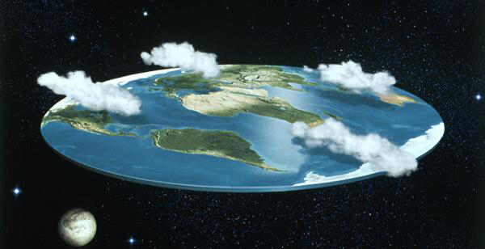
Precision counts
© HP Beck, IPPOG
flat Earth
ok to build a house or a bridge
only after a fraction f
of the Earth diameter
its surface is more than
a fraction f below horizon:
Higgs coupling precision:
LHC: f=10% : 1300 km
LC: f= 1‰ : 13 km
Higgs W,Z, t, … Standard Model
SUSY
GUT
Extra Dim.
Beyond
Standard Model

Slide 7
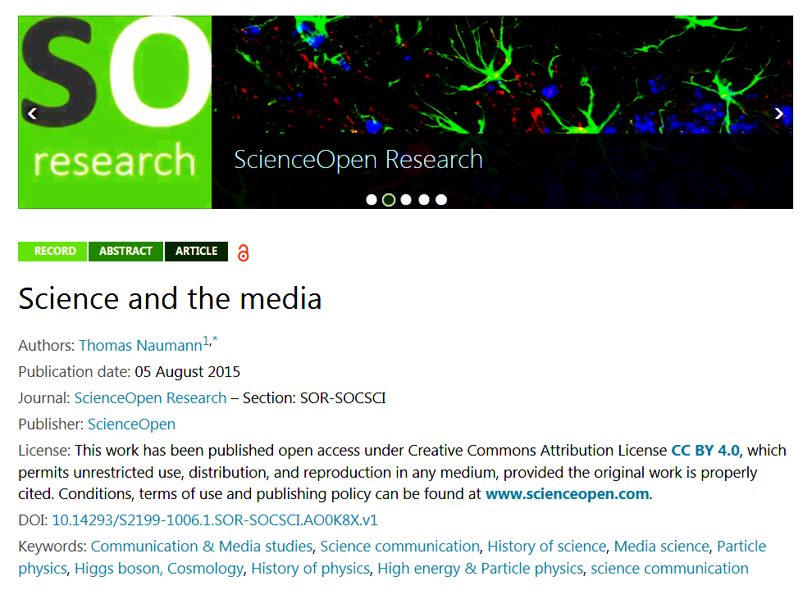

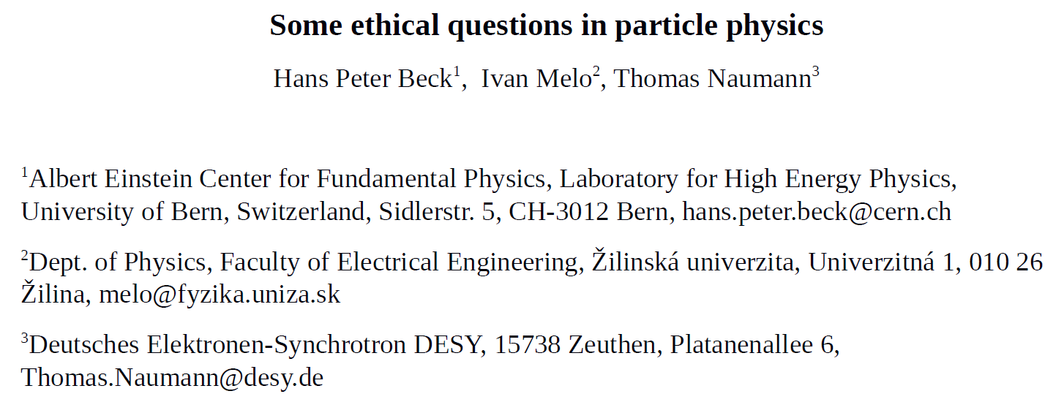
cooperation of IPPOG members
IPPOG discussions -
paper -
paper:
International conference
“Physics, Technology, Ethics”, September 2016, Žilina, Slovakia
Invited contribution on
“Ethical Questions
related to
Particle Physics”
IPPOG authors:
Hans Peter Beck, CH
Ivan Melo, SVK
Thomas Naumann, DESY

Slide 8
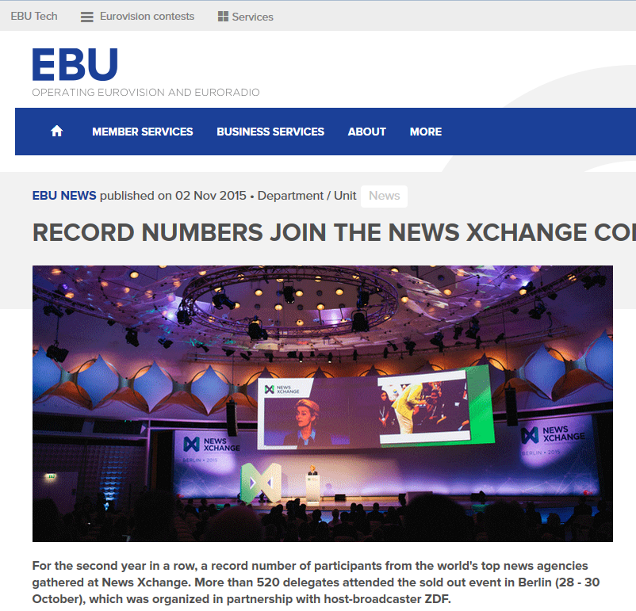
cooperation of IPPOG members
Eurovision conference
Berlin, 30.10.2015
Session
„The Challenges of
Covering Science News“
with CERN + ESA
based upon discussions
in IPPOG
DESY representative tells
“The Higgs Story -
Science and the Media”

Slide 9
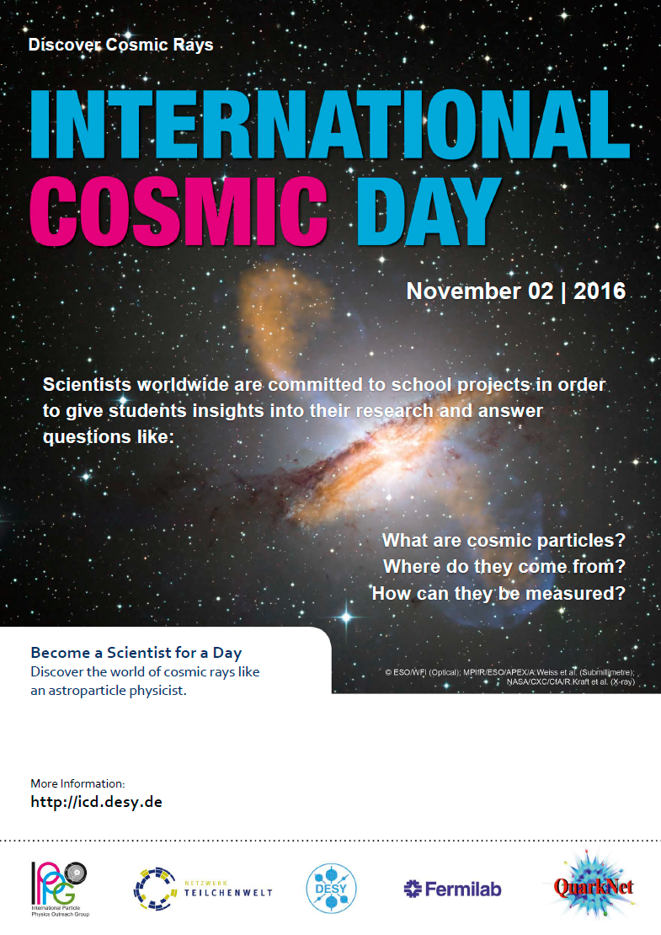
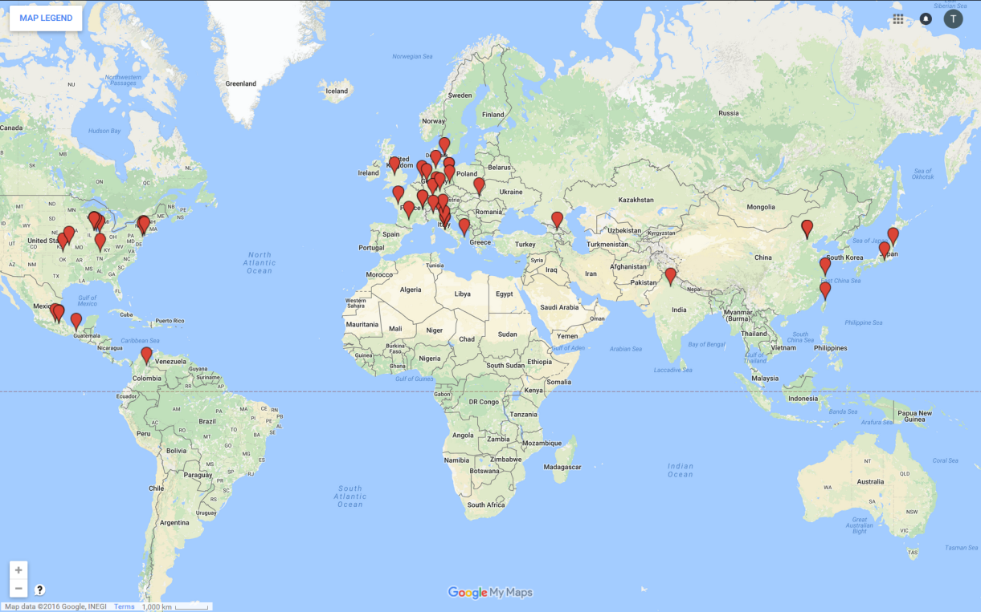
International Cosmic Day
coordinated since 2012 by
~1 FTE at DESY (Zeuthen)
http://icd.desy.de
possible in-kind contribution
of DESY to IPPOG

Slide 10
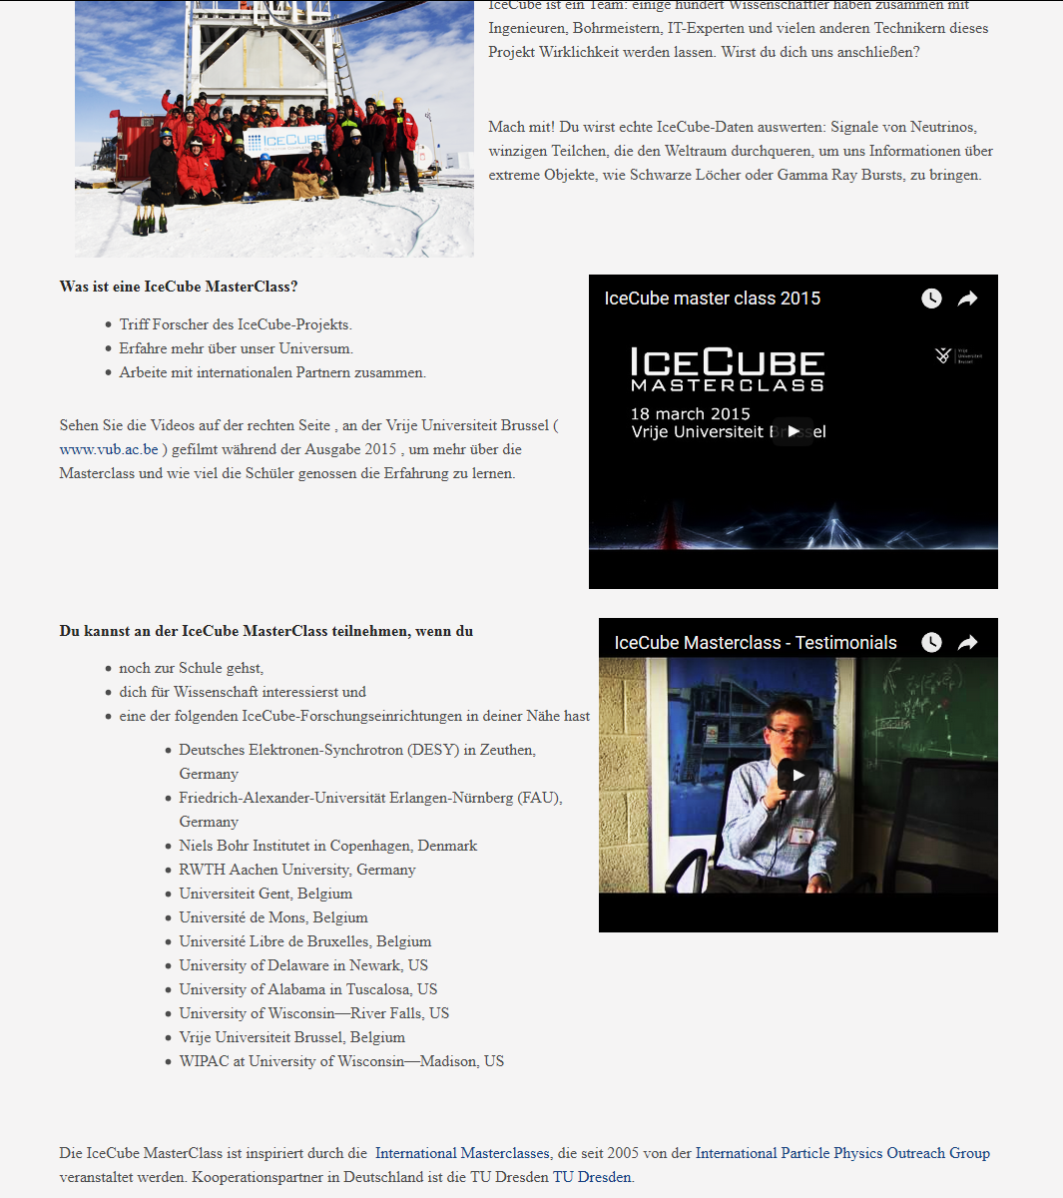
International IceCube + Auger Masterclasses
at DESY
in Zeuthen:

Slide 11
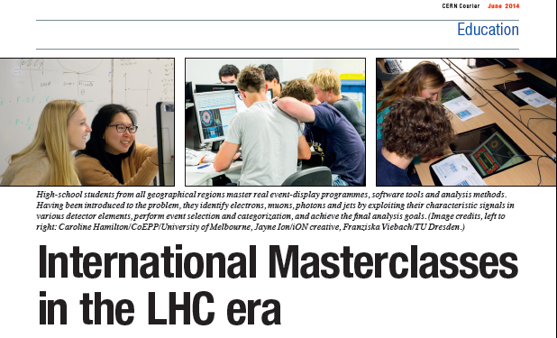
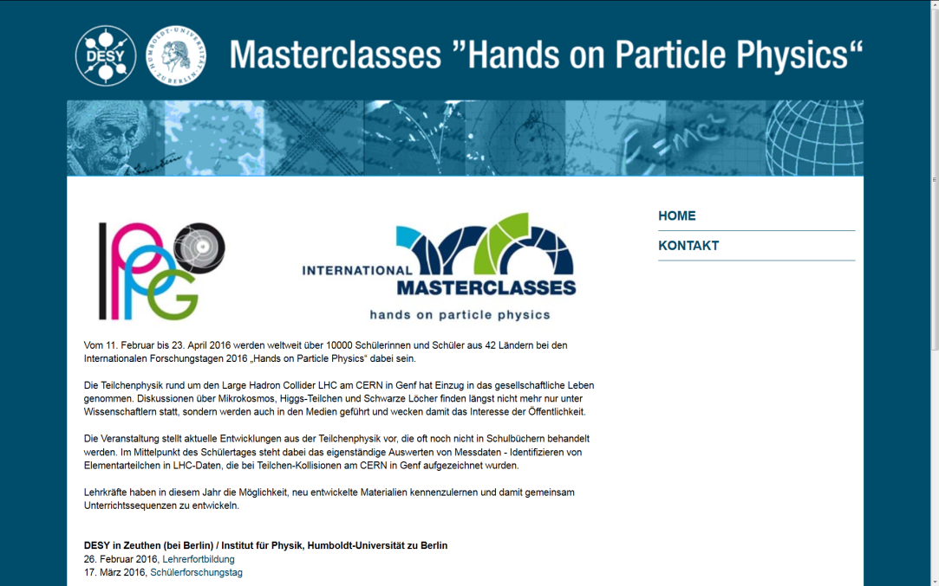
International Particle Physics Masterclasses
DESY one of the founding members since 2005
always offers teacher program
Germany very active

Slide 12
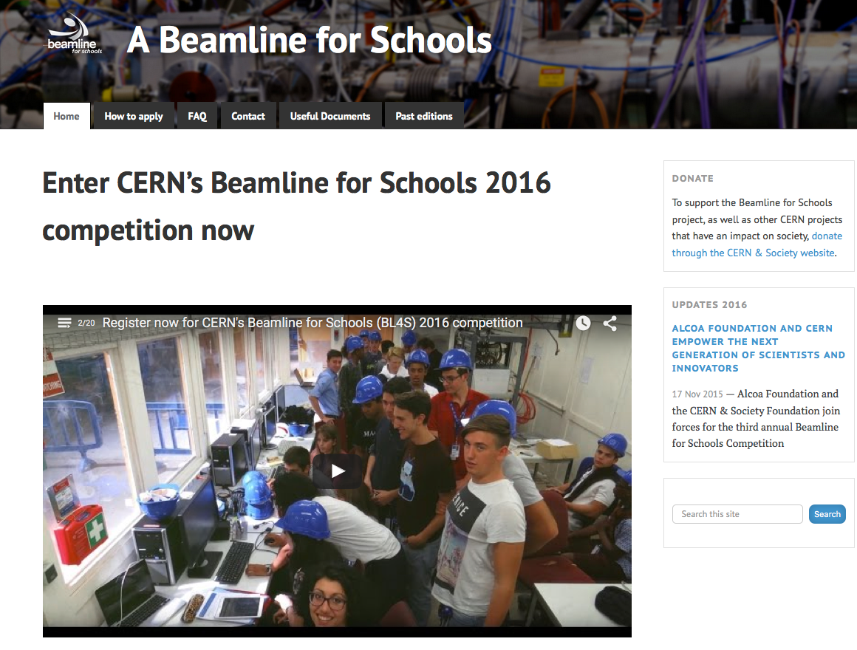
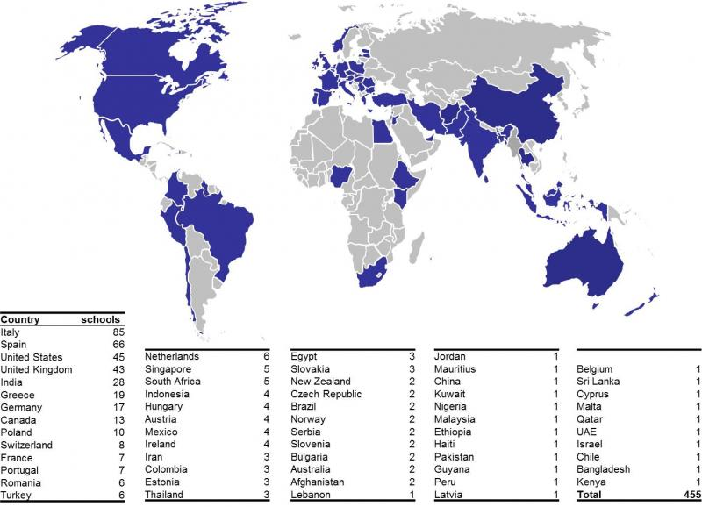
BL4S - Beam Line for Schools at DESY ?
Competition 2017 call on 14 July
http://beamline-for-schools.web.cern.ch
German Beam Line for Schools
at DESY under discussion

