Slide 1
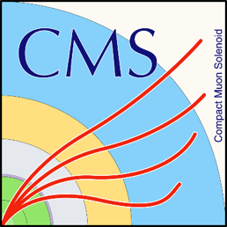




CMS CREATE #2
With technical support from

Slide 2
CMS CREATE
2 day workshop in which teams compete to create a prototype for a public exhibit to explain elements of CMS to the public
Goal: Design an interactive exhibit for the general public illustrating what CMS does and how it does it
The winning exhibit is inserted on the visit circuit of CMS at Point 5 (underground control room) and should be suited for the general public and children in particular

Slide 3
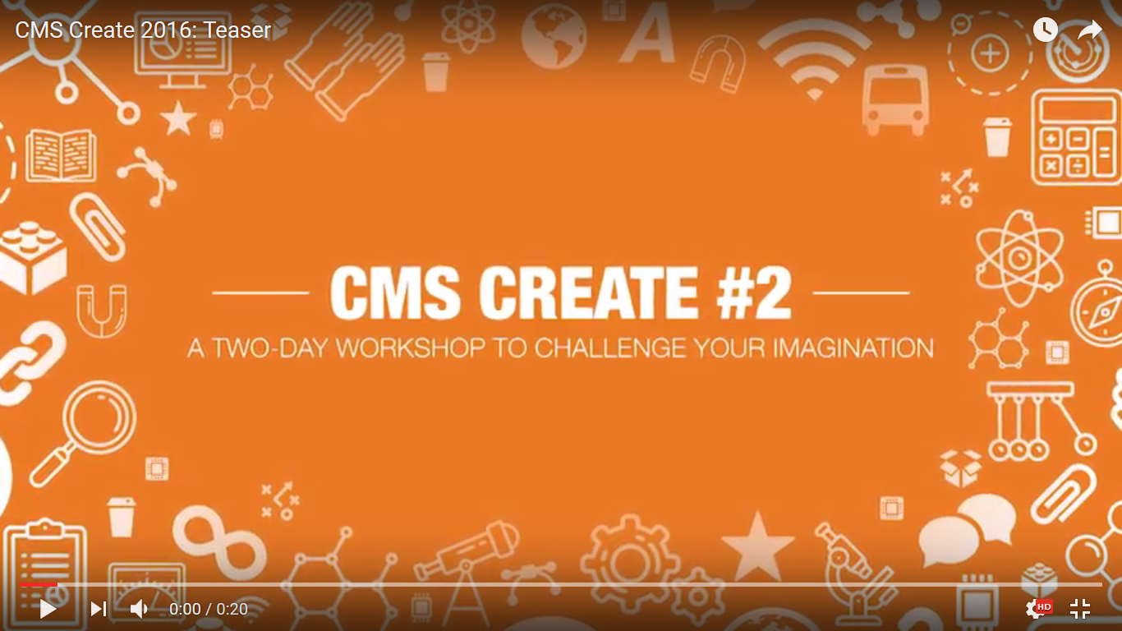

Slide 4
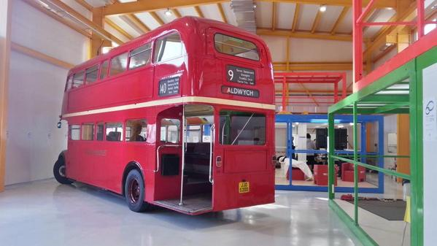

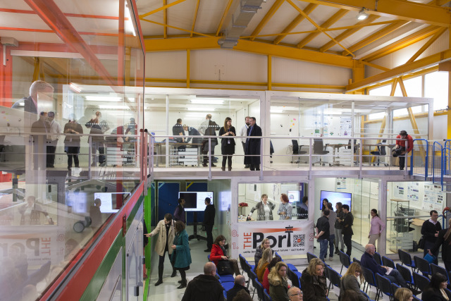
VENUE
IDEASQUARE at CERN
Dedicated test facility at CERN that hosts detector R&D projects, and facilitates MS student programs
Hosts special innovation-related events

Slide 5


DIVERSE TEAMS
Each team made up from 4 CERN members and 2 students from IPAC School of Design, Geneva.
Ambition of the CMS CREATE organisers:
“Maximise team diversity in order to enhance the creative process”
4 teams of 6 people
Example of team: 1 CMS physicist
1 software engineer
1 hardware engineer
1 outreach person/guide
1 graphist
1 architect
This activity could be done wherever also by high school or even younger students
The aspect of multidisciplinary teams is very inclusive – reaching also to students who don’t feel comfortable with physics or engineering, but study management, arts, architecture, etc…
Reaching to NEW AUDIENCES

Slide 6
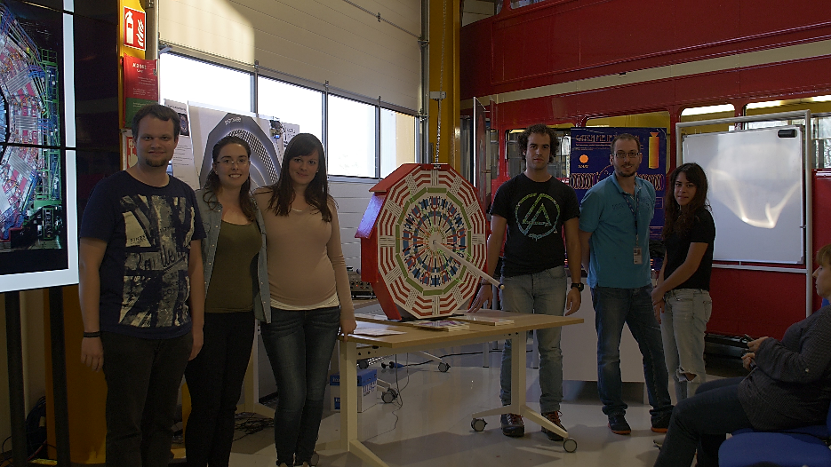
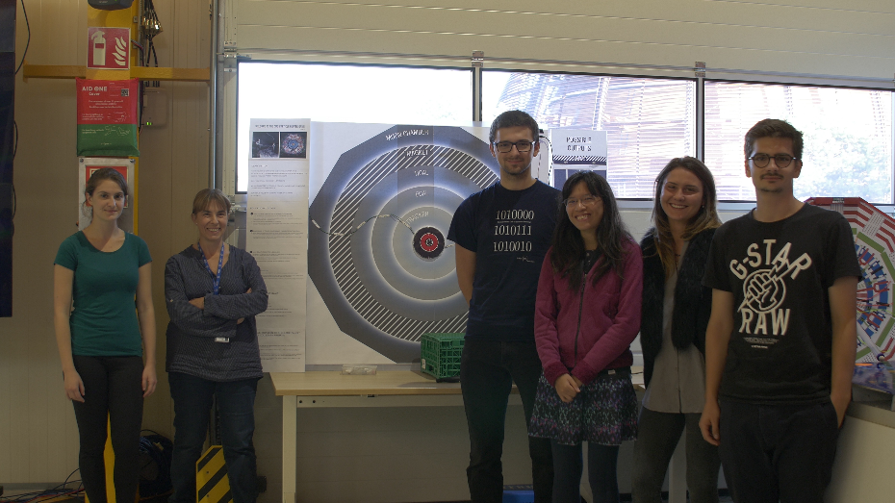
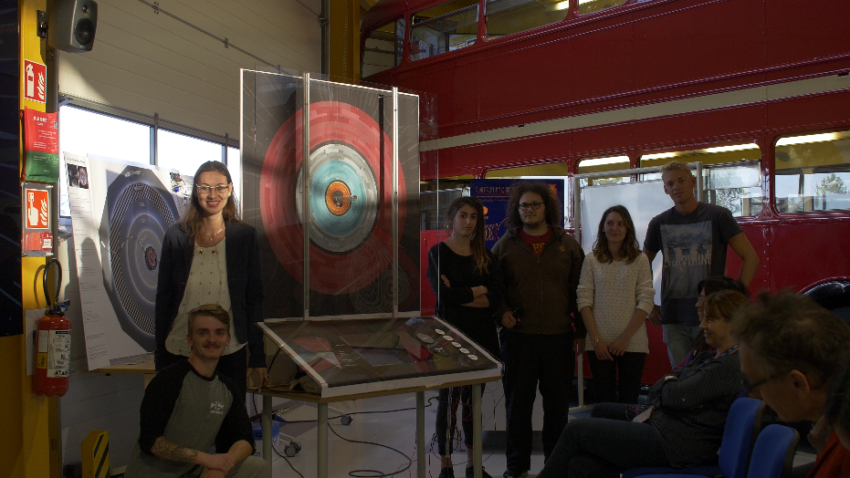
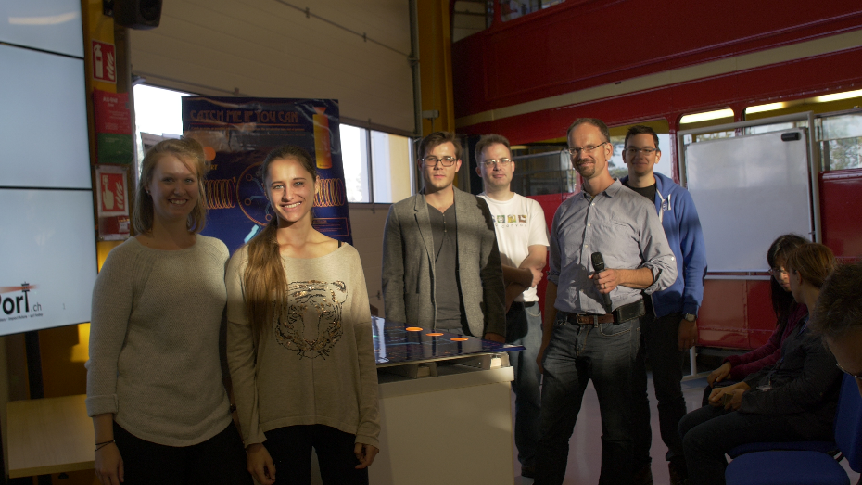
DIVERSE TEAMS
Diversity
24 participants
12 nationalities
50% of women
Physicists
Tech/Engineers
Graphic Design
Architecture
CMS CREATE 2
Team 3
Team 4
Diversity
25 participants
15 nationalities
36% of women
CMS CREATE 1
Team 2
Team 1

Slide 7

TIMELINE
Started on 03.10.2016 at 09:00 and ended on 04.10.2016 at 17:00
33 hours
Each team will have 33 hours to complete the challenge with guidance from design professionals and technical experts
A 33hour team project supported by advisors
CMS scientists (and guides)
    Senior product designers
    Technical professionals
    Communication professionals
Pizza party
included

Slide 8
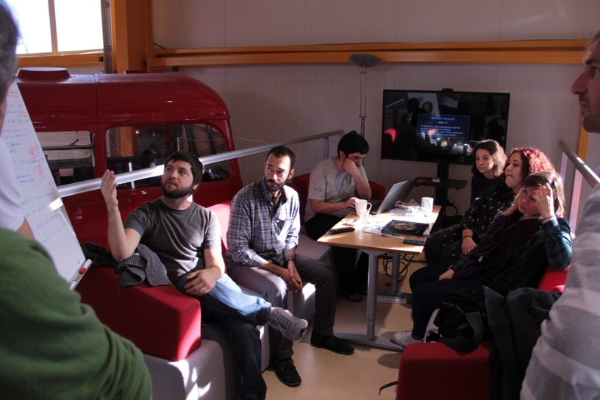
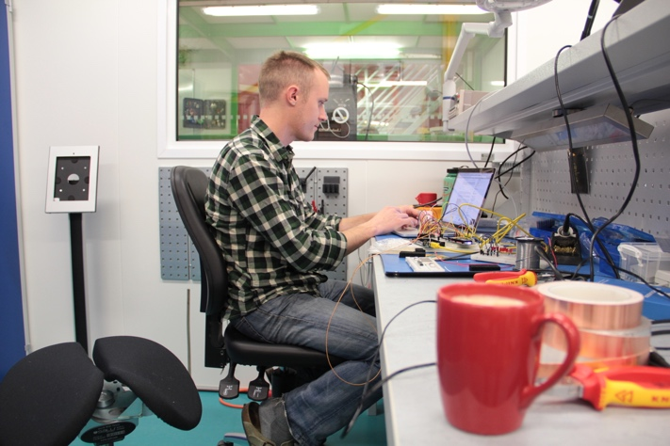
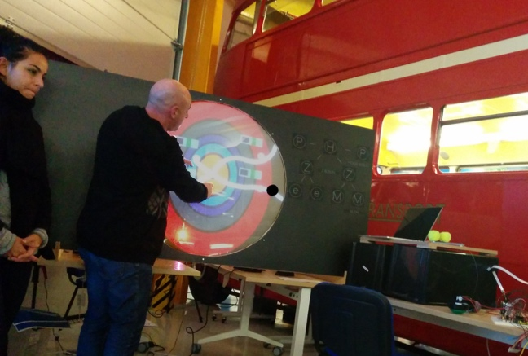
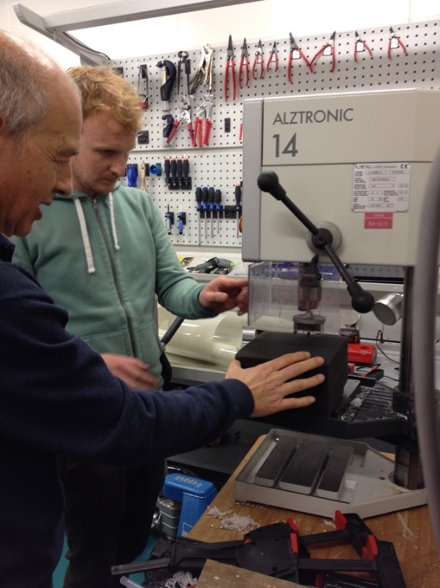
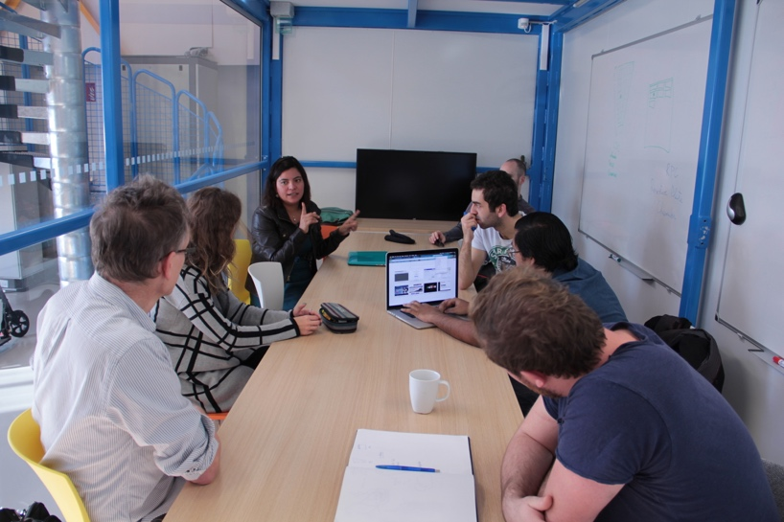
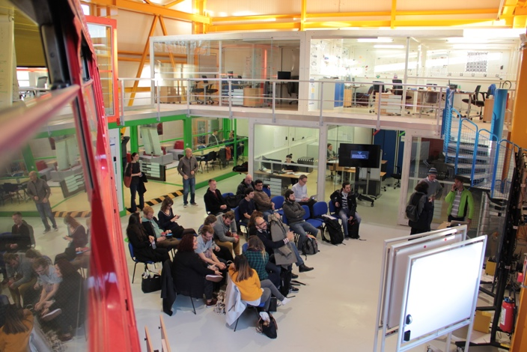
STEPS
Conceptual design
Prototyping
Presentation
  Prototyping facilities and material:
  3D printers, machine shop, electronics workshop
  Wood, metal, cloth, lego blocks, electronics components, foam, Sugru, Pledoh, tape, cardboard, springs, magnets …
  17:00
  Duration: max 20’ incl. Q&A
  From 09:00 in team containers
  Advisers feedback ~ 10:00

Slide 9
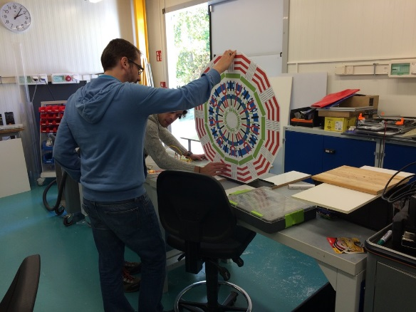
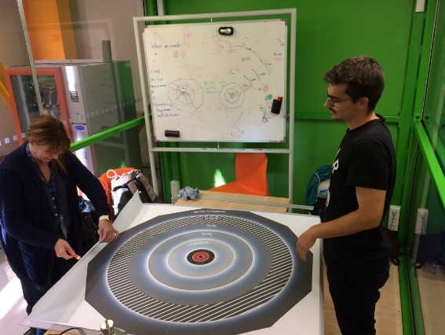
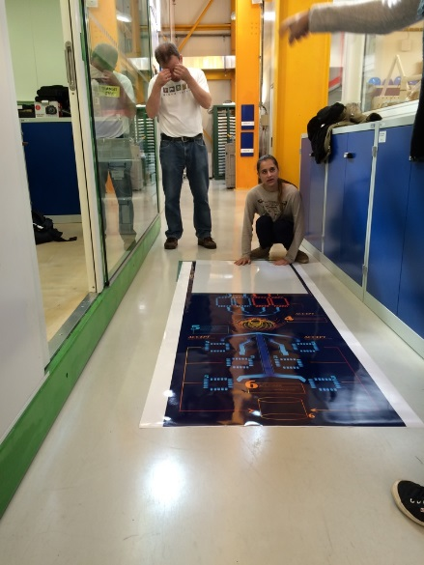
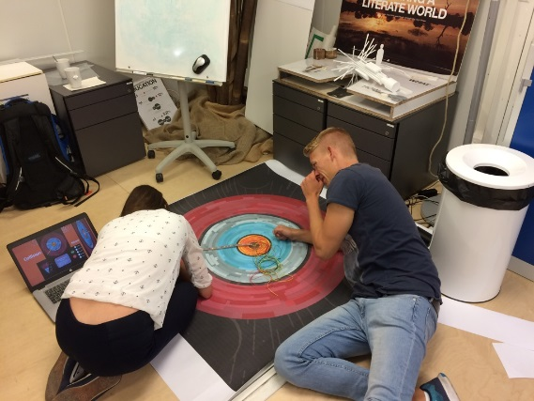
WORKING…
Team 3
Team 4
Team 1
Team 2
Last hour !!!!

Slide 10

WINNING PROTOTYPE
The best design will become a reality and take its place as a visitor attraction in the underground control room at the CMS site in Cessy.
Winner
Jury
Head of Office of Tourism of Pays de Gex
Senior Graphic designer IPAC Design School
Senior physicist at CMS
Head of CERN Education, Communications & Outreach group
Evaluation Criteria
30%: Suitability for visits
30%: Educational content
30%: Product design
10%: Reproducibility
Prizes
Tickets to TEDx at CERN
Mont Jura Ski passes
Exhibit can be replicated using a cloud based design pack

Slide 11
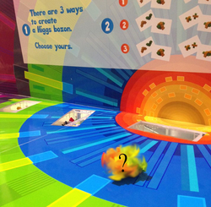
2015 WINNERS: HIGGS PLAYGROUND
The Higgs playground is an exhibit that allows users to experience that Eureka moment whilst learning about how physicists use the CMS experiment to collect evidence to support the Higgs Boson and other exotic particles.
Instructions:
1. Take a look at the Higgs Silhouette. This represents the idea that physicists felt something was missing from the standard model.
2. Can you think what shapes would fit best into the silhouette?
3. Have a look at the different data pieces coming from the CMS experiment.
4. Is there a way these add up to fit your theory?
5. Test your theory using the shape tester

Slide 12
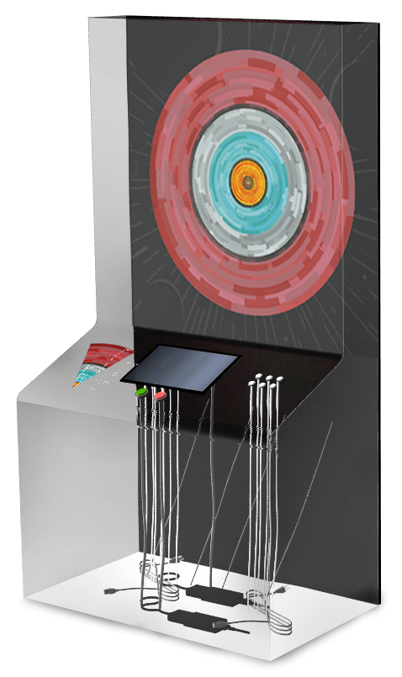
MY TEAM 2016: CMS ARCADIA
Showing the importance of magnetic field / solenoid
How do we distinguish different particles (by different subdetectors) according to their detected path
3D dynamic representation of collision + using LEDs to demonstrate the path of the particles
Interactive buttons and monitor with learning messages

Slide 13
MY TEAM 2016: CMS ARCADIA
Showing the importance of magnetic field / solenoid
How do we distinguish different particles (by different subdetectors) according to their detected path
3D dynamic representation of collision + using LEDs to demonstrate the path of the particles
Interactive buttons and monitor with learning messages

Slide 14

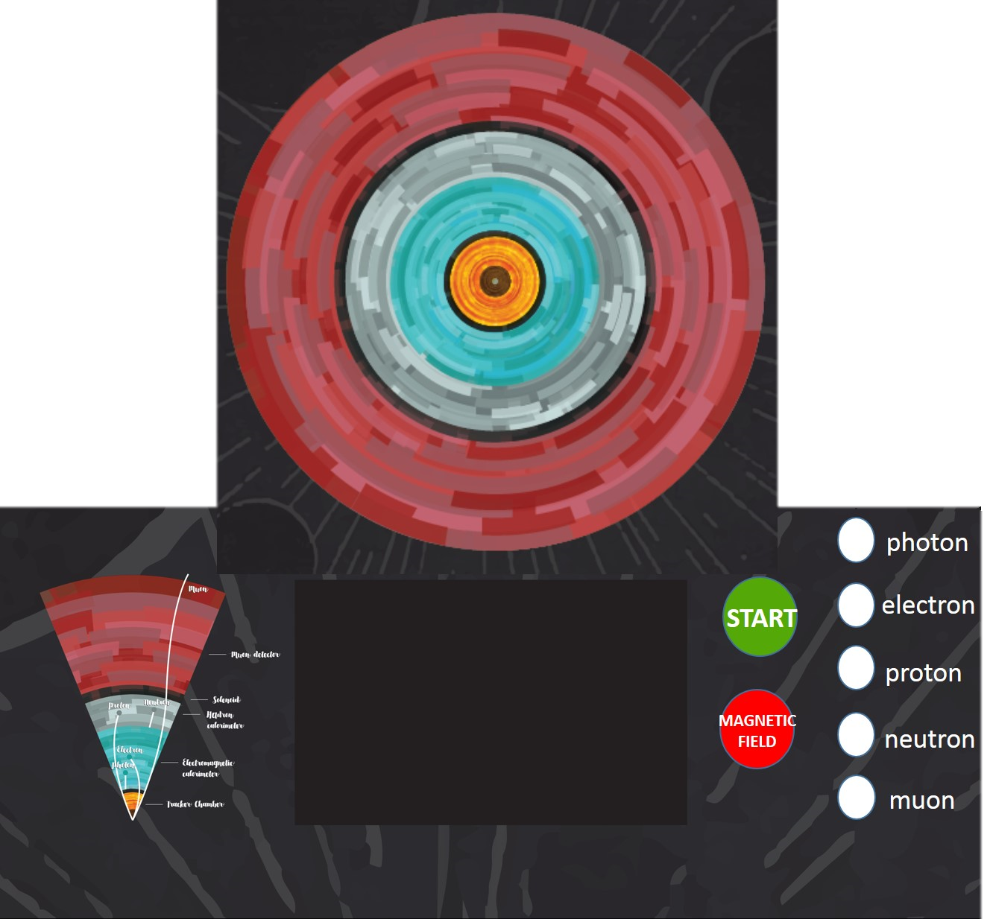
Play
CMS Game
Press
START
Welcome! I am a CMS detector.!
I will teach you how to distinguish the particles which I detect!
Let’s CMS GAME get started!
Press START!

Slide 15
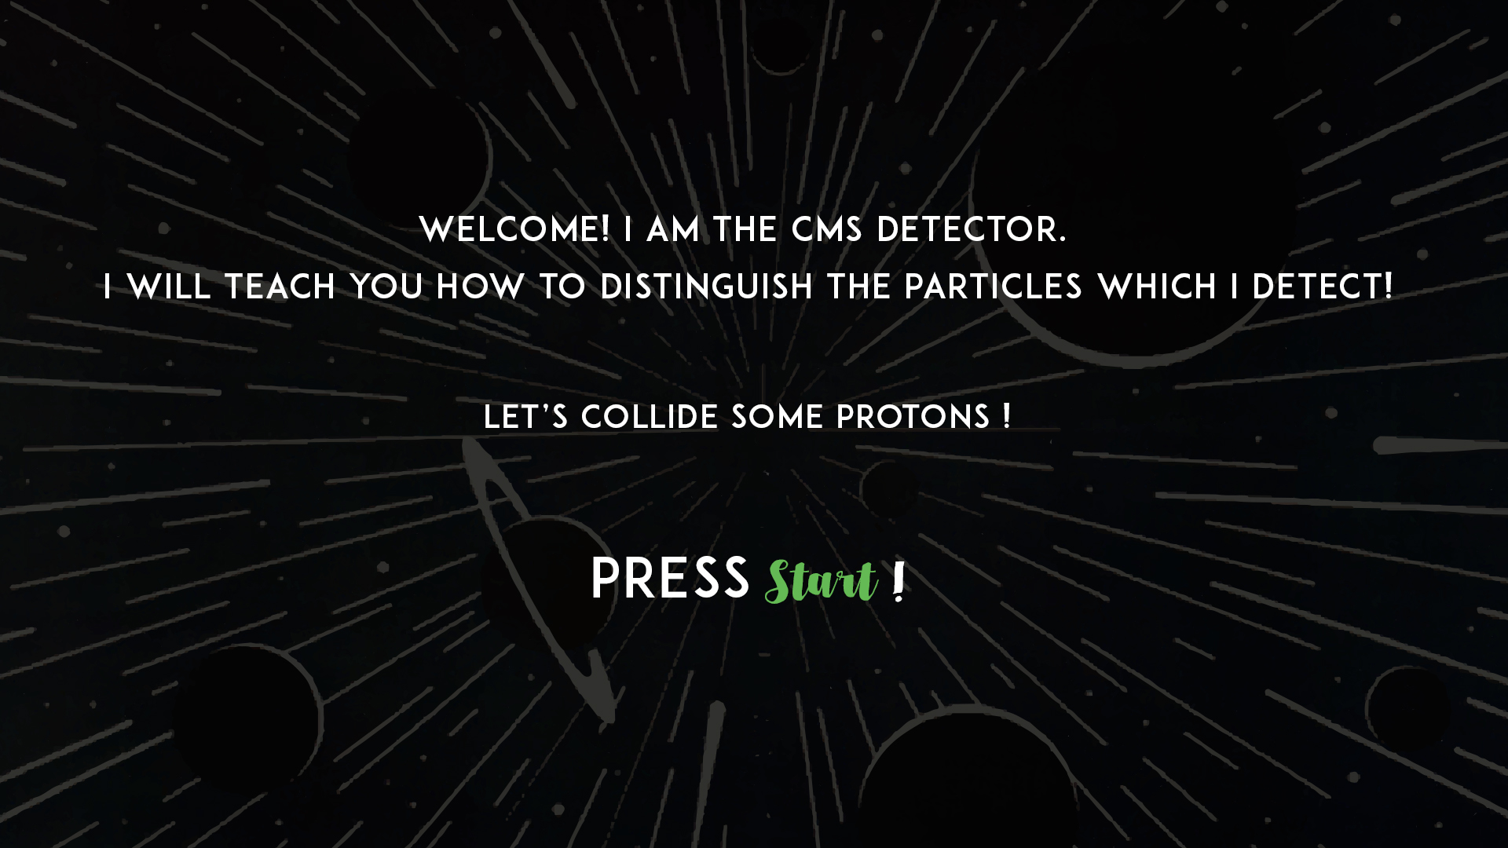

Slide 16
Collision
Mirror
ERROR MESSAGE
MAGNETIC FIELD IS NOT ON!
I need you to switch on the magnetic field, because without solenoid the detector is not able to analyse particles properly.

Slide 17
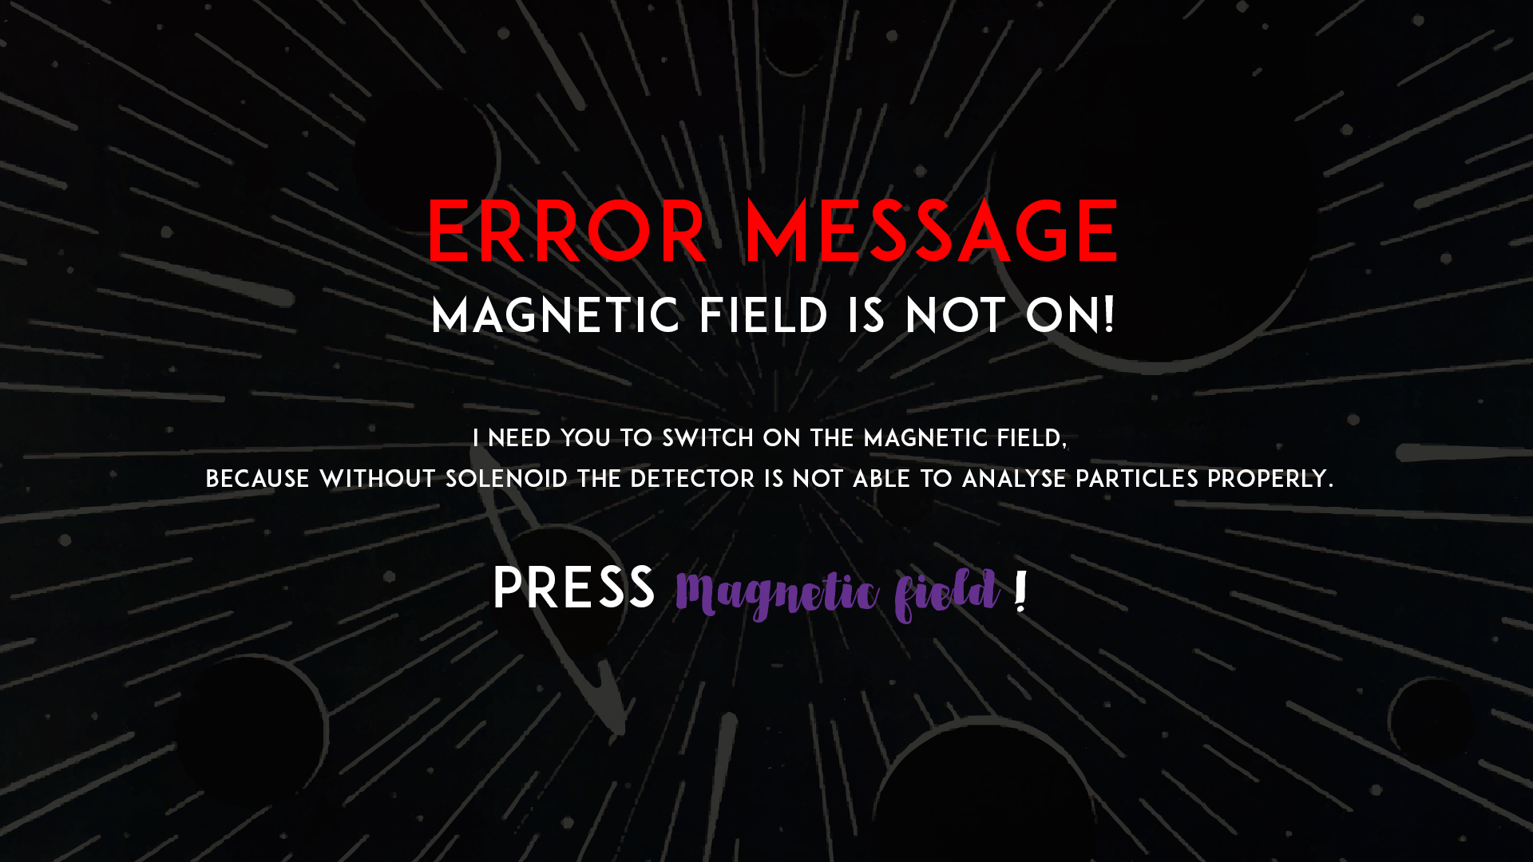

Slide 18
Switch on solenoid!
GREAT!
MAGNETIC FIELD ON
Charged particles move on curved paths!
Opposite charged particles bend opposite direction.

Slide 19
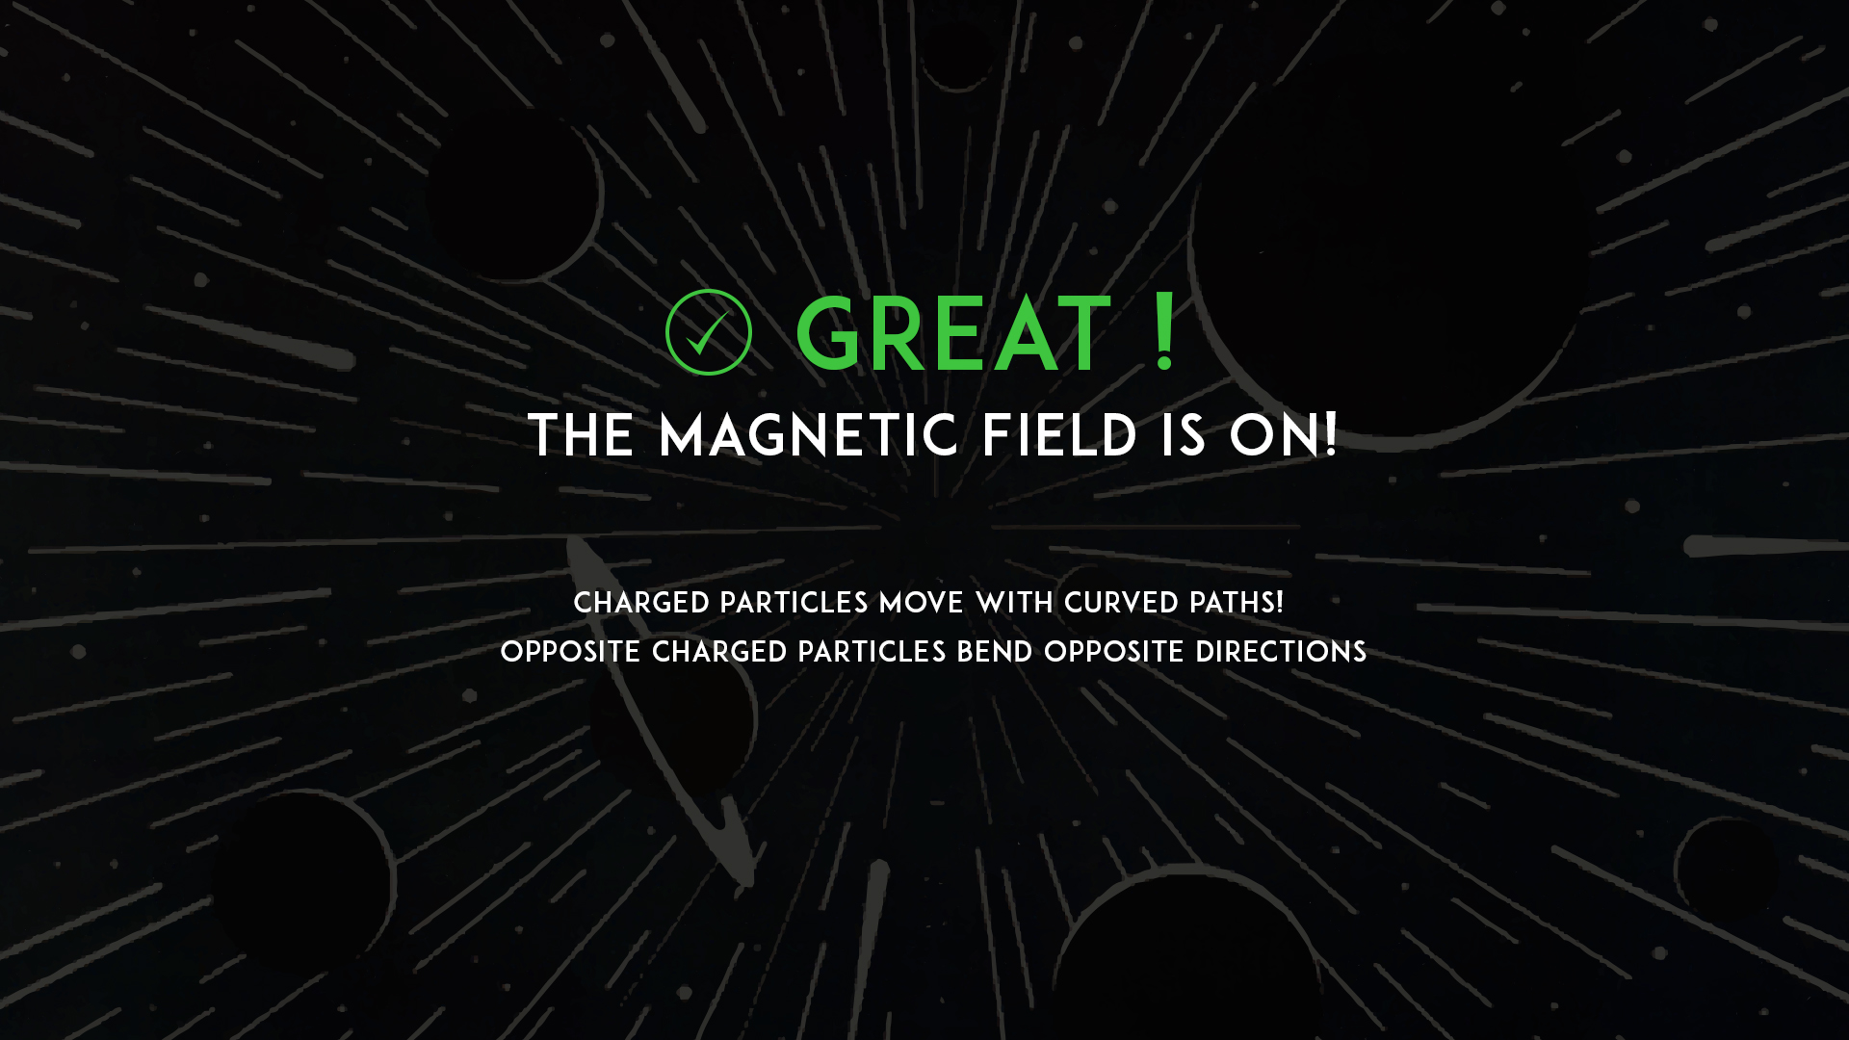

Slide 20
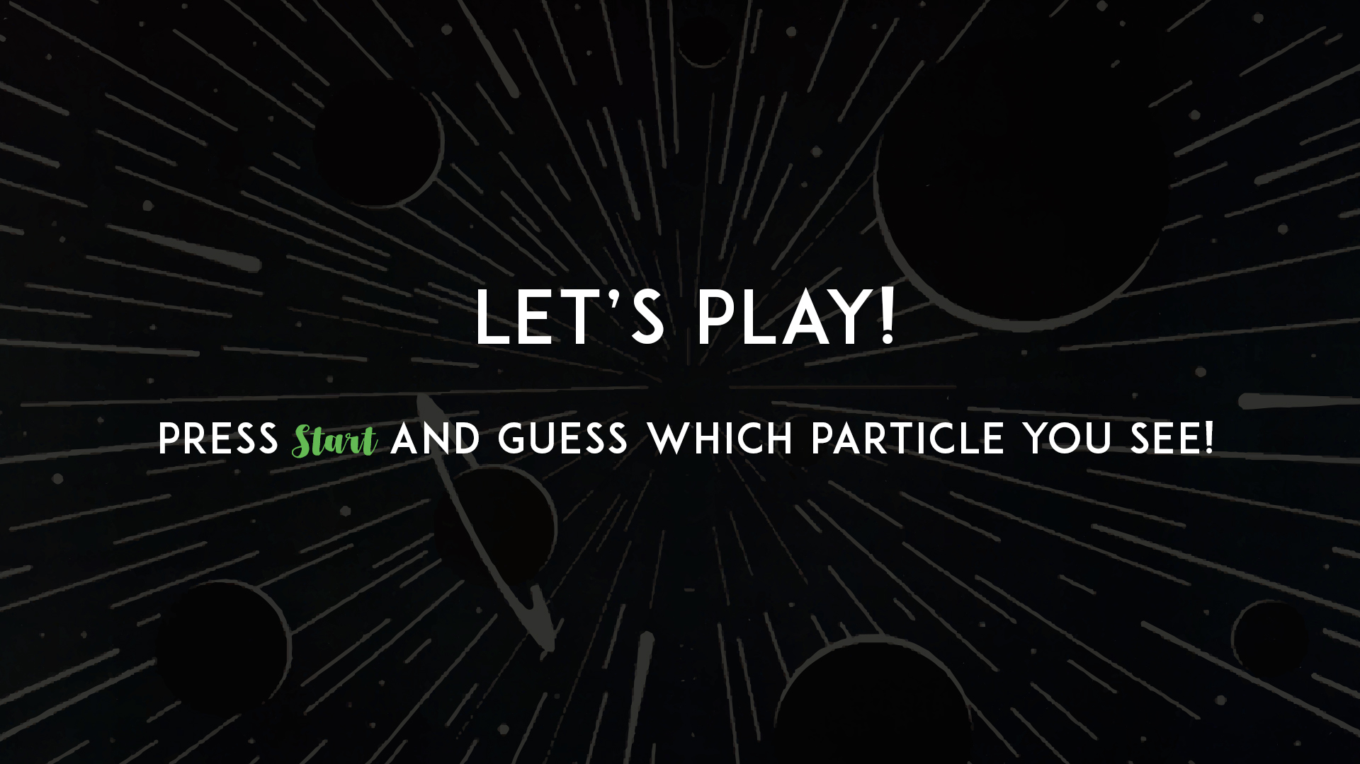

Slide 21
Guess the particle!
Which particle
do you see?

Slide 22
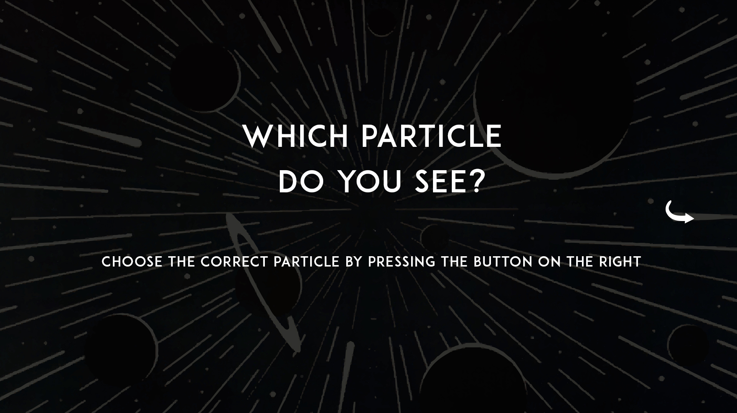

Slide 23
Guess the particle!
Which particle
do you see?

Slide 24
Get the correct answer
Correct reply is:
MUON is big brother of electron, it has an electric charge, which makes its path curved and its low interactivity with matter makes it travel very far – through the outermost layer – muon chamber.

Slide 25
Guess the particle!
Which particle
do you see?

Slide 26
Answer + Explication
CORRECT!
PHOTON has no mass. It has no electric charge and thus it is not seen by the tracker. Photon can be seen only by the electromagnetic calorimeter, where it stops and its energy is transformed into the light.

Slide 27
Answer + Explication
CORRECT!
PROTON has positive electric charge, therefore it leaves electric signal in tracker and electromagnetic calorimeter. It travels upto hadronic calorimeter (for hadrons – particles made of quarks, like proton, neutron, pion…) where it stops and deposits its energy.

Slide 28
Answer + expilcation
CORRECT!
ELECTRON has negative electric charge, therefore it leaves electric signal in tracker and electromagnetic calorimeter where it interacts with matter and stops.

Slide 29
Answer + explanation
CORRECT!
NEUTRON has no electric charge, therefore it does not leave electric signal and is not detected in tracker and electromagnetic calorimeter. It is seen sometimes by the hadronic calorimeter (for hadrons – particles made of quarks, like proton, neutron…).

Slide 30
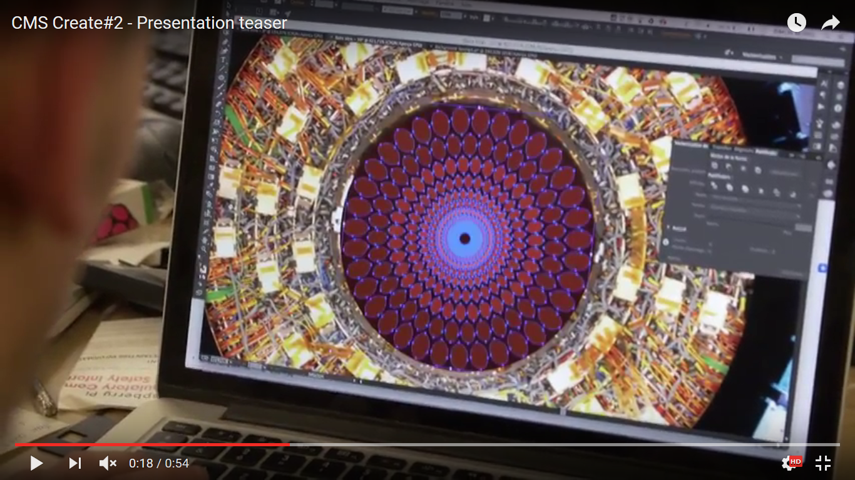

Slide 31
Website: http://cmscreate.web.cern.ch/content/time-table
Trailer 1:
https://www.youtube.com/watch?v=X67IfkZLNBc
Trailer 2:https://www.youtube.com/watch?v=-2qDBl6bNOc

