Slide 1
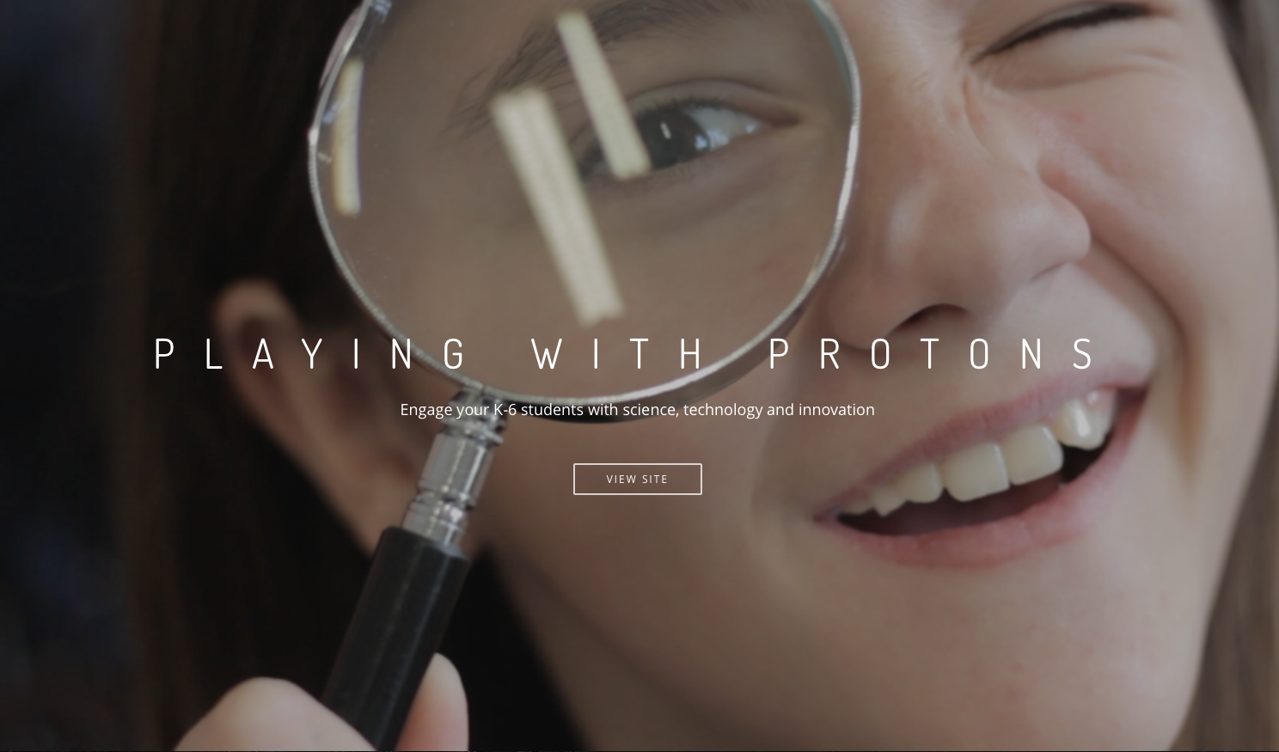

A Pilot CPD Course for Primary School Teachers from Greece
12th IPPOG Meeting at CERN

Slide 2


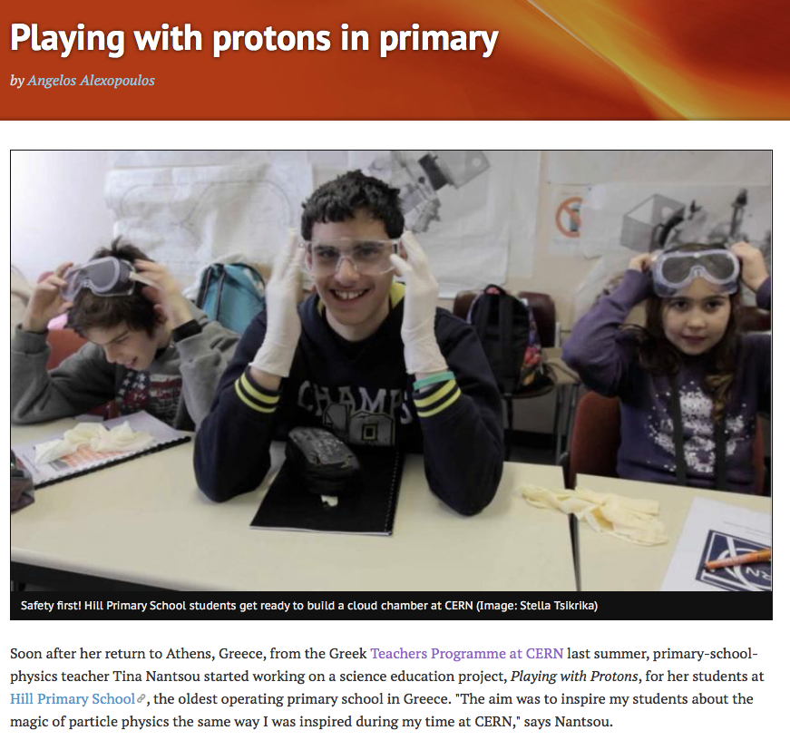
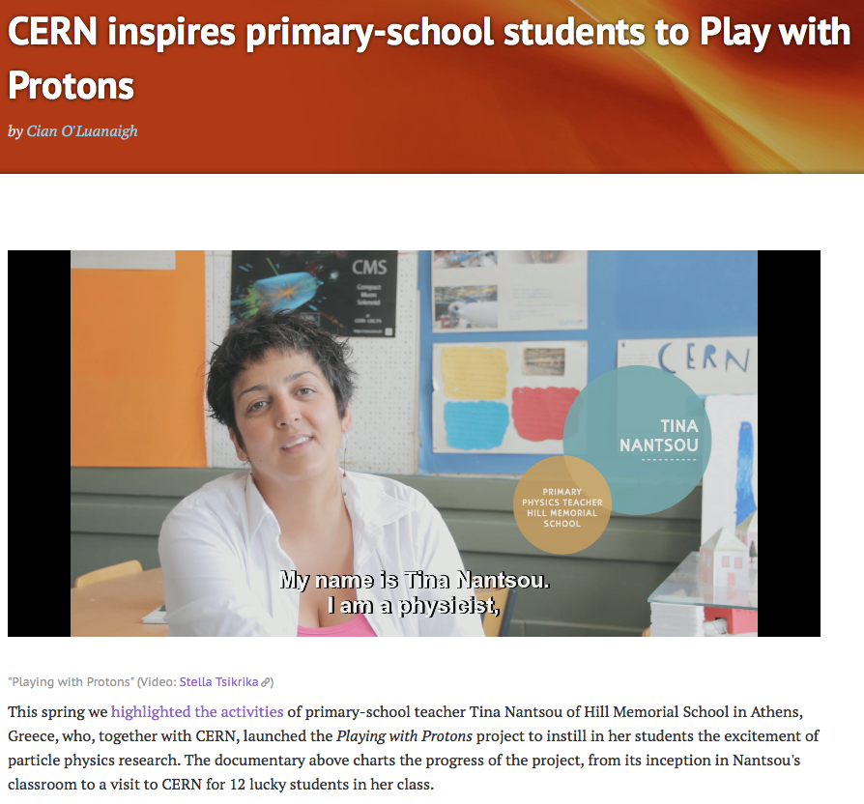
Background
Fall 2013 - Spring 2014

Slide 3

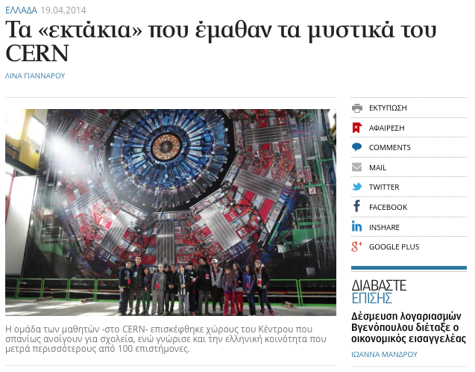
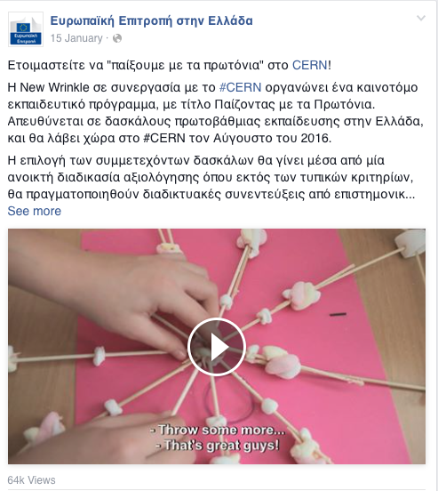
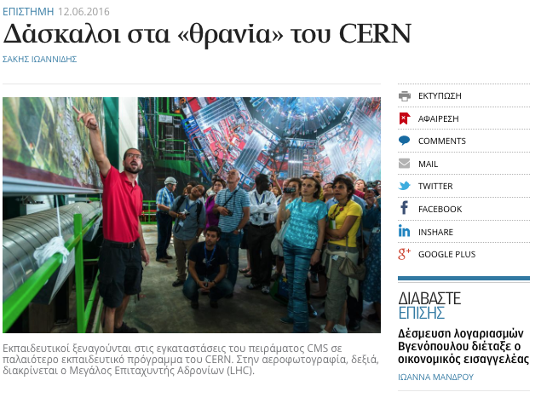

Public Attention

Slide 4
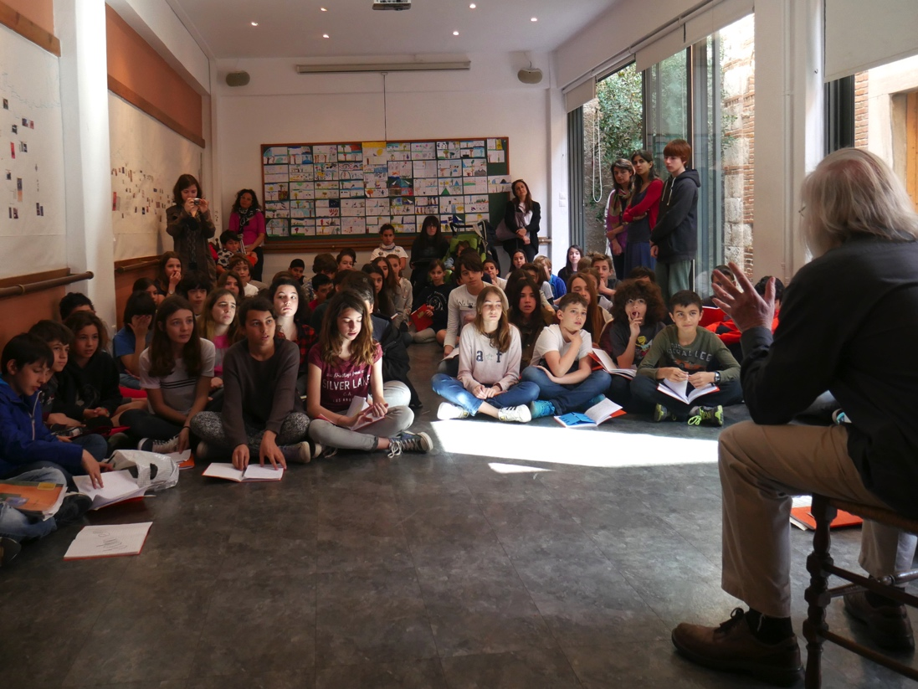
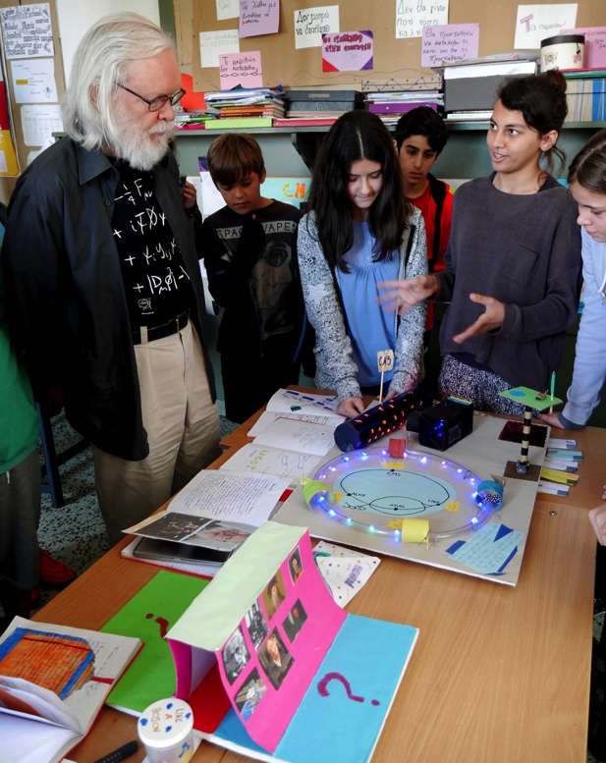
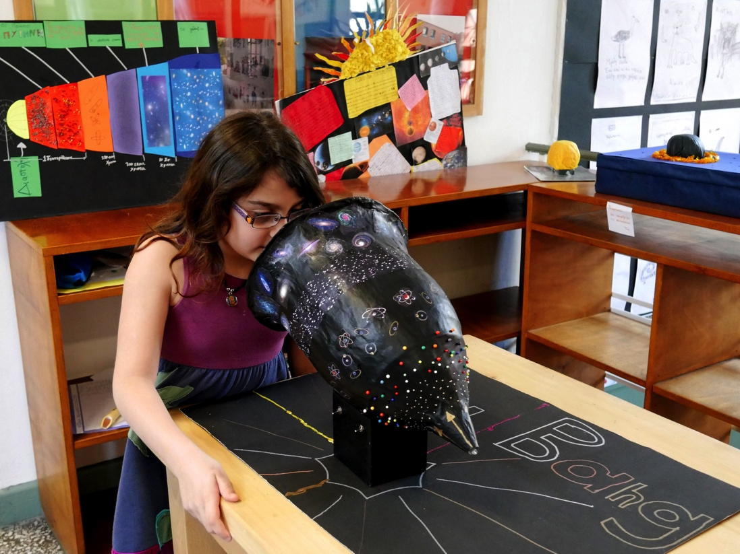
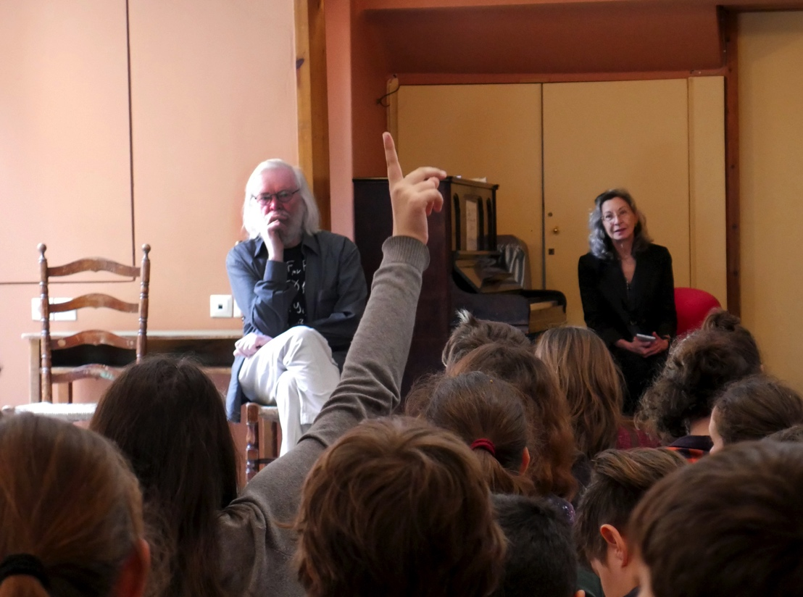
Support
“It was moving and exciting to see what is possible with primary school students, going beyond exciting them about science to getting them engaged effectively.”
John Ellis

Slide 5
Aims & Expected Impact
Teachers will:
Create sustainable impact by:
get familiar with unique culture of cutting-edge science, technology and innovation at CERN
get inspired and motivated to share their newly acquired knowledge and experience with pupils and peers
design learning activities, especially hands-on experiments in the classroom, customized to pupils’ needs
develop educational methodologies and resources to enhance the standard curriculum
instilling a culture of collaboration and participation among educators and pupils, especially in remote and underprivileged areas
developing a digital platform for sharing ideas, advice and resources
creating a network of science ambassadors who will act as leaders and role models in their local communities
serving as a blueprint for future science education initiatives

Slide 6







Organizers | Partners | Sponsors
Organized by
Supported by
Hosted by
Under the auspices of
Sponsored by
Organization
A. Alexopoulos (CERN)
G. Divanis (New Wrinkle)
Educational Coordination
T. Nantsou
(Hill Memorial School)
Follow-up & Evaluation
S. Cherouvis (CREATIONS)
A. Alexopoulos (CERN)

Slide 7

Recruitment & Selection
Public primary schools
all islands
underprivileged urban areas
permanent & temporary teachers
CV
motivation letter
vision for the school of tomorrow
29 Mar
Call by Ministry οf Education
Deadline for submissions
151 applications received
(70% females)
31 May
Two committees
advisory (Greece)
selection (CERN)
Pre-screening ✔
Shortlist ✔
Video interviews (20) ✔
Final selection (10) ✔
30 Jun
Typical criteria
eligible areas
good ENG (B2)
min 30% females
Desired criteria
5th+6th grades
community involvement
PD in STEM
17-22 Aug
PwP Course at CERN

Slide 8
Committees
Advisory Committee
Selection Committee
Thanasis Valtinos
President of the Academy of Athens
Stavros Zoumboulakis
President of the Supervisory Council of the National Library of Greece
Dimitris Nollas
Writer
John Ellis
Mick Storr
Machi Tsirou
Emmanuel Tsesmelis
Angelos Alexopoulos

Slide 9

Participants

Slide 10
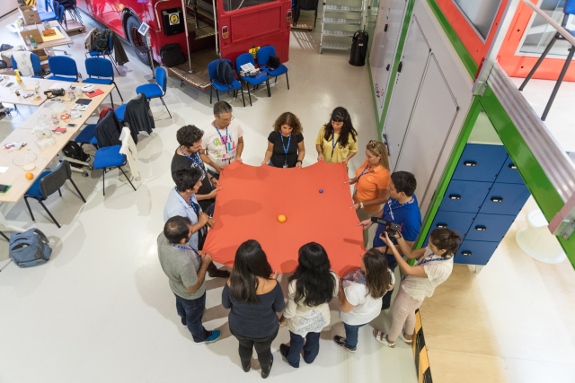
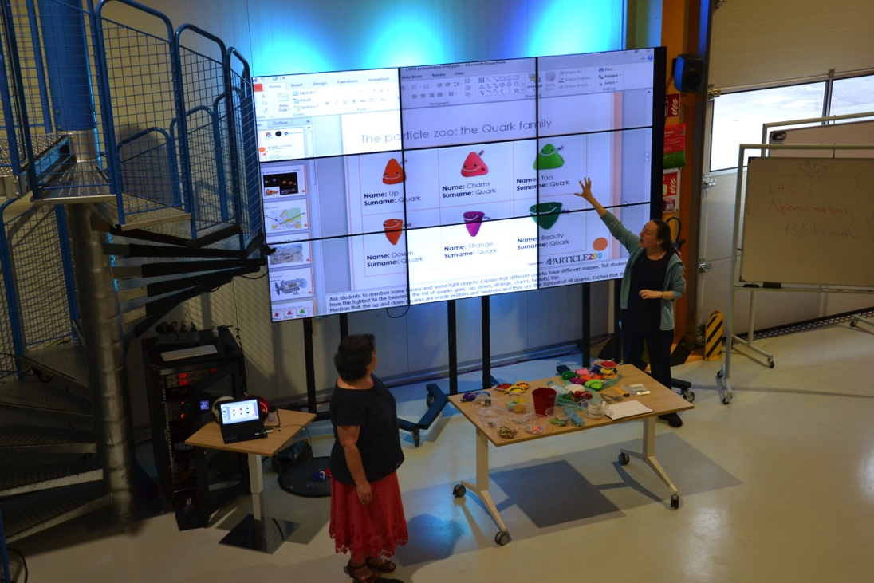
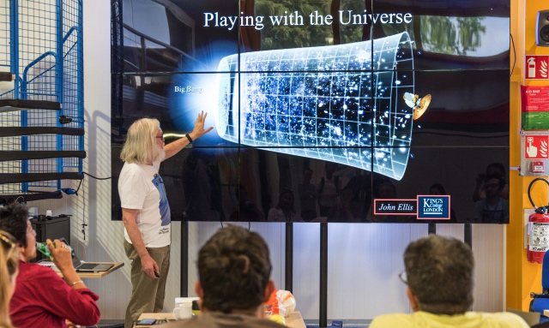
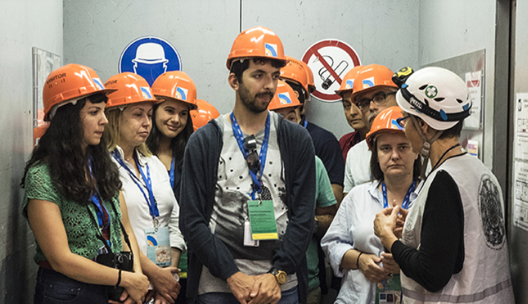
Five-day Programme
Hands-on experiments
Special workshops
Seminars
Visits

Slide 11

Evaluation

Slide 12
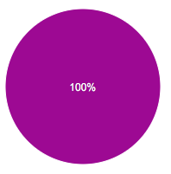
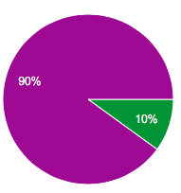
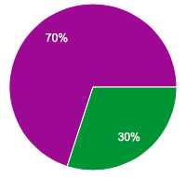
Evaluation
Usefulness
Get familiar w/ culture of science, technology & innovation at CERN
Share with colleagues
Disagree → Agree

Slide 13
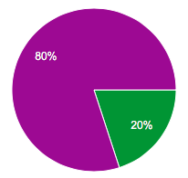
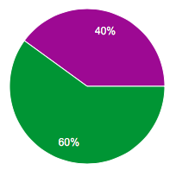
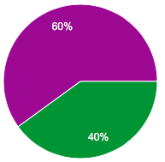
Evaluation
Recommend to colleagues
Happy w/
organization
Met my expectations
Disagree → Agree

Slide 14
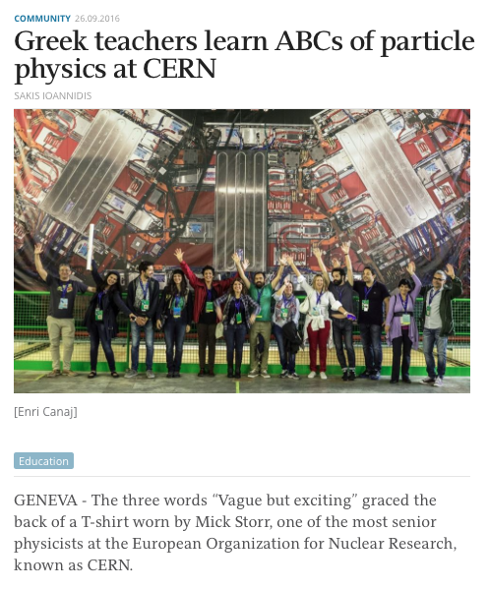
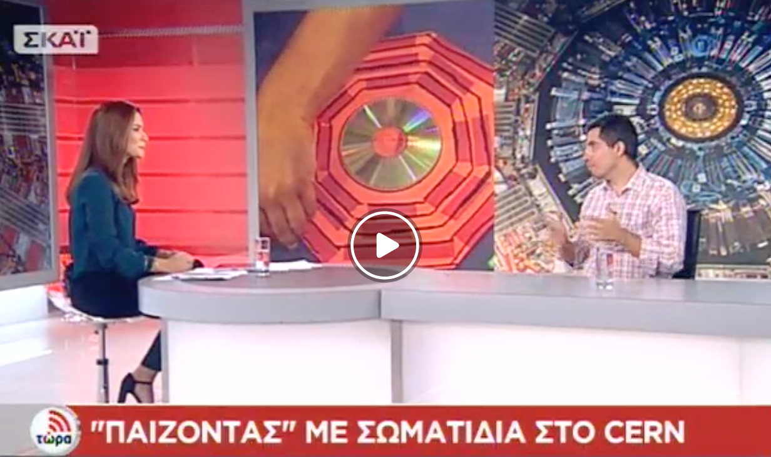
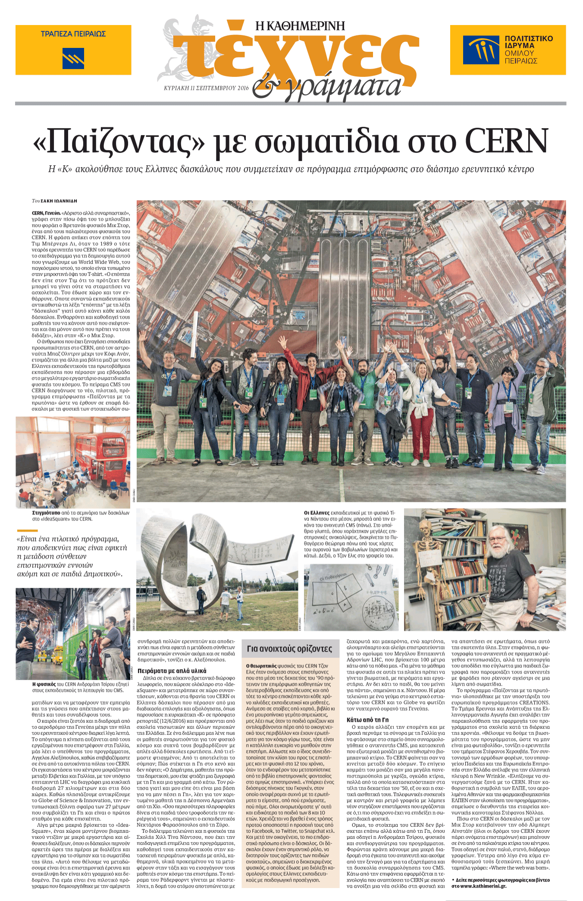
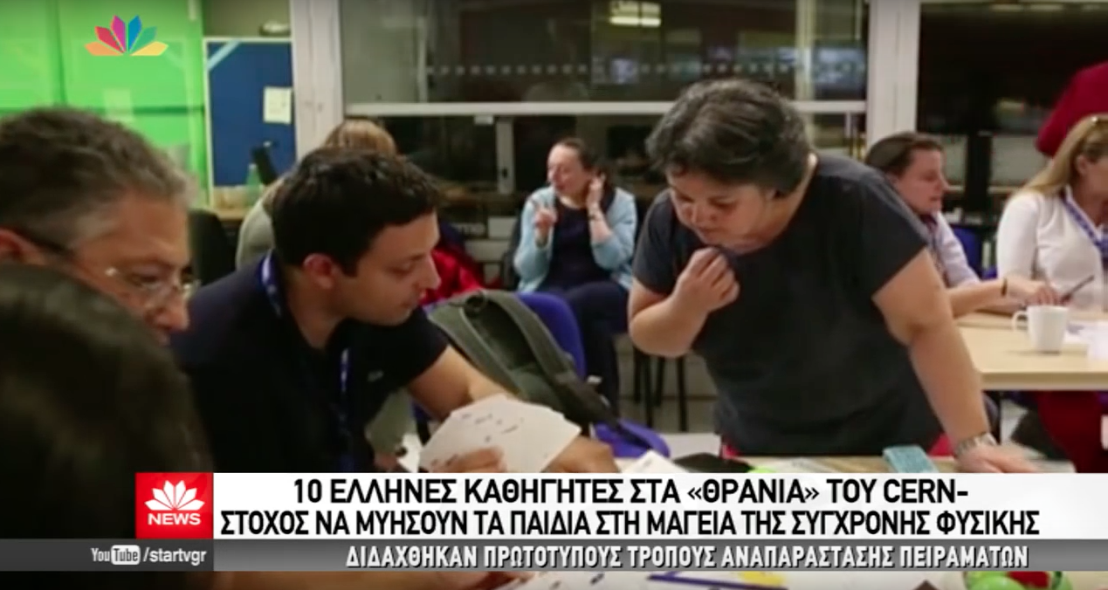
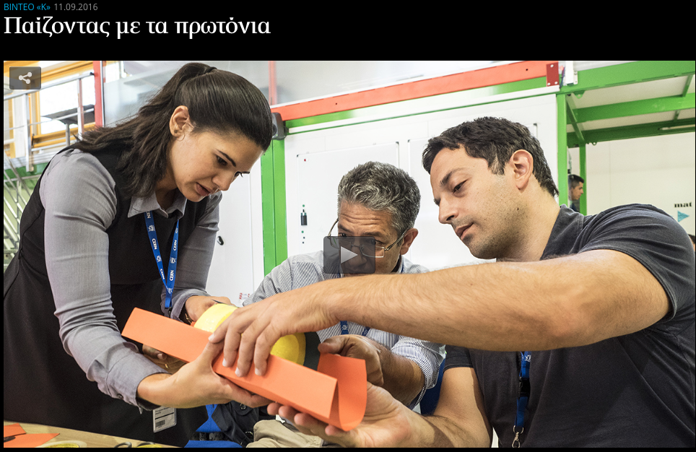
Dissemination
National Newspaper (+video)
National TV

Slide 15
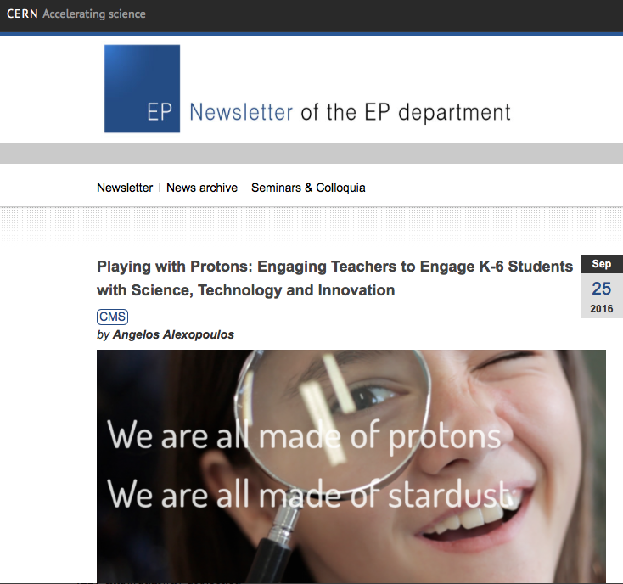
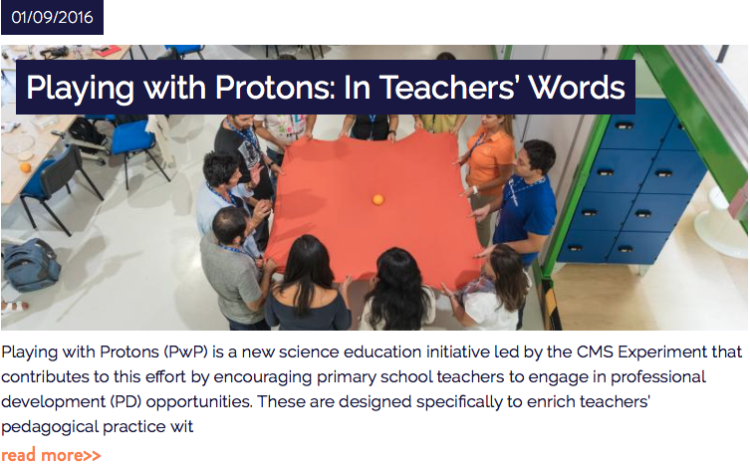
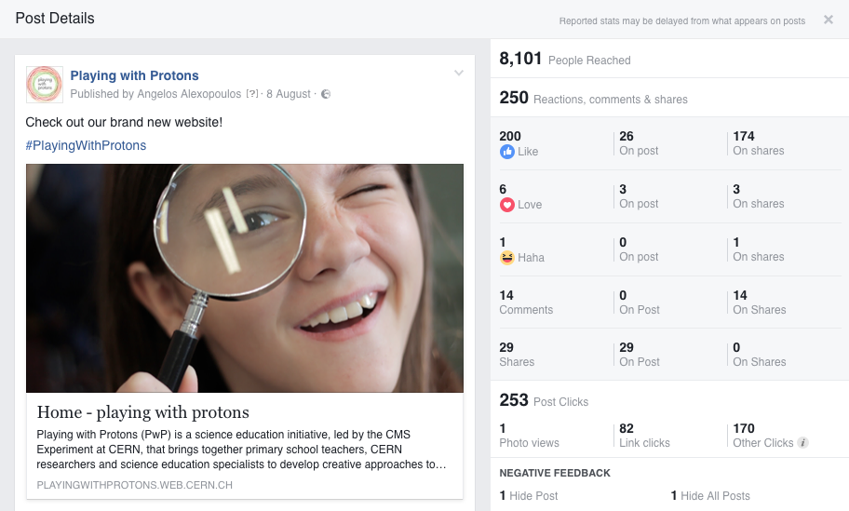

Dissemination

Slide 16
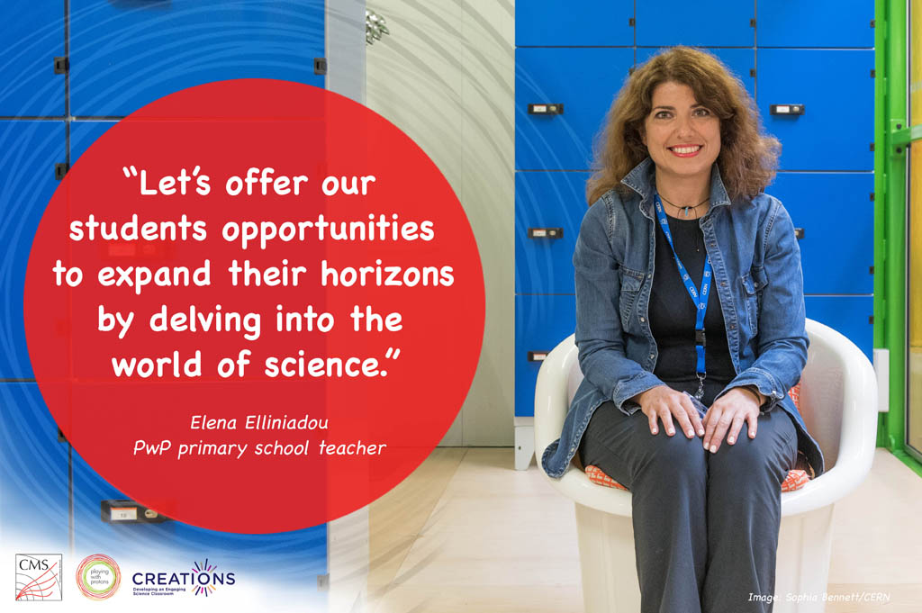
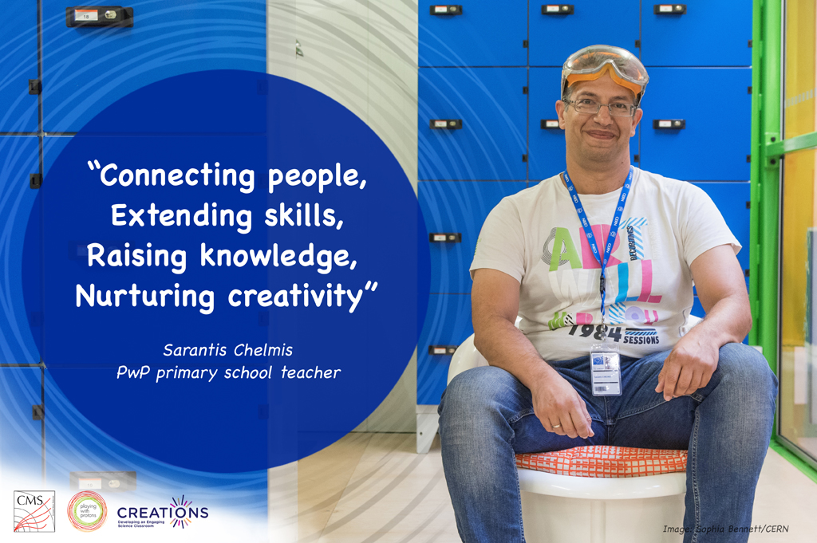
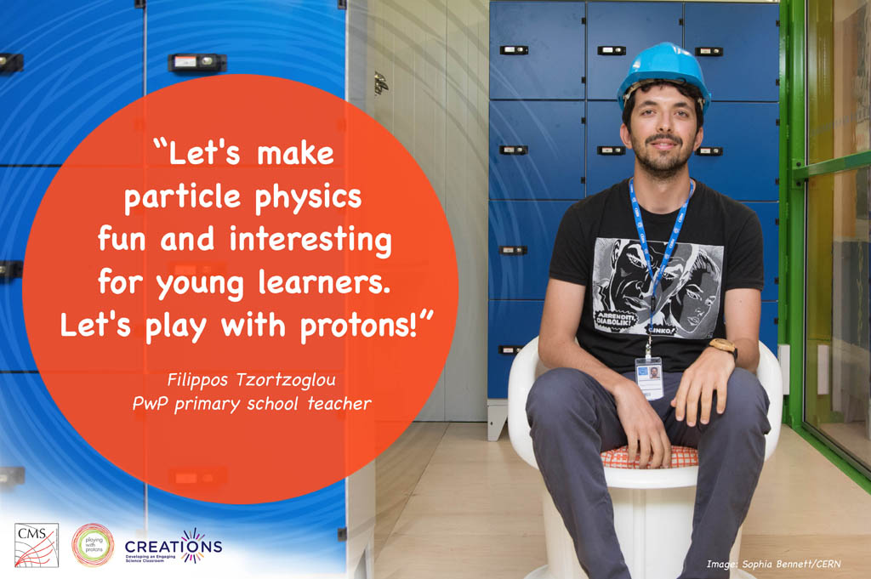
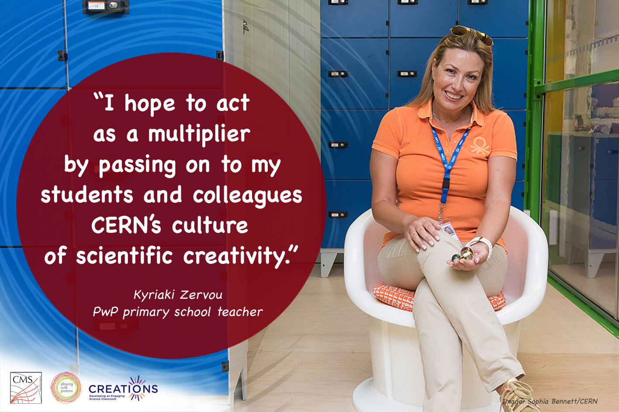
Dissemination

Slide 17
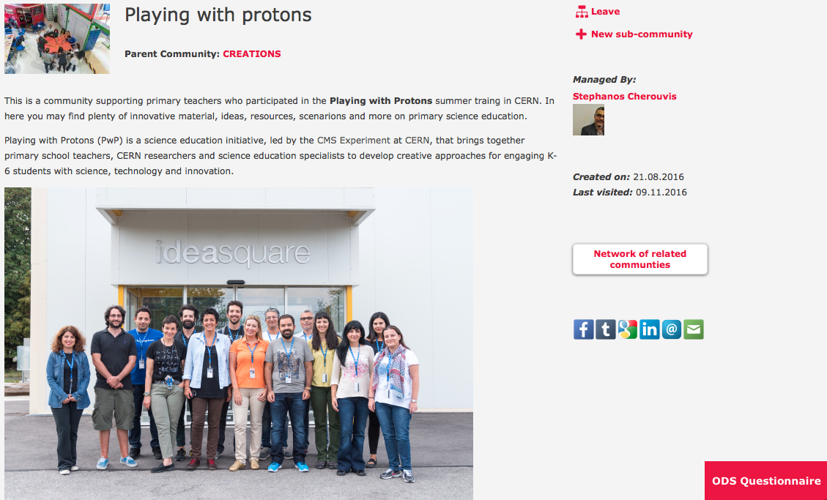
Community Building

Slide 18



