Slide 1
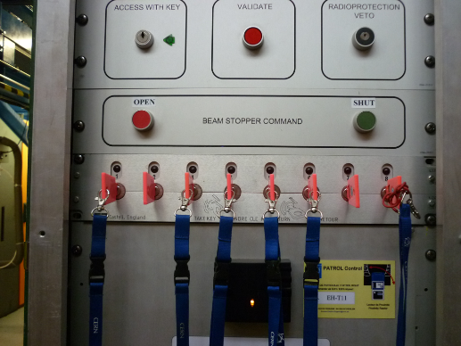


Report on the Beamline for Schools (BL4S) Competition
IPPOG Open Session, 10.11.2016, Markus Joos

Slide 2
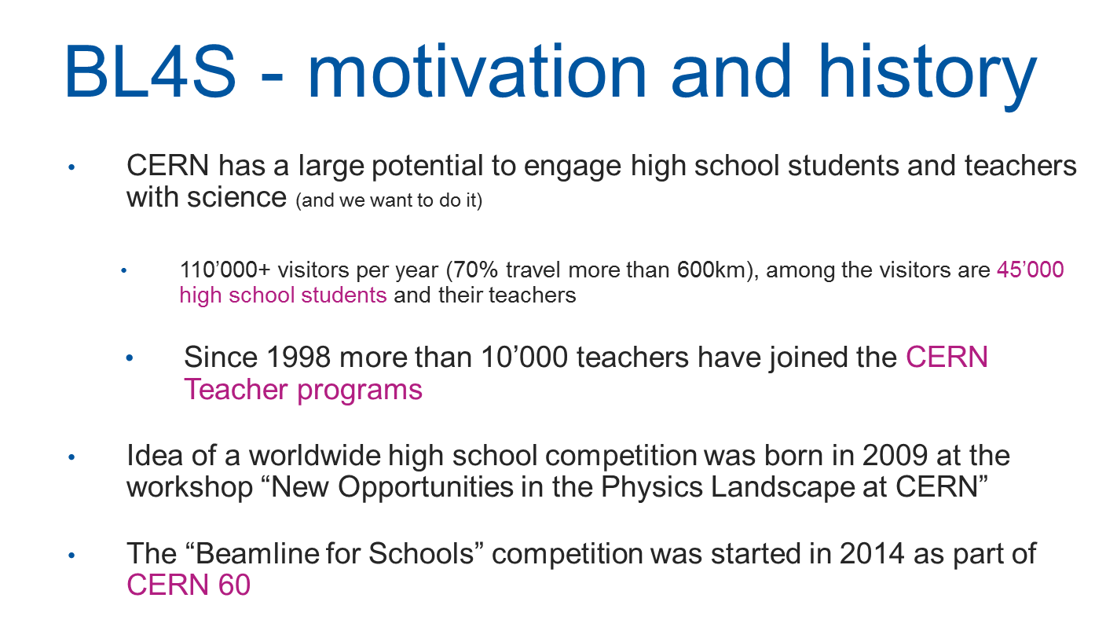

Slide 3
BL4S - taking part
BL4S is a worldwide competition for teams of high school students, aged at least 16 years and guided by a teacher (or other adult), to use a fully equipped beam line at CERN’s Proton Synchrotron
Teams have to design an experiment which uses a particle beam. They have to submit a written proposal (max. 1000 words) and a one-minute video
Launch: autumn (earlier if possible), proposal submission: 31 March
Teams can get support and advice from CERN’s BL4S team or from volunteer physicists from all over the world, mainly via the International Particle Physics Outreach Group (IPPOG)
Equipment provided by CERN can be used for the proposed experiments:
  A beam providing electrons, muons, pions, kaons and protons with momenta between 0.5 and 10 GeV
  State-of-the-art particle detectors (delay wire chambers, lead glass calorimeters, multi-gap resistive plate chambers, scintillators, silicon pixel detectors) read out by (a simplified version of) the ATLAS data acquisition system
“CERN is a symbol of scientific progress itself, and it would be a pleasure for us to work in this magnificent factory of innovation and to be a part, even if a very small one, of the “acceleration of science”. “
I Tauresini – Candidate team of 2016

Slide 4
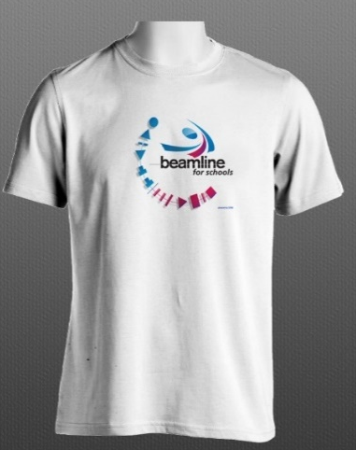
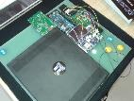
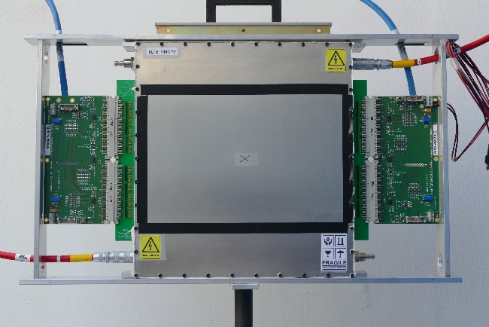
New in 2016
Additional prizes for shortlisted and noteworthy* teams
Improved documentation and Web site
  cern.ch/bl4s
Short descriptions of BL4S in 20 languages
  https://beamline-for-schools.web.cern.ch/useful-documents#languages
A new type of detector: MRPC
  Designed and built by the BL4S support scientists with help from an expert
T-shirt
CosmicPi detector
* Teams that made a well motivated but unfeasible proposal
MRPC detector

Slide 5
New in 2017
Competition announced much earlier (July)
  September 2016: Video from Bastille released
  November 2016 and January 2017: Two more waves of publicity
Still improving Website and documentation
Better definition of who is allowed to participate
Planning to build two MicroMega detectors

Slide 6
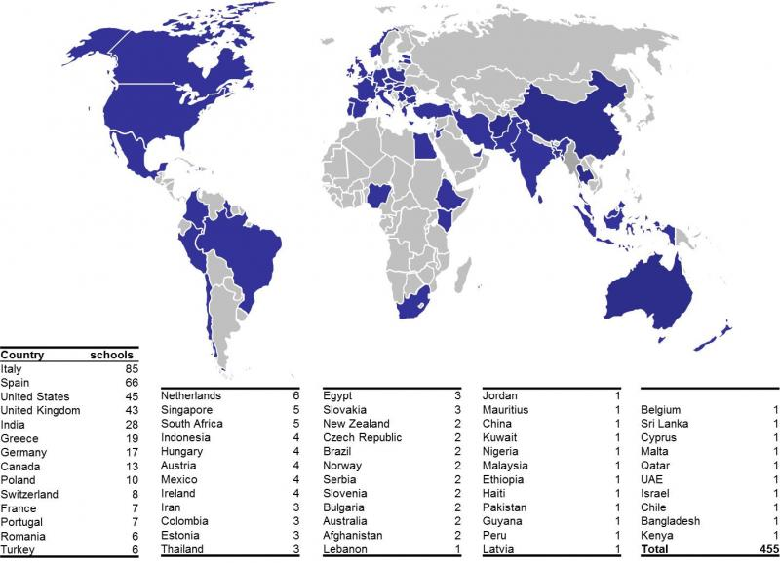
BL4S – Impact
 | 2014 | 2015 | 2016
Full proposals | 292 | 119 | 151
Countries | 50 | 28 | 37
In total ~5500 students have participated since 2014
2/3 boys, 1/3 girls
1/3 from non member states
Teams spent on average 22 hours on making their proposal
Short listed teams spent 48 hours (effort pays out…)
Two winning teams have written scientific papers about their experiment
“Modern physics has always been considered by the scholastic system as a marginal part of the educational plan. For this reason the project has been very appealing for us because it consents to keep in touch with a physics topic that is still unknown for most of the students. “ - Alessyenphysik – Candidate team of 2016

Slide 7
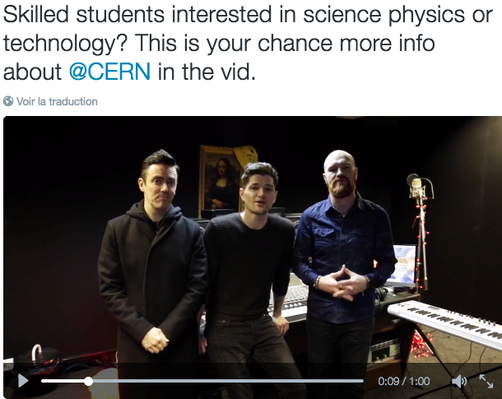
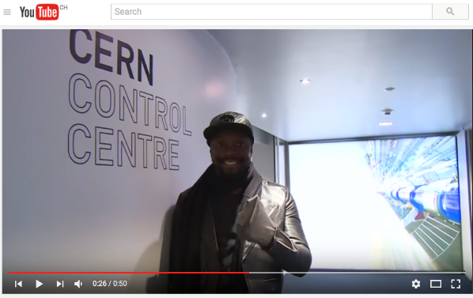
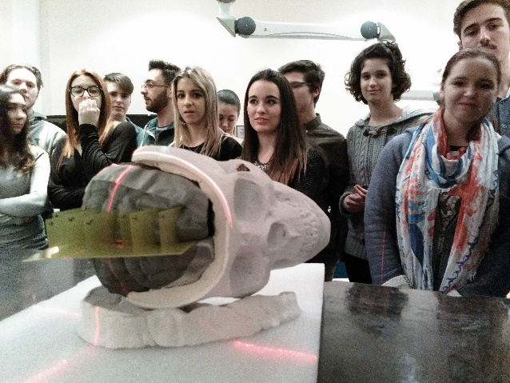
BL4S - Impact [2]
Celebrities visiting CERN help us to promote BL4S among the target group
2014: Will.I.am (viewed 5000+ times on YouTube)
2015: The Script (viewed 2500+ times on YouTube)
2016: Bastille (video just released)
Even though the impact of BL4S on the Web is still small compared to other activities of CERN, statistics show that BL4S helps to reach special target groups (women, younger people and people in non-member states such as Brazil and India) in an efficient way.
National efforts:
USA in 2014 and 2015 (and maybe 2016):
US highly commended teams were invited to run their experiment in the Fermilab test beam by one of their physicists
Italy (INFN):
2015: Team “The fellowship of the ring” was invited to CNAO (Pavia)
2016: Team “Athomos” will be invited to LNS (Catania)

Slide 8

Support for BL4S
Cost of the project:
  Beam time and time invested by staff: Offered by CERN
  Direct cost: 140 - 170 kCHF
Share of the cost financed by grants of the CERN & Society foundation
Year | Source | Amount ( kCHF)
2014 | National Instruments | 9.4 + 17 (in-kind)
 | Danfysik | 2
 | Total | 28.4
2015 | Motorola Solutions Foundation | 54
 | National Instruments | 17 (in-kind)
 | Ernest Solvay fund | 7.9
 | Total | 78.9
2016 | Alcoa foundation | 96.6
 | Motorola Solutions Foundation | 59
 | National Instruments | 8.5 + 17 (in-kind)
 | Ernest Solvay fund | 8.1
 | Total | 189.2
2017 | Alcoa foundation | 159.1
 | Motorola Solutions Foundation | ~25
“The students in our country are forced to believe that science is only limited within text books. Just like our participation in this competition changed the way we look at science, this opportunity can help us inspire them to believe that miracles can only be achieved through science, that science can create revolutions and that the discoveries like the Higgs Boson and initiatives like the Montreal Protocol are the thoughts of scientists who weren’t born genius but turned out to be ones because they too were like us, children with dreams of getting the answers to their life through science itself, believing that they could make a difference.” -- The Rocket Bros, candidate team of 2016 from Bangladesh

Slide 9
BL4S - selection
The evaluation of the proposals and videos is based on these criteria:
  motivation of the students
  creativity
  feasibility of the proposal
  demonstration of ability to follow the scientific method
Step 1: volunteers from CERN (including member state universities and laboratories) selected the best 20 proposals and 10 winners of a special prize
Step 2: a team of accelerator, beamline, detector and physics experts selected 10 proposals and carried them forward
Step 3: CERN’s SPS and PS Experiment Committee, SPSC, reviewed the 10 shortlisted proposals and selected the winners, who then were invited to CERN for 11 days to carry out their experiments

Slide 10
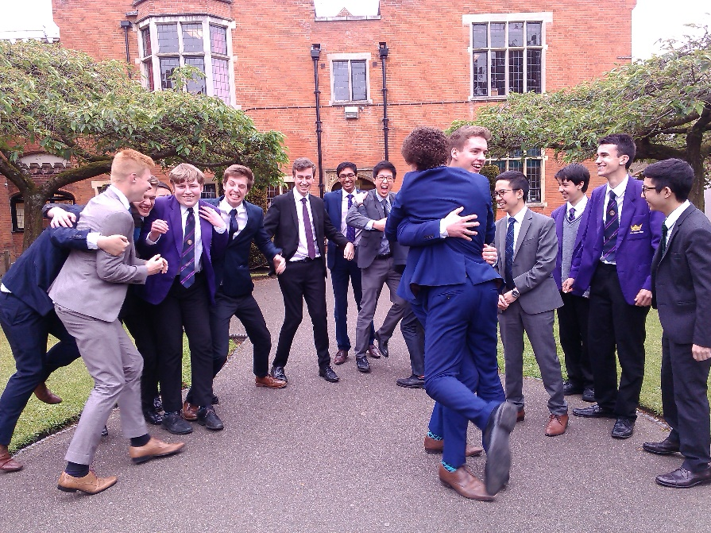
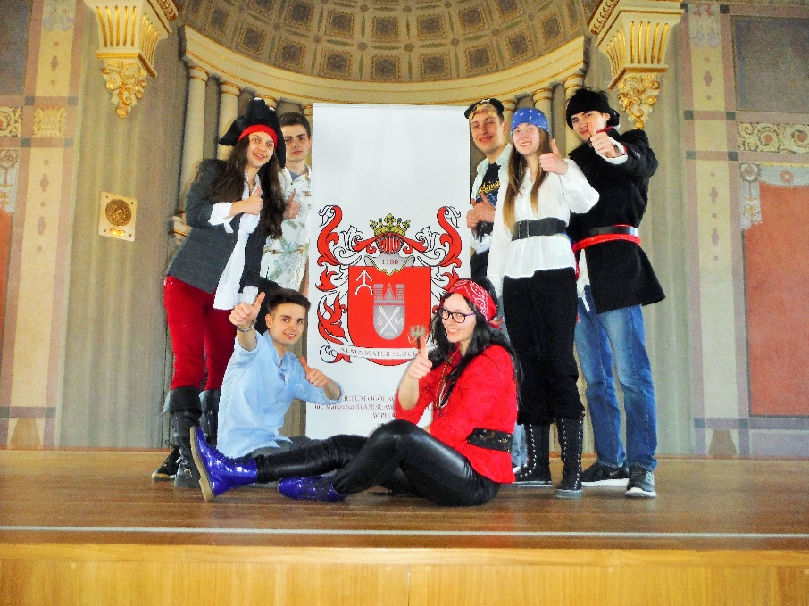
The winners
2014:
Odysseus' Comrades from Greece
Dominicuscollege from the Netherlands
2016:
2015:
Leo4G from Italy
Accelerating Africa from South Africa
Relatively Special from the UK: Test the validity of the Lorentz factor by measuring the effect of time dilation due to special relativity on the decay rate of pions.
Pyramid hunters from Poland: Try to examine the internal structure of the Chephren pyramid using muon tomography
‘My Mum asked me “What is your team doing in the competition?” To which I replied, “Oh, just proving Einstein’s Special Theory of Relativity” ‘ - Achintya Singh, member of 2016 winning team

Slide 11
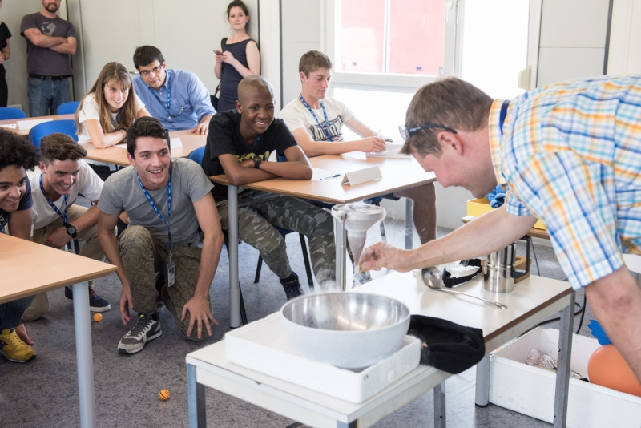
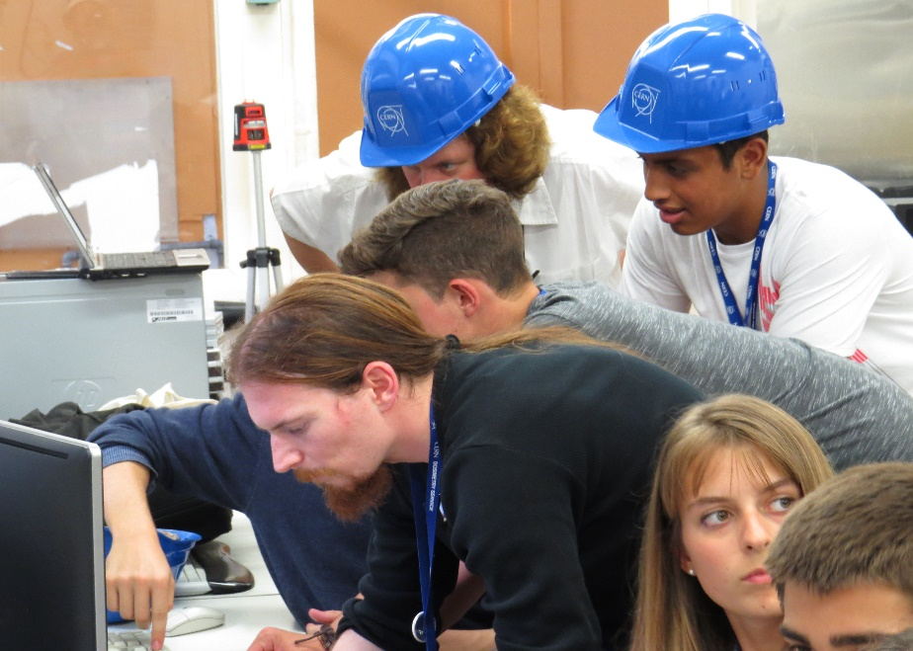
The students at CERN
"When I first heard the good news I was ecstatic, my hands where shaking and my heart was beating faster than usual. I could not believe that such an amazing opportunity has been blessed to me. I've always wanted to pursue a career in Physics or Engineering and winning this amazing competition has brought me closer to my dreams. I'm truly thankful for this opportunity given to me and I know that I will take it with my two bare hands and not let go of it. " - Malaika Elliot Motsoai, member of 2015 winning team
“This competition showed us that science is something that you can share with other people, have fun with and also miss once you don’t do it anymore. Personally I think this was one of the best experiences of my life” - Giulio Marrone, member of 2015 winning team

Slide 12
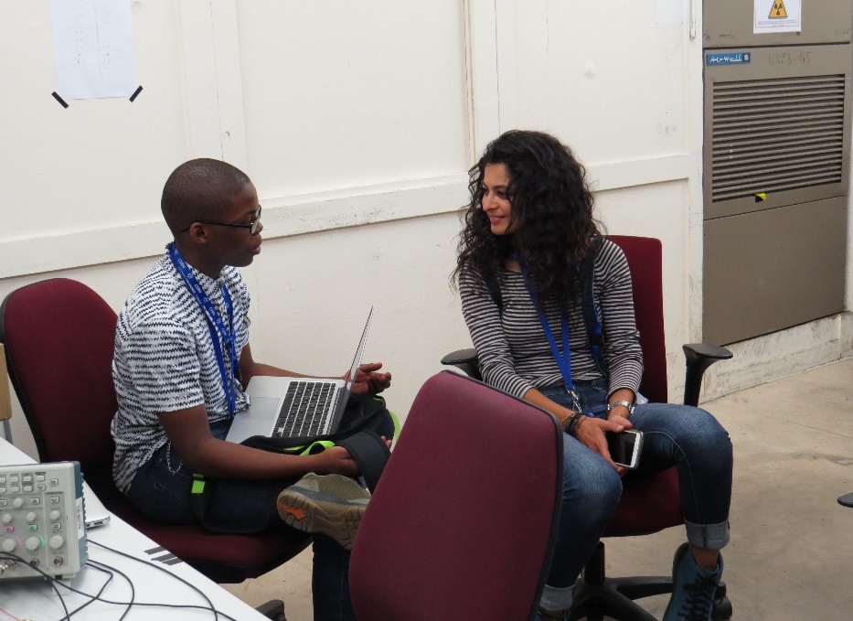
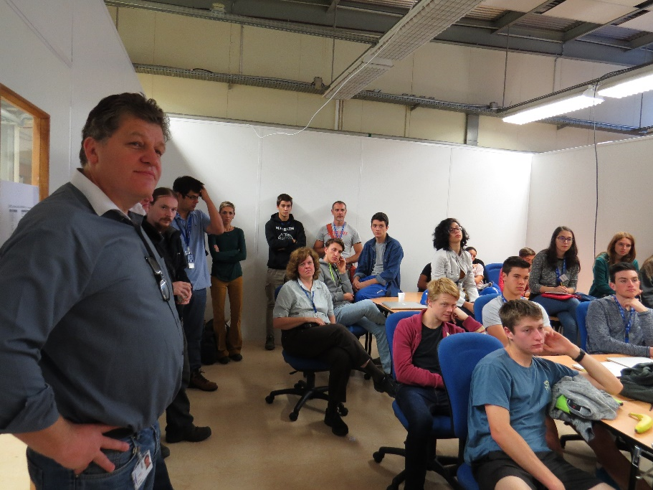
The students at CERN
"When our teacher came and told us that we had won and we would go to CERN and do the experiments I couldn't believe. I was shocked. I had hoped that maybe some day I would go there to visit CERN but I have never expected that it would happen so quickly." - Ewa Pijus, winner of 2016
“The fact that we won has yet to sink in. This is simply the most brilliant way to connect school kids with real-life, world class scientists.” Tek Kan Chung , winner of 2016
“Being responsible for implementing an experiment that was proposed by a team of ambitious students was not a small burden in the beginning. The 10 days we spent with the students have been an incredible experience and have helped me a lot to develop skills that will be essential for my professional career.” – Candan Dozen, 2015 support scientist
“BL4S is the definition of turning my hobby into my work. It’s one of the most fun projects I had through my years at CERN.” – Theodoros Vafeiadis – 2016 support scientist

Slide 13
2017 and beyond
Financing for 2017 secured
No regional contacts for:
  Australia, Bulgaria, Denmark, Ireland and Romania (as well as some non-IPPOG nations such as India, China, japan, Russia, etc.)
  https://beamline-for-schools.web.cern.ch/contact
We have to make (even) more publicity
I am still looking for two support scientists
  Offer: PJAS contracts from Feb. 2017 to Sep. 2017
Ready to continue in 2018 once financing has been clarified
2019 and 2020
  PS switched off for maintenance
  Possibility to host BL4S at another institute
    CERN may be able to offer support (experience, material)
2021+: BL4S possible in the refurbished East Hall
The main challenge every year: Publicity
    World wide there are ~470 million students of the right age….

Slide 14
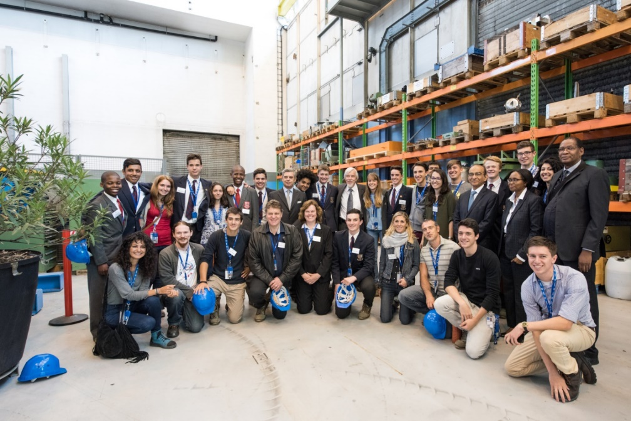
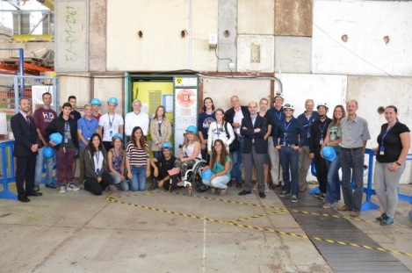
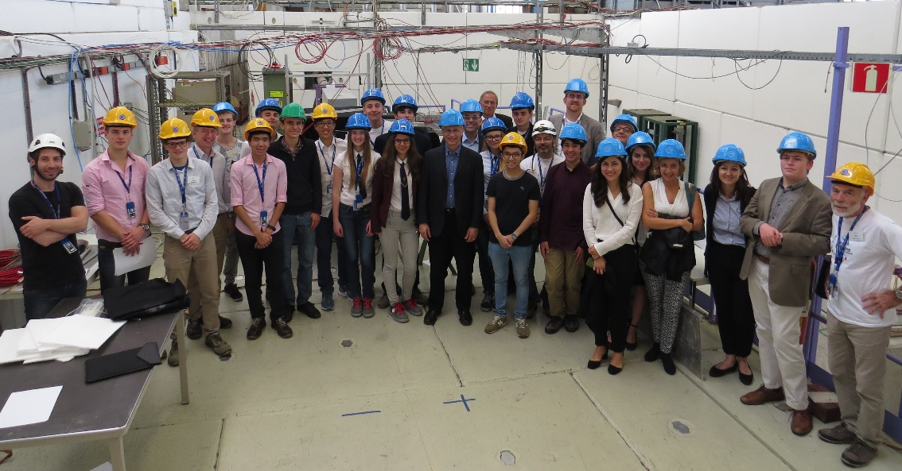
Thank you!

