Slide 1
Cosmic Rays going Global
Nicolas, Marge, HP, Catarina, Despina, Rasmus, Catia, Julia, Charles

Slide 2
Contacts with experiments
project name | contact person | data publicly available | analysis tools | interested in meeting | writeup | comment
HiSPARC | Bob van Eijk vaneijk@nikhef.nl | yes | yes | yes | yes | includes stations in UK and Denmark
CZELTA | Karel Smolek karel.smolek@utef.cvut.cz | site with passwd | C++ frame | yes | yes
cosmic@web | Carolin Schwerdt carolin.schwerdt@desy.de | yes | yes | yes | like to create
SkyView | Julian Rautenberg julian.rautenberg@uni-wuppertal.de | No (yes) | from Teilchenwelt | yes | German
QuarkNet Cosmic Ray Studies | Mark Adams adams@fnal.gov | yes | yes | yes | yes
ROALTA | Vlad Popa vpopa@spacescience.ro |  |  | yes |  | not active
SEASA | Mark Pearce pearce@kth.se |  |  |  |  | not active
EEE - Science inside schools | Rosario Nania rosario.nania@centrofermi.it Marcello Abbrescia <Marcello.Abbrescia@ba.infn.it> | to participants | internal | yes | yes
Shower of Knowledge | Georgy Shelkov chelkov@jinr.ru Alexey Zhemchugov | to participants | yes | yes | yes
CROP | Dan Claes dclaes@unl.edu | to participants | create text files | yes | http://crop.unl.edu
Cosmix | Benoit Lott lott@cenbg.in2p3.fr | upon request | yes | yes | yes
CREDO | Piotr Homola Piotr.Homola@ifj.edu.pl | yes | yes | yes | yes
COSMOS à l'Ecole | Claire Bonnoit-Chevalier claire.bonnoit@obspm.fr | upon request | no | yes | yes
CREATE | Prof. Thompson l.thompson@sheffield.ac.uk
MAZE | Dr Wibig wibig@zpk.u.lodz.pl
DUKS | Dr Fynbo fynbo@phys.au.dk

Slide 3
Next steps
Organize a meeting between the different experiments (2 days)
  You are not alone!
  share experiences
  Experimental fact-sheet
  discuss the sharing of information and data
    Common data format
  Perform a student analysis on the data
  Funding request..
Likely week of feb 20th
First step towards common data format/tools
Masterclasses
Possible locations: Amsterdam/Rome

Slide 4
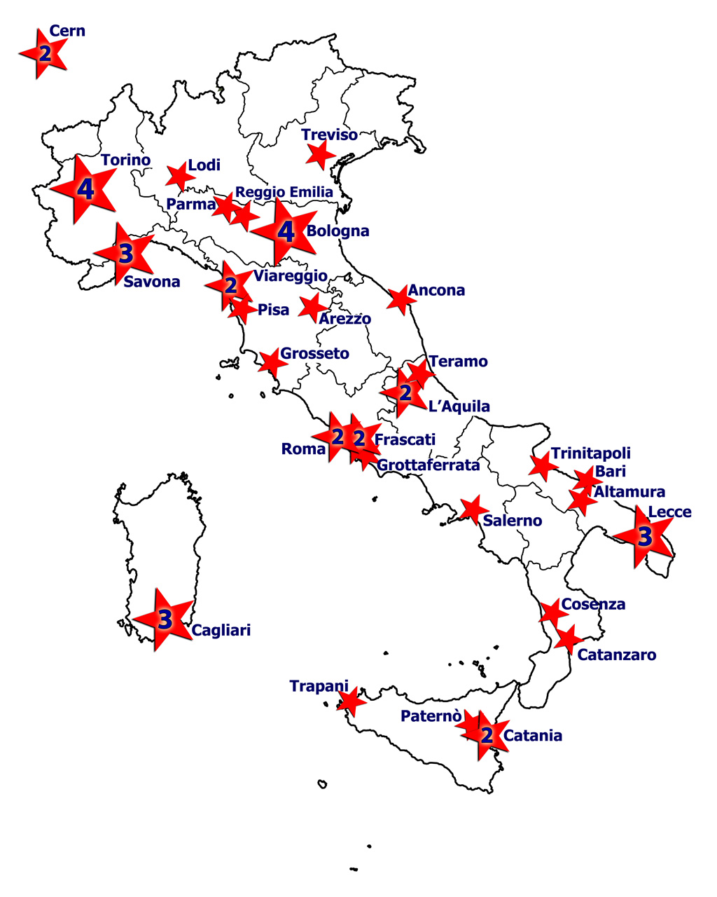
An extended array of muon telescopes EEE (Despina Hatzifotiadou)
50 telescopes in Italy
MRPC
6 gas gaps of 300 microns each
dimensions : 82 cm x 180 cm
Requirements : reliable (long-term); easy to use; not expensive
Design based on the MRPCs of the ALICE TOF (Time Of Flight )

Slide 5
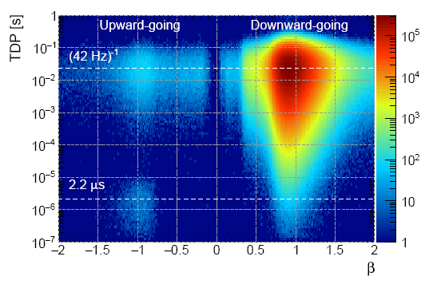
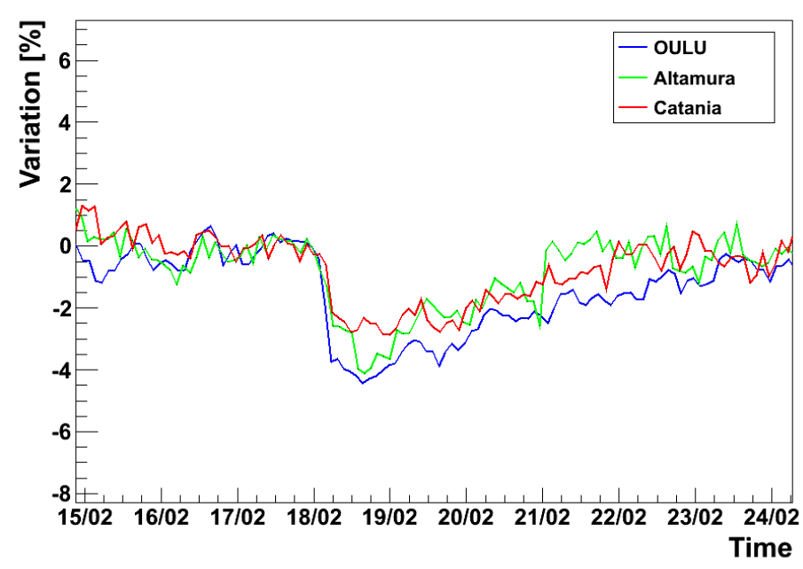
Analysis topics (EEE)
Upward going muons! (muon decay)
Forbush decrease

