Slide 1
Table top experiments
Rasmus Mackeprang
Julia Woithe
Paul Jackson
Krzysztof Wozniak
Daniel Lellouch
Angelos Alexopoulos

Slide 2
Actually means very different things
Equipment : from “built by students” to “fully bought from a company”
Target audience
Content: experiment vs Mock-up
Consensus: as for primers/backgrounders, a clear need for a centralized repository of experiment recipes is felt

Slide 3
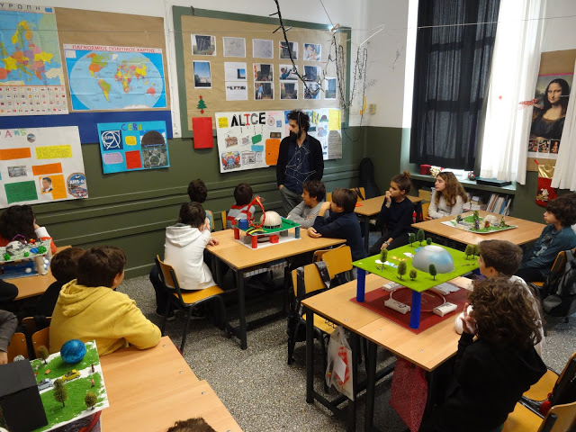
© Tina Nantsou

Slide 4
