Slide 1
Panel report:
Table top experiment show experiments or activities, which offer insight and excitement to students - “playing” and experiencing particle physics
Julia.woithe@cern.ch

Slide 2
Categories
Opportunities to talk about particle physics
Demonstration experiments / mechanical analogies
„Real“ particle physics measurements

Slide 3
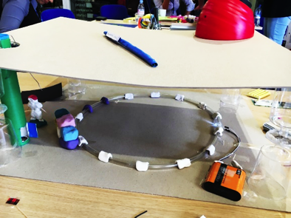
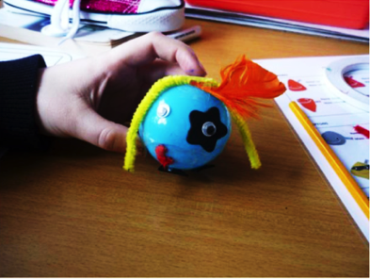
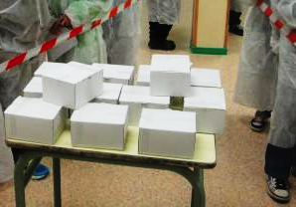
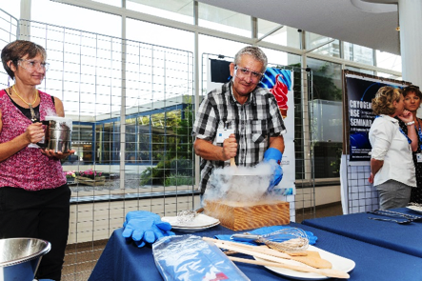
Opportunities to talk about particle physics
For example
Playing with protons
Pavlidou, M., & Lazzeroni, C. (2016). Particle physics for primary schools - enthusing future physicists. Physics Education, 51(5), 054003.
Mystery boxes
Liquid nitrogen show
…

Slide 4
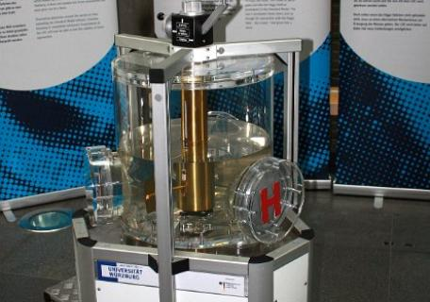
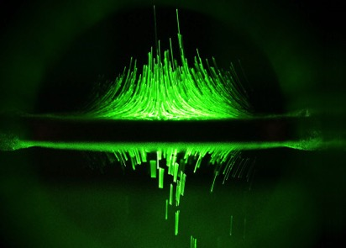
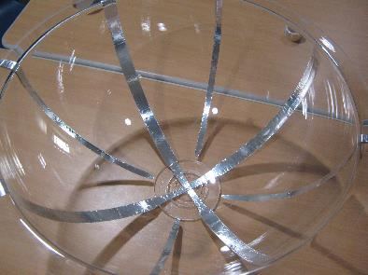
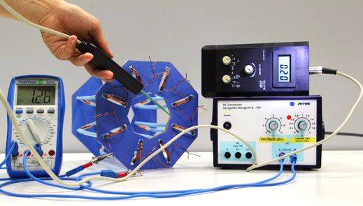
Demonstration experiments / mechanical analogies
For example
Quadrupole Ion Traps
Salad bowl accelerator
Weltmaschine exhibits
Feistmantl A., & Woithe, J. (2017). Elektromagneten der Teilchenphysik
hands-on – das ATLAS Magnetsystem. PHYSIK in der Schule 66(1)
Rutherford scattering with marbles (form factors, cross section, …)
!!! Don‘t forget to discuss the limits of these models, avoid misconceptions !!!

Slide 5
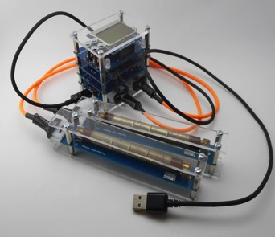
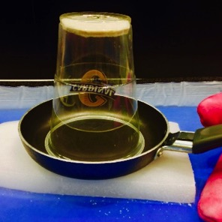
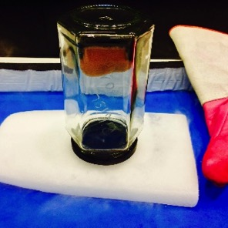
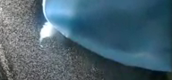
„Real“ particle physics measurements
For example
DIY Cloud Chambers
Muon Hunter
DIY Ionisation chambers
CosMO and other cosmic particle detectors
RCLs (Remotely Controlled Laboratories)
…

Slide 6
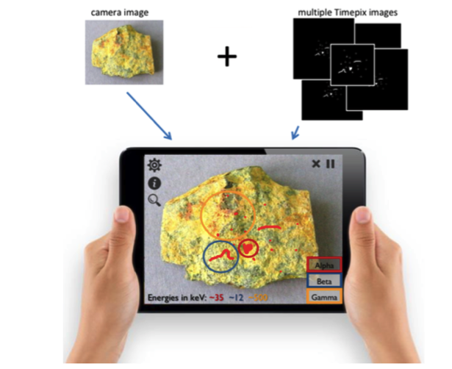
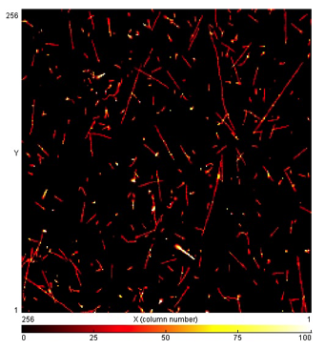
More expensive equipment …
MX-10 Pixel detector
IpadPix prototype (Oliver Keller, S’Cool LAB, is also working on a new (and cheaper) pixel detector for education at the moment)
…

Slide 7
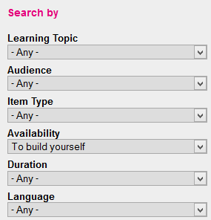
Where to find resources? http://ippog.web.cern.ch/resources
Add more!
(A new S‘Cool LAB PhD student will have a look what exists and what teachers want ...)

