Slide 1

STATUS OF IPPOG WEBSITE
Barbora Bruant Gulejova

Slide 2

IPPOG WEBSITE TODAY
www.ippog.web.cern.ch
☺
But…

Slide 3


STATUS OF IPPOG WEBSITE
OUTLINE
2 DISTINCT ISSUES:
1) IPPOG WEBSITE : WEBDESIGN and STRUCTURE
2) IPPOG RESOURCE DATABASE

Slide 4
IPPOG RESOURCE DATABASE
WHAT WAS DONE SO FAR???

Slide 5
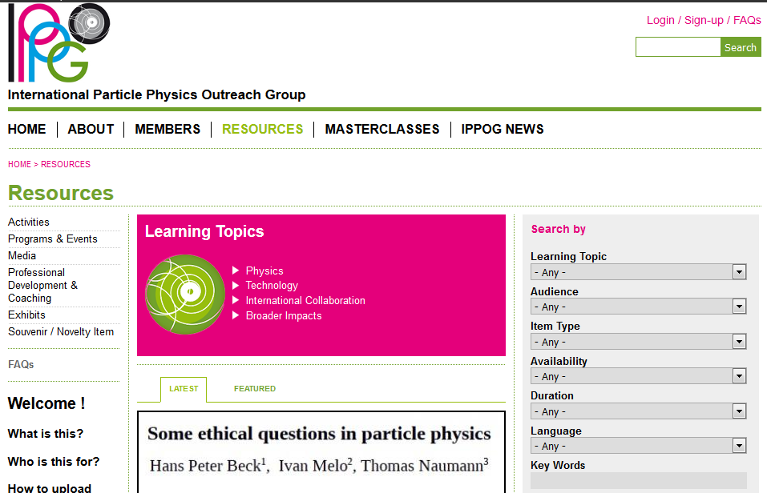
HOW IPPOG DATABASE
LOOKS TODAY?

Slide 6
LEARNING TOPICS (44)
IPPOG DB TODAY
ITEM TYPES/ CATEGORIES (41)
1) PHYSICS
Conservation Laws
Cosmic Microwave Background
Cosmology
Dark Energy
Dark Matter
Extra / Multi Dimensions
Forces
Higgs Boson
W' Z' Bosons
Mass
Matter / Antimatter
Micro Black Holes
Neutrinos
New Physics
Particles
Quark Gluon Plasma
Standard Model
SUSY
Symmetry
3) INTERNATIONAL COLLABORATIONS
History
Life as a Physicist
(Maps) Who does What?
Process of Discovery
Working with Industry
3) Media
Audio / Podcast
Film / Video
Animation - real event
Animation - simulated event
Images
Photos
Illustrations
Event Displays (static)
Plots
Computer game
Non-game Inter-actives / Virtual Tours
Website
Print Media
Fact Sheet
Brochure / Flyer / Leaflet
Article / Journal
Poster
Banner / Print Pannel
Book
4) Professional Development & Coaching
5) Exhibits
Permanent Exhibitions
Portable Exhibitions
Exhibits
6) Souvenir / Novelty Item
Activities
Cart Demonstration
Classroom Activity
Facilitated Activity
Presentation
Game
Display
2) Programs & Events
Science Fair / Science Festival
Science Camp
Science Shows & Performances
Symposium / Conference
Classroom Outreach Program
Multi-Media Contest
4) BROADER IMPACT
Cancer Treatment
Culture
Education
Medical Applications
Medical Screening
Technology Transfer
WWW
FILTERING/ SEARCH BY:
6) Duration
0-5 mins
6-15 mins
16-30 minutes
31-45 minutes
46-60 minutes
61+
Half day
1 day
2-3 days
4-6 days
1 week or more
2) TECHNOLOGY
Accelerators
Calorimetry
Civil Engineering / Construction
Computing Grid
Detectors
Information Technology
Magnets
Particle Identification
Tracking
5) Language
Arabic Catalan Chinese
Czech Danish Dutch
English Finnish French
German Greek Hungarian
Italian Japanese Norwegian
Polish Portuguese Romanian
Russian Serbian Slovak
Slovenian Spanish Swedish
Turkish
1) Learning Topic (44 topics!) 2) Item Type (41!)
3) Audience
6 to 9 years
9 to 12 years
12 to 15 years
15 to 18 years
18 to 25 years
25 years+
Science Educator / Science Explainer
4) Availability
Build yourself
Download
Have for free (but not download)
Rent
Borrow
Buy
7) Key Words

Slide 7
In 2014 there was a Group working on DB:
Marge Bardeen, Pete Watkins, Ken Cecire and Achintya Rao

Slide 8

Filtering by ITEMS (Marge et al), CERN Fall 2014

Slide 9
Spring 2015 meeting in Paris
Official Working Group on Website:
Marge, Achintya, Pete, Ivan, Jonas, Marzena, Jacek, Jonivar, Ana
+ Barbora

Slide 10
[Report from Paris]
ITEMS, Paris, Spring 2015
(From 44 to 10)
Standard Model
Higgs Boson
Neutrinos
Antimatter
Accelerators and Detectors
Beyond Standard Model
Dark Matter / Dark Energy / Cosmology
Extra-dimensions
New Physics
Broader impacts

Slide 11
GOOD NEWS
Based on all above & discussions with Rolf Landua and Hans Peter Beck, Barbora proposed the structure and layout of DB
Sent only to original WG members: Marge, Pete, Ken and Achyntia
Informal discussion took place during Fall 2015 Meeting at CERN (Barbora, H-P, Marge, Pete and Ken)
CONSENSUS ☺

Slide 12
CURATED CATHEGORIES
ITEM TYPES /CATEGORIES:
Photos/ Posters/ Charts
Videos
Animations / Simulations
Presentations (ppt,pdf)
Games
Classroom materials / Tutorials / Lesson plans / Text books
Books
Projects / Competitios
Exhibition items
Souvenirs (could go also to separate item on the website)
From 44 to 16
From 41 to 10
TOPICS:
1) MATTER, PARTICLES AND UNIVERS (KNOWN PHYSICS)
PARTICLES AND THEIR INTERACTIONS
COSMOLOGY
HIGGS
ANTIMATTER
QUARK-GLUON PLASMA
NEUTRINOS
2) EXPLORING THE UNKNOWN (BEYOND KNOWN PHYSICS)
SUPERSYMMETRY
DARK MATTER
DARK ENERGY
EXTRA DIMENSIONS
3) TECHNOLOGIES and EXPERIMENTS
ACCELERATORS
DETECTORS
4) PARTICLE PHYSICS AND SOCIETY
WHY FUNDAMENTAL RESEARCH
INTERNATIONAL COLLABORATION
APPLICATIONS & SPIN-OFFS
PEOPLE BEHIND THE SCIENCE
FILTERING / SEARCH BY:
Topic (see above = 17)
Type / Category (see above =9)
Language
  Arabic
  Catalan
  Chinese
  Czech
  Danish
  Dutch
  English
  Finnish
  French
  German
  Greek
  Hungarian
From 6 to 4
22
4) Audience
  Primary school level
  Lower secondary school level
  Upper secondary school level
  Broad public
  Educators
5) Keyword
We should think first carefully how to address keywords, if we can manage to be coherent or not…otherwise could be confusing, like CDS
Additional tag will be added to all items in database to sort out and show the resources by their quality (IPPOG recommended, good, old but still ok)
  Italian
  Japanese
  Norwegian
  Polish
  Portuguese
  Romanian
  Russian
  Serbian
  Slovak
  Slovenian
  Spanish
  Swedish
  Turkish

Slide 13
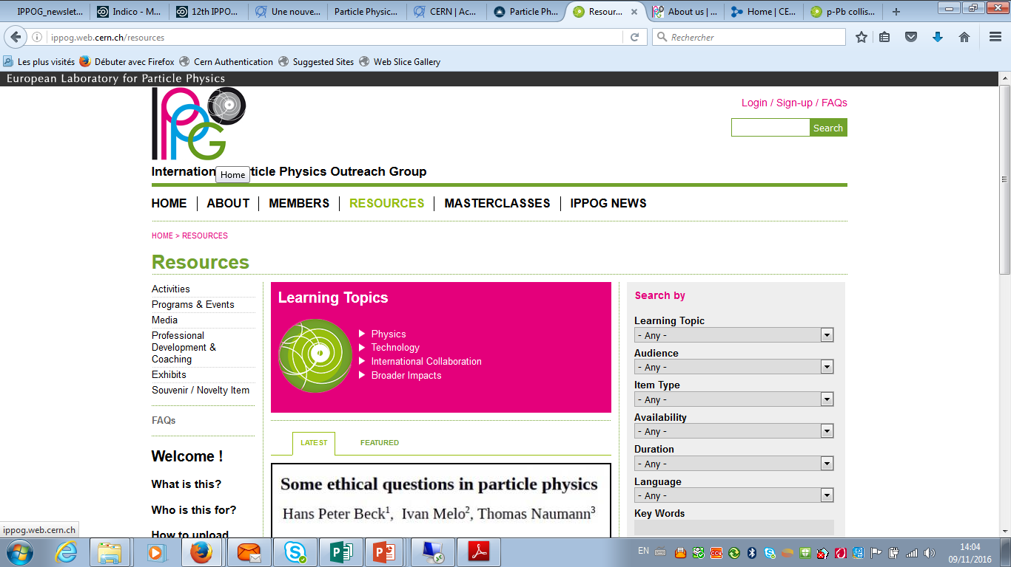

Slide 14

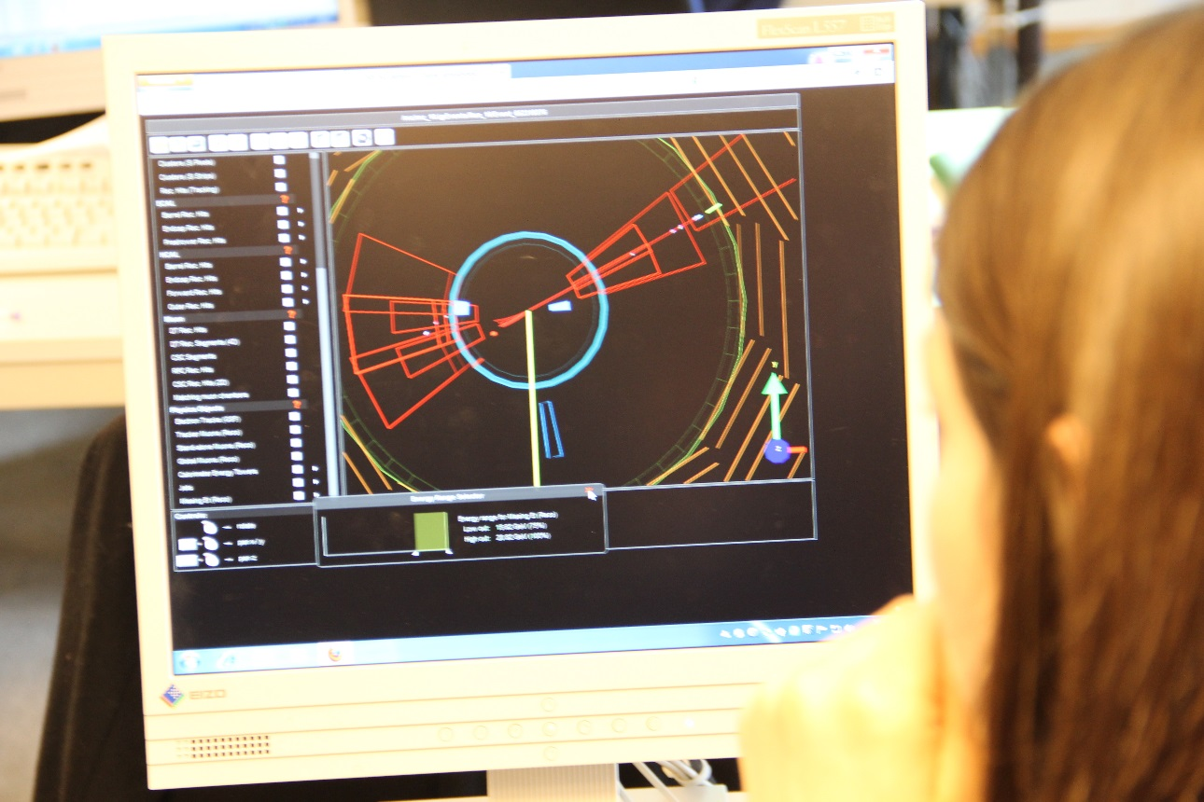

International Particle Physics Outreach Group
HOME | ABOUT US | MEMBERS | RESOURCES | MASTERCLASSES | NATIONAL RESOURCES | PUBLICATIONS
PARTICLE PHYSICS RESOURCES DATABASE
From wonders to excitement….
A collection of high quality engaging materials, e.g. videos, posters, talks, hands-on activities and more to help you share the wonders and excitement of particle physics with teachers, students and the general public.
Filter:
Latest
Topic
Item type
Featured
Language
Tweets
Facebook
Audience
Free text search
Scroll down
Events calendar
IPPOG DB FAQs

Slide 15
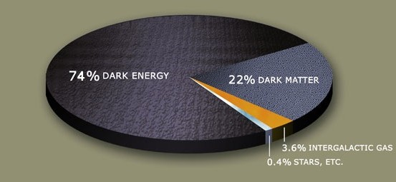
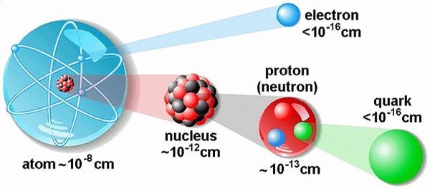
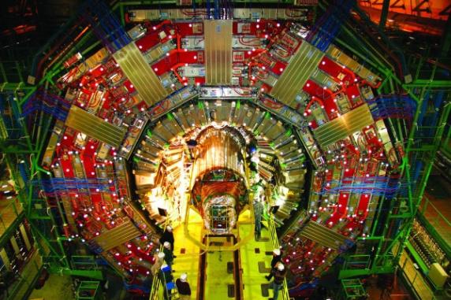
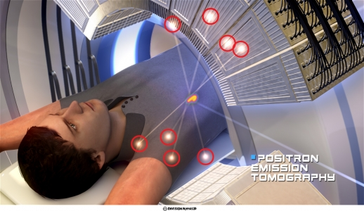
International Particle Physics Outreach Group
HOME | ABOUT US | MEMBERS | RESOURCES | MASTERCLASSES | NATIONAL RESOURCES | PUBLICATIONS
PARTICLE PHYSICS RESOURCES DATABASE
Idea is that one can search by the filter on the left, but also use the quick search by topics in the middle, while at every moment there is a possibility to refine the search by the filter on the left, which will always appear there.
From wonders to excitement….
A collection of high quality engaging materials, e.g. videos, posters, talks, hands-on activities and more to help you share the wonders and excitement of particle physics with teachers, students and the general public.
Particle Physics Learning Topics
Latest
Filter:
Matter, Particles,
and the Universe
Exploring the unknown
Topic
Item type
Featured
Language
Tweets
Facebook
Audience
Technologies & Experiments
Particle Physics and Society
222
Free text search
Events calendar
IPPOG DB FAQs

Slide 16
Now you click on
Matter, Particles and Universe

Slide 17
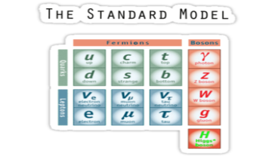
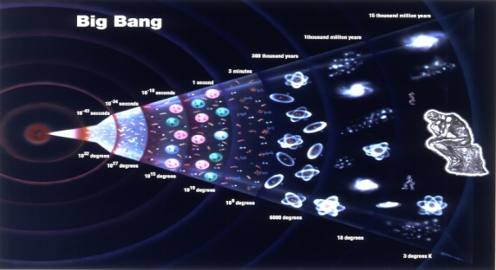
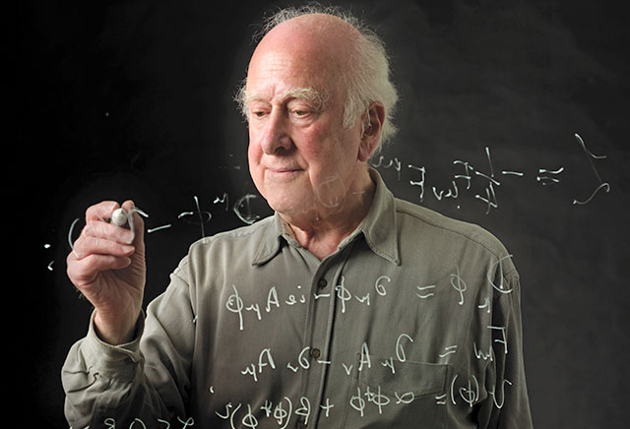
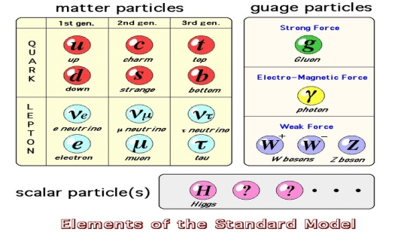
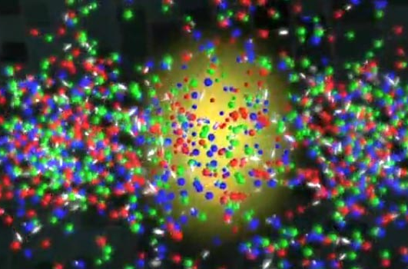
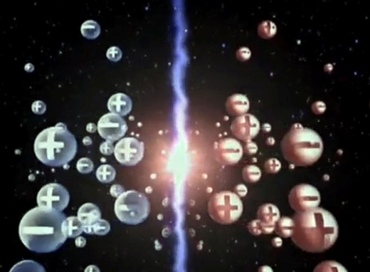

International Particle Physics Outreach Group
HOME | ABOUT US | MEMBERS | RESOURCES | MASTERCLASSES | NATIONAL RESOURCES | PUBLICATIONS
PARTICLE PHYSICS RESOURCES DATABASE
Matter, Particles, and the Universe
Intro Text of what Matter, Particles, and the Universe is all about. The picture here on the right appears so that one knows that he/she is in Matter, Particles and Universe section.
Filter:
Particles and
their intercations
Cosmology
Higgs
Latest
Topic
Item type
Featured
Language
Quark-Gluon plasma
Antimatter
Neutrinos
Tweets
Facebook
Audience
Free text search
Events calendar
IPPOG DB FAQs

Slide 18
You click on
Particles and their interactions

Slide 19
International Particle Physics Outreach Group
HOME | ABOUT US | MEMBERS | RESOURCES | MASTERCLASSES | NATIONAL RESOURCES | PUBLICATIONS
PARTICLE PHYSICS RESOURCES DATABASE
Particles and their interactions
Intro Text of what Partcles and their interactions is all about.
(Here could be eventually also the full resume of all choice options, which have been done so far in the filter on the left, so that one knows where in DB is he at the moment.)
Filter:
RESULTS Topics Audience Language Type
Latest
Matter, Particles & Universe Lower secondary English Competition
Exploring unknown Upper secondary Slovak
Technologies and experiments
Particle Physics and Society
Particles and their interactions Lower secondary English Poster
Upper secondary French
Arabic
German
…
Topic
Item type
Featured
Language
Audience
Tweets
Facebook
Information about all overlapping cathegories in the view of selected items
Free text search
Events calendar
IPPOG DB FAQs
See also

Slide 20
If after the first slide you clicked on
Exploring the unknown

Slide 21
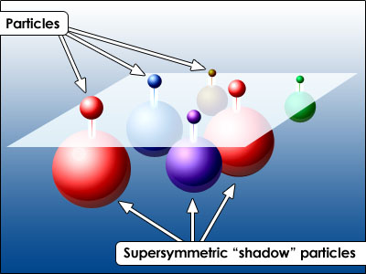
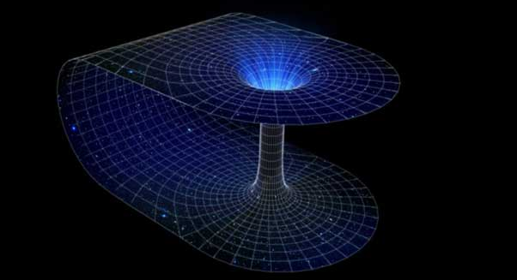


International Particle Physics Outreach Group
HOME | ABOUT US | MEMBERS | RESOURCES | MASTERCLASSES | NATIONAL RESOURCES | PUBLICATIONS
PARTICLE PHYSICS RESOURCES DATABASE
Exploring the unknown
Intro Text of what Exploring the unknown is all about. The picture here on the right appears so that one knows that he/she is in Exploring the unknown section.
Filter:
Supersymmetry
Extra dimensions
Latest
Topic
Item type
Featured
Language
Tweets
Facebook
Audience
Dark Matter
Dark Energy
222
Free text search
Events calendar
IPPOG DB FAQs

Slide 22
If after the first slide you clicked on
Technologies and Experiments

Slide 23
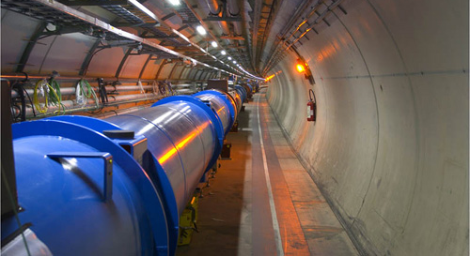
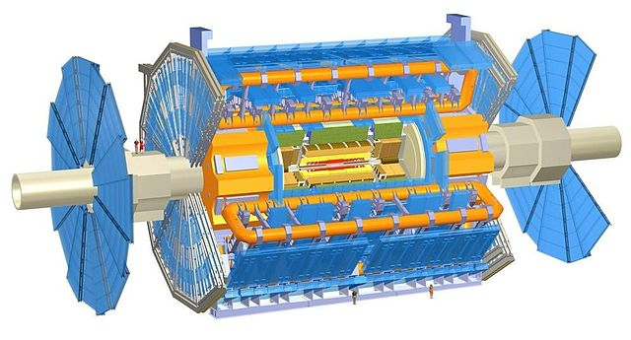
International Particle Physics Outreach Group
HOME | ABOUT US | MEMBERS | RESOURCES | MASTERCLASSES | NATIONAL RESOURCES | PUBLICATIONS
PARTICLE PHYSICS RESOURCES DATABASE
Technologies and experiments
Intro Text of what Technologies and Experiments is all about. The picture here on the right appears so that one knows that he/she is in Technologies and Experiments section.
Filter:
Latest
Topic
Accelerators
Detectors
Item type
Featured
Language
Tweets
Facebook
Audience
Free text search
Events calendar
IPPOG DB FAQs

Slide 24
If after the first slide you clicked on
Particle physics and Society

Slide 25



International Particle Physics Outreach Group
HOME | ABOUT US | MEMBERS | RESOURCES | MASTERCLASSES | NATIONAL RESOURCES | PUBLICATIONS
PARTICLE PHYSICS RESOURCES DATABASE
Particle physics and society
Intro Text of what Particle Physics and Society is all about. The picture here on the right appears so that one knows that he/she is in Particle Physics and Society.
Filter:
Why fundamental research
International collaboration
Latest
Topic
Item type
Featured
Language
Tweets
Facebook
Audience
Applications and spin-offs
People behind the science
Free text search
Stories and anectodes of persons who have been former researchers in PP and are now active in other areas in society and made a difference; and also good stories of active particle physicists
Events calendar
IPPOG DB FAQs

Slide 26
BIG TASK STILL TO DO!
CURATION of EXISTING RESOURCES!

Slide 27
[Report from Paris]
Paris, Spring 2015
Committee from IPPOGers ?
To be seen with new resources?

Slide 28
IPPOG WEBSITE
WEBDESIGN & STRUCTURE

Slide 29
IPPOG WEBSITE
WEBDESIGN & STRUCTURE
We need the page to be:
Sustainable – DRUPAL at CERN??
Well-organised – easy to navigate - STRUCTURE
Appealing – GRAPHICS

Slide 30



Why DRUPAL AT CERN ?
(and NOT EXTERNAL COMPANY?)
Existing IPPOG website is done in DRUPAL, but impossible to change
The way it was done, DRUPAL web content management is not used efficiently, but a lot is simply programmed…
Brand new website needed!!!
DRUPAL: open source web content management system
The way to have a sustainable webpage – with modules etc. continuously updated and supported by ENTICE group at CERN - Enterprise Needs for Tools and Infrastructure for Content Exploitation - brings together stakeholders from the CERN community to develop web content management, integration and exploitation solutions.
(for instance today’s website has many outdated modules)
- IT Drupal support of IPPOG website – InKind contribution of CERN
Using the CERN theme ensures that it looks good at all devices

Slide 31
IPPOG WEBSITE
WEBDESIGN & STRUCTURE
We need the page to be:
Sustainable – DRUPAL at CERN??
Well-organised – easy to navigate - STRUCTURE
Appealing – GRAPHICS

Slide 32
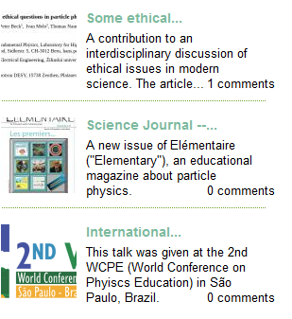
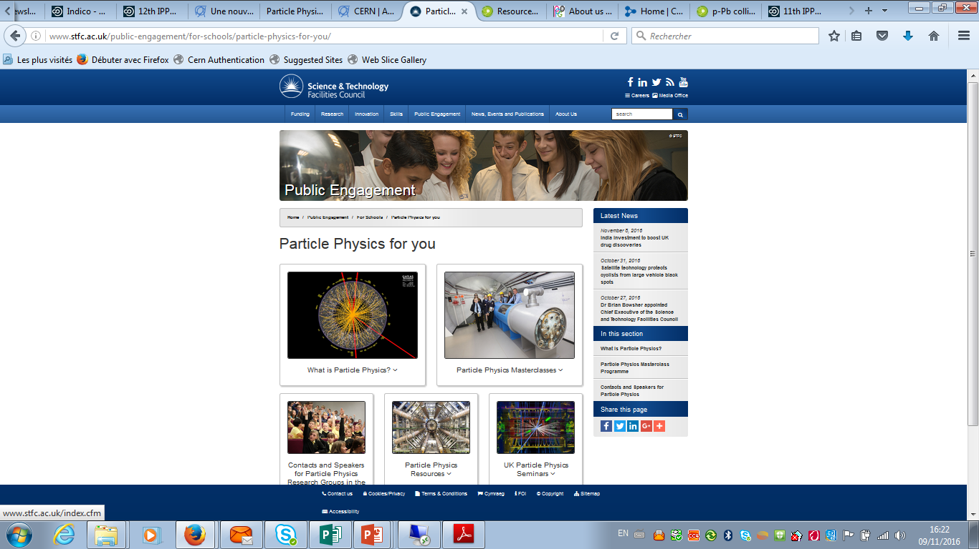
STRUCTURE
MAIN MENU:
HOME | MEMBERS | RESOURCES | MASTERCLASSES | COSMIC RAYS | NATIONAL RESOURCES | PUBLICATIONS
(ABOUT US)
SIDEBAR:
NEW RESOURCES
EVENTS CALENDAR
Masterclasses 2017
Beamlines for Schools
Exhibition Arts@CMS
….
NEWSLETTER

Slide 33
IPPOG WEBSITE
WEBDESIGN & STRUCTURE
We need the page to be:
Sustainable – DRUPAL at CERN??
Well-organised – easy to navigate - STRUCTURE
Appealing – GRAPHICS

Slide 34
Fall 2016 meeting in Krakow
Panel discussion E&O websites (DESIGN)
Steven Goldfarb, Marge Bardeen, Michael Kobel, Marzena Lapka, Kate Shaw

Slide 36
INSPIRATIONS
from other websites
Today’s trends…
Appealing pictures and colours

Slide 42
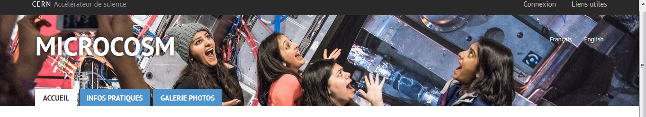
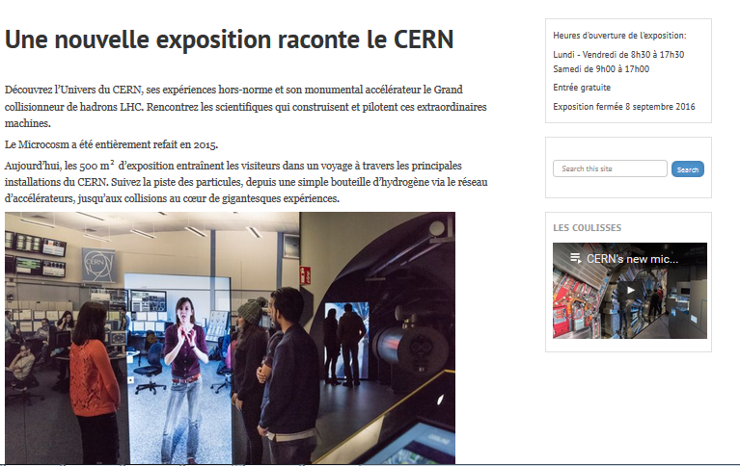
DRUPAL
&
CERN THEME

Slide 43
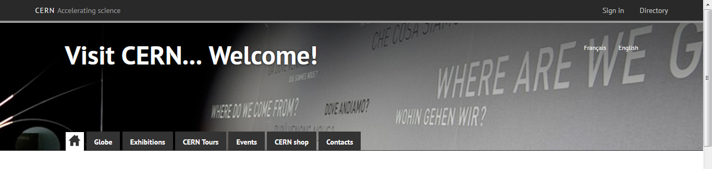
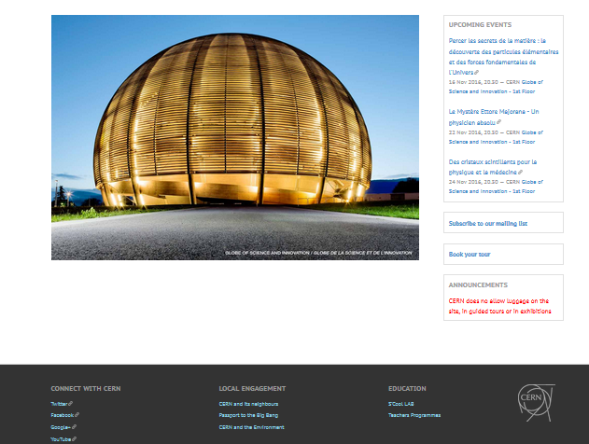
DRUPAL
&
CERN THEME

Slide 44
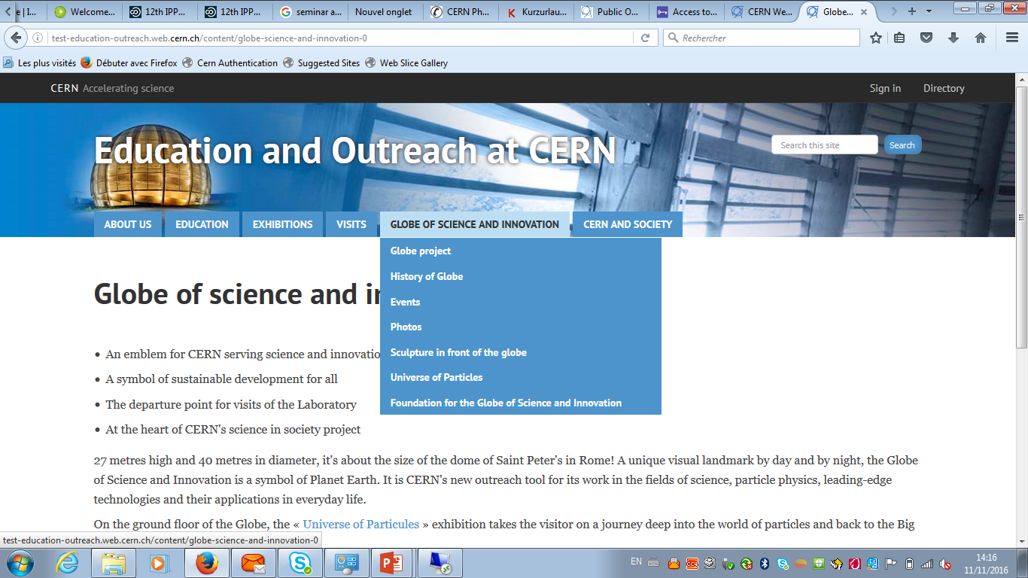
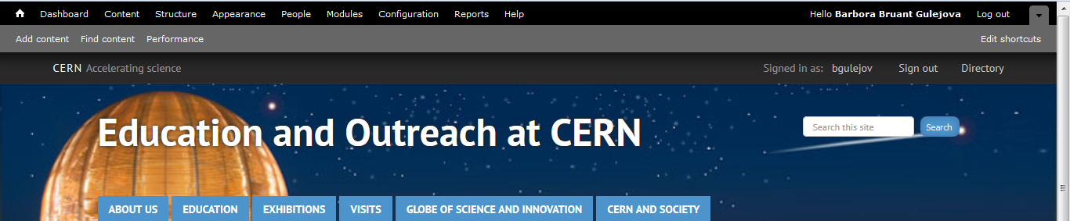

Slide 45
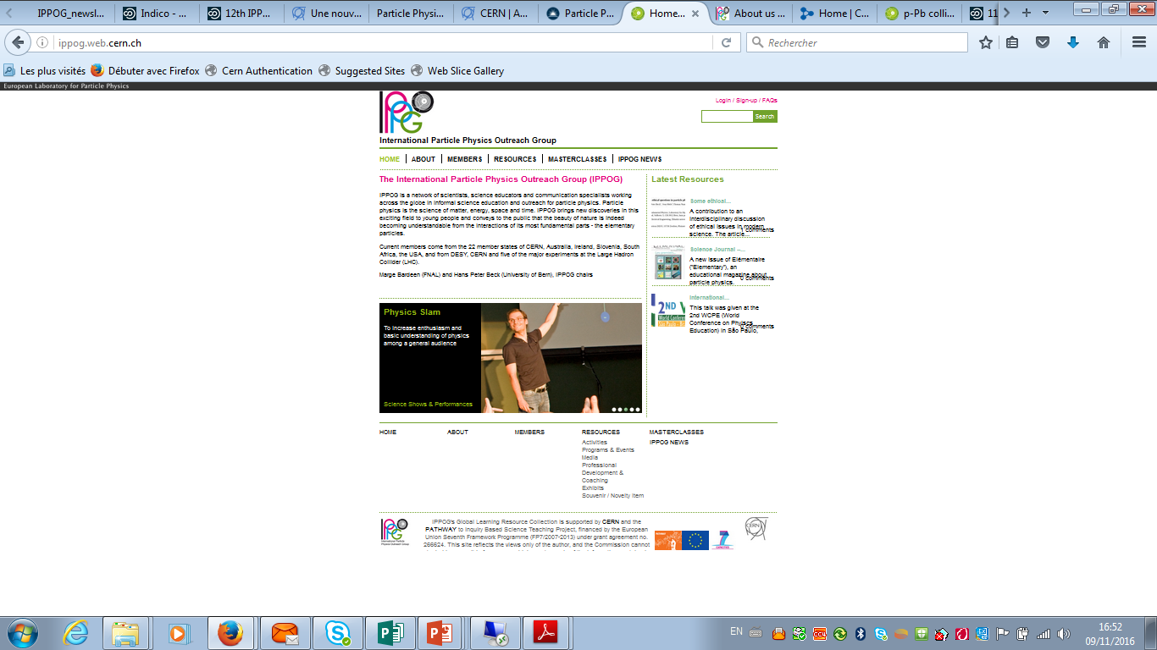

Slide 46
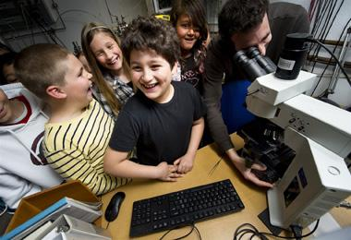

Slide 47
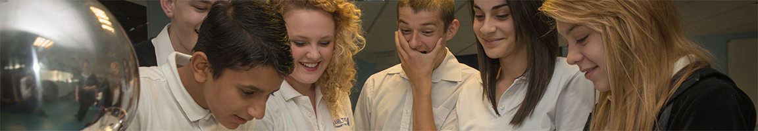

International Particle Physics Outreach Group

Slide 48

International Particle Physics Outreach Group
HOME | ABOUT US | MEMBERS | RESOURCES | MASTERCLASSES | PUBLICATIONS

Slide 49
Fall 2016 meeting in Krakow
Panel discussion E&O websites

Slide 50
The website address : ippog.web.cern.ch
ippog.org
Still supported by CERN IT DRUPAL?
CERN IT is ok with configuring the ippog.org domain into the central web infrastructure
but there are some steps to follow outside their control:
- Get the domain name
- Give control of the domain to the CERN Network infrastructure
- Then point the domain name to CERN DRUPAL servers
Then CERN IT could start configuring this domain as an alias of the existing one (ippog.web.cern.ch)
However:
- anonymous users will access the site as ippog.org and transparently continue browsing the website under this domain
- CERN authenticated users will always be redirected to ippog.web.cern.ch.

Slide 51
PLAN
Just do it! ☺

