Slide 1

IPPOG Wrap-up
Hans Peter Beck: IPPOG Co-chair, Bern University
Marjorie Bardeen: IPPOG Co-chair, Fermilab

Slide 2
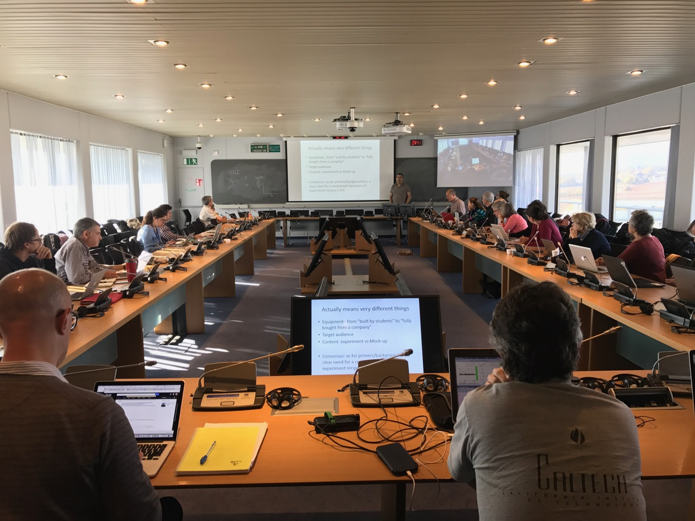
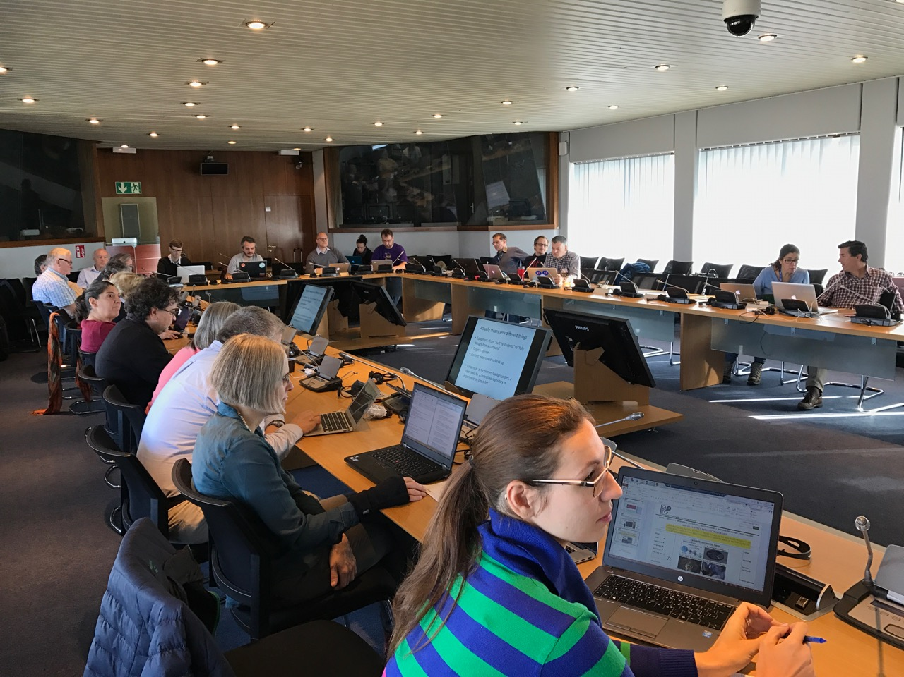
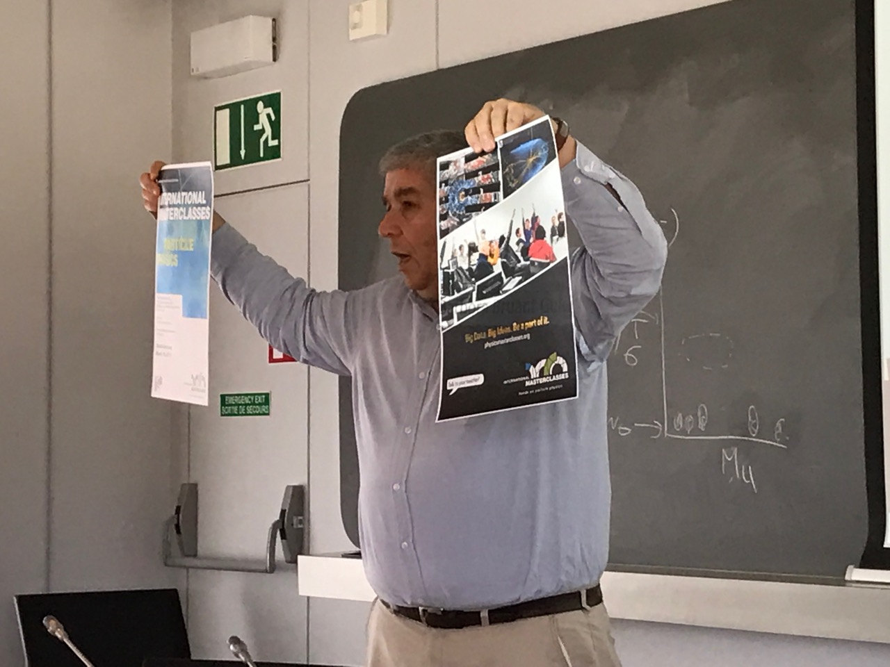
Intense 2½ days
Explaining PP hot topics to lay audience
Organising E&O sessions for LHCP and ICHEP
Table top experiments
Beamline for schools 2016 and call for 2017
Masterclasses in New Countries
Broadening the physics scope of Masterclasses
Inspiring success stories
Special events and exhibitions
Masterclasses 2016
IPPOG website
MoU discussion
Country highlights
An inside view from IPPOG
Impact and usage of worldwide open data
Ethics in particle physics
Physics for everyone - The Higgs particle
Election of new chairs

Slide 3
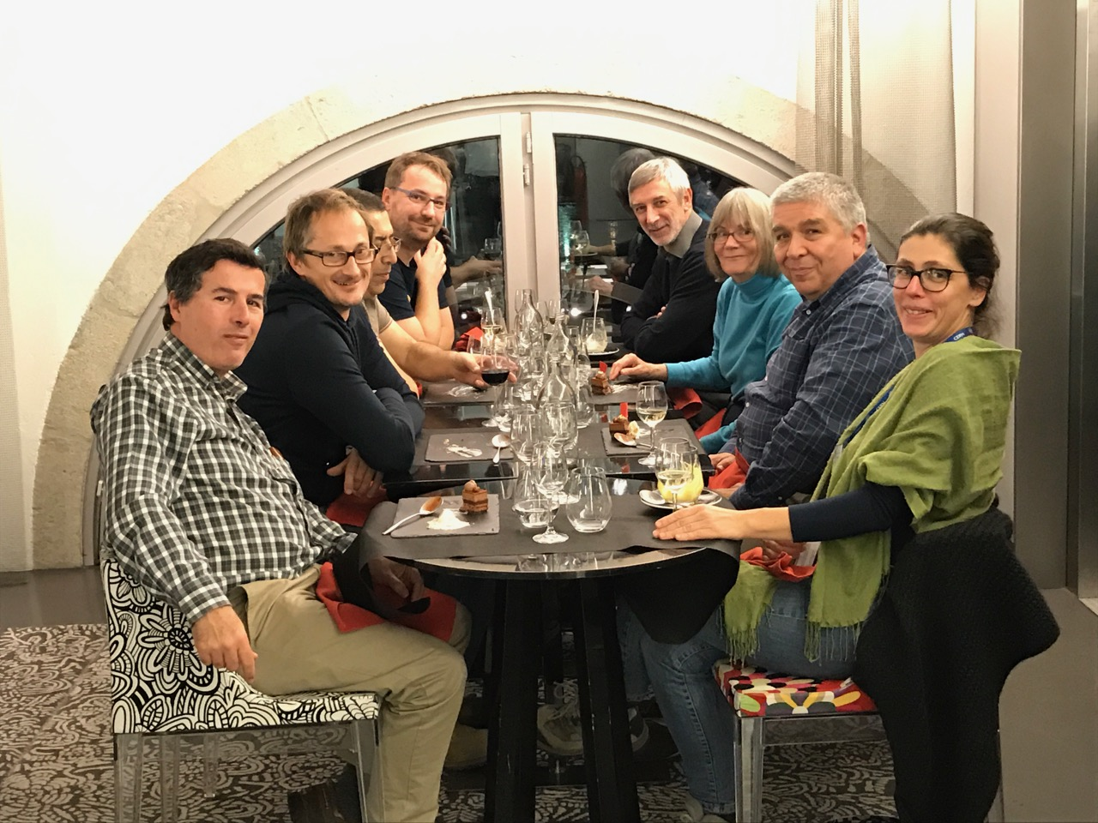
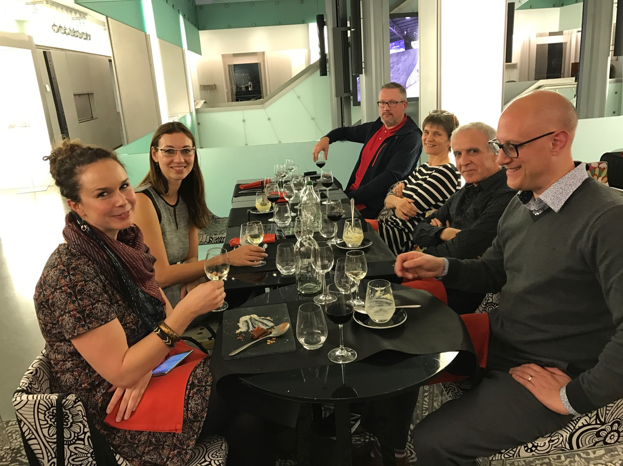
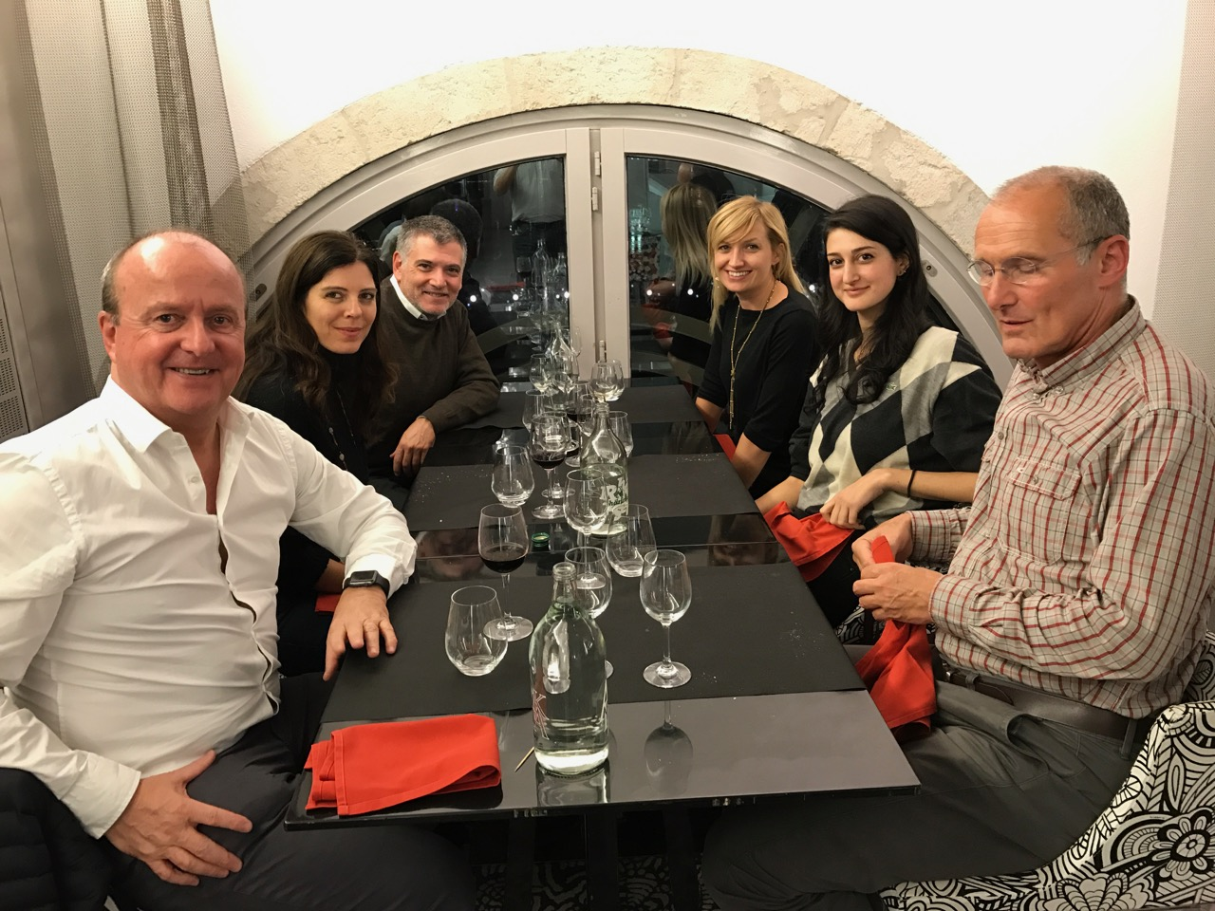
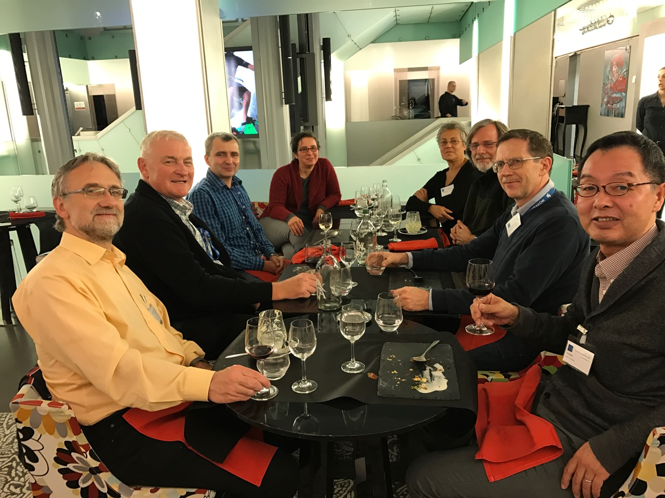
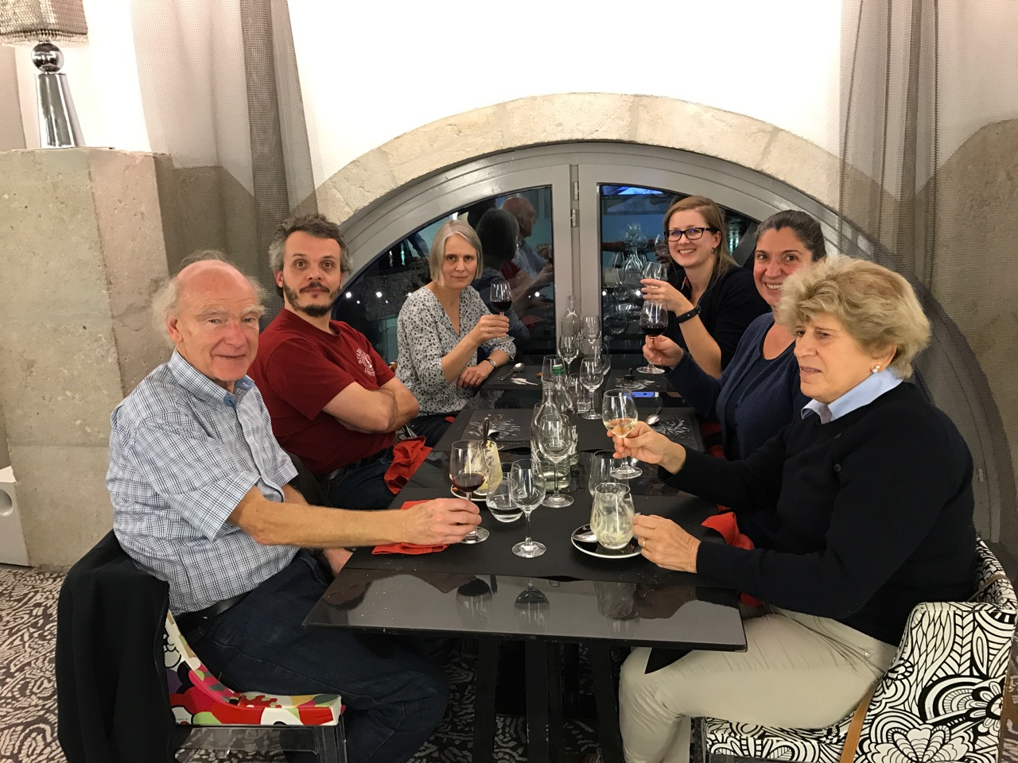
also intense at the Cité du Temps

Slide 4

IPPOG MoU
Collaboration will be considered starting when 10 Member have signed.
Today signed, or clear commitment to sign:
CH, D, I, F, FIN, N, NL, P, RO, S, SK
Will be achieved in few weeks form now!

Slide 5
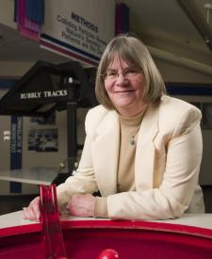
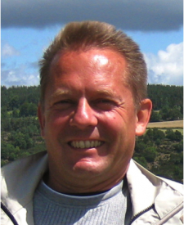

Thank you, Marge !
For wonderful support, dedication,
discussion, ideas, etc
during our time as co-chairs of IPPOG,
and the continuity we will enjoy with you
in your ongoing IPPOG engagement,
representing the US and in the IPPOG
speakers and publication committee.

Slide 6
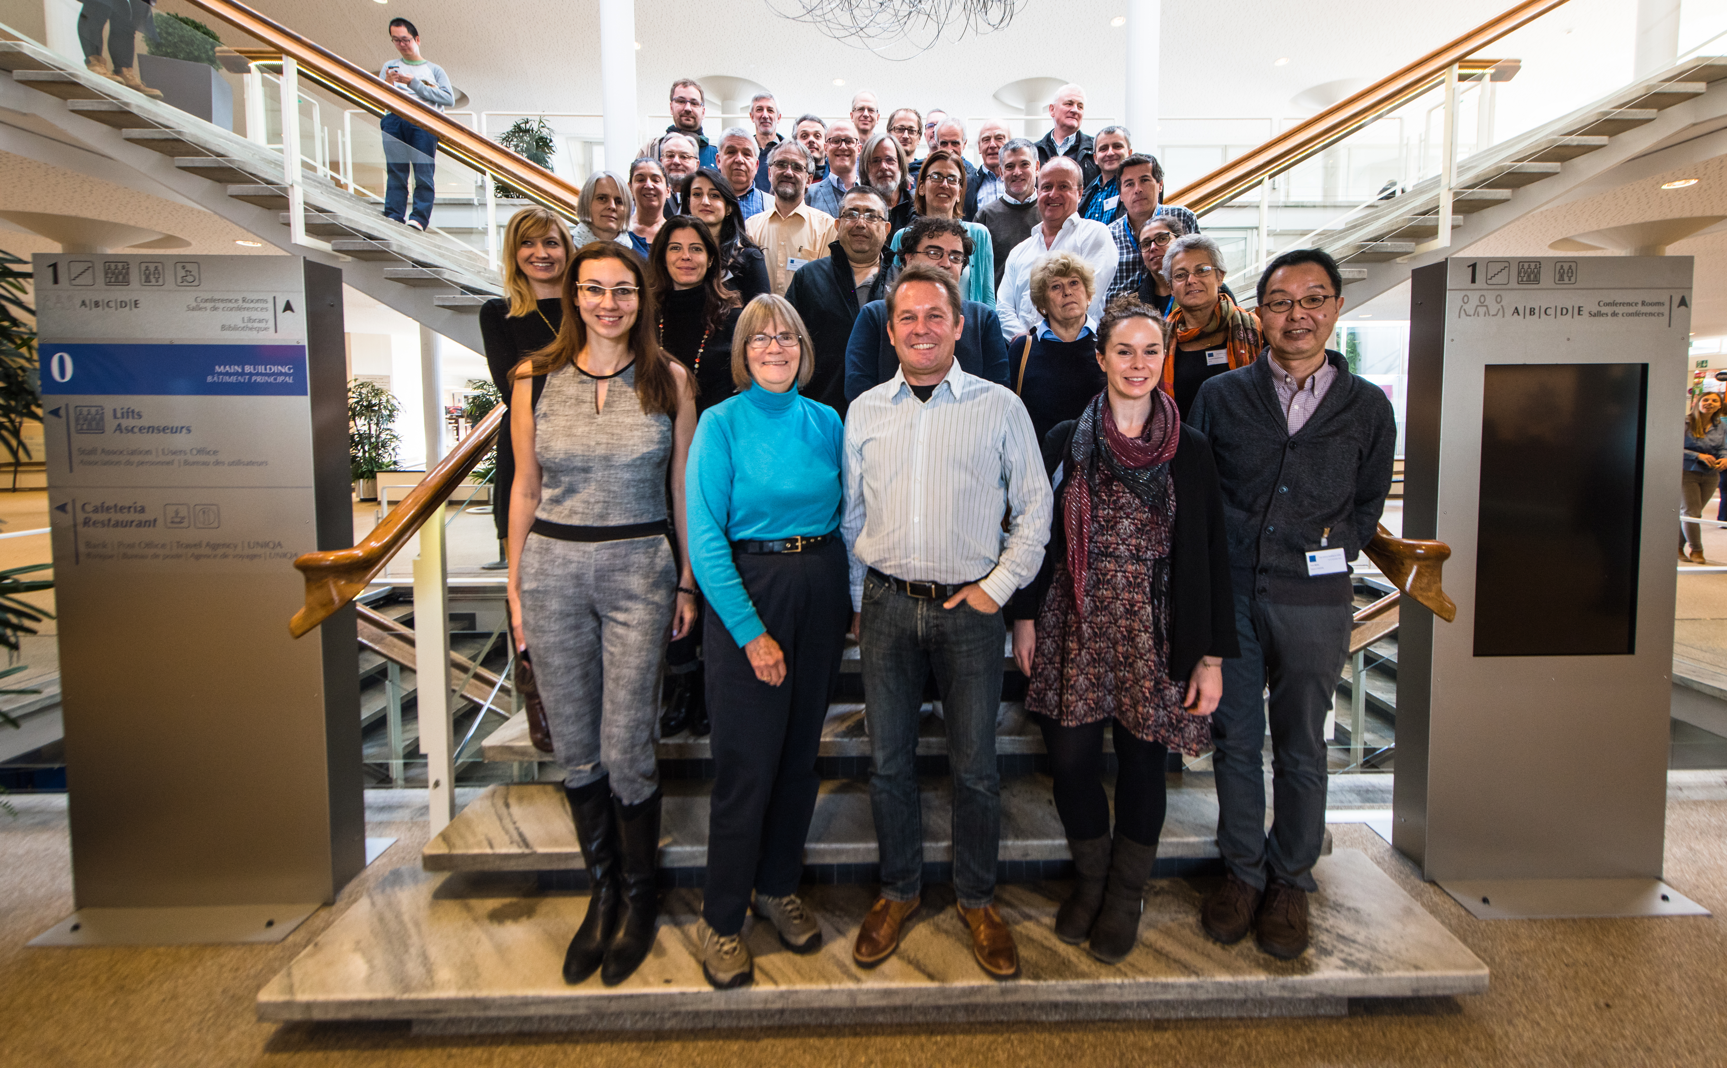
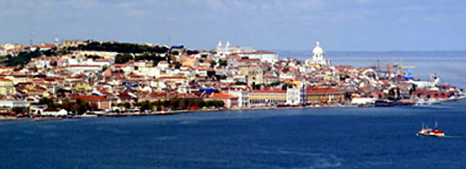
Looking forward
to seeing you all in in Lisbon
20-22 April 2017

