Slide 1

Baby MIND Detector Magnet System:
Status of Design, Manufacturing, Module Testing and System Integration
Gabriella Rolando, Philippe Benoit, Alexey Dudarev, Helder Pais Da Silva and Herman ten Kate
Baby MIND collaboration meeting 17 November 2016

Slide 2
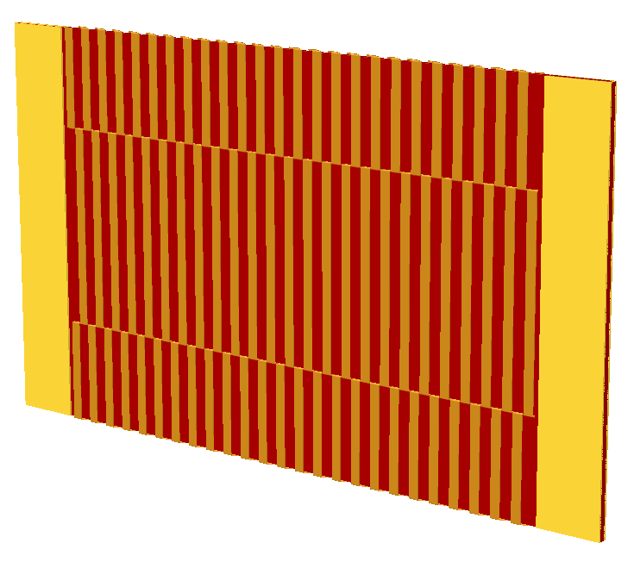
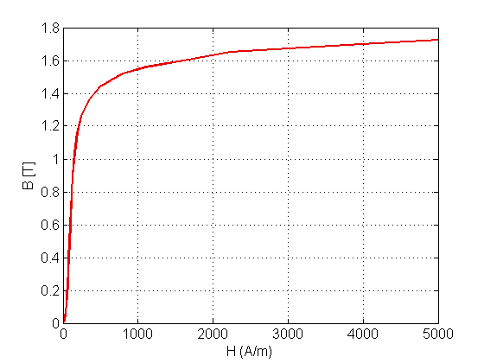
Magnetic design & material
33 main plates: 3.5 m x 2 m x 0.03 m
2 slits: 2.8 m x 1 cm
4 side plates per module: 32.5 cm x 2 m 10 mm
Optimal design for flux return independently from material choice and coil winding technique!
B = 1.5 T
The selected material is Armco
Based on literature properties, a 1.5 T homogenous B field requires 3 kA·m
H ~ 800 A/m

Slide 3
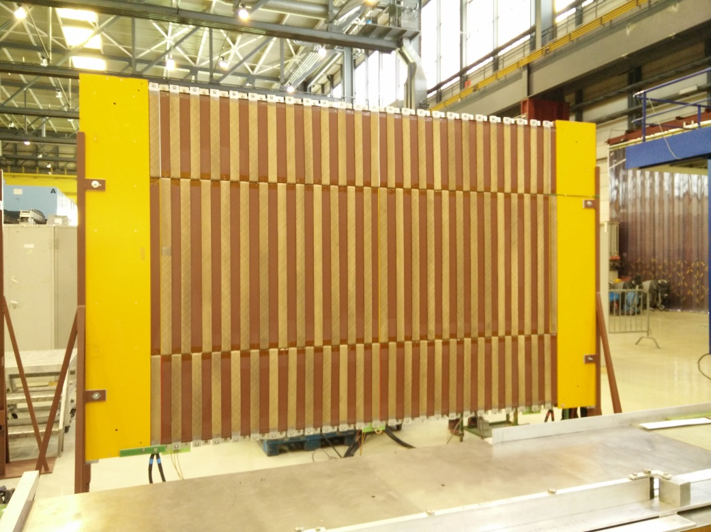
Coil winding - 1
Constraints
3 solenoids at the top, center and bottom of each plate
Winding on separate plates is practical, but bad for flux return
The welded terminals of the turns must be at the top or bottom of the plate to avoid damaging the insulation
Solution
Sewed coil design: the conductor is bent such as to pass through the slits and it is welded to the neighbor conductors at the top and bottom of the plate
The conductor is a 4 mm x 50 mm aluminum strip

Slide 4
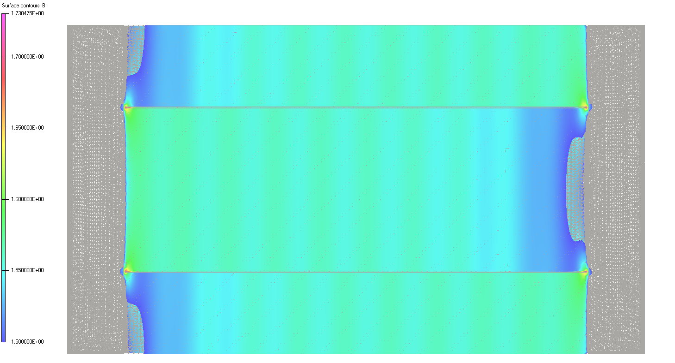
Coil winding - 2
In the sewed coil design the two halves of each turn are shifted
Single plates are effectively magnetized even with a low number of turns
Irregular field patterns originate in stacks of plates when the number of turns is low

Slide 5
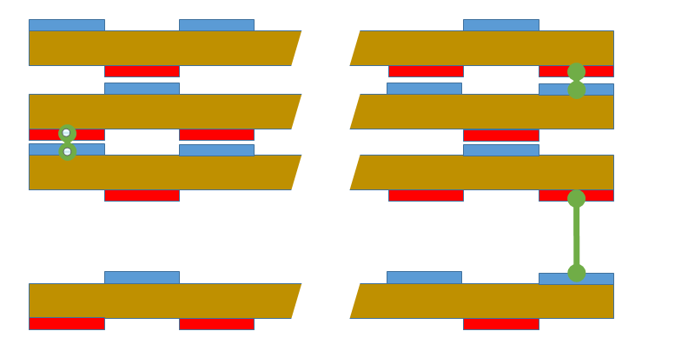
Coil winding - 3
The problem is solved by:
  Using a sufficiently high number of turns, i.e. 25 turns
  Powering the coil in stacked assemblies according to the scheme below
Negative current
Positive current
This layout also minimizes the length of the electric interconnections between plates.

Slide 6
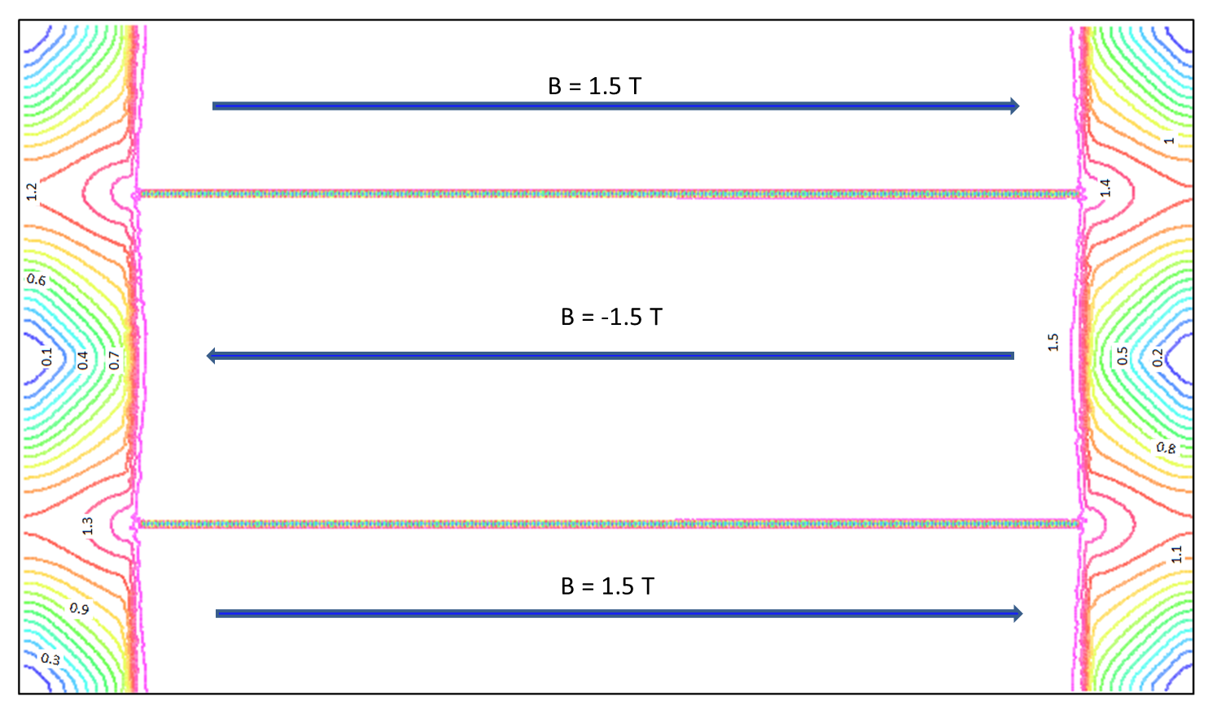
Magnetic field map - Bx
B_{x} in the outer plate of a stack of 3 plates

Slide 7
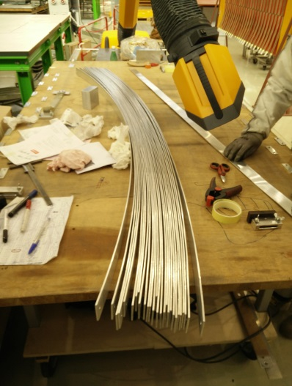
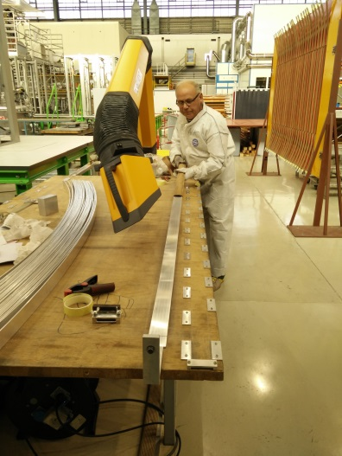
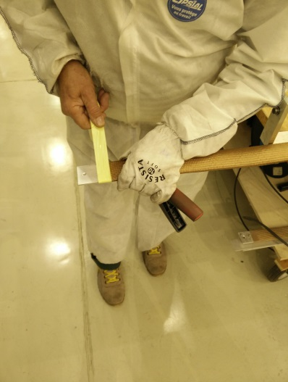
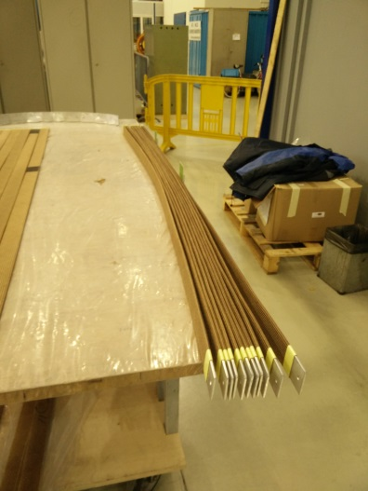
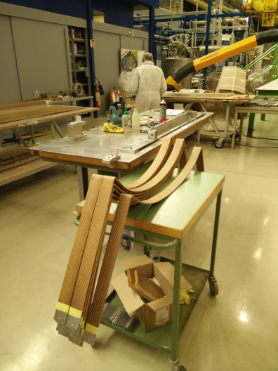
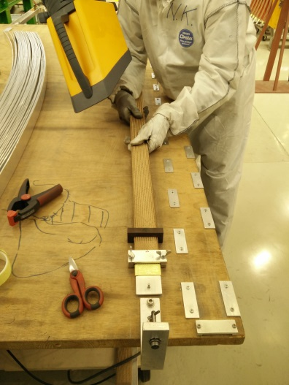
Conductor preparation
Cut the aluminum conductor spools in pieces of length equal to half turn
Install insulation tightly around the conductor
Pre-bend the conductor pieces
1
2
3
5
6
4

Slide 8
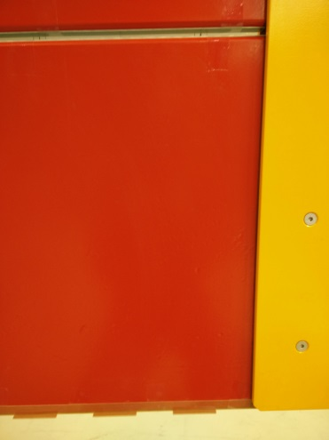
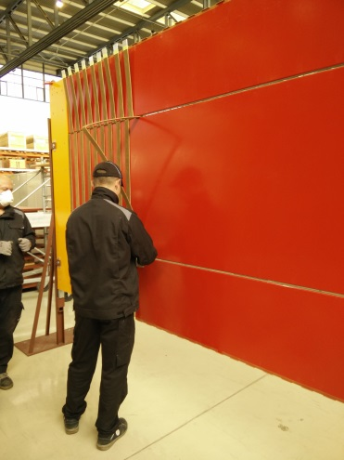
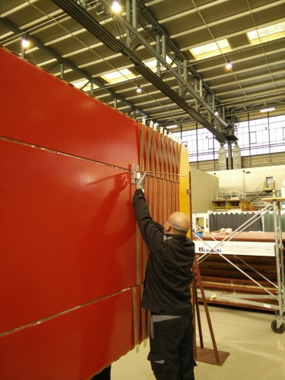
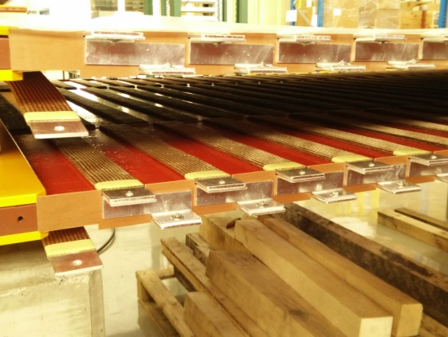
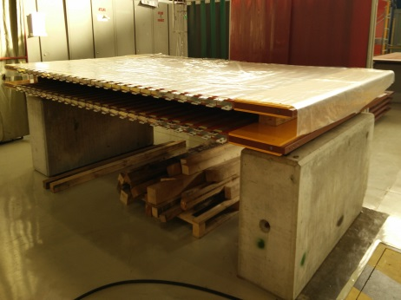
Magnet module assembly
Attach the side plates to the main plate
Place the plate in the vertical stand
Install insulation at the top/bottom of the plate and in the slits
Insert the pre-bent conductor piece in the slits
Fold back the conductor piece
Install the turn-to-turn Al linking elements at the top and bottom
Move the plate to horizontal position for welding
insulation
1
2
3
4
4
5

Slide 9
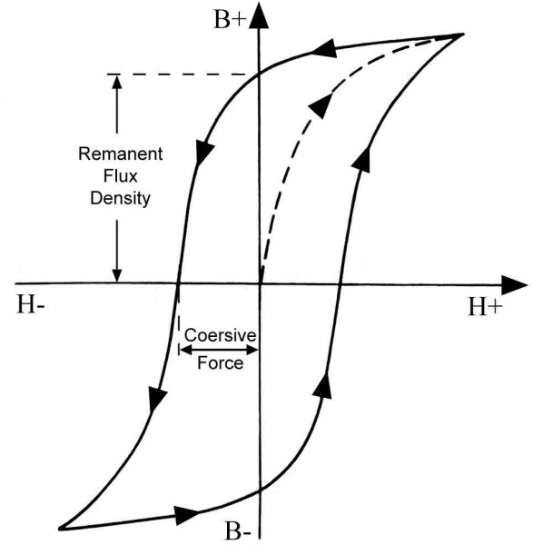
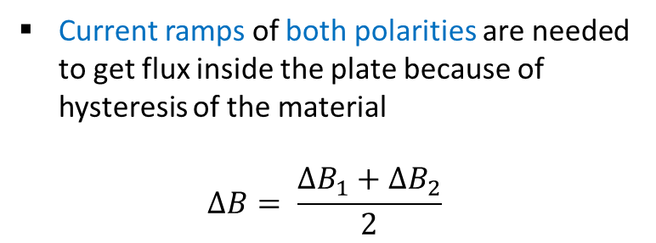
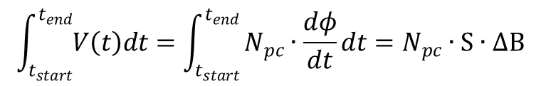
Magnet module test - 1
Magnetic field inside the Armco plates is measured via pick-up coils
Test consists in fast current ramps to get significant voltage signal (limited number of turns possible for pick-up coils)
$$\int_{t_{start}}^{t_{end}}{V\left(t\right)dt}=\int_{t_{start}}^{t_{end}}{N_{pc}∙\frac{dφ}{dt}dt}=N_{pc}∙S∙∆B$$
ΔB₁
ΔB
Current ramps of both polarities are needed to get flux inside the plate because of hysteresis of the material
$$∆B= \frac{{∆B}_{1}+{∆B}_{2}}{2}$$
ΔB₂

Slide 10

Magnet module test - 2
1st Armco plate
9 pick-up coils to check for flux homogeneity in the plate (PC 1-9)
1 pick-up coil in the center enclosing all 3 solenoids (PC10)
PC3
PC2
PC1
PC10
PC4
PC6
PC5
PC7
Successive plates
1 pick-up coil in the center enclosing all 3 solenoids (PC10)
PC9
PC8

Slide 11
1st Armco plate test
Field homogeneity
B [T] | Left | Middle | Right
Top | 1.52 | 1.55 | 1.50
Center | 1.50 | 1.54 | 1.49
Bottom | 1.52 | 1.55 | 1.50
I_{test} = 140 A
B ≥ 1.5 T everywhere in the plate
Field homogeneity ΔB < 5%
Armco B-I curve
Points are average of at least 10 ±I cycles
Error = ±σ
For I > 130 A, B ≥ 1.5 T
According to simulation I_{op} = 120 A

Slide 12
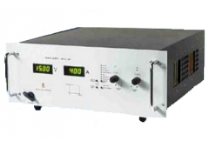
Operating current
Operating current is set to 140 A
  Ensure 1.5 T everywhere in the plate, including close to the side plates
  Take advantage of the maximum current delivered by power supply (Delta SM 45 - 140)
Coil resistance is about 16.5 mΩ per magnet module
  Voltage drop per magnet module is about 2.3 V
  2 power supplies are sufficient to power the Baby MIND coils
  Power dissipation is about 320 W per magnet module

Slide 13
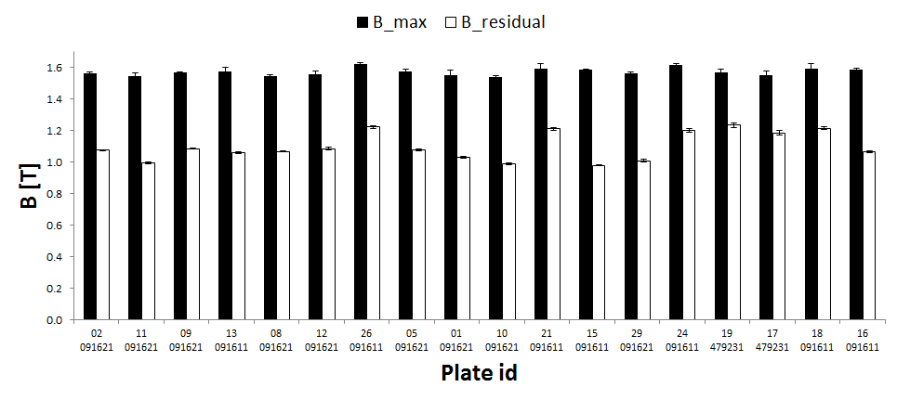
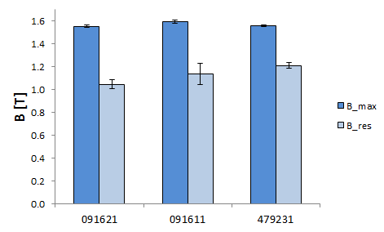
All Armco plates test
1.5 T
B_{mean} = 1.571± 0.023 T
Batch 091611 has on average better properties than batches 091621 and 479231
Plate Nr.
Batch Nr.

Slide 14
Conclusion
Magnet module assembly is proceeding well:
  Production rate is 2 modules per week
  18 modules are fully complete (assembled & welded)
  2 modules are assembled and waiting to be welded
  Production will be concluded by February 2017
2 Delta SM 45 -140 power supplies have been ordered
Magnet module test is also ongoing:
  Operating current is set to 140 A
  Power dissipation per module is about 320 W
  Some performance differences are noticeable between batches, but they are below requested field accuracy

