Slide 2

Dependability Analysis of a Quench Protection System for HL-LHC
Alejandro Fernandez Navarro
Inputs from Andrea Apollonio
TE-MPE-PE
27.10.2016
Dependability Analysis of a QPS
A. Fernandez

Slide 3
Outline
Motivation for dependability studies on QPS for HL-LHC
ClLIQ operating principle
Past FMEA study Vs. present Dependability study
FMEA of a CLIQ-based QPS for D1 of HL-LHC
Total CLIQ failure rate and price depending on redundancy level
Dependability analysis of a QPS for HL-LHC
Conclusions and next steps
Annex
Dependability Analysis of a QPS
A. Fernandez

Slide 4
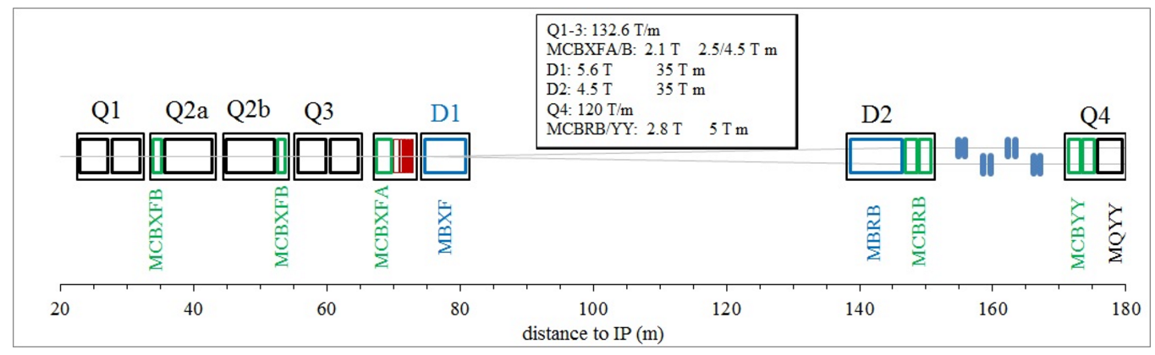
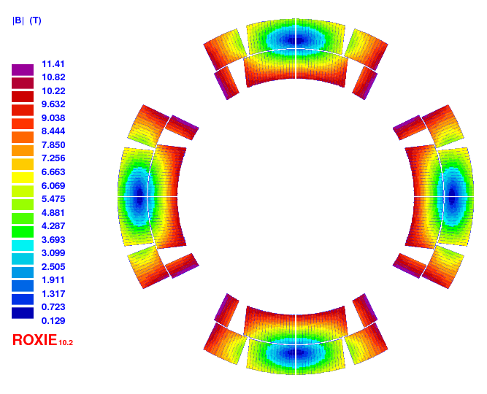
Motivation for dependability studies on QPS for HL-LHC
Separation Dipole
Inner Triplet chain
Insertion Region
New magnets with new superconducting materials (Nb3Sn)
New magnet protection technology (CLIQ)
Dependability Analysis of a QPS
A. Fernandez

Slide 5

CLIQ (Coupling-Loss Induced Quench)
Current change
Magnetic field change
Coupling losses (Heat)
Temperature rise
QUENCH
Dependability Analysis of a QPS
A. Fernandez

Slide 6
Past study Vs. Present study
Past study: FMEA of a CLIQ-based QPS for HL-LHC
Case of study: D1
Goal: To identify reliability problems in a CLIQ system and to assess the appropriate level of redundancy of the internal CLIQ components.
Method overview: Calculation of the Risk Priority Number (RPN) for the failure scenarios identified and suggest improvements.
RPN = Severity * Probability * Detectability; (Scaled from 1 to 10)
Severity: According to the hotspot temperature and maximum voltage to ground of the failure cases. Used TALES for electro-thermal simulations.
Probability: According to the failure rate of the failure modes. Failure rates for CLIQ components assessed with datasheets, inputs from experts, and Isograph Reliability Workbench (MIL-HDBK)
Detectability: Qualitative assessment of the implemented mechanisms of detection of the failure cases.
Dependability Analysis of a QPS
A. Fernandez

Slide 7
Past study Vs. Present study
Present study: Dependability analysis of a QPS for HL-LHC
Case of study: Hybrid CLIQ-QH QPS of the Inner Triplet chain
Goal: To identify reliability problems in a complex QPS (hybrid CLIQ-QH), propose improvements and to design the maintenance strategy.
Method overview: The availability study considers a repairable system that includes the monitoring systems for the QPS, quench events and technical stops. Three approaches have been implemented for a proof of concept model (one CLIQ unit on a generic magnet):
Analytical method (conservative): Product of probabilities of CLIQ failure and quench.
Reliability Block Diagram: Implemented on Isograph Availability Workbench (IAW).
Markov model: Solved with ode23 in Matlab and implemented on Isograph Reliability Workbench (IRW).
Dependability Analysis of a QPS
A. Fernandez

Slide 8
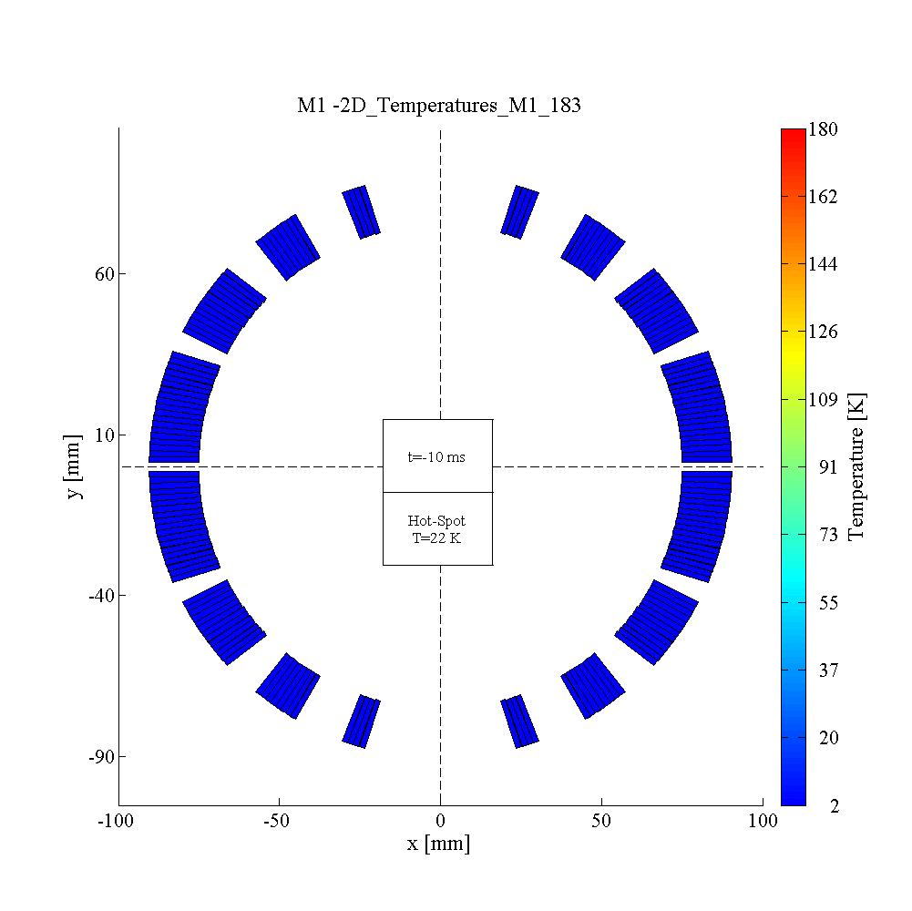
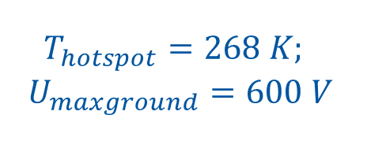
FMEA of a CLIQ-based QPS for D1 of HL-LHC
Magnet protection scheme and performance
CLIQ connection scheme: redundant system composed of two CLIQ units of 600 V/ 40 mF
CLIQ discharge, nominal performance at 13 kA.
(TALES simulation)
$$T_{hotspot}=268 K;$$
$$U_{maxground}=600 V$$
Dependability Analysis of a QPS
A. Fernandez

Slide 9
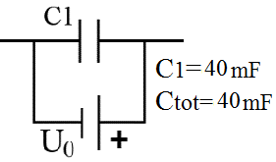
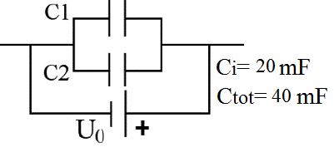
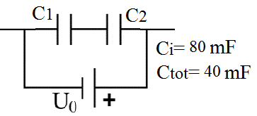
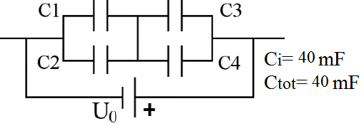
FMEA of a CLIQ-based QPS for D1 of HL-LHC
TALES simulations to assess severity
Main failure scenarios for different capacitor bank configurations
Dependability Analysis of a QPS
A. Fernandez

Slide 10
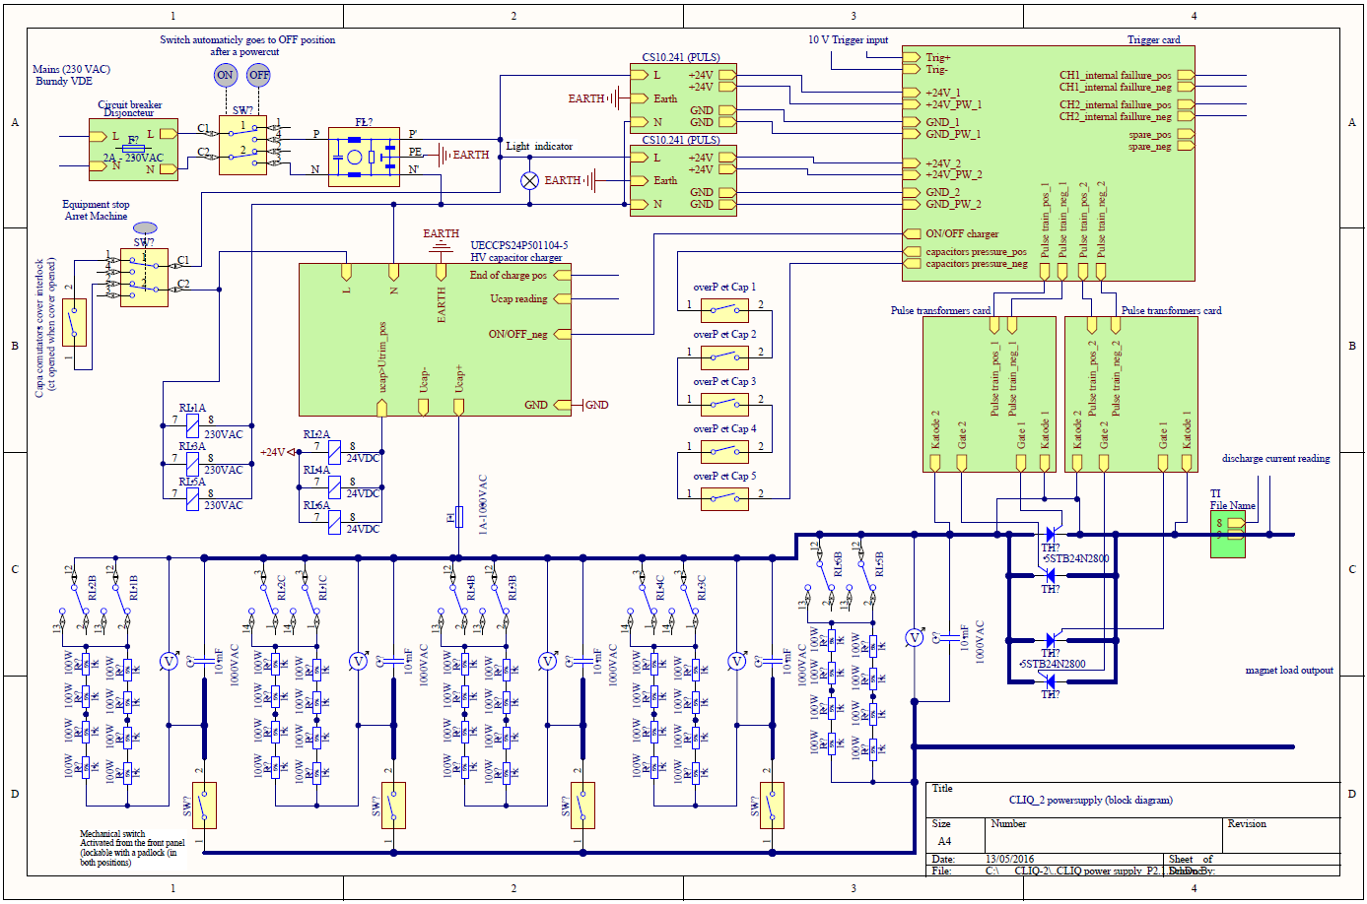
FMEA of a CLIQ-based QPS for D1 of HL-LHC
Study of the circuit schematic of a CLIQ unit to calculate failure rates
TC power supply
Redundant power supply (?)
Trigger card
Redundant circuit (?)
Capacitor charger
Pulse transformer
Redundant transformer (?)
Capacitor bank
(1,2 parallel/series,4?)
Bi-directional thyristor
Redundant thyristor (?)
Courtesy of Joaquim Mourao
Dependability Analysis of a QPS
A. Fernandez

Slide 11
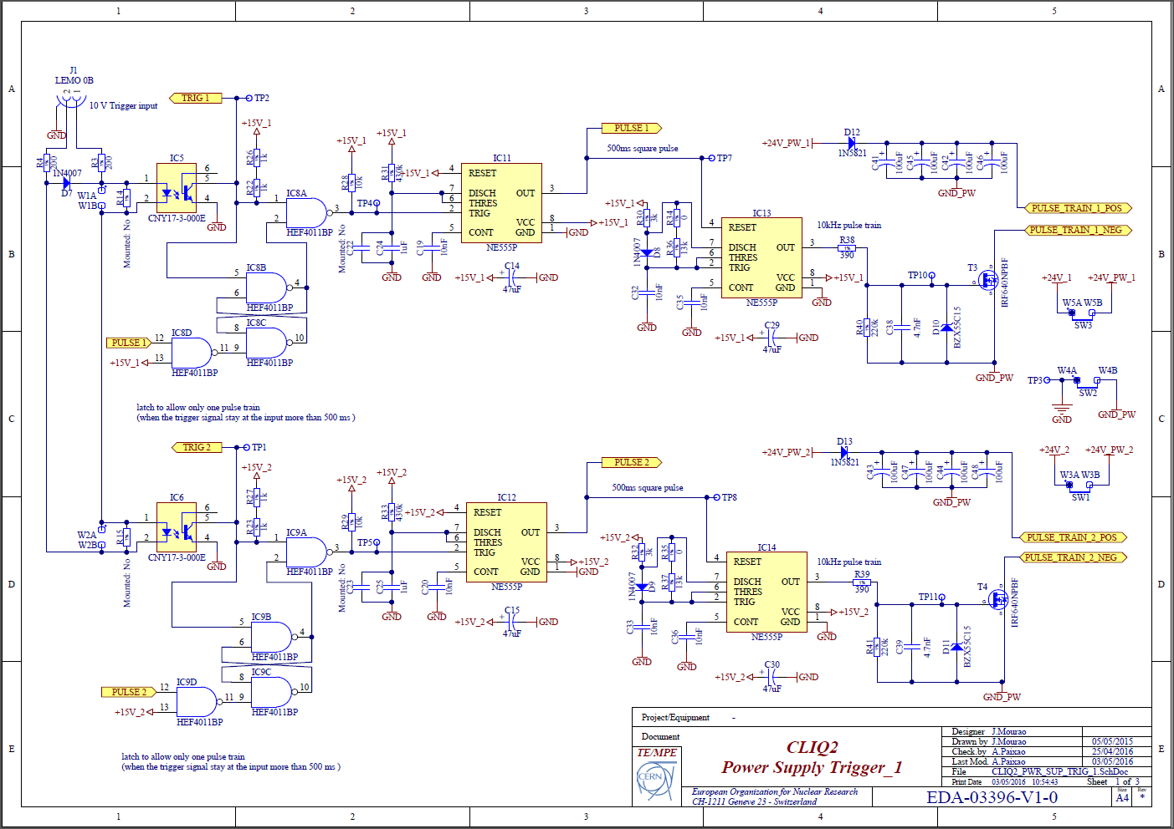
Example of calculation of failure rates: trigger card
FMEA of a CLIQ-based QPS for D1 of HL-LHC
Courtesy of Joaquim Mourao
Dependability Analysis of a QPS
A. Fernandez

Slide 12
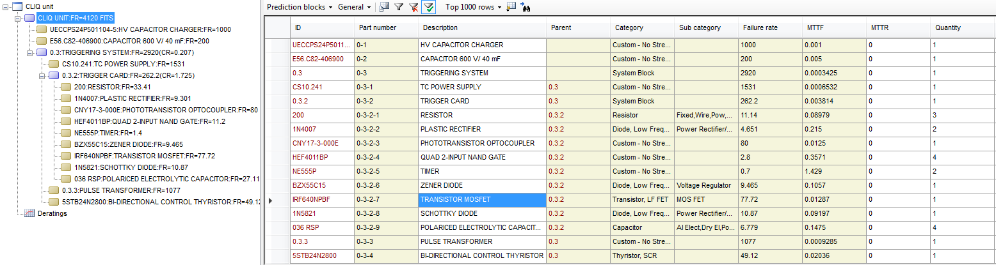
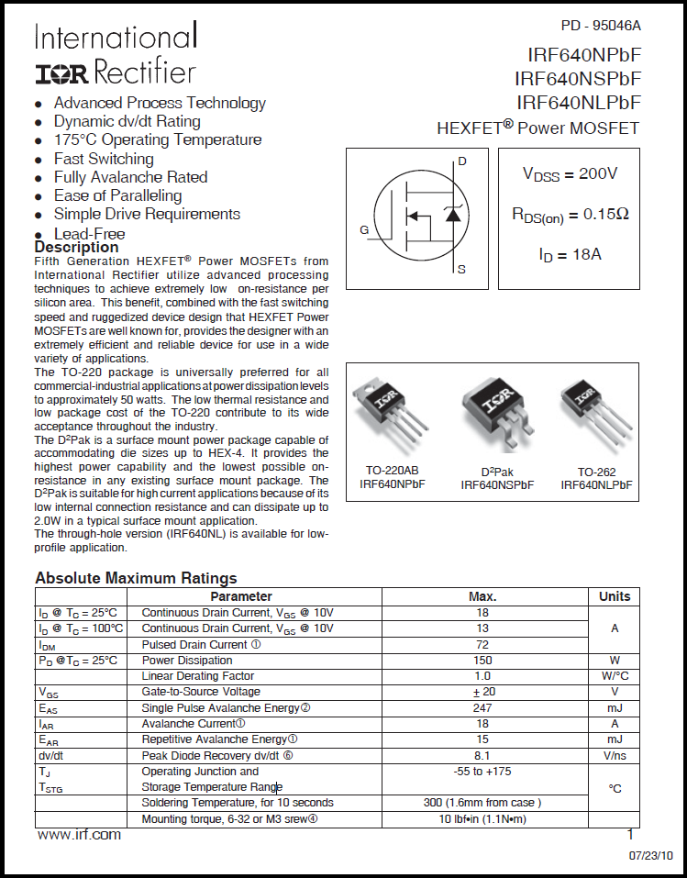
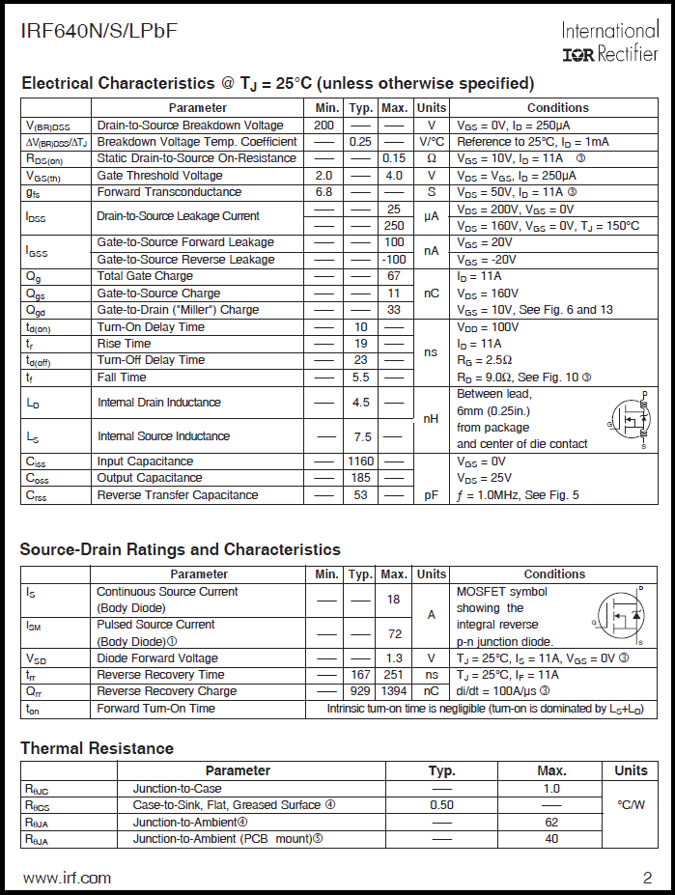
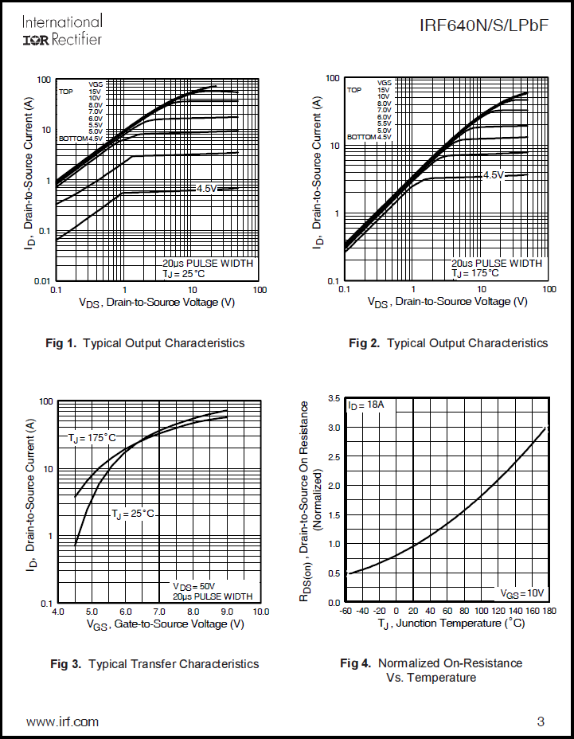
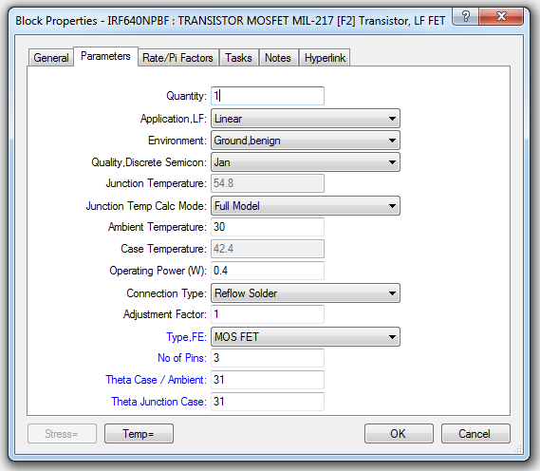
Example of calculation of failure rates with Isograph Reliability Workbench (MIL-HDBK-217F): Transistor Mosfet
FMEA of a CLIQ-based QPS for D1 of HL-LHC
Dependability Analysis of a QPS
A. Fernandez

Slide 13
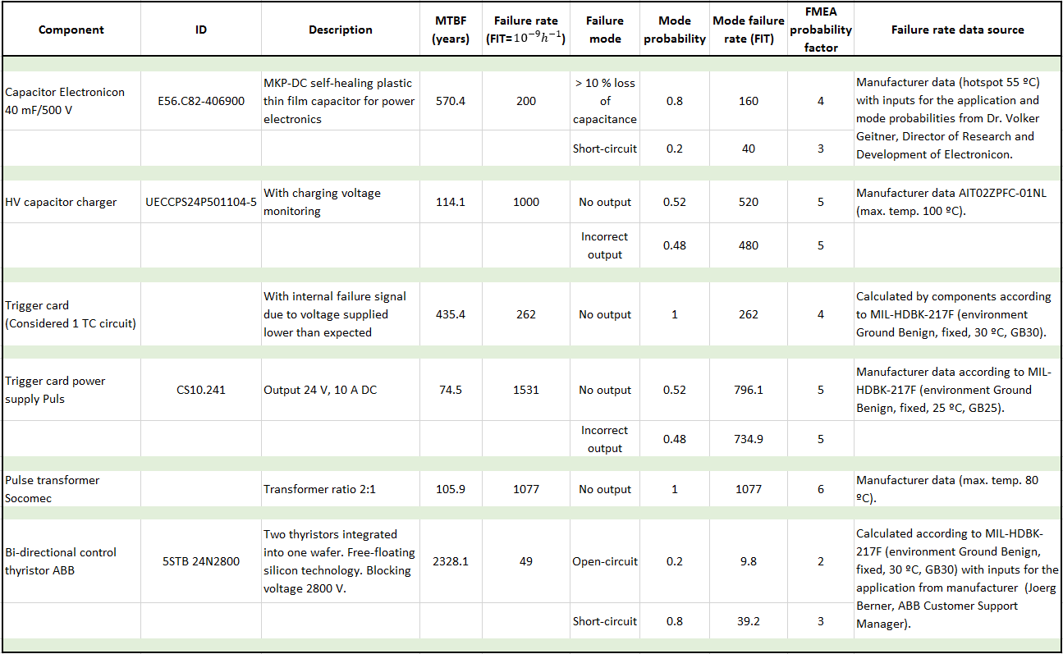
FMEA of a CLIQ-based QPS for D1 of HL-LHC
Failure rates and failure modes for the CLIQ components
Dependability Analysis of a QPS
A. Fernandez

Slide 14

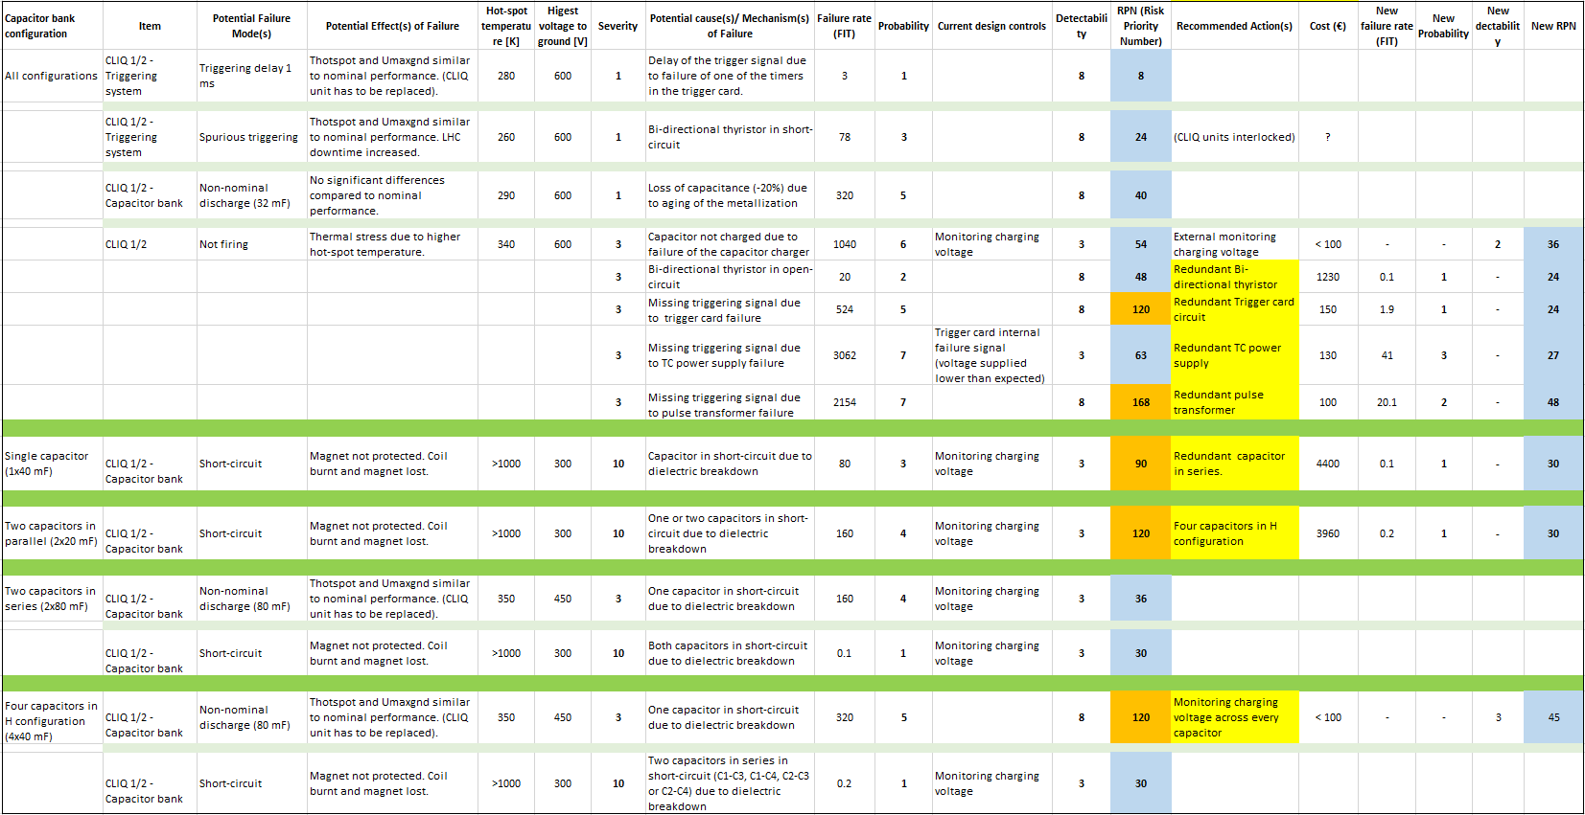
FMEA of a CLIQ-based QPS for D1 of HL-LHC
FMEA study summary
Dependability Analysis of a QPS
A. Fernandez

Slide 15
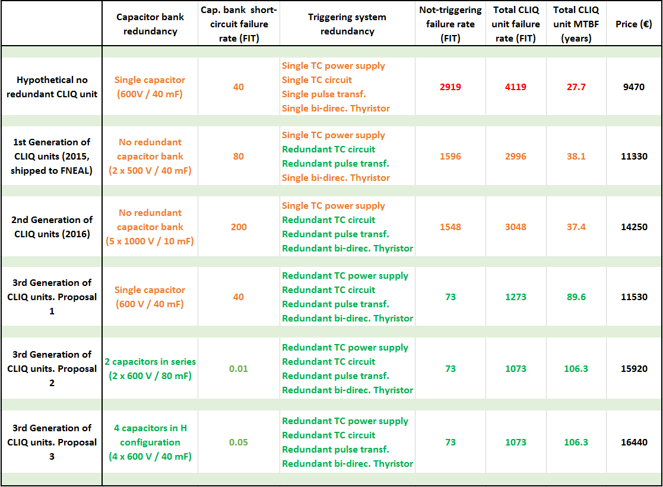
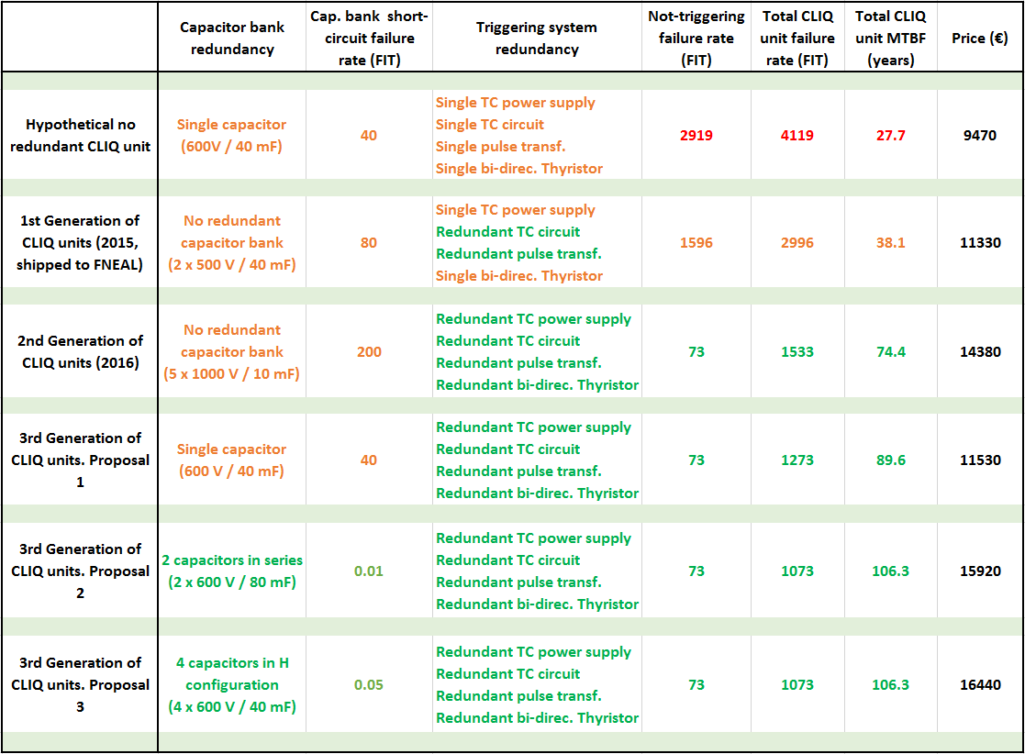
Total CLIQ failure rate and price depending on redundancy level
(The series production of the CLIQ units will significantly reduce these estimated prices)
Other considerations taken into account for the final decision, like possible open-circuit failures in connection points
Dependability Analysis of a QPS
A. Fernandez

Slide 16
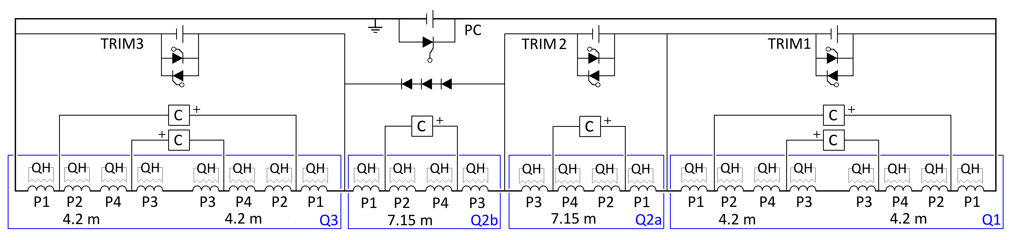
Case of study: Hybrid CLIQ-QH QPS of the Inner Triplet chain
Dependability analysis of a QPS for HL-LHC
Triplets baseline protection: hybrid CLIQ-QH Quench Protection System
Proof of concept: One CLIQ unit attached to a superconducting magnet
Dependability Analysis of a QPS
A. Fernandez

Slide 17

Proof of concept: Assumptions and input parameters
Dependability analysis of a QPS for HL-LHC
Assumptions
No monitoring system and no technical stops considered
Inspection time: $t_{i}$=1 year (8766 h)
Dependability Analysis of a QPS
A. Fernandez

Slide 18
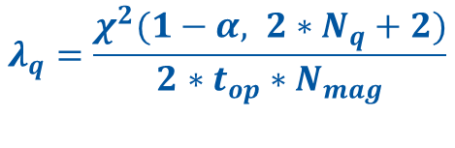
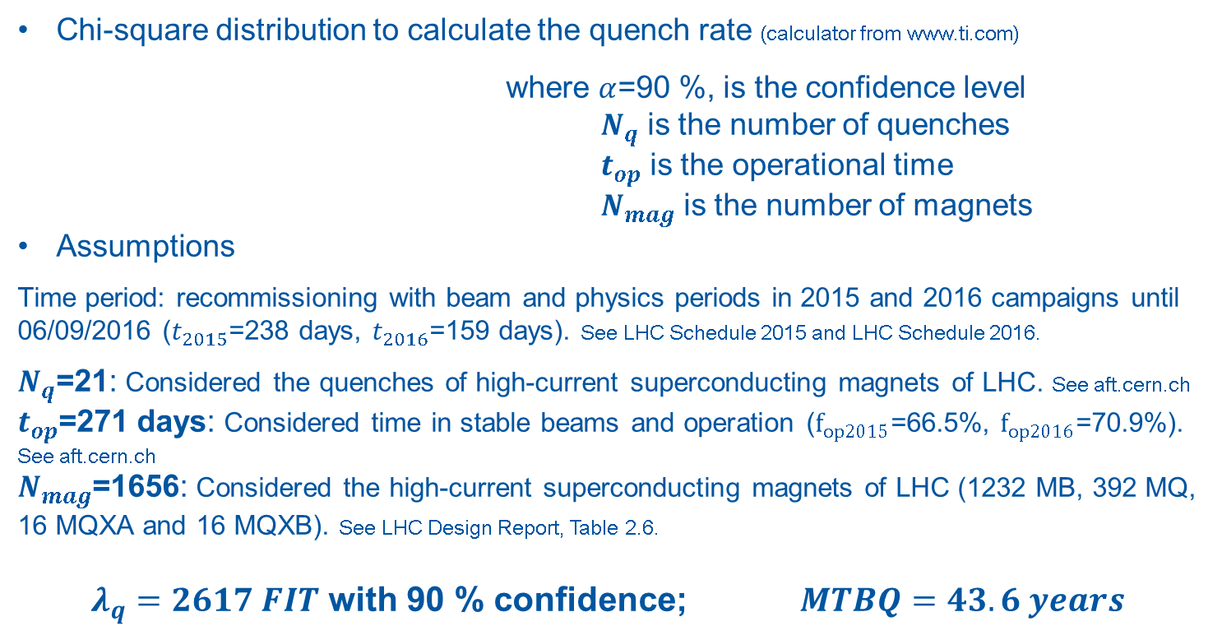
Quench rate calculation
Dependability analysis of a QPS for HL-LHC
Chi-square distribution to calculate the quench rate (calculator from www.ti.com)
where $α$=90 %, is the confidence level
$N_{q}$ is the number of quenches
$t_{op}$ is the operational time
$N_{mag}$ is the number of magnets
Assumptions
Time period: recommissioning with beam and physics periods in 2015 and 2016 campaigns until 06/09/2016 ($t_{2015}$=238 days, $t_{2016}$=159 days). See LHC Schedule 2015 and LHC Schedule 2016.
$N_{q}$=21: Considered the quenches of high-current superconducting magnets of LHC. See aft.cern.ch
$t_{op}$=271 days: Considered time in stable beams and operation ($f_{op2015}$=66.5%, $f_{op2016}$=70.9%). See aft.cern.ch
$N_{mag}$=1656: Considered the high-current superconducting magnets of LHC (1232 MB, 392 MQ, 16 MQXA and 16 MQXB). See LHC Design Report, Table 2.6.
$λ_{q}=2617 FIT$ with 90 % confidence; $MTBQ=43.6 years$
$$λ_{q}=\frac{χ^{2}(1−α, 2∗N_{q}+2)}{2∗t_{op}∗N_{mag}}$$
Dependability Analysis of a QPS
A. Fernandez

Slide 19
Dependability analysis of a QPS for HL-LHC
Analytical approach
Unreliability: Probability of main failure
Defined as the product of probabilities of QPS failure and quench until the inspection time.
Conservative assumption: Neglected order of events (QPS failure-quench)
$$F=F_{QPS}∗F_{quench}=\left(1−e^{−λ_{QPS}∗t_{i}}\right)∗\left(1−e^{−λ_{quench}∗t_{i}}\right)$$
Dependability Analysis of a QPS
A. Fernandez

Slide 20
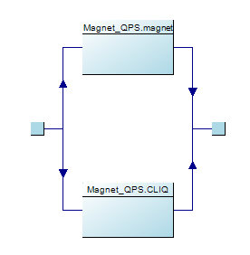
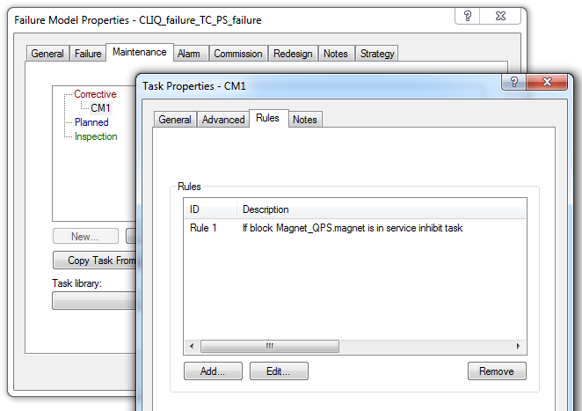
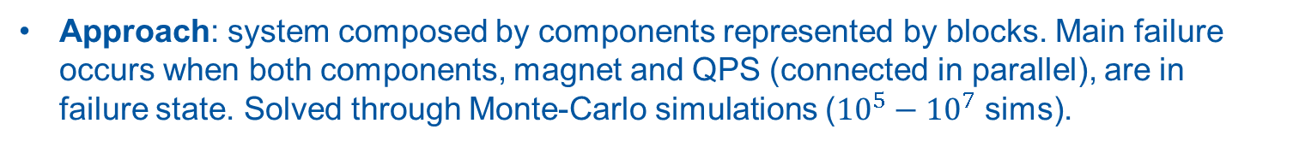
Reliability Block Diagram in Isograph Availability Workbench
Dependability analysis of a QPS for HL-LHC
Approach: system composed by components represented by blocks. Main failure occurs when both components, magnet and QPS (connected in parallel), are in failure state. Solved through Monte-Carlo simulations (${10}^{5}−{10}^{7}$ sims).
Model settings
Dependability Analysis of a QPS
A. Fernandez

Slide 21
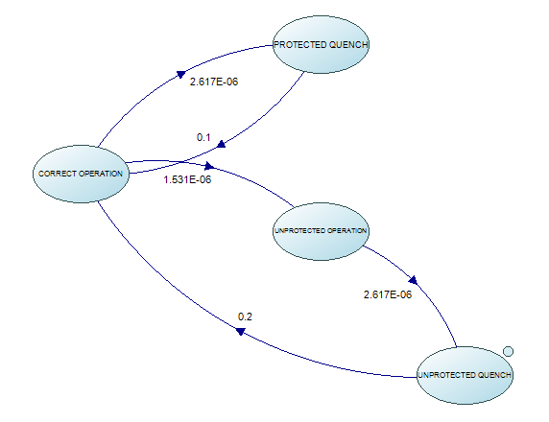

Dependability analysis of a QPS for HL-LHC
Markov model in Isograph Reliability Workbench
Approach: system composed by states (instead of components). Transitions among states defined by the failure/quench rates and repair rates.
Calculation method: Differential equilibrium equations are defined for every state:
$$\frac{dP_{o}\left(t\right)}{dt}=−\left(λ_{q}+λ_{c}\right)P_{o}\left(t\right)+μ_{q}P_{q}\left(t\right)+μ_{c}P_{c}\left(t\right)+μ_{cq}P_{cq}(t)$$
$$\frac{dP_{q}\left(t\right)}{dt}=λ_{q}P_{o}\left(t\right)−μ_{q}P_{q}\left(t\right)$$
$$\frac{dP_{c}\left(t\right)}{dt}=λ_{c}P_{o}\left(t\right)−(μ_{c}+λ_{q})P_{c}\left(t\right)$$
$$\frac{dP_{cq}\left(t\right)}{dt}=λ_{q}P_{c}\left(t\right)−μ_{cq}P_{cq}\left(t\right)$$
0
0
Limitation: only constant failure rates (not relevant for this study)
Dependability Analysis of a QPS
A. Fernandez

Slide 22
Comparison of results
Dependability analysis of a QPS for HL-LHC
Results are coherent!
RBD and Markov models in Isograph validated against the analytical models
Dependability Analysis of a QPS
A. Fernandez

Slide 23
Conclusions
RBD and Markov models in Isograph validated against the analytical models.
Marcov model has been chosen for dependability analysis of QPS due to a number of reasons: Intuitive and simple model construction (graphically self-explained), flexibility to model more complex systems, simulation time much lower than the RBD model (1 s instead of 2.5 min).
Next steps
Proof of concept of Marcov model with monitoring system and technical stops.
Failure rate calculation for QH technology (heater strips, power supplies, connection points).
Implementation of the Marcov model to the Inner Triplet QPS.
Dependability Analysis of a QPS
A. Fernandez

Slide 24
Annex
Dependability Analysis of a QPS
A. Fernandez

Slide 25
General failure scenarios
Triggering delay of 1 ms of one CLIQ unit with respect to the other
Spurious triggering of one CLIQ unit
One CLIQ unit not firing
Specific failure scenarios
Non-nominal discharge due to one/several capacitors in open/short circuit (depending on the capacitor bank configuration)
Short-circuit of the capacitor bank of one CLIQ unit
FMEA of a CLIQ-based protection of D1
A. Fernandez

