Slide 1



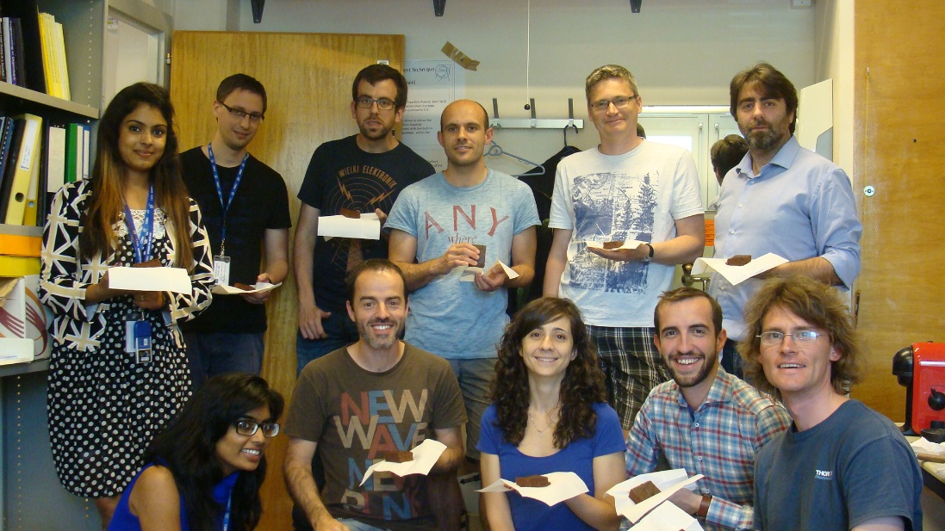
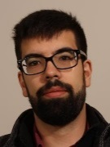
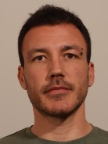
EP-DT-DD: SSD-Solid State Detectors
EP-DT-DD Meeting – 13.10.2016
R&D: Development of radiation tolerant silicon detectors
in the framework of RD50 and CMS
Service: Characterization of semiconductor detectors
PhD students:
Sofia OTERO UGOBONO
Esteban Curras Rivera
Hannes Neugebauer
Laura Franconi
Short term visitors
(in period 7-10.2016):
Rogelio Palomo (1m)
(ES, University Seville)
Geetika Jain (2m)
Delhi University
Visiting Scientist:
Marcos Fernandez [1 FTE]
Sebastian White [0.25 FTE]
Fellows
Julio Calvo Pinto (1FTE)
Trainees:
Joaquin Gonzalez (0.5 FTE)
Isidro Mateu Suau (0.5 FTE)
Pedro Almeira (1 FTE)
CERN Staff
Michael Moll (0.6 FTE)
The team (CERN & visitors):
Urban
Isidro
Michael
thesis writing
Sebastian
Esteban
Joaquin
Shivika
Marcos
Julien
Hannes
Bhavita
Laura
Left SSD since July 2016:
4 Summer Students
Ayushi Jain, Bhavita Modi, Shivika Chhabra, Urban Senica
Pedro
Julio
Sofia
….no dedicated technician!

Slide 2
Present Projects and Services
SSD activities at CERN
RD50 Collaboration
  Steering and Management of the RD50 collaboration (50 Institutes, 300 members)
    Michael: Co-Spokesperson, budget holder, CERN Contact, Glimos; Veronique: secretary
  Characterization and simulation of radiation effects in silicon devices
    Development of characterization tools (TSC, edge-TCT, Two-Photon TCT, …)
    Measure damage parameter (CV,IV, CCE, TCT) and defect properties (TSC, I-DLTS)
    Simulate detector performance (TCAD, TRACS)
    Defect/Material engineering: p/n-type, different resistivity, impurities,…
  LGAD (Low Gain Avalanche Detectors) and APDs (Avalanche Particle Detectors)
    Fast timing applications
    Charge amplification in highly damaged detectors
  3D detectors, CMOS sensors, …
CMS Collaboration & RD50
  Sensor development for the High Granularity Calorimeter (HGC)
Service
  Measurement of sensors for/with external groups
….its all about silicon sensors
and their application as HEP detector.
Disclaimer: In following I point out
“SSD project leaders”
(not the full project teams)!

Slide 3
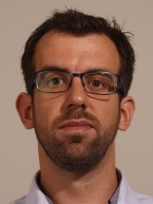
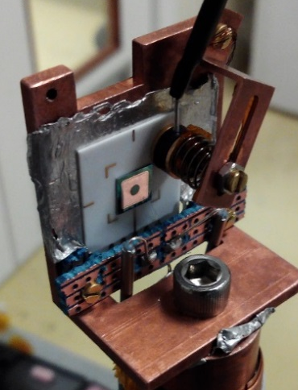
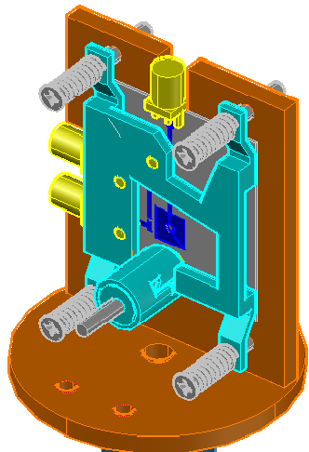
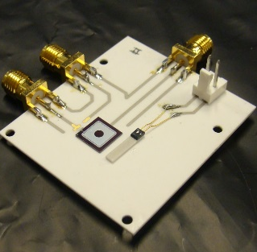
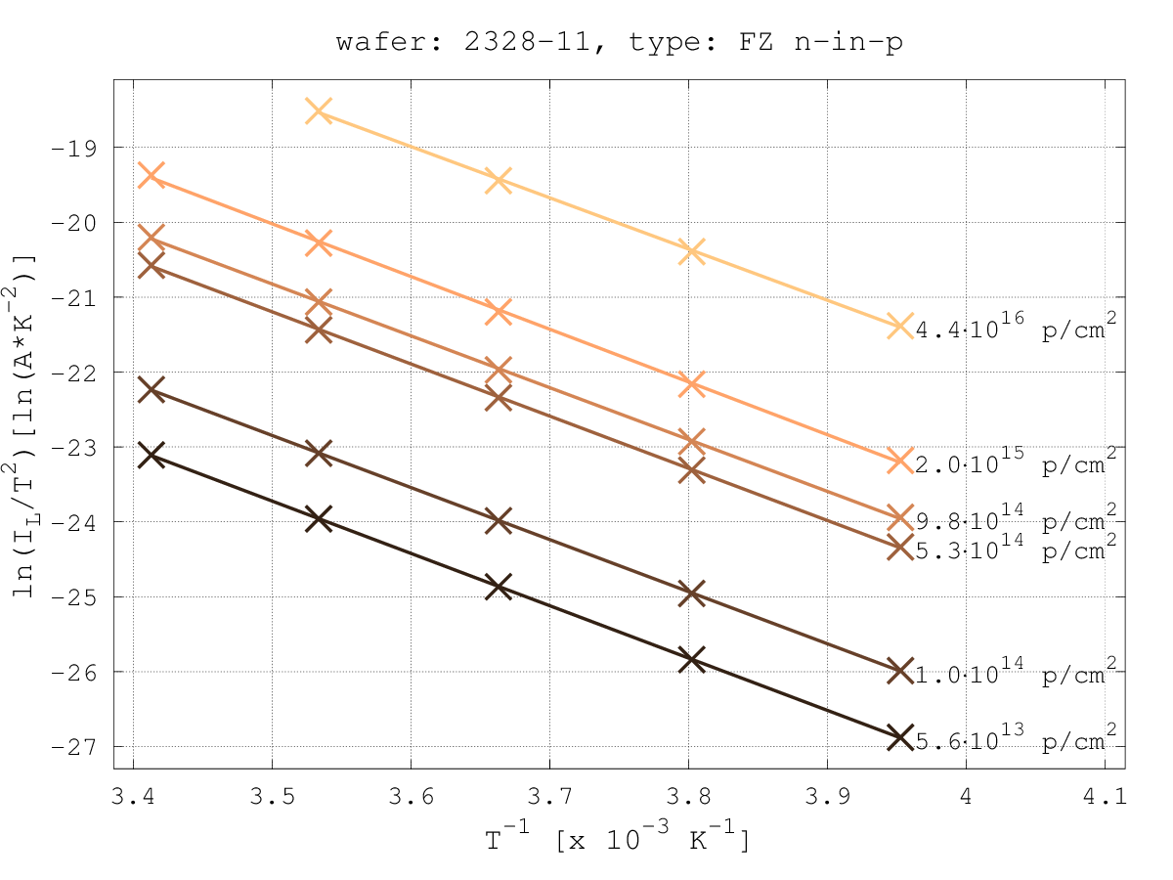
Damage & defect parameterization
Lab infrastructure improvements
  Optimization of cryocooler for more accurate temperature reading during temperature scan (20K to 240K in 20min)
    Production of new ceramic PCB (MPT Workshop: Antonio, Rui) & validation in TCT
    Re-design of the mechanical support and connections to reduce thermal loads
    Multi-pin feedthrough installed ➔ injection of carriers using an LED (Collaboration with Manchester University)
    Better readout configuration ➔ Resolution improved to 100 fA
  Addition of functionalities in the controlled temperature chamber (Susi)
    Automatic I-V measurements at different temperature steps, I-T measurements, C-V measurements (in test phase)
Study on leakage current temperature dependence
  Evaluation of activation energy for silicon (work with IRRAD team)
    Wide range of temperature scaling values published in literature
    A value of Ea = 1.20 eV was obtained by our work in agreement of theoretical predictions with midgap defect level
From proof of concept to mechanical design + production of ceramic PCB
Details: RD50 workshop 6/2016: Isidre for T-scaling of leakage current [link]

Slide 4
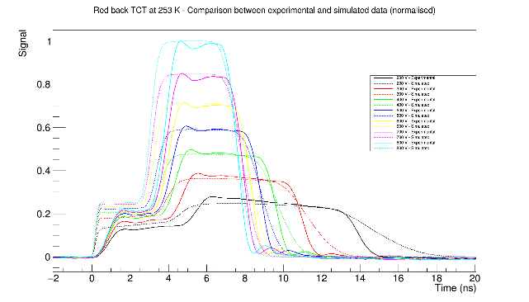
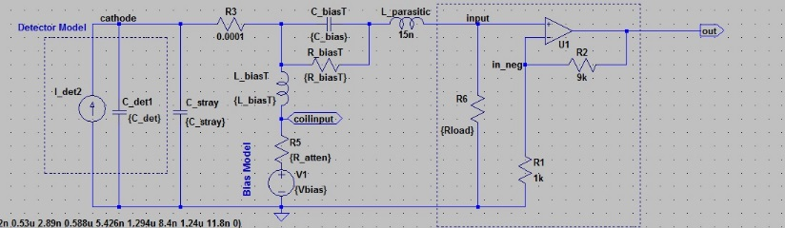
Sensors with intrinsic gain
LGAD (Low Gain Avalanche Detectors) [Ultrafast Silicon Detectors – UFSD]
  RD50 collaboration (several institutions); producer CNM and FBK, soon: HPK
  Experiments considering LGAD as option: ATLAS HGT, CMS fast (hermetic) timing, CTPPS
  SSD: Study of gain homogeneity and gain loss after proton irradiation
  Ongoing: TCAD modelling of devices
    Tuning of input parameters (TCAD) and readout chain (spice) using non-irradiated devices
    Test beam of RD50 (no direct SSD involvement):
      50μm sensors of 1.4 mm² size (reaching 26ps)
      N = number of sensors used for experiment
gain approx. 5 before irradiation
..writing publication
Details: RD50 workshop 6/2016: Sofia for LGAD [link], Michael for DD-APD [link]

Slide 5
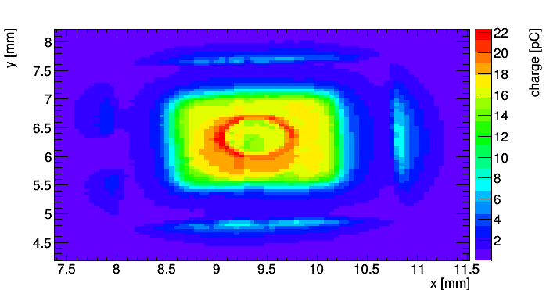
Sensors with intrinsic gain
DD-APD (Deep Diffused Avalanche Particle Detectors) [Hyperfast Detectors]
  Collaboration with some US CMS groups and producer RMD in the US
  Test beams in collaboration with RD51
    Time resolution obtained (non-irradiated): ≤ 20ps
  Homogeneity of response testing in SSD lab and test beam
  Next step: Testing of irradiated devices
    Neutron irradiated DDAD arrived at CERN last week
  Ongoing:
    Unpackaged devices supplied by producer RMD
    New packaging of devices with mesh (150 μm mesh on 50 μm Kapton)
    TCAD simulation of signal [optimization of design parameters]
    Design of transimpedance amplifier (Si-Ge)
^{- 8x8mm2}
^{- 1800V}
σ = 21ps
Details: RD50 workshop 6/2016: Sofia for LGAD [link], Michael for DD-APD [link]

Slide 6
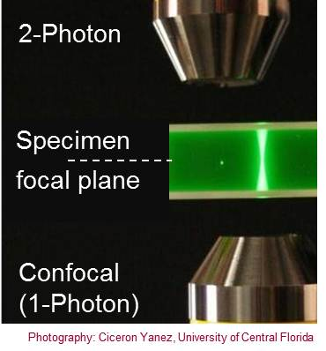
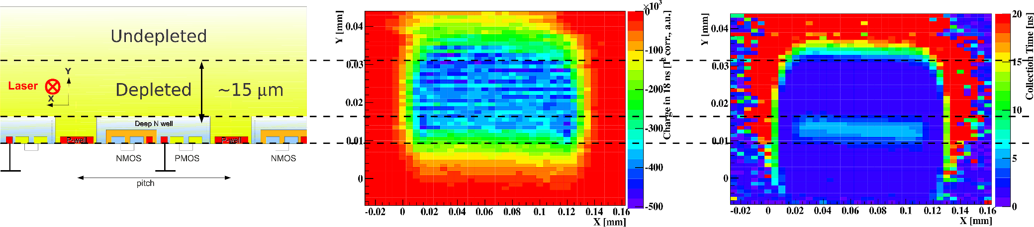
TPA – Two Photon Absorption
Two Photon absorption:
Investigation on a new technique
for sensor characterization (TPA – TCT)
  Deposition of charge at specific position in detector
  Laser: λ ∼ 1300 nm; P ∼ 50-100 pJ; ΔT ∼ 240 fs
  Proof of principle presented last LHCC
  Example of application:
    HVCMOS sensors (AMS 180nm), 10 ohmcm
    100μm x 100 μm passive pixel, measured at 80V, 20°C
[M.Fernandez-Garcia et al, VCI 2016, Feb.2016]
To be presented on KT innovation day (Tomorrow)
    Map of charge
    collected within 10ns
    Map of collection time
    needed to get 98% of charge
    Sketch of HVCMOS sensor

Slide 7
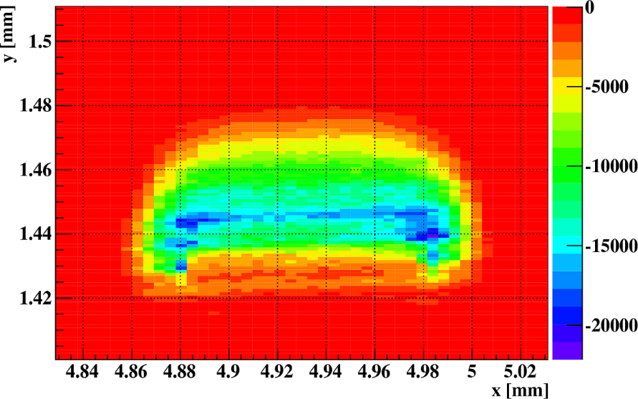
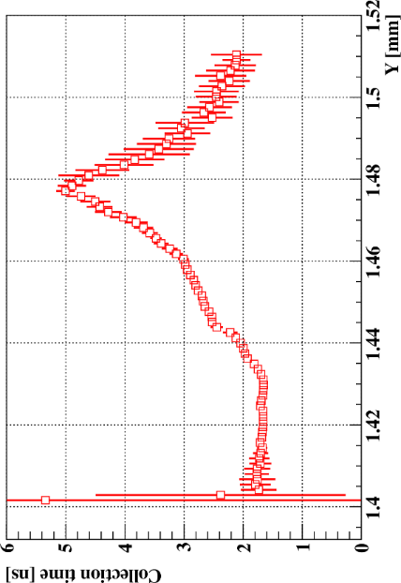
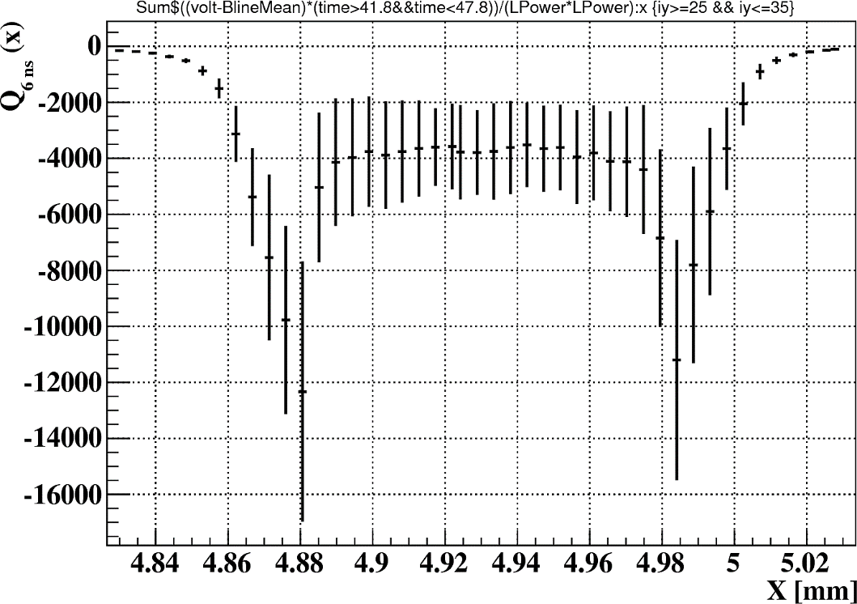
TPA-TCT after irradiation
Technique can also applied to heavily irradiated sensors!
2D map of collected charge for an irradiated HVCMOS (7×10¹⁵ n_{eq}/cm²) shows regions with high electric field.
Implant position inferred from collection time and collected charge information.
[M.Fernandez-Garcia, RD50 Workshop, 6/2016]

Slide 8
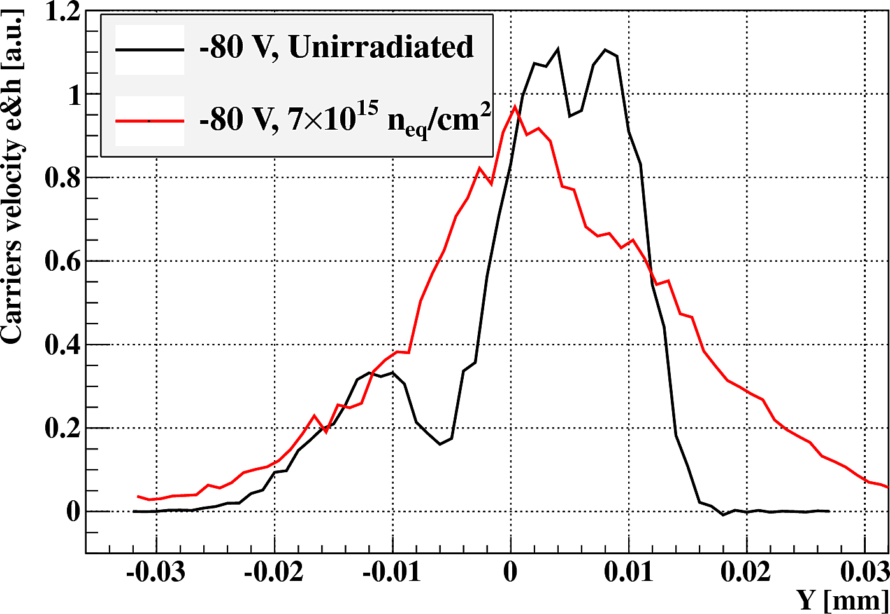
TPA-TCT after irradiation
Electric field profiling with TPA:
  Unirradiated detector shows 3 regions of different doping concentration. Implant is only partially depleted.
  Irradiated detector shows depleted implant, pointing to a radiation induced reduction of doping concentration.
DNW
Bulk

Slide 9
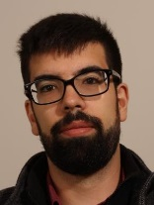
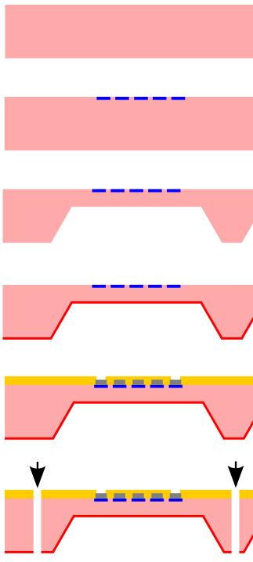
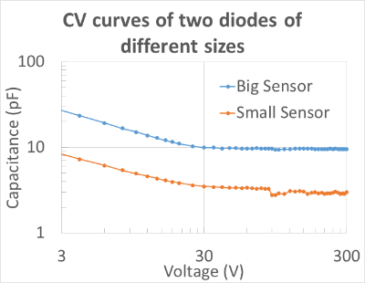
Characterization of Thin Sensors
Use thin sensors (CIS) of various silicon materials to learn about:
  Acceptor Removal (using CV)
    [Relevance: LGAD, APD, CMOS, thin sensors]
  Detrapping close to room temperature (using DLTS)
    [Relevance: Radiation induced signal loss, the killer to all LHC detectors]
  Defect Characterization after high fluences (using TSC)
    [Relevance: defect modelling, TCAD simulation, defect engineering]
First measurements started last week
    If characterization successful:
    Next step is irradiation of samples.
New project!
Sensors (took 2 years to get them!):
Pad, Ministrip, Spaghetti, e-TCT
Material:
FZ Silicon (10 Kohmcm): 50,100, 150,200,285 μm
CZ Silicon (2 Kohmcm): 50,100,150,200 μm
CZ Silicon (100 ohmcm): 50,100,150,350 μm
EPI Silicon (10,50,250,1000 Ωcm): 50 μm
New sensors!
Wafer layout
.. years of work ahead ..

Slide 10
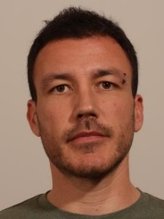
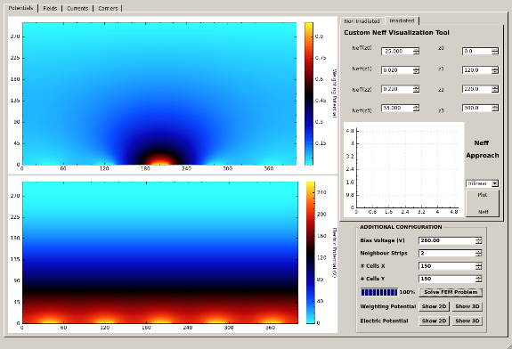
TRACS – Transient Current Simulator
TRACS
    Developed as Summer Student Project (2014-2016); Julio took up the project in 8/2016
    Finite Element Solver for signal formation in silicon detectors (with focus on edge-TCT measurements)
    Short term aim: Extract E-Field in irradiated silicon sensors by fitting e-TCT measurements
    Long term aim: Extensive simulation and fitting tool for various measurement scenarios
    Progress: Running now on 32 cores in parallel (e-TCT run simulated in 8 min instead of 2 hours)
      easily installable, manual , running on Virtual Machine at CERN; open to RD50 user community (beta version)
TRACS GUI
..using multiple cores
..E-Field parameterization model

Slide 11
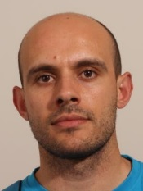
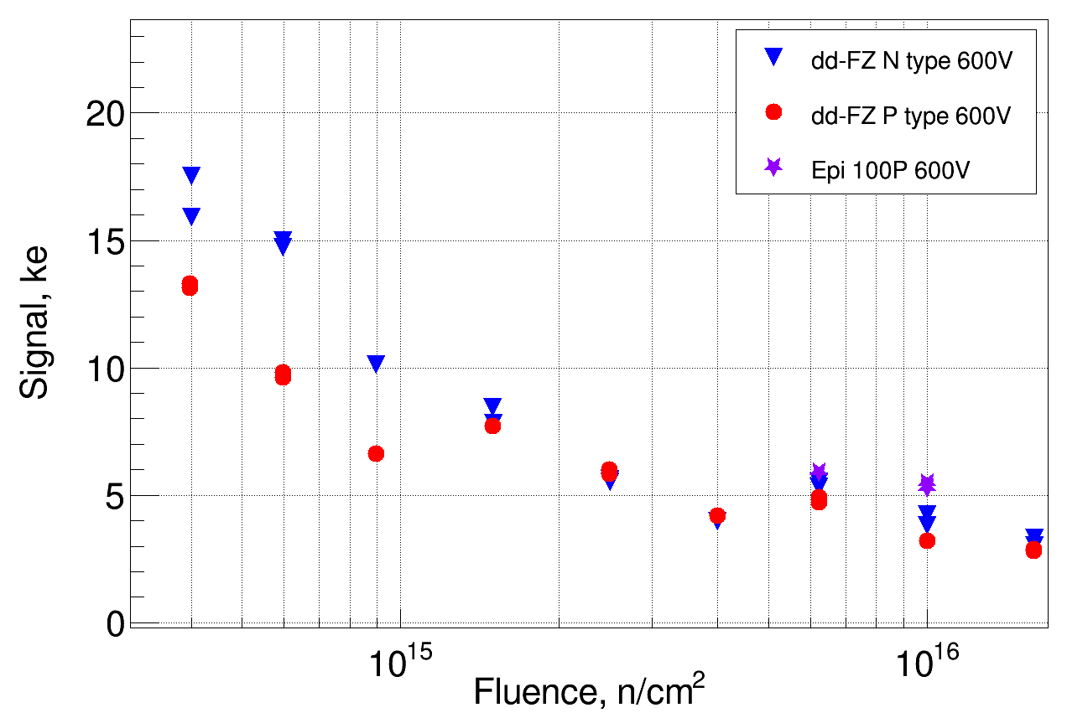
CMS: High Granularity Calorimeter
HGC - Sensors
  600 m² of silicon sensors (6M channels) exposed up to 1.5x10¹⁶ n_{eq}/cm²; Structure of sensors: Hexagonal pads
  Radiation tests of sensor structures performed by SSD [Esteban thesis] with Uni HH
  CCE (beta, laser), CV, IV, test beam (with CMS team) on irradiated sensors: (p, n, FZ, EPI, 50 to 300 μm)
IR - laser
dd-FZ 320um
dd-FZ 200um
dd-FZ 120um
Epi 100um
Sensors: p- vs. n-type ; FZ vs. EPI
  Proof of concept: Sensors operational up to highest fluence
  300μm sensors: unclear why n-type is better !?
  120μm sensors: unclear why EPI better than DD-FZ !?
    Very welcome effect: For HPK 8” production no DD-FZ wafers available, will have to use epitaxial wafers!
Timing (test beam data)
    Reaching 20ps time resolution for S/N > 30 (Signal > 20 mips)
20ps
Details: IPRD16: Esteban Curras for CMS collaboration (October 2016)

Slide 12
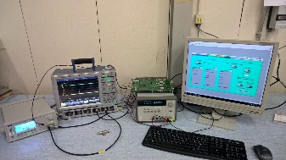
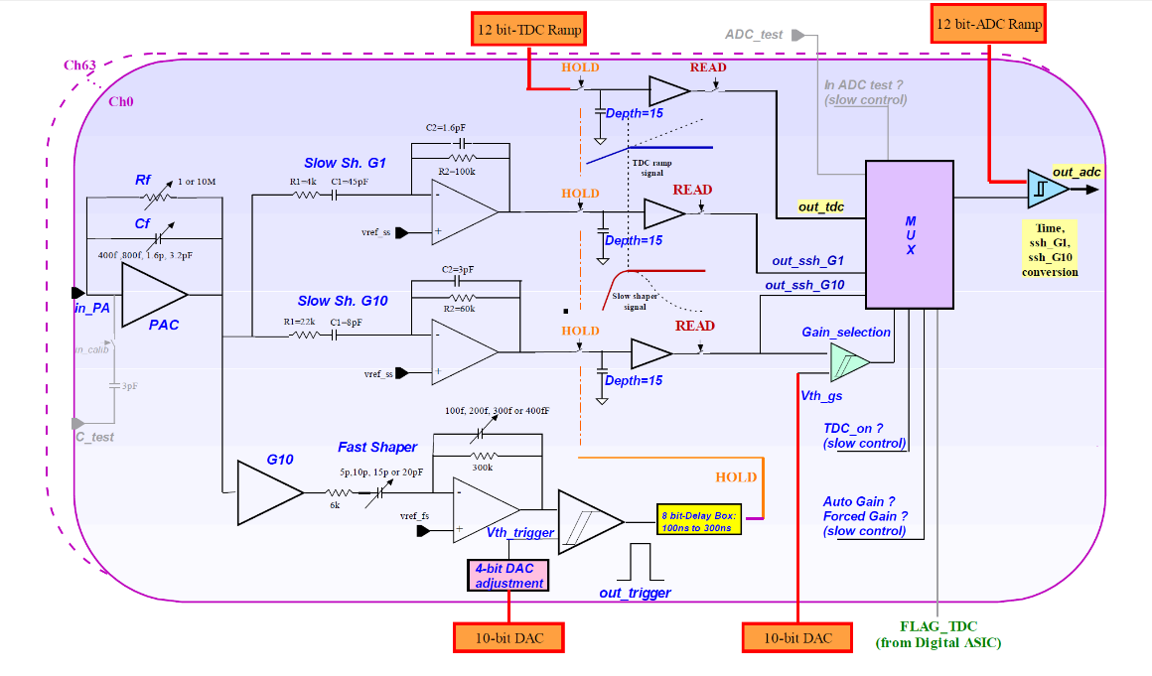
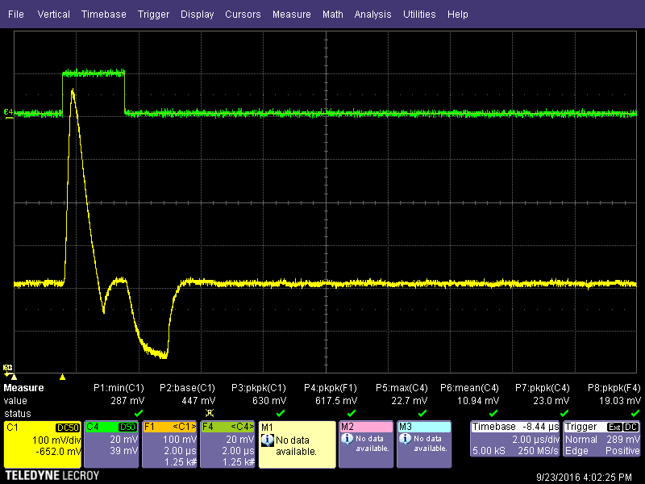
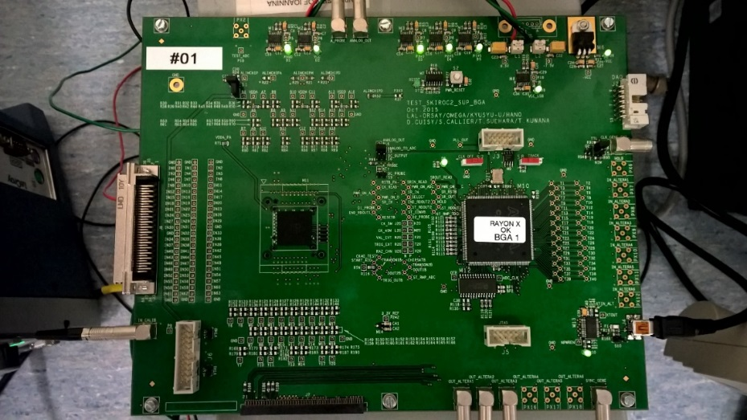
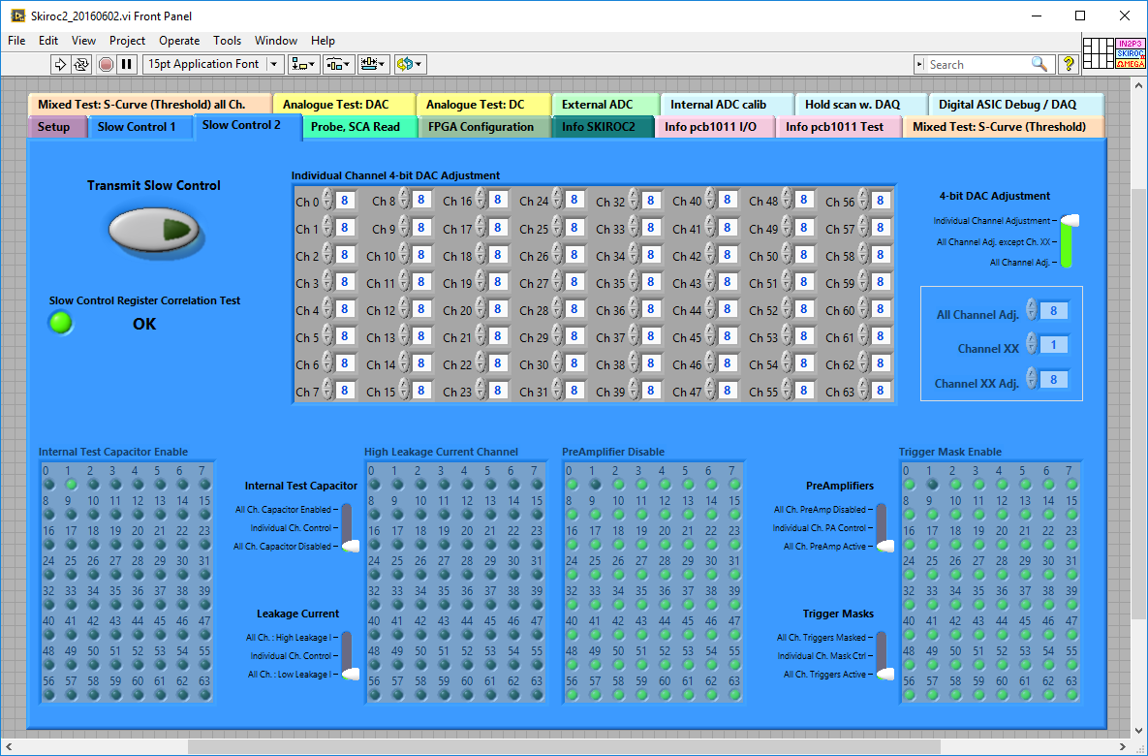
CMS HGC : skiroc2
Skiroc2 assets (towards Skiroc2CMS):
  64 Channels. Fully independent
  Preamplifier (adjustable gain)
  High dynamic range (two parallel amplifiers)
    0.5 to 150 MIPs (High Gain amp)
    150 to 2500 MIPs (Low Gain amp)
  Auto trigger + Analog + Digitalization (On chip)
  Token ring read out
x64
All 64 channels has its own parameter for trigger and delay, both amplifiers and dedicated SCA memory
Work status
  Test lab fully deployed
  First measurements on going
  Measurement automatization ongoing
Next steps
  mass measurements to generate statistics
  data analysis of “massive” in-lab data
Control software developed by Omega

Slide 13
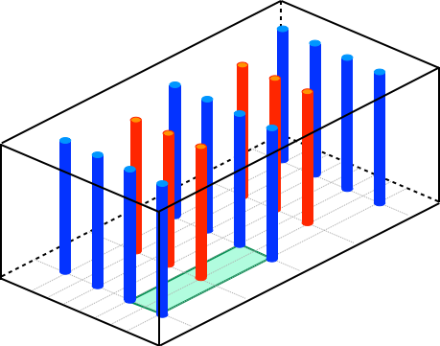
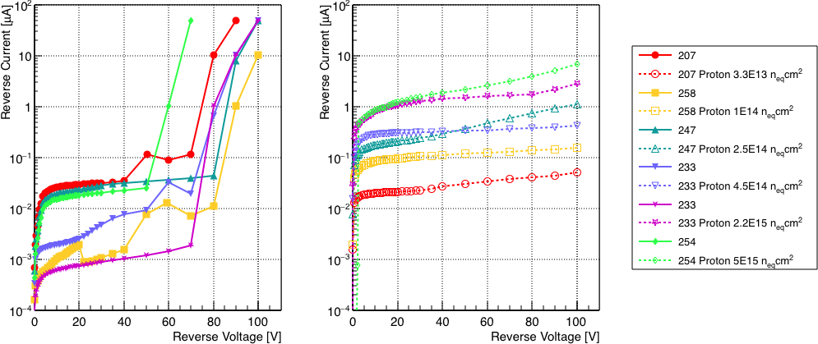
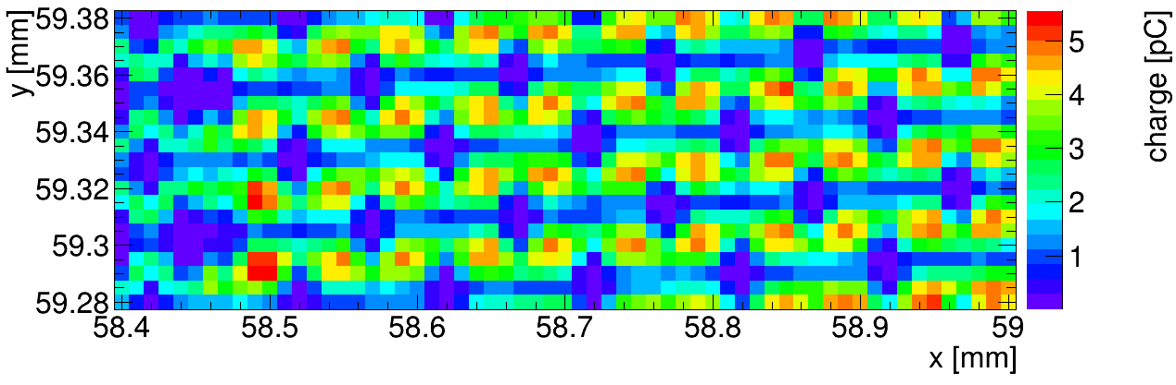
3D sensors
Project of Laura Franconi (visiting PhD student, Talent) ….writing thesis now
p+ column
IV curves before and after proton irradiation at different fluences
Same colour = same 3D diode, before and after irradiation
n+ column
Sketch of 3D sensor
Laser mapping in SSD lab
3.3E13 n_{eq}/cm²
1.0E14 n_{eq}/cm²
Red front light gets reflected on the metal lines connecting the n⁺ and the p⁺ columns and on the columns themselves: reduced charge collection in these areas.
2.5E14 n_{eq}/cm²
4.5E14 n_{eq}/cm²
2.2E15 n_{eq}/cm²
5.0E15 n_{eq}/cm²
... good example of collaborative use of the SSD equipment (service)
Punch through
column
n+ column
p+ column

Slide 14
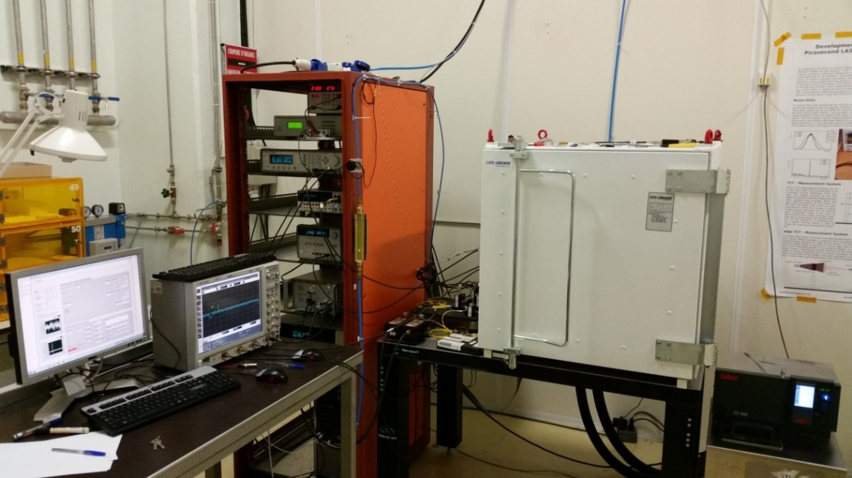
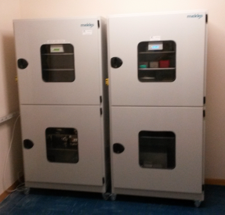
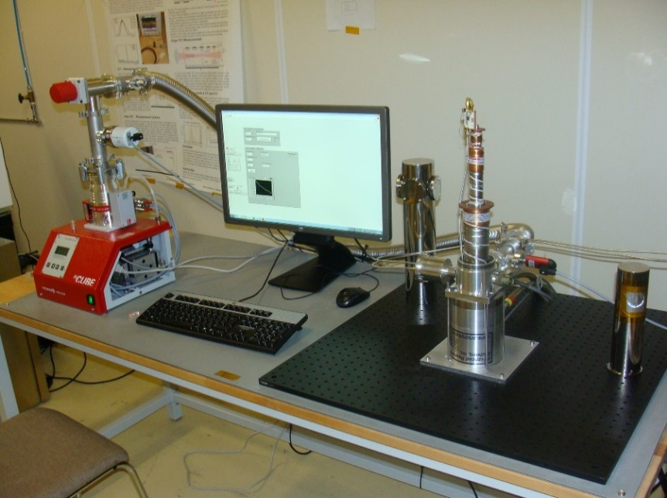
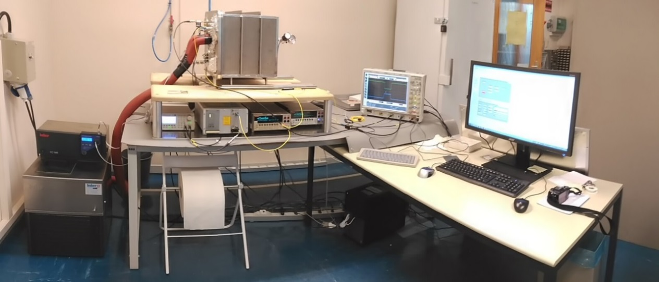
Infrastructure & Equipment
Bldgs.28/186 (4 labs, 1 sensor storage area, 4 offices, ..)
  IV/CV [2x], Alibava (CCE) [2x], Beta (CCE), e-TCT, TCT+; I-DLTS, TSC
-70C to 180C
Wafer/Sample storage
CCE (Charge Collection Efficiency)
TCT+: TCT (Transient Current Technique)
Cooling to 10K
I-DLTS (Current Deep Level Transient Spectroscopy)
TSC (Thermally Stimulated Currents)

Slide 15
1year outlook – SSD activities
Laboratory and equipment
    Continue working on sample holder fitting on “all characterization stations”, CV/IV in climate chamber
    Continue building up a TSC system for defect characterization (evaluate possibility to get DLTS)
    Prepare TCT+ to measure time resolution with laser beams
    Evaluate possibility for “low-cost” TPA system at CERN
Upcoming & running projects in framework of RD50 with SSD participation
  Nitrogen enriched silicon (RD50-2016-01)
    Status: Material produced in collaboration with TOPSIL, Mask design finalized
    [CERN SSD → TCT, CCE(Alibava), proton irradiation]
  Gallium doped LGAD sensors (RD50-2016-02)
    Status: First tuning of implantation and diffusion hardware at CNM against TCAD tools finished; First set of detectors with different implant/diffusion ready for distribution to project partners [CERN SSD → TCT, CCE, proton irradiation]
  HVCMOS sensors
    Preparation of RD50 submission ongoing [CERN SSD → e-TCT, TPA-TCT]
  Acceptor removal and defect characterization
    Dedicated production run at CIS, Erfurt for CERN SSD finished, sensors arrived at CERN, next step: testing of sensors and irradiation; then TSC and DLTS measurements [..finally started project]
  Timing with LGAD and APD
    Study of time resolution as function of fluence (Ga-LGAD and DD-APD); TCAD simulations
  TRACS simulation and fitting tool
CMS HGC
    SKIROC [Joaquin] … evaluating test systems for the HGC readout chip
    Finalize CCE study on highly irradiated sensors and test beam studies [Esteban]
    Start evaluating epitaxial silicon [….HPK has no deep diffused 8” possibility!] (no CMS resources)

Slide 16
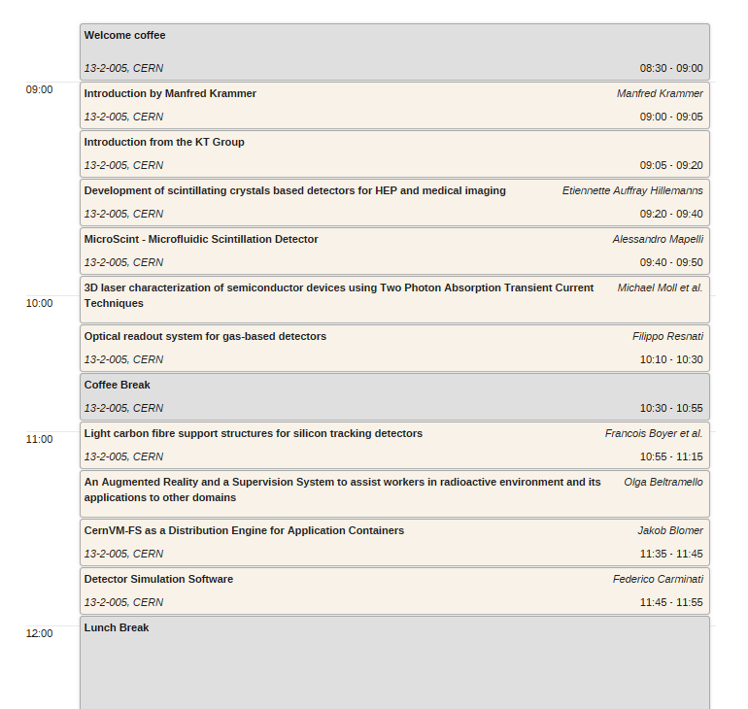
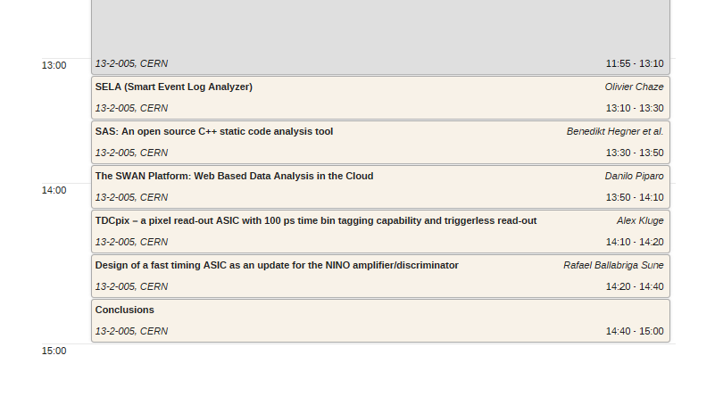
KT Innovation Day
Tomorrow: KT Innovation Day
  https://indico.cern.ch/event/575296/timetable/#20161014
Yes, we are the ..
…most innovative section in the whole Department ☺.
EP-DT-DD
EP-DT-DD
EP-DT-DD
EP-DT-EO

Slide 17
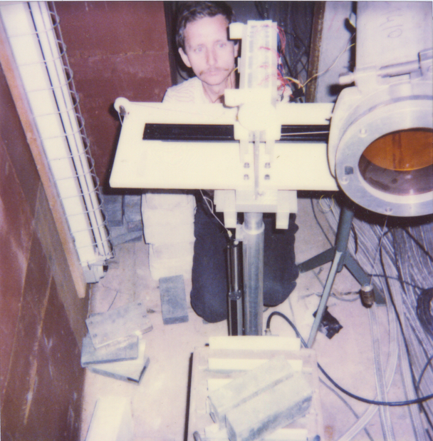

Goodbye Maurice
2013-16: PH-DT-DD
CERN staff since 1.5.78
2012: PH-DT-DI
2011: Retirement in 2013
2012: Hiring Federico
.. Retirement in 2014
… Retirement in 2015
… Retirement in 2016 ?
… we can have another party next year
…lessons learnt from Maurice
2008: PH-DT-DI
2004: PH-TA1-SD
2005: PH-DT2-SD
Lesson: Maurice will not disappear ☺
Never put a sticker like this on your equipment or door! Lifetime is less than 5 years
(i.e. have a vision and plan for the long term)
1985: LEP-BI
1992: ECP-MIC-TF
Le Chat Noir
Carouge; approx. 3am
1990: SL-BI
1994: ECP-MIC-SD
1990: EF-DSM
1998: EP-MIC-SD
1994: ECP-MIC-SD
1992
…first irradiations
ROSE 1995
..first evidenced contact with Maurice
2.12.1998 - ROSE meeting
2001: EP-TA1-SD

Slide 18
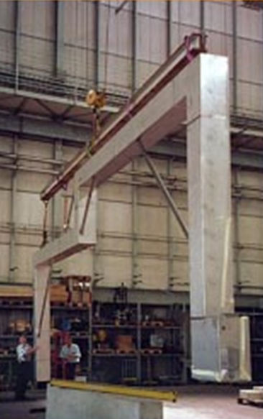
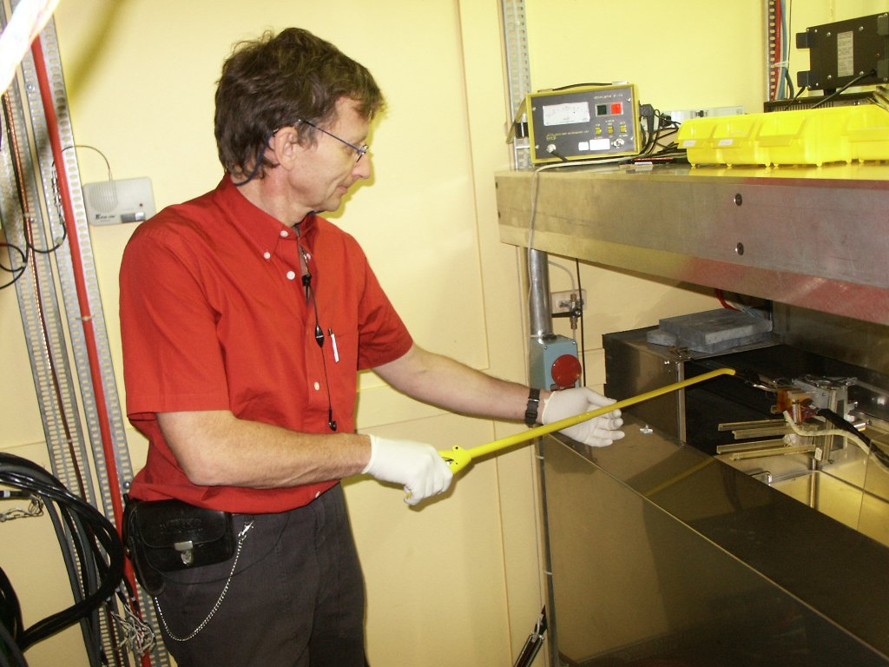
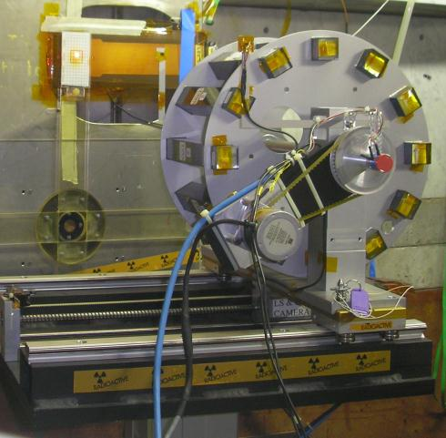
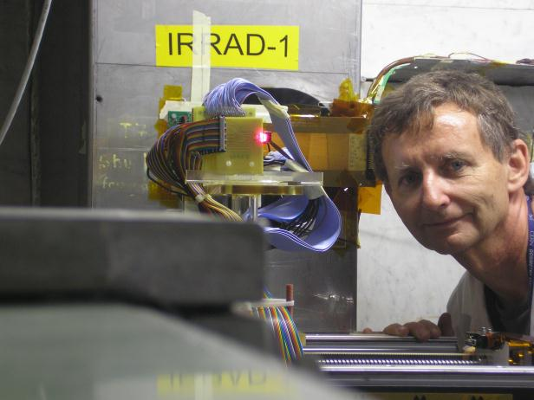
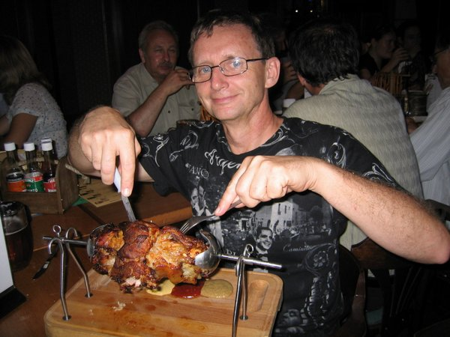
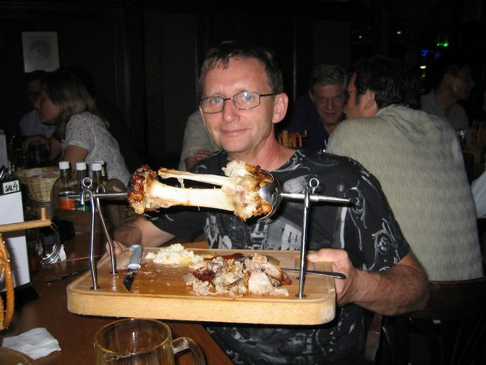
Goodbye Maurice
CERN staff since 1.5.78
2013-16: PH-DT-DD
..guess who took the photo?
PSI 2000: Don’t put Aluminium blocs
into high intensity pion beams;
(i.e. never trust reactor people)
2002
Maurice; .. teaching me French …
and 2000 in Paris how to eat oysters
..how to keep workplace tidy
RD50
2001
We had many challenges…
… but Maurice mastered them!
2006 Prague

Slide 19
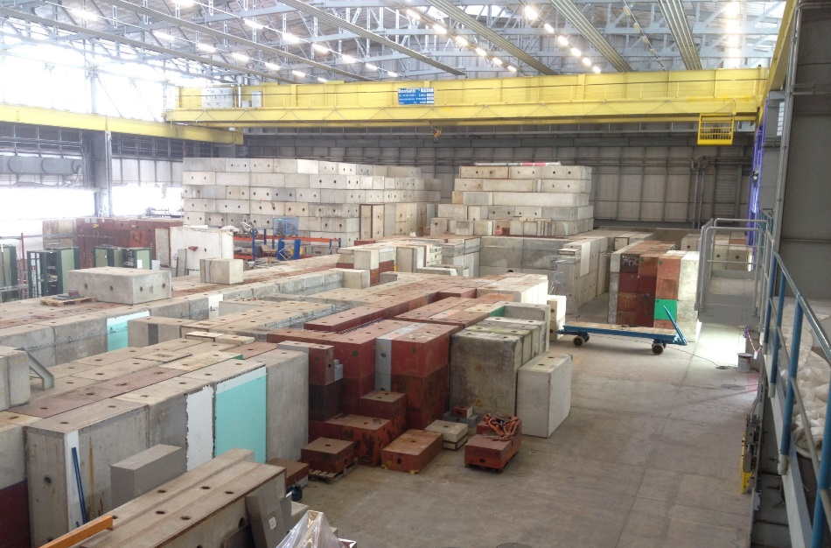
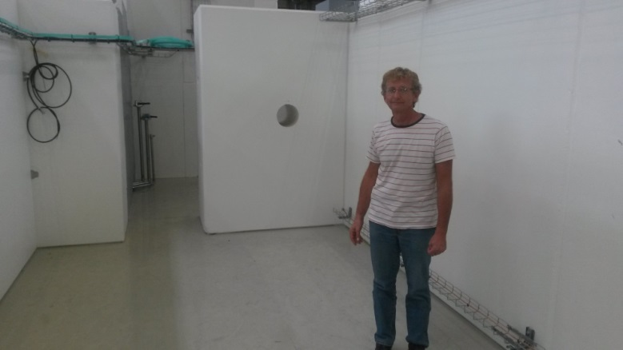
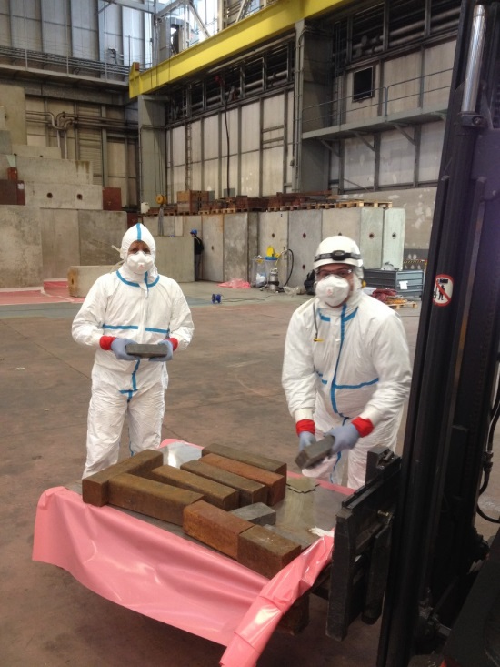
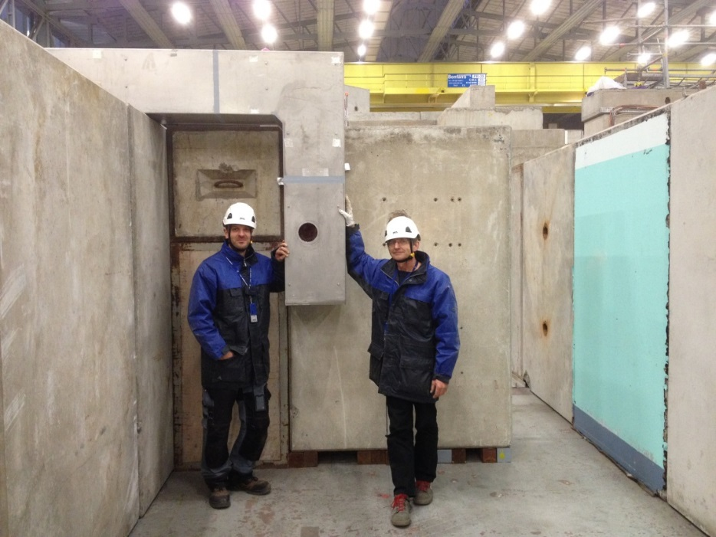
Goodbye Maurice
RD50
2001
CERN staff since 1.5.78
2013-16: PH-DT-DD
…we had bigger dreams and challenges..
…and huge achievements!!!
Thanks to Maurice
2002
1992
…first irradiations
Thank you Maurice!
…CERN would be much more efficient, more innovative, better equipped
and more friendly place, … if we just could clone you ☺ Enjoy retirement!
…more work …and progress…

