Slide 1

Universal adjustment solution for non motorized components in high radiation areas
M.Sosin, J.Jaros EN-ACE/SU
WP15 Meeting – 19.05.2017

Slide 2
Outline
HL-LHC residual doses vs. access constraints
Typical issues with position adjustment
Alignment system requirements
Universal adjustment platform - CLIC DBQ support example
Standardized adjustment solution
Case of collimators alignment
Universal adjustment platform – R&D schedule
Summary

Slide 3
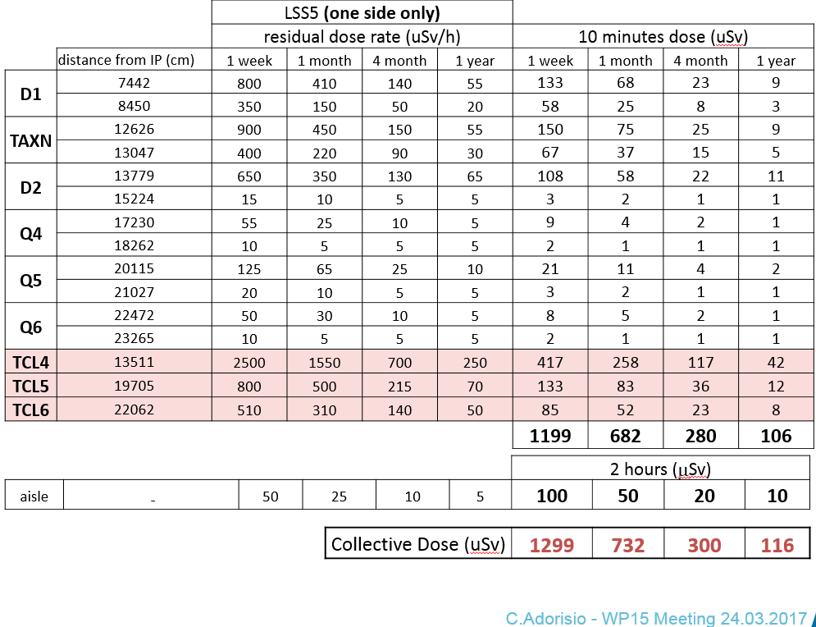
HL-LHC residual doses estimation

Slide 4
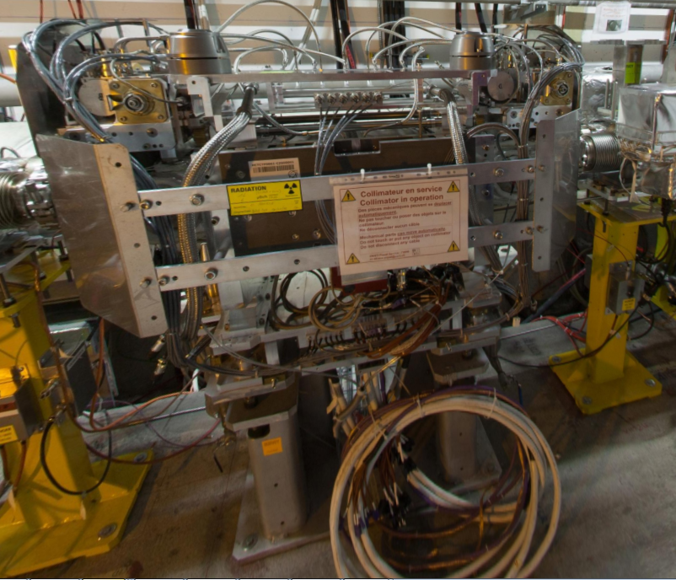
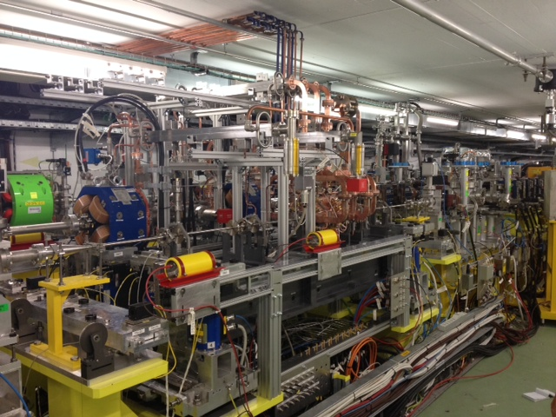
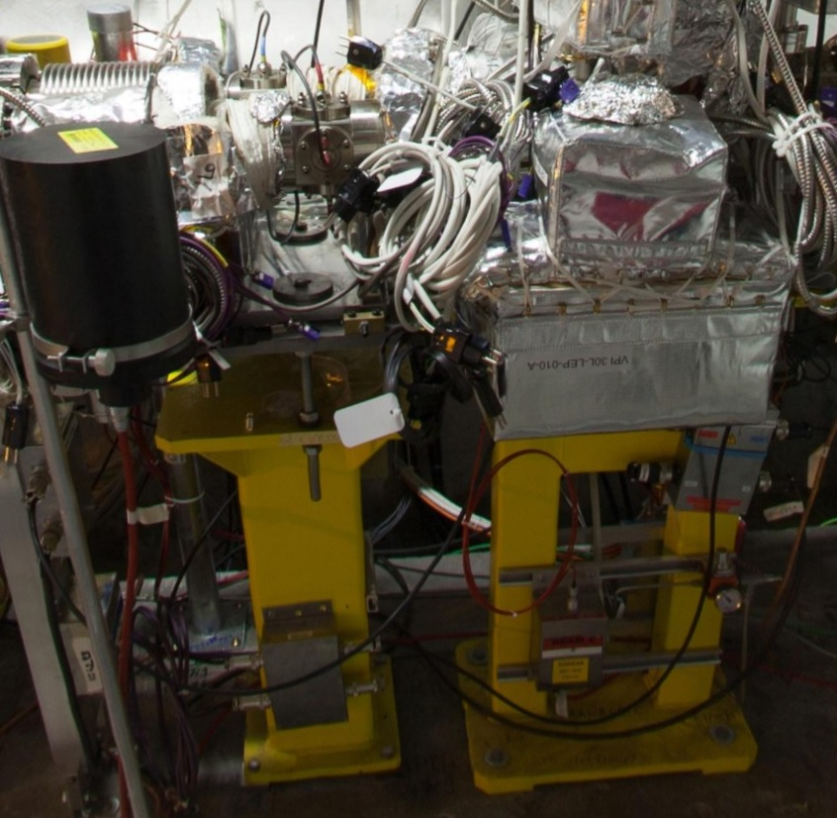
Typical issues with position adjustment
Crowded neighbourhood of aligned components
  Difficult access to regulation mechanisms/screws – (circus skills needed for some of components regulation)
  Fragile equipment around workspace – slow an careful manipulation
Ergonomics of adjustment
  Mechanisms not always intuitive
  Simple mechanisms =>
  big backlash =>
  multiple measurement and
  adjustment iterations
  needed =>
  Long adjustment time

Slide 5
Alignment system requirements
Limit the presence of personnel in high radiation areas:
  Easy access from transport zone
  Intuitive kinematics of adjustment system
  Possibility of position measurements from bigger distances
  Option of remote (distance) adjustment using portable motorized adapters
5DOF position adjustment preferred
  Accuracy, resolution, stiffness – application dependent
  Simple robust and cheap solution

Slide 6
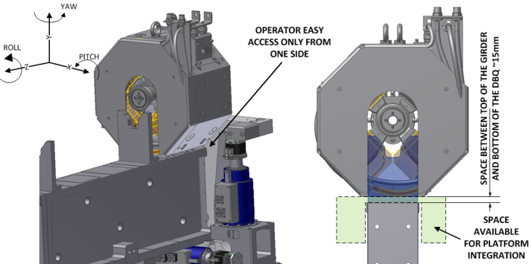
A bit of history – CLIC DBQ adjustment platform
Tight space constraints
  14.5mm for „hexapod” platform integration
  Crowded environment – access from one side needed
  Small distance to neighbouring components
Needs
  +/- 1mm of stroke in X and Y
  µm resolution of X-Y position adjustment
  Rotations adjustment within +/- 4 mrad
  ~20µrad resolution of angular adjustment
  Short adjustment time

Slide 7
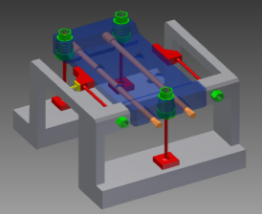
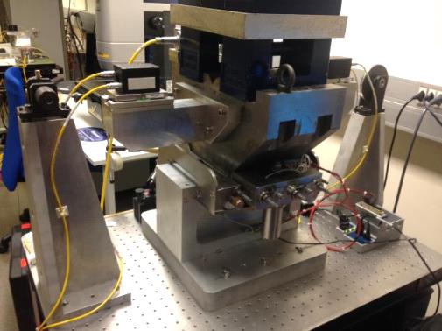
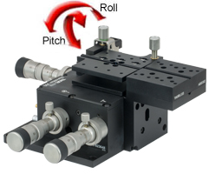
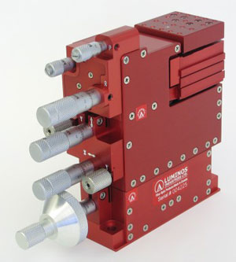
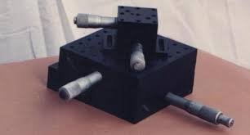
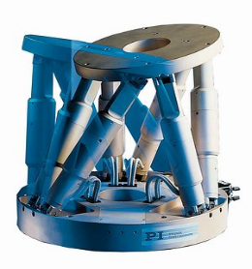
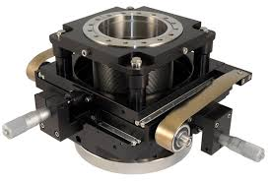
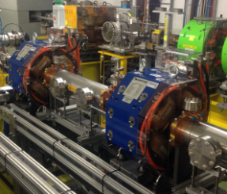
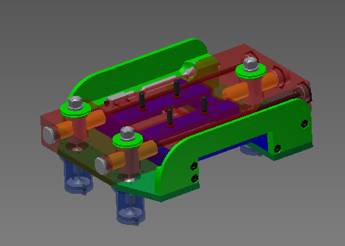
A bit of history – CLIC DBQ adjustment platform

Slide 8
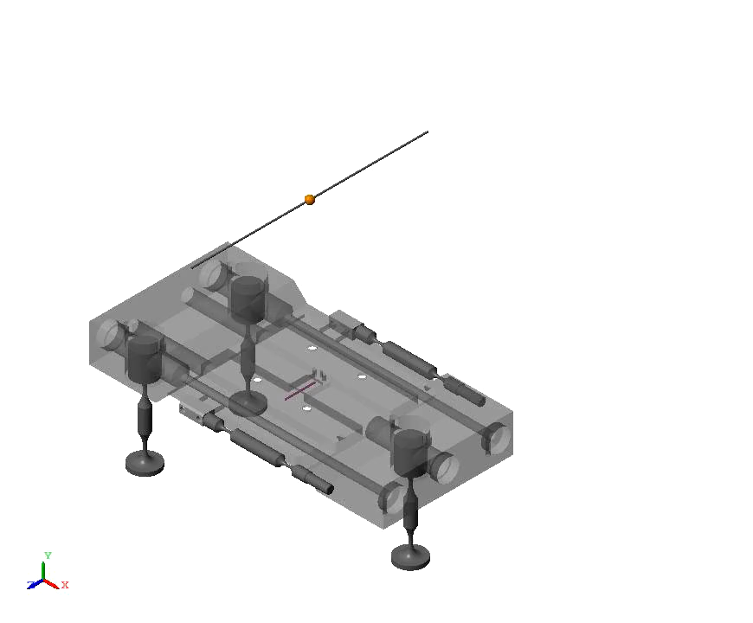
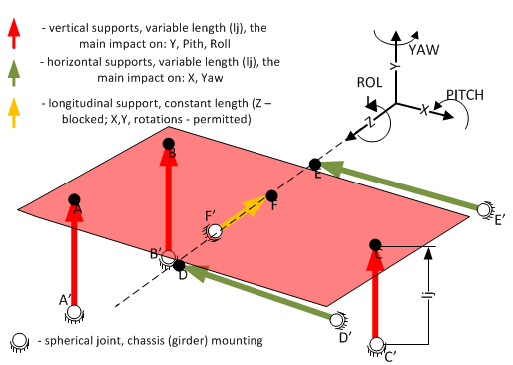

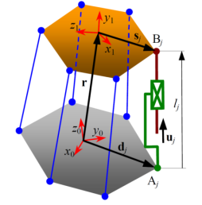
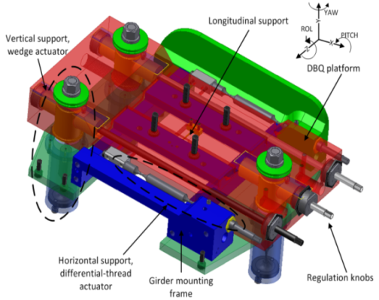
A bit of history – CLIC DBQ adjustment platform
Modified Stewart platform configuration

Slide 9
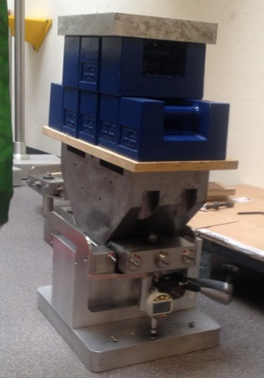
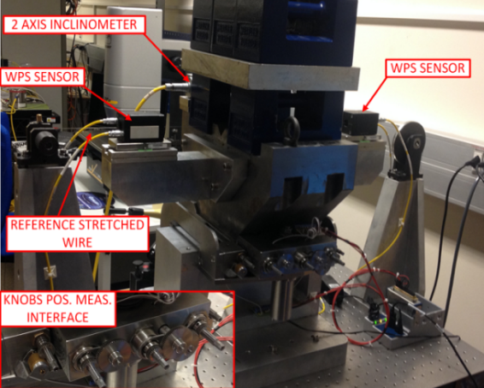
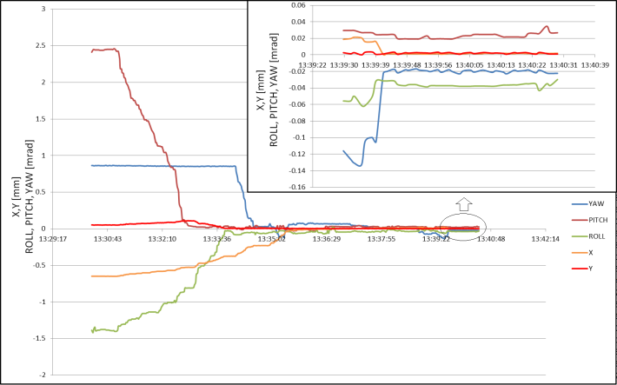
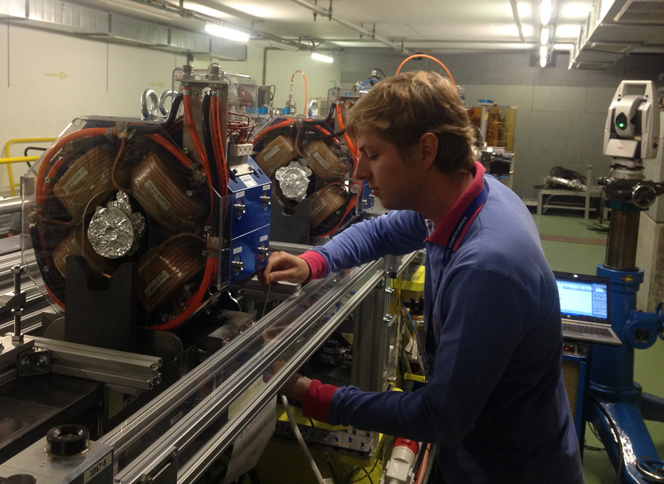
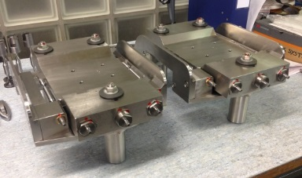
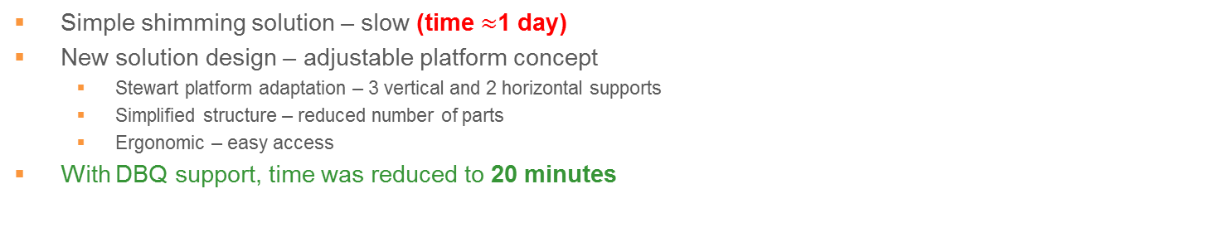
DBQ Support enabled to reduce pre-alignment time from one day to 20 minutes
Simple shimming solution – slow (time $≈$1 day)
New solution design – adjustable platform concept
  Stewart platform adaptation – 3 vertical and 2 horizontal supports
  Simplified structure – reduced number of parts
  Ergonomic – easy access
With DBQ support, time was reduced to 20 minutes

Slide 10
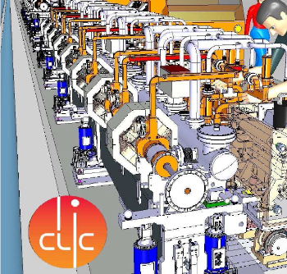

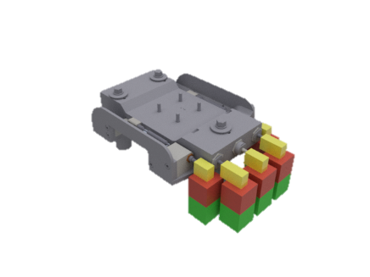
Second possible use → option for the tunnel fast re-adjustment
Portable motorised adapter needed
  Position and orientation feedback coming from the absolute tracker
  Option of permanent installation (remote
  adjustment)
    Pos. feedback sensors as eg. WPS needed
Trans-
missions
Gears
Position feedback
Motors
Controller
The idea:

Slide 11
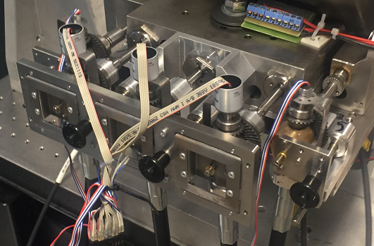
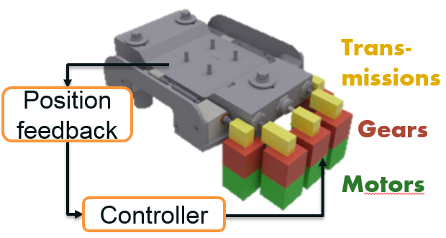
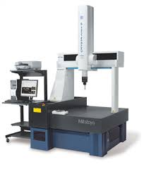

Motorized adapter functional prototype designed and preliminarily tested
Mechanical design
  Light and compact
  Mobility – fast auto-lock
  mechanism
  Build-in sensors
Control algorithms adopted to
automated and semi-manual use
  Feedback tunel measurements (eg. Laser tracker or position sensors)

Slide 12
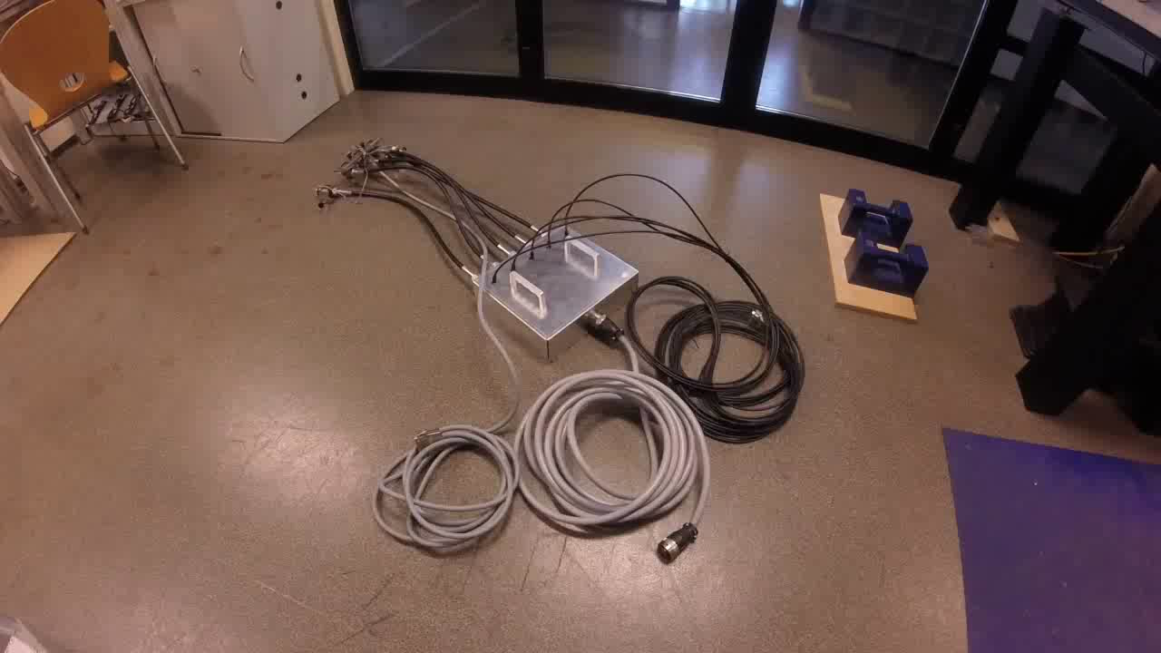
Motorized adapter functional prototype designed and preliminarily tested

Slide 13
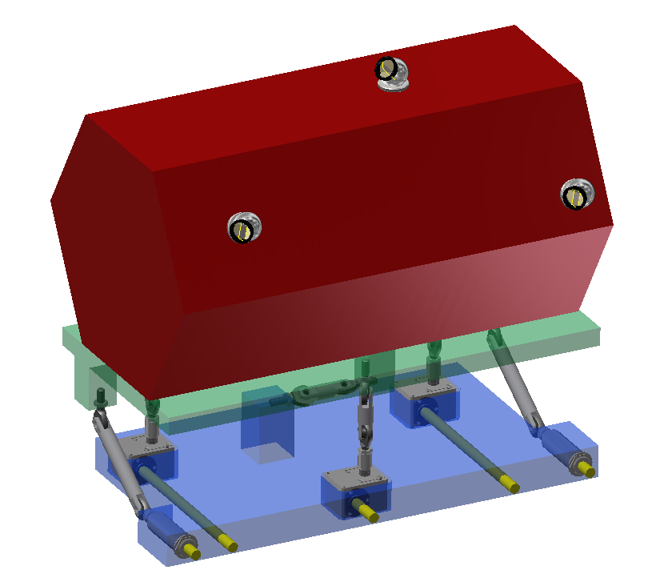
Standardized adjustment solution
Universal adjustment platform based on vertical/horizontal Stewart platform configuration
  Regulation knobs accessible on one side of platform
  Easy and ergonomic manual operation, fast manual adjustment
  Standardized interface to regulation knobs – possibility
  to easy connect the motorized adapter
Full remote adjustment control
  Upgrade in position sensors
  (eg. WPS, inclinometers, HLS)
  Easy integration of permanent motors

Slide 14
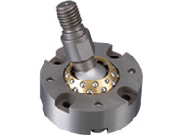
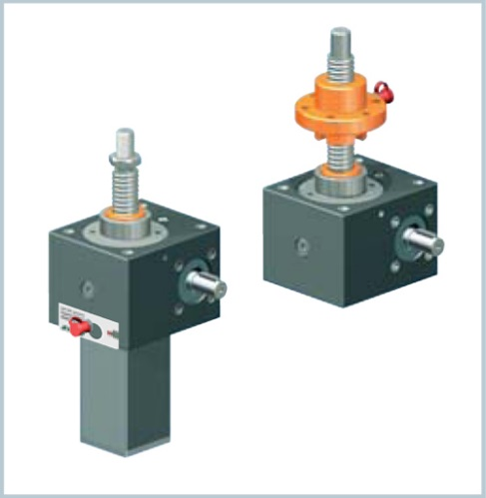
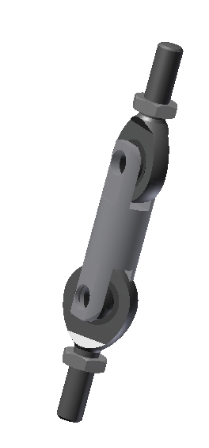
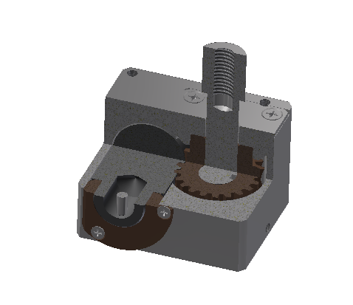
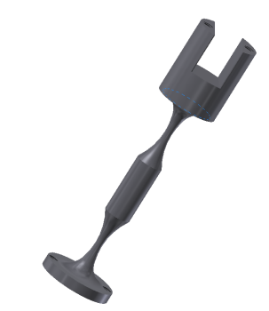
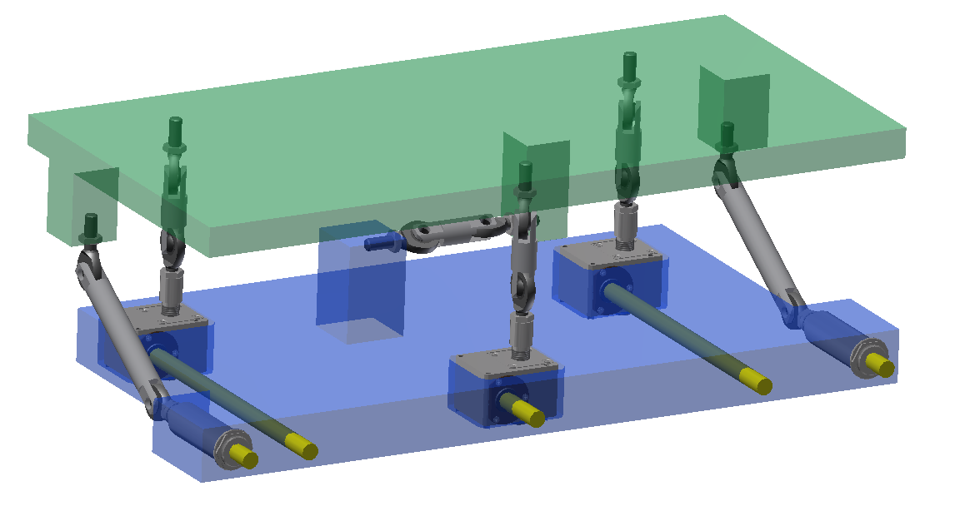

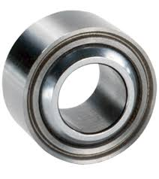
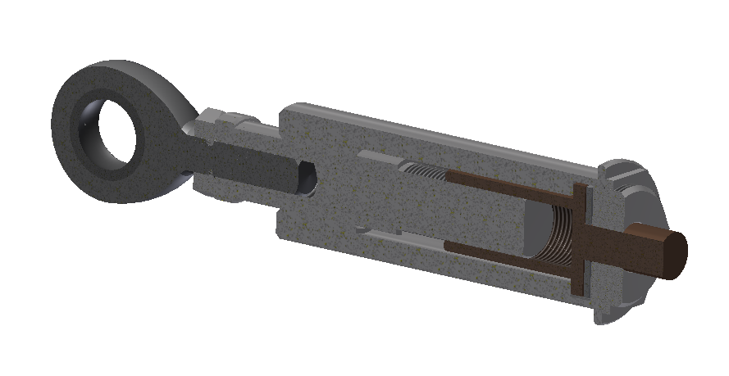
Standardized adjustment solution
Standardization of alignment mechanics
Standardized way of
joints design
Standardized vertical/radial
actuators mechanics
Standardized regulation
and blocking interface
Needed discussion with all interested users to recognize all requirements and future parameters:
  Mechanisms accuracies, resolution, stiffness
  Platform dimensions limitations, actuators dimensions
  Maximal loads, external forces, etc.
Validation of solutions chosen

Slide 15
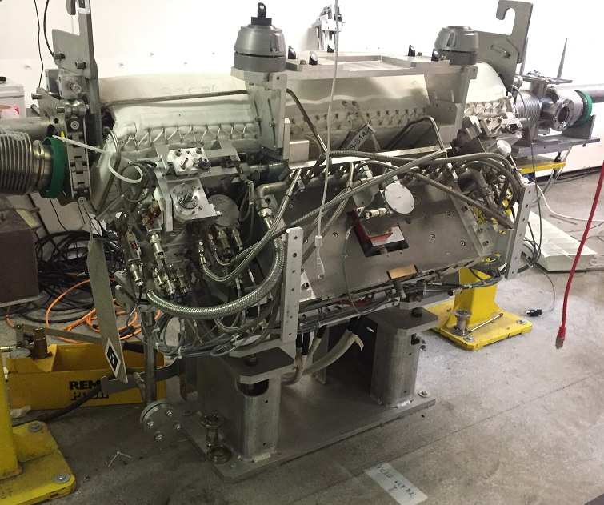
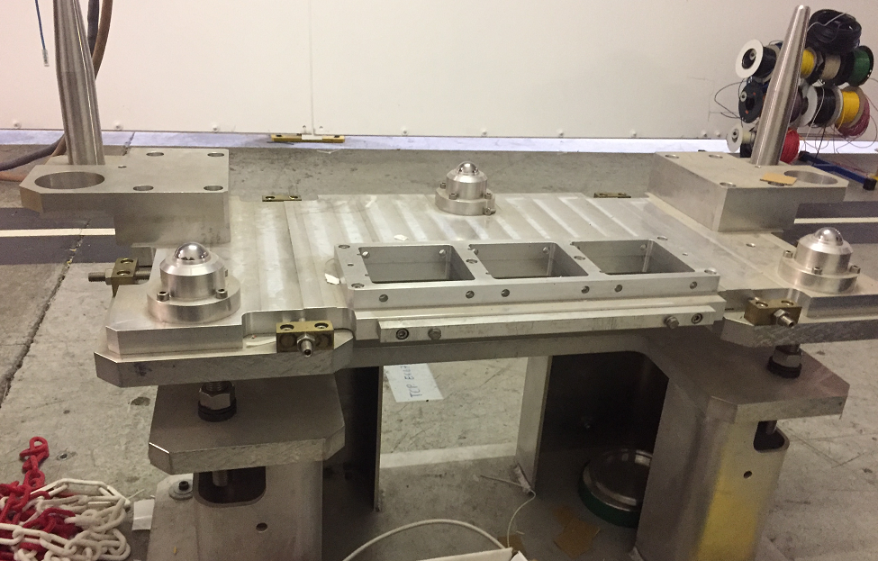
Case of collimators alignment
Universal adjustment platform can be easily adopted for adjustment solution for collimators
  Range of X-Y +/- 10mm and +/-10mrad of roll-pitch-yaw adjustment feasible
  Accuracy, resolution, stiffness to be defined
  Space below collimator seems sufficient to integrate the platform mechanics

Slide 16
Proposed development schedule
Discussions with users interested, needs analysis → June-July 2017
Adjustment solution standardization specification → August - September 2017
Platform prototype(s) studies and initial design → October 2017 – January 2018
Adapter prototype studies and design → October 2017 – January 2018
Prototype platforms tests, components validations → February-September 2018
Final design report, standardized solution description → October-December 2018

Slide 17
Summary
To increase safety of Survey personnel in radiation
zones during components alignment - change of approach in design of adjustment supports is needed
  Intervention time optimization have to be taken as important factor during adjustment solutions design
We propose standardized, Stewart platform based
5DOF adjustment solution, allowing easy adjustment and motorisation
of components if needed

Slide 18
Back up

Slide 19
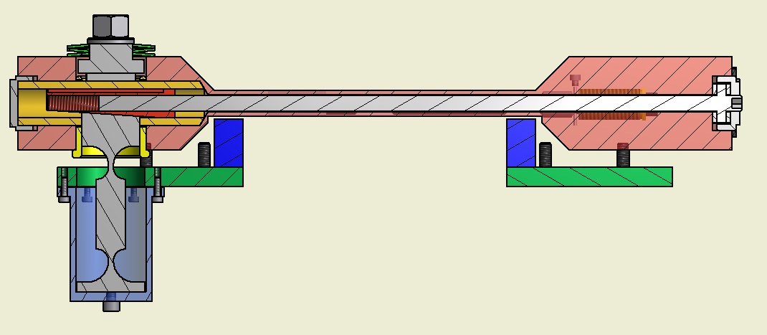
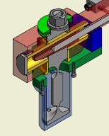
Vertical regulation unit
Threaded
wedge
Belleville spring stack
Regulation screw
Wedge sliding bearing
Flexural vertical support
sliding bearing
Regulation screw
bearing unit
(2 flat needle bearings
+ tightening screw)
Flexural vertical support
with wedge-profiled head

Slide 20
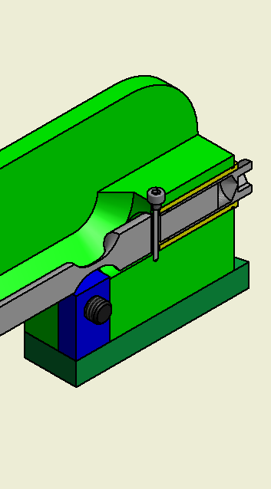
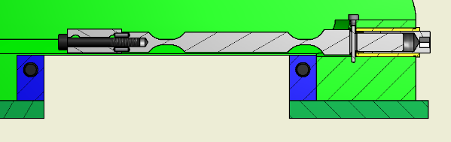
Horizontal regulation unit
Flexural horizontal support.
One end threaded
(as a part of regulation screw)
DB Quad platform clamping block
Differential thread
regulation screw

Slide 21
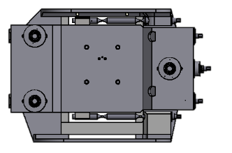
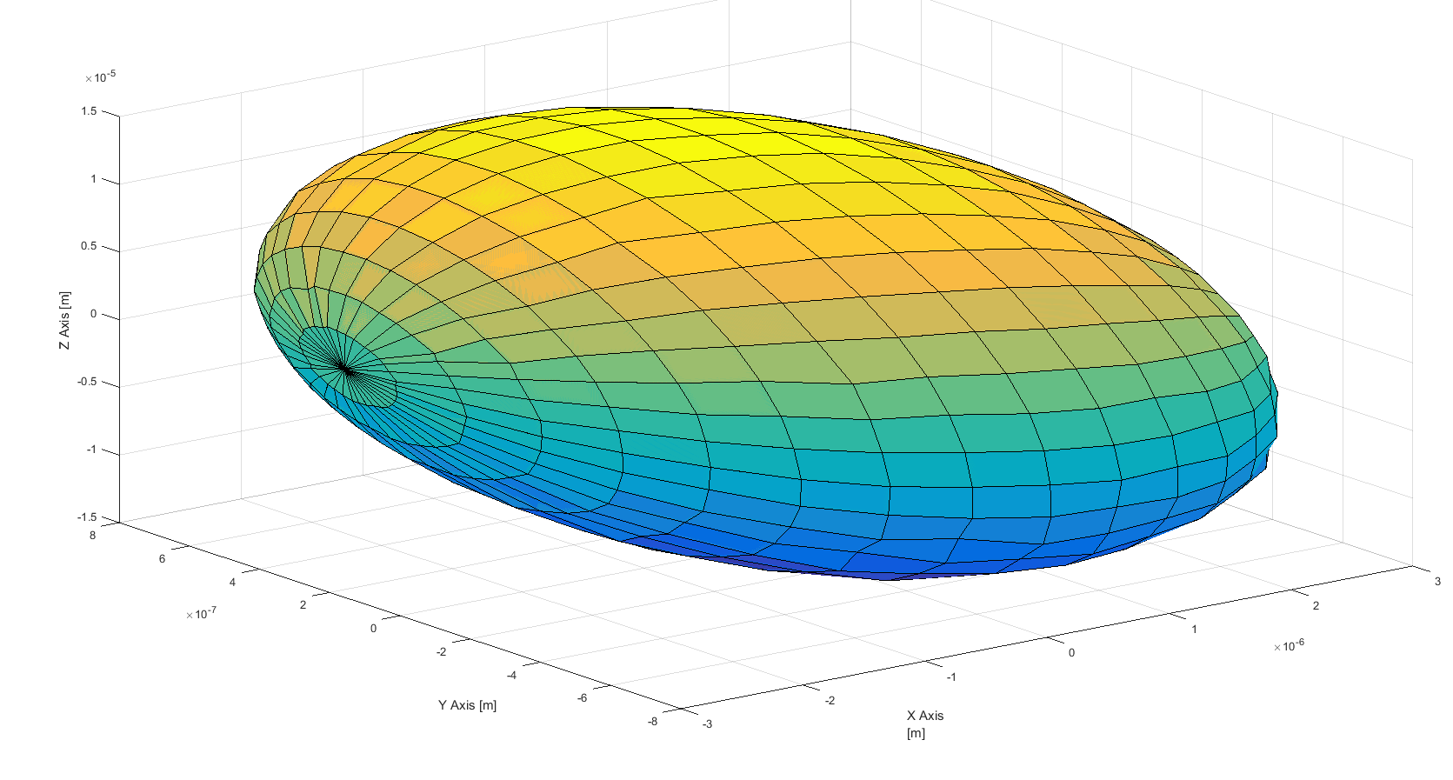
Stiffness results
Force load in XZ plane
Z
Maximum deformation along X axis is about 2.5 micron
X
F=100N
And along Y axis is less than 0.5 micron

Slide 22
Vertical movement (Y axis)

Slide 23
Roll movement (Z axis angle)

Slide 24
Roll movement (Z axis angle)

Slide 25
Pitch movement (X axis angle)

Slide 26
Pitch movement (X axis angle)

Slide 27
Yaw movement (Y axis angle)

Slide 28
Yaw movement (Y axis angle)

Slide 29
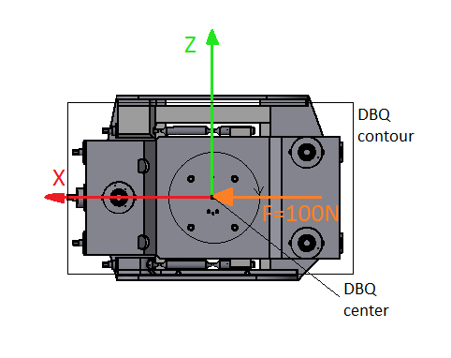
XZ plane deformation

Slide 30
XZ plane deformation

Slide 31
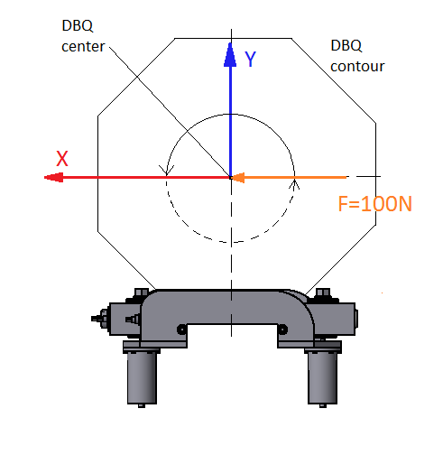
XY plane deformation

Slide 32
XY plane deformation

Slide 33
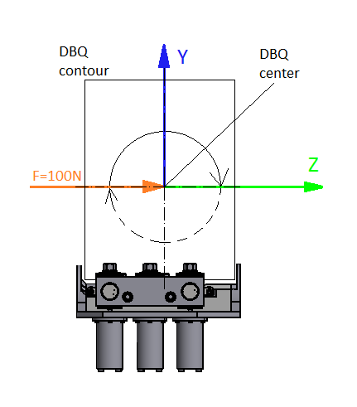
YZ plane deformation

Slide 34

YZ plane deformation

