Slide 1
New Main Linac Design Progress
D. Schulte

Slide 2
Structure Choice
 | DB | klys. | DB 244ns | K 244ns | B 244ns
a₁/λ | 0.1525 | 0.145 | 0.1625 | 0.15 | 0.15
a₂/λ | 0.0875 | 0.09 | 0.104 | 0.1044 | 0.1044
D₁/L_{cell} | 0.297 | 0.25 | 0.303 | 0.28 | 0.28
D₂/L_{cell} | 0.11 | 0.134 | 0.172 | 0.17 | 0.17
N_{cell} | 36 | 28 | 33 | 26 | 26
G [MV/m] | 72.5 | 75 | 72 | 79 | 79
P [MW] | 50.9 | 42.5 | 59.5 | 54.3 | 54.3
N [10⁹] | 3.98 | 3.87 | 5.2 | 4.88 | 4.88
Δz [λ] | 6 | 6 | 6 | 6 | 6
n_{b} | 454 | 485 | 352 | 366 | 366
τ_{RF} [ns] | 321 | 325 | 244 | 244 | 244
R_{DB}/N_{DB} | 3.0 | --- | 4.005/4 | 3.69/4 | 3.69/4
P_{wall} [MW] | 217 | 224 | 221 | 222 | 222
C [a.u.] (w. drive beam) | 3.451 | 3.520 | 3.502 | 3.523 | 3.523
C [a.u.] (w. klystrons) | 3.616 | 3.551 | 3.825 | 3.744 | 3.744

Slide 3
Selected 380 GeV Beam Parameters
N | 10⁹ | 5.2
n_{b} |  | 352
f_{rep} | Hz | 50
ε_{x}/ε_{y} | μm/nm | 0.95/30
β_{x}/β_{y} | mm/mm | 8.2/0.1
σ_{x}/σ_{y} | nm/nm | 149/2.9
σ_{z} | μm | 70
L_{total} | 10³⁴cm⁻²s⁻¹ | 1.5
L_{0.01} | 10³⁴cm⁻²s⁻¹ | 0.9
n_{γ} |  | 1.5
δ_{E} | % | 6
The emittances are nominal values at the IP
Draft values for emittances targets are
Exit of damping ring
ε_{x} < 700nm, ε_{x} < 5nm
Exit of RTML
ε_{x} < 850nm, ε_{x} < 10nm
Exit of ML
ε_{x} < 950nm, ε_{x} < 20nm
A limited flexibility exists for the collision parameters O(10%) since the beam size is larger than the minimum that could be achieved
Also the waist shift allows to gain a few percent

Slide 4
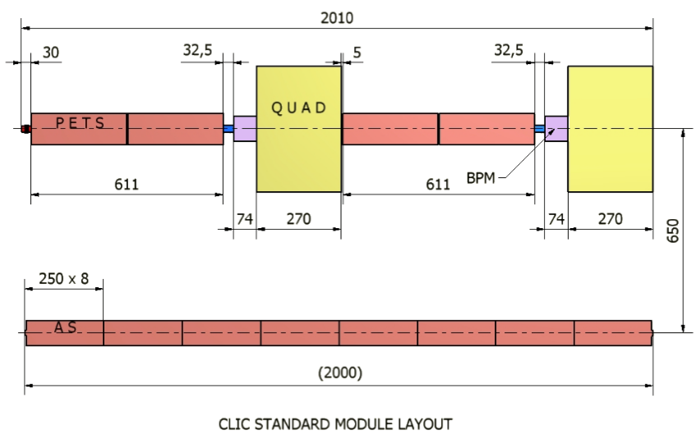
Reminder of Lattice Design
Main linac is build from regular modules of constant length
Keep the same logic but use the new, longer structures
230mm effective length => 27.16mm effective length
2010mm => 2343mm = 2010mm + 8*5*8.33mm
CDR design

Slide 5
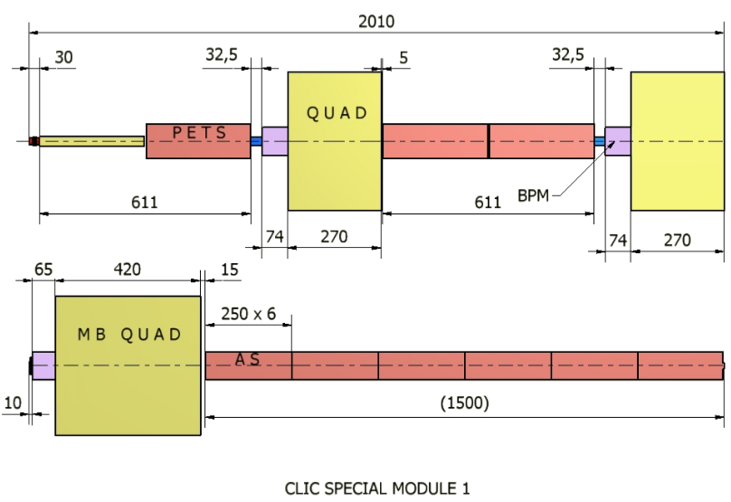
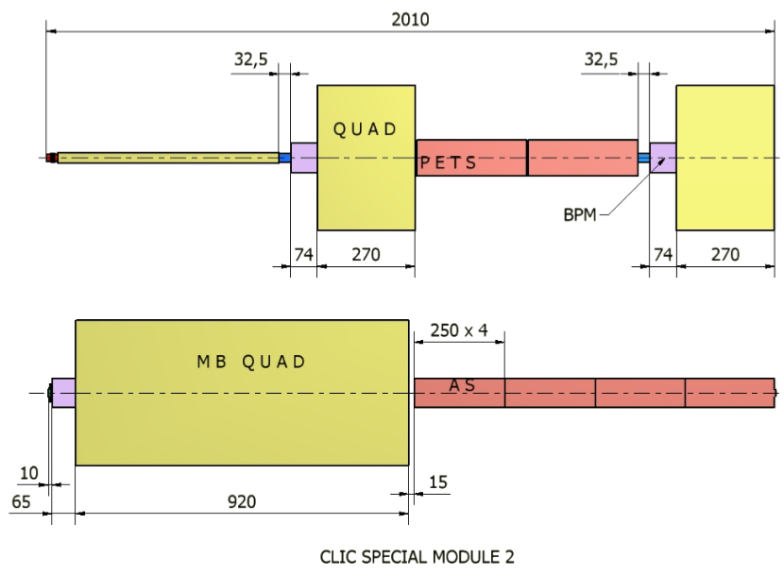
Reminder of Lattice Design
Main linac is build from regular modules of constant length
Magnetic length has been 420 and 920mm
i.e. 350mm/850mm magnetic length
New quadrupole magnetic lengths are
430mm and 1010mm
Do not need longer magnets

Slide 6
Ideal Lattice Design
Ideal lattice is scaled using
This keeps a roughly constant filling factor
Also required relative energy spread for BNS damping remains constant
And good trade-off for imperfections

Slide 7
Real Lattice Design
Follow scaling but use modules
Form sectors with equal quadrupole length and spacing
Number of girders between quadrupoles chosen to be close to ideal L(s)
Type of quadrupole chosen to be shortest that is consistent with K(s)
Optics functions are periodic in each sector
Match optics functions from one sector to the next using 7 quadrupoles
CDR 3TeV lattice

Slide 8
Tentative Choice of Values
CDR used L(0)=2m, f(0)=1.5m
Scaling assumed the same lattice
With this choice filling factor is slightly low in new design (because of longer modules)
Performed a full scan of lattices to identify best new lattice
Solution L(0)=2.2m and f(0)=1.5m
Last sector could be merge with previous on
Tentative numbers per linac:
356 girders with short quadrupoles
216 girders with long quadrupoles
912 girders with structures
5148 (double) structures
Filling factor 80%, after adding decelerator ends 79%

Slide 9
Note on RF Phases
Need to operated off-crest in main linac to compensate wakefield induced energy spread
Goal is 1% full width (0.35% RMS) energy spread
Average phase is 12° (part of the optimisation)
Example with 6° in sectors 1 and 2
11.5° in sector 3, 30° in sector 4
Can operate at different phases in each decelerator, will adjust in real life as required
Choose phase of first three/two
Use last/last two to compensate
Different phases lead to different energy spread
Different beam dynamics

Slide 10
First Results: Beam Jitter
Beam offset at the entrance of main linac
Beam is stabilised by BNS damping
larger energy spread is better for our lattice and RF range
natural emittance growth is 4nm from decoherence
For smallest energy spread see an effect
But still acceptable

Slide 11
First Results: Structure Misalignment
Average emittance growth in CDR for 3TeV is Δε=0.54nm
So gain about a factor 2

Slide 12
First Results: BPM Misalignment
Larger energy spread makes us more sensitive to BPM misalignments
Values for 0.4μm scatter and one-to-one correction are shown
About 6 times less emittance growth than in CLIC at 3TeV

Slide 13
First Results: Quadrupole Jitter
Quadrupole jitter of 10nm
independent
white noise
Results in about 5% luminosity loss
Tolerance is about 4.4nm for 1% luminosity loss
In CDR tolerance for 1% luminosity loss is 1.6nm
gained factor 3
main gain is ML lattice, but small gain from BDS

Slide 14
Reminder: Structure and Main Linac Design
Coupling of main and drive beam structures
This requires quite some work, need to develop a model for the coupling
Static emittance growth should be smaller than at 3TeV
Scaling has been done to ensure same stability, this is tighter scaling
Gain factor 2 for emittance growth (40% larger tolerance, not specification)
Gain on stabilisation, depends on wavelength (factor 6 for independent quadrupole jitter)
Shorter wires since maximum betatron wavelength is shorter?
All predictions are fulfilled by new lattice
Temperature changes
Intuitively wires/alignment system are most critical
Should find a way to follow slowly moving modules
Robustness if systems fail
  Wires and alignment components
  Stabilisation
  Structures
Plenty of work

Slide 15
A Good Choice?
Many different lattices tried automatically
Longer focal lengths compromise beam stability
Shorter focal lengths increase emittance growth due to jitter and misalignments
Find optimum
Beam jitter
BPM misalignment
Structure misalignment

Slide 16
A Good Choice?
Note: medium RF phase (6°) is the preferred one to have flexibility
The focal length should not exceed 1.5m too much
It should not be much smaller than 1.5m
Choice of L(0)=2.2m and f(0)=1.5m seems best
Allows widest range of RF phases

Slide 17
Filling Factor OK?
Larger filling factor compromises the beam stability
Smaller filling factor makes emittance growth worse
Good trade-off, as expected

Slide 18
Different Scalings
Different translations from ideal to real lattice
Difference is small
Good choice
Beam jitter
Structure misalignment
BPM misalignment

Slide 19
Comment: Common Support
Currently, main beam module can move independently of drive beam module
If drive and main beam structures are connected rigidly, they need to be able to move independently of the quadrupoles
already the case for main beam
Use of corrector to feed forward on quadrupole movement appears risky
The process has to be fast
Done daily or so
many girders to be moved
Will almost certainly have to support 1 drive beam quadrupole per meter independent of PETS

Slide 20
Conclusion
Preliminary version of new main beam main linac lattice is ready
  Keep the same logic as before
    4 double structures per girder
    Replace double structures at the beginning with quadrupoles as needed
  Modules become slightly longer (2.343m) including bellows
  Need quadrupoles of 0.43m and 1.01m length
  Some iterations needed to optimise details
    Some work by hand
  Full study to update tolerances required
Need to make decelerator lattice

Slide 21
Reserve

Slide 22
Note: Change of Tolerances and Specifications
A number of imperfection affect the beam less at 380GeV than at 3TeV
  E.g. same luminosity loss for 3x beam-beam offset
  Or for 40% more misalignment in the main linac
Strategies
  Maintain specifications (minimal changes for energy upgrade, less risk or better performance in first stage)
  Hand-out the respective factors to everyone
  Adjust specifications according to benefit for the project
    If the change leads to technology change, cost reduction etc.
    Case by case decision based on benefit vs. risk/upgradability
Preferred strategy is to handout adjustments on case by case basis
  Substantiated by technical systems, looking at gain and cost for upgrade
  Evaluated by beam dynamics

Slide 23
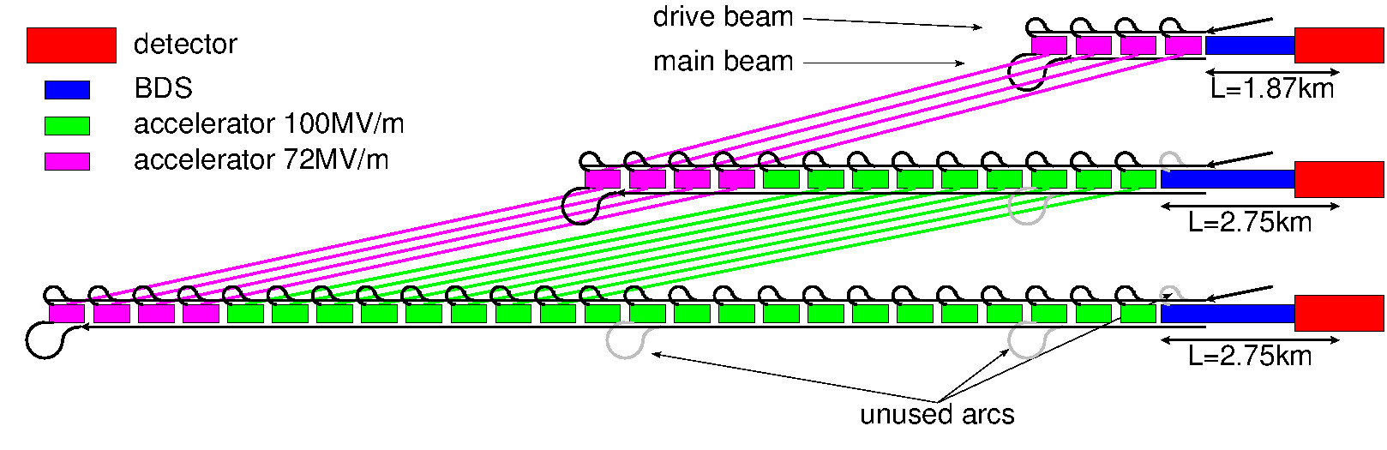
CLIC Energy Stages
  E_{cms}=380Gev, L=1.5x10³⁴cm⁻²s⁻¹, L_{0.01}/L>0.6
For higgs and top production, specified by CLIC physics group
E_{cms}=O(1.5TeV)
Depends on LHC findings
E_{cms}=3TeV, L_{0.01}=2x10³⁴cm⁻²s⁻¹, L_{0.01}/L>0.3

Slide 24
Basic Parameters
Based on CDR study results and SLC experiences

