Slide 1
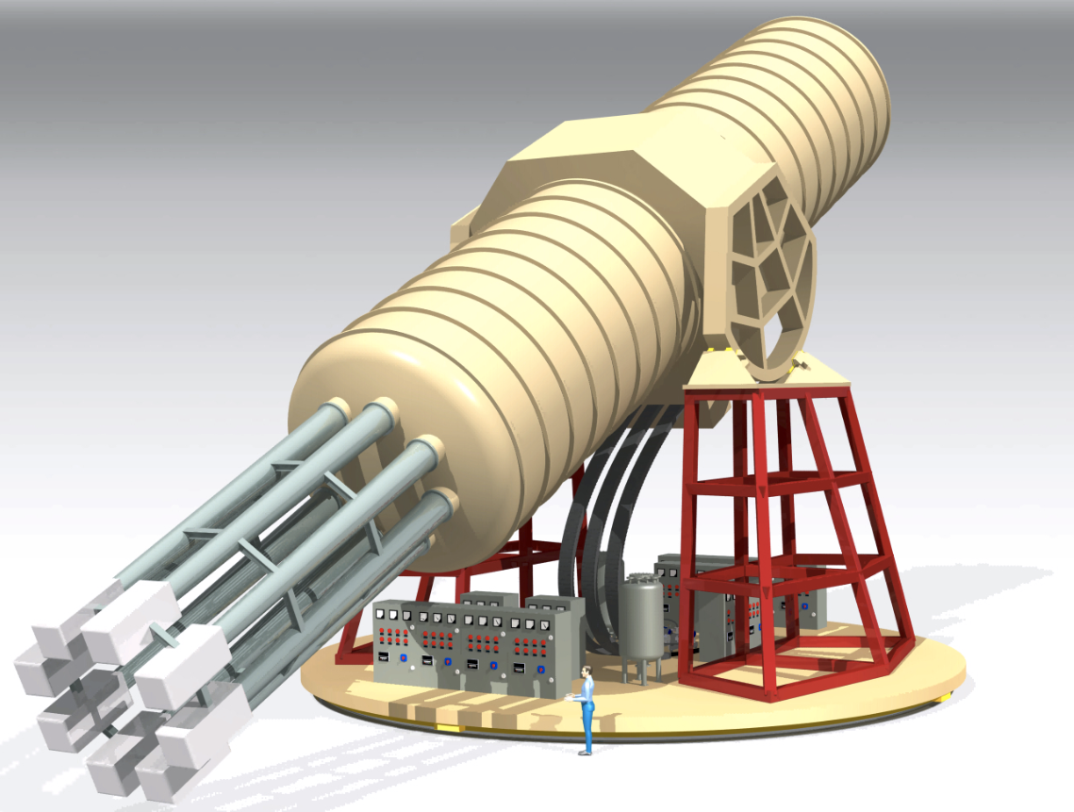
Physics case, prospects and status of the International AXion Observatory IAXO
Igor G. Irastorza (U. Zaragoza)
Axions&IAXO in Spain, Zaragoza, October 27th 2016

Slide 2



IAXO in the axion landscape
Source | Experiments | Model & Cosmology dependency | Technology
Relic axions | ADMX, ADMX-HF, Casper, CAPP, … | High | New ideas emerging, Active R&D going on,…
Lab axions | ALPS, OSQAR, fifth force exps,… | Very low
Solar axions | SUMICO, CAST, IAXO | Low | Ready for large scale experiment
Helioscopes → do not rely on the axion being the dominant DM component. Solar axion emission robust prediction
Helioscopes → No R&D needed. Technology mature enough for a large scale experiment (IAXO)
Large complementarity with other detection strategies

Slide 3
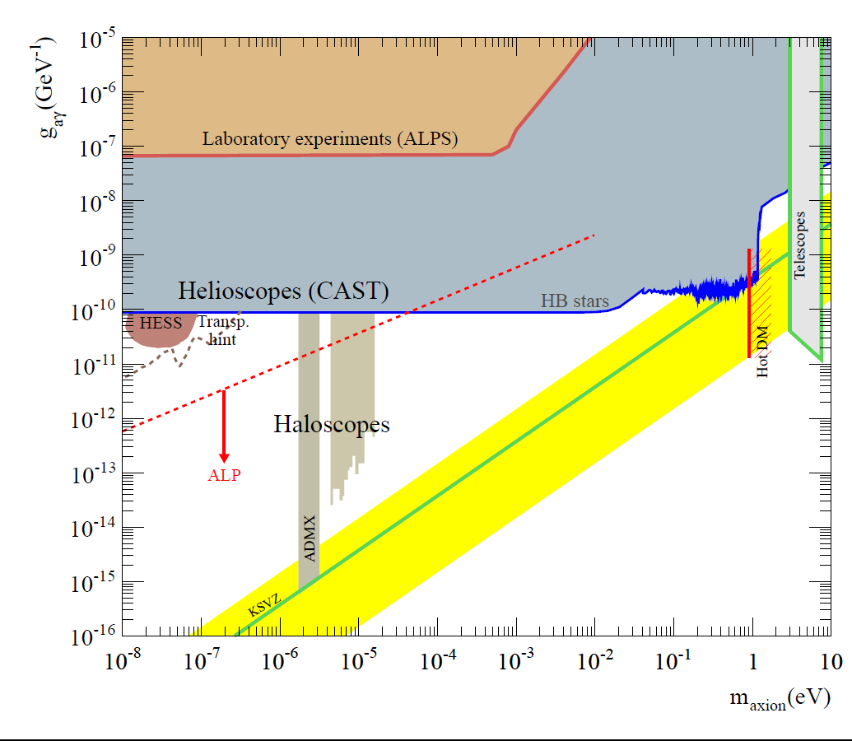

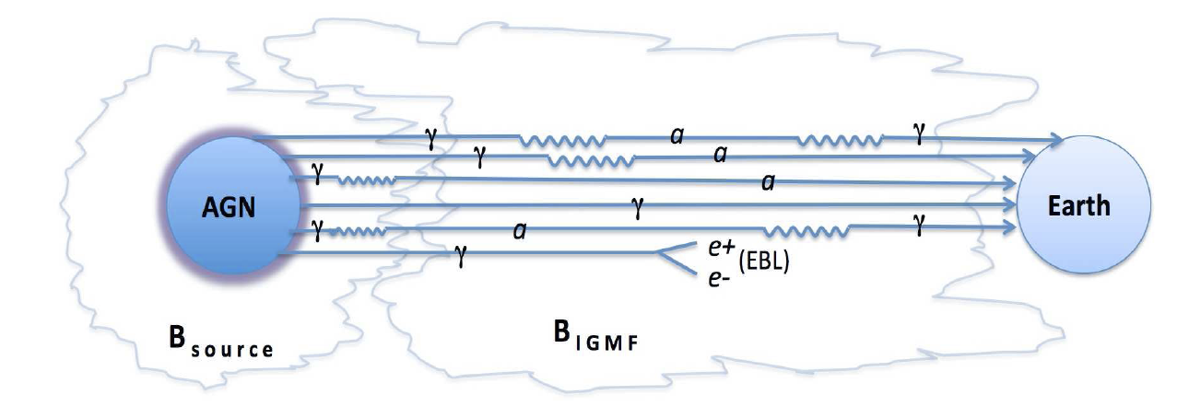
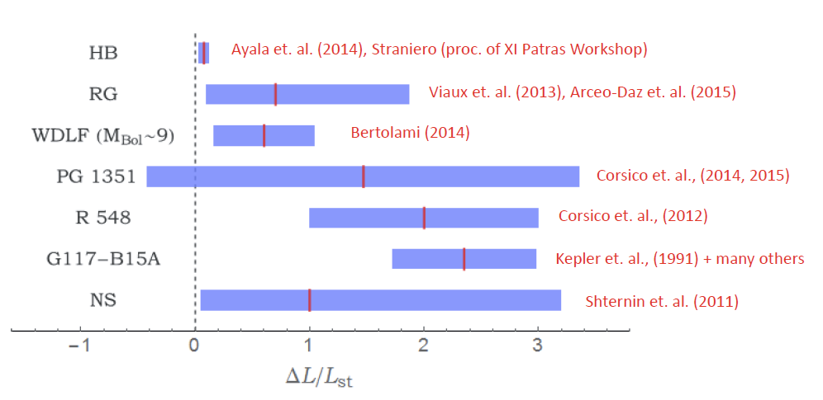
Axion/ALP parameter space
Transparency of the Universe
Stellar cooling hints

Slide 4
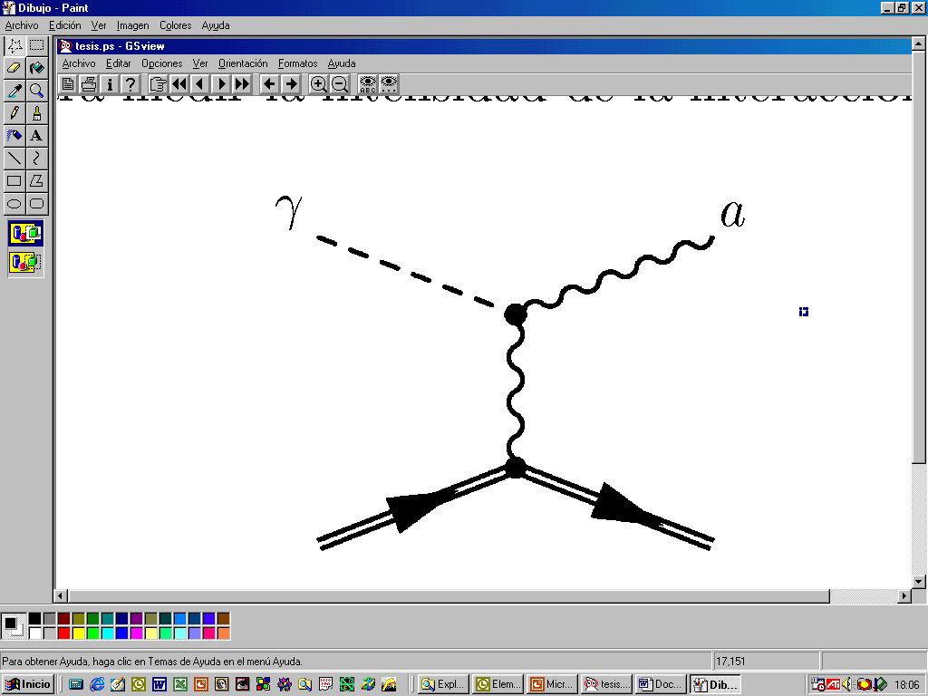
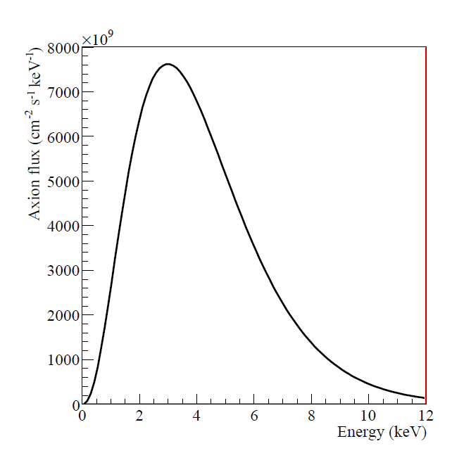
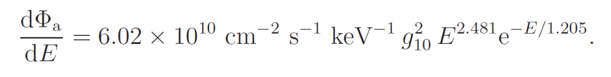
Solar Axions
Solar axions produced by photon-to-axion conversion of the solar plasma photons in the solar core
axions
“Primakoff” Solar axion flux at Earth
JCAP 04(2007)010

Slide 5
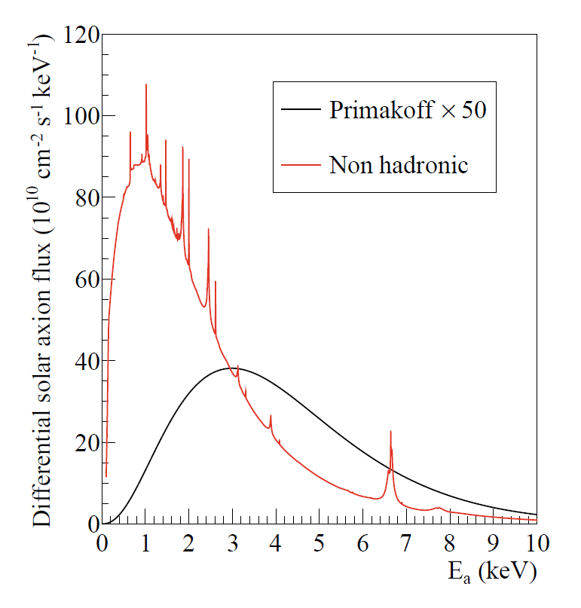
Solar Axions
Solar axions produced by photon-to-axion conversion of the solar plasma photons in the solar core
axions
Non-hadronic “ABC” Solar axion flux at Earth
JCAP 1312 008
* if the axion couples with the electron (g_{ae})
(non hadronic axion)

Slide 6
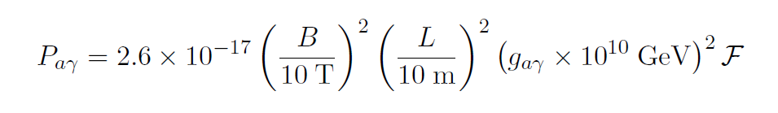
Helioscopes
Axion helioscope concept
P. Sikivie, 1983
+ K. van Bibber, G. Raffelt, et al. (1989)
(use of buffer gas)
axions
Transverse magnetic field (B)
L
X ray
detector
X ray

Slide 7
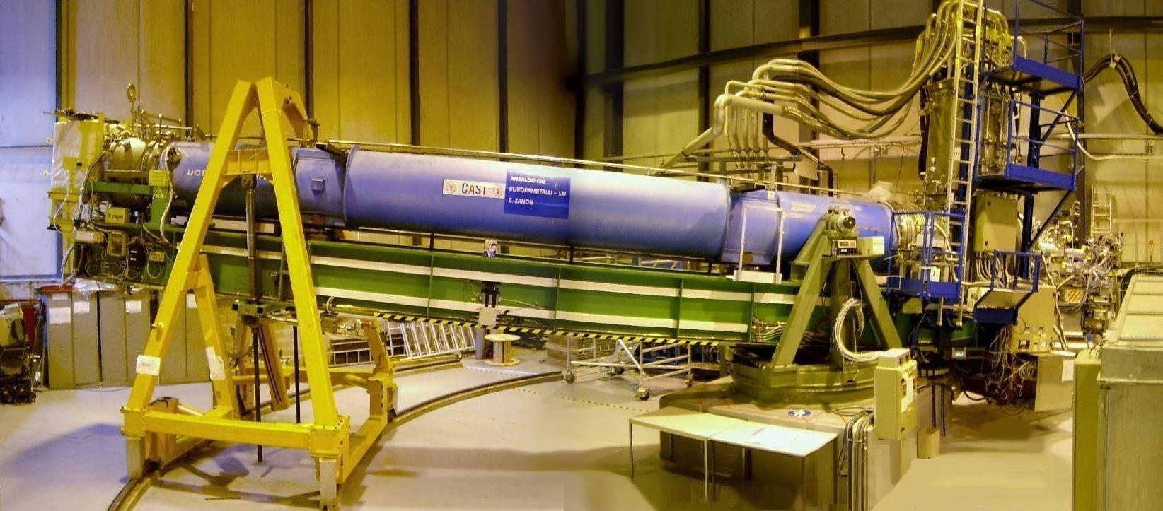
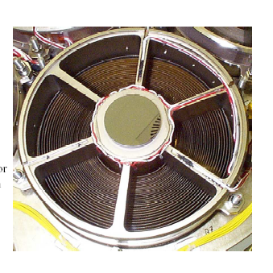
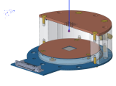
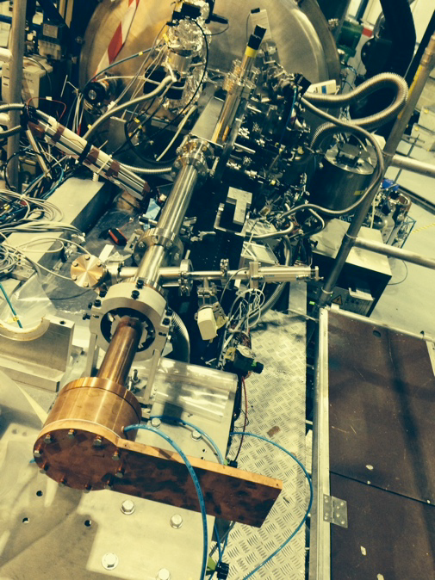
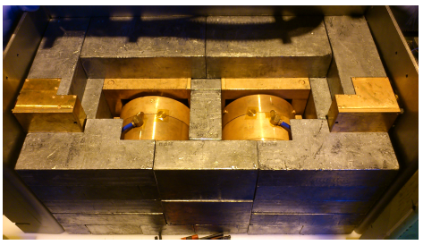
CAST experiment @ CERN
Decommissioned LHC test magnet (L=10m, B=9 T)
Moving platform ±8°V ±40°H (to allow up to 50 days / year of alignment)
4 magnet bores to look for X rays
2 X ray telescopes to increase signal/noise ratio.
Moving platform ±8°V ±40°H
LHC test magnet
2 low background Micromegas
1 Ingrid + XRT
1 Micromegas + XRT
7

Slide 8
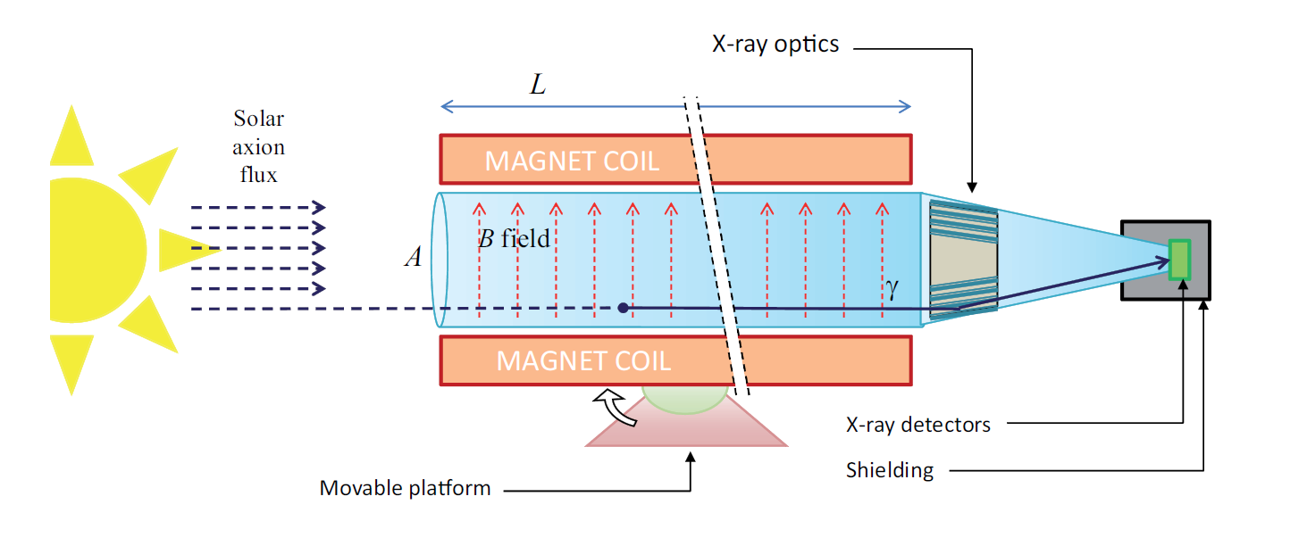
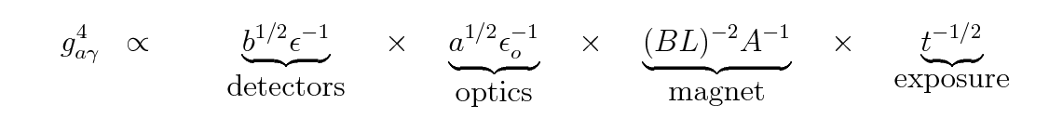
IAXO – Concept
Enhanced axion helioscope: JCAP 1106:013,2011
4+ orders of magnitude better SNR that CAST (JCAP 1106:013)

Slide 9
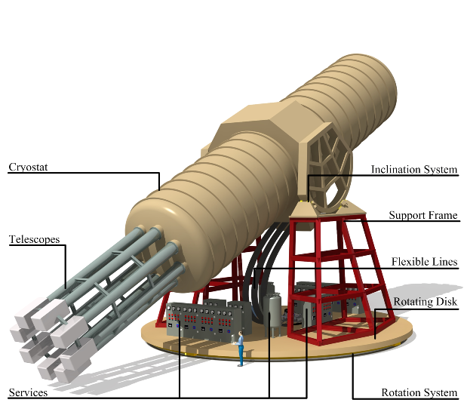
IAXO – Conceptual Design
Large toroidal 8-coil magnet L = ~20 m
8 bores: 600 mm diameter each
8 x-ray telescopes + 8 detection systems
Rotating platform with services

Slide 10
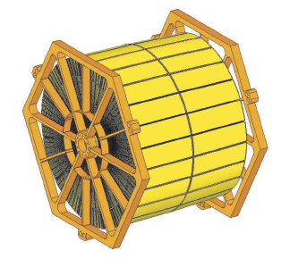
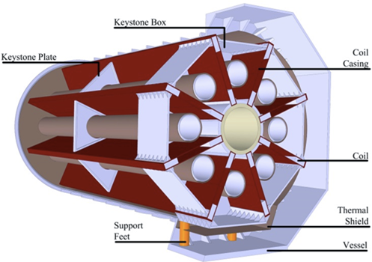
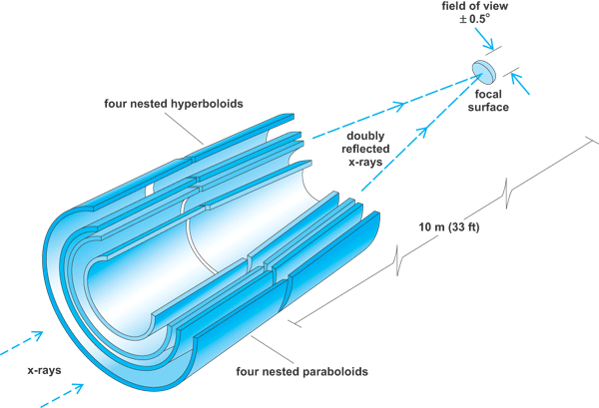
IAXO technologies – Baseline
IAXO telescopes
Slumped glass technology with multilayers
Cost-effective to cover large areas
Based on NuSTAR developments
Focal length ~5 m
60-70% efficiency
LLNL+UC+DTU
+ MIT + INAF
IAXO magnet
Superconducting “detector” magnet.
Toriodal geometry (8 coils)
Based on ATLAS toroid technical solutions.
CERN+CEA expertise
8 bores / 20 m long / 60 cm Ø per bore
Focal length
Baseline developed at:
IAXO Letter of Intent: CERN-SPSC-2013-022
IAXO Conceptual Design: JINST 9 (2014) T05002 (arXiv:1401.3233)

Slide 11
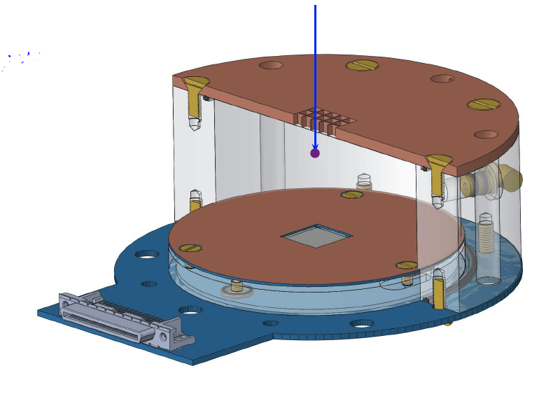
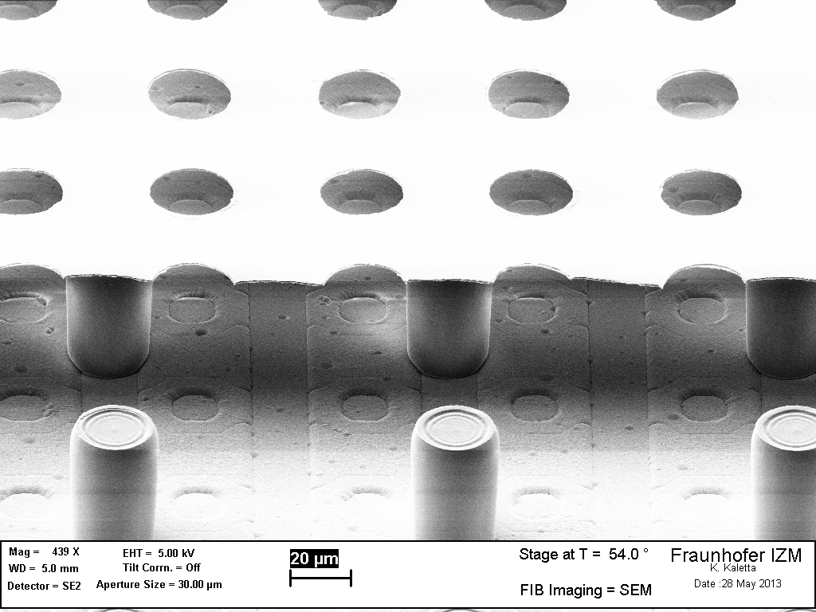
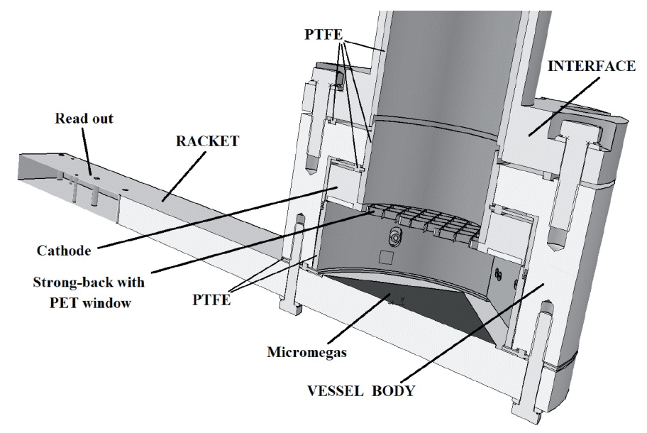
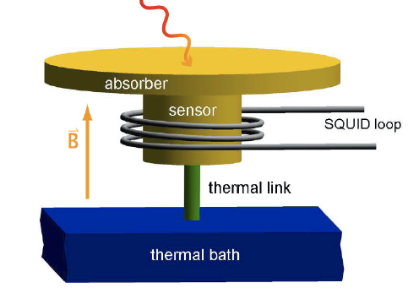
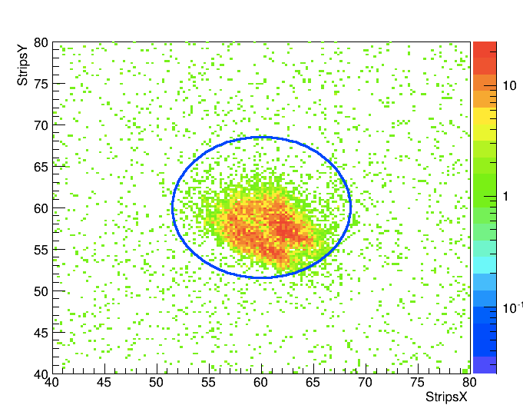
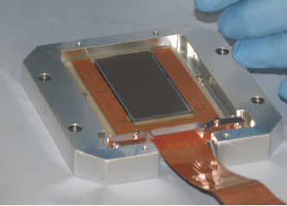
IAXO technologies – Baseline
IAXO detectors
Micromegas gaseous detectors
Radiopure components + shielding
Discrimination from event topology in gas
Long trajectory in CAST
Zaragoza + CEA + Bonn + others expertise
IAXO detectors
Ingrid detectors
Better threshold
U. Bonn
MMC (Magnetic Metallic Calorimeters)
TES (Transition Edge Sensors)
Very good E resolution & threshold
Heidelberg + CEA + CNSMS
Low noise CCDs
Optics+detector IAXO pathfinder system
(in operation in CAST during 2014-5)
Solar axion spectroscopy:
Axion-electron ABC spectrum
Axion mass determination
8.5 mm
Talk
F. Iguaz
Calibration photons (source 14 m away) focused onto the Micromegas

Slide 12
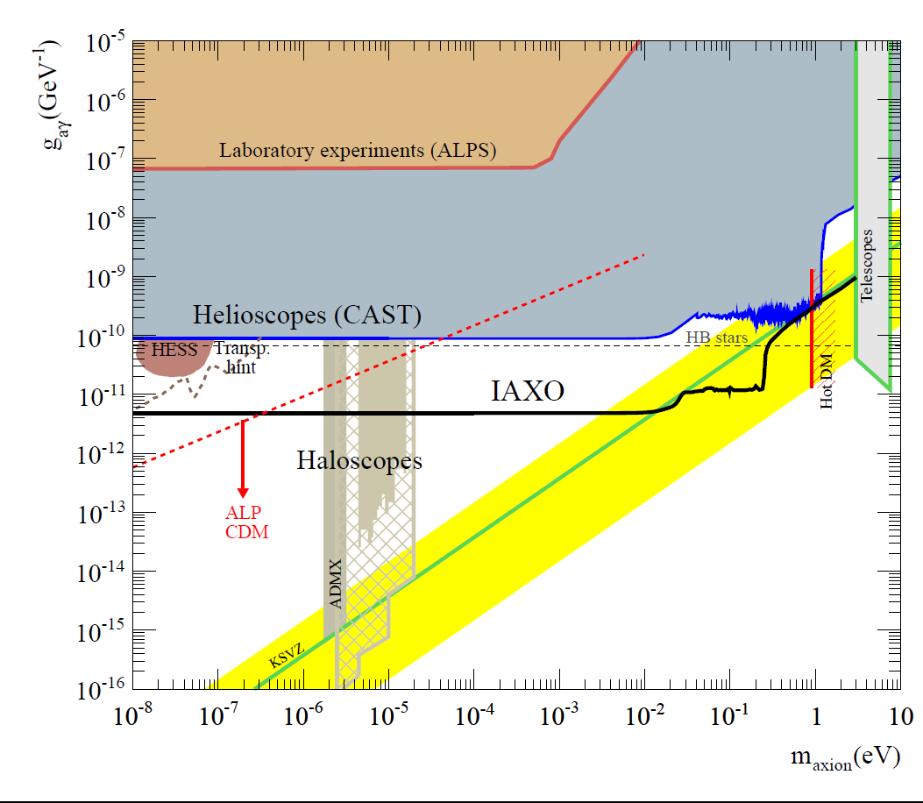
of
Axion/ALP parameter space
Transparency ALP hints accesible to IAXO & ALPS-II
Few meV scale QCD axion accesible to IAXO
& anomaly cooling hints
ALPS-II

Slide 13
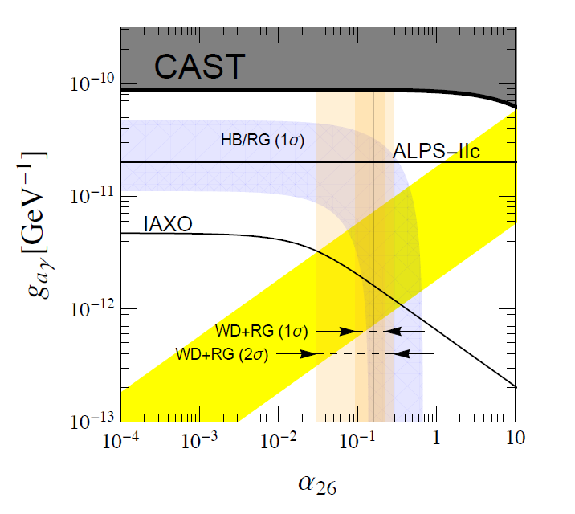
Axion-electron coupling
ABC-produced solar axions
Sensitive to g_{ae} values down to ~10⁻¹³
ALSO…
Dark Matter Axions (→ use of IAXO magnet with cavities / RF antennas)
ALPs from Dark Radiation
ALPs from nearby Supernova (connection with SNEWS) → MeV photon detector at the other end
…
Talk
J. Carmona

Slide 14
Dark Matter with IAXO
Motivation to perform “ADMX-like” searches in other mass ranges.
Many new ideas being put forward. R&D needed.
Various possible arrangements in IAXO. Leverage the huge magnetic volume available:
  Single large cavity tuned to low masses (ADMX-like but larger)
  Thin long cavities tuned to mid-high masses. Possibility for directionality. Add several coherently? (RADES?)
  Dish antenna focusing photons to the center. Broadband(?) search. Competitive at higher masses? (MADMAX like?)
  “DM-radio” idea?
Initial stages of exploring and developing concepts.
B₀
Talk
J. Redondo
Talk
A. Alvarez & A. Lozano

Slide 15
IAXO status of project
2011: First feasibility studies concluded (JCAP 1106:013,2011)
2013: Conceptual Design finished (arXiv:1401.3233).
  Most activity carried out up to now ancillary to other group’s projects (e.g. CAST)
August 2013: Letter of Intent submitted to the CERN SPSC
  LoI: [CERN-SPSC-2013-022]
  Presentation in the open session in October 2013:
January 2014: Positive recommendations from SPSC.
  Acknowledge physics case + encourage proceed to TDR
2014-15: Transition phase towards TDR (technical design)
  Some IAXO preparatory activity already going on as part of CAST near term program: IAXO pathfinder system in CAST in 2014-15
  Preparation of a MoU to carry out TDR work + formal establishment of collaboration
  Strengthen collaboration, awareness actions, meetings, coordinated funding applications
  First discussion on long-term plan to construction

Slide 16
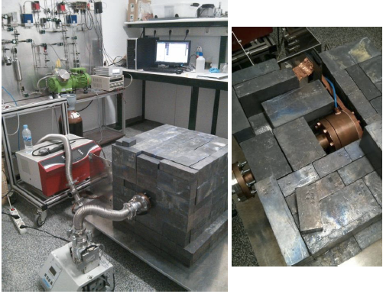
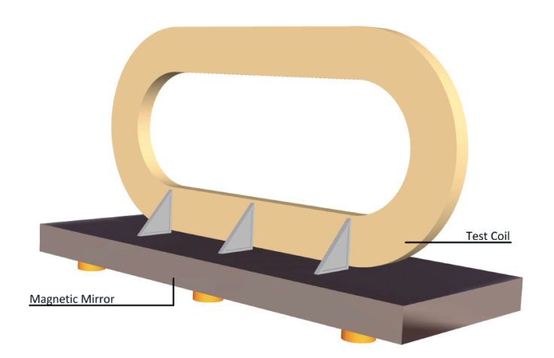
TDR in progress
IAXO-T0: demonstration coil magnet
IAXO-X0: prototype x-ray optics
IAXO-D0: prototype low background detector setup testing different technologies for detector
Studies to refine IAXO physics case
Additional physics potential
Site studies
Consolidate and structure collaboration
IAXO-D0 Micromegas
IAXO-X0
IAXO-T0

Slide 17

IAXO proto-collaboration
Big effort to strengthen collaboration → large consortium involved in a number of funding applications, covering all TDR needs
Zaragoza (Spain)
CEA-Saclay (France)
Mainz (Germany)
Bonn (Germany)
Heidelberg (Germany)
INR-Moscow (Russia)
LLNL
Columbia
MIT
INAF-Milano (Italy)
DTU (Denmark)
RBI (Croatia)
DESY (Germany)
U. Hamburg (Germany)
U.Valencia (Spain)
U. Cartagena (Spain)
INFN-Frascati, (Italy)
U. Barry
S. Carolina
+ …
CERN
CEA/Saclay (France)
New partners welcome…
(*) Only shown groups for which formal activity is ongoing or under discussion/preparation.
Potentiaal interest in more groups than shown

Slide 18
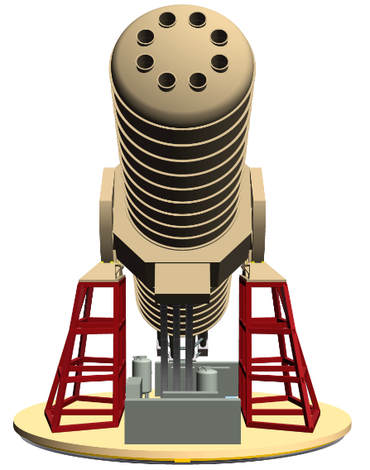
Conclusions
IAXO: best use of technologies (magnet, optics, detectors) and past trajectory of CAST at CERN
IAXO will probe deep into unexplored axion+ALP parameter space:
  QCD axions at the few meV scale → not at reach of any other technique
  ALPs at the g_{aγγ} ~10⁻¹² GeV⁻¹ scale
  ALPs at the g_{ae} ~10⁻¹³ scale
IAXO as a generic “axion/ALP facility”
First steps towards TDR after the positive recommendation from CERN SPSC.
Large community now endorsing the project.
Longer-term strategy towards construction under discussion. Site: CERN but also DESY or LNF

