Slide 1


Radiation Detectors Group
RDG
IMB-CNM, Barcelona
RDG, IMB-CNM (CSIC)
Barcelona, Spain

Slide 2
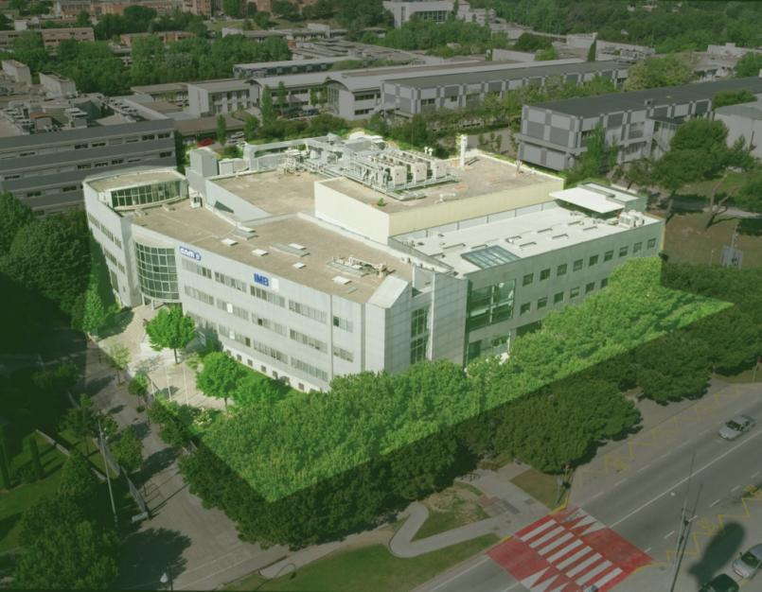
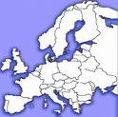
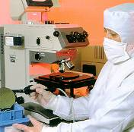
Introducing IMB-CNM, CSIC
Instituto de Microelectrónica de Barcelona, Centro Nacional de Microelectrónica
National Microelectronics Center
Belongs to CSIC: Spanish National Research Council
Located in Bellaterra, Barcelona
Dedicated to Nano- & Micro-electronics
Micro- y Nano- Fabrication Facility “Clean Room”
Departments
  Micro and Nano Systems
    Silicon sensors and Actuators
    Nanotecnology
  Systems Integration
    Power Devices and Systems
    Circuit and System Design
    Biomedial Applications

Slide 3
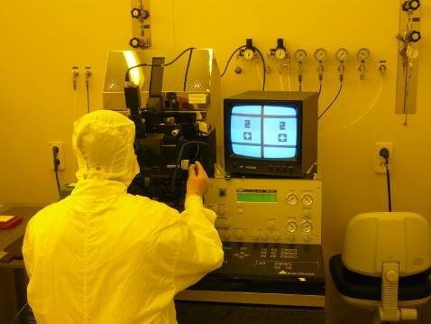
IMB-CNM Research Facilities
Clean room
  1.500 m², class 100 to 10.000
  Technologies for Micro y nano fabrication
  Areas:
    CMOS (high purity, no contaminants)
    MNC (Noble Metals – contaminants for Si)
    Nanotecnology
  Processes
    4'' complete
    6'' partial
  Technologies:
    CMOS, Bi-CMOS, MCM-D, MEMS/NEMS, power devices, radiation detectors
Silicon Micromachining
Microelectronic Packaging Area
  200 m², class 100
  Wafer cutting, wire-bonding, bump-bonding
Laboratories
  Test and characterization
    Automatic wafer probing
    DC y RF (up to 8 GHz)
    Thermography
  Reverse engineering
  Simulation
  CAD
  Mechanical workshop
  Chemical sensors
  Bio-sensors
  Radiation sensors
  Optical sensors

Slide 4
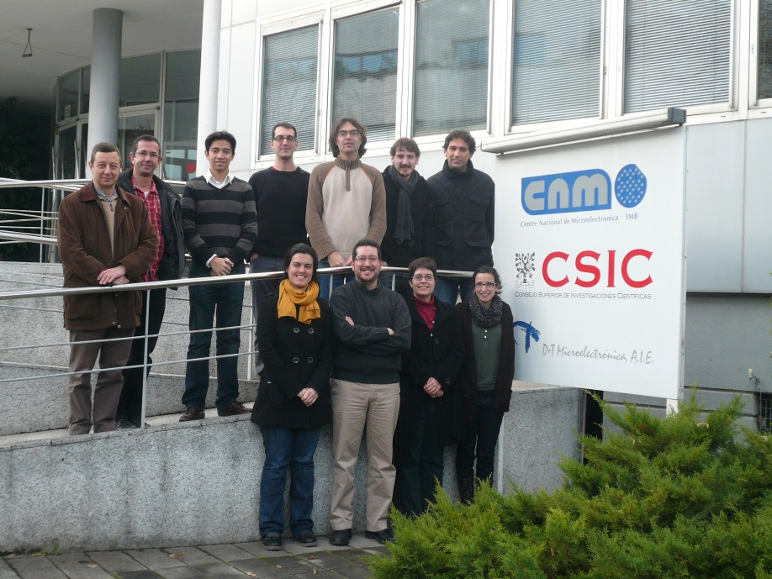
Radiation Detectors Group (RDG)
Personnel
  8 permanent researchers (PhD)
  4 experienced researchers (PhD)
  5 PhD students
  1 technician
Statting activities in 1996
Experiments
  ATLAS, CMS, LHCb
  Founder members of RD50
  ASTROMED
Colaborations
  IFAE, IFIC, IFCA (Spain)
  BNL, SCIPP-Santa Cruz (US)
  INFN (It)
  Glasgow, Liverpool (UK)
  DESY, Freiburg, Karlsruhe (Ger)
  Medical applications: Roberts Proton Therapy Center (Univ. Pennsylvania, US), Orsay (Fr), Univ. Wollongong (Aus)

Slide 5
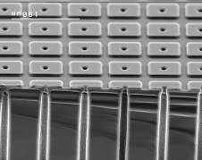
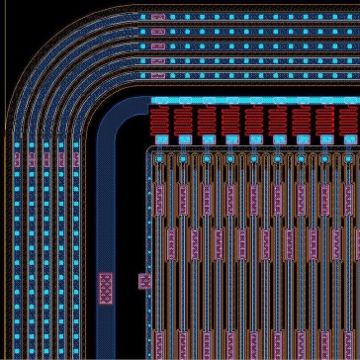
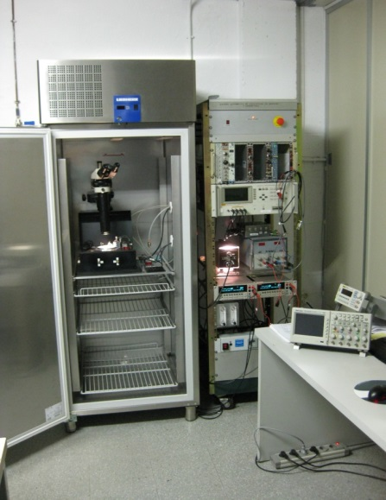
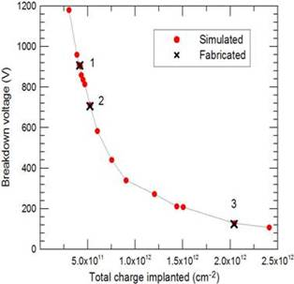
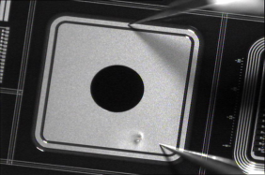
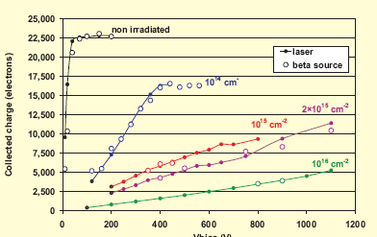

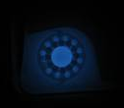
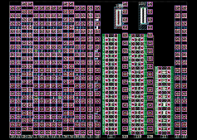
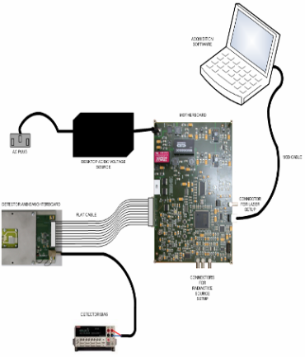
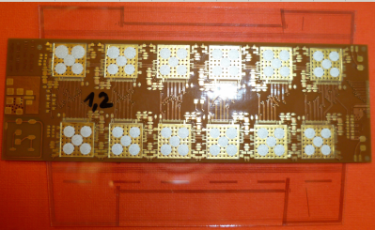
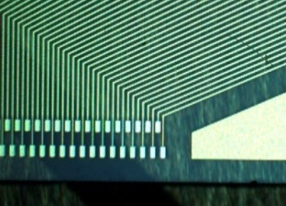
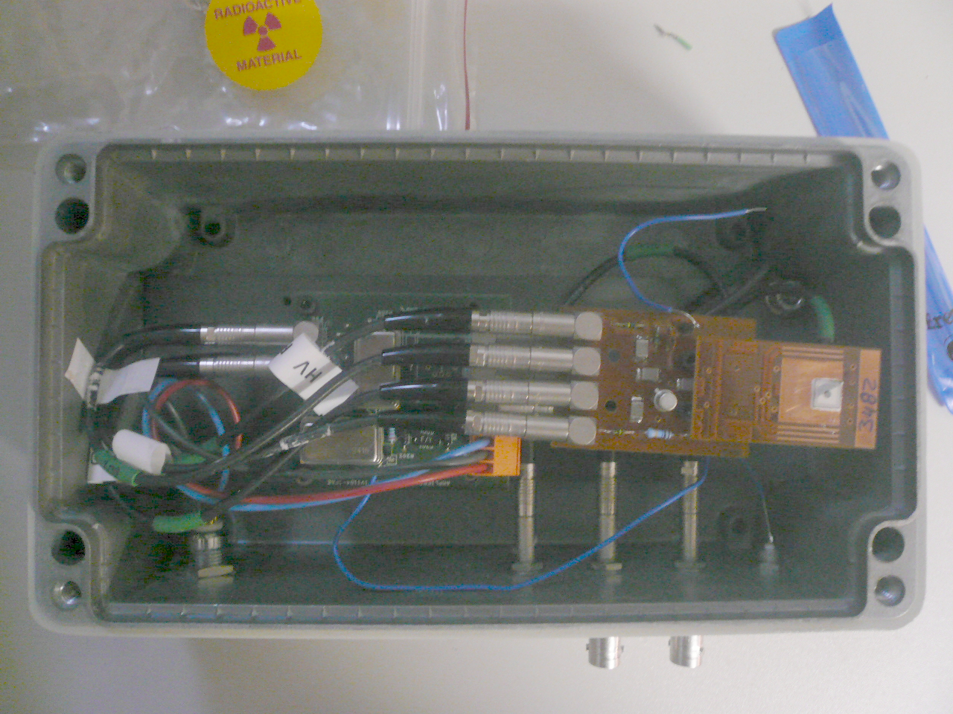
CNM’s Capabilities
Technological contributions for Experimental Particle Physics
since 1996
  Silicon radiation detectors
    Fabrication and development
    Design and optimization
    Simulation
    Characterization
  Radiation hardening and assurance
    Radiation detectors
    Microelectronic technologies and devices
    Other materials
  Other technologies
  System + services

Slide 6
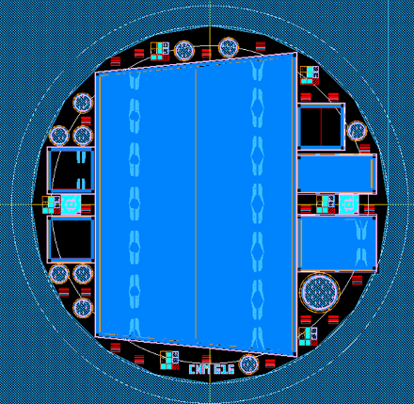
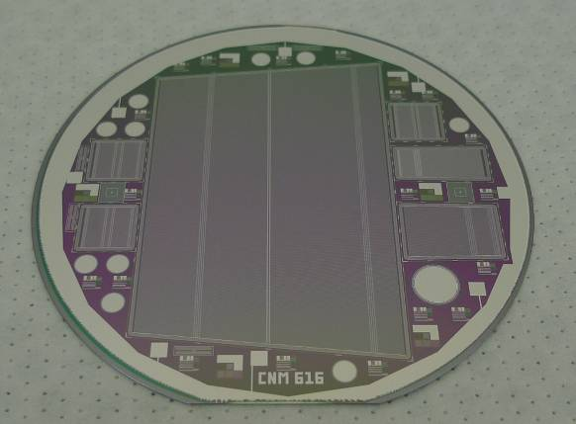
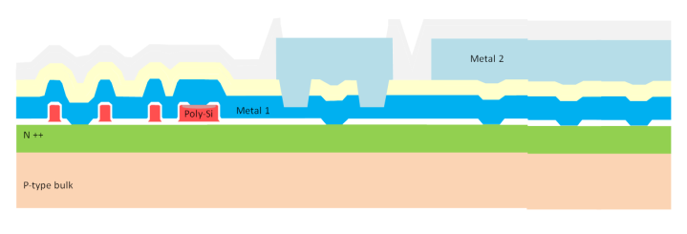
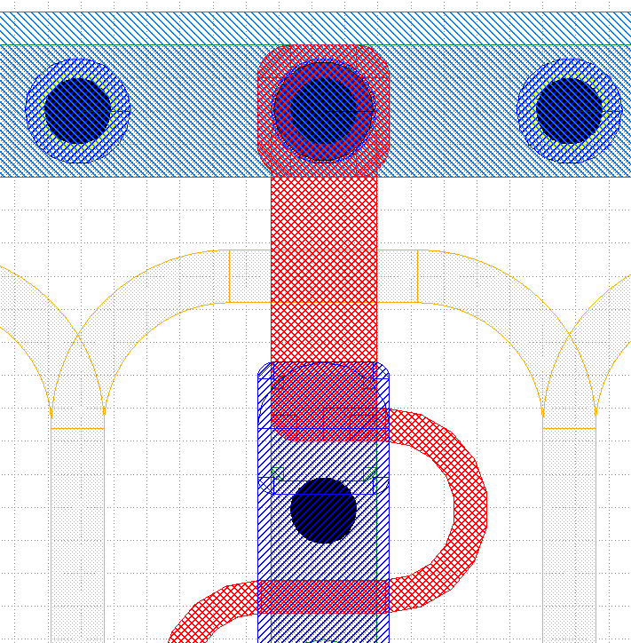
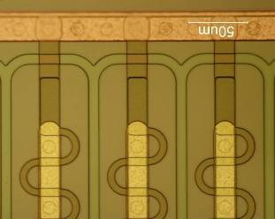
Radiation Detectors R&D at CNM
Design, fabrication and optimization
  Design and fabrication of full ATLAS-like sensors
  Fabrication of sensors for the ATLAS Upgrade End Cap prototypes
  Fabrication of sensors for the RD50 Collaboration
s
Bias rail
Optimization
p
d
s
Polysilicon “bridge/gate”
Implant

Slide 7
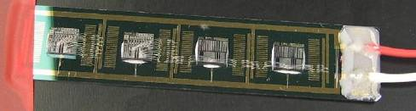
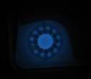
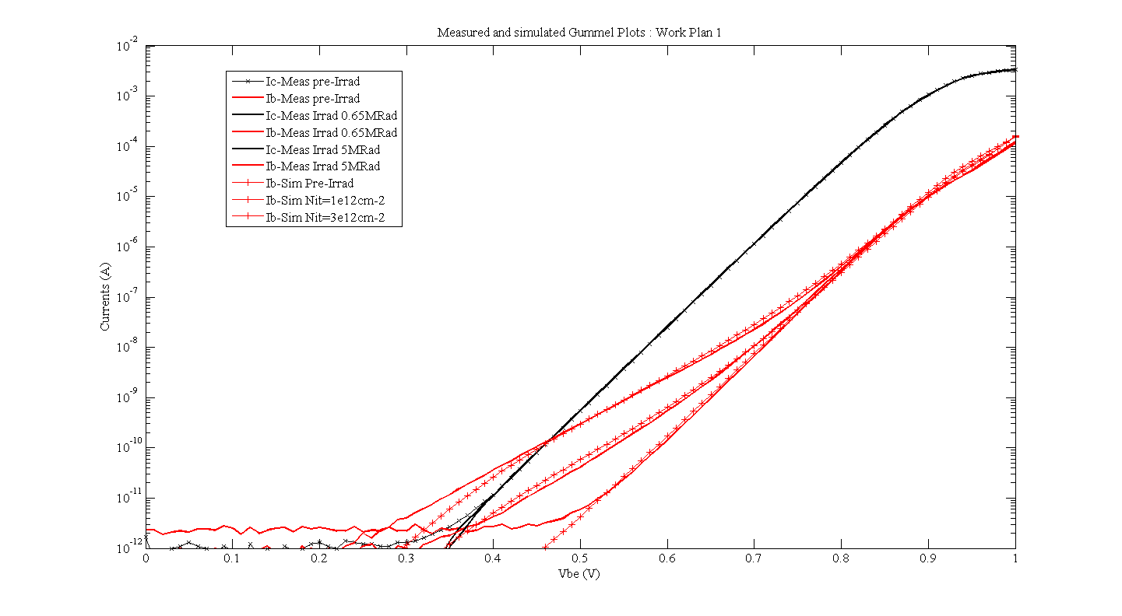
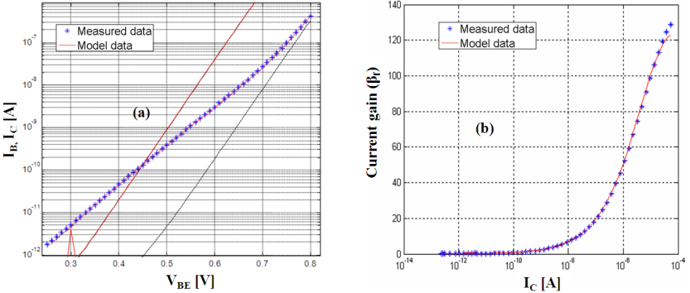
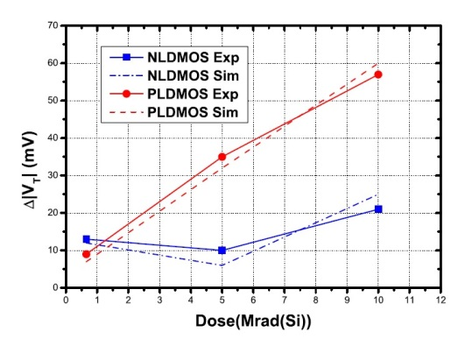
Radiation Effects Studies
Characterization of microelectronic devices degradation with radiation
Simulation of radiation effects in microelectronic devices
  TID, displacement, SEE
Modeling radiation degradation
Radiation hardening
Development of rad-hard technologies
Increased irradiation dose
Increased Nit concentration

Slide 8
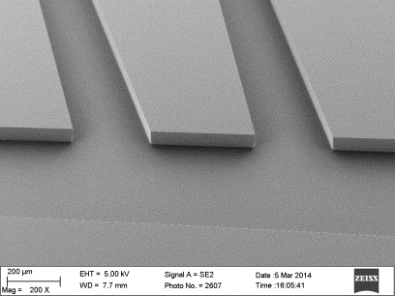
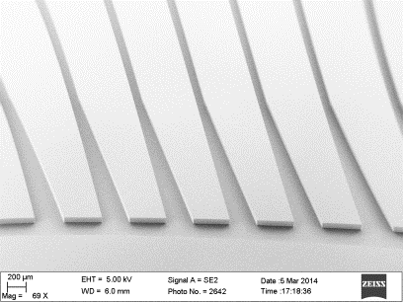
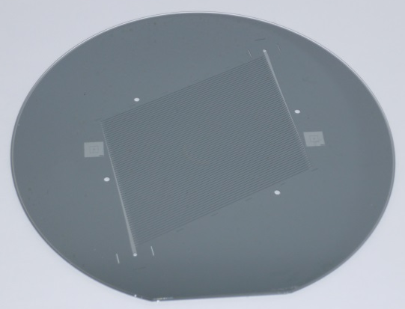
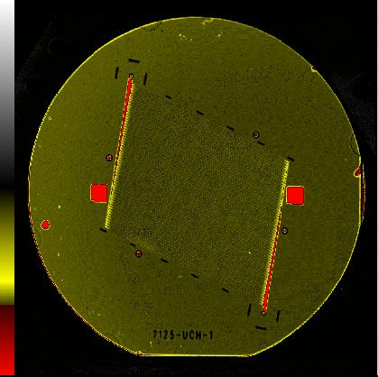
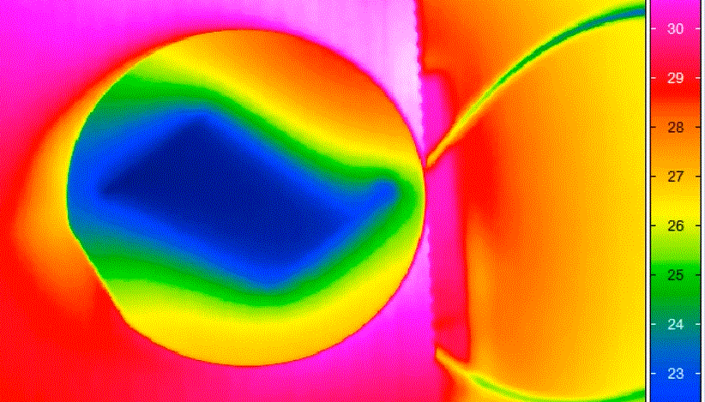
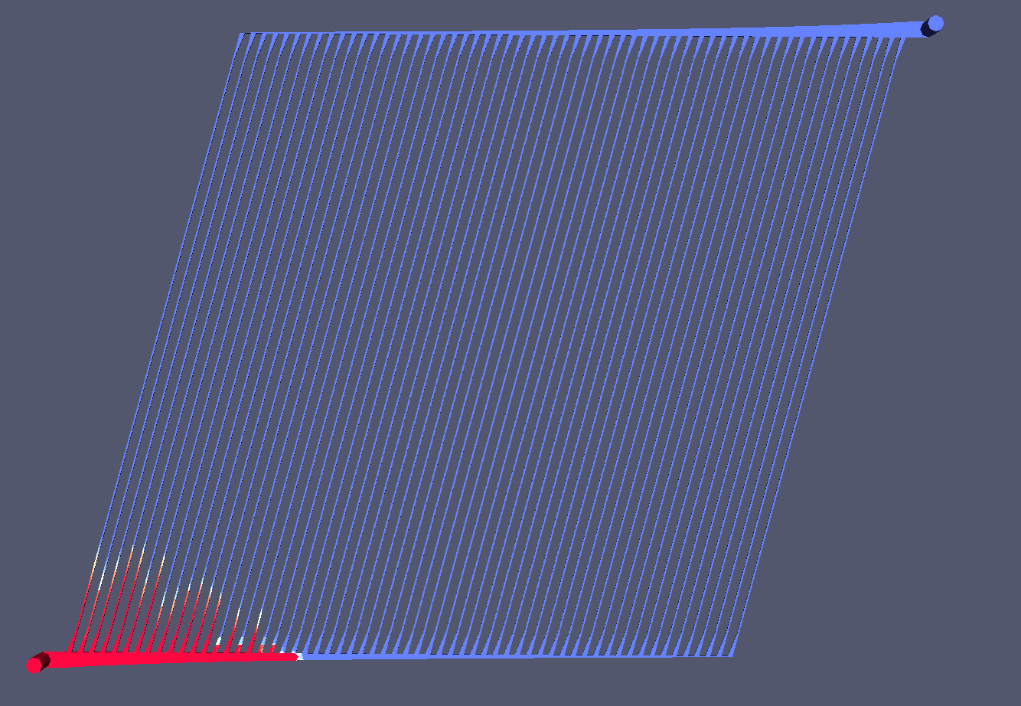
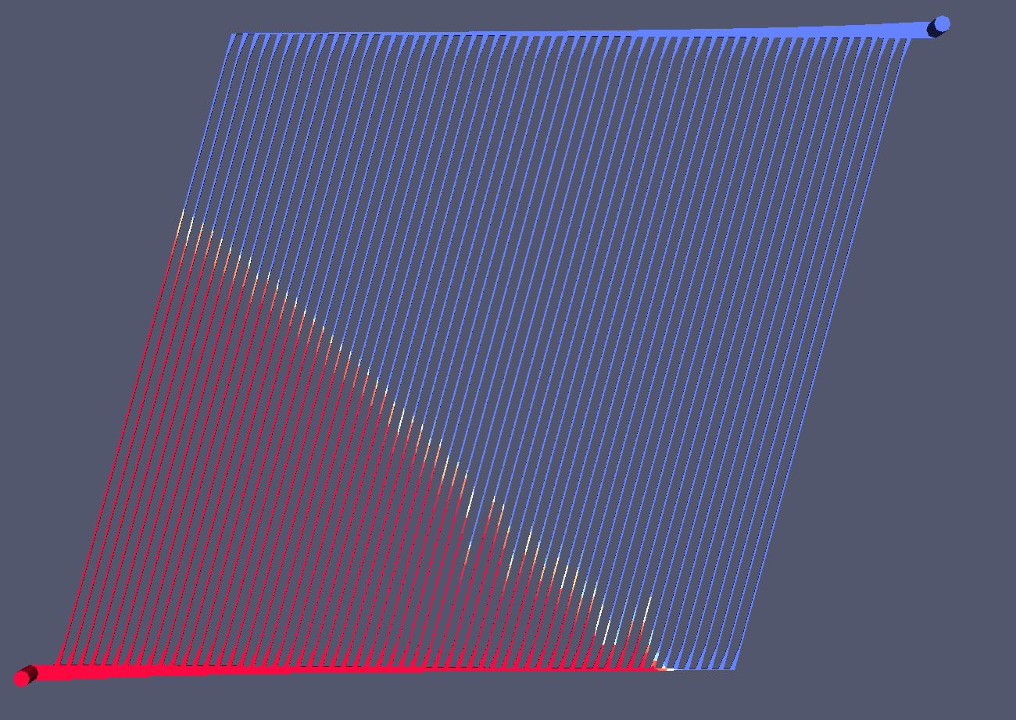
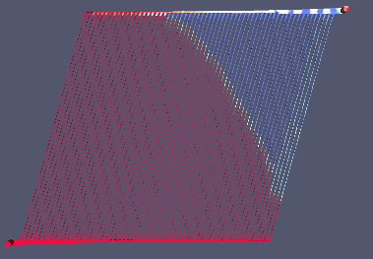

Micro-Channel Cooling (with DESY)
Objective:
  Reduce the mass of the cooling systems
  Cool only the detectors increases efficiency
Technology being developed:
  Micro-channel generation
    Deep Reactive Ion Etching (DRIE)
  Wafer bonding
    Anodic bonding (Si-SiO₂)
    Fusion bonding (Si-Si)
    Eutectic bonding (Metal-Metal)
Fluidics
Cooling Power

Slide 9
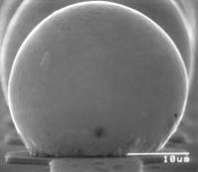
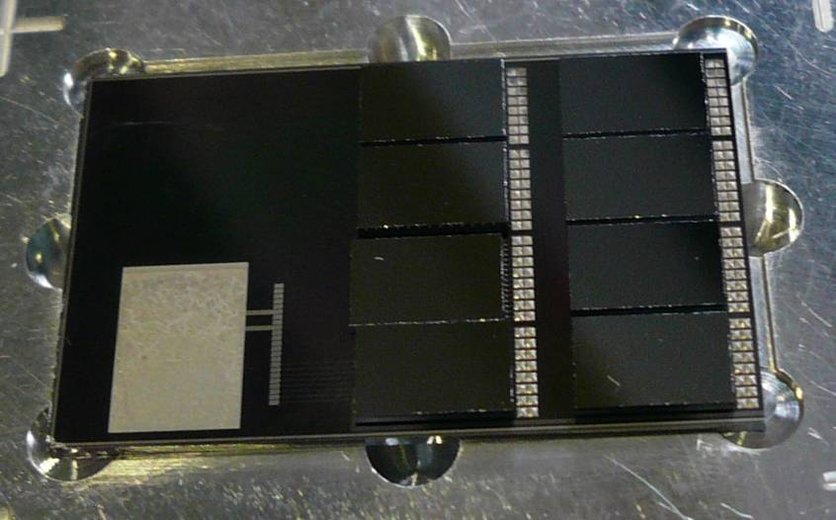
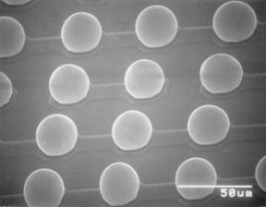
Flipchip Packaging
Sn/Ag and Sn/Pb bump electroplating
TiW/Cu electroplated UBM
Ni/Au electroless UBM
SET FC150 Pick&Place
1 micron placing accuracy
Reflow in formic acid

Slide 10
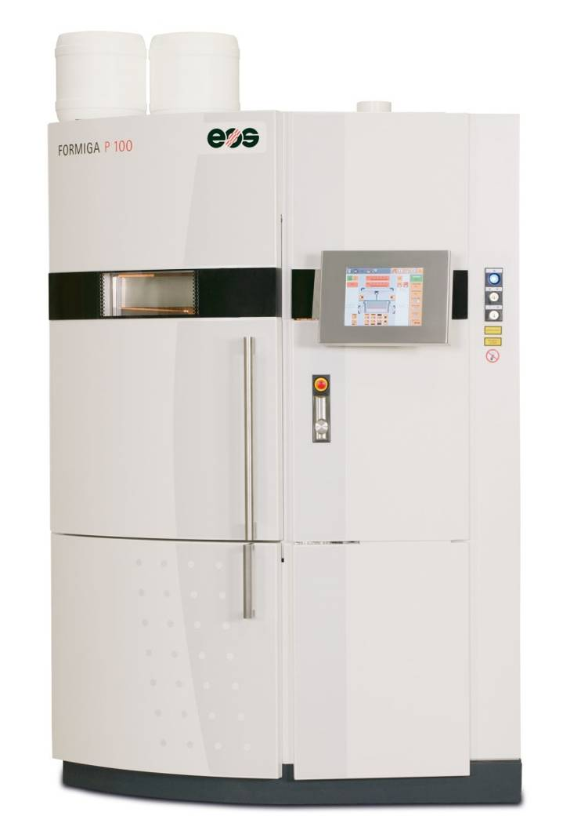
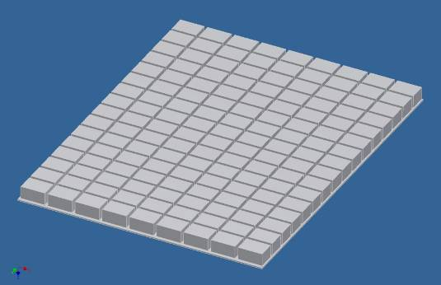
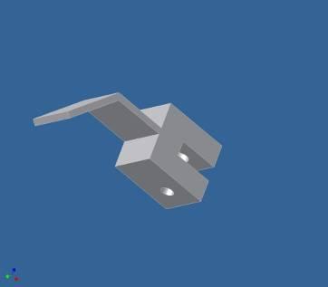
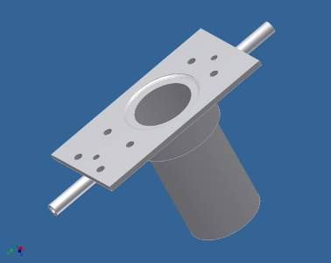
3D Rapid Manufacturing
Polyamide Laser-sintering system
EOS FORMIGA P 100
From CAD to piece in few hours
  Effective building volume:
  20 cm x 25 cm x 33 cm
  Resolution ~0.1 mm (vertical)

Slide 11
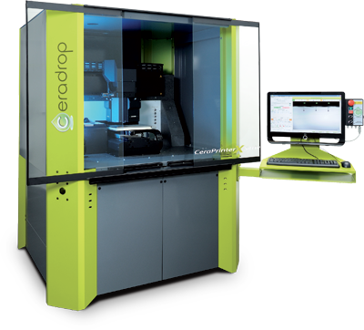
New technological line: Printed Electronics
Inkjet type printer
Many different inks available
  conductor
  Insulator
  Semiconductor
  sensing elements
  LEDs
Many groups working in the development of new types of inks
  Mostly based on nanoparticles
Ceradrop Ceraprinter X-Series
Accuracy 1.5µm
Print resolution 5µm
Print surface 30cm×30cm

Slide 12
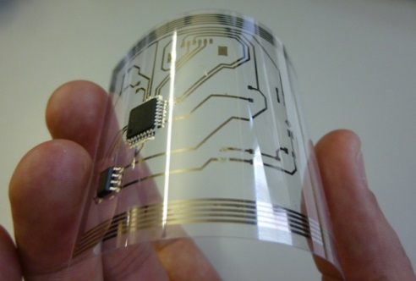
Electronics design
Potential applications
  HF Antenna
  RFID
  OPV
  OLED
  Interconnection
  Printed memories
  Photodetectors
  Lens
  Semiconductor
  Biology
  Ceramic thick films
  LTCC
  Multilayer Ceramic Capacitor
  Magnetic components
  Temperature sensors
  Piezoelectric actuators
  Sol gel selective deposition
  Photocatalytic elements
  Fuel cells
  Solar cells front contacts
Example made at CNM:
  Silver nanoparticles conductive ink
  SU8 insulator

Slide 13
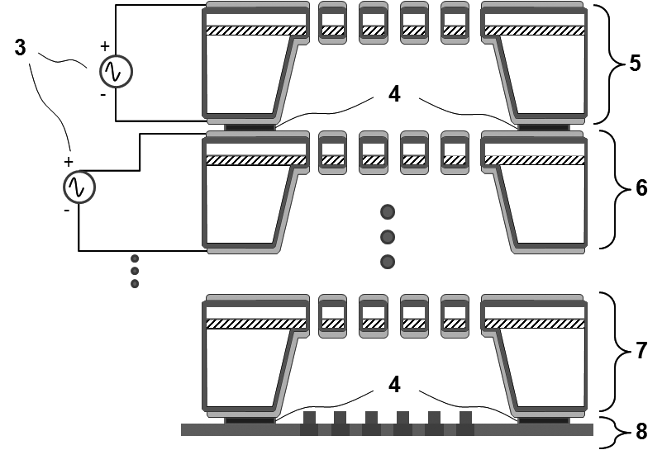
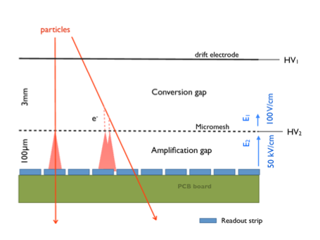
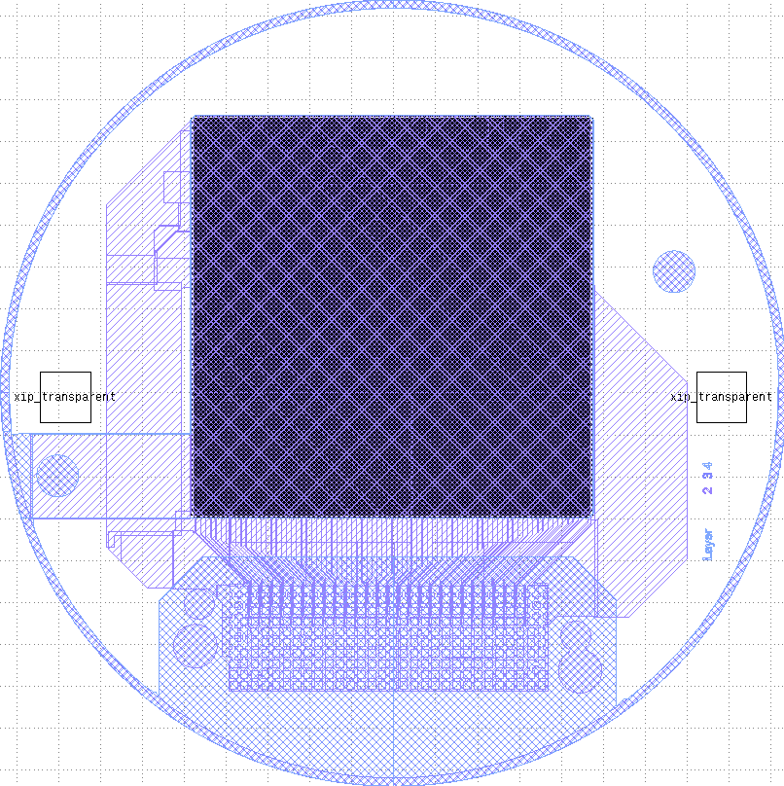
Si-GEMS Nanomigas Project Objectives
There are two main approaches to Gaseous Detectors: The GEM (Gas Electron Multiplier), which is a thin metal coated insulator foil, perforated by a high density of holes and the MicroMegas, a similar layout, but in a multiple stage configuration.
CNM is developing a gaseous detector using Silicon instead of the foil. This is a development following CNM’s patent on a pilable detector made out of several individual Si-GEMs.
Side objective: SU-8 GEM together with UniZar (not included in original application)

Slide 14
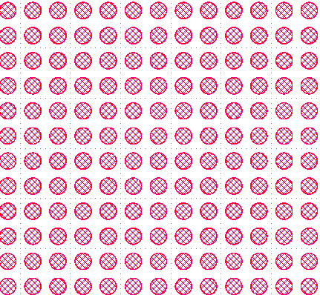
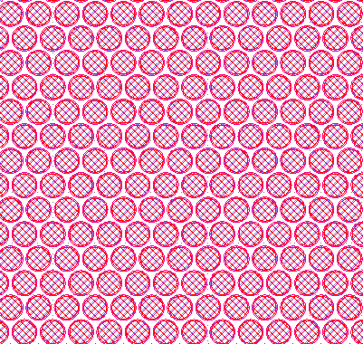
Experiments
Trials with micromachined silicon wafer
2 designs: squared and rhombohedral-shape distributed
Hole diametre 80µm.
Pitch 110 (double medipix pitch)

Slide 15
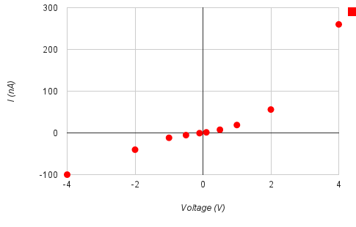

Resistance Measurement
first the GEMs were tested with a Multimeter and for some R>2 GOhm were found
afterwards measurements with Keithley
Results: Several hundred nA at low voltages, not symmetric in respect of polarity
Keithley
Si-GEM
Channel B
GEM 1
GEM 2

Slide 16


CNM758: Visual Inspection
One side looks good:
Rim is visible and of right size
The other side not …
No rim
Al hole diameter smaller than Si hole diameter
SiO₂ hanging in the hole (EXRS study at CNM)

Slide 17



Results
First Si-GEMs showed a too high leakage current
Improvement with 2µm-thick SiO₂
A final Si-GEM was build and is being tested

Slide 18

55Fe source. Stable after 2 hours operation. No sparks

Slide 19
Conclusions on Si-GEMs
First Si-GEMs showed strange V-I curves (e.g. not symmetric to 0V)
Obvious problem with hole etching -> problem identified and currently being fixed. Thicker oxide + ONO
Si-GEM with thicker SiO₂ layer showed better results.
Promissing results, but further development needed.

Slide 20


ATOMGEM: Preliminary tests
Two mask sets CNM759 & CNM811
SU-8 polimer 50µm-thick
Technical problems encountered
Solution will be found within ATOMGEM

Slide 21
SU8: Results
ATOMEGAS: Spanish project to develop this technology starting next January

