Slide 1
Simulation, Key Issues for the Coming Decade
Federico Carminati
CERN-SFT

Slide 2
Disclaimer
I took my mandate for this talk to identify which aspect of simulation leaves room for improvement and how I think it could be improved
This (also) means to put the accent more on the negative than on the positive side of things
Although the issues I raise are quite general for the simulation field, most of my experience is with the GEANT family of codes (2,3,4,V) and this may have introduced a bias

Slide 3
Acknowledgements
For this talk I have received an impressive amount of feedback and suggestions from colleagues
Of course I take full responsibility for the content and all errors or misunderstandings are mine…

Slide 4
The panorama
EGS 1,2,3,4 (1965, ~1970, 1978, ~1990)
  e- gamma. It has set the basic structure of the transport MC
  EGSnrc for medical applications released in 2000 (C++ geometrical library)
FLUKA (1962)
  Complete particle transport solution
GEANT 1,2, 3 (1974, 1976, 1980)
  HEP standard for detector simulation before 2000
GEANT4 (1998)
  Current HEP standard for detector simulation
GEANTV
  Prototype of the future generation GEANT

Slide 5
The panorama
MARS (1974)
  Biased transport and beam simulation
MCNP(x) (1957)
  One of the “bibles” of simulation. Now a closed source code
PENELOPE (1996)
  High-accuracy for coupled electron-photon transport
PHITS (2002-present)
  NMTC/JAERI97 all-particle transport with extra capabilities for heavy ion transport

Slide 6
The simulation cycle
Fast simulation

Slide 7
Present situation
Two main simulation products used in HEP today: FLUKA and GEANT4
  FLUKA is the main tool per accelerator, beam-machine interactions, targets and secondary beam design, radioprotection & waste prediction and management
  GEANT is the program of choice for full-detector simulation
Each one has its strengths and weakness
  Which I will not discuss here
Collaboration between these two entities is limited
I believe there are missed opportunities here
  But I do not see the situation changing anytime soon
The upside is that we have independent confirmation of results and scientific competition, which are positive elements

Slide 8
The components
Historically simulation has been ”split” into several components
User
application
Event generation
Transport
Hits & Digits
X-sections
Reconstruction
EM physics
Physics
Geometry
hadrons
neutron
Persistency
CAD, GDML, ROOT…
Visualisation, event display
neutrinos,...

Slide 9
Geometry
Geometry is ubiquitously used in HEP (simulation, calibration, reconstruction, alignment, visualization, fast simulation)
  Navigation algorithms can be used in other contexts
  A large development and maintenance effort
Still no simulation package has “by design” provided a ”modular” geometry engine that can be easily reused in other contexts
“Generic” geometry projects give priority to an “exchange format” and several packages that can read from it
Pros:
  Each package can specialize in its own domain of application
Cons
  The wheel has been reinvented many many times

Slide 10
Convergence (at last?)
One becomes two, two becomes three, and out of the third comes the one as the fourth.
Maria Prophetissa (3rd century AD)
USolids was developed to unify TGeo and GEANT4 geometry packages (or at least shape algorithms)
VecGeom (AIDA I&II projects) code has been developed for GEANTV vectorised transport
Now VecGeom algorithms are available both to GEANT4 and to TGeo
  The USolid interface has been maintained, so the user should see no difference
VecGeom has the potential to introduce a %-level gain for GEANT4
  Algorithm improvement and (internal) vectorisation of some shapes
  It might well offer substantially more benefit if its navigation system is used
  See S.Wenzel’s talk “Accelerating Navigation in the VecGeom Geometry Modeller” 12 Oct, 12:00 Sierra A

Slide 11
Common exchange format
This solution has been prototyped several times
It is a step in the right direction but
It produces a proliferation of readers and a duplication of algorithms
It hinders community efforts toward solid geometrical algorithms since the code remains in the experiment framework
Simulation
Reconstruction
Internal Format
Internal Format
Geom exc format
GDML, DD4HEP, VGM
Visualisation
Alignment
Internal Format
Internal Format

Slide 12
Common geometrical library
Developing a geometrical modeler is one year of coding and ten years of debugging…
A HEP community geometry package could help concentrate efforts on common algorithms and format convertors
Concentrating on a single, standalone and modular package could avoid the many fresh starts we have witnessed
It could also allow to address the interface with CAD systems, for which all packages have partial solutions
Visualisation
Simulation
Reconstruction
Alignment
Geometry package
Native format
Other formats
CAD

Slide 13
Physics
As precision experiments look for rarer processes, the requirements for their accurate description increase
Scarcity of (stable) (wo)manpower sometimes makes planning dependent on the effort available (in time and quality)
  More physics experts with would allow better organization and planning
(In GEANT4) often developments are “user driven” and in “reaction mode”
  It has worked well, but not without some “close calls”
Transport MC physics experts are very few and they not always have the “institutional mandate” to develop physics for MC

Slide 14
Physics
It is now the case, namely in GEANT4, that a generation of extremely skilled developers are approaching the end of their career
Although the problem is known, there is no community-agreed community to address it
Institutions invest heavily in GEANT4
But it would help if there was clear institutional commitment to maintain / develop a given area of physics

Slide 15
Electromagnetic
Supposedly the “simple” part, since QED is well under control
Reinvented several times (EGS, FLUKA, GEANT3, GEANT4, GEANTV)
  Sometimes with more or less “inspiration” (and code) taken from previous versions
The devil is in the details
  Tight connection with transport due to continuous / discrete (energy loss / ionization) processes and multiple scattering
  Low energy (<1keV) and very high energies (>10TeV) require completely different treatment (nuclear shell and molecular effects, high-energy suppressions, nuclear em interactions…)
  High accuracy threshold modeling (higher-order QCD corrections ) is mandatory for ILC, CLIC and FCCee (e.g. ttbar), both for generators and for the transport code
  In FLUKA for instance the Compton model evolved from 5 lines to sample Klein-Nishina to 3000 lines to take into account shell-by-shell electron motion!
Transport in EM field add an additional dimension of complexity that is still an open field for R&D

Slide 16
Electromagnetic
Often attention to this area is devoted only in case of problems
However developments may take a lot of time, since all ”low hanging” fruits have been harvested by now
It would be important to continue R&D to prepare for the future requirements in terms of precision and rare processes, even if the current codes are quite appropriate for the present needs

Slide 17
Hadronic
Four main “energy regions” are needed with different features and models
  Hadron hadron interaction, intra-nuclear cascade, pre-equilibrium stage, evaporation
  Critical to ensure coherence in the “overlap region”
Different models can be available for each region
Very few experts worldwide
Mixture of “model based” and “parametric data tuning”
  However if the tuning is done correctly and respecting known conservations, it could provide a sound (and predictive) code
Sometimes we have a “butterfly effect”
  Any change (even an improvement) can have unforeseen effects on the result

Slide 18
Hadronic
Give precedence to thin target or shower benchmarks?
  “Perfect” thin targets with “perfect models” should ensure good shower reproduction
Sometimes either the model or the thin target data are faulty
  A “good shower” does not guarantee correctness of simulation
  A “bad shower” does not give you almost any hint of what is wrong
Almost infinite number of possible validation plots
  Inclusive, exclusive, angular, spectra, shower shapes
Even “theory-based” models have several “tunable” parameters
Higher energies mean that we will need to describe the nuclear interactions of more short-lived particles
Trigger-less experiments will also require a precise description of the time structure of the showers

Slide 19
Hadronic
Same remarks as for electromagnetic, the future has to be prepared with a lot of advance
A new, coherent community-driven effort in this area could be beneficial in addressing future challenges
Systematics should be addressed in a more coherent way
  Running two models does not give any information on the accuracy of the results
  Other domains have already moved to full sensitivity analysis (generators)
model B
truth
model A
systematics??

Slide 20
Fast simulation
Essential to satisfy the foreseen simulation needs of HL-LHC
Rarely introduced “structurally” in the MonteCarlo at the beginning
  GEANT4 had some hooks since the beginning but with few adopters
  Used by CMS, and partly by ATLAS
Considered “too experiment specific” to go beyond some “hooks” in the MC
Usually prompts the development of ”experiment specific” frameworks that either
  Try to “second guess” the MC event loop and are ”maintenance heavy”
  Or are completely disconnected from the full MC

Slide 21
Fast simulation
An ab initio design integration would have helped a better synergy between experiments
  See A.Zaborowska’s talk Full and Fast Simulation Framework for the Future Circular Collider Studies, Track 2, 11 Oct, 14:30
Even if FS is often very experiment dependent, a common framework for FS would probably go a long way in helping experiments
  Provision of common algorithms and tools
  Provision of a common framework to move in and out of fast simulation according to the particle type and the detector
Or at least… (weaker form)
  A good example on how to implement this for a given experiment
Exploring machine learning is also important in this field!
  See O.Shadura’s talk Stochastic optimisation of GeantV code by use of genetic algorithms, Track 2, 11 Oct, 11:45

Slide 22
Infrastructure
Simulation is often the first application developed in an experiment
Since simulation codes tend to offer a ”framework” (at least architecturally if not functionally, since they handle the event loop) this requires the development of a different ”framework” for reconstruction, reducing reuse and modularity
A more modular approach to simulation would help reuse of the simulation code and would give more freedom to experiments to define their own framework

Slide 23

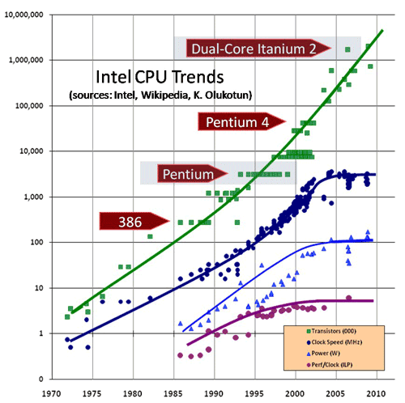
Speed speed speed
Precision is inversely proportional to the sqrt of the number of events
And needs are projected to grow
The only way to get speed is to exploit SIMD capabilities
And use accelerators...
This (IMNSHO) requires a complete re-write of the code (see GeantV phase 2: developing the particle transport library, Track 2, 11 Oct, 16:30)
10⁷
10⁶
Growing gap
between theoretical
and actual performance
for HEP applications
10⁵
transistors
10⁴
10³
clock
10²
10
power
1
ILP
10⁻¹
70
75
80
85
90
95
00
05
10

Slide 24
Portability
Back in the 80’s CERNLIB was maintained on machines with 32, 48, 60, 64, and 66 bit words with different endiannes and byte size, each one with its “idiosyncratic” compiler
For several years now we lived an easy life thanks to Intel and IEEE floating point
The environments of the future will be a lot more heterogeneous
Writing portable code (a lost art) becomes (again) absolutely essential.
This introduces new dimensions to architectural design and testing
Language of course helps a lot, but if you want to reach for the best performance, you will always be a step ahead of what language can offer

Slide 25
Validation – regression
Given the distributed nature of development, validation is also distributed / inhomogeneous
  Developers have their own validation environment, often private
  The situation with “thin target” tests is very diverse (some excellent, some less)
  The “golden standard” for validation are experiment test beams, but they are often impossible to “reproduce”
  Unit tests are scarce / absent (and arguably difficult to implement anyway)
“Automatic alarms” for physics regression could probably help to increase the number of tests we can run
  But there is a steep learning curve to implement them

Slide 26
Validation – regression
Other community have a set of “sanctified benchmarks”
  See for instance Shielding Aspects of Accelerators, Targets and Irradiation Facilities https://www.oecd-nea.org/science/wprs/egsaatif (SATIF )
Some activity (FNAL-CERN-SLAC) started in the direction of providing a consistent Database of validation data in a “MC friendly” way
  See “Software Aspects of the Geant4 Validation Repository”, Track 2, 13 Oct, 16:30
We have to do a better job with experimental data
  Make sure that test-beam data can be used for validation beyond the test-beam lifetime
  Use more high-quality data from experiments in our regression

Slide 27
Biasing
Some codes have a long-established biasing infrastructure (FLUKA, MARS, MCNPx)
Others are relatively new to biasing (GEANT4)
Mixing biasing and “analog” simulation is an ambitious proposition with which we have little experience
Biasing could substantially reduce calculation time in some situations (if used judiciously, very risky otherwise)
It should however be built into the design of the code from the start

Slide 28
Generator interface
The gestation of HepMCx has been long and difficult, but the very fact of having a standard is a very good thing per se
  Even difficult problems have a “common” solution with enough patience and determination
There is still a deep divide between “generators” and “hadronic models” which should and could be bridged
  Sometimes two versions of the same code are used, one for the “generation” of the events and the other for the “nuclear interaction model”

Slide 29
Physics lists
GEANT4 has formally introduced the concept of “physics list” which was “somehow” there in GEANT3 and FLUKA
Not one of the “easiest” items to handle in GEANT4
  It has been perhaps too much “exposed” and “publicized” to users
We now have few “sanctified” physics lists
The flexibility of the physics list is a powerful instrument if used wisely
Very useful concept also to mix fast and full simulation
Having different models easily interchangeable is great
  but… see previous discussion on “systematics”

Slide 30
Outside HEP…
The list of applications outside HEP is very large
  Design of medical instruments
  Radiation treatment planning
  Radiation safety (space, accelerators…)
  DNA damage, microdosimetry
In general these are considered “highly welcome users” and we largely profit from the reciprocal feedback and developments
  Possibly ~50% of GEANT4 users are outside HEP
However more coordination of these activities between them could be useful here
  Particularly in the medical domain where we really make a difference and our impact could even be greater

Slide 31
Outside HEP
In the GEANT4 case some of these activities are highly coordinated internally
  G4NAMU (G4 North American Medical Users -even if now is from all over the world-) has at least a yearly meeting
  The majority of the tutorials outside of US are organized by non-HEP
  The “Geant4 Space User Workshop” is held approximately every 18 months
  Geant4-DNA is even advertised as a “collaboration” on their own
A large fraction of the hadrotherapy treatment planning systems in Europe are based on FLUKA (in particular for the carbon ions)
Still synergy between these activities and HEP could be improved

Slide 32
Us (simulators) and the others
Simulation codes tend to be self-contained
  Even CLHEP, which is an external package, ships with GEANT4 for convenience
Relations with other packages is usually limited
  Reduction of dependencies ensures an easier installation and use
  It also introduces globally duplications and reinvention of wheels
At CERN, ROOT and GEANT4 have been in the same group for more than 10 years but their development has been largely parallel
The difficult balance between the advantages of code reuse and the problems of managing dependencies has been usually decided in favor of monolithic distributions (if not frameworks)

Slide 33
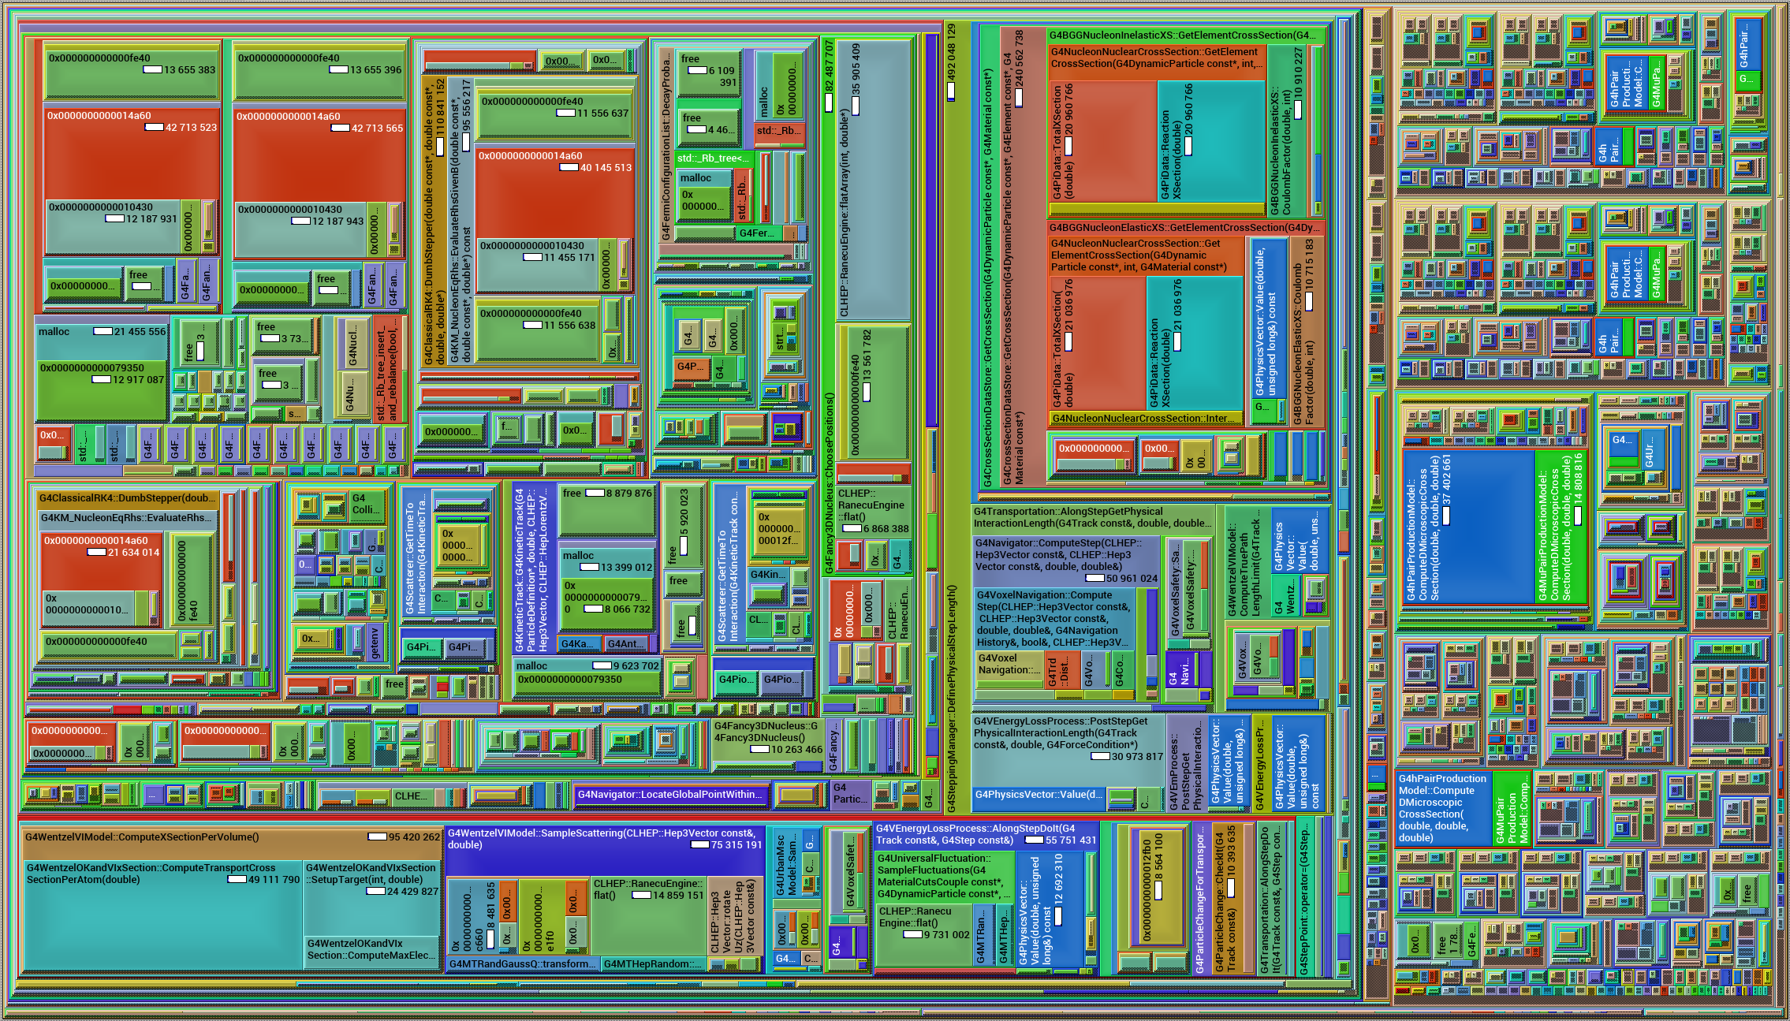
A path toward the future
The need to rewrite the code in order to take advantage from the new architectures has lead to the GeantV project
We think this is a good occasion to address the issues mentioned before and to bring together the community
The carpet

Slide 34
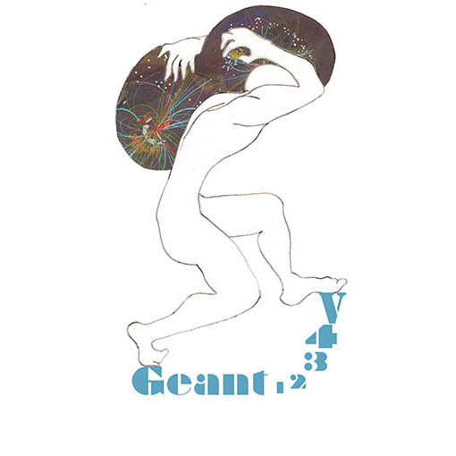
Goals of the GEANTV project
Develop an all-particle transport simulation programme with
  A code aiming at being 2-5 times faster than Geant4
  Continue improvement of physics
  Full simulation and various fast simulation options
  Portable on different architectures (CPUs, GPUs and Xeon Phi’s…)
Understand the limiting factors for a (10x) improvement
There will be an HEP community open meeting to review progress sponsored by HEP Software Foundation on October 27-27 at CERN
  Everybody welcome! https://indico.cern.ch/event/570876/

Slide 35
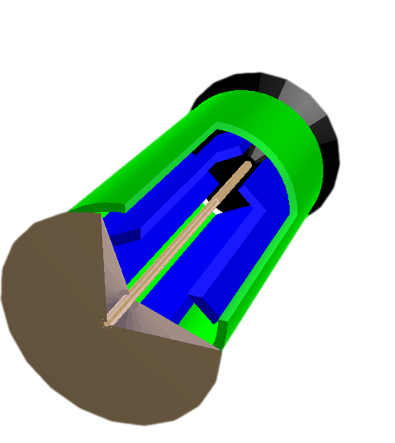
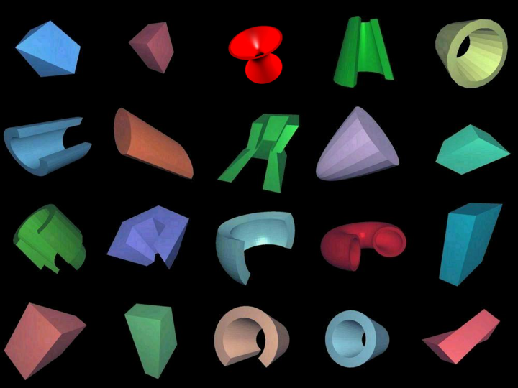
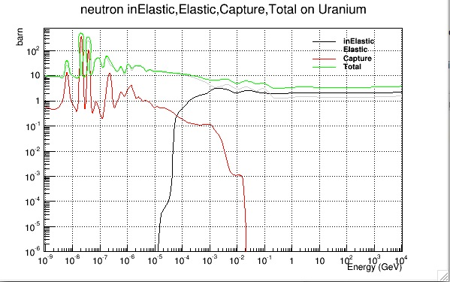
Scheduler
The initial ideas sounded easy
Transport particle
In groups (baskets)
Basket of tracks
Basket of tracks
Dispatching
MIMD
SIMD
Geometry navigator
Physics
Geometry algorithms
x-sections
Reactions

Slide 36

Challenges
Overhead from reshuffling particle lists should not offset SIMD gains
Exploit the metal at its best, while maintaining portability
Test from the onset on a “large” setup (LHC-like detector)
  Toy models tell us very little – complexity is the problem
We see a substantial speedup between GEANTV and GEANT4 in similar conditions without vectorisation
  But since this is with “fake” tabulated physics, this is not yet a benchmark but a verification that rebasketization does not slow us down
Scheduler
CPU
GPU
Phi
Atom
XXX

Slide 37

Portable HPC?
Here how
“Backend” is encapsulating standard types/properties for “scalar, vector, CUDA” programming; makes information injection into template function easy
distance( double &);
distance( vector_type &);
Dual interfaces
Long-term maintainability of the code => write one version of each algorithm and specialise it to the platform via template programming and low level optimised libraries
Dispatch structure of array data to functions with vector signatures
  Template on type sets, which are defined by backends
  Use backends to implement generic functions to operate on data
    Basic arithmetic, load/store, masking operations (assigns, blending, gather/scatter), numerical limits, …
  Use backends to insulate technology/library: Vc, UME::SIMD, Cilk+, VecMic, …
A Xeon Phi specific backend (UME::SIMD) is being developed in collaboration with CERN’s Openlab
Scalar interface
Vector interface
template<typename Real_v>
static void
common_distance_function( Vector3D<Real_v> input, Real_v &output )
{
// Single kernel algorithm using Backend types
}
Kernels
Backends
Scalar.h
template <typename T = Real_s>
class ScalarT {
public:
using Real_v = T;
using Double_v = Double_s;
…
}
// Functions operating with backend types
UMESimd.h
{
using Real_v = UME::SIMD::SIMDVec<Real_s, SIMDWidth<Real_s>()>;
using Double_v = UME::SIMD::SIMDVec<Double_s, SIMDWidth<Double_s>()>;
…
};
// Functions operating with backend types
VcSimdArray.h
{
using Real_v = Vc::SimdArray<Real_s, N>;
using Double_v = Vc::SimdArray<Double_s, N>;
…
};
// Functions operating with backend types
For Vc see: http://code.compeng.uni-frankfurt.de/projects/vc

Slide 38
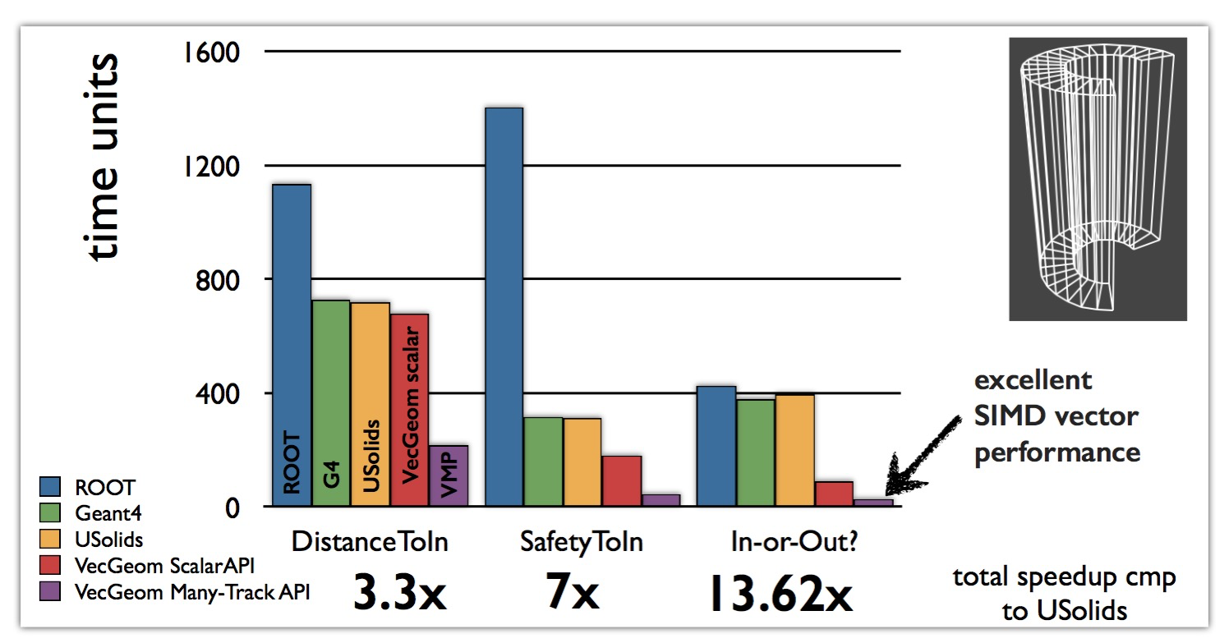
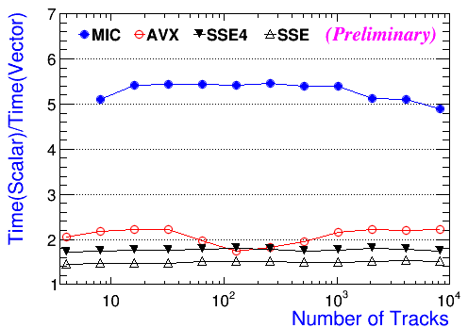
Gains from vectorisation
Source S.Wenzel
Vectorisation of Compton scattering shows good performance gains
Vector code is better scalar code!
Better scalar
code
Source S.Jun et al.
Source S.Jun et al.
Geometry is 30-40% CPU time on Geant4, (depending on the cuts)
Substantial performance gains also in scalar mode

Slide 39
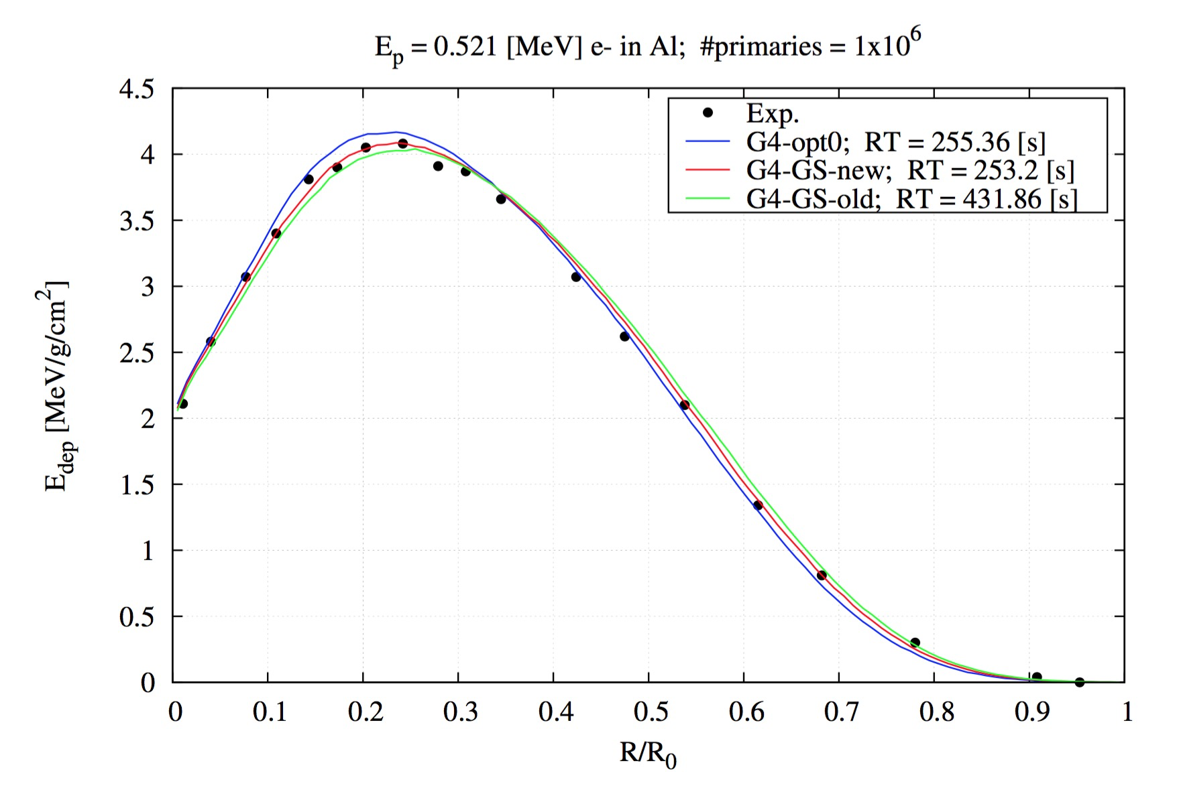
EM – a new start?
We are developing an independent EM library that can be used both from GEANTV and GEANT4
It will express the best performance with vectors when used by GEANTV
It turns out that vector code is better scalar code
A fresh look at multiple scattering has allowed to develop a better algorithm
G4 fast
GV
G4 precision
Sandia data
Source: M.Novak

Slide 40
Redesigning simulation
Maintain minimal coupling between components, in particular kernel and physics
  Keep transportation in the kernel, outside the physics
Re-use as much as possible the design of Geant4 physics
  Avoid reinventing the wheel
Streamlining by reducing the inheritance depth
  Replace whenever possible, virtual polymorphism with static (template) polymorphism
  Offer thin interfaces for direct calls to cross sections and final-state models
Build into the design provision for biasing and fast simulation

Slide 41
Redesigning simulation
Design components that can be used by different simulation codes
  Highest performance when used in vector mode
  Portable on CPUs and accelerators thanks to well identified backends (do NOT spread ifdefs in the code!)
  Make sure they can be used by GEANT4 and GEANTV at least
Progressively build a set of tests as granular as possible taking the data from a database
  Introduce automatic alarms for failing tests
Perform continuous integration and testing
  Nightly
  At every pull request

Slide 42
Timescales
The lifecycle of a simulation package is decades
Introducing changes requires close coordination with the customers
In the case of LHC, anything new has to be delivered before 2019 to be even considered before the end of Run 3
  Need LS2 (2019-2020) for commissioning
This requires a level of planning that is hardly compatible with the “informal” nature of the resource commitments

Slide 43
A look at the future
The two major players will remain GEANT’s and FLUKA
  Strengthening the collaboration (e.g. on inter-comparisons would help)
As the problem grows more complex and more demanding, the two different models
  Medium size developer team with lightweight formal organization for FLUKA
  Large and formal collaboration with varying formal commitment and long term planning for GEANT4
May not be optimal
HEP (its institutions) should perhaps take a more “organic” role in the development of simulation codes
  Since there is already a very large investment in the community (CERN, IN2P3, FNAL, SLAC, KEK, ESA and few others)

Slide 44
A look at the future
Move from a “logical” toolkit to a more “physical” toolkit
  From “use what you need” to “download / install what you need”
  Independent libraries with defined interfaces
More independent but more cohesive working groups working around a modular library
  Better defined programme of work and single code base
  More long term “institutional” involvement in ensuring the maintenance and development
Enhanced validation
  Continuous integration
  Unit tests
  Sensitivity analysis
  Automatic alarms

Slide 45
A look at the future
Closer interaction with the users
  Meetings like LPCC are excellent, but they are far apart
  GEANT4 technical forum is a good example
  We should strive to cross community boundaries for MC users
  Better use of experiment high-quality data for regression testing
Better packaging and configuration control
  Automatic installers (Mac OS X, Linux, Windows)
  Tools like apt, dpkg, fink, homebrew and so on
  Modularity allowing better synergy with ROOT and experimental code

Slide 46
Conclusions
Simulation is essential for HEP (and beyond)
Current simulation codes respond well to the needs of the HEP community
The increase of requirements of all sort (speed, accuracy, functionality) may stress the current development and maintenance model and pose substantial technical and human challenges
A more organised development strategy could better exploit the resources that are available in the community and beyond in order to respond to the new challenges

