Slide 1
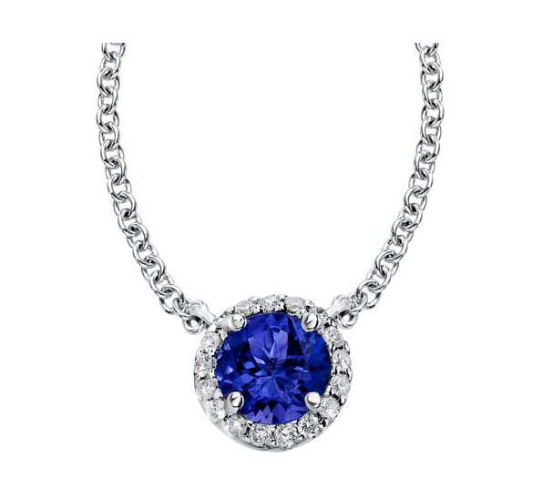

GEM DETECTORS
20 YEARS OF DEVELOPMENTS AND APPLICATIONS
Fabio Sauli
TERA Foundation
CERN

Slide 2
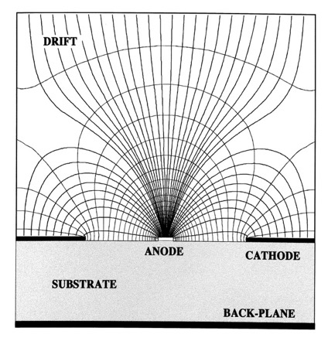
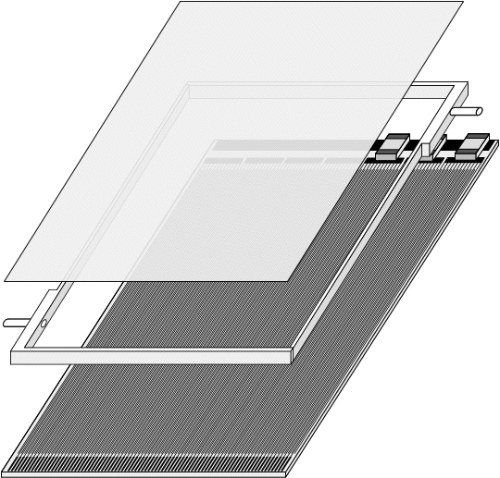
1988: MICRO-STRIP GAS COUNTER (MSGC) (MSGC)
THIN METAL STRIPS ON GLASS SUBSTRATE
LIGHT AND COMPACT DETECTOR CONSTRUCTION
A. Oed,
Nucl. Instr. and Meth. A263(1988)351
RATE CAPABILITY ~ 1 MHz/mm²
POSITION ACCURACY ~ 40 µm
2-TRACK RESOLUTION ~ 500 µm
J. Bohm et al, Nucl. Instr. and Meth. A360(1995)34
HERA-B MSGC INNER TRACKER ~ 200 MSGC 20x20 mm²
CMS CENTRAL TRACKER ~ 5500 MSGC

Slide 3
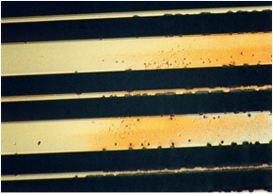
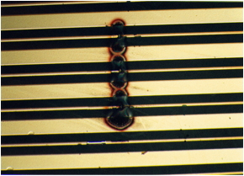
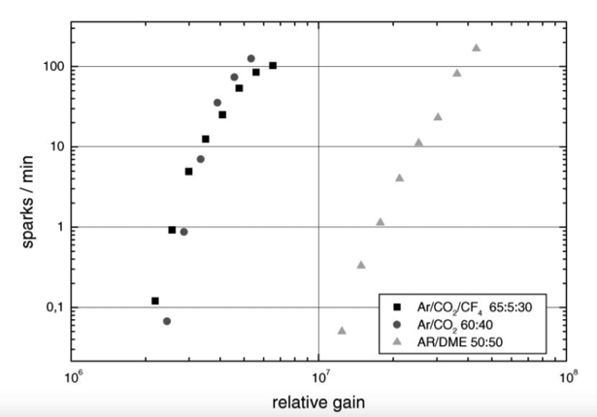
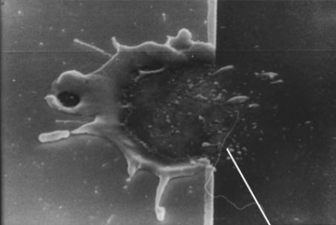
MSGC: DISCHARGE PROBLEMS
MILD OR SERIOUS DISCHARGE PROBLEMS!
HERA-B MSGC INNER TRACKER
50 sparks/min
S. Keller et al, Nucl. Instr. and Meth. A419(1998)382

Slide 4
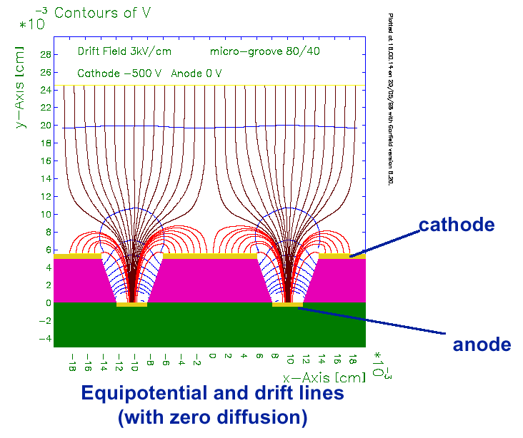
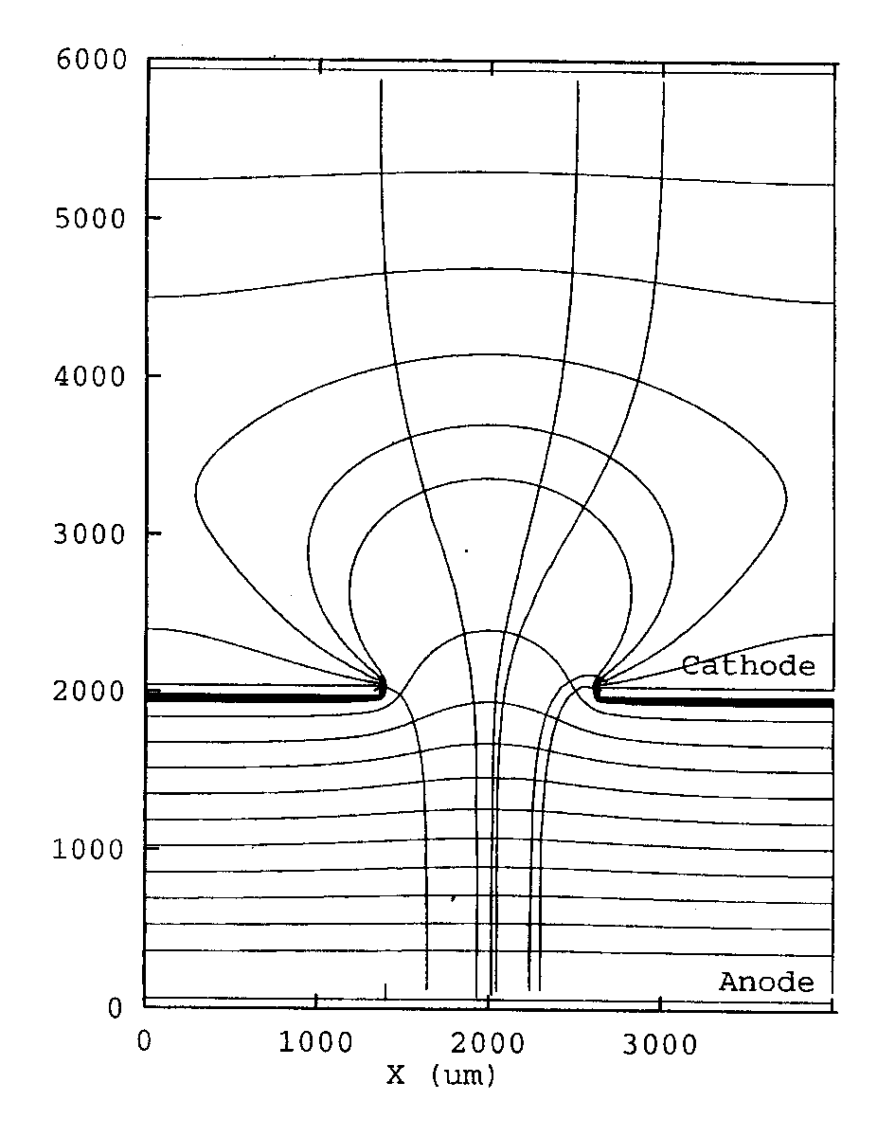
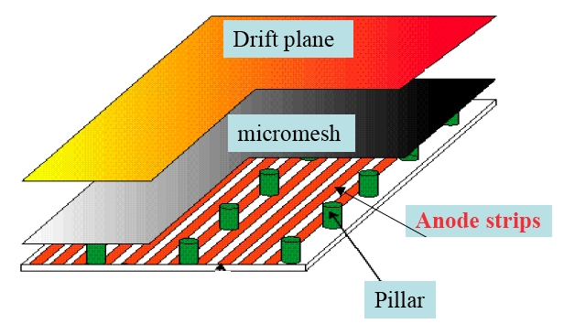
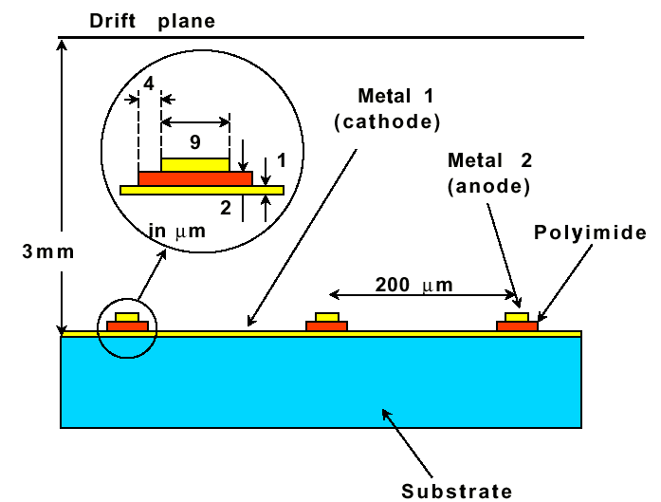
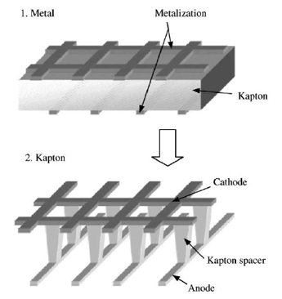
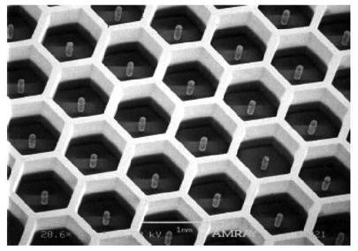
~ 1990 TO PRESENT: NEW DEVELOPMENTS
MICRO-GROOVE
COMPTEUR A TROUS
MICROMEGAS
MICRO-GAP
MICRO-WIRE
MICRO-PIN ARRAY
Y. Giomataris,
Nucl. Instr. and Meth. A419(1998)239

Slide 5
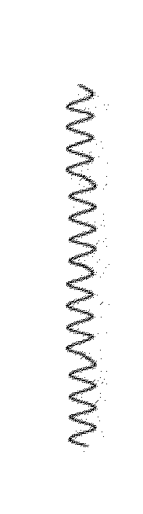
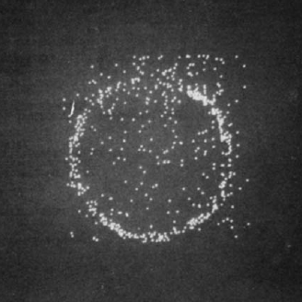
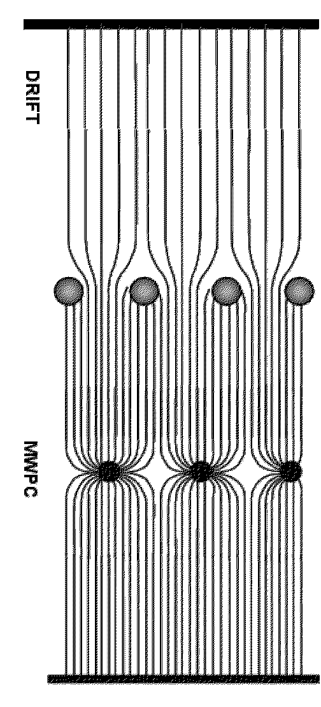
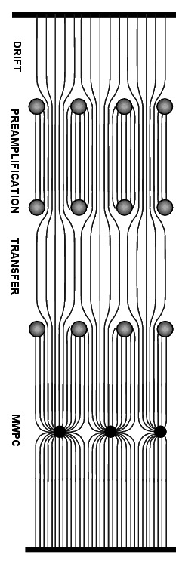
1978: THE MULTISTEP CHAMBER (MSC)
UV PHOTONS DETECTION (RICH): MWPC WITH PHOTOSENSITIVE GAS (TEA)
MULTISTEP CHAMBER
PREAMPLIFICATION
GAIN 10³
SINGLE ELECTRON DETECTION
SIMULATED CHERENKOV RING (COLLIMATED UV SOURCE)
TRANSFER
10%
E605 RICH
MWPC
GAIN 10⁵
TOTAL GAIN 10⁷
G. Charpak and F. Sauli, Phys. Lett. 78B(1978)723

Slide 6
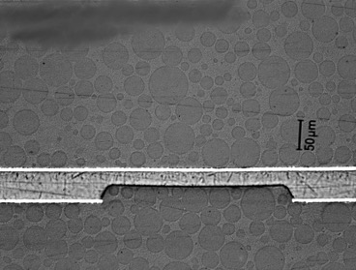
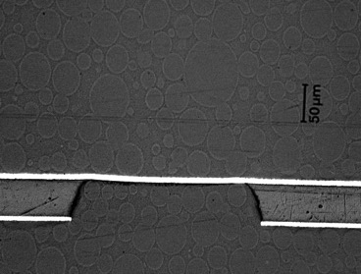
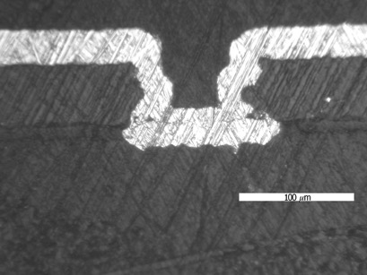
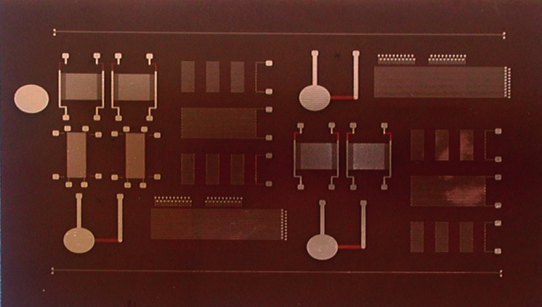
~ 1995 : µVIAS DEVELOPMENT
POLYIMIDE ETCHING:
CONTACTS THROUGH FLEXIBLE PRINTED CIRCUITS
Angelo Gandi and Rui De Oliveira
CERN’s Printed Circuit Workshop (EST-DEM)

Slide 7
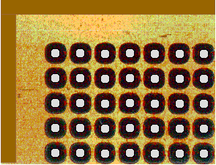
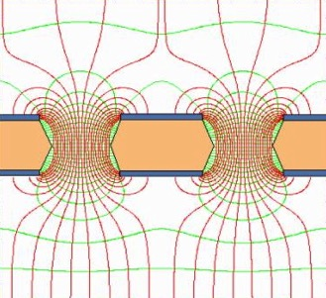

1996: MSC+µVIAS => GEM
THE GAS ELECTRON MULTIPLIER (GEM):
100 µm PITCH HOLES ON COPPER-CLAD POLYIMIDE FOIL
PRESENTED AT:
IEEE Nuclear Science Symposium & Medical Imaging Conference
Anaheim, CA November 3-9, 1996
F. Sauli, Nucl. Instr. and Meth. A386(1997)531

Slide 8
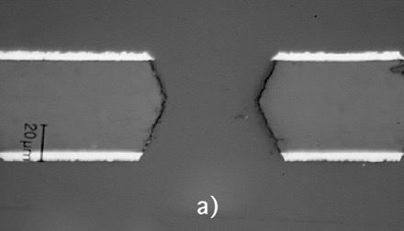
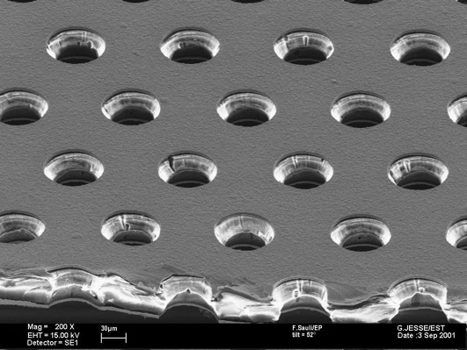
GEM MANUFACTURING
“STANDARD” GEM
DOUBLE MASK PHOTOLITHOGRAPHY
50 µm Kapton
5 µm Cu
Photoresist coating, masking and exposure to UV light
DOUBLE CONICAL
“HOURGLASS”
Metal etching
140 µm
Kapton etching
Second masking
70 µm
Metal etching
and cleaning

Slide 9

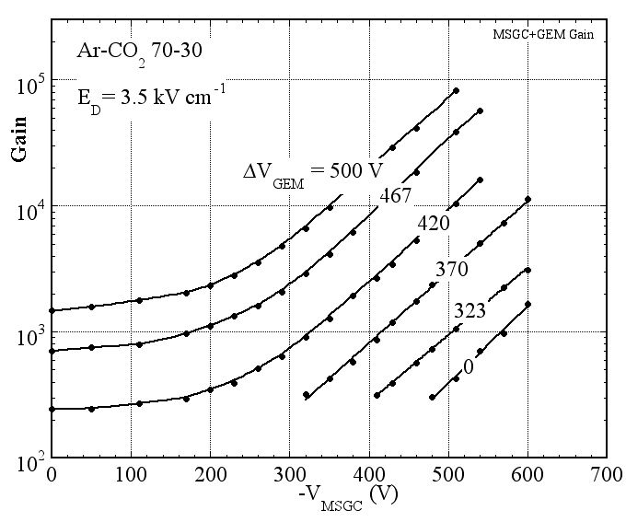
TWO-STEP DETECTOR
MSGC WITH GEM PREAMPLIFIER
COMBINED GAIN CURVES
GEM
MSGC
R. Bouclier et al, Nucl. Instr. and Meth. A396(1997)50

Slide 10
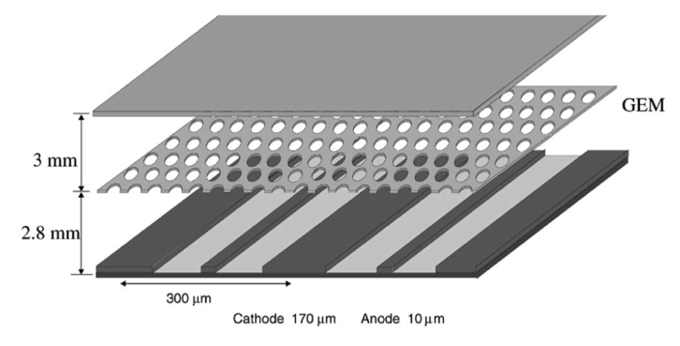
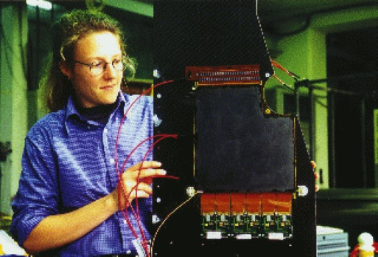
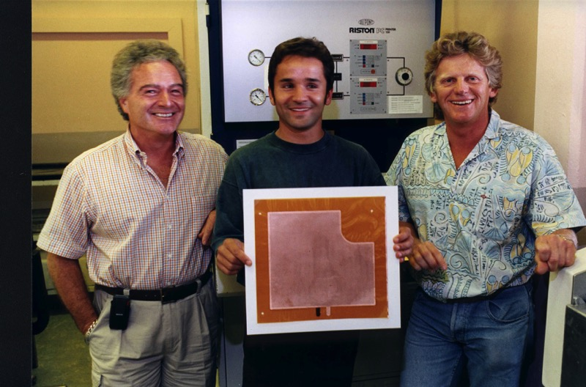
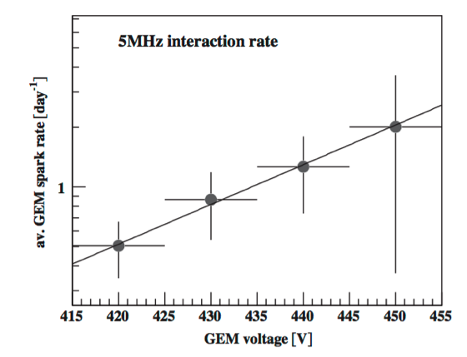
HERA-B MSGC+GEM
CERN’s Printed Circuit Workshop (EST-DEM)
~ 200 GEM FOILS, 20x20 cm²
J-C Labbé
Bagaturia et al,
Nucl. Instr. and Meth. A490(2002)223
Angelo Gandi
Rui De Oliveira

Slide 11

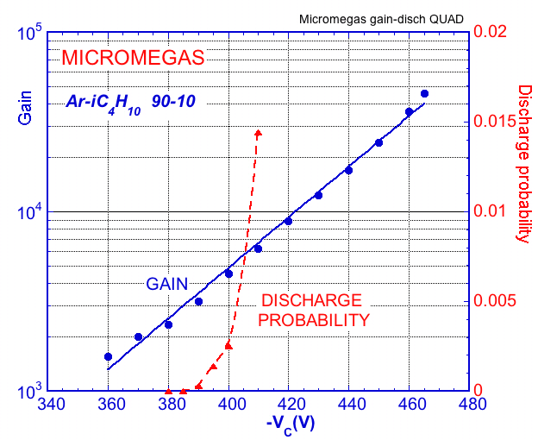
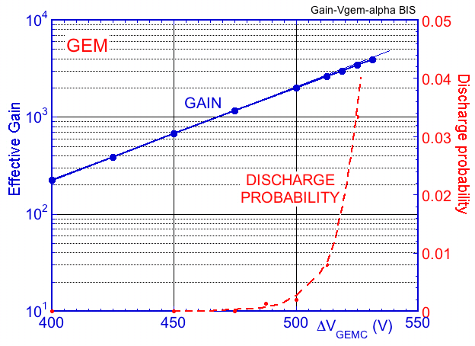
MPGD DISCHARGE STUDIES
GASEOUS α SOURCE: ²³²Th -> ²³²Rn+α (6.4 MeV) ΔE ~ 500 keV ~ 10⁴ e I⁺
THORIUM
MICROMEGAS:
MPGD
GEM:
~2000
~3000
Q ~ 10⁴.10³ = 10⁷ e I⁺
RAETHER LIMIT
A. Bressan et al.Nucl. Instr. and Meth. A424(1999)321

Slide 12
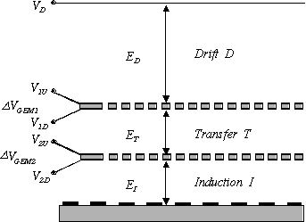
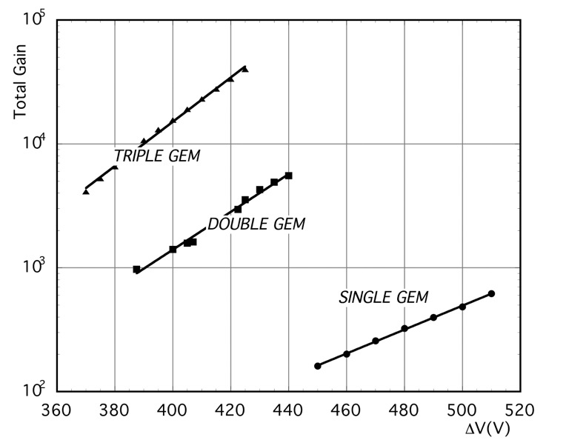
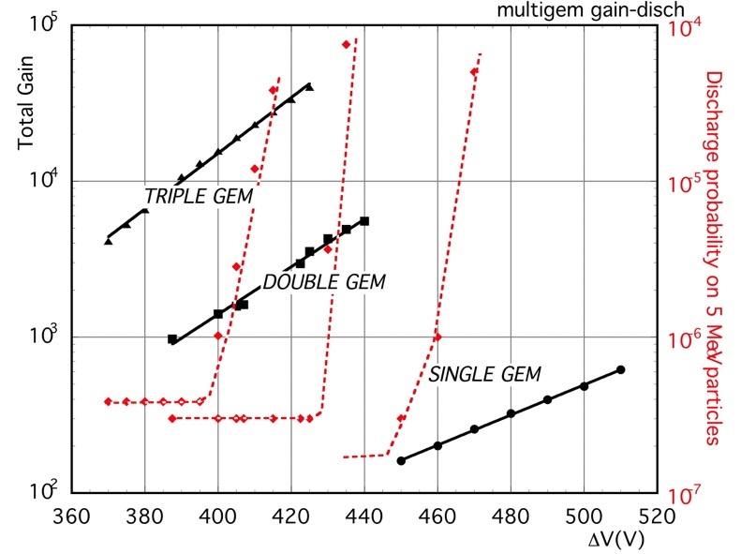
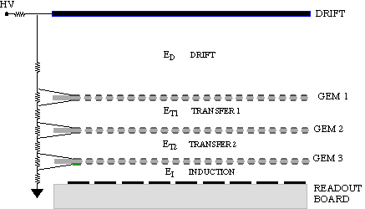
MULTI-GEM STRUCTURES
DOUBLE GEM
HIGHER GAINS
REDUCED ION BACKFLOW
LOWER DISCHARGE PROBABILITY
TRIPLE GEM
V_{GEM}
S. Bachmann et al, Nucl. Instr. and Meth. A 443(1999)464

Slide 13
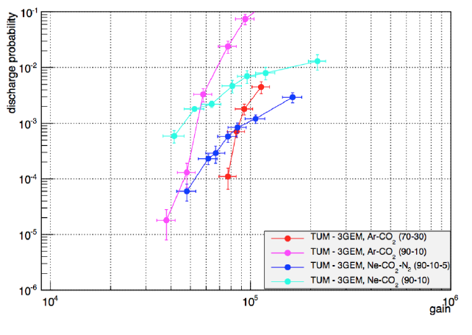

DISCHARGE STUDIES - ALICE GEM TPC
²²⁰Rn INTERNAL α SOURCE
TRIPLE GEM
NO
DISCHARGES
3 10⁴
P. Gasik RD51Coll. Meeting (CERN 2016)

Slide 14
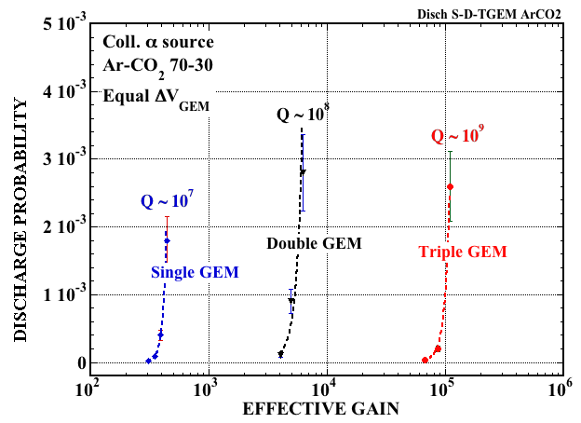
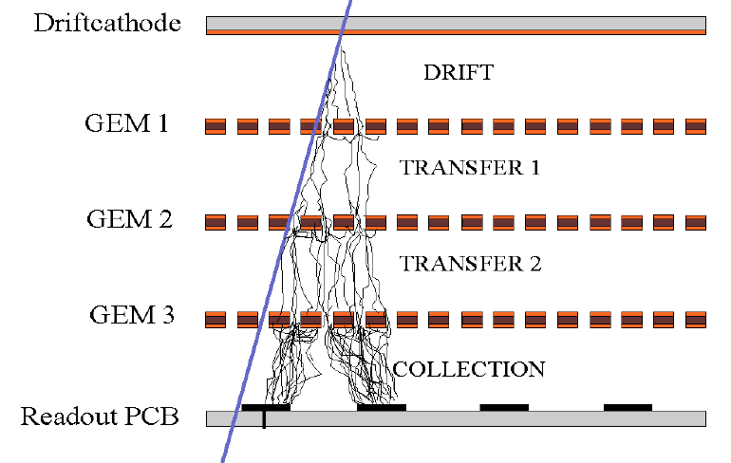
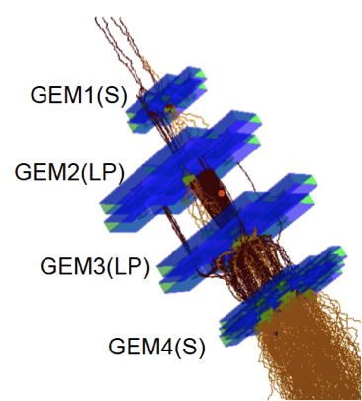
BACK TO MULTIGEM DISCHARGES
DISCHARGE PROBABILITY ON ~ MeV α
IN MULTI-GEMs, THE CHARGE SPREADS BY DIFFUSION OVER MANY HOLES!
4-GEM SIMULATION (ALICE TPC)
WHAT ABOUT THE RAETHER LIMIT?
VERY LARGE GAINS OBSERVED IN PURE NOBLE GASES
CHARGE CONFINEMENT: HOLES ARE (QUASI) INDEPENDENT
A. Buzulutskov et al, Nucl. Instr. and Meth. A433(1999)471
P. Bhattacharya, MPGD Workshop (Trieste 2015)

Slide 15

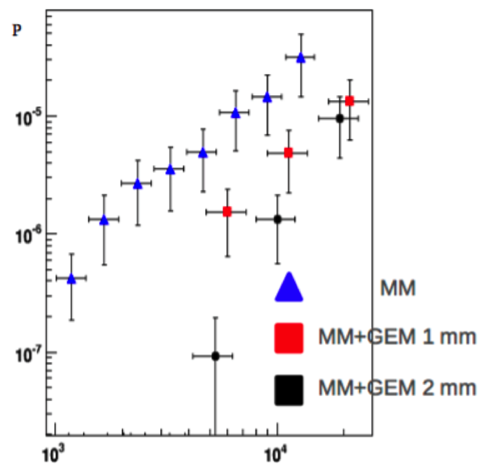
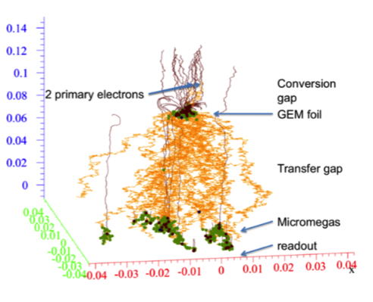
HYBRID DETECTORS
GEM + MICROMEGAS
AVALANCHES SIMULATION
GEM+MICROMEGAS
GEM
MICROMEGAS
1 GeV π BEAM
8000
VGEM=280 V
10⁻⁴
DISCHARGE PROBABILITY
10⁻⁵
GAIN
S. Procureur et al, Nucl. Instr. and Meth. A659(2011)91
M. Vandenbroucke, JINST 7(2012)C05014

Slide 16
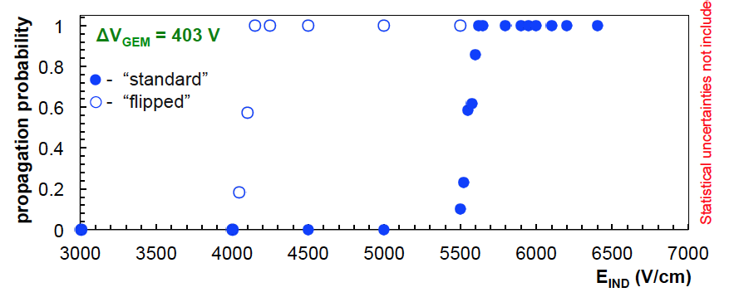
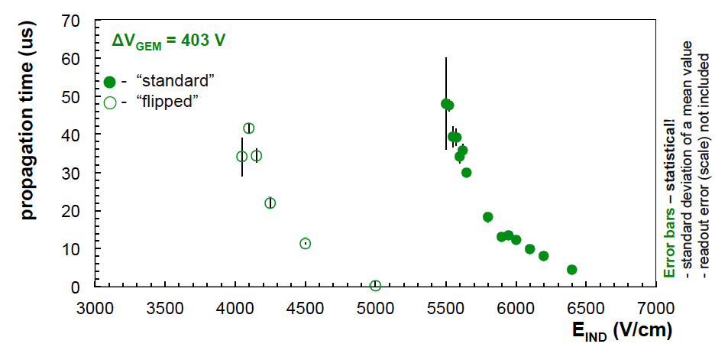


DISCHARGE STUDIES - ALICE GEM TPC
DISCHARGE PROPAGATION: LAST GEM TO ANODE
SECTORS POWERING: STANDARD
DISCHARGE PROPAGATION PROBABAILITY:
HV_{T}
GEM
HV_{B}
E_{IND}
FLIPPED:
flipped
standard
GEM
HV_{T}
E_{IND}
HV_{B}
DISCHARGE PROPAGATION DELAY:
flipped
standard
P. Gasik RD51Coll. Meeting (CERN 2016)

Slide 17
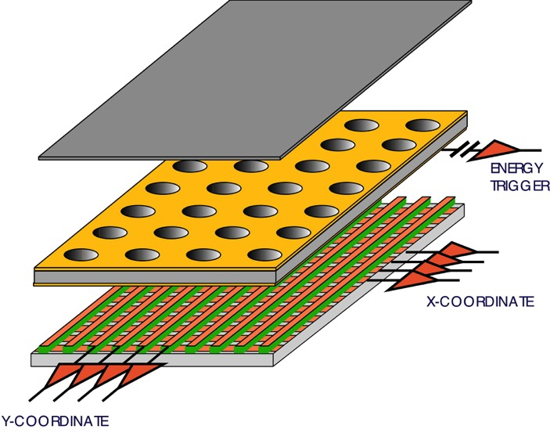
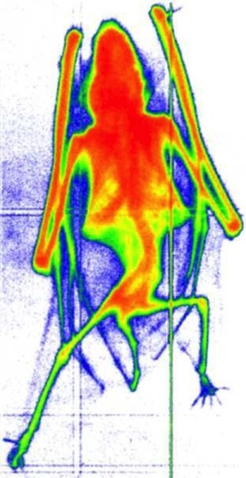

SINGLE GEM X-RAY DETECTOR
2-DIMENSIONAL CARTESIAN STRIPS READOUT
6 keV RADIOGRAPHY
HIGH PROPORTIONAL GAINS
FAST ELECTRON SIGNAL
READOUT PLANE AT GROUND POTENTIAL
PATTERNED AT WILL
A. Bressan et al,
Nucl. Instr. and Meth. A425(1999)254

Slide 18
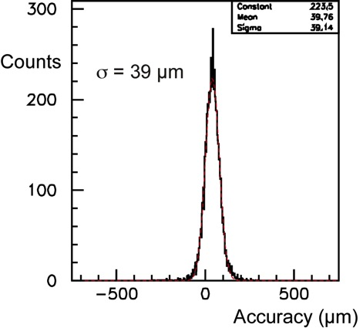
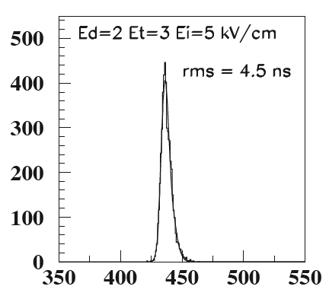
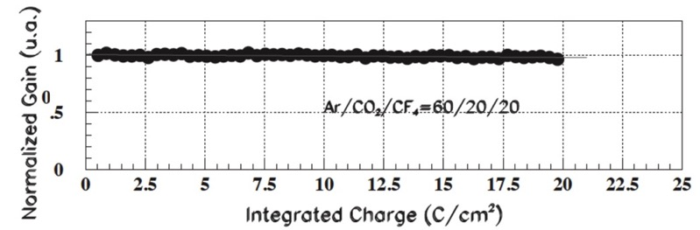
MAIN GEM PERFORMANCES: MIPS
LOCALIZATION ACCURACY
SINGLE GEM RATE CAPABILITY
DOUBLE GEM Ar-CO₂
σ ~ 40 µm
A. Bressan et al,
Nucl. Instr. and Meth. A425(199)262
GEM+MSGC
1 MHz mm²
J. Benlloch et al, IEEENS-45(1998)234
TIME RESOLUTION: LHCB MUON TRIGGER
TRIPLE GEM A-CO₂-CF₄
RADIATION RESISTANCE
20 C/cm²
~ 4 10¹⁴ MIPS cm⁻²
σ ~ 4.5 ns
M. Alfonsi et al, Nucl. Instr. and Meth. A535(2004)319
M. Alfonsi et al, Nucl. Instr. and Meth. A518(2004)106

Slide 19
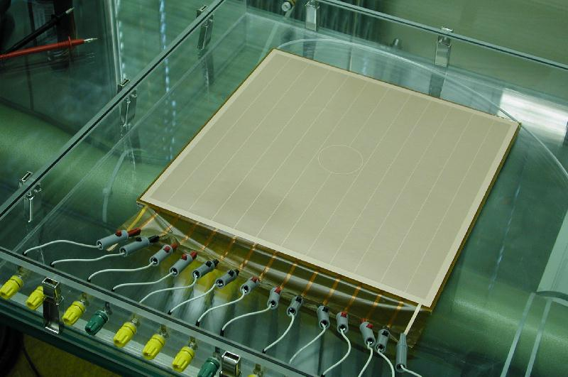


TRIPLE GEMs FOR COMPASS TRACKER
~30 TRIPLE GEM 30x30 cm² - 2D CARTESIAN READOUT
HV TESTING DURING ASSEMBLY
Honeycomb
plates
GEM foils
Readout
board
C. Altumbas et al,
Nucl. Instr. and Meth. A490(2002)177
L. Ropelewski

Slide 20




GEM SECTORS AND READOUT PATTERNS
GEM SECTORS SEPARATION (200 µm)
CENTRAL BEAM KILLER
1x1 mm² PIXELS AND STRIPS
MEASURED FLUX IN HADRON BEAM:
1.2 10⁵ Hz/mm²
M. Krämer et al, 2008 IEEE Nucl. Sci. Symp. Conf. Rec.

Slide 21


TOTEM TRIPLE GEM FORWARD CMS TRACKER
SEMI-CIRCULAR MODULES
TEN-GEM TOTEM FORWARD SECTOR
M.G. Bagliesi et al, Nucl. Instr. and Meth. A617(2010)134

Slide 22


CYLINDRICAL GEMS
TRIPLE-GEM PROTOTYPE
GAS DETECTORS DEVELOPMENT
CERN
L. Ropelewski....M. Van Stenis.....

Slide 23


CYLINDRICAL GEM DETECTORS
KLOE-2 INNER TRACKER
BES III DETECTOR at IHEP (Beijing)
A. Balla et al,
Nucl. Instr. and Meth. A732(2013)221
R. Farinelli, RD51 Coll. Meeting (Aveiro 2016)

Slide 24




CERN GDD: SPHERICAL GEM CHAMBERS
“SPHERICAL” MULTIGEM AND READOUT BOARD
GDD
S. Duarte Pinto arXiv:1011.5528v1
IEEE 2011 Nucl. Sci. Symp. Conf. Rec.

Slide 25

LARGE SIZE GEM PRODUCTION
SINGLE MASK PHOTOLITOGRAPHY
R. De Oliveira, CERN EP-DT-EF
Cu-clad Kapton
“CYLINDRICAL” HOLES
Single mask
Photoresist
Cu etching
Kapton etching
Second Cu etching
M. Alfonsi et al, Nucl. Instr. and Meth. A617(2010)151

Slide 26



CMS HIGH-η MUON DETECTOR UPGRADE
Archana Sharma, CMS GEM Upgrade Project Manager
DISMOUNTABLE MECHANICAL ASSEMBLY
EDGE STRETCHED GEM FOILS
CERN-INFN-BONN
GEM MODULES: 100-120 cm x 22-45 cm
36 SUPERCHAMBERS IN EACH ENDCAP
M. Alfonsi et al, Nucl. Instr. and Meth. A617(2010)151
D. Abbaneo et al,
Nucl. Instr. and Meth. A732 (2013) 203
B. Dorney, MPGD WORKSHOP (Trieste 2015)

Slide 27



CMS HIGH-η MUON DETECTOR UPGRADE
LARGE PROTOTYPE IN TET BEAM
DESIGN GAIN: 5.10³
B. Dorney, MPGD Workshop (Trieste 2015)

Slide 28



ALICE GEM-TPC UPGRADE
Chilo Garabatos, Deputy Project Leader
QUAD-GEM WITH STAGGERED HOLES
A. Deisting, MPGD Workshop (Trieste 2015)

Slide 29



ALTERNATIVE GEM STRUCTURES
GLASS GEM
GOOD GAIN UNIFORMITY
GOOD ENERGY RESOLUTION
NON-OUTGASSING MATERIALS
H, Takahashi et al, Nucl. Instr. and Meth. A724(2013)1

Slide 30


THICK ELECTRON MULTIPLIER (THGEM)
ALSO CALLED LARGE ELECTRON MULTIPLIER (LEM)
MECHANICAL DRILLING OF METAL-CLAD PC BOARD
SELF-SUPPORTING
HIGH GAIN (?)
A. Breskin
R.Chechik et al, Nucl. Instr. and Meth. A535(2004)303

Slide 31




THGEM: GAIN AND CHARGING UP
DEVELOPMENTS FOR THE COMPASS RICH-1 UPGRADE
GAIN
RIM:
100 µm
10 µm
LARGE RIM:
HIGH GAIN
CHARGING UP
0
RIMLESS:
LOW GAIN
STABLE
ΔV (kV)
GAIN VS TIME (CHARGING UP EFFECT):
0.1 mm rim
No rim
MULTIPLE
STRUCTURES
M. Alexeev et al, Nucl. Instr. and Meth. A695(2012)159

Slide 32


MULTIGEM GAIN AT VERY HIGH RATES
GAIN VS X-RAY RATE: TRIPLE GEM (2006)
GDD
P. Everaerts, PhD Thesis Gent University (2006)

Slide 33




MULTIGEM GAIN AT VERY HIGH RATES
NEW MEASUREMENTS (2015)
SIMULATION: CHARGE DENSITIES VS RATE
SINGLE GEM
TRIPLEGEM
GDD
P. Thuiner, PhD TU Vienna (2016)
S. Franchino et al, IEEE 2015 Nucl. Sci. Symp. Conf. Rec.

Slide 34



POSITIVE IONS BACKFLOW
POSITIVE IONS BACKFLOW (OR FEEDBACK):
IBF =
I_{DRIFT}
THE WISH:
I_{ANODE}
ONE IBF ION PER PRIMARY
S. Backmann et a, l
Nucl. Instr. Meth. A438(1999)376
MULTIGEMS:THE IBF VALUE DEPENDS ON GEOMETRY, FIELDS AND DIFFUSION:
SINGLE GEM
~ 30%
E_{D}/E_{I}=25%
DOUBLE GEM
0.2%
TRIPLE GEM
0.05%
Gain
A. Bondar et al, Nucl. Instr. and Meth. A496(2003)325

Slide 35



ION BACKFLOW REDUCTION: OFFSET HOLES
e⁻ I⁺ TRANSVERSE DIFFUSION:
EXPLOIT THE DIFFERENCE BETWEEN IONS’ AND ELECTRONS’ DIFFUSION IN AN OFFSET DOUBLE GEM
OFFSET SCAN:
F. Sauli et al, Nucl. Instr. and Meth. A560(2006)269

Slide 36

ALICE TPC GEM UPGRADE
FOUR GEMS WITH STAGGERED HOLES
ENERGY RESOLUTION VS IBF:
ALICE TDR CERN-LHCC-2013-020
GEM 1 & 4: STANDARD PITCH 140 µm
GEM 2 & 3: LARGE PITCH 280 µm
A.Deisting, MPGD Workshop (Trieste 20125)

Slide 37


IBF SIMULATIONS FOR THE PANDA TPC
TRIPLE GEM OPERATED IN Ne-CO₂ 90-10
2 10⁷ p-p ANNIHILATIONS GAIN M=2000 IBF 2.5 10⁻³
SPACE CHARGE DENSITY:
ELECTRIC FIELD DISTORTIONS:
F.W. Bohmer et al,Nucl. Instr. and Meth. A719(2013)101

Slide 38

GAS DETECTORS SIMULATION TOOLS
MAGBOLTZ (Steve Biagi)
GARFIELD (Rob Veenhof)
+ ELECTRIC FIELD, ENERGY LOSS,...
P. Bhattacharya, RD51 Collaboration

Slide 39



GAS DETECTORS SIMULATION TOOLS
ALICE GEM TPC SIMULATION
P. Bhattacharya, MPGD Workshop (Trieste 2015)

Slide 40


GEM APPLICATIONS: NEUTRON DETECTORS
CASCADE: ¹⁰B-COATED GEM ELECTRODES
THERMAL NEUTRON RADIOGRAPHY
M. Klein and Ch. Schmidt, Nucl. Instr. and Meth. A628(2011)9

Slide 41


NEUTRON DETECTORS
b-GEM:
TRIPLE GEM WITH ALUMINUM FOIL CATHODE COATED WITH 1 µm OF BORON CARBIDE
READOUT: 144 PADS, 8x8 mm²
n
2-D THERMAL NEUTRON BEAM PROFILE
α
SENSITIVITY TO GAMMA BACKGROUND:
G. Croci et al, Nucl. Instr. and Meth. A732(2013)217

Slide 42


NEUTRON DETECTORS
BORON ARRAY NEUTRON DETECTOR (BAND-GEM)
48 LAMELLAS PROTOTYPE
Alumina Lamellas coated on both sides with ¹⁰B₄C
n
10 cm
Cathode
3D Lamella
System
6 cm
α
E_{d}
2 mm
Triple GEM
e-
Padded Anode
G. Croci et al, MPGD Workshop (Trieste 2015)

Slide 43


UV PHOTON DETECTION: CsI PHOTOCATHODES
REFLECTIVE CsI PHOTOCATHODE ON UPPER GEM ELECTRODE
NO PHOTON FEEDBACK
INSENSITIVE TO DIRECT IONIZATION
TRIPLE GEM
COLLIMATED SINGLE UV PHOTON SOURCE
POSITION ACCURACY
200 µm
55 µm rms
GDD
T. Meinschad, L. Ropelewski and F. Sauli, NIMA 535(2004)324

Slide 44


PHENIX HADRON BLIND DETECTOR
“INVERSE FIELD” TPC
Protons
e⁺
e⁻
E
C. Aidala et al, Nucl. Instr. and Methods A502(2003)200
Z. Fraenkel et al, Nucl. Instr. and Methods A546(2005) 466

Slide 45



COMPASS RICH 1 UPGRADE
THICK GEM CsI-COATED 30x30 cm²
TRIPLE THGEM PROTOTYPE
SINGLE EVENT (6 GeV π⁻ BEAM)
M. Alexeev et al, Nucl. Instr. and Meth. A732(2013)264

Slide 46



CHERENKOV RING IMAGING
COMPASS RICH-1 MPGD UPGRADE
DOUBLE STAGGERED THGEMS+MICROMEGAS
M. Alexeev et al, MPGD Workshop (Trieste 2015)

Slide 47




GEM APPLICATIONS: POLARIMETRY
SOFT X-RAY POLARIMETRY
5.9 keV PHOTOELECTRON (80 µm pixels pitch):
MEASURED ANGULAR MODULATION:
R. Bellazzini et al, Nucl. Instr. and Meth. A720(2013)173

Slide 48


GEM POLARIMETER IN SPACE
GEMS MISSION CANCELLED BY NASA (2012)
NEW MISSION (2017):
POLARIMETRY FOR RELATIVISTIC ASTROPHYSICAL X-RAY SOURCES (PRAXyS)
W.B. Iwakiri et al, Nucl. Instr. and Meth. In press (2016)
Toru Tamagawa, MPGD Workshop (Saragoza 2013)

Slide 49



GEMPIX: GEM + MEDIPIX
TRIPLE-GEM WITH MEDIPIX READOUT
256x256 pixels, 55x55 µm²
RECORDED EVENTS:
COMPTON ELECTRON:
F. Murtas et al, JINST10(2015)P11003

Slide 50



X-RAY FLUORESCENCE ANALYSIS
28x28 mm² MICRO-HOLE AND STRIP PLATE (MHSP)
WITH RESISTIVE LINES 2-D READOUT
ELEMENTAL ANALYSIS:
X-RAY TRANSMISSION IMAGE:
A.L.M. Silva et al, Spectrochimica Acta B86(2013)115

Slide 51

ENERGY-RESOLVED X-RAY FLUORESCENCE
J. Veloso, RD51 Special Workshop on Photon detection (CERN, 2015)

Slide 52




OPTICAL IMAGING
IMAGING CHAMBER (1987)
COSMICS
TRIETHYLAMINE (TEA):
INTERNAL WAVELENGTH SHIFTER
G. Charpak, J.-P. Fabre, F. Sauli and M. Suzuki,
Nucl. Instr. and Meth. A258(1987)177

Slide 53




OPTICAL IMAGING (2002)
CARBON TETRAFLUORIDE SCINTILLATION:
α PARTICLES TRACKS
n INTERACTIONS IN ³He
He-CF₄ GAS FILLING
F.A.F. Fraga, et al, Nucl. Instr. and Meth. A478(2002) 357

Slide 54




DOSE MONITORING IN HADROTHERAPY
DOUBLE GEM WITH OPTICAL DETECTION
BEAM PROFILE:
E. Seravalli et al, Phys. Med. Biol. 53(2008)4651

Slide 55





OPTICAL IMAGING
α PARTICLES FROM ²²⁰Rn and ²¹⁶Po
⁵⁵Fe 5.9 keV X-RAYS
⁵⁵Fe source
Full energy
Escape
Pileup
GDD
F. Resnati , EP Detector Seminar (CERN, April 29, 2016)

Slide 56





ENERGY RESOLVED FLUORESCENCE ANALYSIS
‘painting’
pin-hole
X-ray tube
GEMs
shielding
Camera and lens
Red
Green
Blue
GDD
F. Resnati, MPGD Workshop (Aveiro, 2016)

Slide 57



OPTICAL X-RAY IMAGING
SMALL DRONE-IN-THE BOX
JUMPING DRONE RADIOGRAPHY (30 keV)
11 kV
40 kV
F. Resnati, MPGD Workshop (Aveiro, 2016)
GDD

Slide 58



X-RAY TOMOGRAPHY
IMAGE -> SINOGRAMS -> FILTERED BACK PROJECTION -> 3D IMAGE
GDD
F. Resnati, MPGD Workshop (Aveiro, 2016)

Slide 59

CORRECTION OF THE PARALLAX ERROR
PINHOLE CAMERA:
PARALLAX ERROR
PLANISPHERICAL GEM
CONCENTRIC GRADED POTENTIAL RINGS ON CATHODE AND GEM ELECTRODES
RADIAL CONVERSION AND DRIFT:
CATHODE
DRIFT
GEM 1
GEM 2
F. Sauli, PCT Patent WO99/21211
Computed with COMSOL Multiphysics

Slide 60

PLANISPHERICAL GEM WITH OPTICAL READOUT
CAD-CAM DESIGN
3-D PRINTING OF MOST PARTS
SEGMENTED GEMS MANUFACTURED AT CERN (R. De Oliveira)
10 cm Ø 10 cm FOCUS (ADJUSTABLE)
GDD
... F. Brunbauer.....M. Van Stenis.....

Slide 61

PLANISPHERICAL GEM
⁵⁵Fe 5.9 keV
MASK WITH 1 mm Ø HOLES PATTERN
MASK
UNIFORM DRIFT FIELD
RADIAL DRIFT FIELD
GDD
F. Sauli, MPGD Workshop (Aveiro 2016)

Slide 62


PLANISPHERICAL GEM
FLUORESCENCE IMAGE OF A COPPER MESH 1mm STRIPS AT 5 mm PITCH
X-RAY TUBE
20 keV
Florian Brunbauer, October 20
GDD

Slide 63



AND IF YOU WISH TO KNOW MORE.....
Thanks for your attention!

