Slide 1
HEPS Top-up injection schemes
Zhe Duan
On behalf of HEPS accelerator physics group
presented at LER2016 Workshop
Oct 26th 2016，Synchrotron SOLEIL

Slide 2
Acknowledgements
Many thanks to instructive discussions with:
SSRF: B. C. Jiang, S. Q. Tian, and Z. T. Zhao
SLAC: A. W. Chao
Jlab: R. Rimmer
KEK: T. Kobayashi
BNL: M. Blaskiewicz

Slide 3
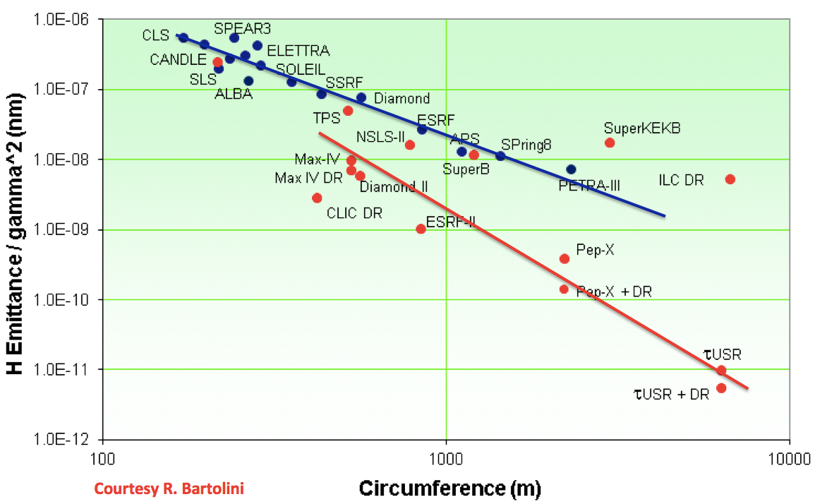
The High Energy Photon Source (HEPS)
courtesy of Q. Qin
HEPS
Design goal:
6 GeV, 1300 m, 200 mA beam current, 50 ~ 100 pm natural emittance

Slide 4
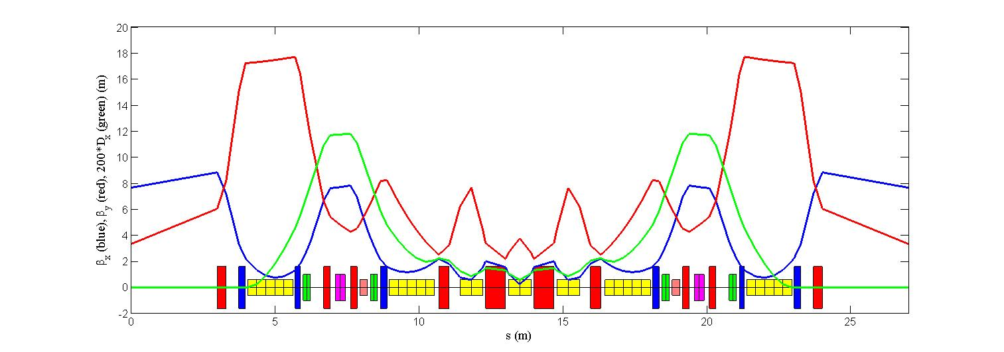
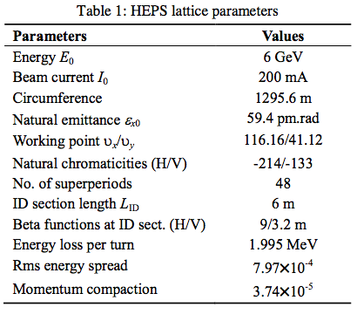
HEPS nominal design & parameters
MAIN RING
E=6GeV
C~1300m
A ESRF-type 7BA cell
periodicity = 48
300MeV LINAC
Booster
C~432m
References:
G. Xu, et al., Proc. IPAC 2016, pp. 2886–2888.
Y. Jiao, Chin. Phys. C, 40 (7): 077002.
Y. Jiao and G. Xu, arXiv:1605.05021.
U0 = 2.5 MeV, w/ insertion devices in the first phase.

Slide 5
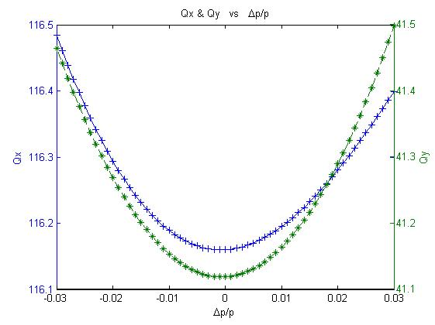
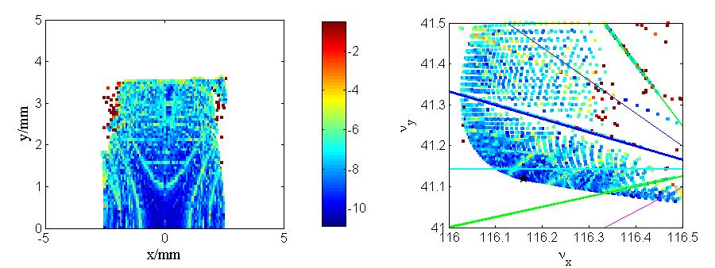
Ring acceptance & injection schemes
Linear & nonlinear aspects are optimized via MOGA & MOPSO algorithms, the achieved dynamic aperture is insufficient for off-axis injection, but should be fine for on-axis injection schemes:
Swap-out L. Emery and M. Borland, in Proc. PAC’03, pp. 256-258.
Longitudinal injection M. Aiba, et al., PRSTAB, 18, p. 020701, 2016.
Double RF voltage adjustment B. C. Jiang, et al., NIM A 814, 1, 2016.
half integer resonance reached at δ = ±3%.
Y. Jiao and G. Xu, arXiv:1605.05021.
‘Effective DA ~2.5 mm in x and ~3.5 mm in y (bare lattice)
We proposed an alternative on-axis injection scheme based on a double-RF system
G. Xu el al., IPAC’16, WEOAA02.
Z. Duan el al., eeFACT2016, TUT2H4.

Slide 6
Longitudinal dynamics of a double-RF system
Fundamental RF system: 166.6MHz, Nf=4
3rd harmonic RF system: 499.8MHz, Nh=2
Same settings for cavities with the same frequency
4 free variables (V_{f}, φ_{f}, V_{h}, φ_{h})
One constraint to fix longitudinal phase of circulating beam relative to the cavities
Longitudinal dynamics can be solved to achieve required RF acceptance, in particular, evolution between operation and injection modes.
operation mode
injection mode
circulating bunch
injected bunch

Slide 7
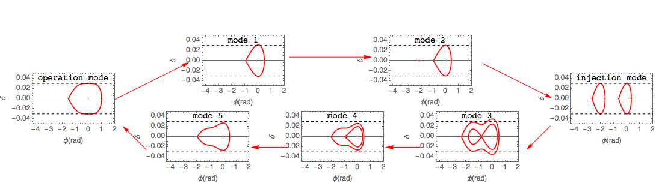
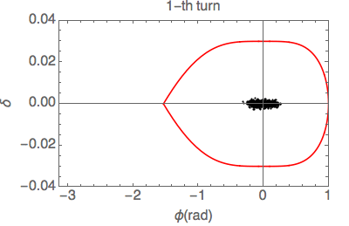
A complete injection period
An injection period takes about 200ms
  Operation to injection: 20ms ~ 1 damping time
  Injection Process: 100ms
  Injection to mode 5: 20ms ~ 1 damping time
  mode5 to operation mode : 60 ms ~ 3 damping time
Injection process could be longer allowing multi-turn injection
20ms is only a tentative choice, could be shorter if RF system permits.

Slide 8
Evolution of beam parameters
Since an injection period takes ~ 200ms, beam lifetime reduction is not a big issue.
Bunch length is as low as 2.8mm at injection mode w/o IBS.
IBS induced beam parameter change might be an issue.
Collective instability might be an issue too (under study).
200 mA, 648 bunches, IBS effect via SAD
Cases | w/o IBS | injection mode | operation mode
ex (pm) | 59.32 | 70.18 | 60.47
ey (pm) | 5.96 | 6.91 | 6.06
ey / ex (%) | 10.04 | 9.85 | 10.02
bunch length(mm) | 2.8 / 32.0 | 3.01 | 33.03
energy spread (1e-4) | 7.96 | 8.57 | 8.03
+ 8% σx
+ 6% σy
+
Impact to user experiments is being evaluated. Gate signal can be sent to users during injection.

Slide 9



RF parameters in a complete injection period
The cavity phase adopts phasor convention
Beam power per cavity is calculated via:
What about beam loading effects?

Slide 10
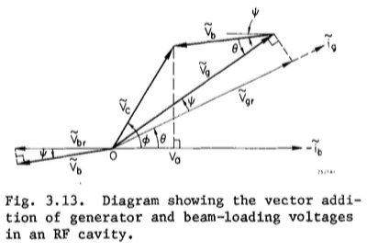
Beam loading effects
(V_{f}, φ_{f}, V_{h}, φ_{h}) are combination of generator voltages and phases, with beam-induced voltages and phases.
Cavity coupling β and tuning angle should be optimized to reduce power reflection and thus required generator power.
optimal β and tuning angle
optimal tuning angle but not optimal β

Slide 11
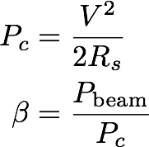
RF parameter table
Parameter | Fundamental RF Cavity (4 cavities) | 3rd Harmonic RF Cavity (2 cavities)
frequency(MHz) | 166.6 | 499.8
Q0 | 5e8 | 1e9
R/Q | 135.8 | 93.5
Max beam power per cavity P_{beam}(kW) | 112.2 | 178.0
Cavity Voltage at maximum beam power V (MV) | 0.66 | 1.32
β | 17293.4 | 9490.9
QL | 28912.8 | 105364.
cavity filling time(μs) | 55 | 67
optimal tuning angle ψ (degree) | -32.29 | -47.77
Notes on the parameter table:
β, QL, tuning angle ψ, are calculated values, assuming optimal coupling at maximum beam power per cavity.
  For fundamental RF cavities, this corresponds to the operation mode.
  For 3rd harmonic RF cavities, this corresponds to the injection mode.

Slide 12

RF control loop
Time scales
  cavity filling time (~ tens of μs)
  amplitude and phase control loops response very fast, ~ tens of μs
  frequency control loop
    mechanical tuner: slow, ~ second
    piezo: fast, <ms, limited dynamic range: BEPCII 500MHz cavity: ~6kHz
In an injection period, required cavity frequency change exceed piezo range
frequency shift between operation and injection mode is ~18kHz.
frequency range ~ 8kHz.

Slide 13
The RF power w/ fixed tuning angle during injection
Incident and reflected power in transmission line can be calculated with:

Slide 14
Discussion on RF control
After injection, the tuning angle of harmonic cavities can be shifted from -47.8degree to 81.3 degree, with mechanical tuner, in seconds. As a result, the incident power per harmonic cavity can be reduced from 116kW, to 11.8kW.
  Require RF amplitude and phase control to work together with frequency control, to keep the same Vc and φ.
Assume tuner ramping takes 2 seconds.
Needs justification

Slide 15
Injection mode and requirements on kicker
Requirements on injection kicker system:
Full pulse width < 6 ns
pulse fall time < 2.5 ns
Current design: stripline kickers + high-voltage fast pulser
Reference:
B. I. Grishanov, et al., “Very fast kicker with high repetition rate for accelerator applications”, Nucl. Instrum. Meth. A, vol. 396, pp. 28–34, Sep. 1997.
V. M. Efanov, et al., in Proc. IPPC’97, pp. 988–991. FIDGmbH,http://www.fidtechnology.com

Slide 16
High voltage fast pulser by FID GmbH
Courtesy of Chen Jinhui
model FPG20-01MC2N4
Paramter | Value
Amplitude adjustment range | 5~20kv
Amplitude stability | ~1%
Rise time (5~95%) | <1ns
Fall time (95~5%) | <3ns
pulse flat-top (90%) | 1~1.2ns
pulse duration at 5% | 3~3.5ns(rectangle shaped pulse)
burst mode repitition rate | 300Hz
macro-pulse length | 2second / 100 ms
repetition rate of the macro-pulse | every 3min / 9 second
pulse will be broaden by stripline kicker, as schematically shown as red dashed line.

Slide 17
Injector specifications
Linac
  single bunch mode
  repetition rate = 300 Hz
  2998 MHz or 2856 MHz
Booster
  1/3 circumeference of main ring, 3 times larger RF frequency
  capable of 2 Hz operation
  capable to accommodate 30 bunches
  Same injection & extraction kicker, full pulse width < 96 ns, similar time structure as main ring injection kicker.
Bunch filling pattern in booster

Slide 18
Top-up considerations
Requirements: ~ 0.2 % beam current stability, beam current = 200mA
Preliminary estimation of beam lifetime w/ optimal lengthening.
parameters | 648 bunches | 60 bunches
charge | 1.33 nC | 14.4 nC
lifetime (during operation) | 30 hours | 3 hours
refill time | 3.5 min | 20 second
tentative injection shots in each refill | 4 | 2
tentative bunch filled in each refill | 30 * 4 = 120 | 30 * 2 = 60
injection time | 200 ms *4 | 200 ms *2
total duration of each refill | 9 s * 3 =27 s | 9s * 1 = 9 s

Slide 19
Summary
Extensive studies have been done on various aspects of the longitudinal on-axis injection scheme with a double RF system.
R&D on 166.6 MHz superconducting RF cavities & injection kickers are being done at IHEP.
Underway study:
  Simulation of dynamic aperture at the injection condition, based on which tolerances of injection errors will be analyzed.
  Evaluation of possible collective effects with the very small bunch length during injection.
  Estimate the impact of injection to user experiments.
Swap-out injection scheme is also being considered.
Alternative lattice design with high-beta insertions to accommodate off-axis pulsed-multipole injection scheme is also under way.

Slide 20
Thank you for your attention!

Slide 21
Backup

Slide 22
Injection mode compared to Aiba-san’s scheme
Injection kicker:
full pulse width < 6 ns
pulse fall time < 2.5ns.
Much smaller αc leads to more stringent requirements on MA.
Or more stringent requirements on kicker pulse fall time -> more pieces of stripline kicker, Challenging!
Aiba, et al, PRSTAB, 18, 020701, 2015.

Slide 23
RF parameters for different U0
U0 (MeV/turn) | RF bucket heights | 166MHz peak power (kW) | 166MHz peak voltage (MV) | 500MHz peak power (kW) | 500MHz peak voltage(MV)
2.0(w/o ID) | 3% | 112*4 | 0.7*4 | 178*2 | 1.4*2
2.0(w/o ID) | 3.5% | 112.5*4 | 0.7*4 | 155*2 | 1.2*2
2.5(ID in first stage) | 3% | 141*4 | 0.85*4 | 225*2 | 1.6*2
2.5(ID in first stage) | 3.5% | 141*4 | 0.85*4 | 196*2 | 1.4*2
3.0(ID in possible upgrade) | 3% | 169*4 | 1.0*4 | 275*2 | 1.9*2
3.0(ID in possible upgrade) | 3.5% | 169*4 | 1.0*4 | 256*2 | 1.8*2
For U0=2.5MeV/turn, RF bucket height=3.5%:
peak reflected power of each 166MHz cavity =23kW
peak reflected power of each 500MHz cavity=151kW, can be reduced to 39kW by optimal tuning after injection

Slide 24
SAD vs. ibsEmittance (injection mode)
Ib =200mA, 166.6 MHz cavity + 499.8 MHz cavity, 3% RF bucket height
Cases | w/o IBS | 60 bunches w/ IBS |  | 648 bunches w/ IBS
Parameters |  | SAD | ibsEmittance | SAD | ibsEmittance
ex (pm) | 59.32 | 111.26 | 117.98 | 70.18 | 69.77
ey (pm) | 5.96 | 10.48 | 11.80 | 6.91 | 6.977
ey / ex (%) | 10.04 | 9.42 | 10 | 9.85 | 10
bunch length(mm) | 2.8 | 3.7 | 3.89 | 3.01 | 3.11
energy spread (1e-4) | 7.96 | 10.55 | 11.06 | 8.57 | 8.84
In SAD, approximate with one 720MHz RF cavity to keep bunch length=2.8mm w/o IBS.
The longitudinal distribution deviates from Gaussian a little, and it is good approximation to replace double RF with a single RF keeping the same bunch length.

Slide 25
SAD vs. ibsEmittance (operation mode)
Ib =200mA, 166.6 MHz cavity + 499.8 MHz cavity, 3% RF bucket height
Cases | w/o IBS | 60 bunches w/ IBS |  | 648 bunches w/ IBS
Parameters |  | SAD | ibsEmittance | SAD | ibsEmittance
ex (pm) | 59.32 | 69.50 | 69.14 | 60.47 | 56.04
ey (pm) | 5.96 | 6.85 | 6.91 | 6.06 | 5.60
ey / ex (%) | 10.04 | 9.85 | 10 | 10.02 | 10
bunch length(mm) | 32.0 | 35.11 | 35.41 | 33.03 | 31.50
energy spread (1e-4) | 7.96 | 8.53 | 8.81 | 8.03 | 8.09
In SAD, approximate with one 108 MHz RF cavity to keep bunch length=32 mm w/o IBS.
Need to check with Monte-Carlo simulation available in Elegant.

Slide 26
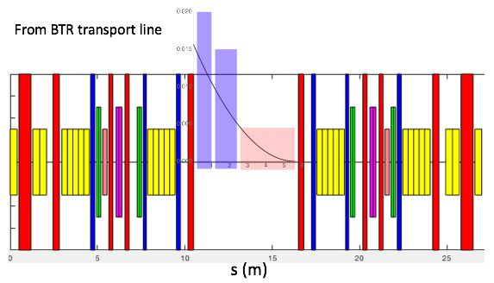
Injection region layout
Two Lambertson magnet (vetical deflection)
10 pieces of stripline kicker (horizontal deflection)

Slide 27
Backup
Linac main parameters
Parameter | specification
Rf frequency (MHz) (s-band) | 2998.8 (or 2856)
Single bunch Charge (nC) | ≥7.2 *
Energy (MeV) | ≥300
Relative energy spread (%) | ≤0.5 (rms)
Repetition rate (Hz) | 300
geometric emittance (nm.rad) | ≤70
Pulse to pulse time jitter(ps) | ≤100

Slide 28
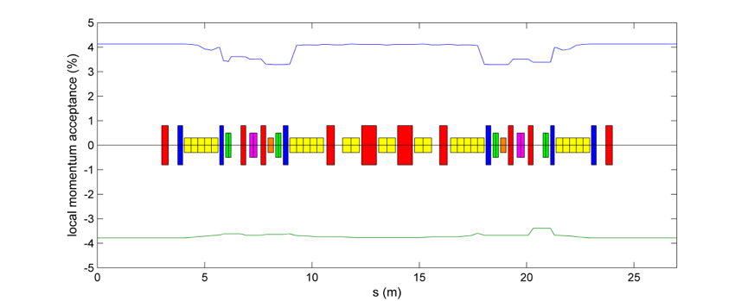
LMA
RF bucket height is set to 3.5%, single-frequency RF
Local momentum acceptance along a single 7BAfor the bare lattice of present nominal HEPS storage ring design, with the limitation of integer resonances into account. In this tracking, RF and synchrotron radiation are turned on.

