Slide 1

Results of MQXF tests in SM18, FNAL, and BNL
Paolo Ferracin
on behalf of the MQXF collaboration
21st HL-LHC Technical Coordination Committee (TCC) meeting
CERN
24 Novemeber, 2016

Slide 2
Acknowledgments
CERN
  A. Ballarino, H. Bajas, M. Bajko, B. Bordini, J.C. Perez, S. Izquierdo Bermudez, P. Fessia, C. Fichera, P. Grosclaude, M. Guinchard, P. Hagen, F. Lackner, H. Prin, E. Rochepault, S. Sequeira Tavares, E. Todesco, G. Vallone
BNL
  M. Anerella, A. Ghosh, J. Muratore, J. Schmalzle, P. Wanderer
FNAL
  G. Ambrosio, R. Bossert, G. Chlachidze, L. Cooley, E. Holik, S. Krave, F. Nobrega, I. Novitsky, S. Stoynev, T. Strauss, M. Yu,
LBNL
  D. Cheng, D.R. Dietderich, R. Hafalia, M. Marchevsky, H. Pan, I. Pong, E. Ravaioli, G. Sabbi, X. Wang
CEA Saclay
  H. Felice
LASA
  V. Marinozzi, M. Sorbi
Tampere Univerisity of Technology
  T. Salmi

Slide 3
Outline
MQXFS1 and MQXFS1b
MQXFS3 and MQXFS3b
MQXFPM1

Slide 4
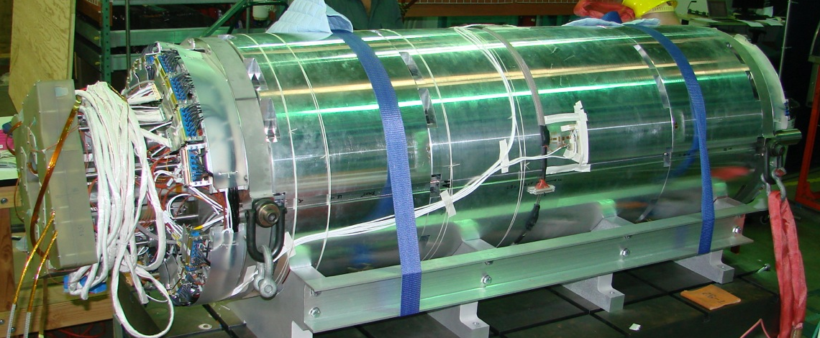
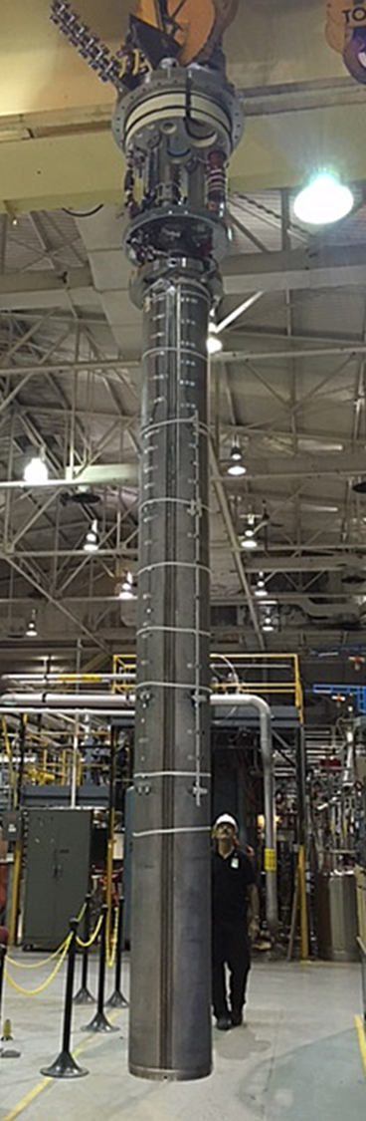
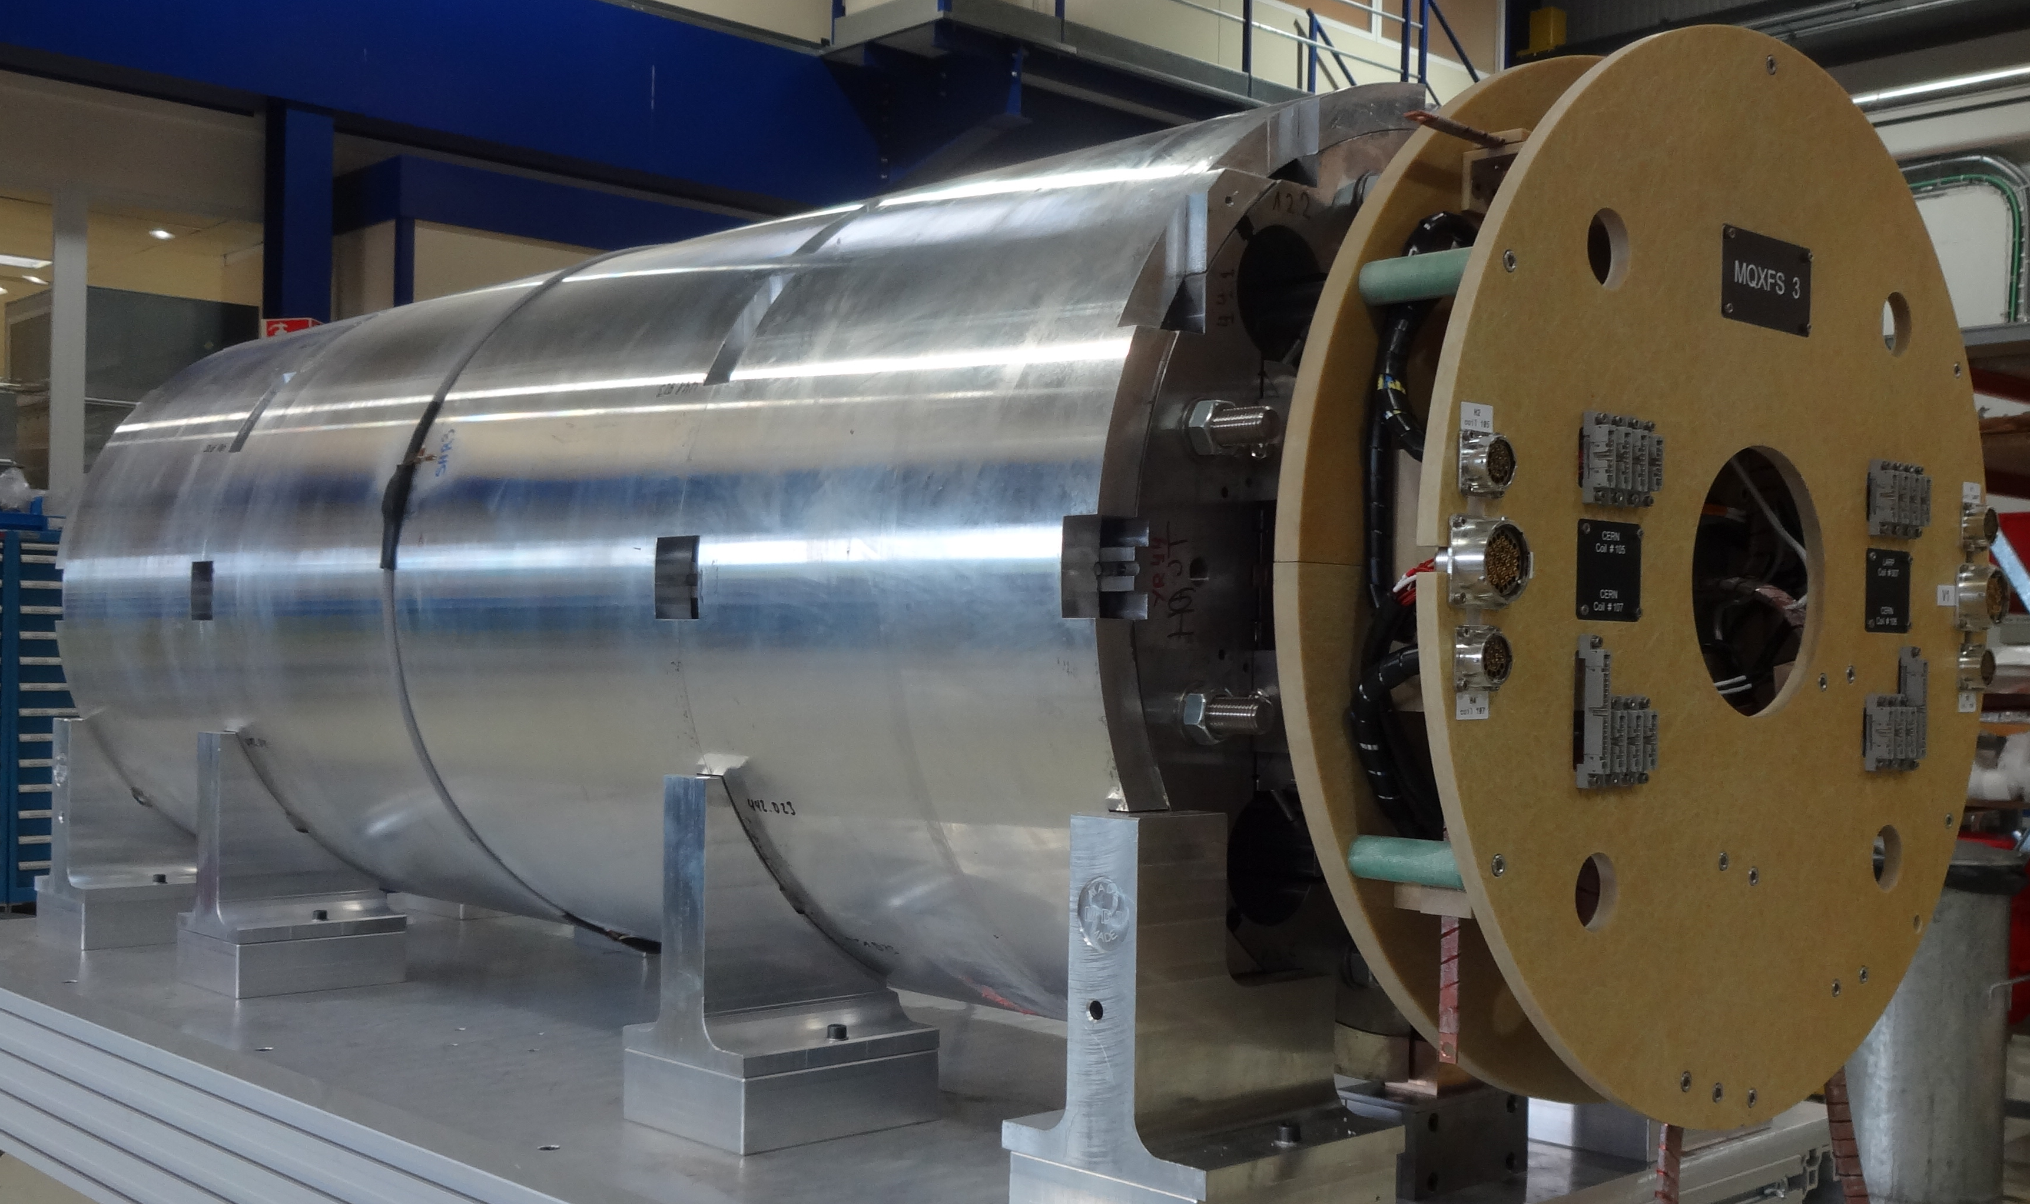
Overview of magnets under test
MQXFPM1
(test at BNL)
MQXF1 (test at FNAL)
MQXF3 (test at CERN)

Slide 5
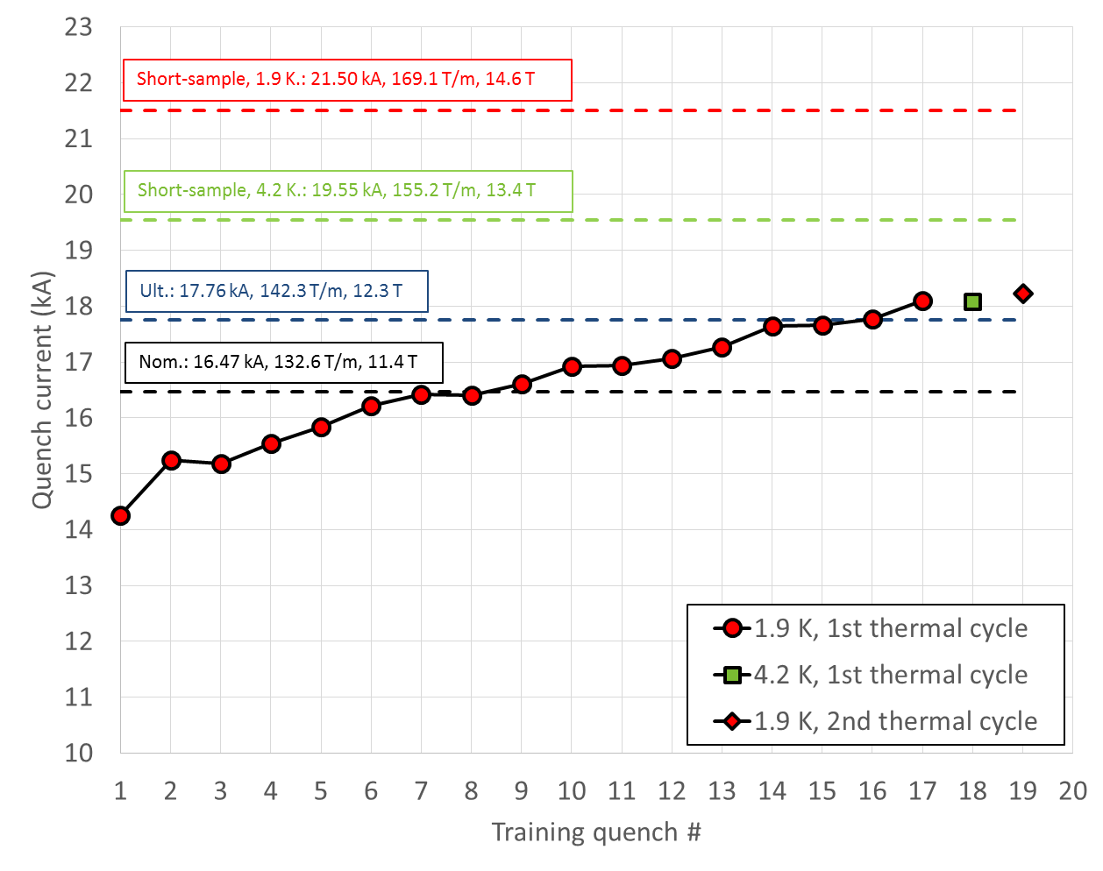
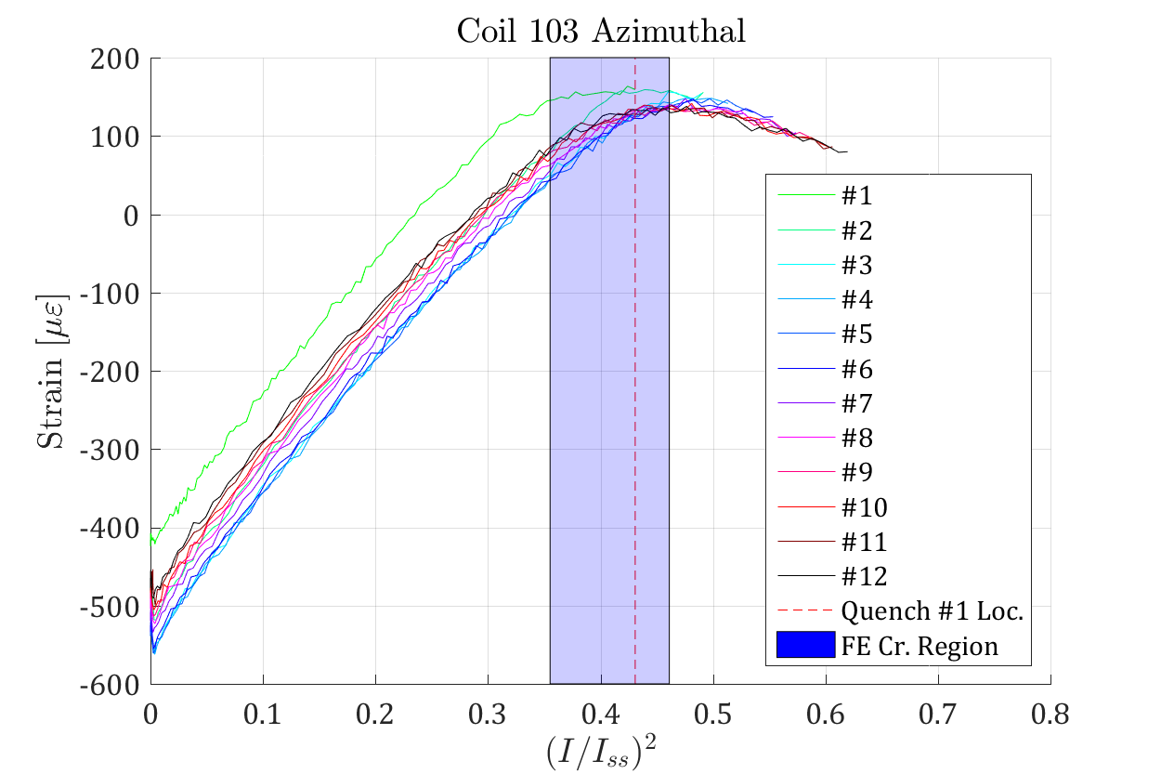
…where we were
MQXFS1a
  Tested at FNAL in April 2016 with coils 3,5,103,104
  Exceeded ultimate current
  Demonstrated temperature margin and excellent memory
  Quenches distributed on the pole turn (end and straight section)
    Training was stopped to increase azimuthal preload

Slide 6
Increase of pre-load of MQXFS1→ MQXFS1b and assembly of MQXFS3
MQXFS1: 80 MPa
MQXFS1b: 100 MPa
MQXFS3 100 MPa
Unloading shifted
  Check impact on training
    trained magnet (MQXFS1b)
    virgin magnet (MQXFS3)

Slide 7
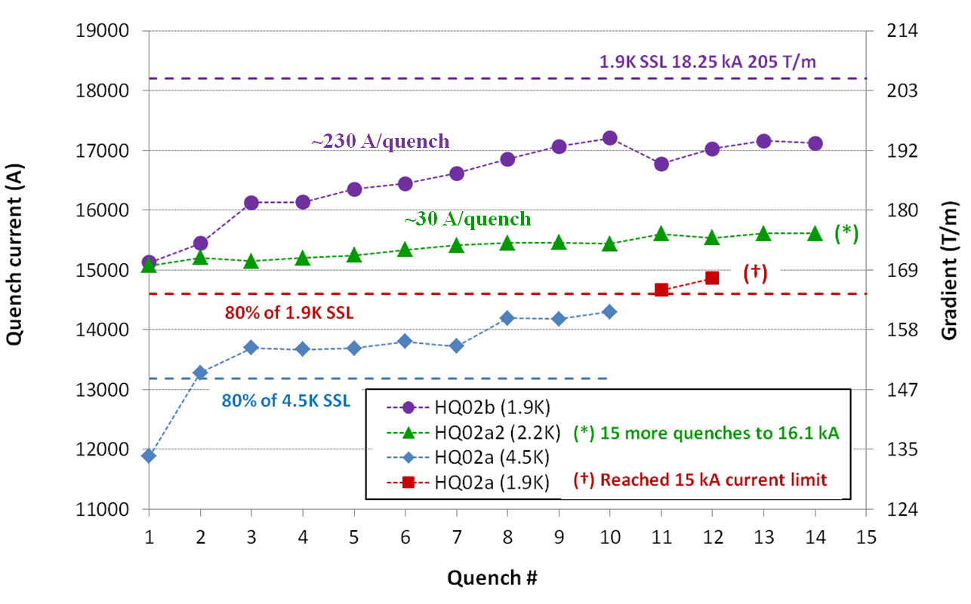
A previous similar case
HQ02b: Much faster training up to 95% SSL after pre-load increase

Slide 8
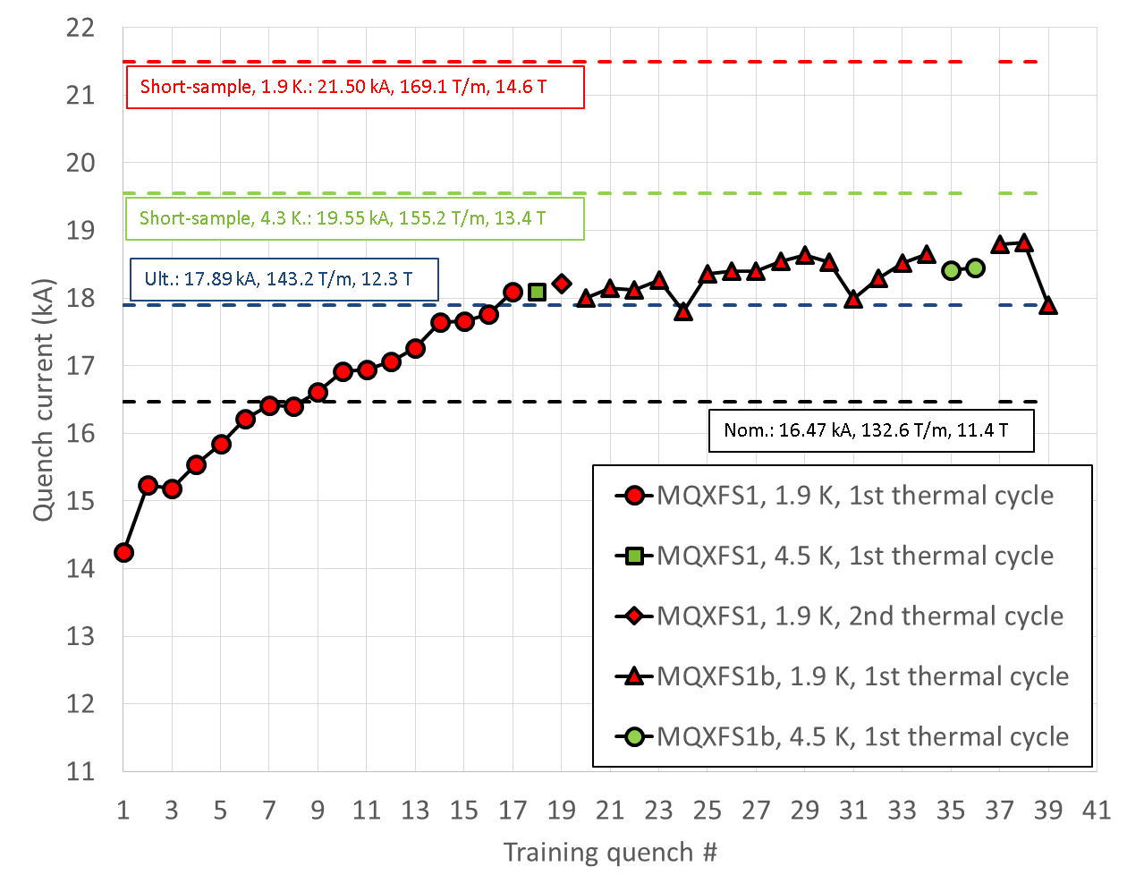
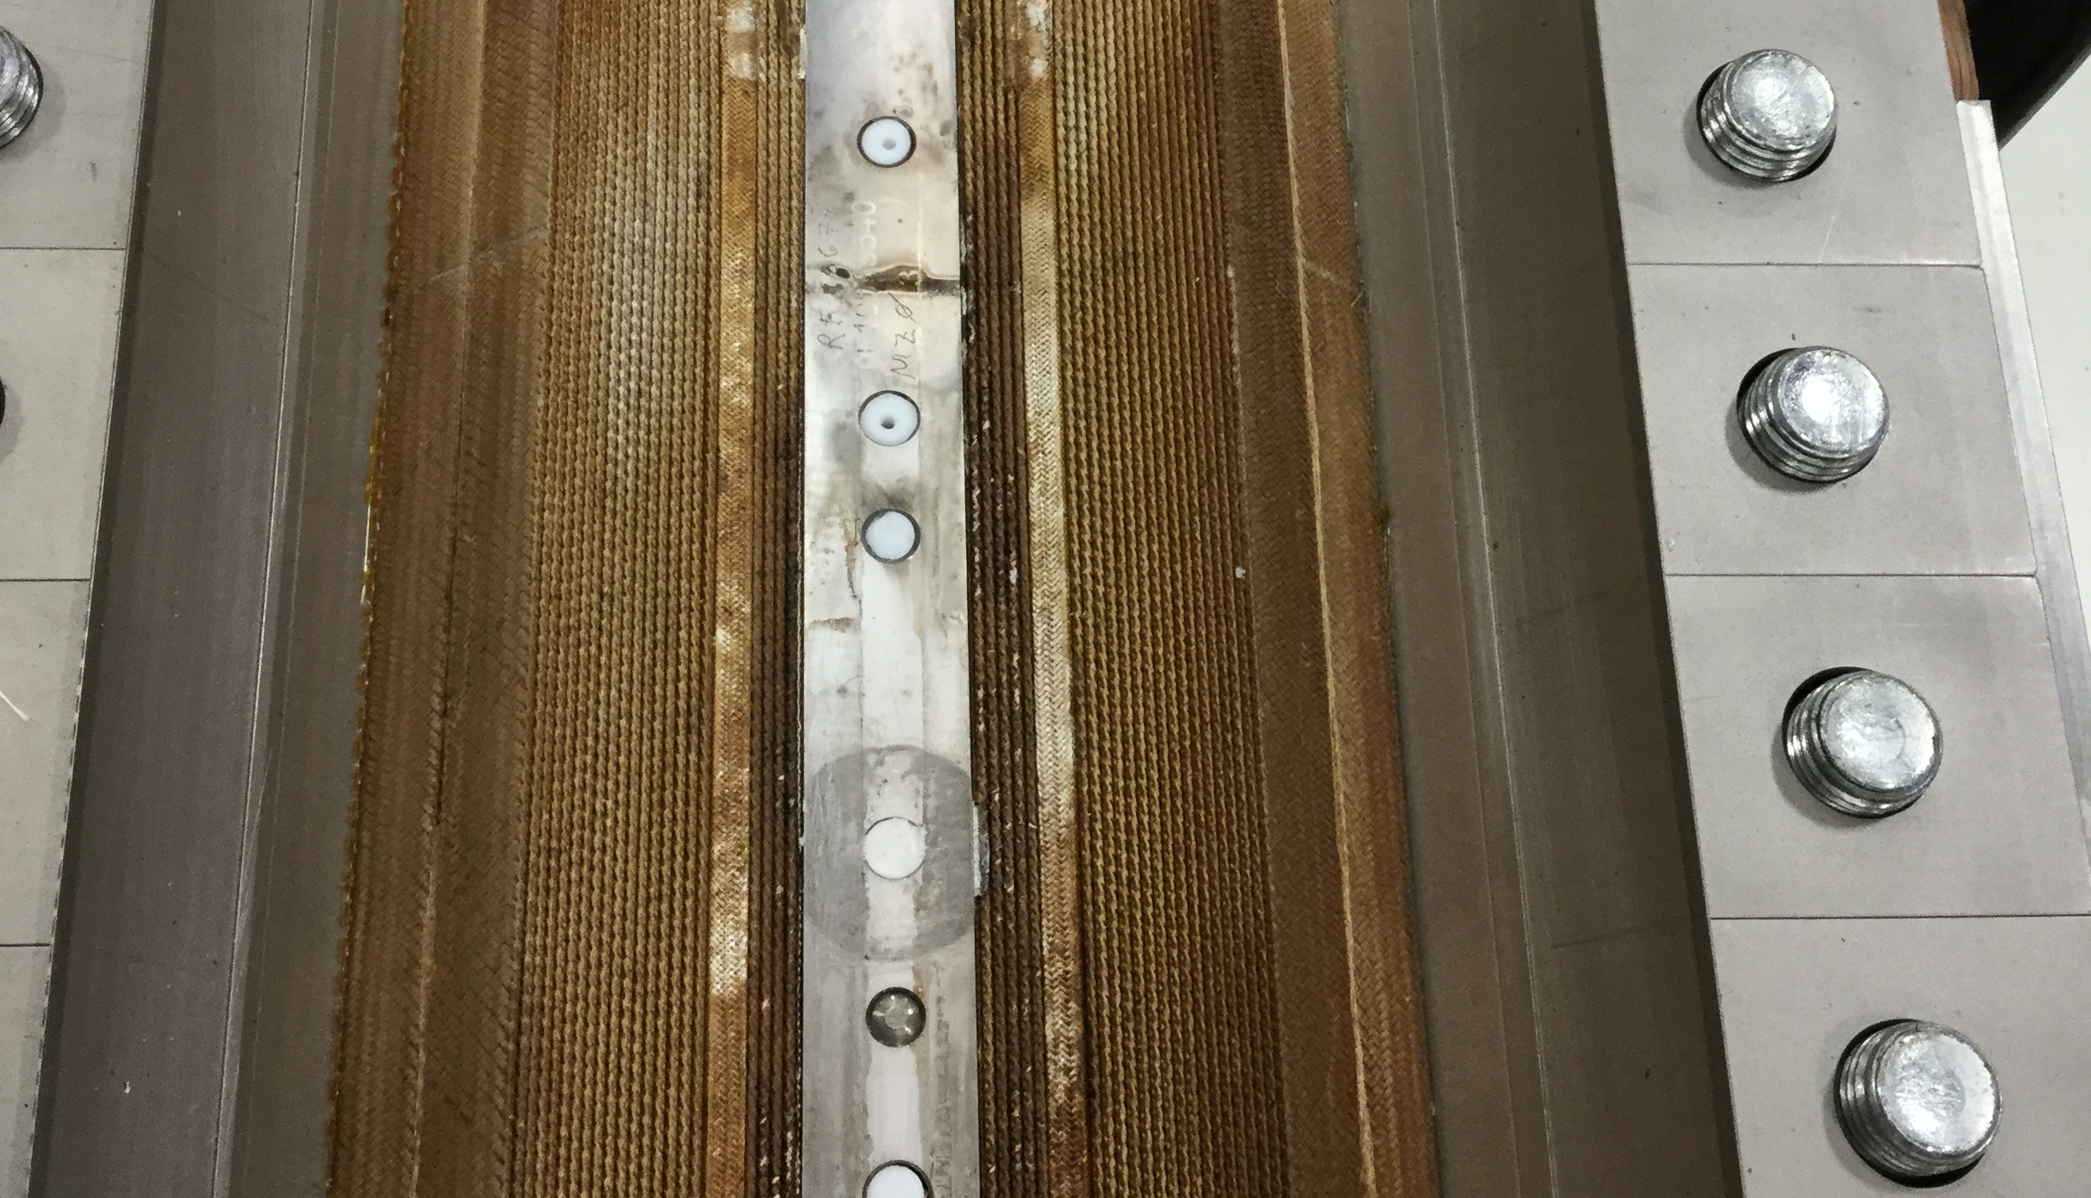
MQXFS1b
Training
Re-loaded at LBNL in summer 2016, test in progress and FNAL
Again, good memory
Stably above ultimate
  Only 1 quench below
Slower training than MQXFS1a
Temperature margin
All quenches in the ends
88% of I_{ss} at 1.9 K
95% of I_{ss} at 4.5 K

Slide 9
Outline
MQXFS1 and MQXFS1b
MQXFS3 and MQXFS3b
MQXFPM1

Slide 10
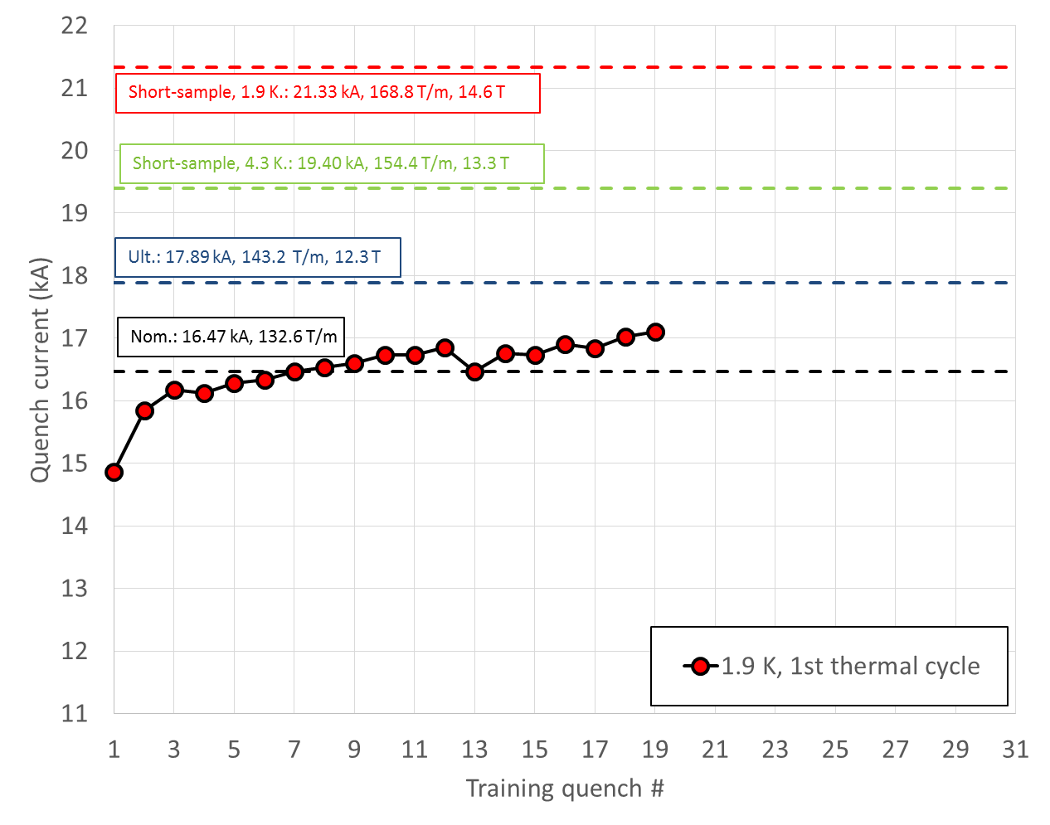
MQXFS3
Tested at CERN in October 2016 with coils 105,106,107,7
Same azimuthal pre-load as MQXFS1b
At nominal in 7 quenches
Most of quenches in coil 105, ends of the inner layer
Slower training than MQXFS1b

Slide 11
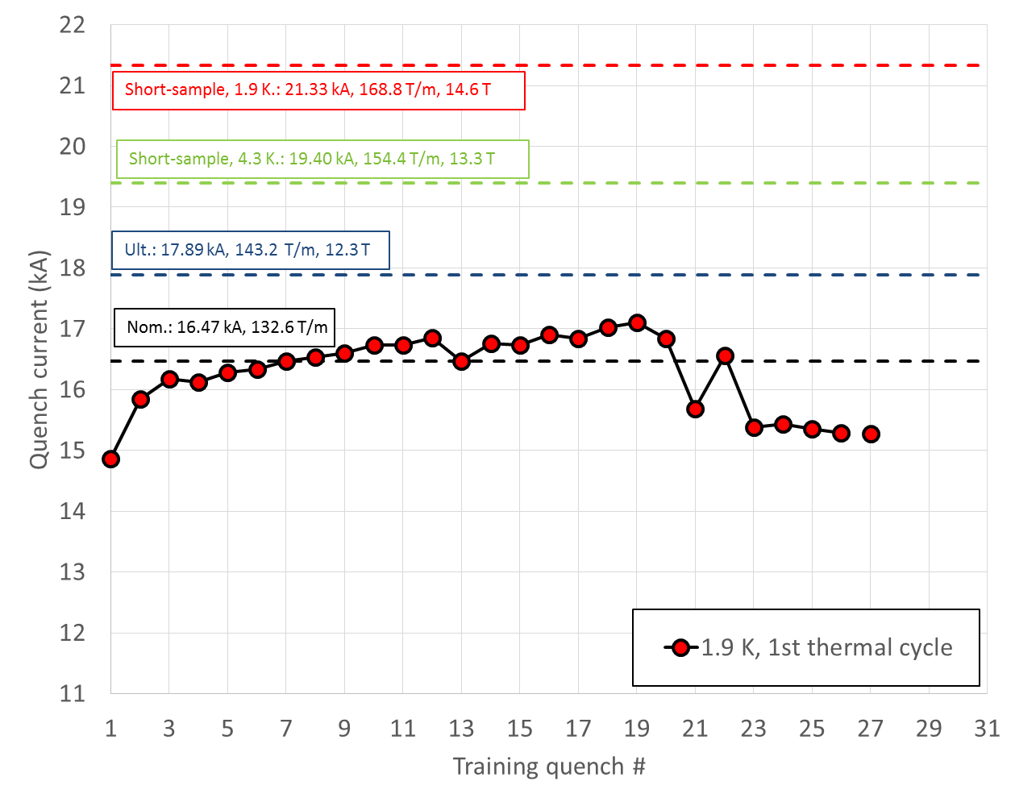
MQXFS3
Detraining after quench 19
Plateau
  coil 7, end region
    Same

Slide 12
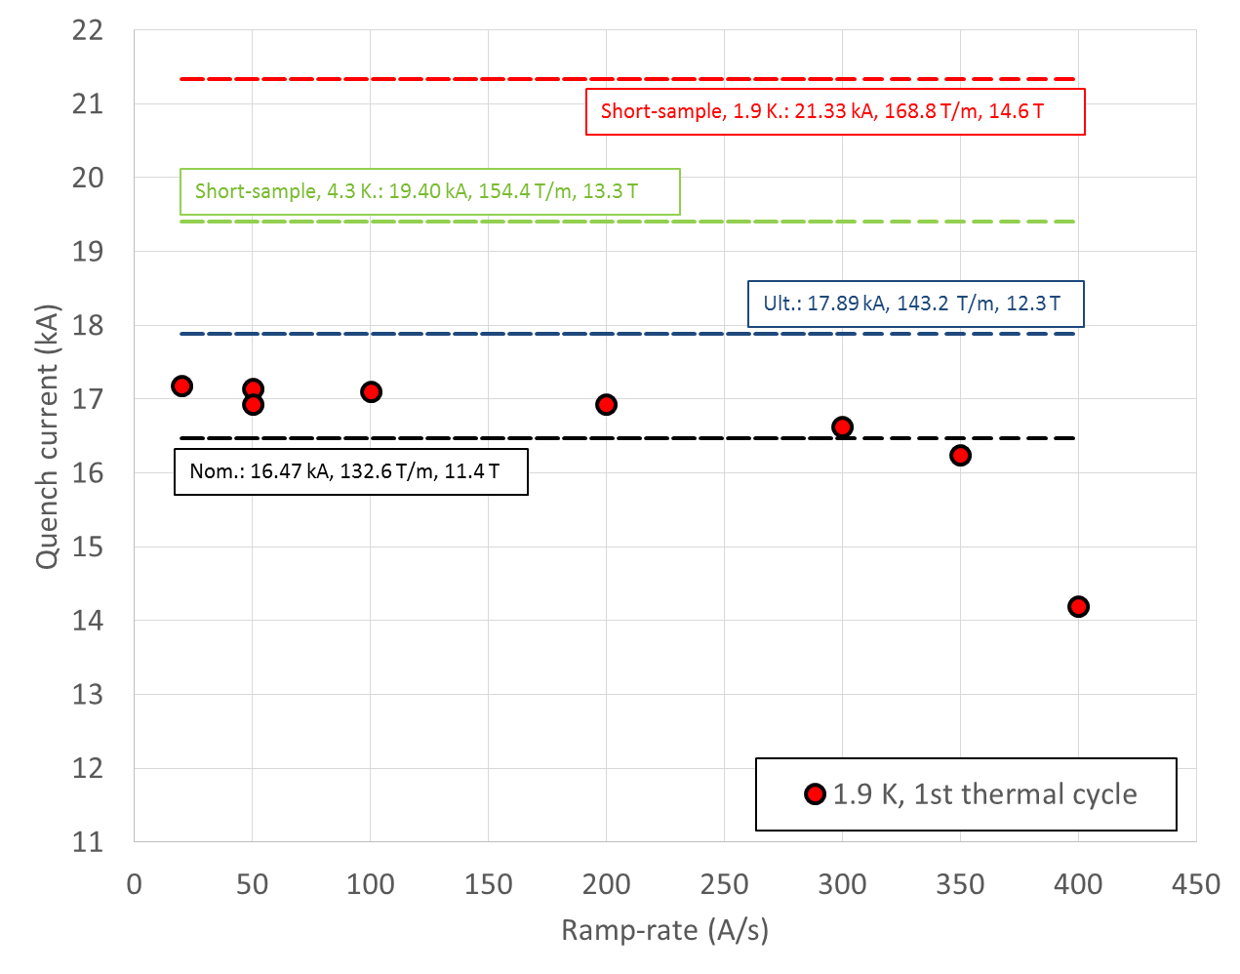
MQXFS3
Ramp-rate quenches
  Full recovery to initial maximum current
  Last 3 quenches in 105, straight section

Slide 13
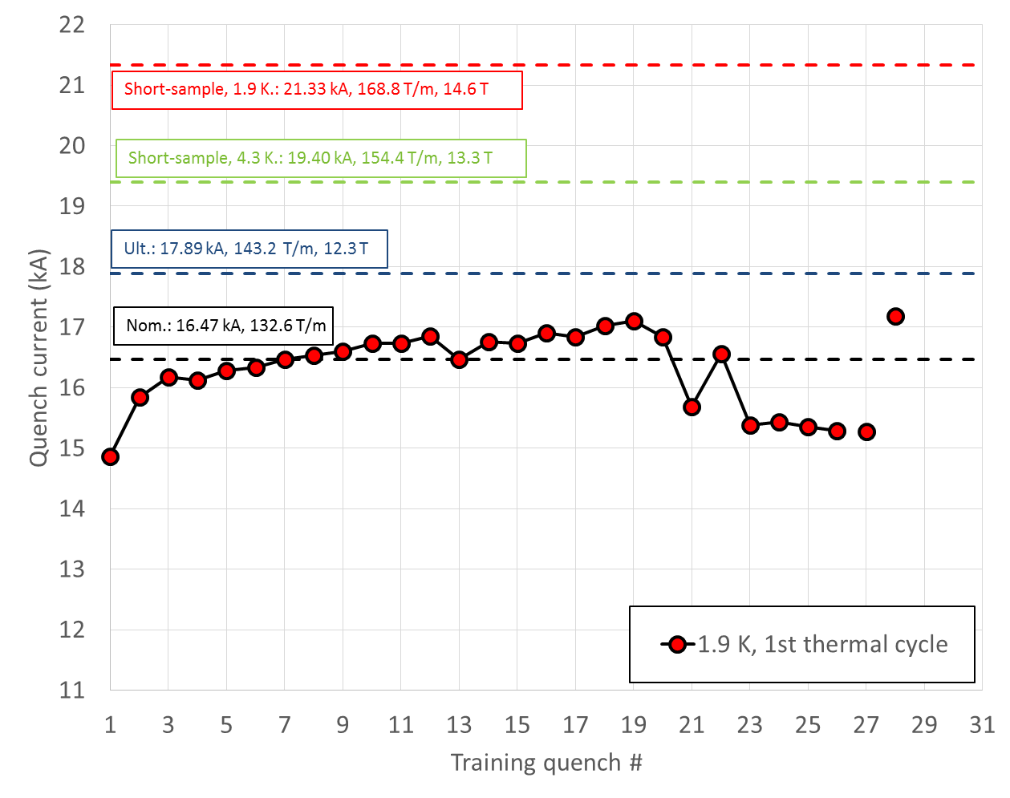
MQXFS3
Full recovery to initial maximum current

Slide 14
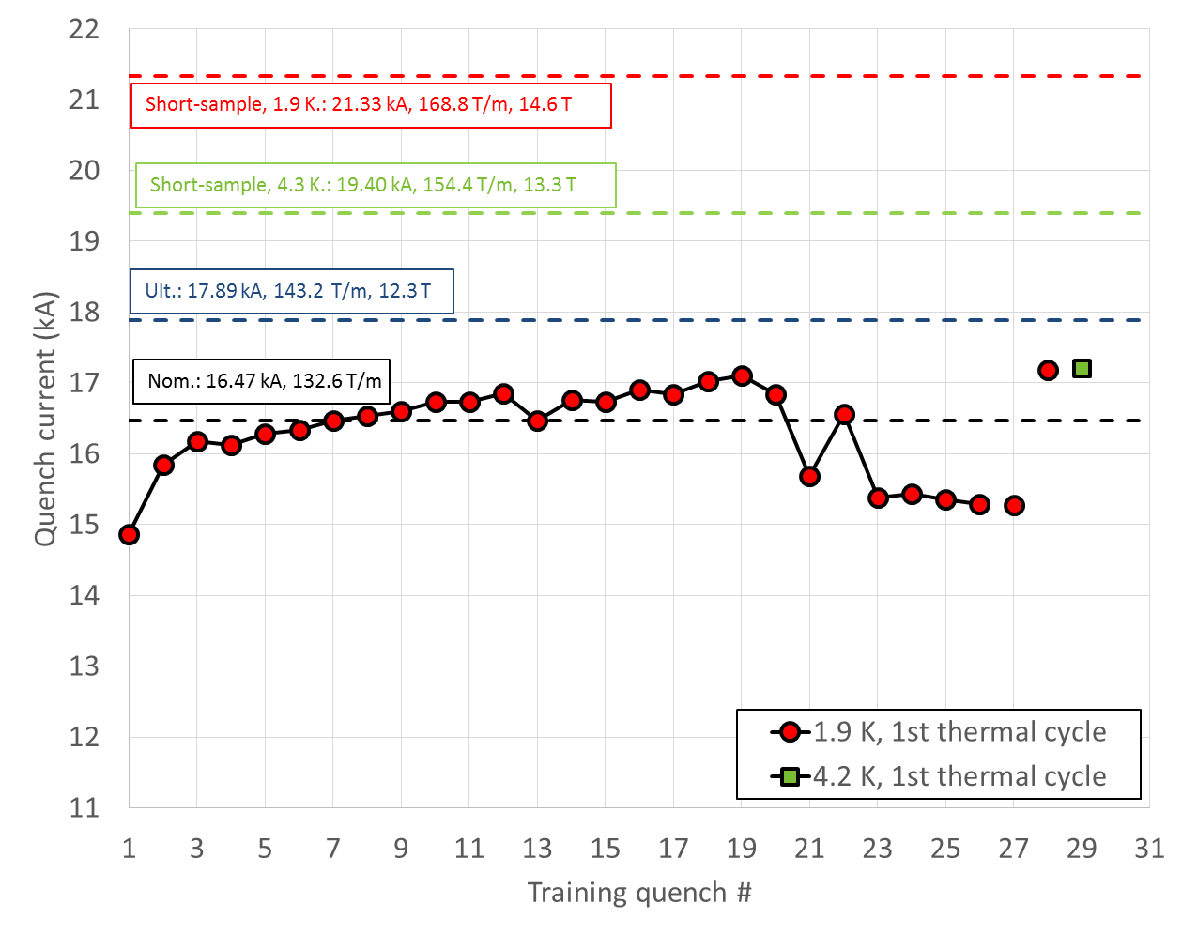
MQXFS3
Again, temperature margin
81% of I_{ss} at 1.9 K
89% of I_{ss} at 4.5 K

Slide 15
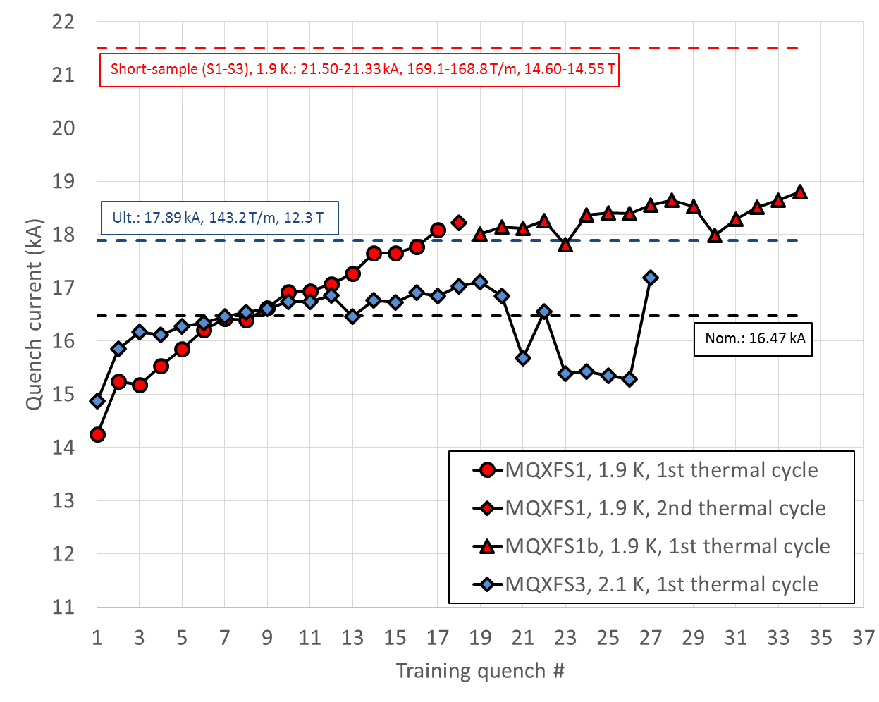
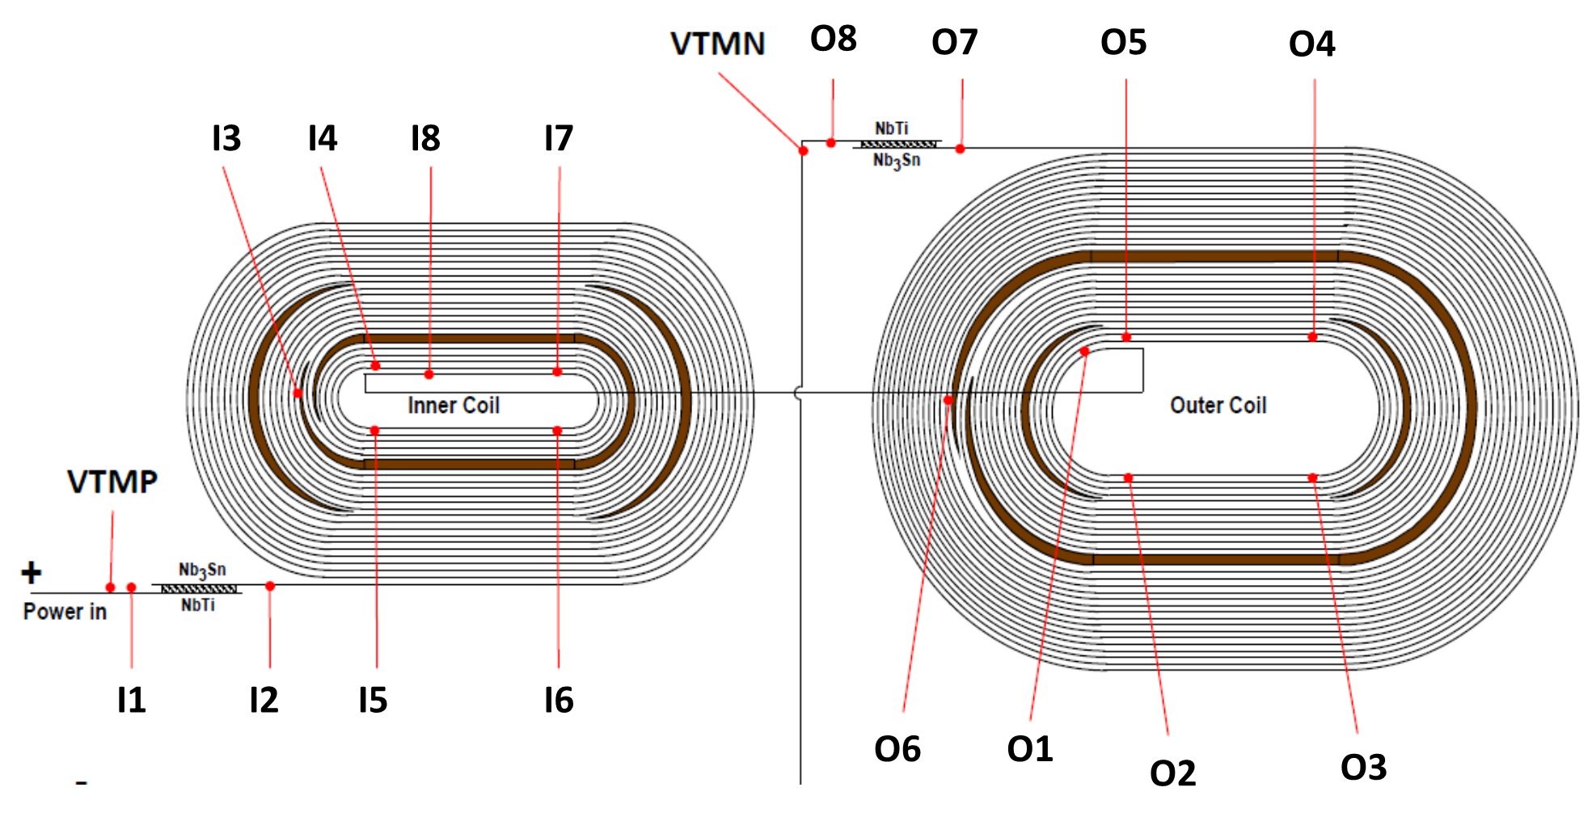
MQXFS1b vs. MQXFS3
MQXFS1b vs. MQXFS3
  Very similar axial and azimuthal pre-load
    wrt MQXFS1, same axial, +20 MPa azimuthal
  Similar training slope
    Although at different current level
      …but 1b not virgin
    Slower than MQXFS1a
  Similar quench locations
    End region, I3I4 segment

Slide 16
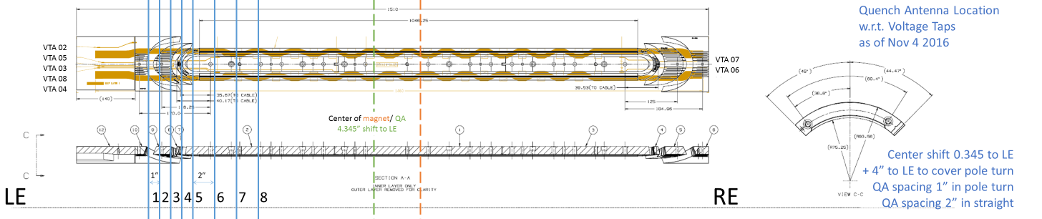
Plans for MQXFS1 and MQXFS3 (I)
Analysis in progress
  More detailed analysis with quench antenna in MQXFS1b
    Adjusted quench antenna to pinpoint quench locations
  Comparison of HQ03 and MQXF pre-loading levels
    Strain gauges measurements
      Pole strain plateau levels
    Finite element model
      Ratio between axial load and e.m. forces
      Contact pressure between coil and end parts
      Model of the LE
  Check for differences between MQXFS1a/1b/3a

Slide 17
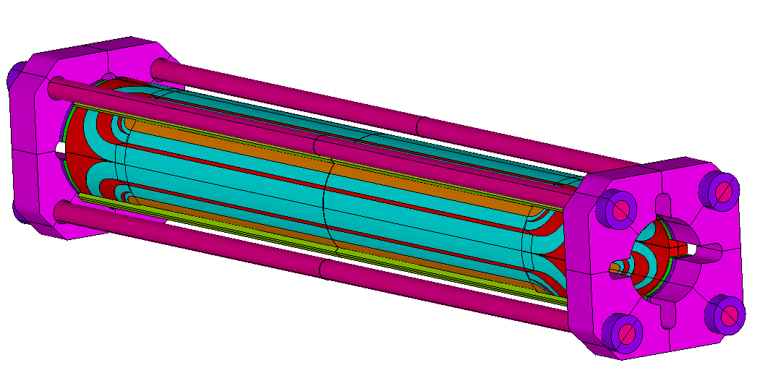
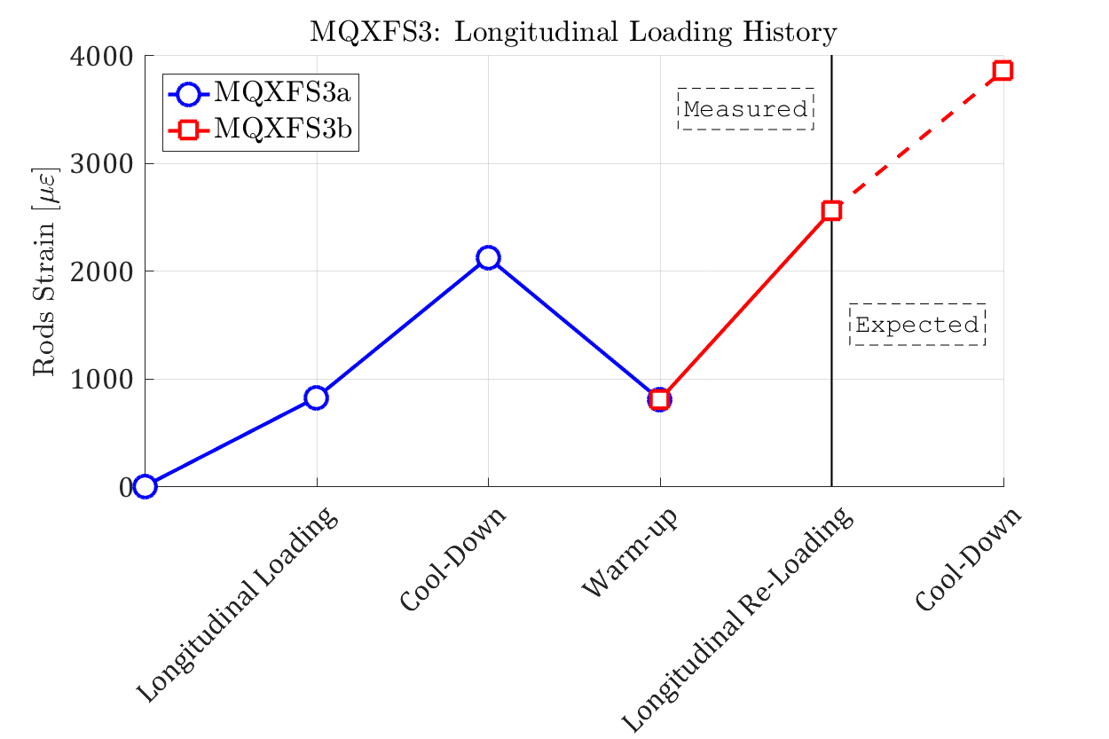
Plans for MQXFS1 and MQXFS3 (II)
MQXFS3b
    Retest with axial pre-load increased
      Pre-load increased by about a factor two at cold
        No need of disassembly
    Insertion of a new quench antenna with 40 mm long coils
    Test expected in December 2016

Slide 18
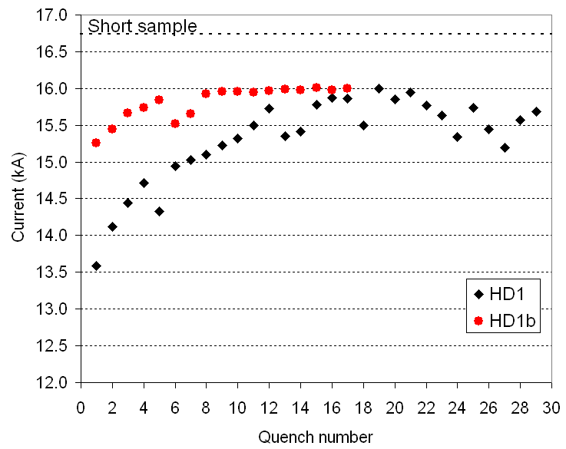
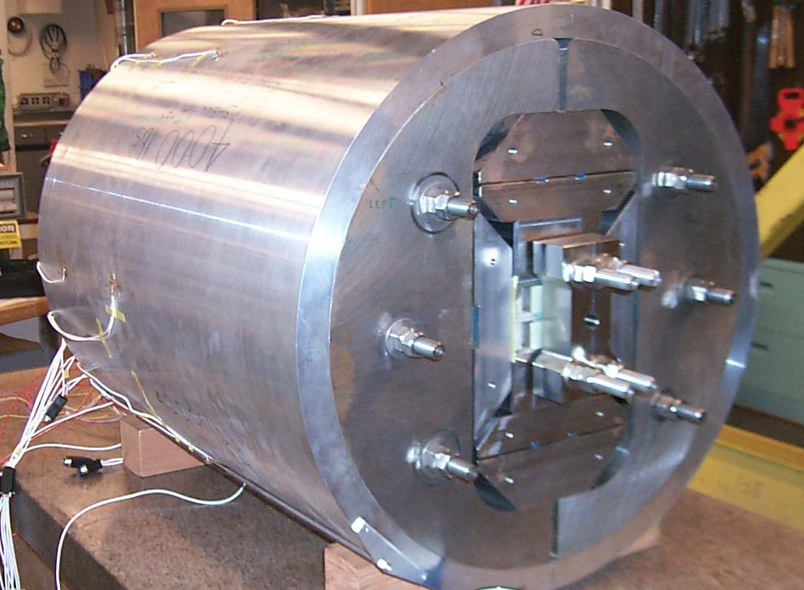
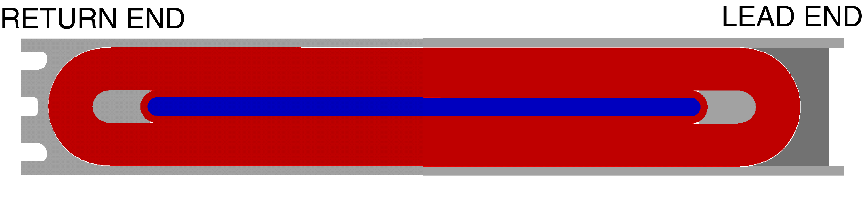
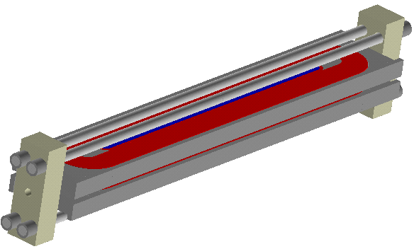
A previous similar case
From HD1 to HD1b, improved axial loading

Slide 19
Plans for MQXFS1 and MQXFS3 (III)
MQXFS3c
  Full disassembly and coil visual inspection
  Reassembly and re-loading with higher azimuthal pre-stress
    Depending on 3b test and visual inspection
MQXFS1c (currently stainless steel shell test)
  Increase of axial pre-load under consideration

Slide 20
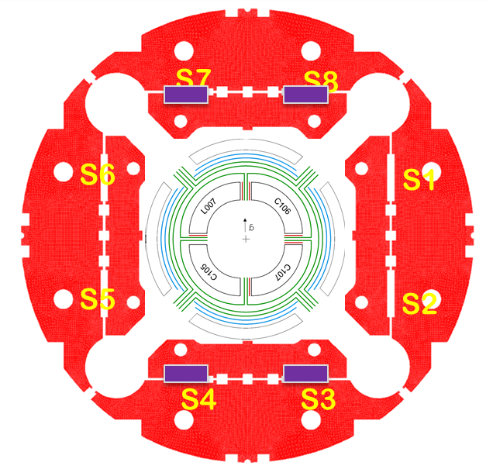
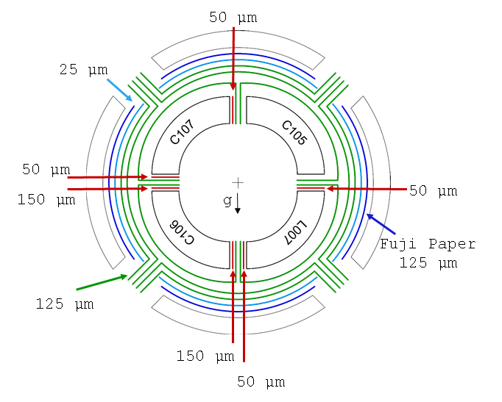
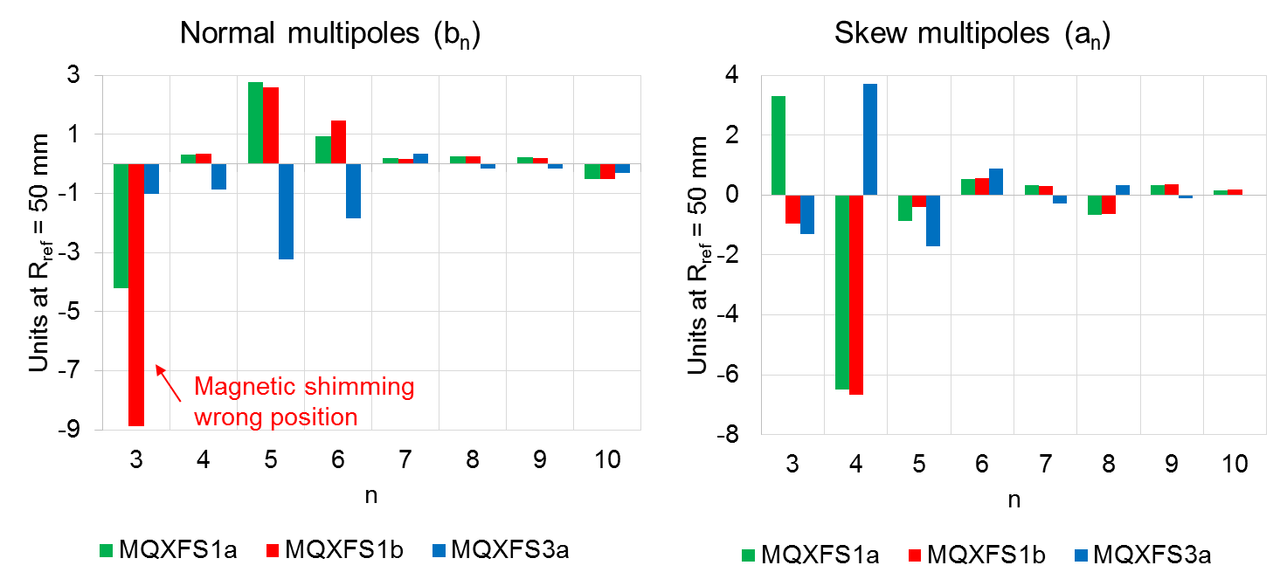
Field quality
Good agreement with expected on saturation, allowed harmonics and persistent currents.
The dominant source of field errors is the coil geometry and its initial assembly in the collared coil → coil shimming
Magnetic shimming:
  Demonstrated the capability to correct 3 units of b₃ and a₃ in MQXFS1b
Successfully corrected 3 units of b₄ in MQXFS3a.
Still work to do on a₄ and b₅

Slide 21
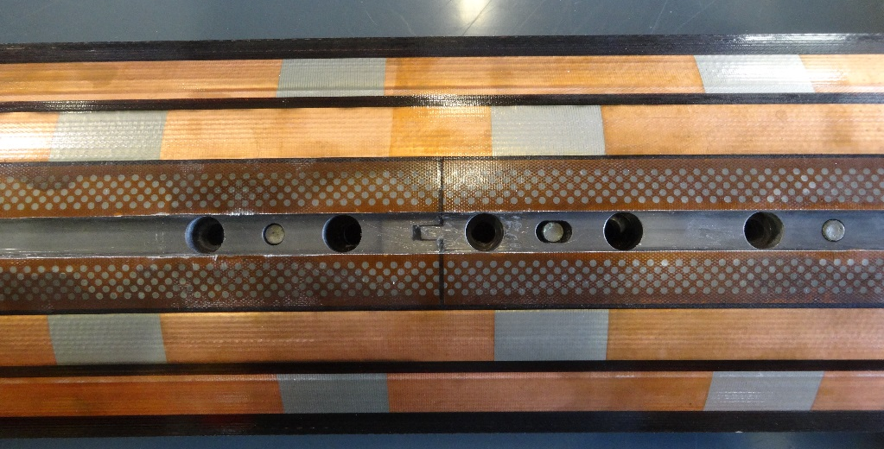
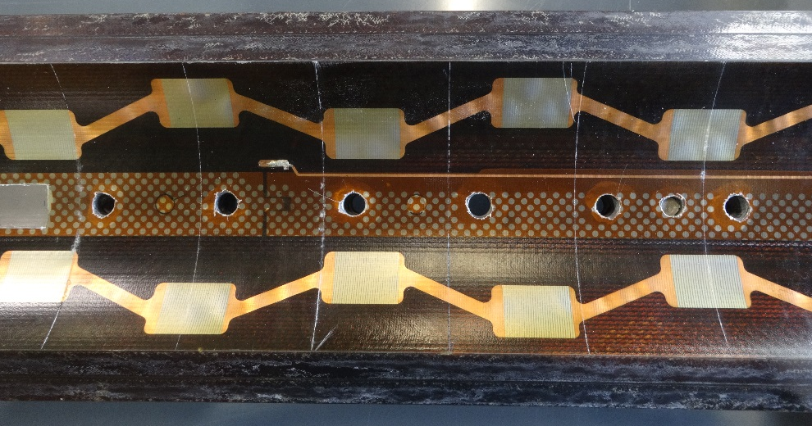
Quench protection
Quench heater powering scheme was adapted to have conditions as close as possible to the full length magnet for the given constrains in SM18.
Outer layer heaters perform as expected.
Two inner layer heater strips were lost. Investigations needed to understand the source of the problems.
Quench integral studies indicate that the heaters effectively quench the magnet.
CLIC test in progress in MQXFS1b (first time on an MQXF model)
  As expected, a significant reduction of the quench load is achieved with respect to O-QH only

Slide 22
Outline
MQXFS1 and MQXFS1b
MQXFS3 and MQXFS3b
MQXFPM1

Slide 23
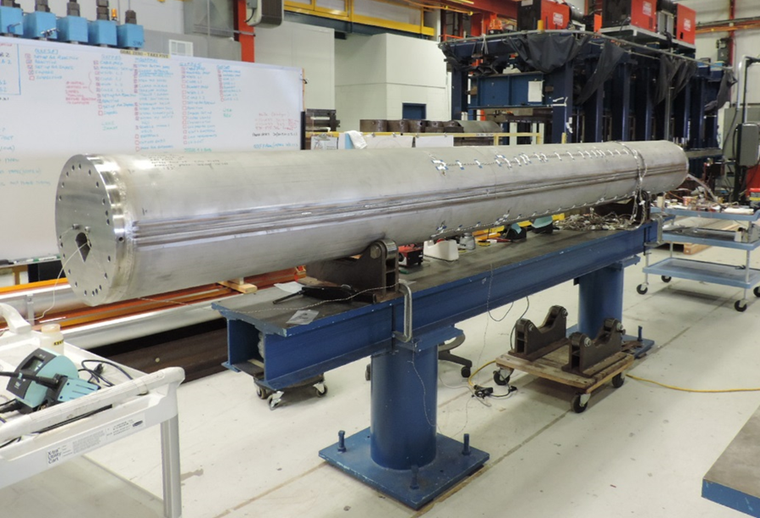
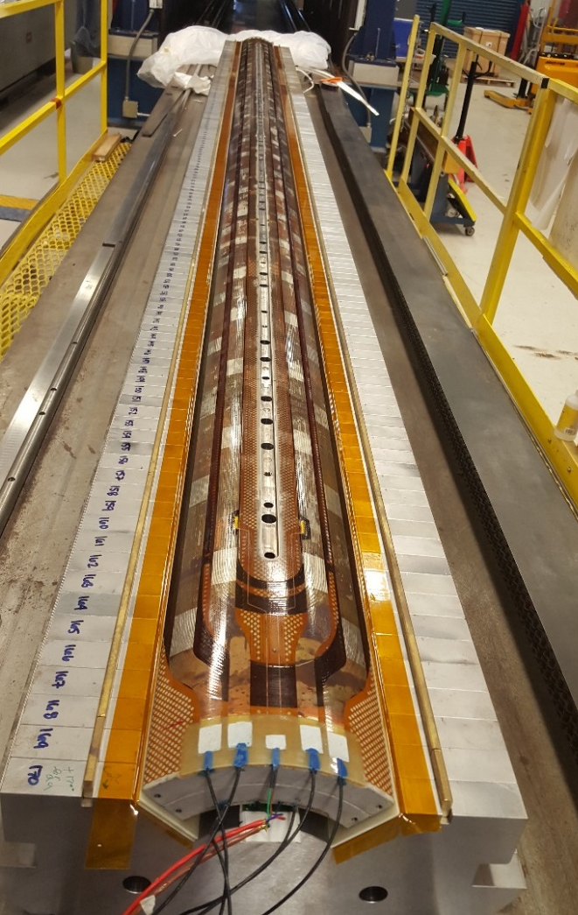
MQXFPM1 assembly

Slide 24
MQXFPM1 test
Vertical Test Facility @ BNL commissioned in September-October 2016
Test results at 1.9 K
  First quench: 14387 A, 65% of I_{ss} (22.1 kA)
    Outer layer mid-plane block
  Second quench: 16040 A, 73% of I_{ss}
    Inner layer pole turn straight section
Replacement of IGBT blown at discharge of quench 2 in progress
Training resuming this week

Slide 25
Appendix

Slide 26
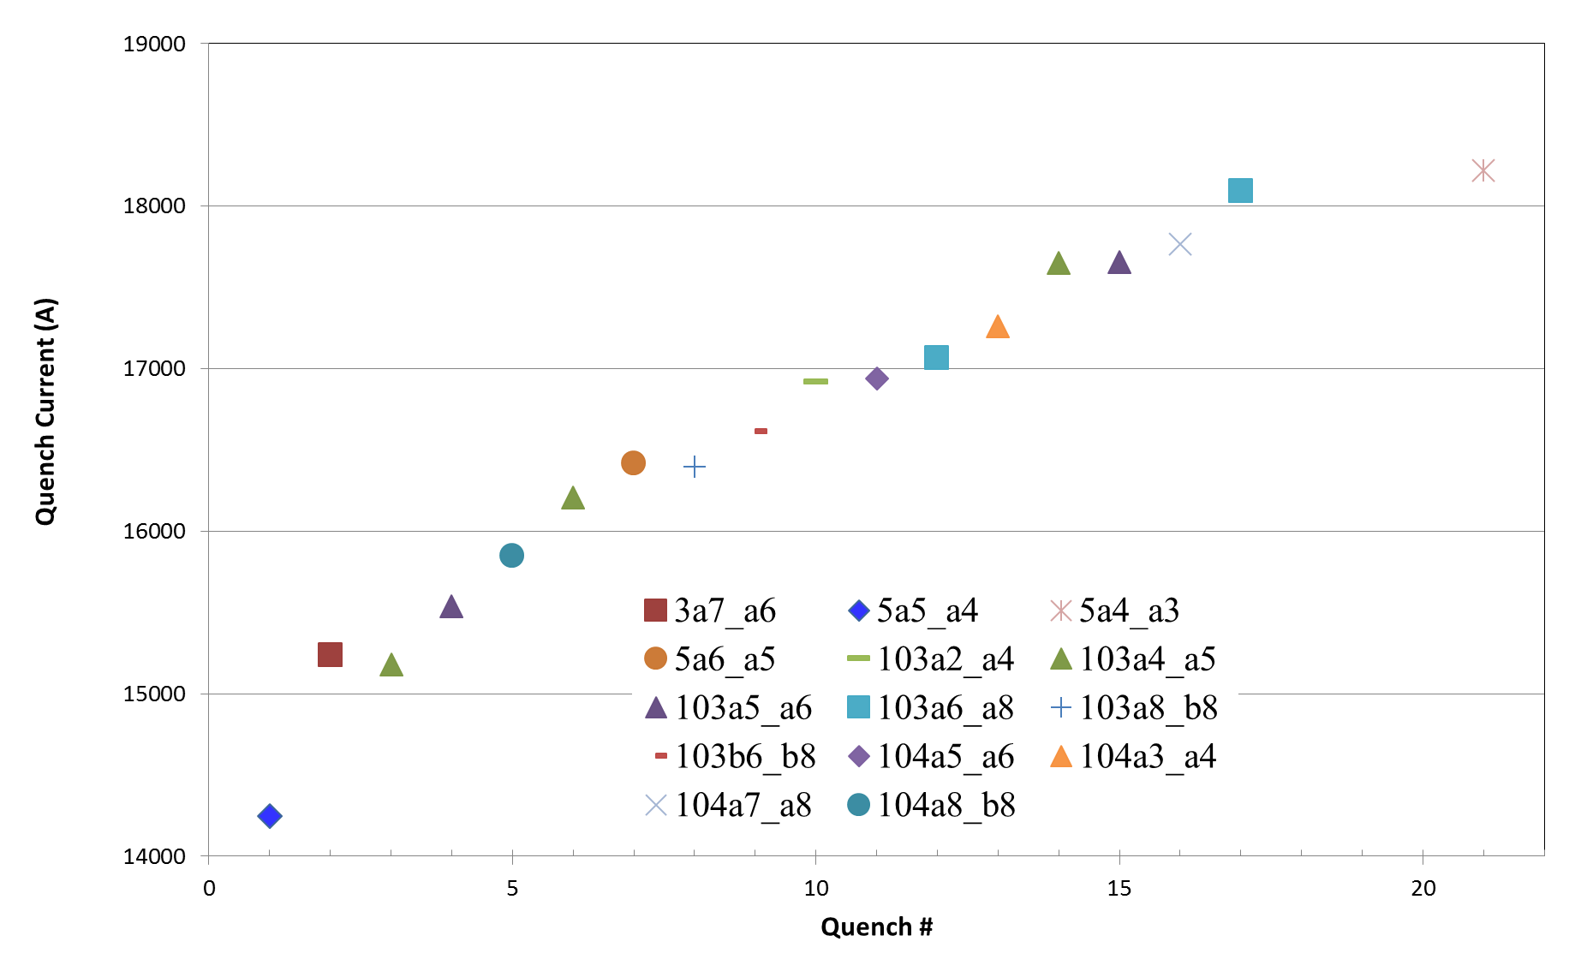
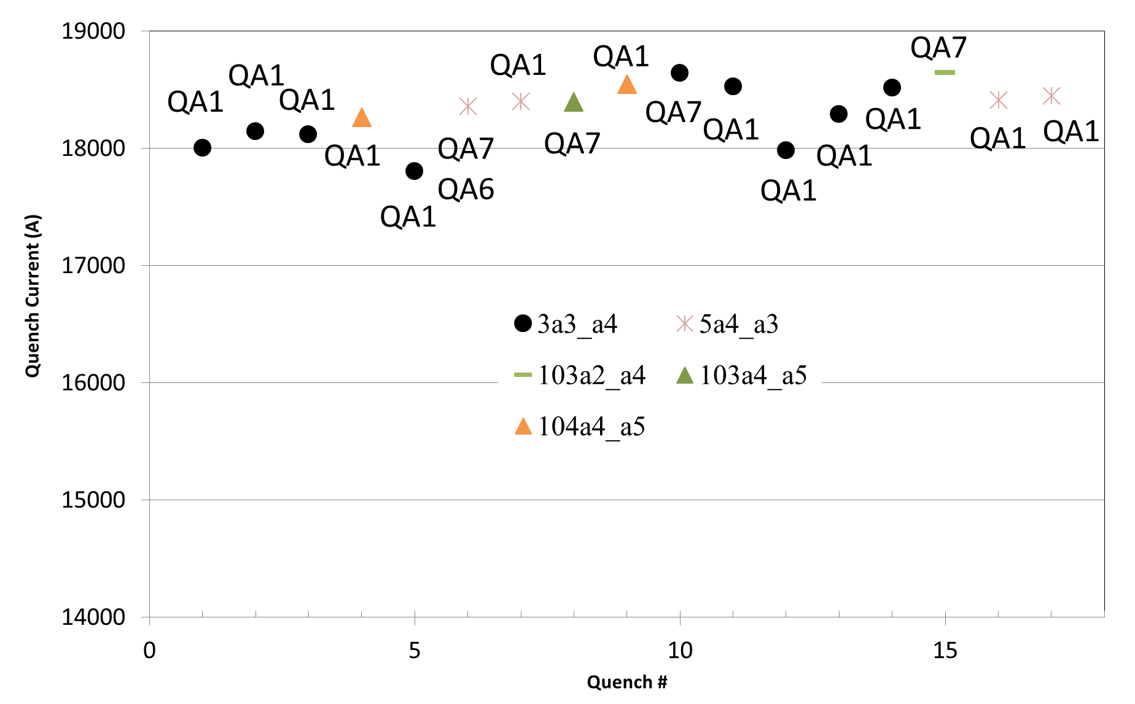
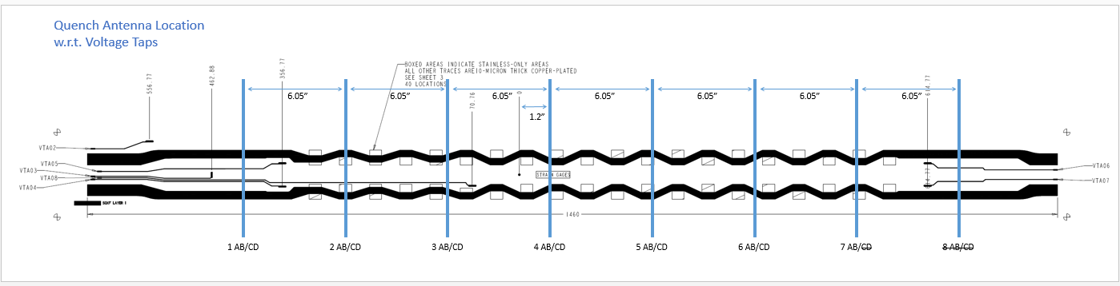
MQXFS1b
Quench locations
aa

