Slide 1
LHC Full Detuning
(Cavity Phase Modulation)
P. Baudrenghien, J. Molendijk, CERN, BE-RF
T. Mastoridis, California Polytechnic State University, San Luis Obispo, USA

Slide 2
Outline
Beam loading compensation to-day
Exact solution: Phase modulation that minimizes the klystron power
The Iterative Algorithm
Simulations
Implementation
Results from Oct 3rd- 4th MD
EOF Physics test on Oct 14th
Side-effects
Conclusions

Slide 3
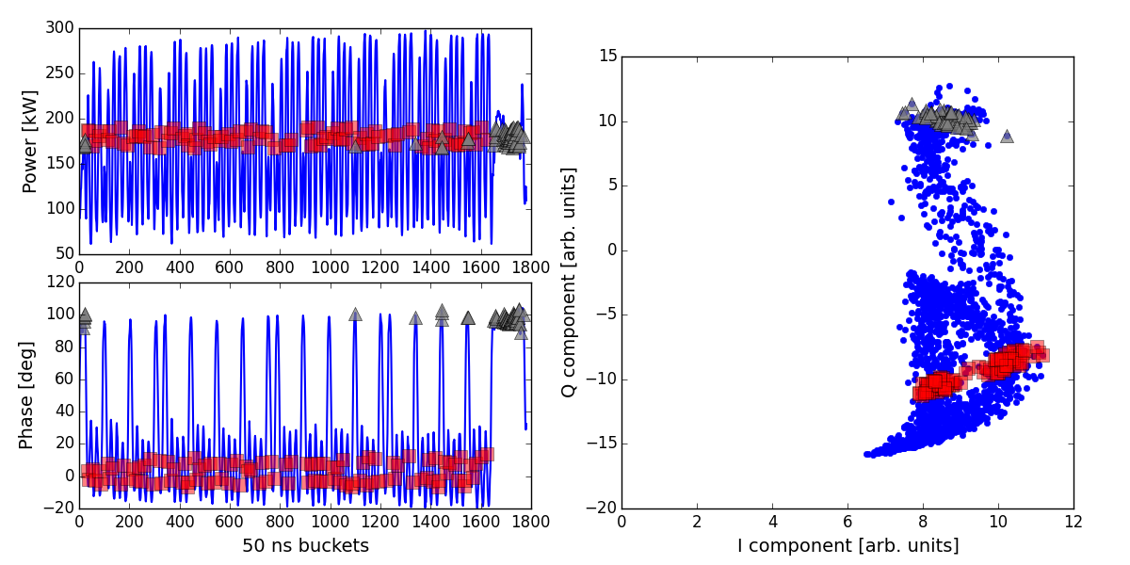
Beam loading compensation. To-day
We keep voltage constant (amplitude and phase) along the turn
Beam-induced voltage must be compensated by the klystron
The klystron current must “toggle” according to
After optimization of Q_{L}, and detuning, the required power is [1]
Theory says 150 kW (10 MV, 1.2 A peak RF current), but we see large transients
↓ Beam present
↓ Beam absent
← Beam absent
← Beam present

Slide 4
Minimizing klystron power. Exact solution
We keep cavity voltage amplitude constant, but accept a phase modulation
We assume that the beam current I_{b}(t) is in quadrature with cavity voltage (180º stable phase). Then the required klystron current I_{g}(t) (reduced at the cavity gap) can be written [2]
and the required power
with
The instantaneous demanded power will be minimal (and constant) if the derivative of the voltage phase modulation is proportional to the envelope of the beam current i_{b}(t)
Then
The power is constant and independent of beam current…Great!
The optimal phase modulation depends on the beam current (decays during fill) and the cavity Q_{L} and V (changes much during ramp). An iterative algorithm is welcome.

Slide 5
Iterative algorithm
Let us first sample all signals. With n the time index, and k the iteration index
The power is a quadratic function of the derivative of phase modulation. We want an iterative method that will adapt to slowly changing conditions (ramp, decreasing intensity in physics, etc). We use Newton’s algorithm
With α=-1, convergence takes place in one step. As we want the adaptation to be adiabatic (with a synchrotron frequency around 20 Hz) and slow compared to tuning (time constant around 1 s), we use a time constant in the order of tens of seconds
The correction is proportional to the phase difference between klystron current and cavity voltage. We update the derivative of the phase modulation
Then we integrate the derivative over 1 turn and remove the mean, that will be adjusted by the tuning.

Slide 6
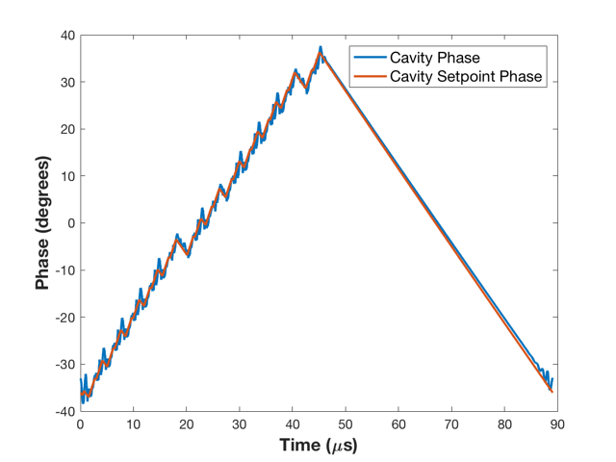
Simulations of the algorithm
The algorithm was first tested in simulations developed in Simulink. These simulations included models of the RF, Beam (each bunch is a single “particle”), Cavity, Tuner Loop, and LLRF feedback.
The adaptive algorithm was tested in two stages. First, an ideal Simulink scheme of the whole chain was developed for initial debugging, filter optimization, and testing. This initial model also allowed us to tune the algorithm time constants to achieve the desired behavior.
The final simulation results were very promising.
The image to the right shows the cavity phase and cavity Setpoint phase.
The algorithm converged to the expected theoretical functional form and values
Simulation of the algorithm with half-full ring. Optimal Phase modulation.

Slide 7
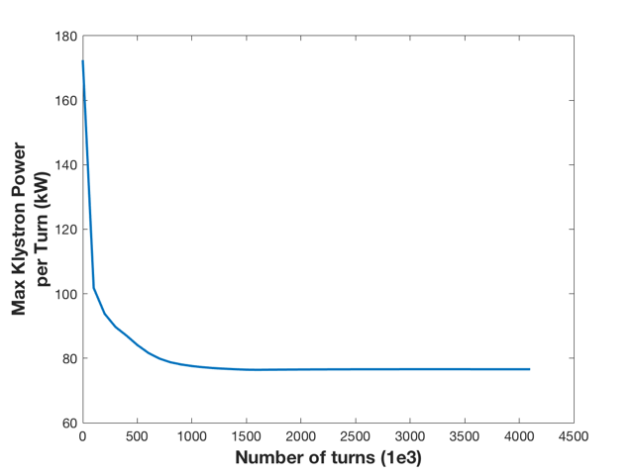
Simulations of the algorithm
In a second stage, the actual VHDL firmware was tested. It was inserted into the Simulink scheme as a fully functional block and allowed us to debug it and determine the operational settings without any MD time.
A lot of safety features were added at that time too, to prevent the algorithm from imposing a big step to the cavity (and thus beam) phase.
The figure shows the maximum klystron power over a turn, caused by the transitions between the beam and no-beam segments.
The peak power is reduced from 170 kW to ~75 kW when the algorithm is switched on!
These numbers correspond to nominal LHC beam.
Decay of the peak power as the algorithm optimizes the phase modulation. Time constants several orders of magnitude faster than implemented.

Slide 8
Implementation

Slide 9
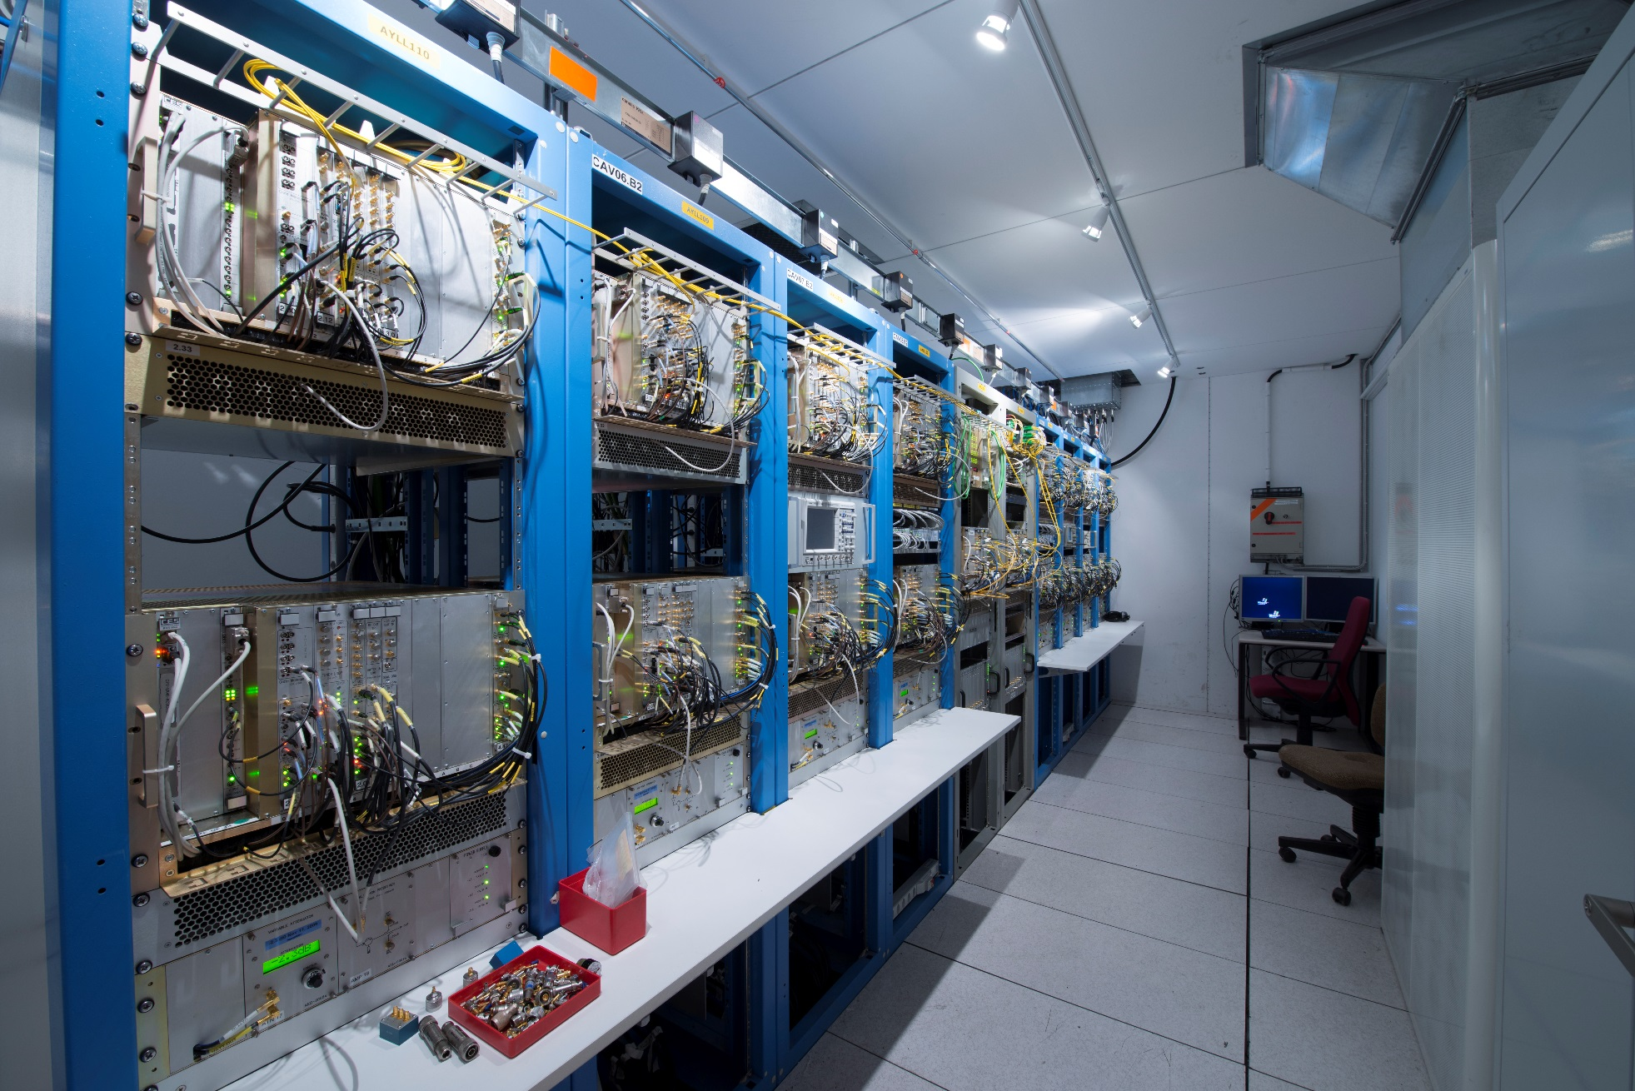
The algorithm was deployed in the Set Point of each cavity, by upgrading the firmware of the VME module.

Slide 10
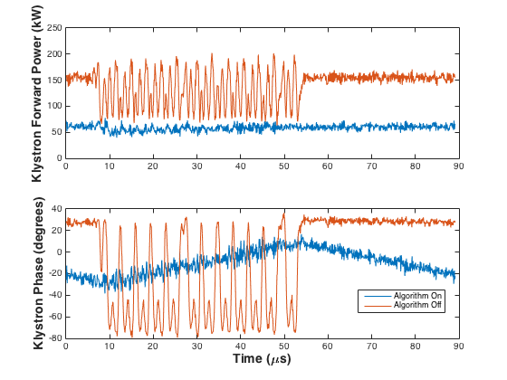
Oct 3-4th MD results. Klystron transients
Half full ring (1164 b)
6.5 TeV, 1.25 MV/cav, Q_{L}=60k
The figure shows klystron power during one turn
  Half detuning scheme (red): average power around 140 kW with peaks at 170 kW, klystron drive phase modulation of 100 deg pk-pk
  Full detuning scheme: 70 kW flat, smooth 40 deg phase modulation along batch.

Slide 11
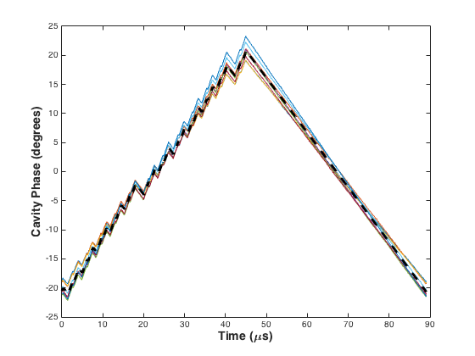
Oct 3-4th MD results. Cavity phase modulation
Phase modulation of the 8 Cavities at flat top (half full ring, 1164 b, 6.5 TeV, 1.25 MV/cav, Q_{L}=60k)
The black dashed line shows the theoretical value
Small differences caused by the slightly different settings for each station (V₀? Detuning?)

Slide 12
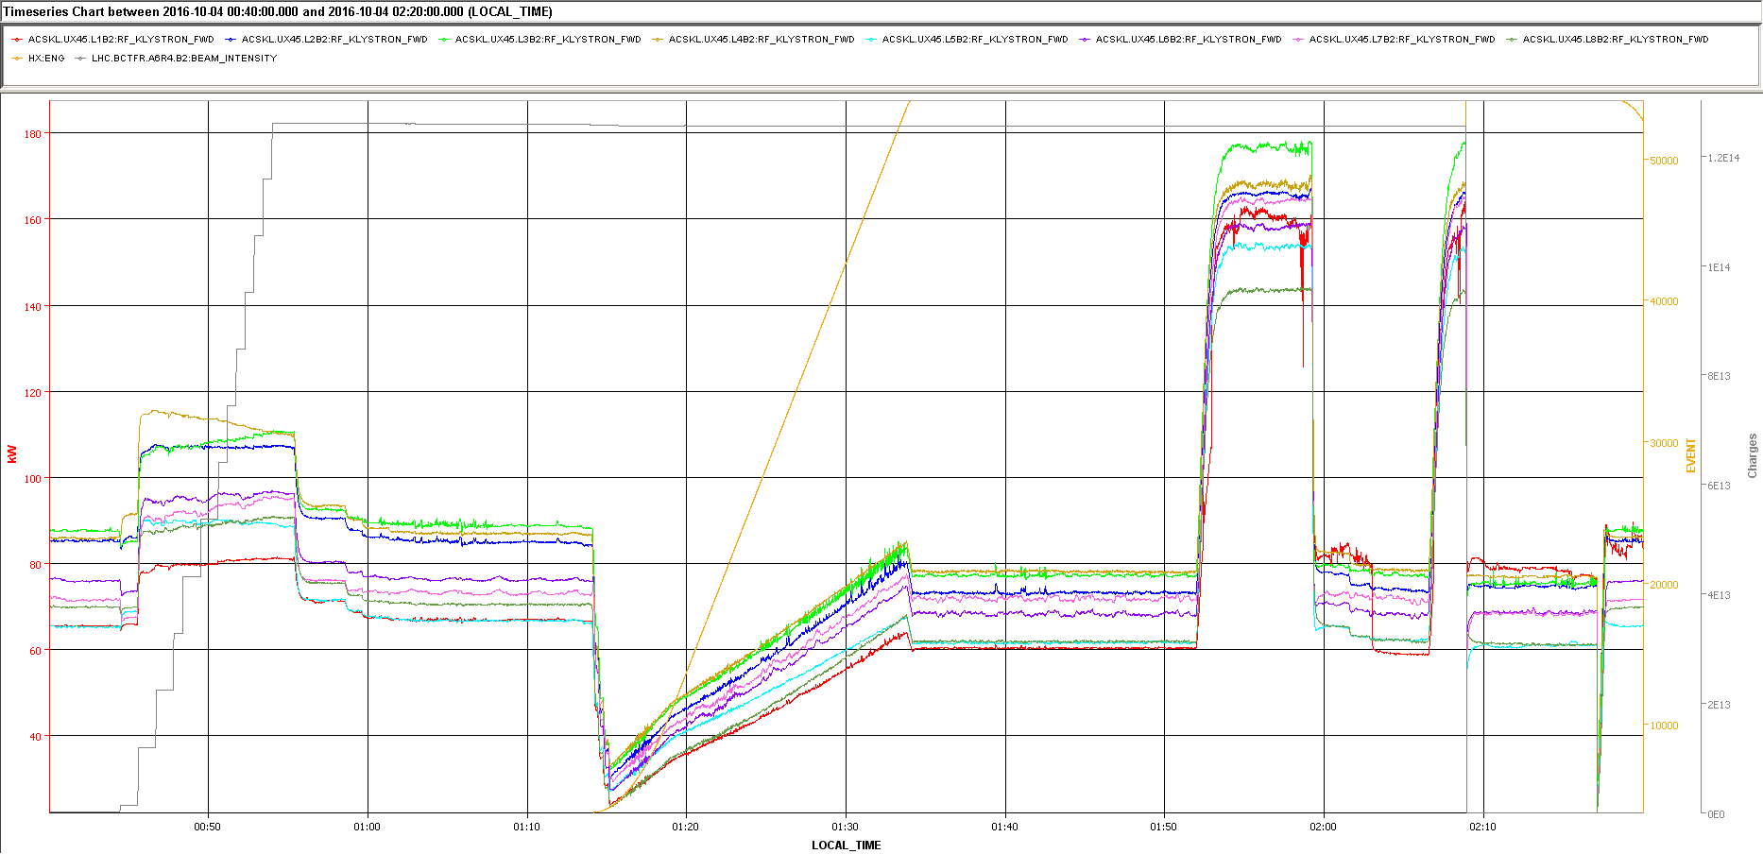
Oct 3-4th MD results. Klystron power
145-175 kW
Full Detuning
Full Detuning
Half Detuning
Full Detuning
Half Detuning
Half Detuning
60-80 kW
Ramp
Filling
Flat top
More details in MD Note [3]

Slide 13
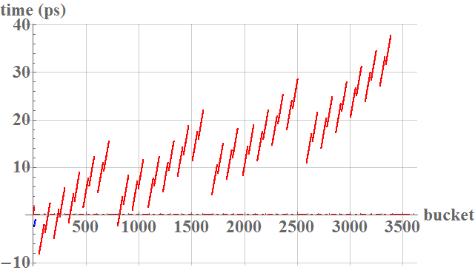
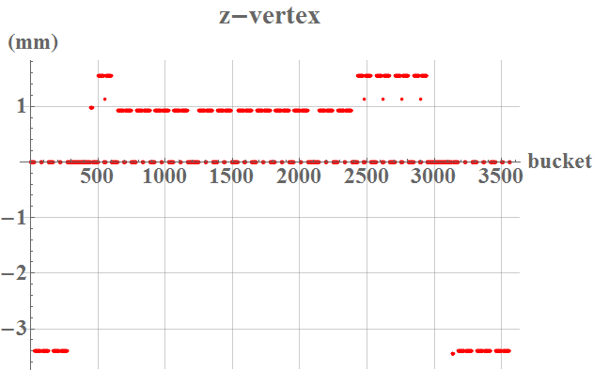
End of Physics Fill Test
Fill 5423, Oct 18th, after 10 hours of physics
2200b, 1-1.05 ns bunch length, ~0.7E11 p/bunch
What we expected
  A modulation (at the revolution frequency) of the bunch phase with respect to the 40 MHz Bunch Clock received by experiments. The modulation would be 45 ps pk-pk.
  A modulation (at the revolution frequency) of the z-vertex. This effect would not be noticed by CMS and ATLAS thanks to the symmetry of beam current with respect to IP1 and 5. But it should be noticed in IP2 and 8. Our calculations give 4.9 mm pk-pk displacement.
Calculated slippage of the bucket center w.r.t. equal spacing. Beam1 in blue, beam2 in red.
Calculated modulation of the z-vertex in Alice.

Slide 14
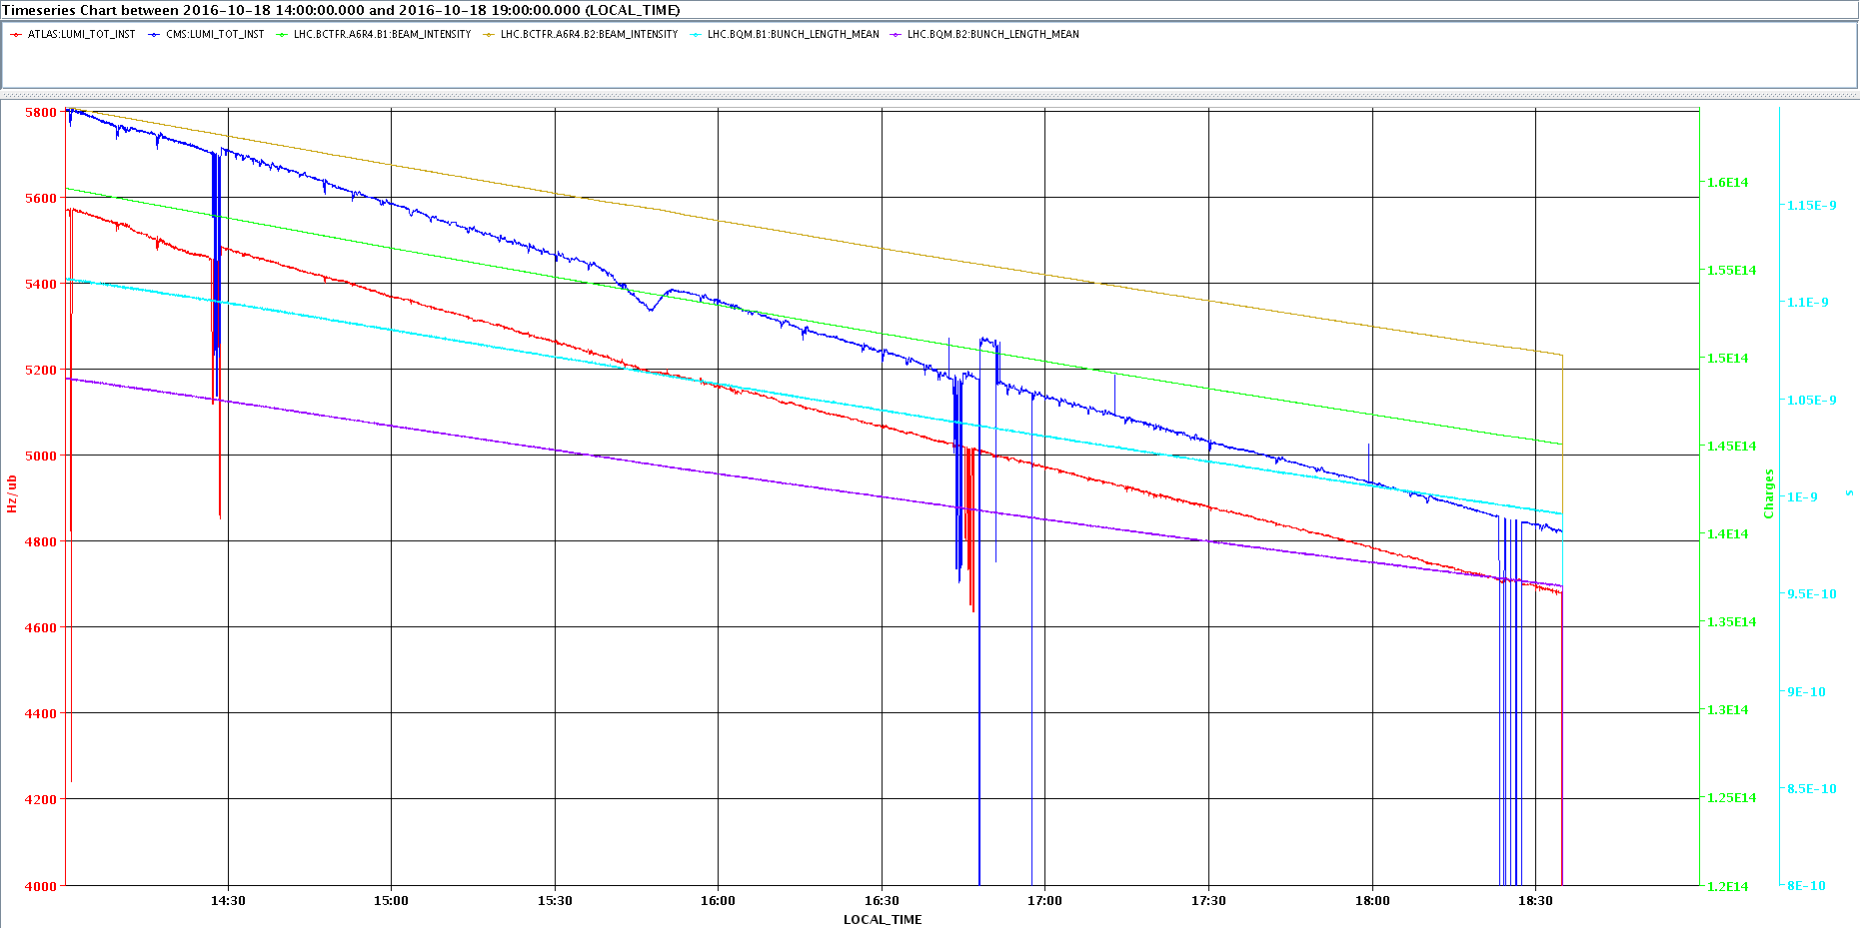
No visible effect on the beams
Full Detuning
Half Detuning
No effect on Lumi or longitudinal emittance
No increase in Abort Gap population

Slide 15
Results from experiments. CMS
Nothing significant shows up for Z (as expected)
The magnitude of the modulation is too small to be a problem for the usual beam spot computation.
Data provided by Riccardo Manzoni, Sara Fiorendi and Greg Rackness

Slide 16
Results from experiments. ATLAS
They do not see any evidence for variation of the z position of the beam-spot with the RF modulation change - as expected
Data provided by Christoph Schwick, Jamie Boyd

Slide 17
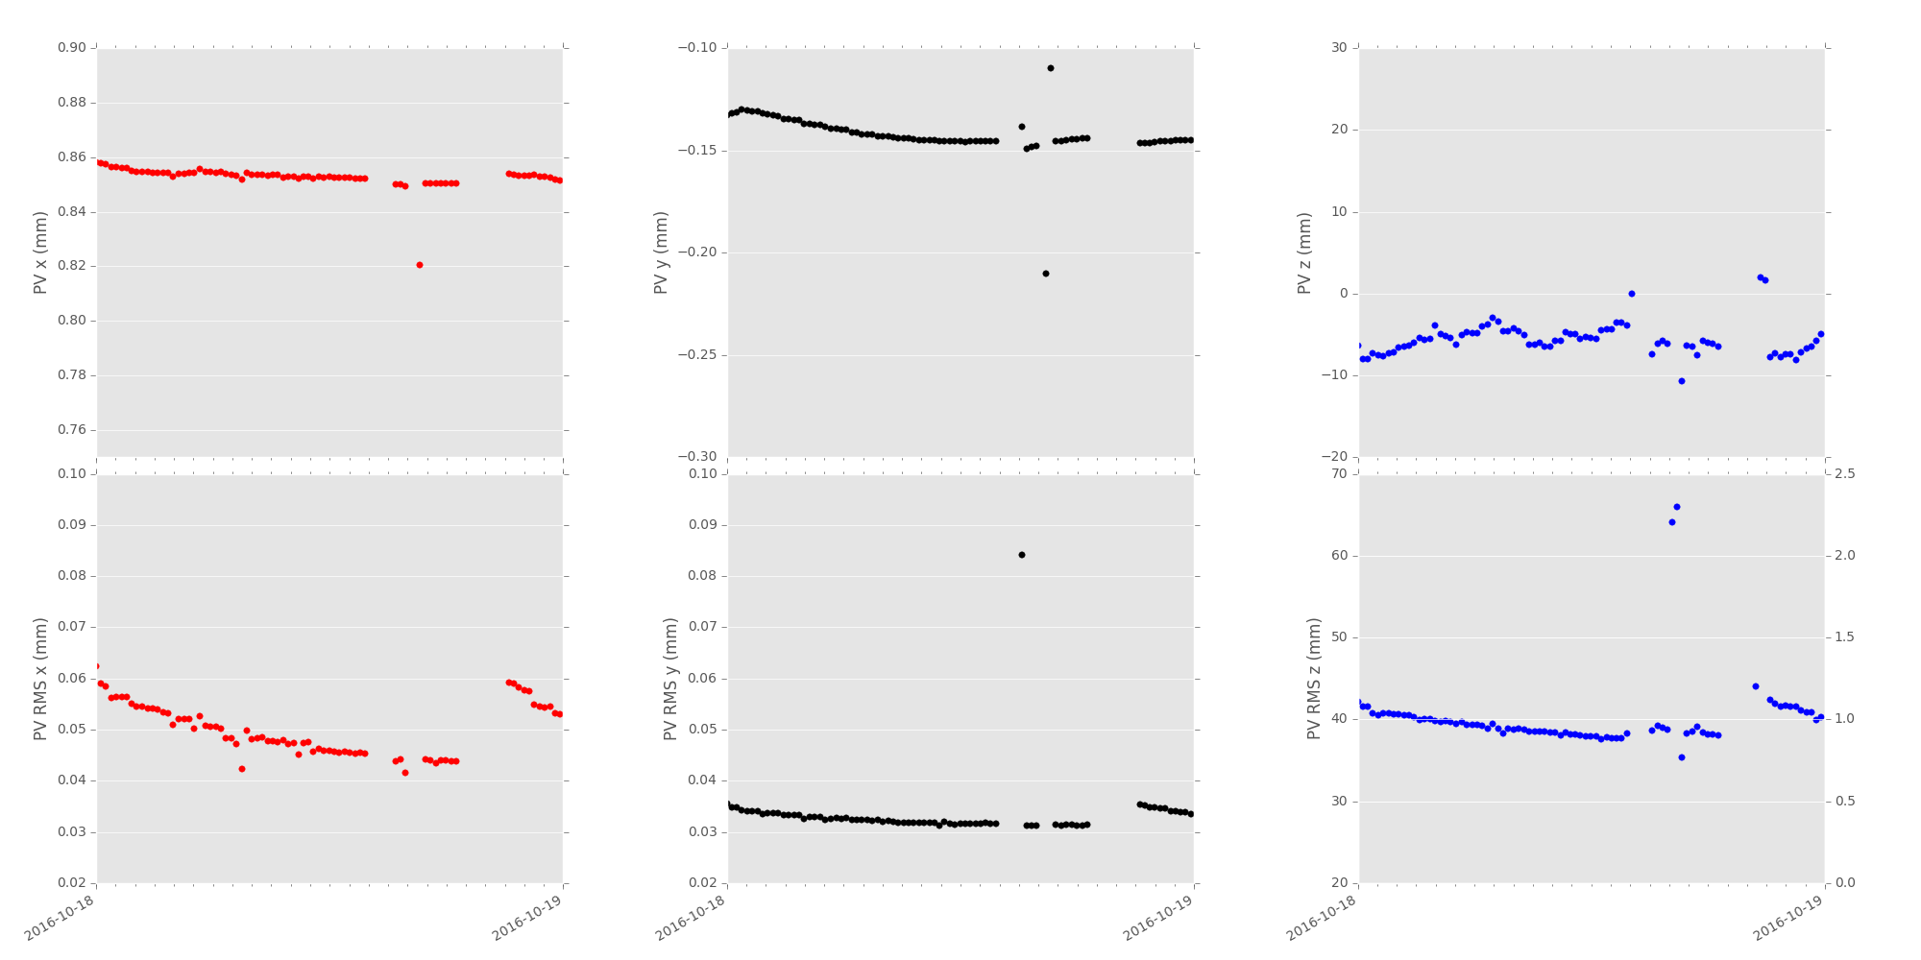
Results from experiments: LHCb
Center of the luminous region in z, integrated over 10 min periods: no visible effect
RMS of luminous region: small increase of ~1mm consistent with 8mm* peak to peak variations
8mm* peak to peak is of the same order of the « natural » movements of the center of the luminous region during a fill
The timing variations seen during the test are of the order of 50ps, comparable to the usual spread seen during fills
Data provided by Patrick Robbe, Federico Alessio
* LHCb was told to expect 8 mm variations, corresponding to 1.1E11 p/bunch. During the test the bunch intensity had dropped to 0.7E11 p/bunch resulting in 4.9 mm. See slide 13

Slide 18
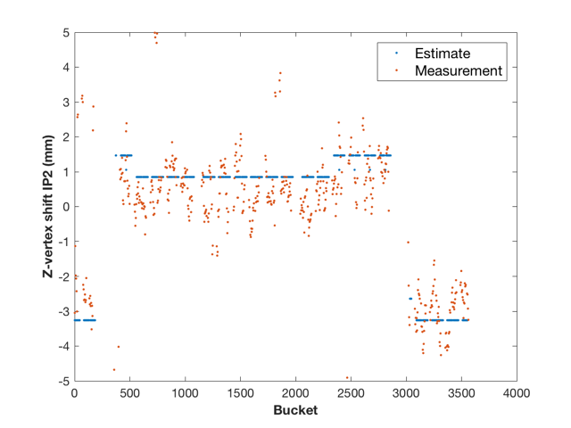
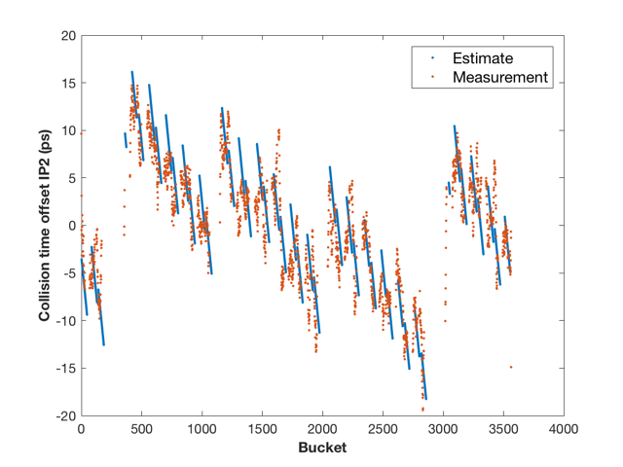
Results from experiments:
ALICE
Mean z-vertex: there is no apparent modulation (certainly not 8 mm) but the trains in the beginning and the end are clearly biased by ~3 mm
Mean collision time vs. bunch ID for T0, showing saw-like modulation with a period of ~900 bunches
4.9 mm
Z-vertex shift at IP2: calculated (blue, see slide 13) vs. measured (red)
Data provided by Ruben Shahoyan, Siegfried Foertsch
Collision time offset from Bunch clock at IP2: calculated (blue) vs. measured (red)

Slide 19
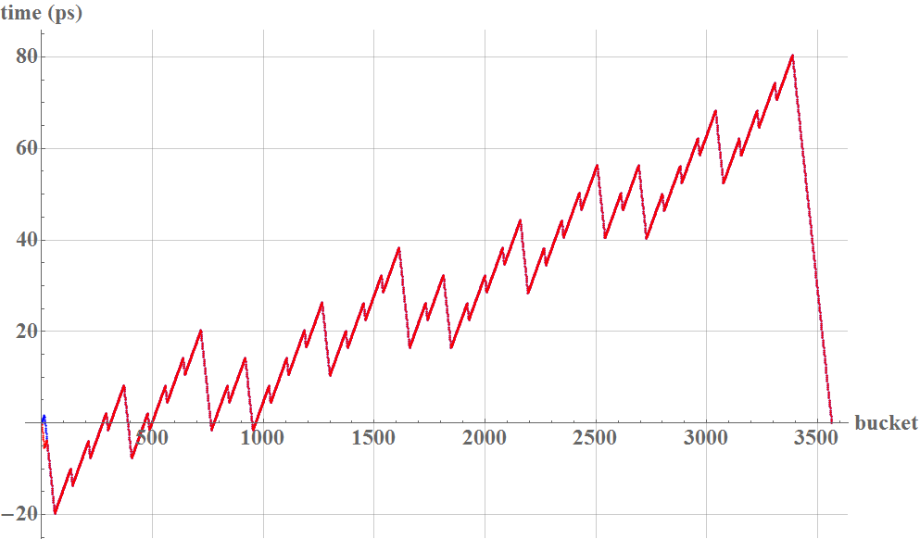
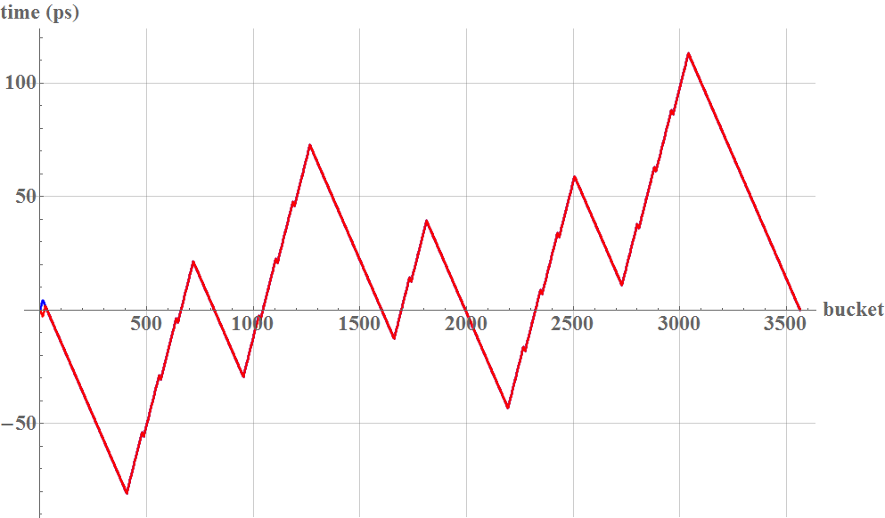
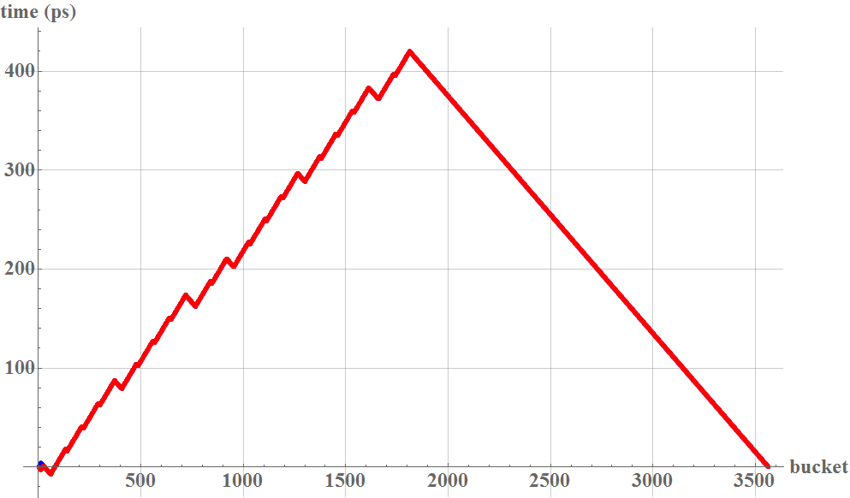
Side-effects (1)
During intensity ramp-up the filling pattern includes large gaps-> large pk-pk modulation
A mitigation would be an even filling pattern
100 ps
200 ps
440 ps
Calculated cavity phase slippage for nominal beams in physics. Top right: 2800 b, 1.2E11 p/bunch, 1 ns length, 10 MV
Bottom right: 1400 b, 1.2E11 p/bunch, 1 ns length, 10 MV, uneven filling
Bottom left: 1308 b, 1.2E11 p/bunch, 1 ns length, 10 MV, even filling

Slide 20
Side-effects (2)
Crab-cavities have very large Q_{L} and cannot follow the phase modulation
The phase of the CC kick will therefore move w.r.t. bunch center
For HiLumi parameters that phase slippage will be 200 ps pk-pk (10 MV RF) or 125 ps (16 MV RF)
Effect to be studied

Slide 21
Side-effects (3)
Harmonic cavities must stay in phase with the 400 MHz cavities
A priori compatible if used in Bunch Shortening mode, but studies needed

Slide 22
Conclusions
After LS2, the LIU program should bring an increase in bunch intensity (above 1.2E11 p/bunch, with the HiLumi target of 2.2E11)
The present scheme will not work anymore -> need to move to Full Detuning by 2021+
The plan is to [4]
  Fill with the Half-Detuning scheme (fixed phase). That is sustainable at injection because the demanded RF voltage is only 0.75 MV/cav
  Move to Full-Detuning (enable the Phase Modulation) before ramping
  Ramp and Physics with Full-Detuning scheme
We have an algorithm that automatically adapts the voltage phase modulation
  Tested during MD
  Validated during a short Physics run. Barely visible to the experiments
We could use the new scheme in 2017-2018
  That would identify problems (if any) while we still have time to solve them
  It would make the scheme fully operational by Run 3
  It would bring large saving in klystron power and aging.

Slide 23
References
[1] D. Boussard, RF Power Requirements for a High Intensity Proton Collider, PAC 1991
[2] J. Tuckmantel, Cavity-Beam-Transmitter Interaction Formula Collection with Derivation, CERN-ATS-Note-2011-002 TECH
[3] T. Mastoridis et al., Cavity Voltage Phase Modulation MD, ATS-Note-2016-061 MD
[4] P. Baudrenghien, T. Mastoridis, Proposal for an RF Roadmap towards Ultimate Intensity in the LHC, IPAC2012

