Slide 1
Crab Cavities:
Conditioning and Sectorisation
Thomas Otto
HL-LHC Project Safety Officer
HL-LHC TCC 8. 12. 2016

Slide 2
Motivation
RF cavities produce X-Rays
  Field emission of electrons from surfaces
  Acceleration in RF field
  Bremsstrahlung in cavity material
Intensity depends on surface state
  Conditioning necessary to clean the surface and diminish emissions

Slide 3
Duration
Based on experience with LHC RF cavities (Nb on copper)
48 hours conditioning after warm-up of the cavities
More time would be required after break of vacuum

Slide 4
Intensity of X-ray emission
Few data available
Proposal to collaborate between BE-RF and HSE-RP groups to model and measure X-ray emissions in SM18 test stands
Qualitative: emission predominantly in direction vertical to beam
No coherent acceleration of electrons, electron stopper not required

Slide 5
Sectorisation during commissioning
Activation of accelerator components by HL-LHC luminosity will require a radiation veto in the LSS 1 and 5
As a preliminary approach, proposal to unify the sectorisation for
  Radiation from activated components
  Commissioning of CC
“Yellow” gridded doors, no access control

Slide 6
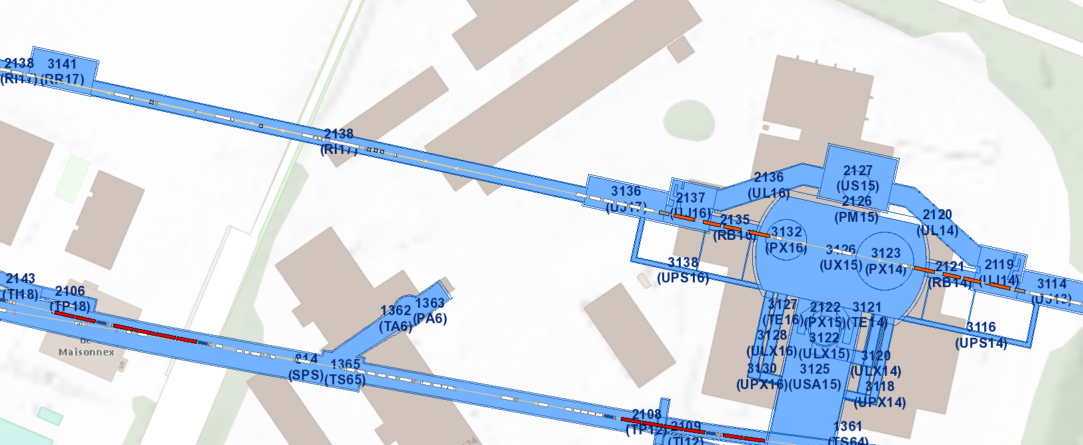
Sectorisation Principle – LSS1 R
Existing PAD/MAD
CC

Slide 7
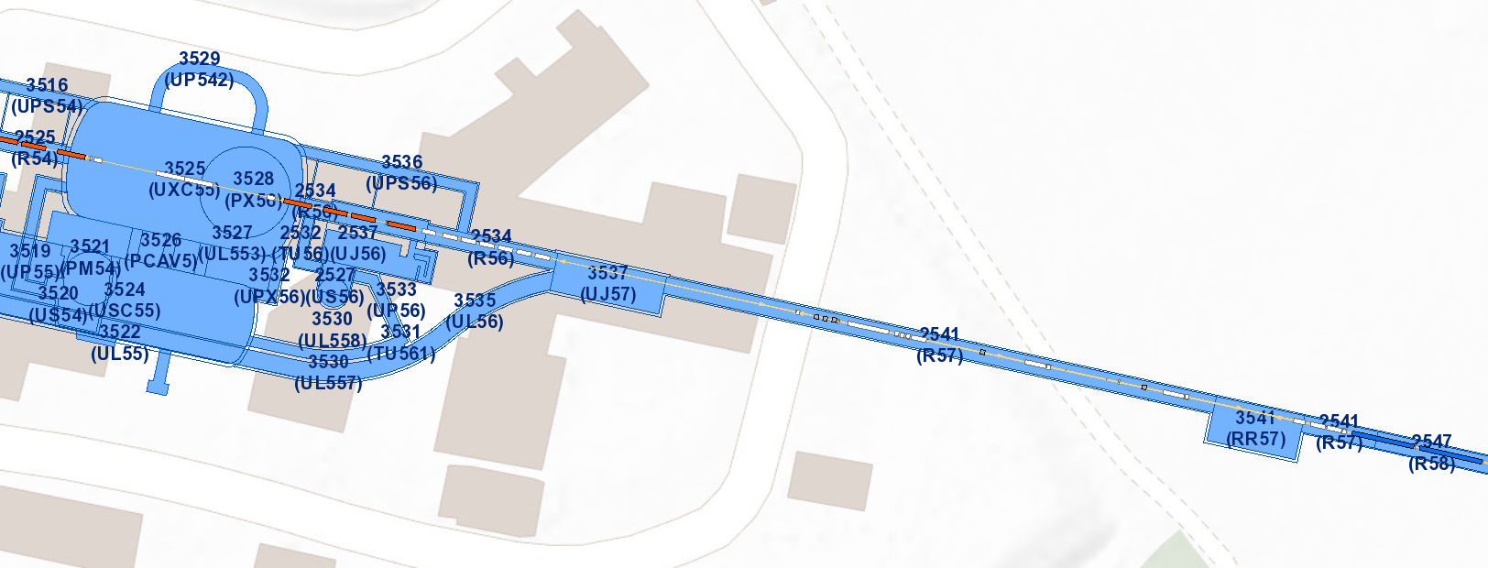

Sectorisation Principle – LSS5 R
CC
Precise position depending on radiation levels

Slide 8
Summary
RF Conditioning est. 48 hours
X-ray emission makes sectorisation indispensable
Proposal to unify sectorisation of activation and for commissioning
Provisional extent : length of the LSS
Re-use access points where available.

