Slide 1
Impact of limitations in Co content in the design and fabrication of cryostats for HL-LHC
D. Ramos
HL-LHC TCC, December 8, 2016

Slide 2
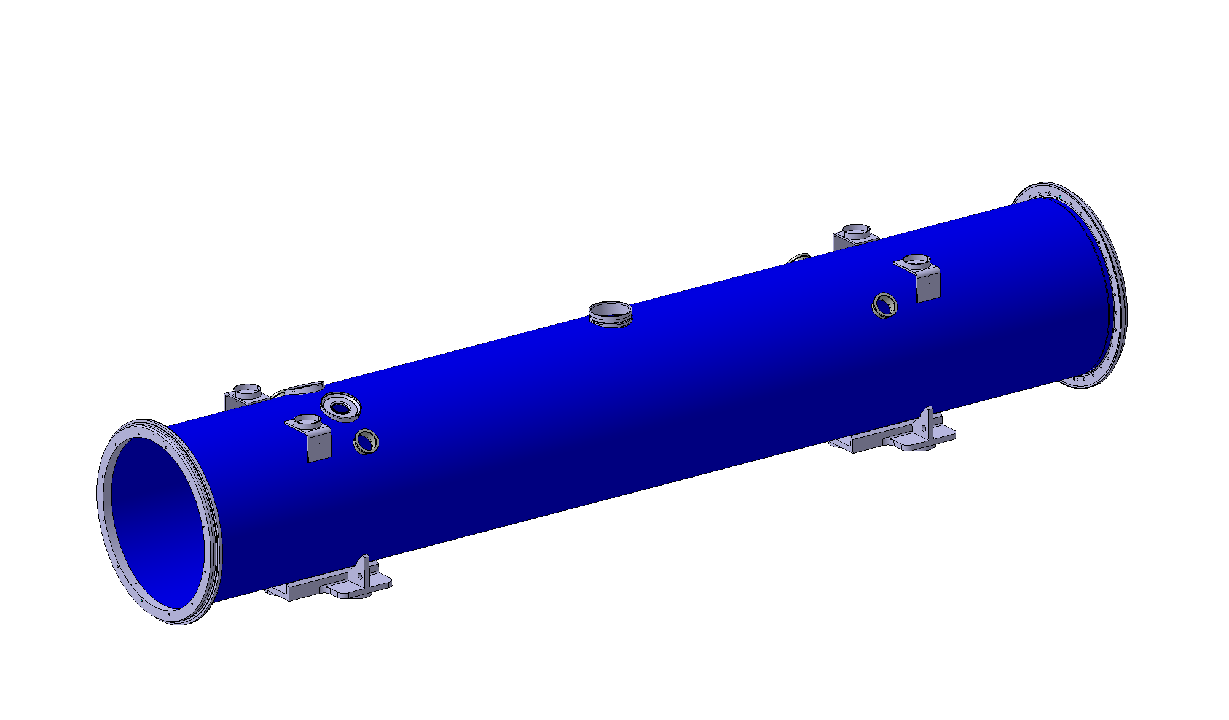
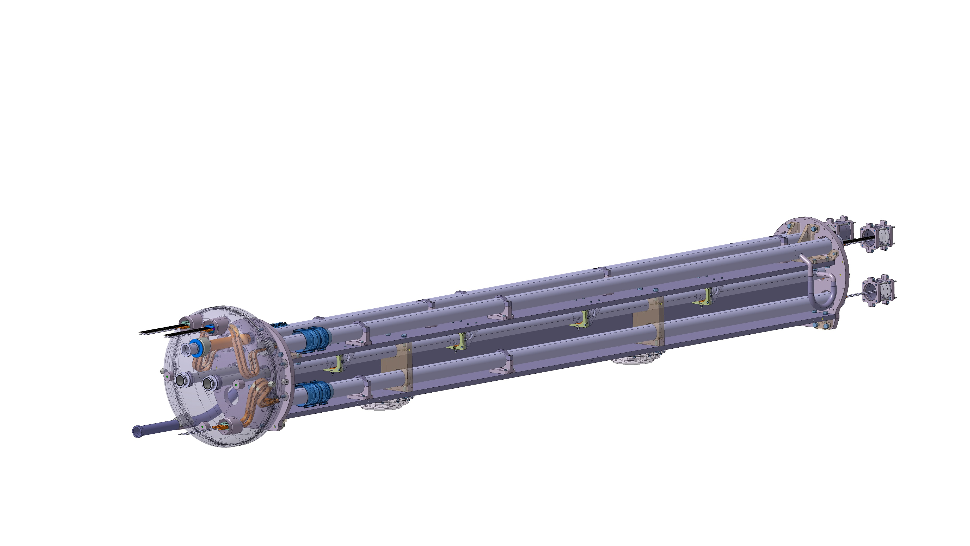
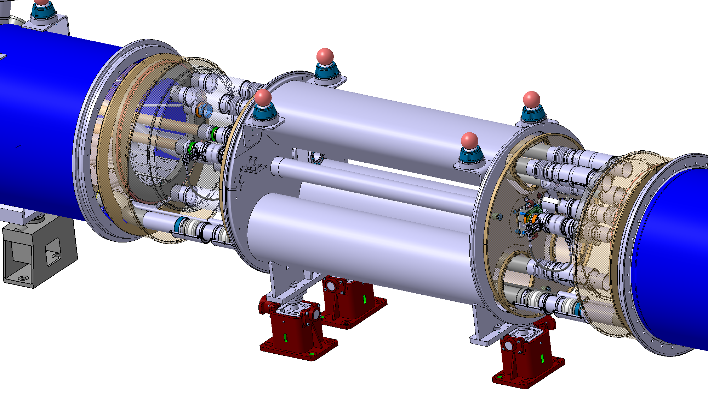
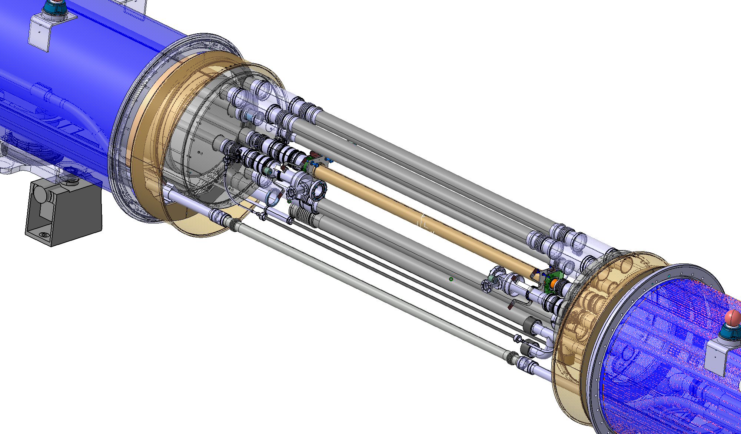
Stainless steel components for WP11
(installation in LS2)
Magnet cryostats
  Vacuum vessel flanges at extremities (forged rings) + instrumentation and pressure relief ports
  Piping
Connection cryostats
  Idem for vacuum vessels
  Cold mass structure
  Shuffling module
  Piping
Bypass cryostats
  Full vacuum vessel
  Piping
Interconnect components: bellows and sleeves
Scope for installation
  Replacement of 2 dipoles in IR7
  Replacement of 2 connection cryostats in IR2
  i.e. 12 cryostats

Slide 3
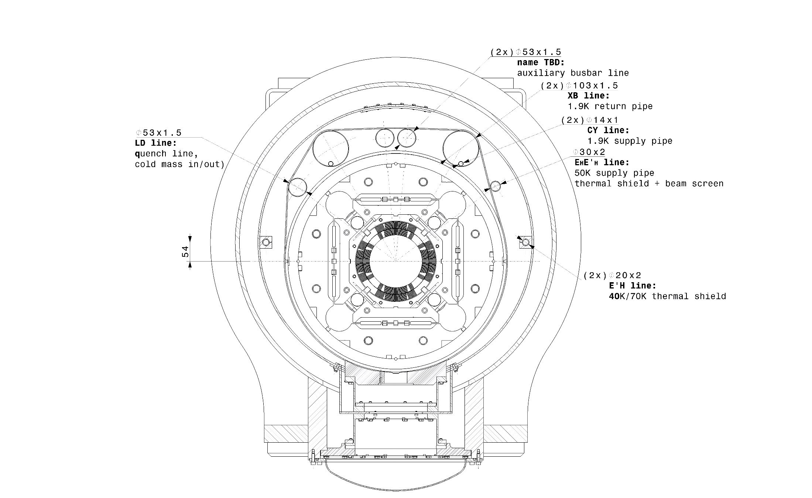
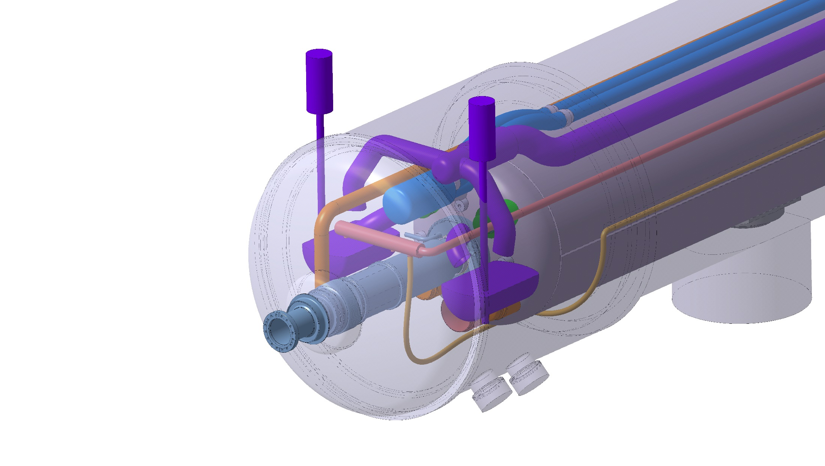
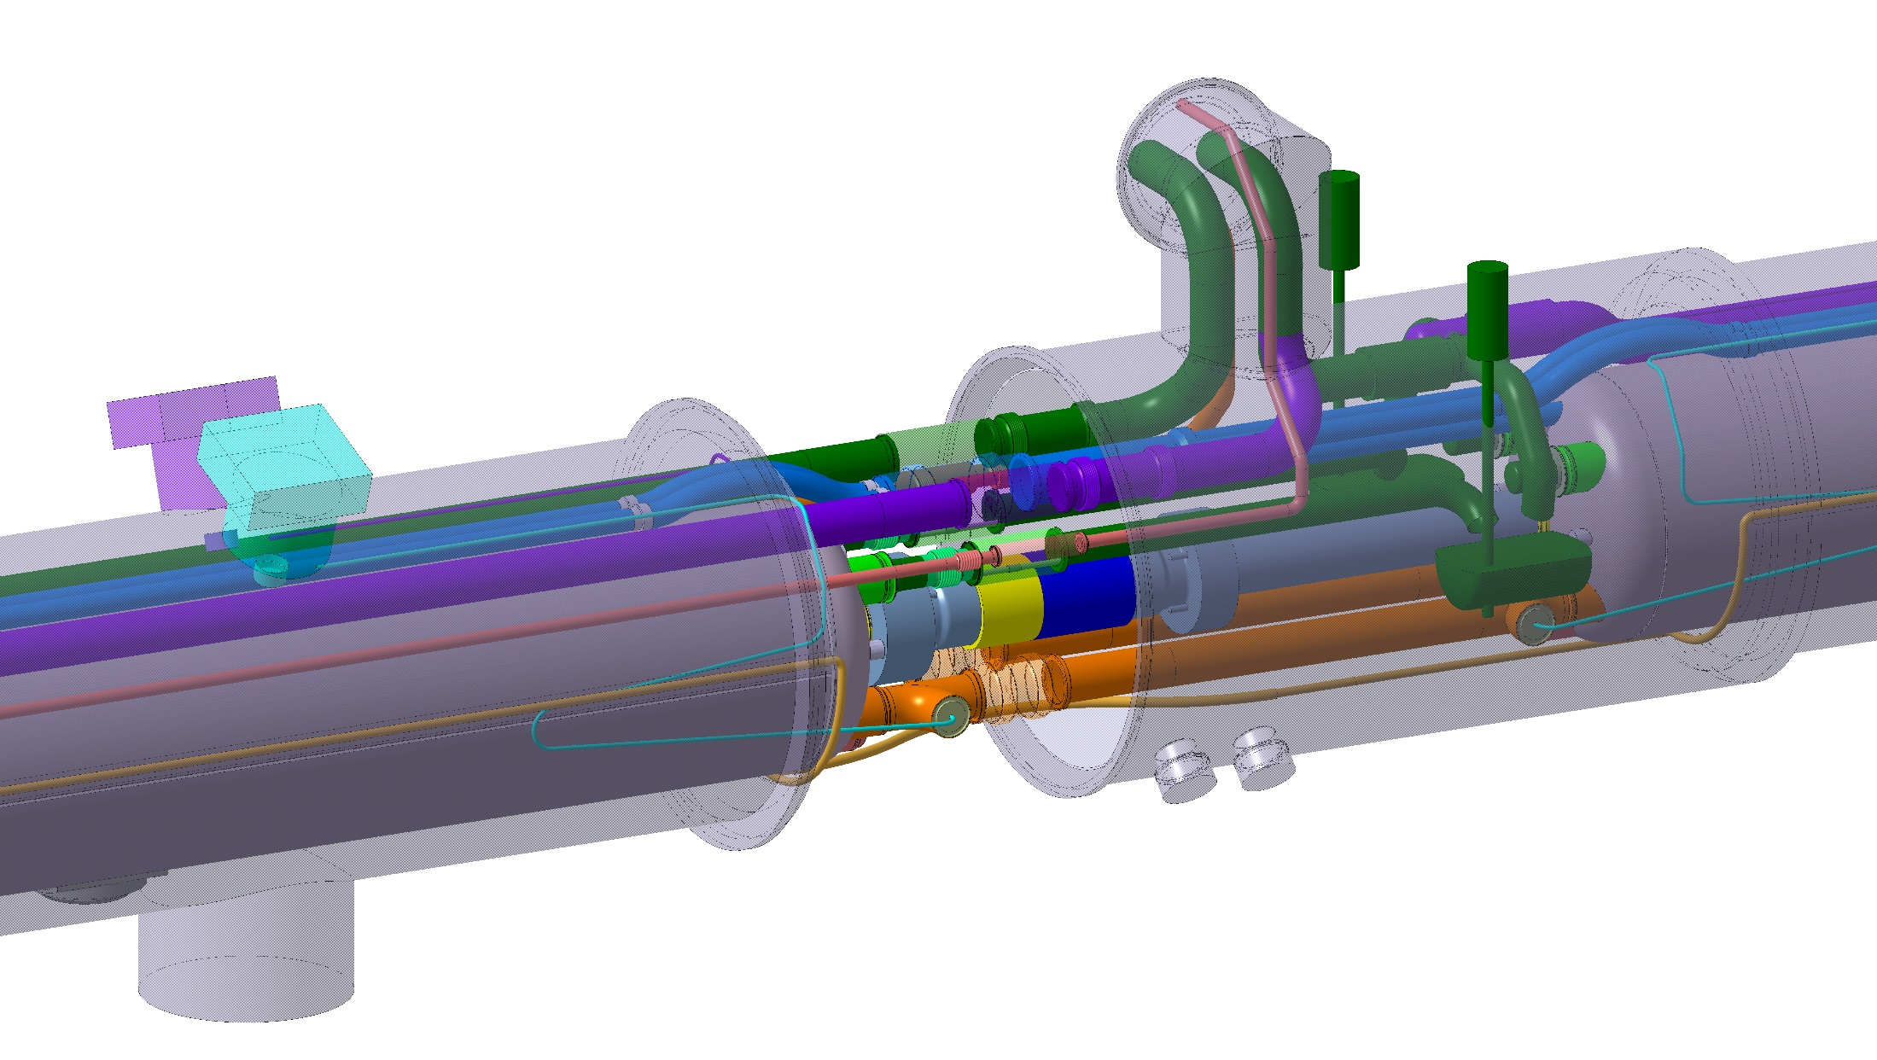
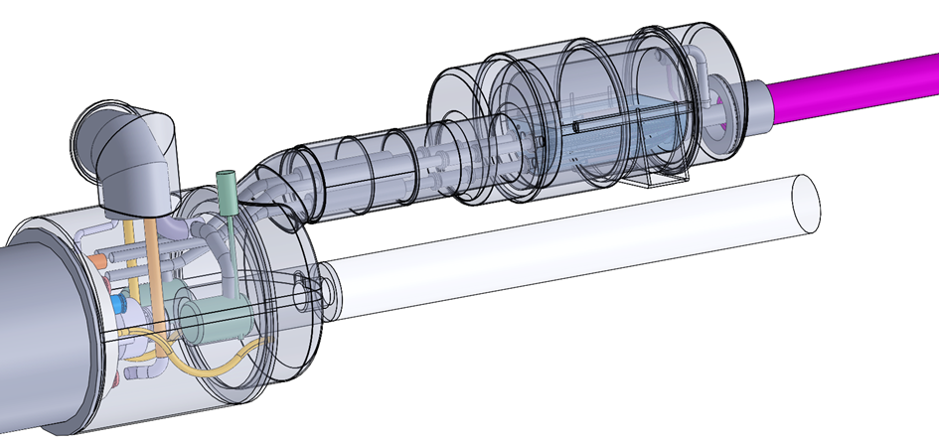
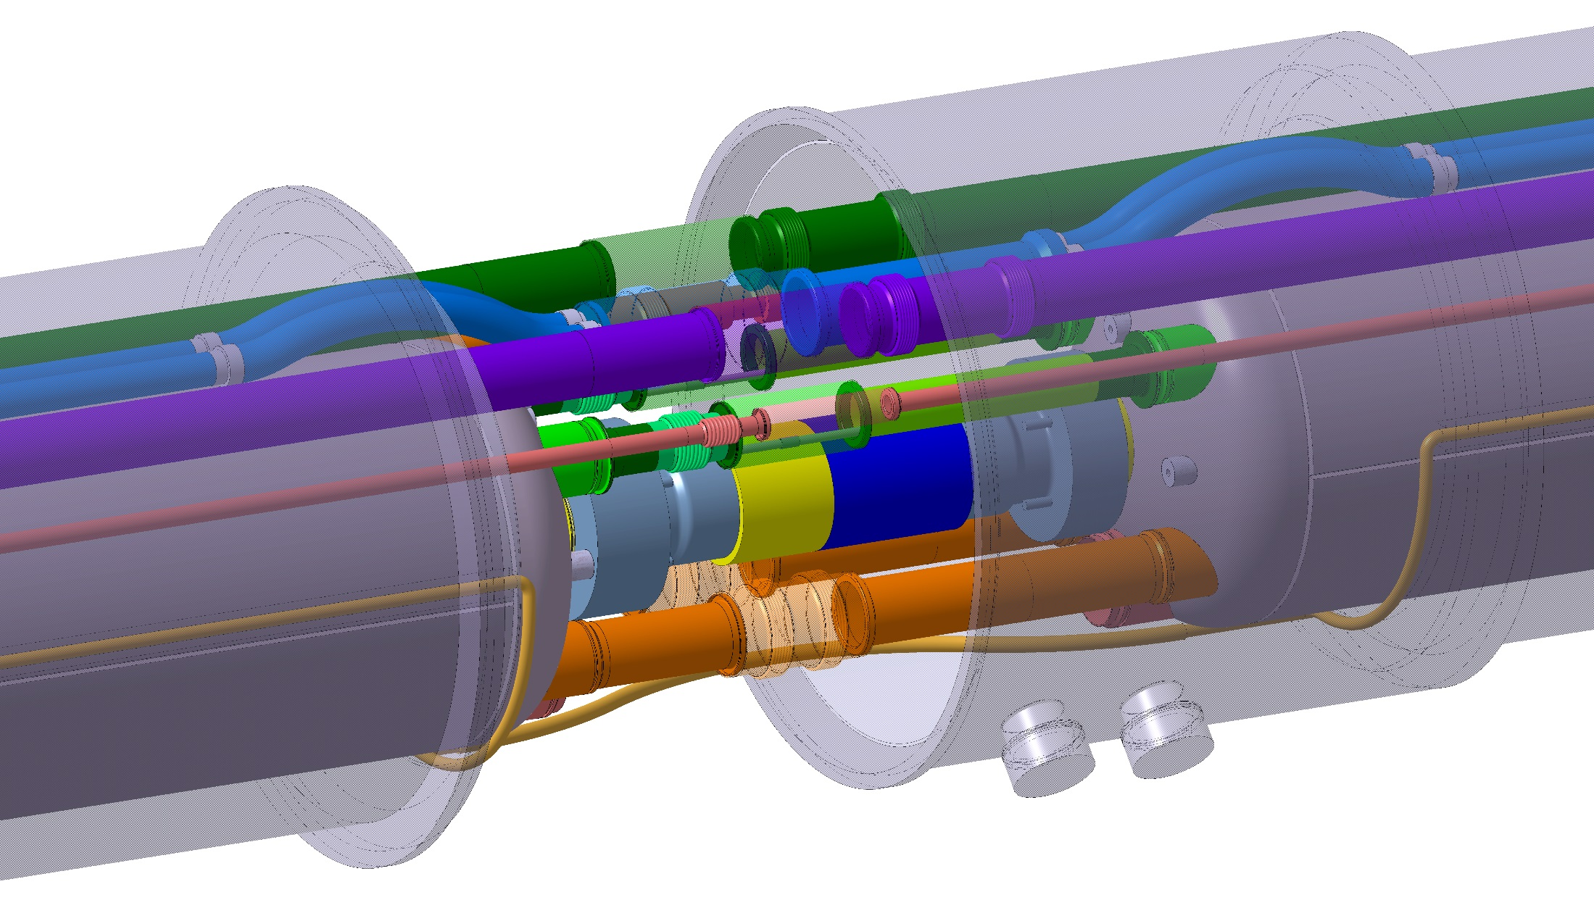
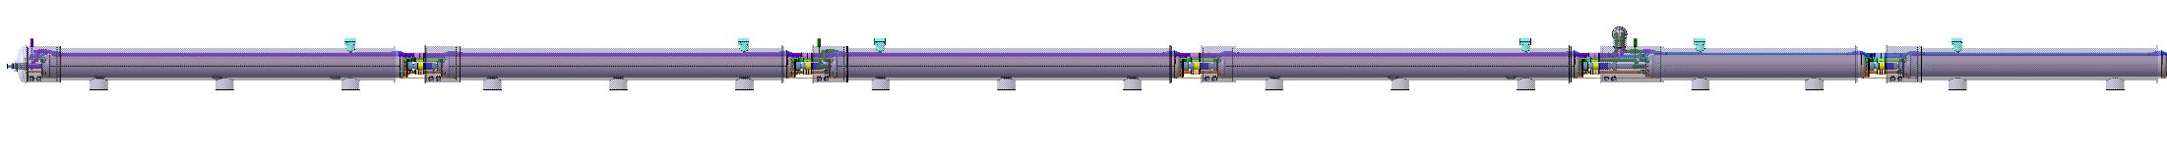
Stainless steel components for WP3 and WP6a
(installation in LS3)
Vacuum vessel flanges
Service modules
Piping and phase separators
Interconnect components (bellows and sleeves)
DFX boxes
Scope for installation
  36 new cryostats
  6 modified LHC cryostats
Q1
Q2b
Q3
CP
D1
Q2a
3

Slide 4
Procurement strategy from LHC until now
Build-to-print contracts
  Oders for sub-assemblies and components as to minimise work at CERN
  Fabrication according to CERN drawings
  Materials specified by CERN according to current industrial standards for pressure equipment (EN standards)
  Material procured by contractor with standard material certificate type 3.1: no reference to limitation in Co content
  Minimum logistics management by CERN
Cryostat assembly at CERN

Slide 5
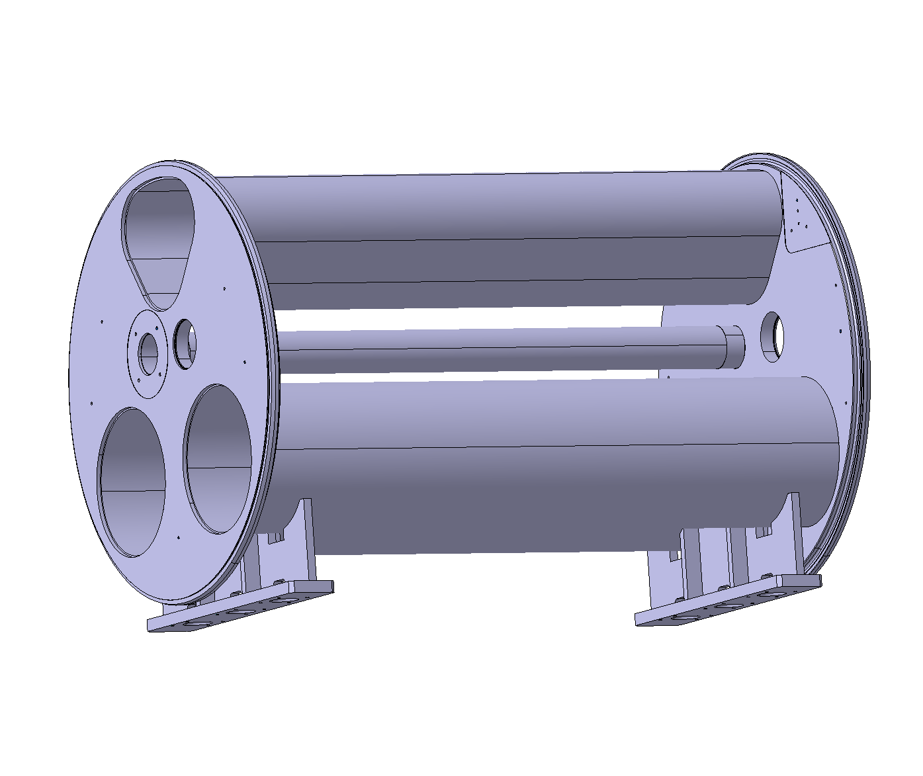
Introducing <0.10% Co spec: Industrial availability
Experience with the contract for the bypass vacuum vessel prototype (order issued last November for 1 unit)
  PE: material still procured by contractor but with limitation of 0.10 % Co
  3 offers, none of the bidders could guarantee better than <0.2% Co
  Order for prototype issued to lowest bidder under the agreement of using the best available in material supplier’s stock
  Expected outcome for this supply by picking the best plates available throughout Europe: <0.15% Co
  Negligeable addititional cost but it was treated as a special case
Conclusion:
  0.2~0.3% seems achievable by picking the best material in stock
  <0.10% Co requires special material production. Only if CERN orders to material suppliers and ships the material to component manufacturers
Stainless steel 1.4307 (304L)

Slide 6
Expected impact
CERN must provide the material to the component manufacturers
  Procurement through CERN stores
  Orders placed for CERN wide usage in order to get enough volume. Not so easy for semi-products such as forged rings (to be assessed case by case)
  Acceptance at CERN
  Contracts with component manufacturers excluding stainless steel (not an
  Shipping to component manufacturers
  CERN is liable for material deffects and shipping delays
Additional costs wrt current practice
  Material cost
  Shipping to and from CERN
  CERN stores space and management
  Additional drawings and specifications for semi-products
  Management (CERN staff managing the contract)
Additional design constraints
  Limited availability of shapes and sizes

Slide 7
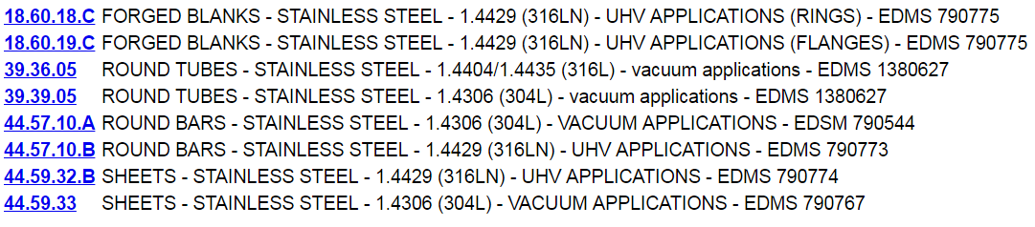
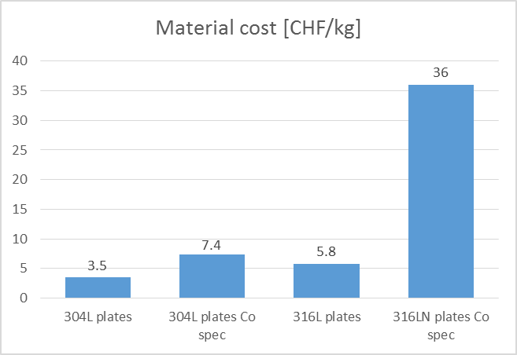
Currently available in CERN stores

Slide 8
Possible compromises?
Distinction between 11T/LS2 and LS3
  More impact on schedule for LS2
  Relatively small modification wrt existing machine
Adapt requirements according to proximity with the beam, ex:
  No Co limitation for vacuum vessel forged rings and service modules
  But limitation for cold mass of connection cryostat
Small components may become the most “expensive”
  Small flanges, sleeves, bellows, elbows, pipe fittings, etc.

