Slide 1


Status and Plans of the AWAKE Experiment
Edda Gschwendtner
for the AWAKE Collaboration
SPSC 18 October 2016

Slide 2
Outline
Introduction
AWAKE Facility and Equipment
AWAKE Beam Commissioning
Electron Acceleration Status
AWAKE Run 2 after LS2
Long-Term Perspectives for Proton-Driven Plasma Wakefield Accelerators
Summary

Slide 3
Proton Drivers for Plasma Wakefield Acceleration
Proton drivers: large energy content in proton bunches → interesting for plasma wakefield accelerators
Drive beams:
  Lasers: ~40 J/pulse
  Electron drive beam: 30 J/bunch
  Proton drive beam: SPS 19kJ/pulse, LHC 300kJ/bunch
Protons drives wakefields over much longer plasma lengths → to reach high energies of a witness beam possible in few stages.
But: need short bunches → self-modulation instability
Plasma cell
Witness beam
Drive beam: protons

Slide 4
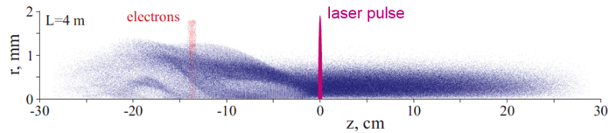
Modulated Proton Bunch
Drive beam for AWAKE: 400 GeV/c SPS proton beam
SPS longitudinal beam size (σ_{z} = 12 cm) is much longer than plasma wavelength (λ = 1mm)
➔ AWAKE Experiment is based on self-modulation instability
  Modulate long bunch to produce a series of ‘micro-bunches’ in a plasma with a spacing of plasma wavelength λ_{p}.
    Strong self-modulation effect of proton beam due to transverse wakefield in plasma
    Resonantly drives the wakefield
    Modulation should be seeded (with laser in AWAKE)
➔ Immediate use of CERN SPS beam

Slide 5

AWAKE
AWAKE Collaboration: 16+3 Institutes world-wide:
Collaboration members:
John Adams Institute for Accelerator Science
Budker Institute of Nuclear Physics & Novosibirsk State University
CERN
Cockcroft Institute
DESY
Heinrich Heine University, Düsseldorf
Instituto Superior Tecnico
Imperial College
Ludwig Maximilian University
Max Planck Institute for Physics
Max Planck Institute for Plasma Physics
Rutherford Appleton Laboratory
TRIUMF
University College London
University of Oslo
University of Strathclyde
Vancouver
Novosibirsk
Oslo
Glasgow
Manchester
Hamburg, Greifswald
London
Dusseldorf
Munich
CERN
Lisbon
Associated members:
Ulsan National Institute of Science and Technology (UNIST), Korea
Wigner Institute, Budapest
Swiss Plasma Center group of EPFL
Further groups have also expressed their interest to join AWAKE.

Slide 6
AWAKE at CERN
Advanced Proton Driven Plasma Wakefield Acceleration Experiment
  Final Goal: Design high quality & high energy electron accelerator based on acquired knowledge.
Proof-of-Principle Accelerator R&D experiment at CERN
Approved in August 2013
First beam end 2016
AWAKE Timeline
 | 2013 | 2014 | 2015 | 2016 | 2017 | 2018 | 2019 | 2020 | 2021 | 2022…
Proton and laser beam-line
Experim-ental area
e⁻ source and beam-line
Installation
Data taking
Data taking
Study, Design,
Procurement, Component preparation
Long Shutdown 2
24 months
Modification, Civil Engineering and installation
Commissioning
RUN 1
RUN 2
cont’d
Study, Design,
Procurement, Component preparation
Phase 1
Studies, design
Fabrication
Installation
Commissioning
Phase 2

Slide 7
AWAKE: Experimental Program
Phase 1: Understand the physics of self-modulation instability processes in plasma.
Laser
10m
p
Proton
beam
dump
SPS
protons
Proton diagnostics
BTV,OTR, CTR
Laser
dump
SMI
➔ Start with physics Q4 2016!
plasma
gas
proton bunch
laser pulse
Self-modulated proton bunch resonantly driving plasma wakefields.
Plasma electron density ρ_{plasma}
Proton beam density ρ_{beam}
J. Vieira et al PoP 19063105 (2012)

Slide 8
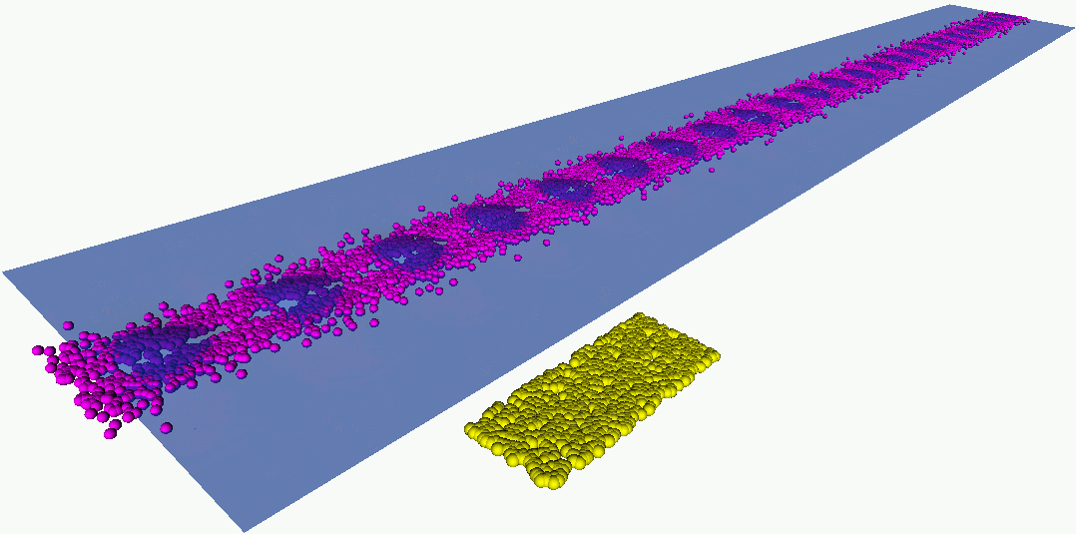
AWAKE Experimental Program
Phase 1: Understand the physics of self-modulation instability processes in plasma.
Phase 2: Probe the accelerating wakefields with externally injected electrons.
e⁻ spectrometer
Laser
RF gun
e⁻
10m
p
Proton
beam
dump
SPS
protons
Proton diagnostics
BTV,OTR, CTR
Laser
dump
plasma
gas
SMI
Acceleration
proton bunch
electron bunch
laser pulse
protons
Beams are co-propagating in this direction close to the speed of light
electrons
Maximum amplitude of the accelerating field E_{z} as a function of position along the plasma. Saturation of the SMI at ~4m.
➔ Start with physics Q4 2017!
A. Petrenko, CERN

Slide 9
Outline
Introduction
AWAKE Facility and Equipment
AWAKE Beam Commissioning
Electron Acceleration Status
AWAKE Run 2 after LS2
Long-Term Perspectives for Proton-Driven Plasma Wakefield Accelerators
Summary

Slide 10
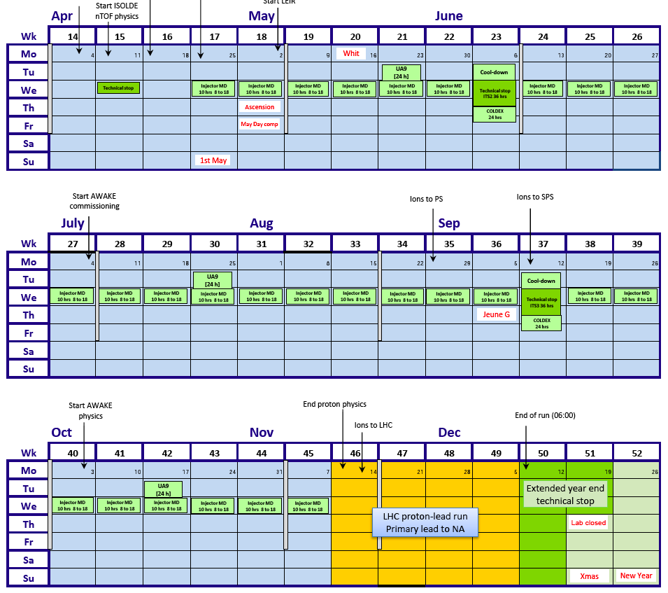
AWAKE Planning 2016
TS1’
E.G. Preliminary version 0.5
Laser installation
HW commissioning p-line:
Diagnostics, magnets, PC, WIC
HW comm.
Laser beam line installation
DSO tests
1st p-beam Comm.
Laser beam line installation
Laser beam commissioning
OTR/CTR comm.
TS2
p-beam commissioning (+RF synch, + laser)
Dry-run1
RF synchronization, streak camera commissioning, etc..
End of run
Plasma cell end flanges installation
p-beam + plasma (no Rb) + laser commissioning
Plasma cell HW commissioning
p-beam + plasma (Rb) + laser commissioning
First AWAKE physics
AWAKE physics

Slide 11
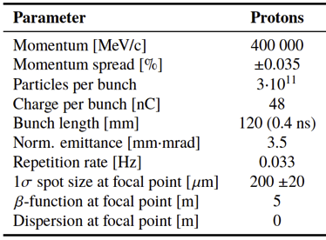
AWAKE Proton Beam Line
Proton beam line upstream
Proton beam line downstream
Proton beam line fully installed (Magnets, Instrumentation, Vacuum)
Hardware commissioning finished
➔

Slide 12
Laser and Laser Line
Protons from SPS
Laser beam line to plasma cell
  λ = 780 nm
  t pulse = 100-120 fs
  E = 450 mJ
Diagnostic beam line (“virtual plasma”)
  λ = 780 nm
  t pulse = 100-120 fs,
  E ≈ 5 mJ
Laser beam line to electron gun (to be installed in 2017)
  λ = 260 nm
  t pulse = 0.3-10 ps
  E = 0.5 mJ
Laser insertion
Point
Electron Source
Electron Merging Point
➔
Laser system installed and commissioned:
  Laser, compressor, safety shutters, beam dumps, mirrors
  Control system → integrated in CERN control system
  Lots of efforts in commissioning of laser itself
Common Beam Line
Start of Plasma Cell

Slide 13
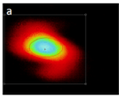
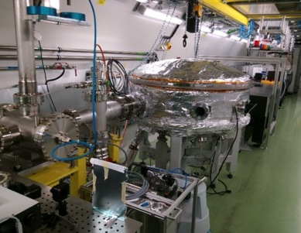
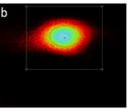
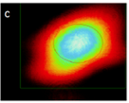
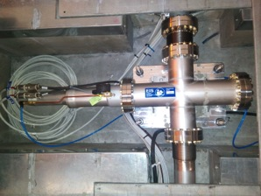
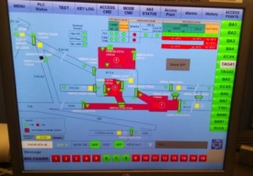
Laser and Laser Line
plasma entrance
Protons from SPS
Laser insertion
Point
Mirrors in vacuum
plasma centre
Electron Source
plasma exit
Laser, compressor in laser room
Laser profile on virtual transport line
Electron Merging Point
Common Beam Line
Laser safety shutters:
Linked with SPS access system
Start of Plasma Cell

Slide 14
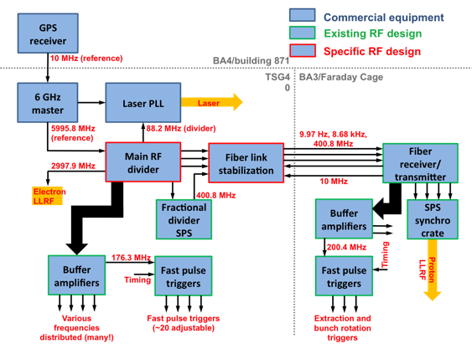
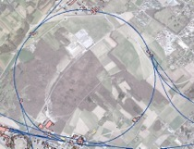
AWAKE RF Synchronization
BA3
~3km
AWAKE
BA3 surface
AWAKE
Deliver wide range of RF signals for laser, proton and electron beams
Precision trigger pulses for beam instrumentation
Active link stabilization to the ps-level for 3km transmission from AWAKE to BA3
Notes:
“fc and frep” divided signals are sent to the SPS to change the time of arrival of the proton beam with respect to the 10Hz laser pulse train.

Slide 15
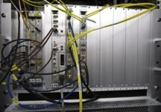
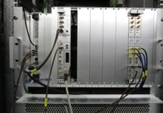
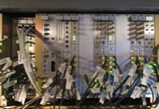
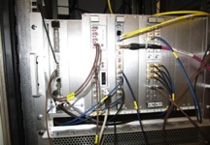
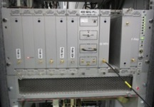
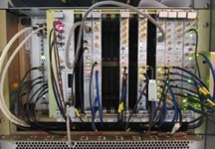
RF Hardware Development and Installation
AWAKE
TSG40
BA3/Faraday Cage
BA3 surface
Link compensation
Fast triggers
Synchro crate
Main divider, RF trains
Distribution, frac. divider
AWAKE crate
➔
Tests and validation steps done to synchronize protons with laser:
Use signals from AWAKE
  All frequencies in correct range
Coarse alignment of SPS proton bunch and laser pulse
  Proton bucket selection mechanism in AWAKE LLRF validated
Fine phase of protons at SPS extraction (within one ‘half bucket’)
  Temporary set-up works as expected

Slide 16
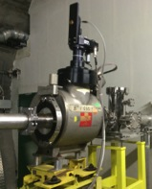
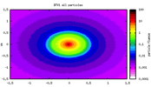
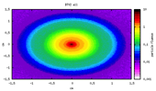
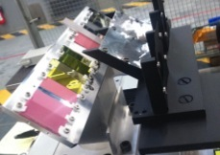
Self-Modulation Instability Detectors
Laser
10m
BTV1
BTV2
SPS
protons
p
Proton
beam
dump
SMI
Indirect SMI Measurement:
Measure the angle of the maximum defocused protons to indirectly prove the SMI development of the proton beam and reconstruct the saturation point of the SMI.
Measurements in the HiRadMat Facility
→ Defined the choice for the BTV screens (1mm Chromox Al₂O₃:CrO₂)
➔
Installed and commissioned
HiRadMat setup
Chromox screen
Measured proton beam on BTV2
Notes:
1mm thick: highest light yield

Slide 17
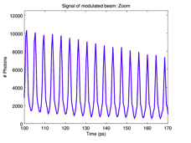
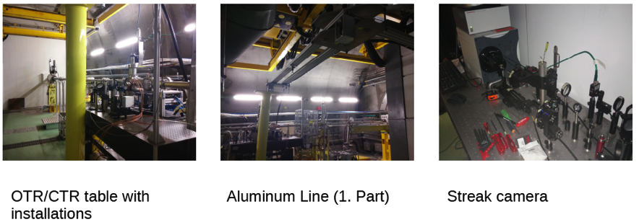
Self-Modulation Instability Detectors
Laser
10m
BTV
BTV
SPS
protons
p
Proton
beam
dump
SMI
σ_{p} ~ 400 ps
CTR & TCTR
Direct SMI Measurement:
Radiation emitted by bunch when traversing dielectric material
→ Streak camera
4 ps
OTR
➔
Installed and commissioned
OTR/CTR table with installation
Light transport to streak camera
Streak camera

Slide 18
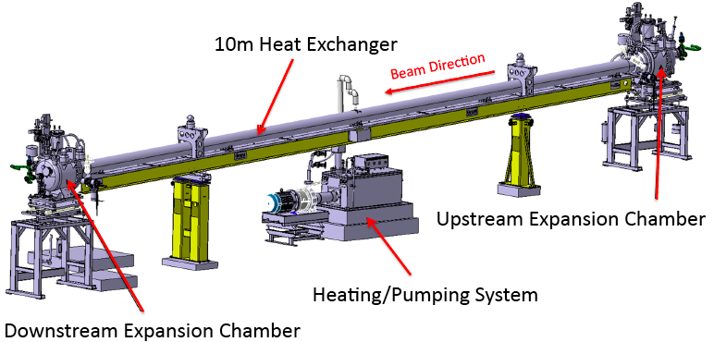
Plasma Cell
Rubidium Vapour Source
Density adjustable from 10¹⁴ – 10¹⁵ cm⁻³, 10 m long, 4 cm diameter
Plasma formed by field ionization of Rb
  Ionization potential Φ_{Rb} = 4.177eV
  above intensity threshold (I_{ioniz} = 1.7 x 10¹²W/cm²) 100% is ionized.
System is oil-heated ~ 210˚ C
  keep temperature uniformity at T_{op} ± 0.1 [°C] over the 10 [m] cell length
  Keep density uniformity
Circulation of Galden HT270 at 210 [°C] in plasma cell

Slide 19

Why this Complex Plasma End Flange?
Pumping Group
Cold trap
Argon Feed Valve
Expansion chamber
View port
Alignment table
Rb Flow path
Revised solution for source ends
Valves resulted in long Rb density ramp and
slow refill time. → strong effect on electron capture!
➔ New solution: continuous flow through small aperture
➔ 2016: final design and manufacturing
Rb Recycling
Glovebox
Notes:
Main function:
Allow injection of Rb vapour into plasma cell at uniform and controlled temperature
Sub-functions:
Allow Rb loading and recycling
Allow Rb temperature control
Allow Rb density monitoring
Safety functions:
Prevent other equipment from Rb contamination
Allow remote chamber neutralization

Slide 20
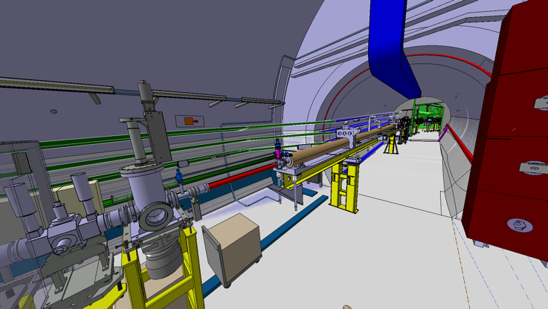
Plasma Cell: Current Status
10m long plasma cell installed in Feb 2016
For beam commissioning: Connected to vacuum system with spare vacuum tube

Slide 21
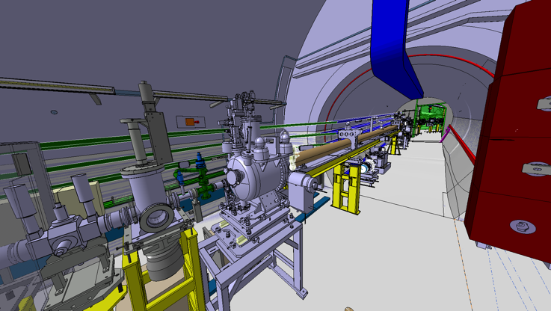
Plasma Cell End Flange Integration
Plasma cell end flange installation

Slide 22
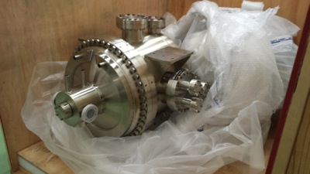
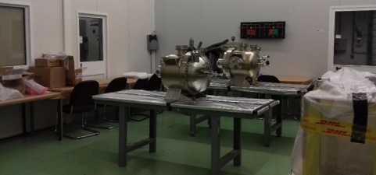
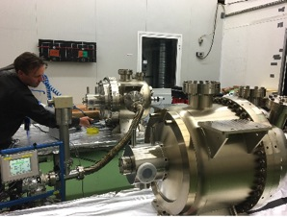
AWAKE Plasma End Flanges
Delivered to CERN in September 2016
Clean Room Activities:
UHV vacuum reception tests
Alignment

Slide 23
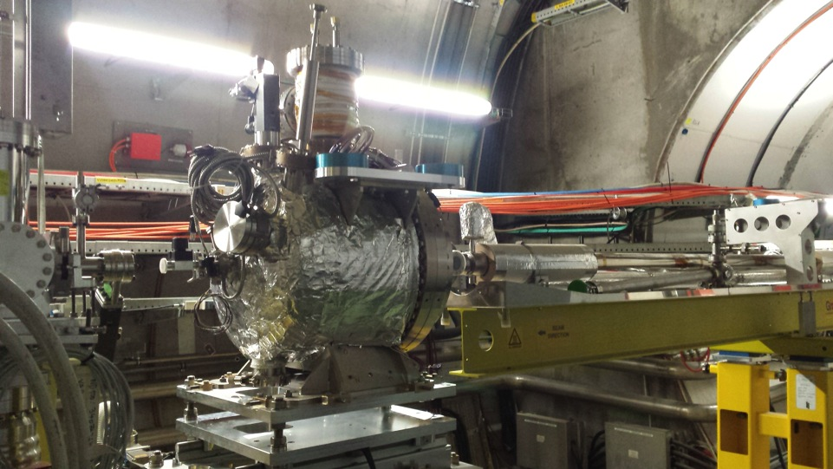
Plasma End Flanges in AWAKE Tunnel
➔
Installed and aligned 17 October 2016

Slide 24
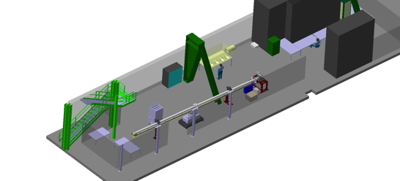
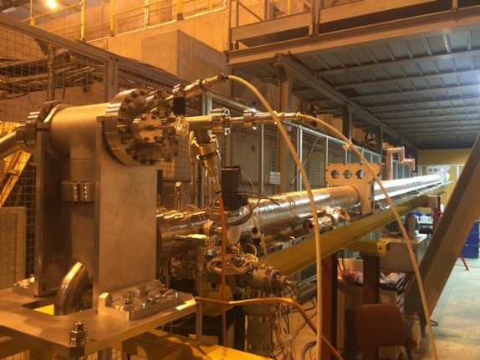
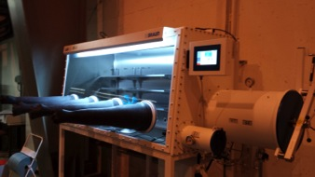
EHN1 Surface Plasma Cell Test Area
Main activities
Control system: integration and test
Probes calibration
Rb handling processes: testing and rehearsal before Rb will be installed in the tunnel
Main Glove box
EHN1 surface test area
Plasma cell replica
Glove box

Slide 25
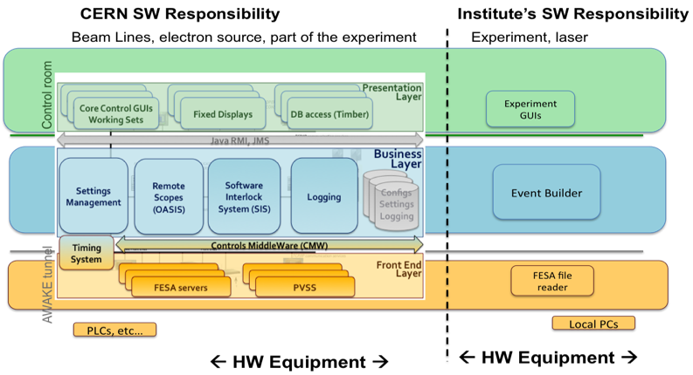
AWAKE Control System
Built on architecture provided by the CERN accelerator controls group.
Strong collaboration between CERN controls groups, CERN equipment groups and institutes to develop technical solutions for integration of AWAKE specific equipment.
➔
Validated during dry-run and commissioning run
Beam line, magnets, beam instrumentation, electron source…
SMI, laser, spectrometer…

Slide 26
Outline
Introduction
AWAKE Facility and Equipment
AWAKE Beam Commissioning
Electron Acceleration Status
AWAKE Run 2 after LS2
Long-Term Perspectives for Proton-Driven Plasma Wakefield Accelerators
Summary

Slide 27
AWAKE Planning 2016
TS1’
E.G. Preliminary version 0.5
Laser installation
HW commissioning p-line:
Diagnostics, magnets, PC, WIC
HW comm.
Laser beam line installation
DSO tests
1st p-beam Comm.
Laser beam line installation
Laser beam commissioning
OTR/CTR comm.
TS2
p-beam commissioning (+RF synch, + laser)
Dry-run1
RF synchronization, streak camera commissioning, etc..
End of run
Plasma cell end flanges installation
p-beam + plasma (no Rb) + laser commissioning
Plasma cell HW commissioning
p-beam + plasma (Rb) + laser commissioning
First AWAKE physics
AWAKE physics

Slide 28
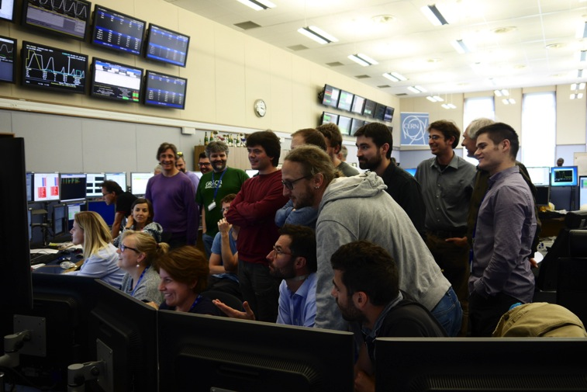
Proton and Laser Beam Commissioning 2016

Slide 29
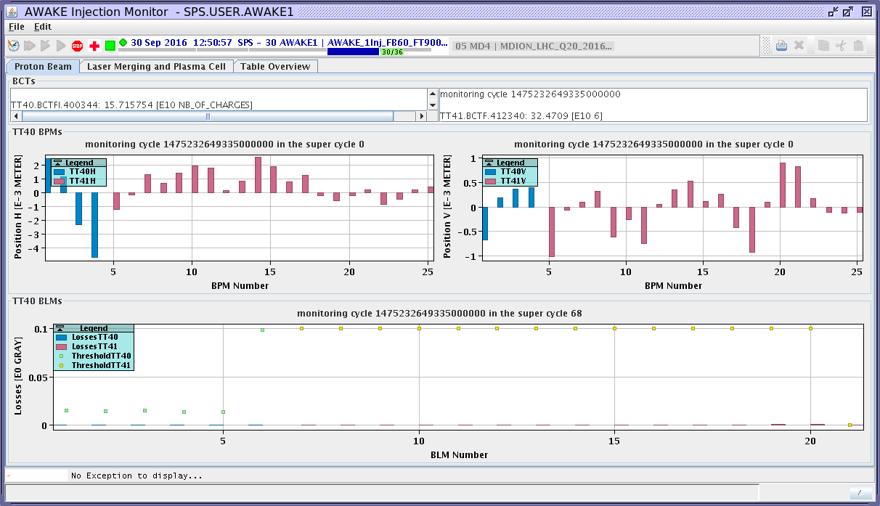
Results Proton Beam Commissioning
Laser
BTV
10m plasma cell
BTV
BTV
p
Proton
beam
dump
SPS
protons
BTV_{streak}
SMI
Acceleration
OTR_{streak}
Proton
diagnostics
Laser
dump
➔
Proton beam line commissioned and running stable with full intensity and matching the specifications
Stable beam at full intensity 3E11 p/bunch
Optimized trajectory at experiment
Standard deviation during stability run of ~60 μm
No beam losses at laser merging mirror

Slide 30
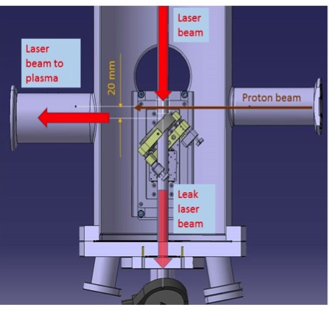
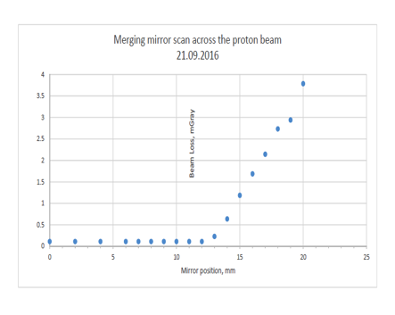
Results Laser Beam Commissioning
Laser
BTV
10m plasma cell
BTV
BTV
p
Proton
beam
dump
SPS
protons
BTV_{streak}
SMI
Acceleration
OTR_{streak}
Proton
diagnostics
Laser
dump
Merging mirror scan across the proton beam
➔
Operational Point: 11 mm
No losses on BLMs even with full intensity of 3E11 protons

Slide 31
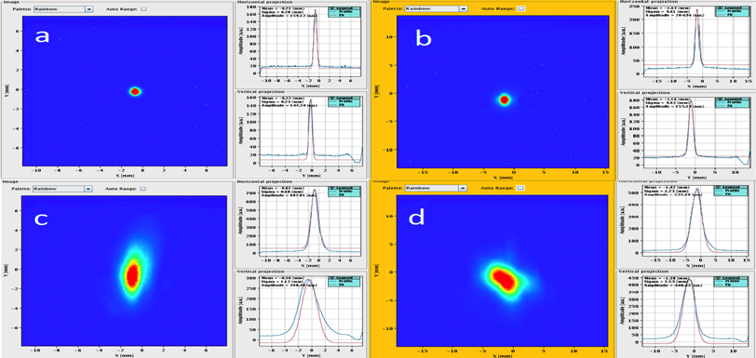
Results Laser Beam Commissioning
Laser
BTV
10m plasma cell
BTV
BTV
p
Proton
beam
dump
SPS
protons
BTV_{streak}
SMI
Acceleration
OTR_{streak}
Proton
diagnostics
Laser
dump
➔
Transversal alignment of proton and laser beam (spatial overlap)
p-beam
laser
Laser positioned on proton beam references to within 300 microns
Notes:
Keep in mind: this is a ~50meter throw from the nearest optic
So 300 micron on a 50 meter throw is 6 urad pointing jitter

Slide 32
Result Proton and Laser Beam Synchronization
Laser
BTV
10m plasma cell
BTV
BTV
p
Proton
beam
dump
SPS
protons
BTV_{streak}
SMI
Acceleration
OTR_{streak}
Proton
diagnostics
Laser
dump
➔
SPS proton beam synchronized with AWAKE laser within ~20ps accuracy
BTV upstream plasmas cell
laser
proton beam
1 ns

Slide 33
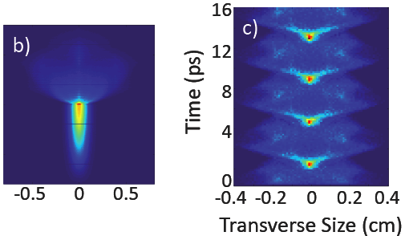

What We Want to See During Physics Run Dec. 2016
Laser
BTV
10m plasma cell
BTV
BTV
p
Proton
beam
dump
SPS
protons
BTV_{streak}
SMI
Acceleration
OTR_{streak}
Proton
diagnostics
Laser
dump
Proton Beam Self-Modulation Instability
Proton beam undergoes Self-Modulation Instability when passing through plasma

Slide 34
Outline
Introduction
AWAKE Facility and Equipment
AWAKE Beam Commissioning
Electron Acceleration Status
AWAKE Run 2 after LS2
Long-Term Perspectives for Proton-Driven Plasma Wakefield Accelerators
Summary

Slide 35
Electron Source in AWAKE
Electron source design finished, construction of hardware ongoing
Waveguide system: launched production
Shielding designed and decided to have a separate access zone for the electron source
Dismantling of PHIN will start next month
➔

Slide 36
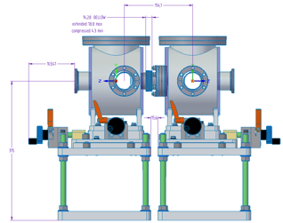
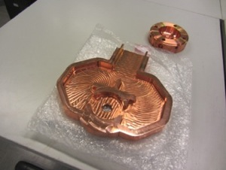
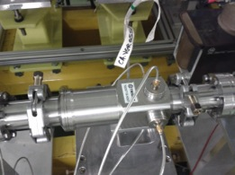
Collaborations for Electron Source
➔
Good progress in collaborations:
  TRIUMF BPM’s and Faraday Cup:
    First successful test in CALIFES
  Pepper pot from Manchester:
    Designed, most of equipment ordered
  Booster structure together with Lancaster and Cockcroft
    fabrication, prototypes accepted
Klystron from CTF3
1m booster linac
Incident, Reflected Power and phase
Laser +Diagnostics
Incident, Reflected, transmitted Power
Spectrometer
E, ΔE
Matching triplet
MTV
FCT
Emittance
MS
FC
BPR
BPR
BPR
RF GUN
Corrector
VPI
Accelerator
MTV,
Emittance
Length ~ 4 m
Triumf BPM
Pepper pot
Booster structure

Slide 37
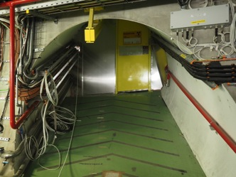
Status of the Electron Beam Line
➔
Layout, specifications frozen
Magnets, power converters ordered
Cabling for BTVs done

Slide 38
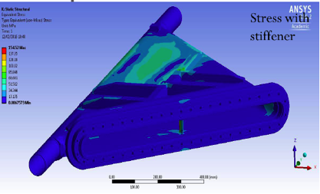
Electron Spectrometer
Design of the light transport line from the spectrometer screen to the CCD camera done
Spectrometer vacuum window design: 2mm Al
→ no risk of buckling of the window
→ scattering of electrons negligible compared to camera resolution
➔
Notes:
For energies of ~100 MeV and upwards, the width of the line spread function due to the window is negligible compared to the camera resolution.
At 20 MeV: at 0 (45) degree incidence: RMS ~0.2 (0.4) mm → broaden distribution by ~4 (13) %.

Slide 39
Electron Phase Master Schedule
Laser
Plasma cell
e⁻ spectrometer
RF gun
e⁻
10m
p
Proton
beam
dump
SPS
protons
SMI
Acceleration
Proton
diagnostics
Laser
dump
2016 |  |  |  | 2017 |  |  |  | 2018
Q1 | Q2 | Q3 | Q4 | Q1 | Q2 | Q3 | Q4 | Q1 | Q2 | Q3 | Q4
➔
on track
EYETS
2016
2017
YETS
20172018
AWAKE
p+
and
e- PHYSICS
Cabling
CV & Infrastr.
Cabling
e- Phase
Experiment
Installation
Plasma Cell:
Installation and HWC
e- LASER: Studies and Purchasing
e- LASER Installation and HWC
HWC
e- and p+ to PLASMA
p+ GLOBAL COMMISSIONING
e- GLOBAL COMMISSIONING
p+ to PLASMA
p+ GLOBAL COMMISSIONING
e- HWC
p+ to PLASMA
p+ to PLASMA
p+ to PLASMA
e- SOURCE: Studies, Purchasing and Production
PHIN SOURCE & Accelerating structure:
Dismounting, Installation and HWC
RF:
Studies and Procurement
RF:
Installation and HWC
Beam Controls& Instrumentation:
Studies and Procurement
BE-CO & BI: Installation and HWC
e- Vacuum:
Studies, Procurement and Production
e- VSC:
Install.
e- Beam line and Magnets
Studies, design, procurement, production and tests
e- Magnet Install

Slide 40
Outline
Introduction
AWAKE Facility and Equipment
AWAKE Beam Commissioning
Electron Acceleration Status
AWAKE Run 2 after LS2
Long-Term Perspectives for Proton-Driven Plasma Wakefield Accelerators
Summary

Slide 41
AWAKE Run 2 and Beyond
AWAKE Run 1 until LS2 : proof-of-concept experiment – fully funded
AWAKE Run 2:
Goals:
Accelerate an electron beam, while preserving beam quality as well as possible
Demonstrate scalability of the AWAKE concept
Requirement:
Compressed proton beam in SPS
Sustain gradient in SMI wake over long distance → density step for freezing modulation
Short electron bunch with higher energy for loading wakefield
Scalable length plasma sources
RF gun
Bunch compression, increased acceleration
e⁻ spectrometer
Laser
e⁻ (~100 fs, > 20 MeV)
e⁻ emittance
measurement
10m plasma
Optimized
SPS
protons
~4m plasma
Proton
beam
dump
Proton diagnostics
BTV,OTR, CTR
Laser
dump
SMI
Acceleration

Slide 42
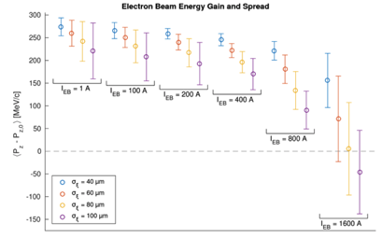
Run 2: Example of Simulation Studies
Accelerating gradient
4% density step
1 m wide gap to inject electrons
Plasma density
Plasma cell (SMI)
Plasma cell (acceleration)
→ Freezing the modulation:
Wakefield amplitude quickly drops after the beam gets modulated
Remedy: control the wave phase by the plasma density profile
Other Simulation studies:
Emittance preservation, tolerances, staging
Reach %-level of energy spread of the electron beam with beam loading.
Typical electron beam parameters:
  40 – 60 µm (100 fs) bunch length
  Few 100 A peak current
  > 50 MeV Injection energy
Notes:
(defocusing regions keep on moving along the beam and destroys the bunches)

Slide 43
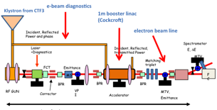


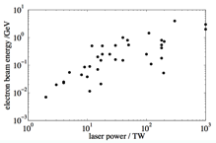
Run 2: Options for Electron Injector
Modify phase 2 injector (S-band)
Modify phase 2 injector, upgrade with X-band
X
X
Can Run 1 AWAKE injector (PHIN S-band photo-injector) be modified to provide 50 MeV and 400 A, within space constraints ?
X-band structure? ~60 MV/m gives required boost
X-band gun? Based on best SLAC results could provide required energy and current in available space. Requires development work.
Laser wakefield acceleration injector
100+ MeV routinely reached with few MW Ti:Sa laser
very short bunches possible (few um)
compact
AWAKE energy requirement (< 100 MeV) relaxed with respect to state-of-the-art (4 GeV)
→ collaboration with LWFA-experts initiated

Slide 44
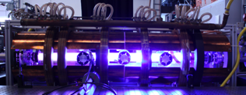


Run 2: Scalable Plasma Sources
Helicon development
Current 1m prototype in Greifswald
Does not need laser ionization
Fully modular (no gaps)
Required density reached
Uniformity (spatial, temporal) needs work
Need to move from prototype to AWAKE-compatible technology
➔ Collaboration between MPP Greifswald, EPFL SPC and CERN is being set up
Gas discharge development
3m prototype developed by Imperial College and IST (Lisbon)
Construction of prototype is pending funding

Slide 45
Outline
Introduction
AWAKE Facility and Equipment
AWAKE Beam Commissioning
Electron Acceleration Status
AWAKE Run 2 after LS2
Long-Term Perspectives for Proton-Driven Plasma Wakefield Accelerators
Summary

Slide 46



Fixed Target Experiments with High Energy Electron Beam
So far, no experimental hints on particle nature of dark matter.
Interest in low-mass particle solutions increasing; e.g., dark photons.
Light shining through walls experiments …
Here, use electron beam.
NA64 experiment
NA64: expect 10⁶ electrons/spill; 10¹² electrons for 3 months
AWAKE-like electron beam driven by SPS proton bunch. Assuming 10⁹ electrons/bunch, would give 3 orders of magnitude increase.
NA64
AWAKE
M. Wing, Physics Beyond Colliders Kickoff Workshop, 7/Sep/2016, CERN

Slide 47


Physics with an Electron-Proton or Electron-Ion Collider
LHeC-Like:
Focus on QCD: Large cross sections → low luminosity enough (HERA level)
Many open physics questions !
→ High energy ep collider: E_{e} up to O(50 GeV), colliding with LHC proton;
→ e.g. E_{e} = 10 GeV, Ep = 7 TeV, √s = 530 GeV already exceeds HERA cm energy.
G. Xia et al., Nucl. Instrum. Meth. A 740 (2014) 173.
Create ~50 GeV electron beam within 50−100 m of plasma driven by SPS protons, But luminosity < 10³⁰ cm⁻² s⁻¹.
VHEeP:
Choose E_{e} = 3 TeV as a baseline and with E_{P} = 7 TeV yields √s = 9 TeV. Can vary.
Centre-of-mass energy ~30 higher than HERA.
Reach in (high) Q² and (low) Bjorken x extended by ~1000 compared to HERA.
Opens new physics perspectives
Luminosity ~ 10²⁸ − 10²⁹ cm⁻² s⁻¹ gives ~ 1 pb−1 per year.
VHEeP: A. Caldwell and M. Wing, Eur. Phys. J. C 76 (2016) 463

Slide 48
Strategy for Run 2 and Beyond
Created a Run 2 Coordination Package
  Define goals, technology and work-packages
Gives opportunity to new institutes interested in joining.
CERN AWAKE Project Leader Mandate Extended:
  Leading the CERN AWAKE project towards and during Run 2
  Coordinating and organizing the general proton driven plasma wakefield acceleration studies at CERN
  Coordinating all resources associated with the AWAKE project and the proton driven plasma wakefield studies.
→ Have a first proposal of Run 2 program ready by end 2017

Slide 49
Summary
➔
Great progress in installation and commissioning of AWAKE Run 1
On track for first AWAKE physics in 1st week in December 2016
On track with installation for electron acceleration phase in 2017
Run 2 and beyond:
  Preparation of proposal for Run 2
  Long-term prospects: Start to develop particle physics program that could be persued with an AWAKE-like beam.
➔
➔

