Slide 1
Updates on orbit correction
Emilia Cruz
JAI FCC Team
FCC-hh BDS Meeting
October 10th, 2016

Slide 2
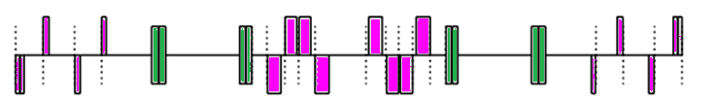
Correction Scheme Studies
The correctors scheme used for this studies include:
  correctors next to the IT and the dispersion suppressor (DS) in the lattice with L*=45 m but with added length (0.5 m).
  New correctors next to the quadrupoles in matching section (MS)
Identify orbit correction by measuring the 90 percentile (value for which 90% of the distribution is included) of:
  Maximum Deviation after the correction
  Corrector Strengths
Do tests for different types of errors (Quadrupole, missalignments, field errors and tilt errors in the dipoles), and for different optics (β*=110 cm and 30 cm).
H/V
H/V
H/V
H/V
H/V
H/V

Slide 3
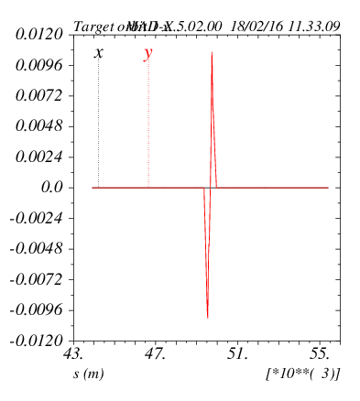
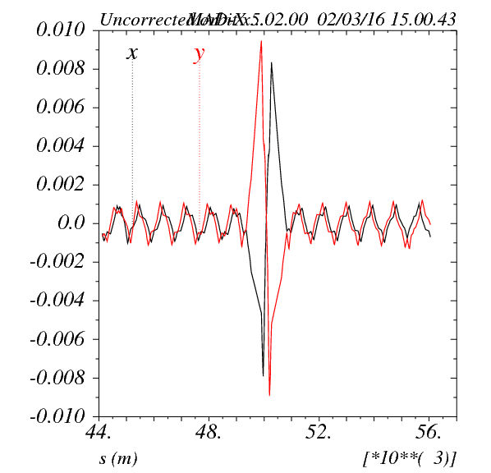
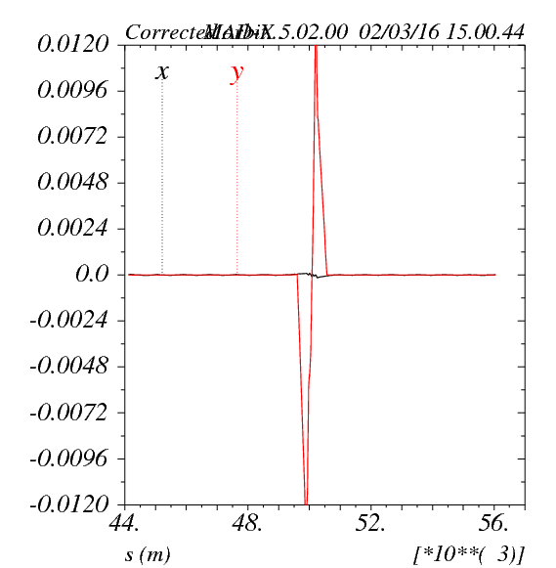
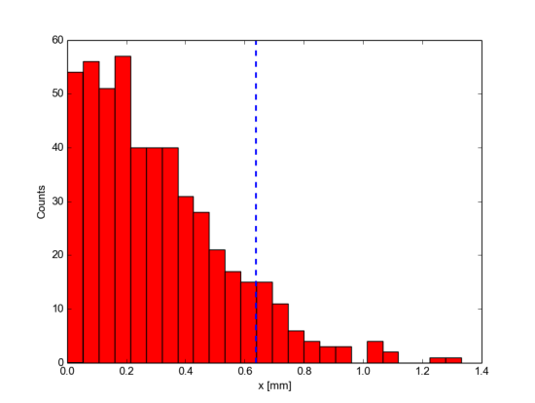

Obtaining 90-percentile
D. Boutin
Correction arcs
Assign random errors. Gaussian errors 2.5$σ$.
Use CORRECT method in MADX.
Calculate maximum orbit deviation in IR after correction.
Repeat for 500 seeds
Calculate value of the maximum orbit deviation
for which 90% of the seeds are included (x₉₀)
No errors
Added IT errors
Correction
x₉₀

Slide 4
Previous Studies
Techniques to identify good correction: Calculate 90% of the distribution of:
  Maximum Deviation
  Maximum Angle
  Beta beating
  Corrector Strengths
Consider alignment and field errors:
  quadrupole errors in the IT+MS+DS
  Field errors in D1 and D2
  Tilt errors in D1 and D2
Consider different optics
  Beta*=110 cm
  Beta*=30 cm

Slide 5
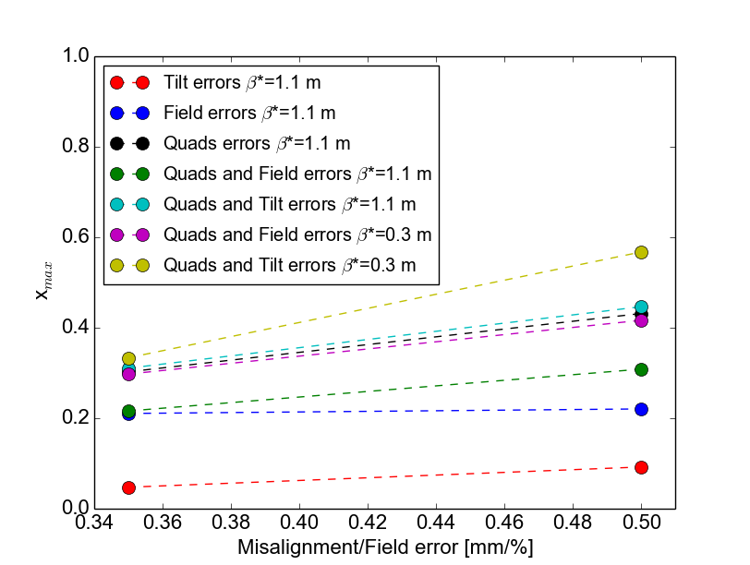
Results
Max deviation:
0.5 mm
  (Almost all) results for the maximum deviation (including sigma errorbars) are below 0.5 mm including more challenging cases: Quad and dipole errors with β*=0.3 m.
  Results look better by using also the MS correctors. I tried also using new correctors in the dipoles but results were really similar.

Slide 6
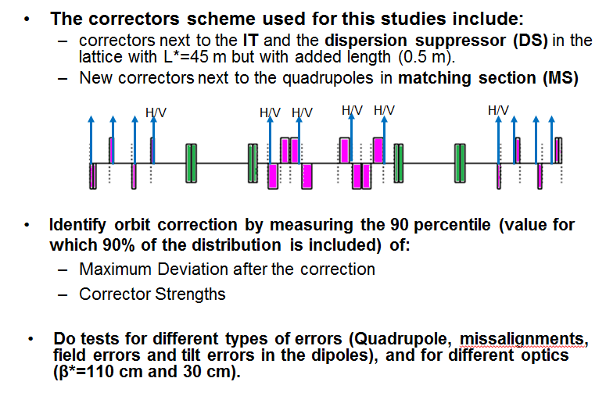
New Lattice, New script
New lattice released by A. Chance with skew quads
New script: make_corr_seq.madx
That creates this task:
Add lengths to correctors
New correctors in MS
Add BPMs in IR
Groups correctors and monitor in families
(helpful to turn on/off families in correction procedure)
This allows me to:
Adapt it easily to new versions of lattice.
Track more easily effect of different parameters (length of correctors for example).
Skew quad MCQSX.3 is very close to correctors when adding length, problem with moving them further away?

Slide 7
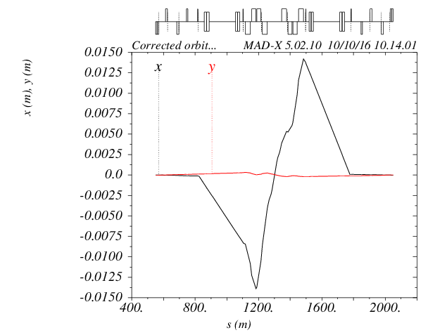
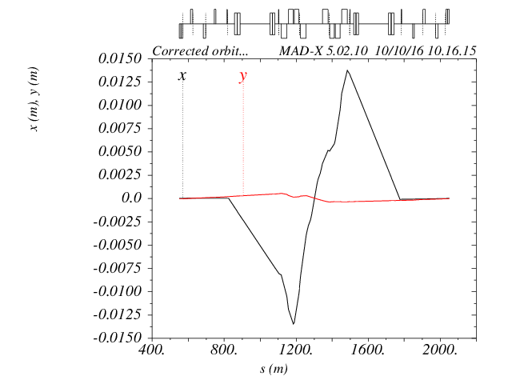
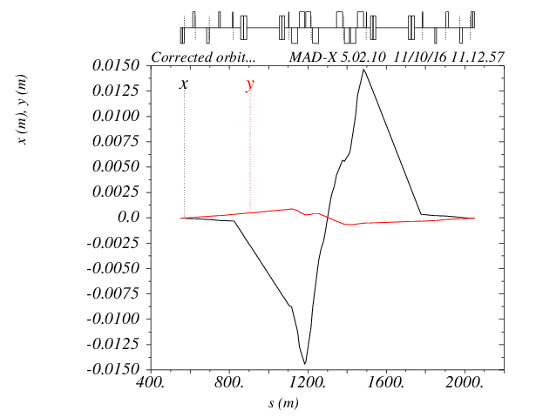
Results were higher than previous lattice. Track the issue.
Issue has to do with the length of the correctors in the IT. Bigger length -> worst correction. Trying to understand the issue.
L=0 m
L=0.3 m
L=0.647 m
Quad errors 0.5 mm
β*=30 cm
100 seeds
90 % of x_max
< 0.5 mm
Quad errors 0.5 mm
β*=30 cm
100 seeds
90 % of x_max
1.3 mm

Slide 8
Work to do
Study issue with bigger max x deviation and length of the correctors.
Communication with D. Boutin to get together work in arcs and IR. His strengths of the correctors in the IR is bigger. We are studying where the discrepancy is.
Obtain optimal length of the correctors that will be achievable in terms of strength and space while providing a good orbit correction.

